Slide 1
Update on the DA studies at injection for HL-LHC
F. Plassard, R. De Maria
Thanks to: M. Giovannozzi, N. Karasthatis, S. Kostoglou,
F. Van der Veken
WP2 Meeting 25/02/2020

Slide 2
OUTLINE
Recall of previous simulations and observations
Update on DA at injection including beam-beam
Conclusions

Slide 3
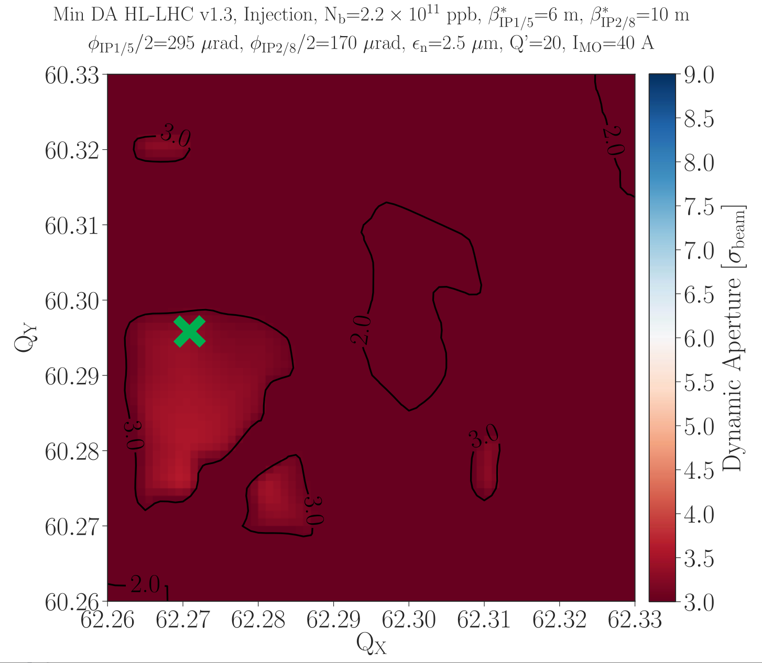
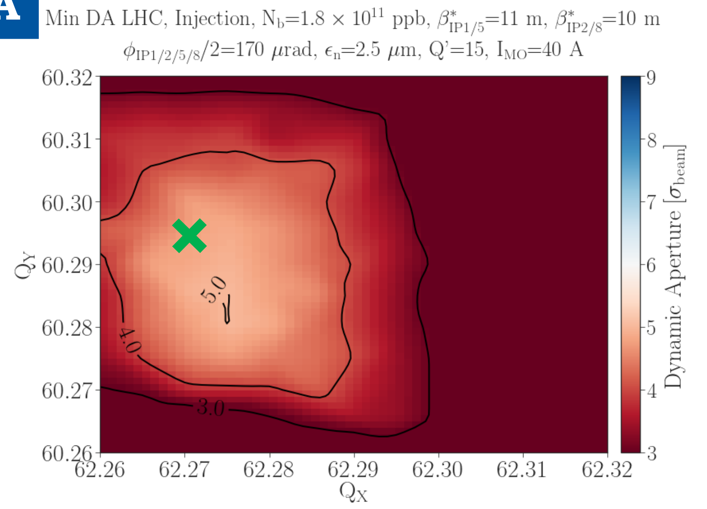
Recall of previous simulations and observations
Previous simulations presented in WP2 28/05/2019 (“HL-LHC Dynamic Aperture at Injection”) have shown an important reduction of DA with beam-beam between LHC run III and HL-LHC (v1.3) at injection and with high octupole current (I_MO = 40 A)
The goal of the study is to understand the large difference observed
Courtesy of N. Karastathis

Slide 4
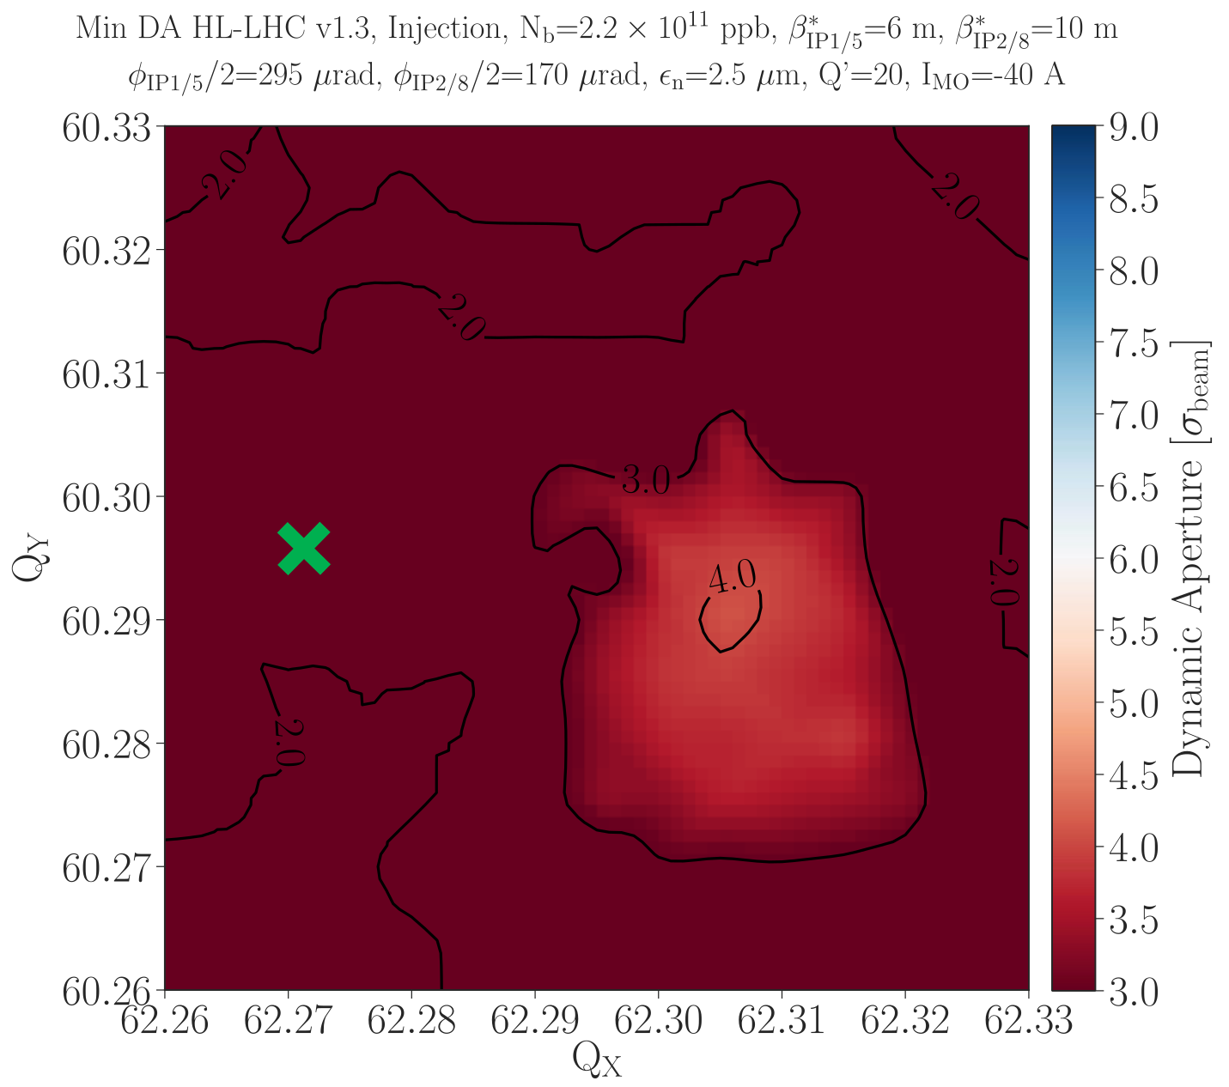
Recall of previous simulations and observations
It was also shown that the polarity of the octupoles change the location of the ‘good DA’ area
Negative polarity gives better DA but move the good tune area further from the optimal WP that was optimized for electron cloud
What makes the DA with octupoles much worst than LHC case?
Courtesy of N. Karastathis

Slide 5
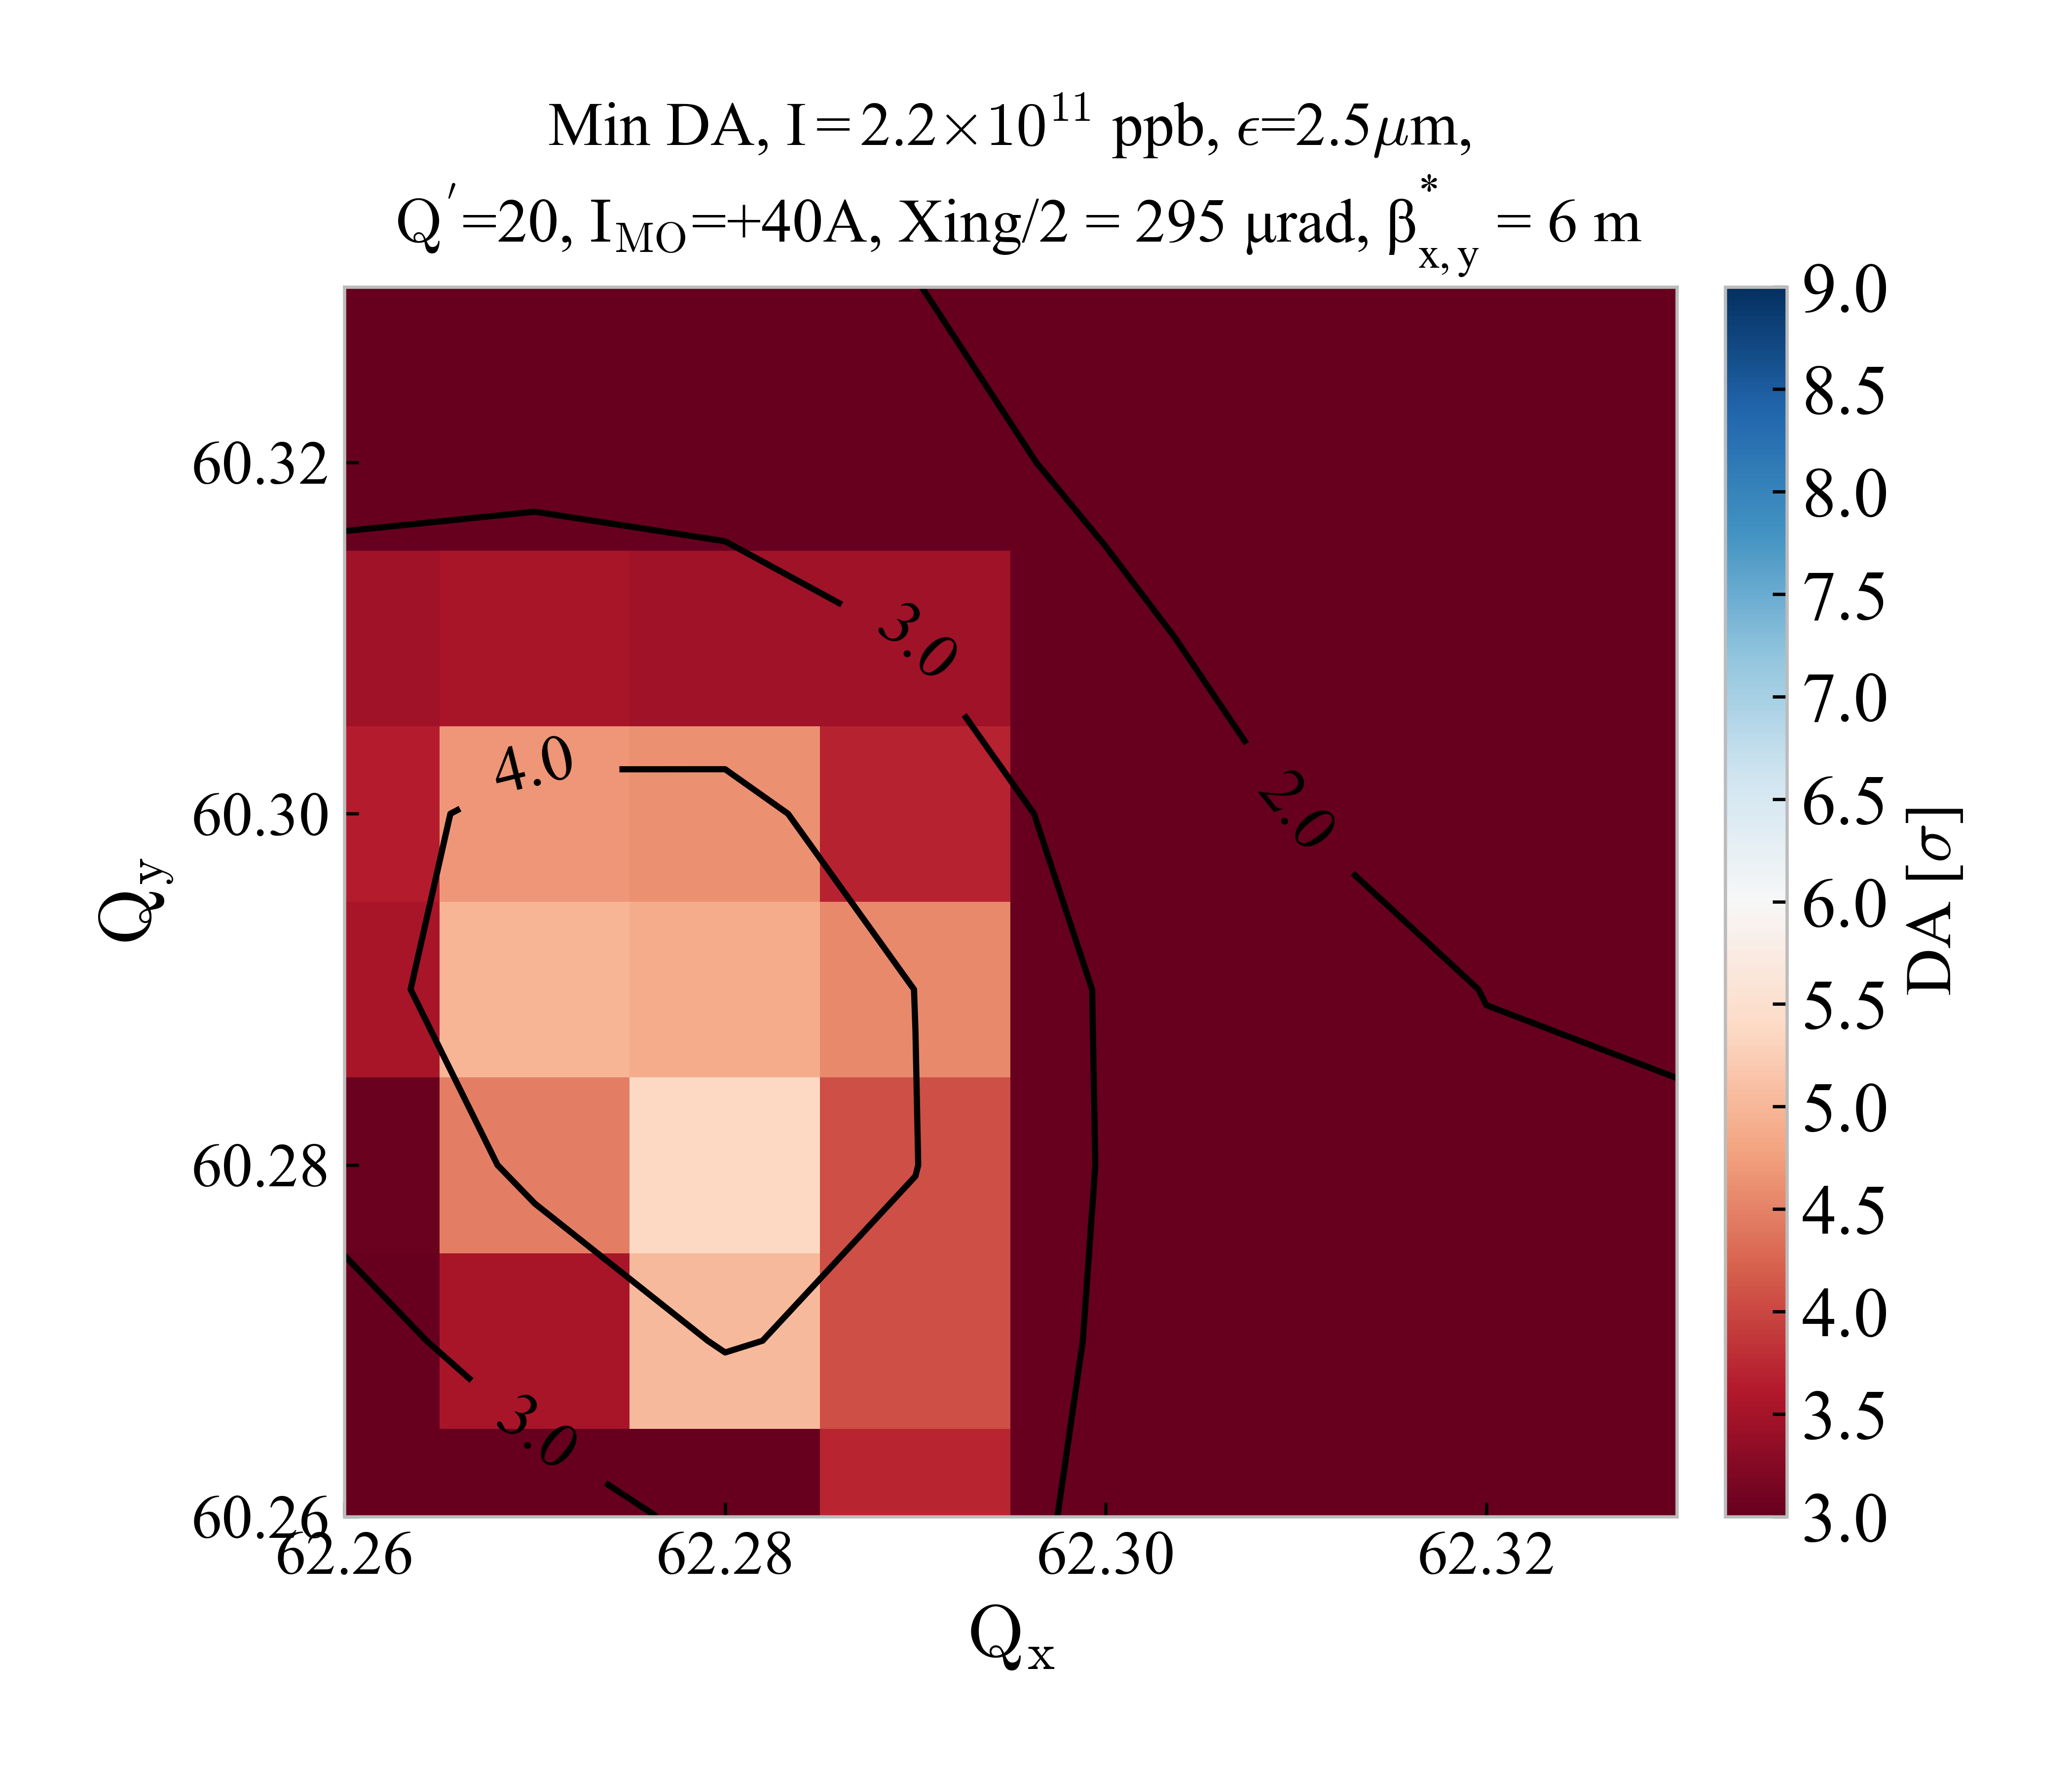
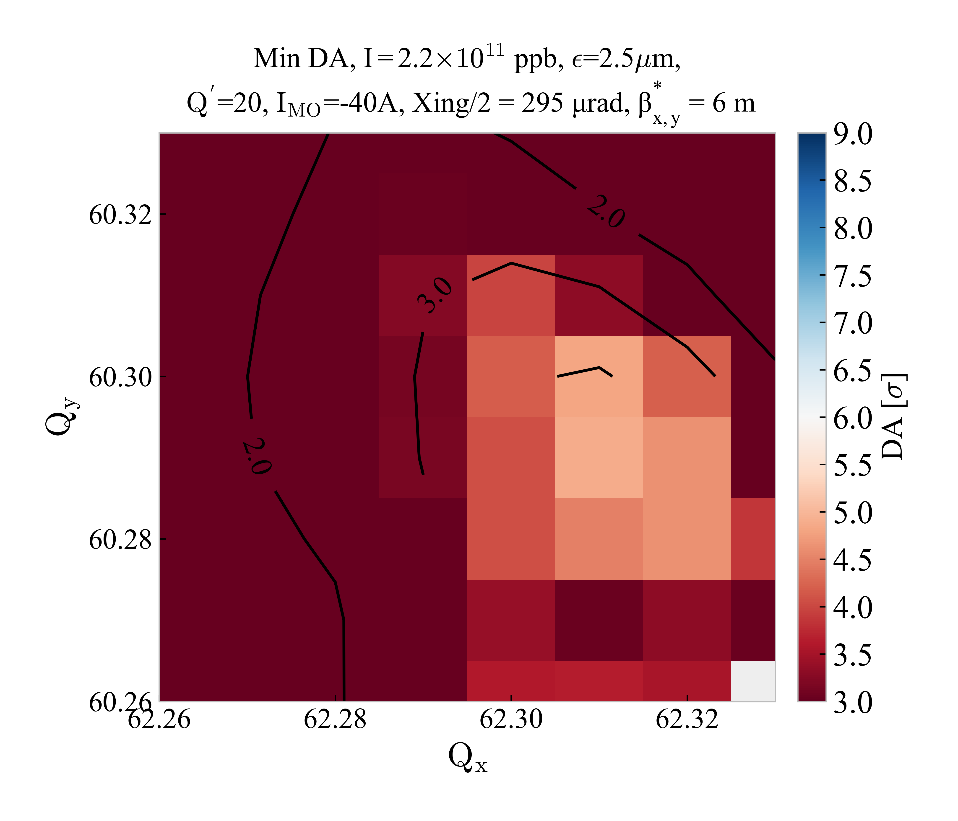
Update on DA at injection for HL-LHC
The simulation for HL-LHC at injection has been repeated including beam-beam and for positive/ negative polarities (at 40 A) for HL-LHC v1.4
However the results show larger DA, more similar to the LHC case.
Also in the new simulation the positive polarity of the octupole gives a better DA than the negative case.

Slide 6


Update on DA at injection for HL-LHC
HL-LHC v1.3
Injection
$I_{MO}$=±40 A
Presented in WP2 149th
Looking at the input data used for simulation it was found that the problem came from a small error in the mask files: the dispersion correction knob on_disp was set to 1 instead of 0
HL-LHC v1.4
Injection
$I_{MO}$=±40 A

Slide 7
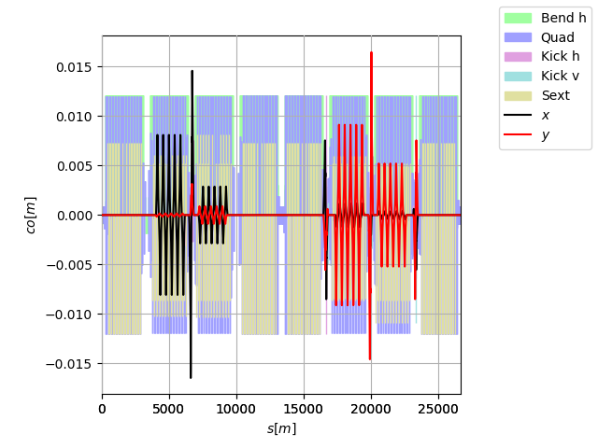
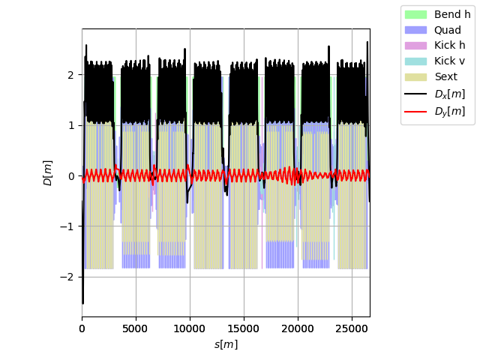
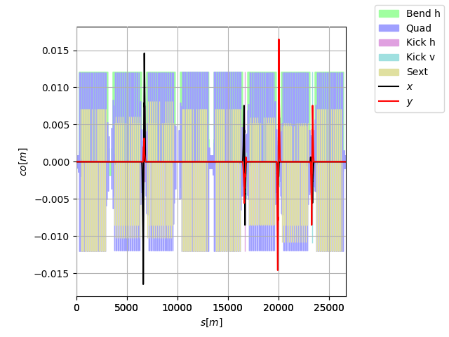
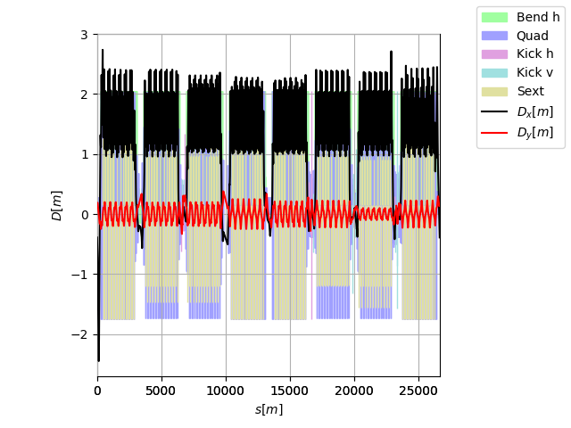
Update on DA at injection for HL-LHC
The dispersion correction knob should not be used at injection due to the large orbit bumps required for small dispersion correction
on_disp = 1 ;
on_disp = 0 ;

Slide 8
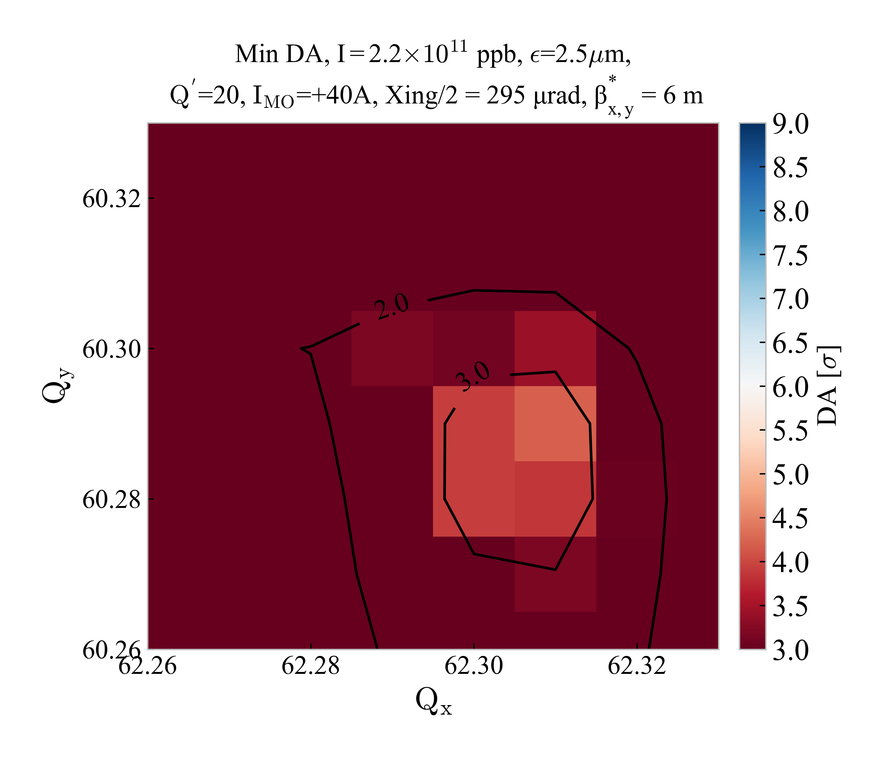
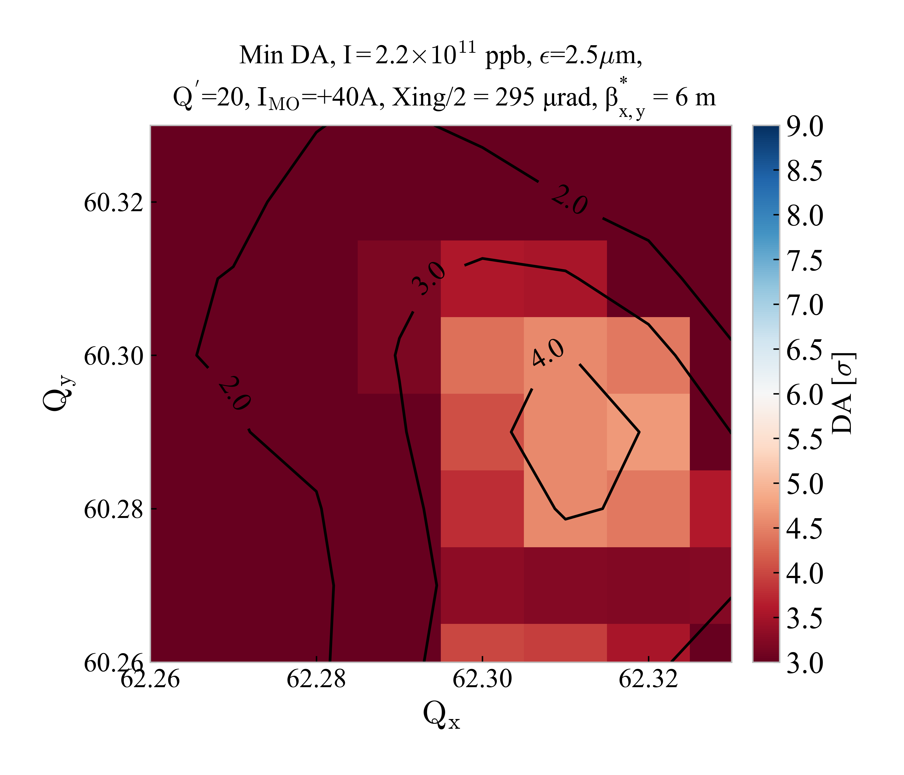
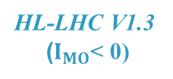
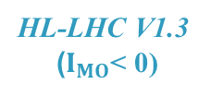
Update on DA at injection for HL-LHC
on_disp = 1 ;
HL-LHC V1.3
($I_{MO}$< 0)
on_disp = 0 ;
HL-LHC V1.3
($I_{MO}$< 0)

Slide 9
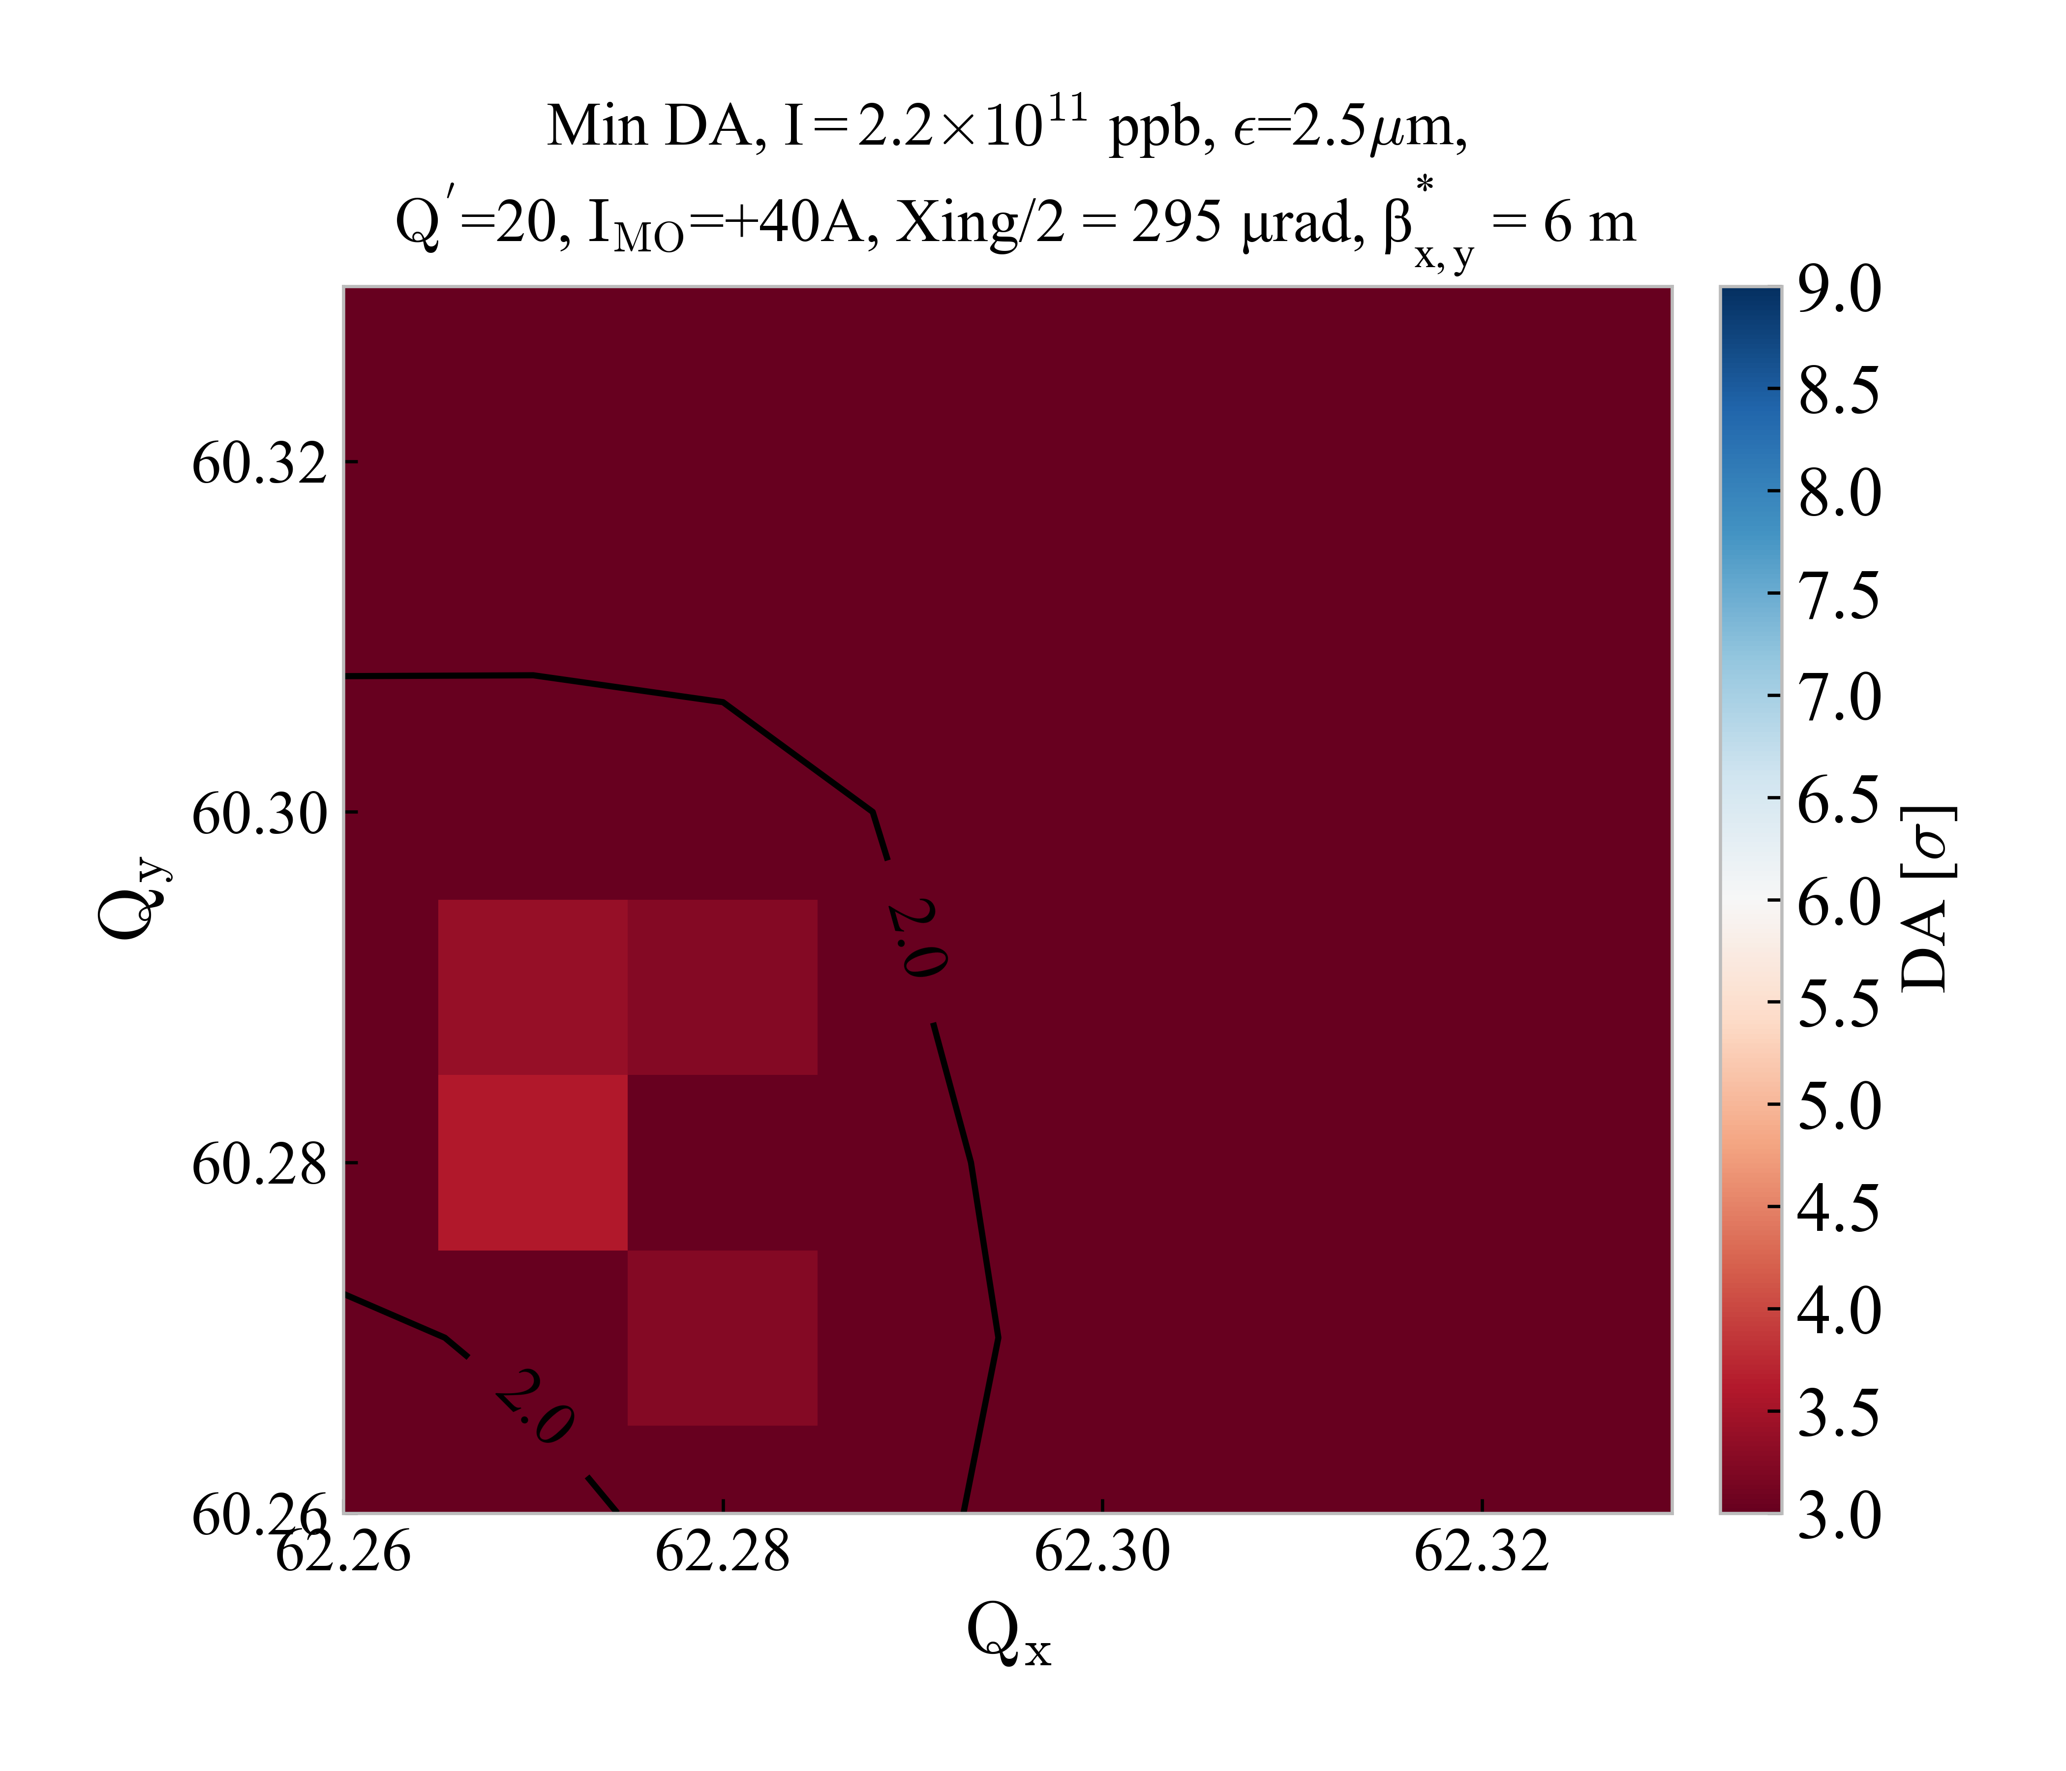
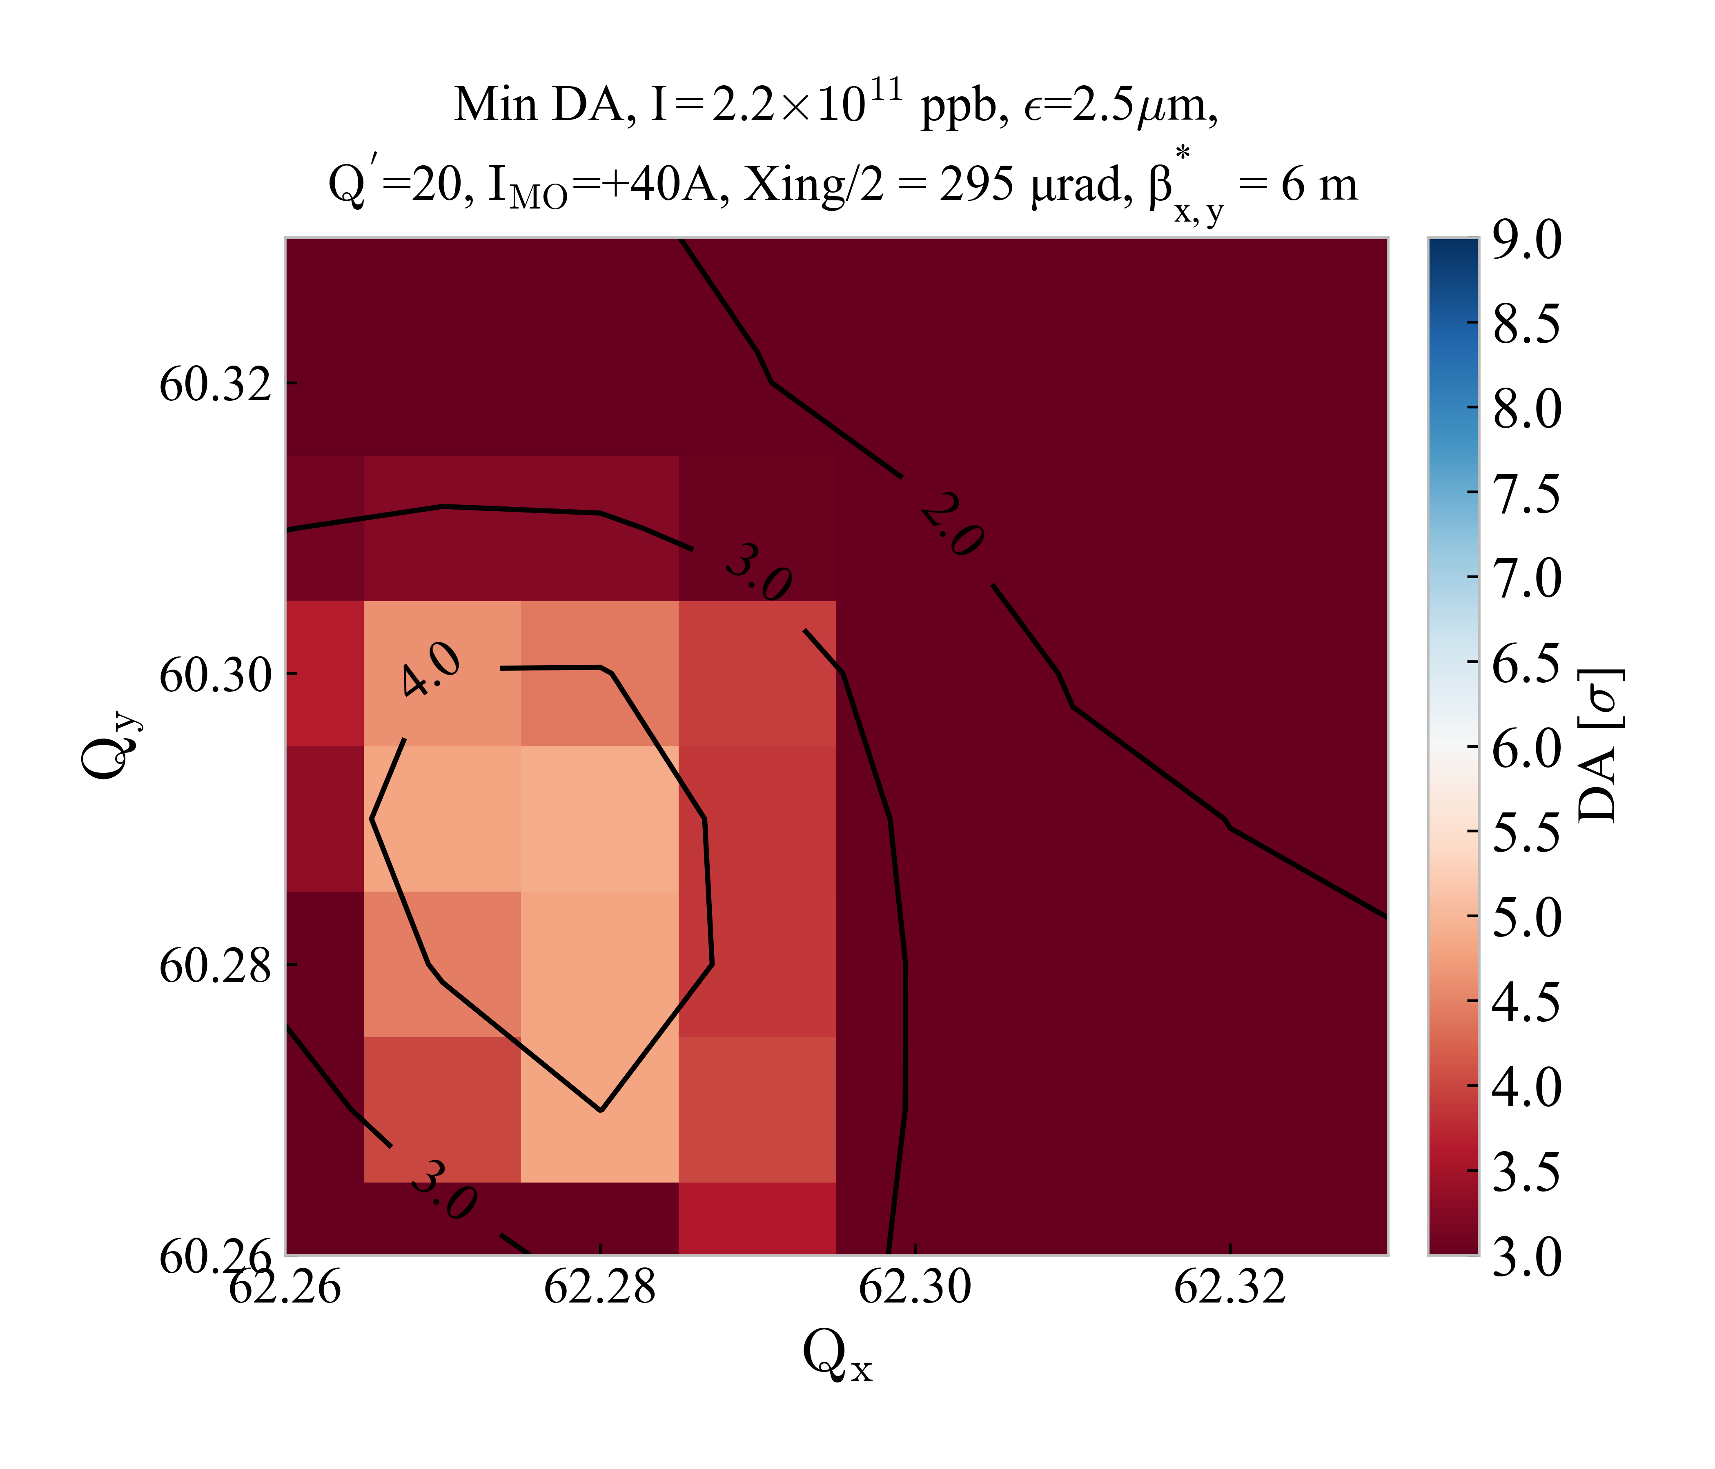


Update on DA at injection for HL-LHC
on_disp = 1 ;
HL-LHC V1.3
($I_{MO}$> 0)
on_disp = 0 ;
HL-LHC V1.3
($I_{MO}$> 0)

Slide 10
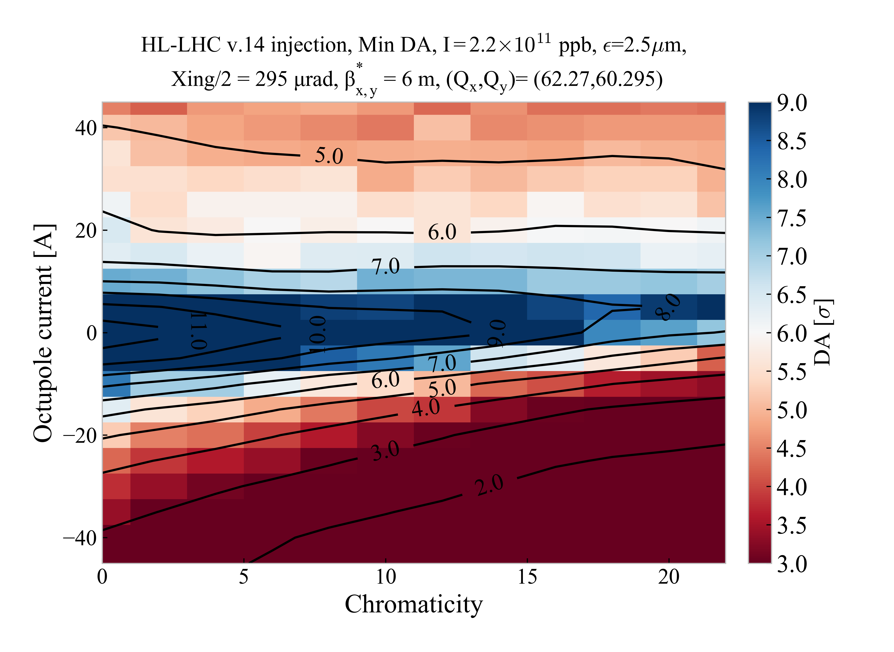
Update on DA at injection for HL-LHC
The octupole vs chromaticity scan has been repeated and shows a clear asymmetry between positive and negative current for the WP (62.27,60,295)
DA in this case is much better for positive octupole current

Slide 11
Conclusions
The DA at injection of the HL-LHC at high octupole current (±40 A) is comparable to the LHC case
For the chosen WP (62.27,60.295), positive current gives much better DA
The change of location of the ‘good’ tune area resulting from the change of octupole polarity is observed also for the LHC case (see Backup slides)

Slide 12
BACKUP

Slide 13
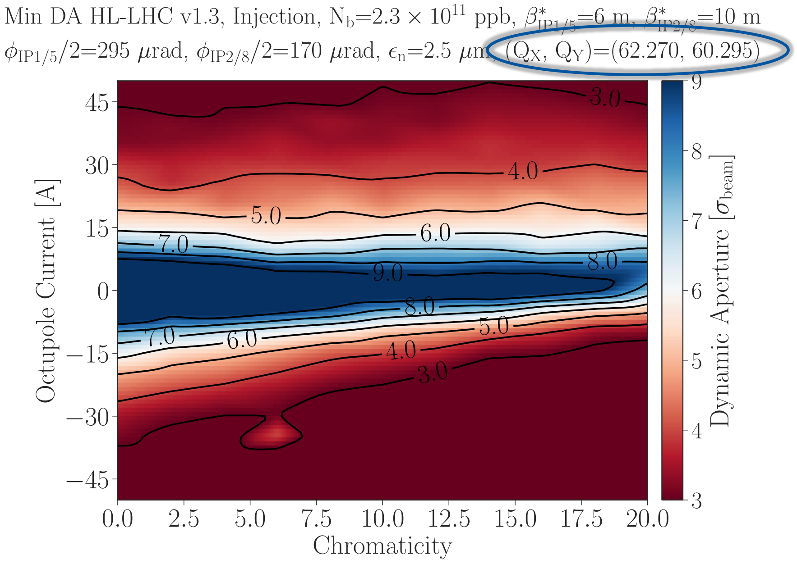
Comparison with/without disp. correction
on_disp = 1 ;
on_disp = 0 ;

Slide 14
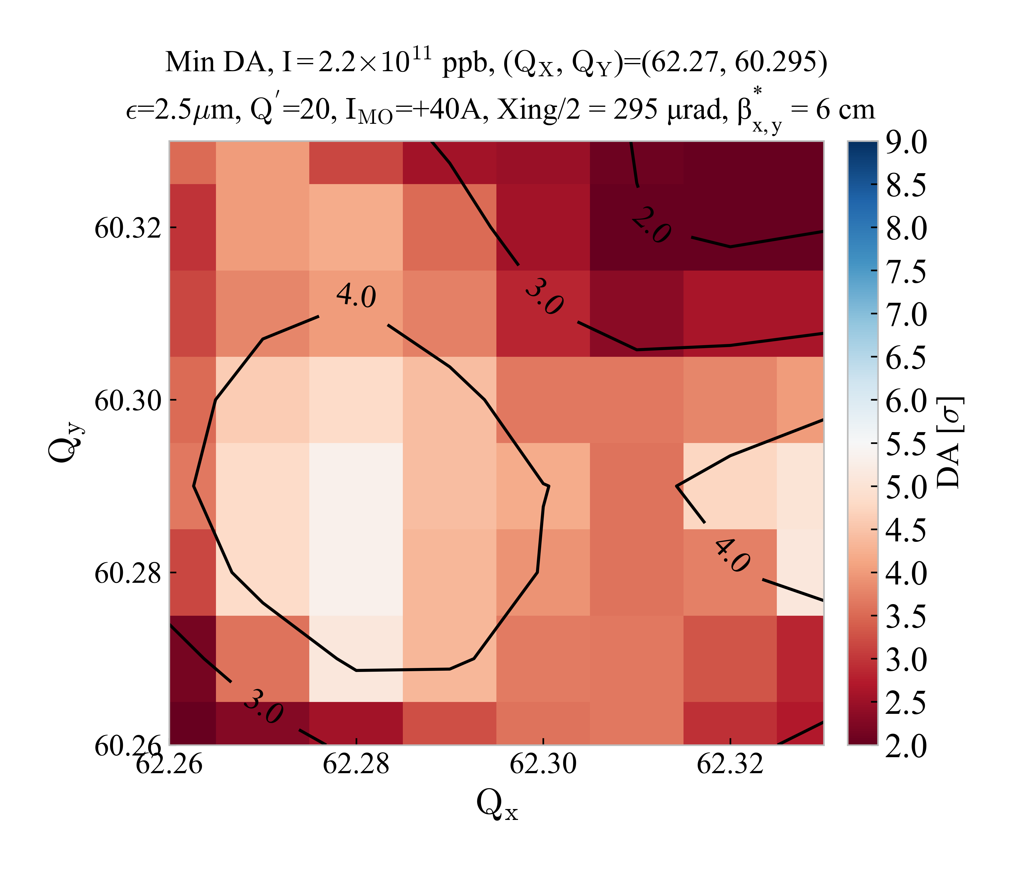
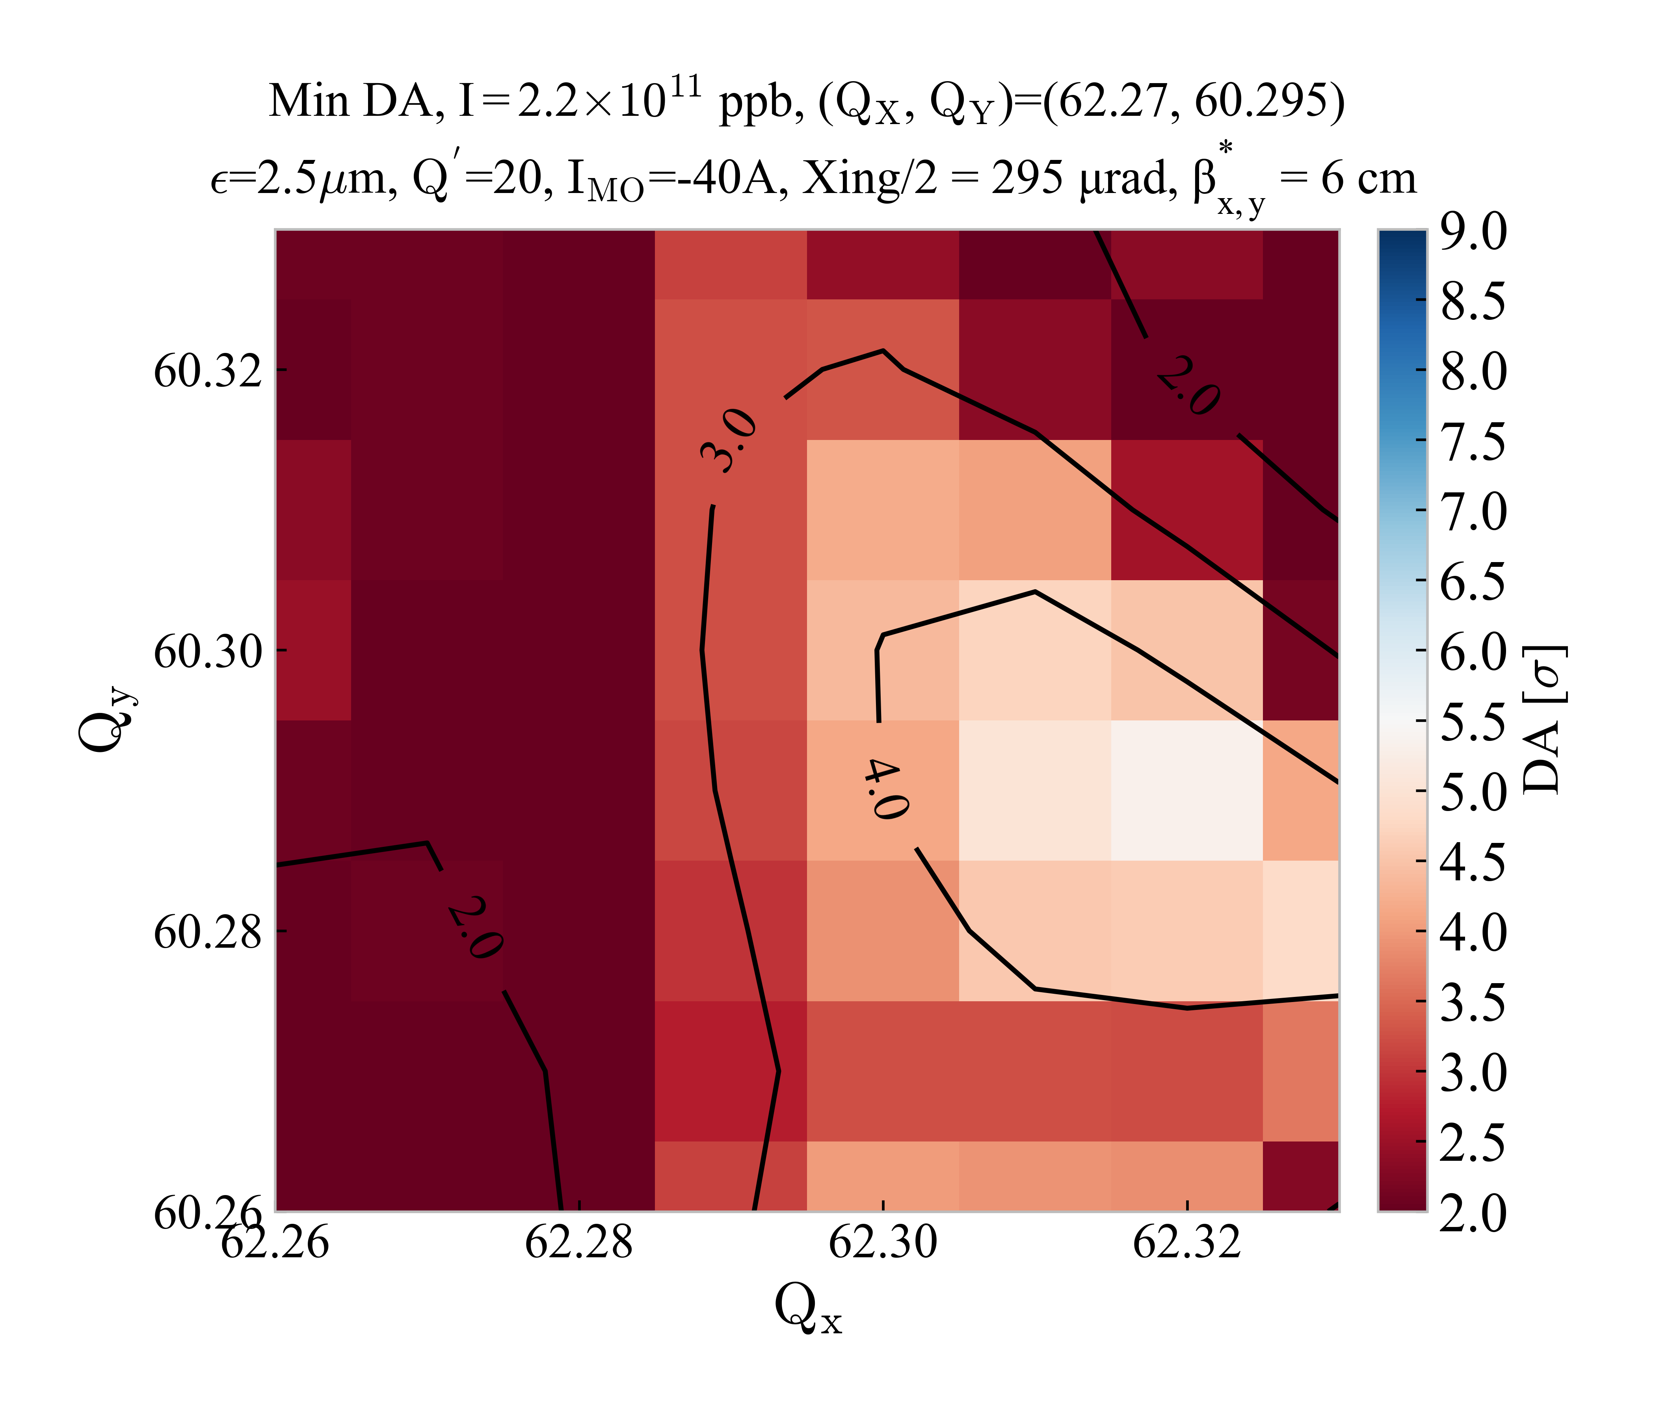


Comparison with/without Beam-Beam
HL-LHC v1.4
Injection
$I_{MO}$=±40 A
No Beam-Beam
HL-LHC v1.4
Injection
$I_{MO}$=±40 A
With Beam-Beam

Slide 15
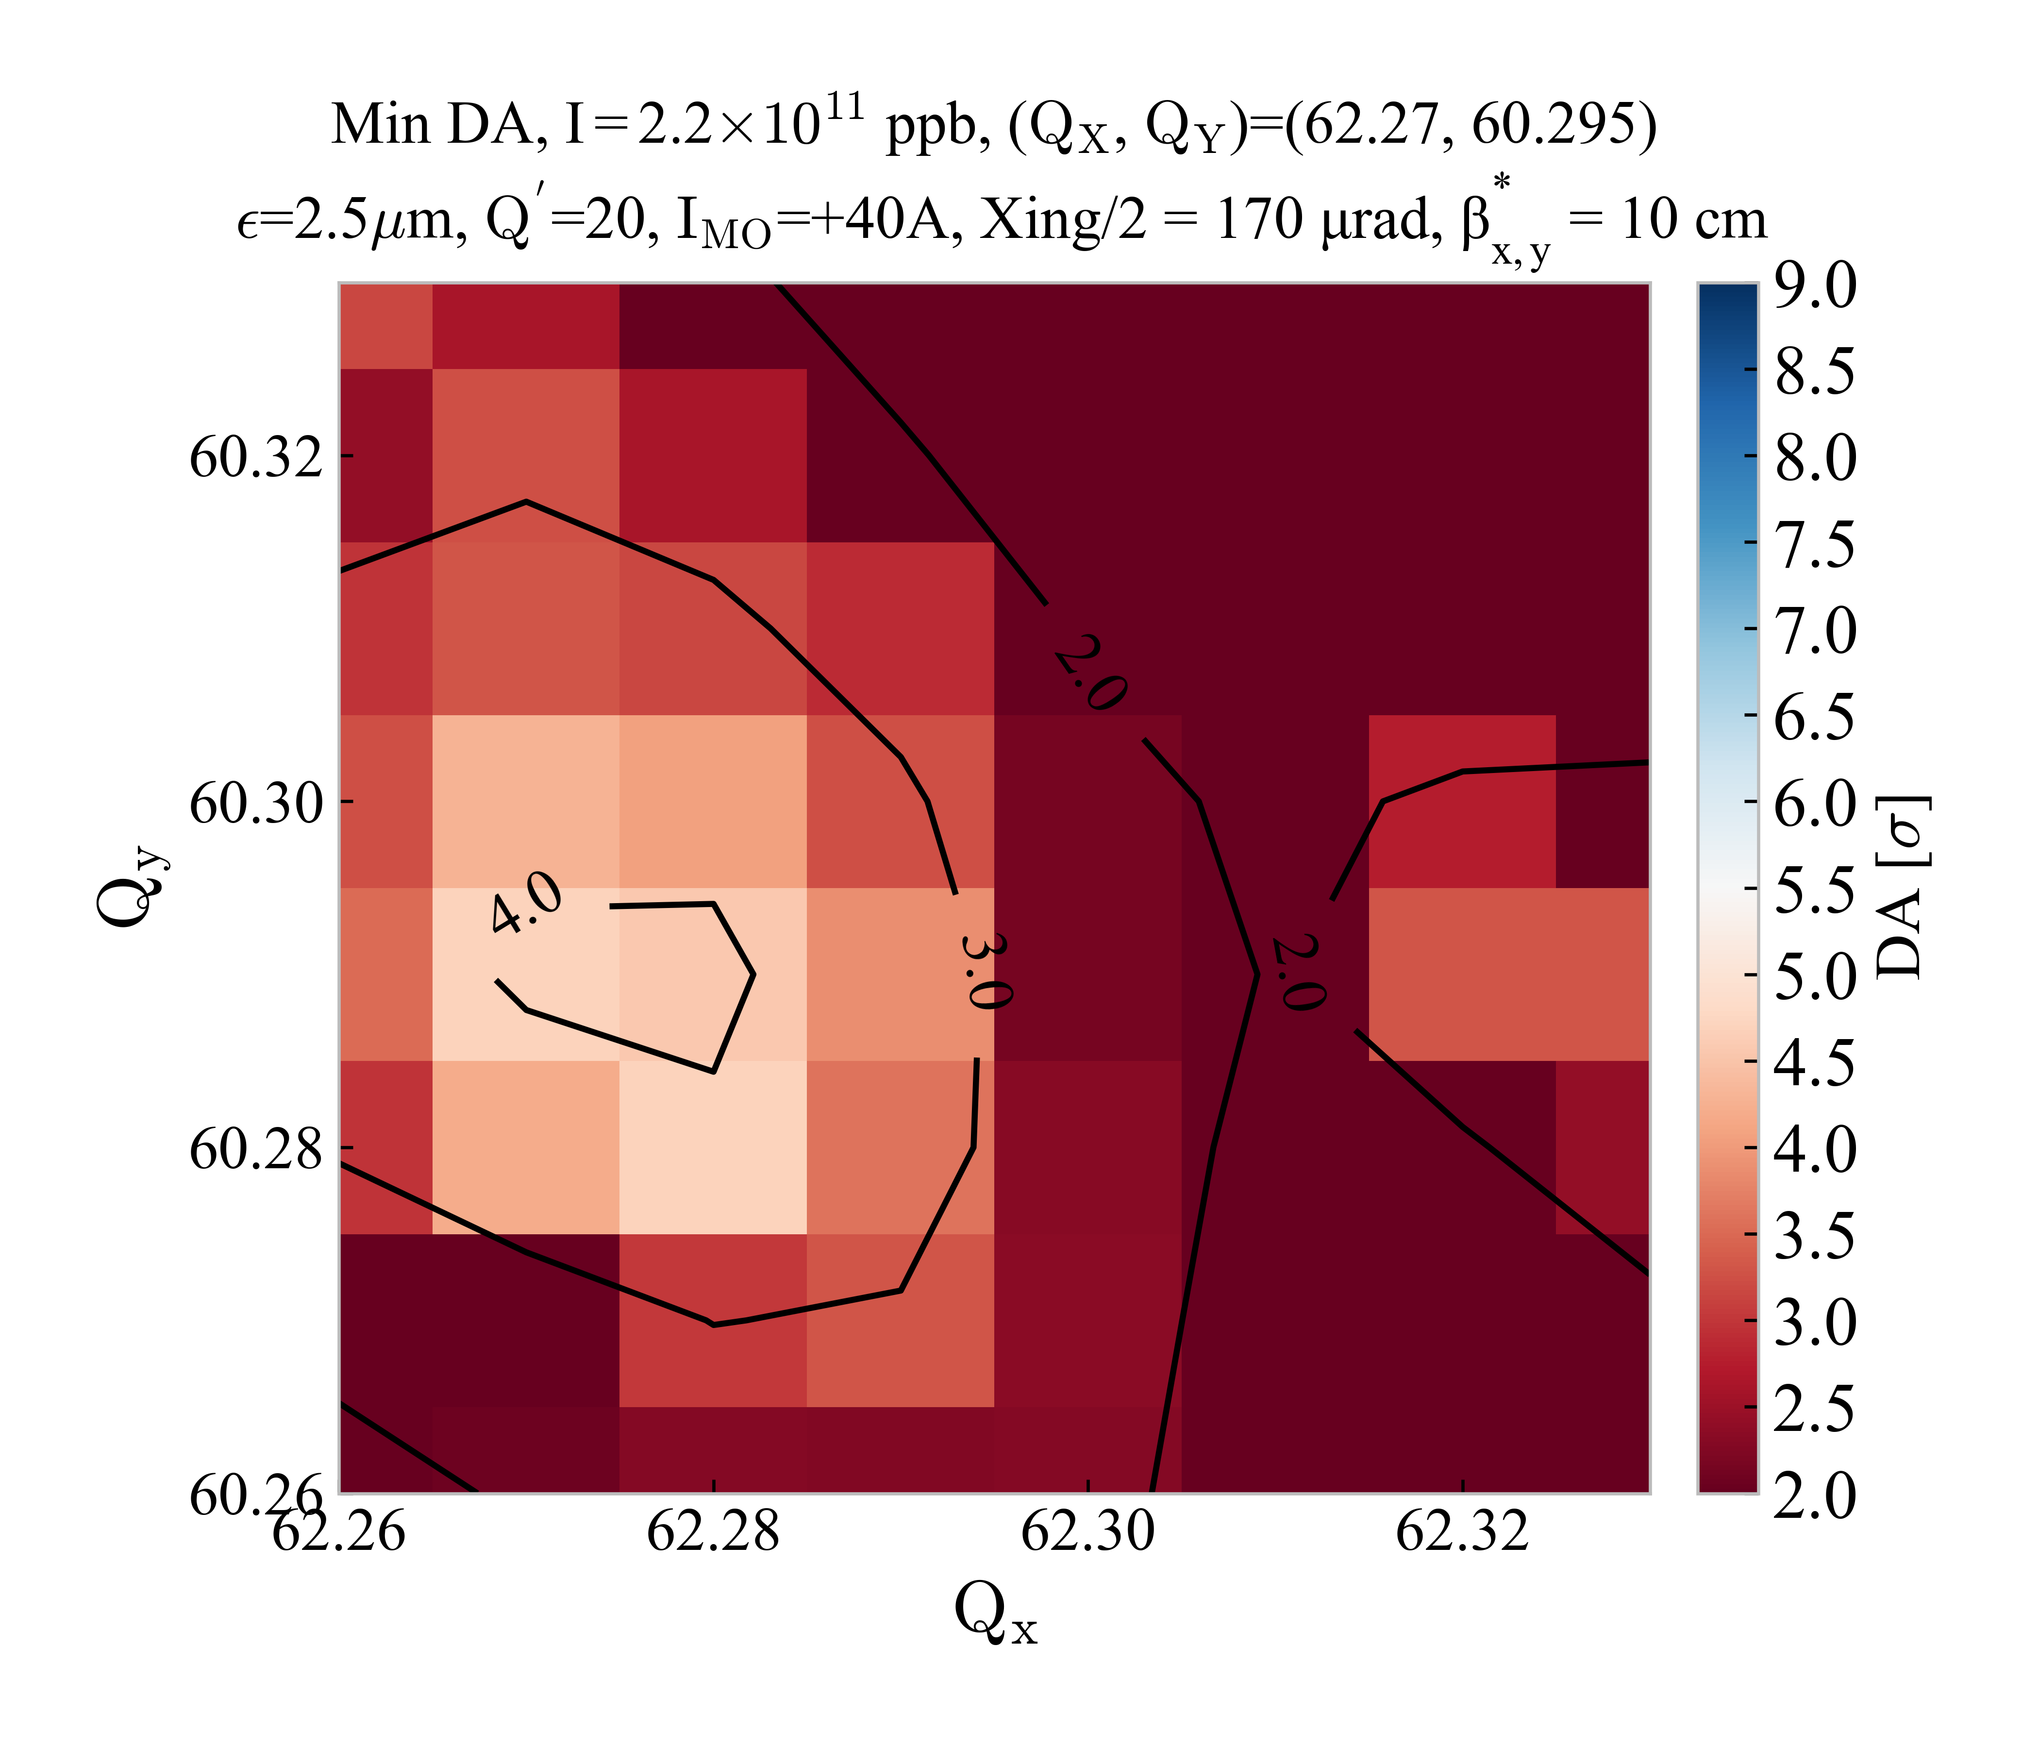
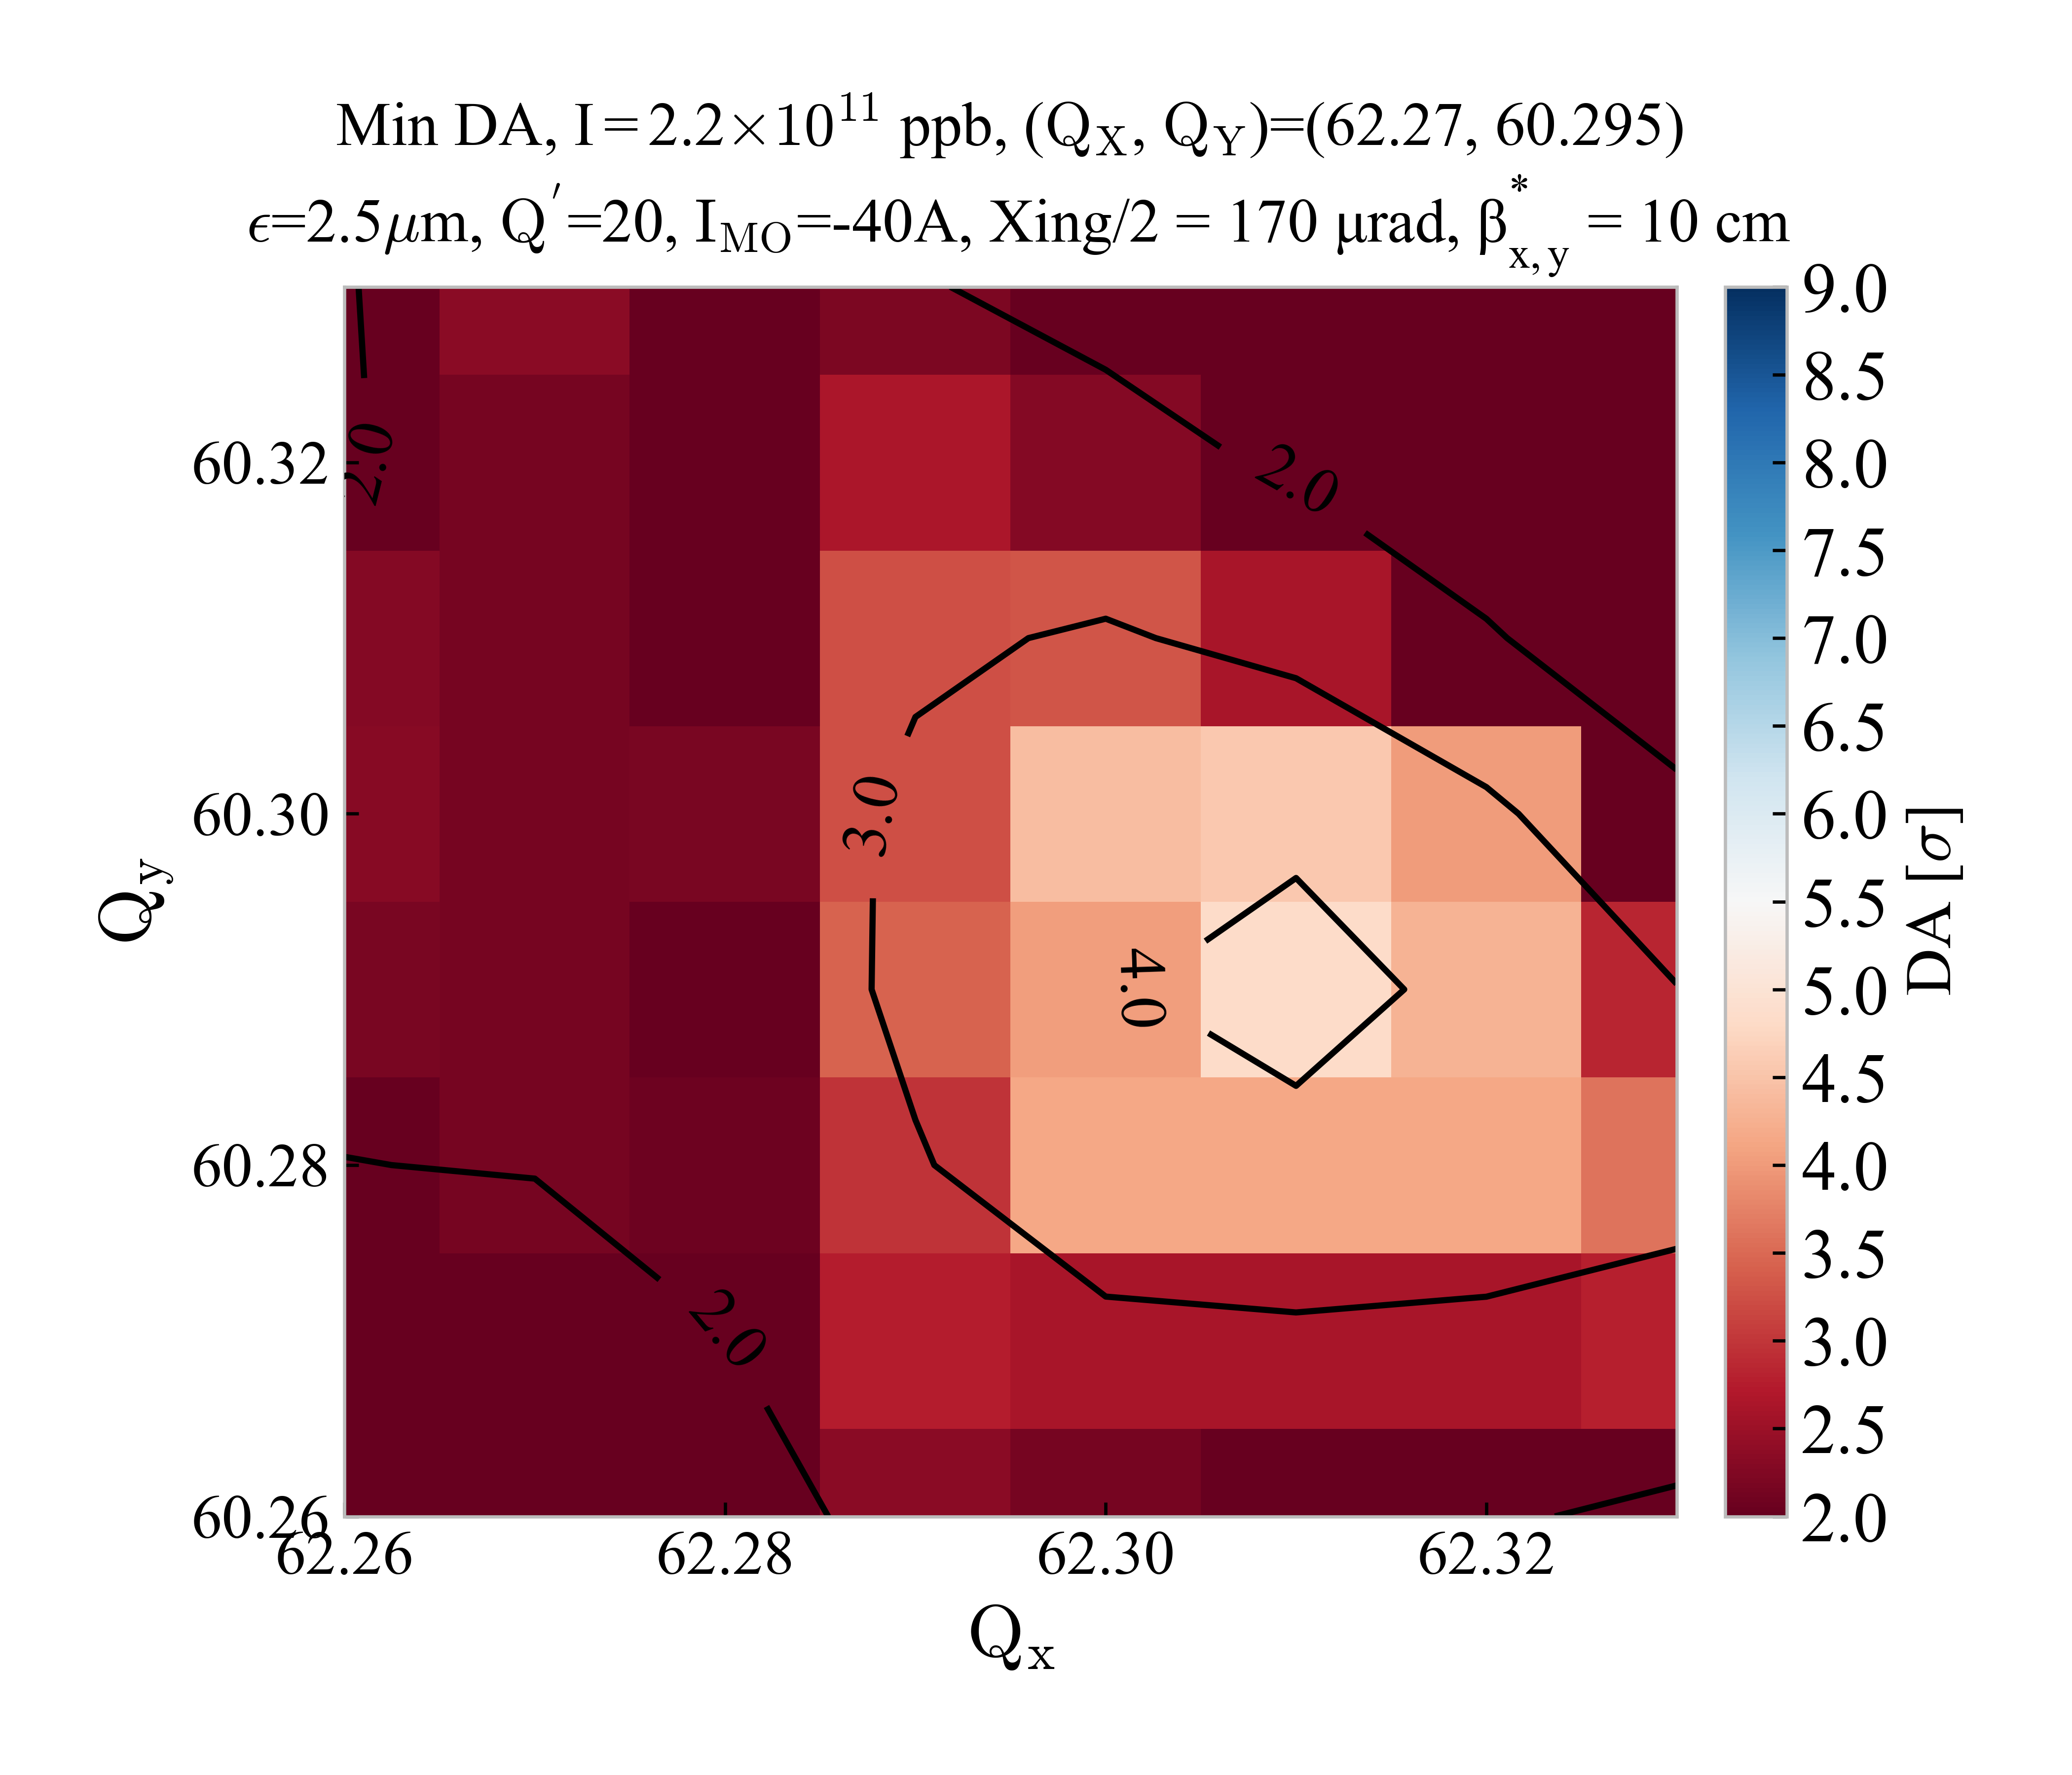


Comparison LHC vs HL-LHC (no beam-beam)
LHC run III Injection
$I_{MO}$=±40 A
No BeamBeam
HL-LHC v1.4
Injection
$I_{MO}$=±40 A
No BeamBeam

Slide 16
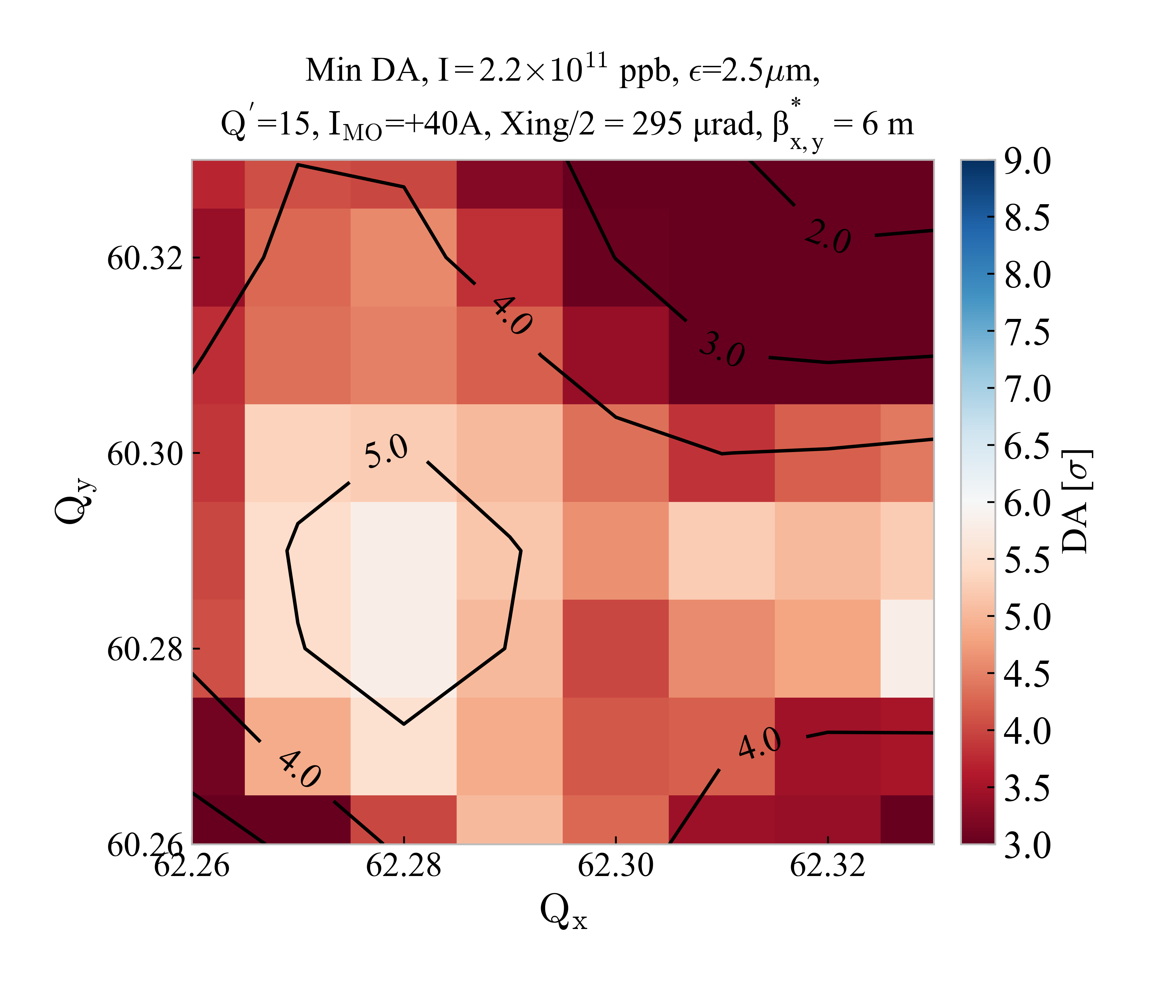
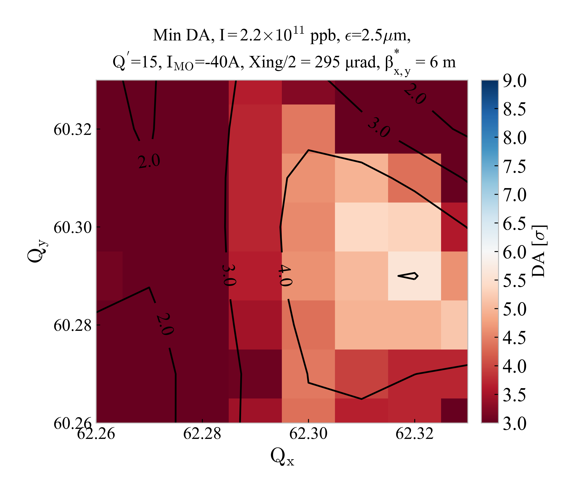


Comparison Q’=20 & Q’=15
HL-LHC v1.4
Injection
$I_{MO}$=±40 A
Q’ = 20
HL-LHC v1.4
Injection
$I_{MO}$=±40 A
Q’=15

Slide 17
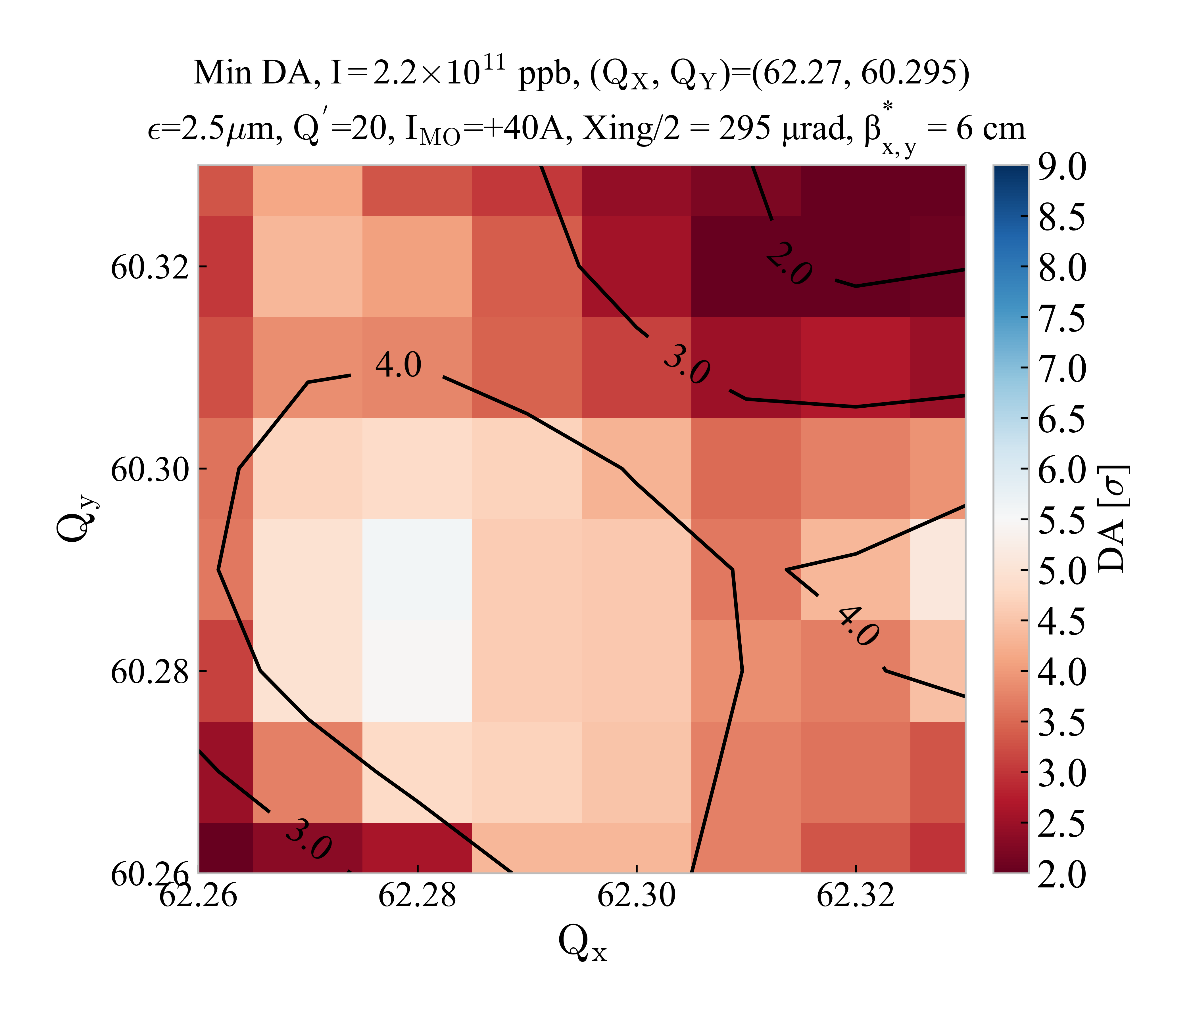
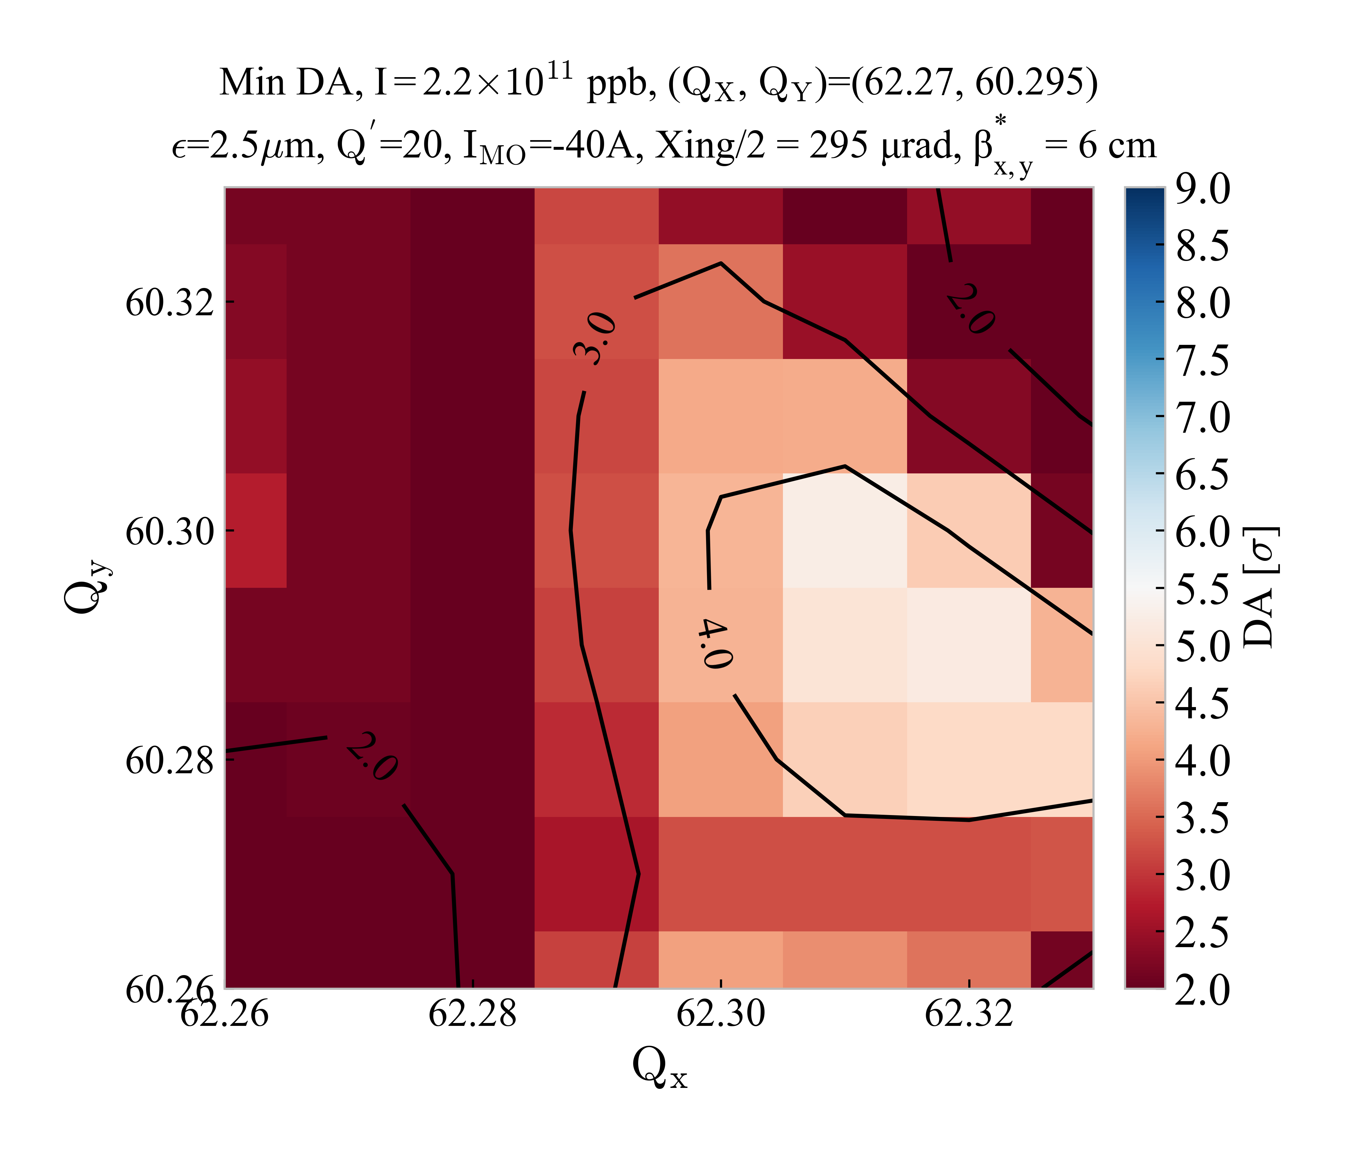


Comparison of sextupole powering
HL-LHC v1.4
Injection
$I_{MO}$=±40 A
Baseline
HL-LHC sextupole powering
HL-LHC v1.4
Injection
$I_{MO}$=±40 A
Equal sextupole powering (LHC-like)

