Slide 1
Update on the MS10 sextupole lattice study
F. Plassard, R. De Maria
Thanks to: M. Giovannozzi,
S. Kostoglou, N. Karasthatis, F. Van der Veken
WP2 Meeting 25/02/2020

Slide 2
OUTLINE
Recall of the 4 sextupole layout options proposed for HL-LHC
Summary of the main advantages / drawbacks
DA comparison after phase optimization
DA comparison including weak-strong beam-beam interactions

Slide 3
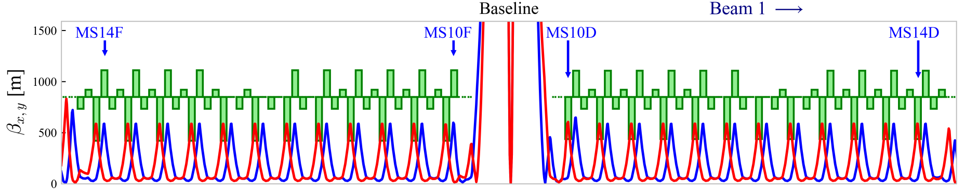
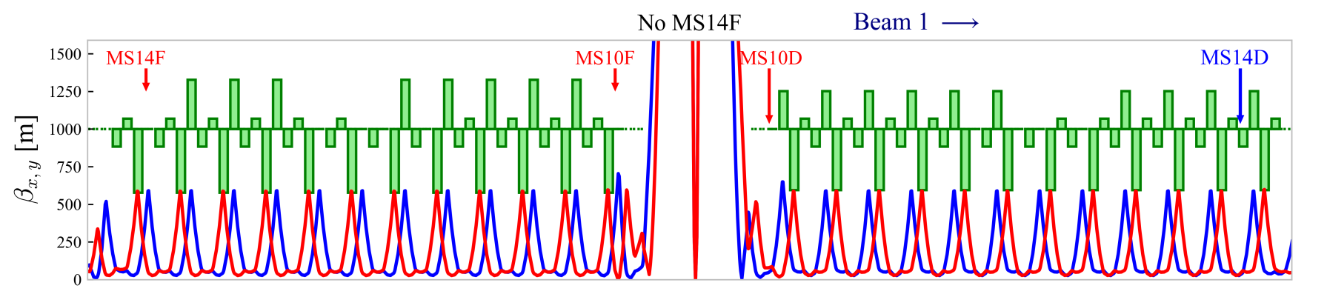
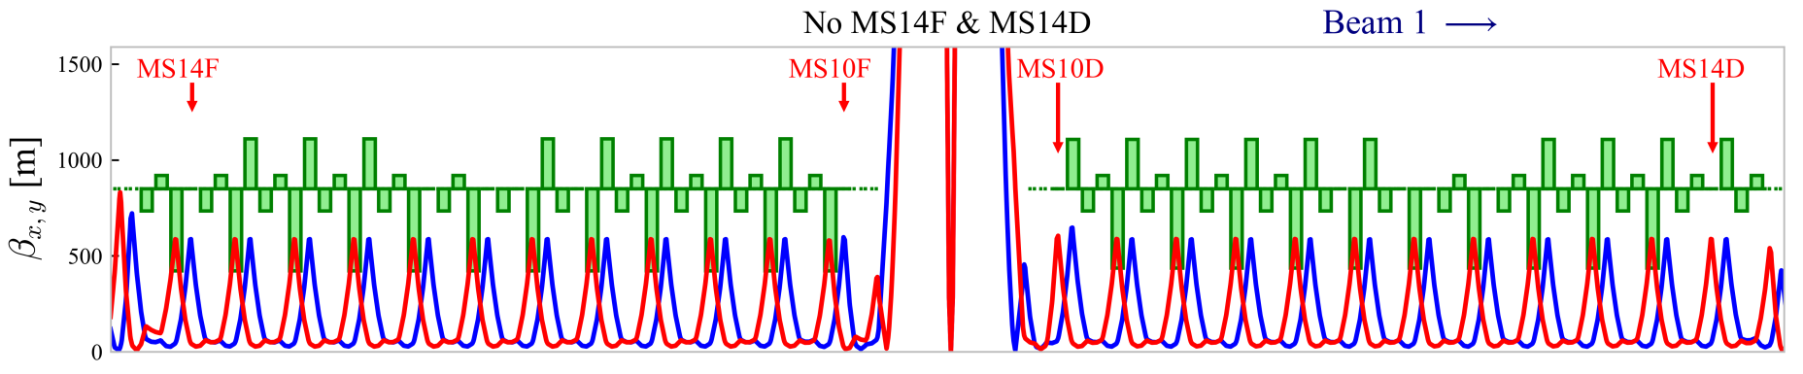
Recall of the sextupole layout options
New phases in IR1 & 5 : ${∆µ}_{y}^{IR1\&5}$ = -$\frac{π}{2}$

Slide 4
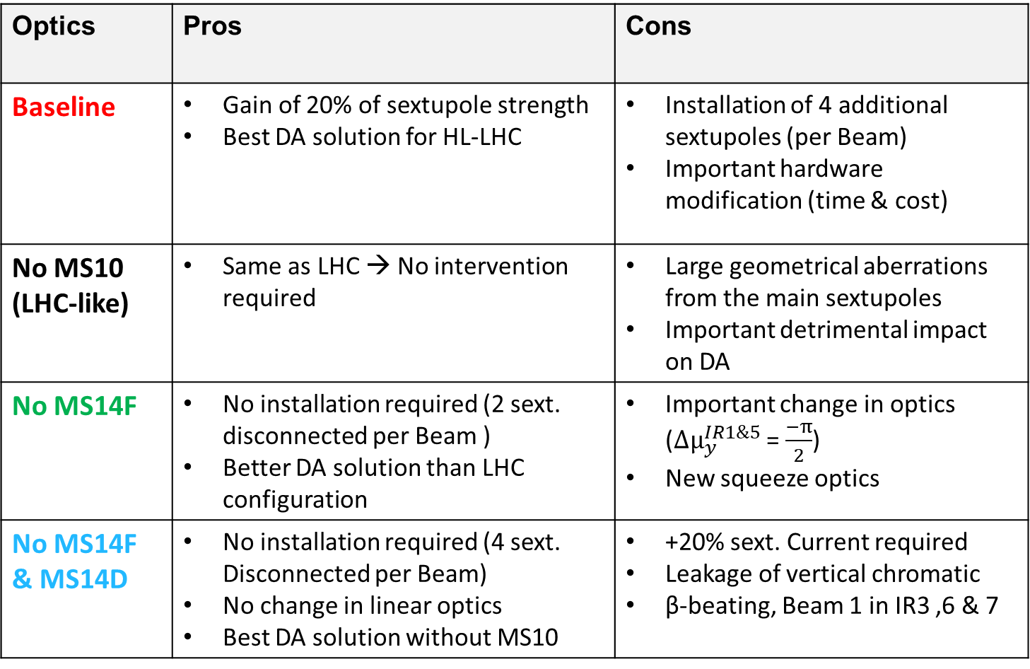
Properties of the proposed alternative options
Optics | Pros | Cons
Baseline | Gain of 20% of sextupole strength Best DA solution for HL-LHC | Installation of 4 additional sextupoles (per Beam) Important hardware modification (time & cost)
No MS10 (LHC-like) | Same as LHC → No intervention required | Large geometrical aberrations from the main sextupoles Important detrimental impact on DA
No MS14F | No installation required (2 sext. disconnected per Beam ) Better DA solution than LHC configuration | Important change in optics (${Δµ}_{y}^{IR1\&5}$ = $\frac{−π}{2}$) New squeeze optics
No MS14F & MS14D | No installation required (4 sext. Disconnected per Beam) No change in linear optics Best DA solution without MS10 | +20% sext. Current required Leakage of vertical chromatic β-beating, Beam 1 in IR3 ,6 & 7
(see WP2 meeting 158th for more details)

Slide 5
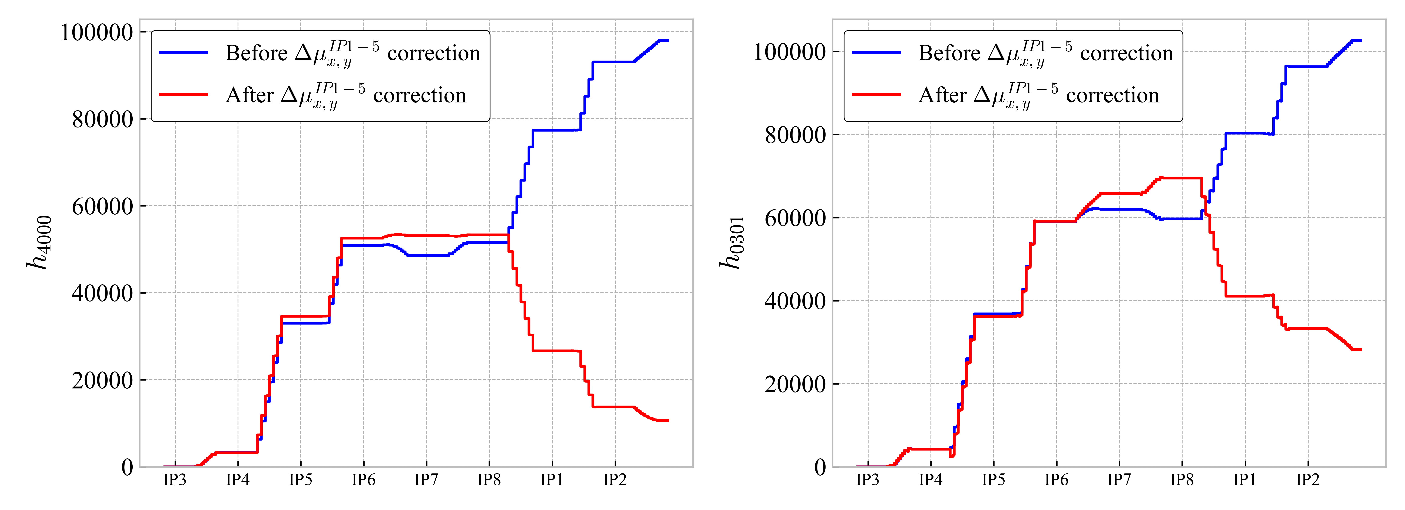
DA comparison after phase ${Δµ}_{x,y}^{IP1→5}$ optimization
Phase optimization between IP1 & IP5 allowing partial compensation of some fourth and higher order resonances in order to improve DA
While some RDTs are well corrected others increase…
The mechanism behind the DA reduction is too complex to target some specific resonances for the correction → optimize the phase directly by observing the DA

Slide 6
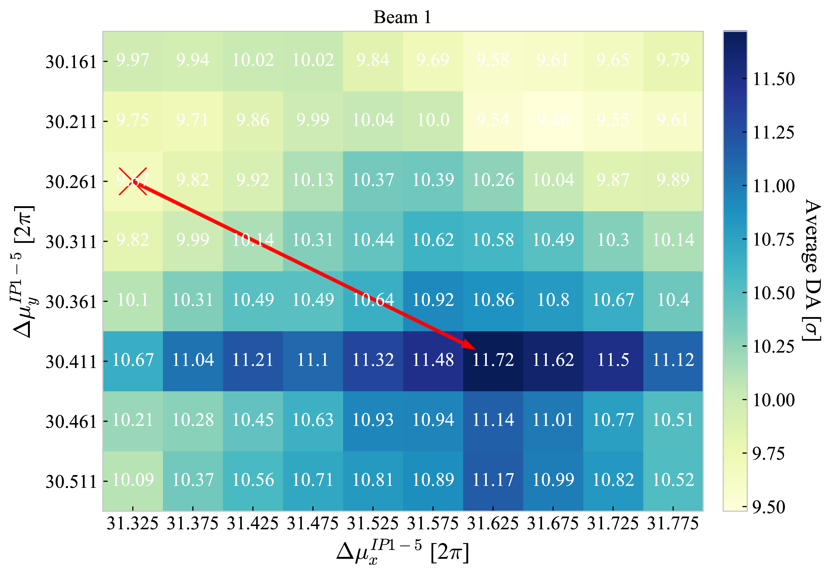
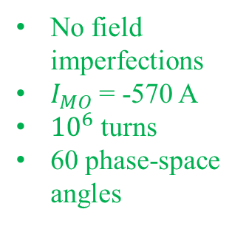
DA comparison after phase ${Δµ}_{x,y}^{IP1→5}$ optimization
Phase optimization between IP1 & IP5 allowing partial compensation of some fourth and higher order resonances in order to improve DA
Phase scan performed without imperfections for each lattice options and both beams
The optimal phase setup takes into account the optics constraints for HL-LHC especially for machine protection
No field imperfections
$I_{MO}$ = -570 A
${10}^{6}$ turns
60 phase-space angles

Slide 7
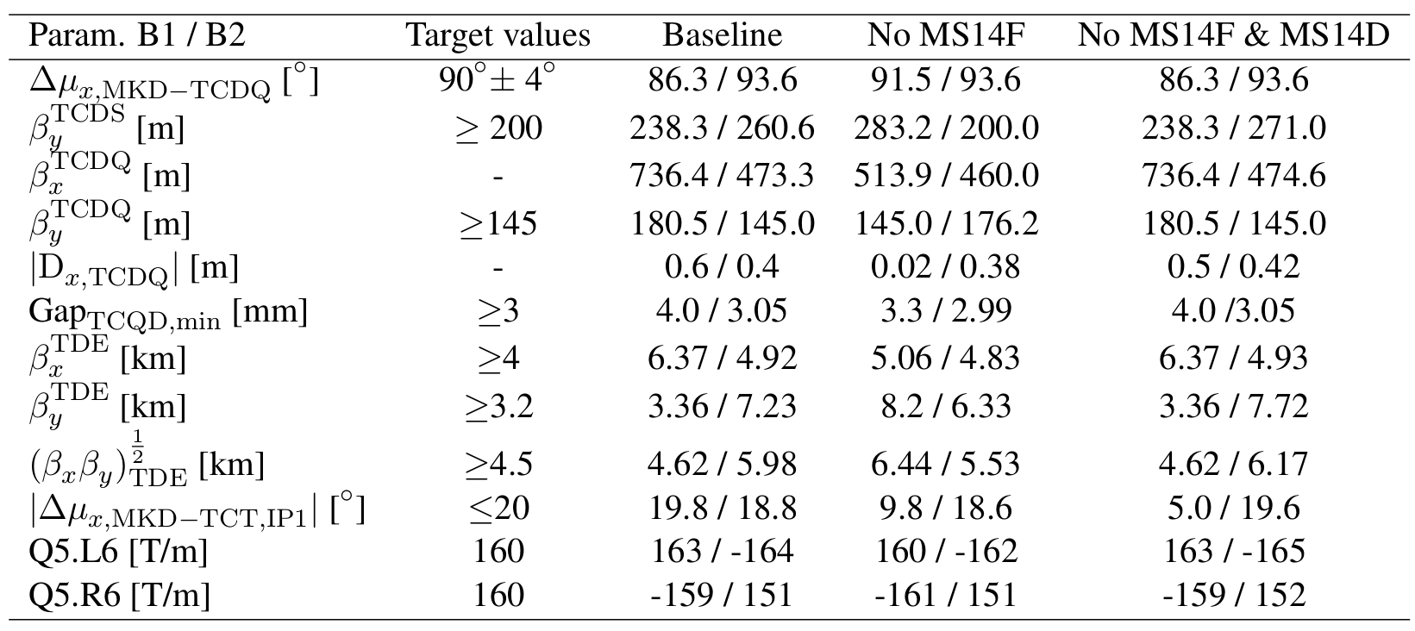
DA comparison after phase ${Δµ}_{x,y}^{IP1→5}$ optimization
The optimal phase setup takes into account the optics constraints for HL-LHC especially for machine protection
The parameters after phase optimization are within the constraints for IR6 region

Slide 8
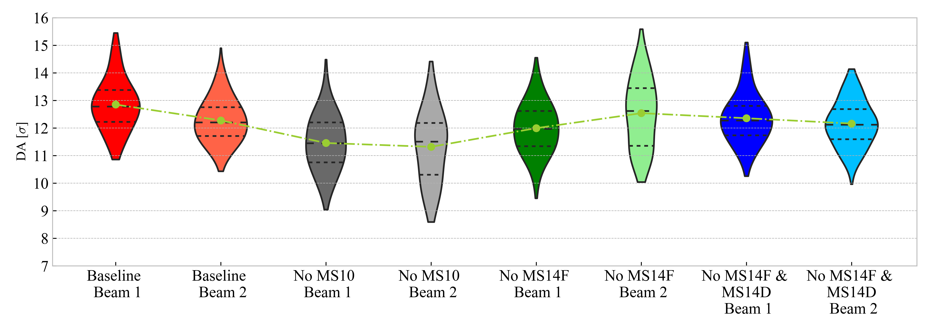
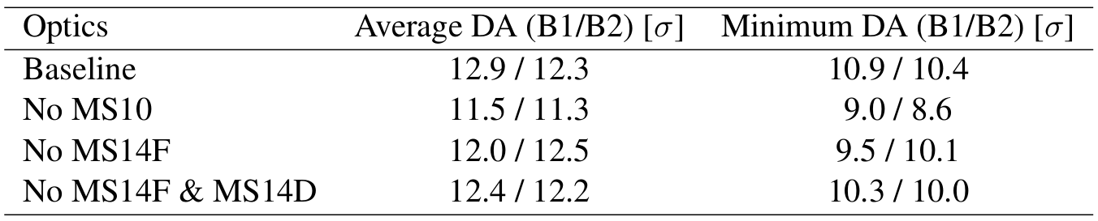

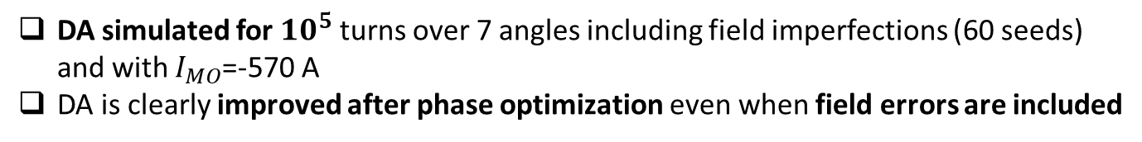
DA comparison after phase ${Δµ}_{x,y}^{IP1→5}$ optimization
DA simulated for ${10}^{5}$ turns over 7 angles including field imperfections (60 seeds) and with $I_{MO}$=-570 A
DA is clearly improved after phase optimization even when field errors are included
DA after ${Δµ}_{x,y}^{IP1→5}$ optimization

Slide 9
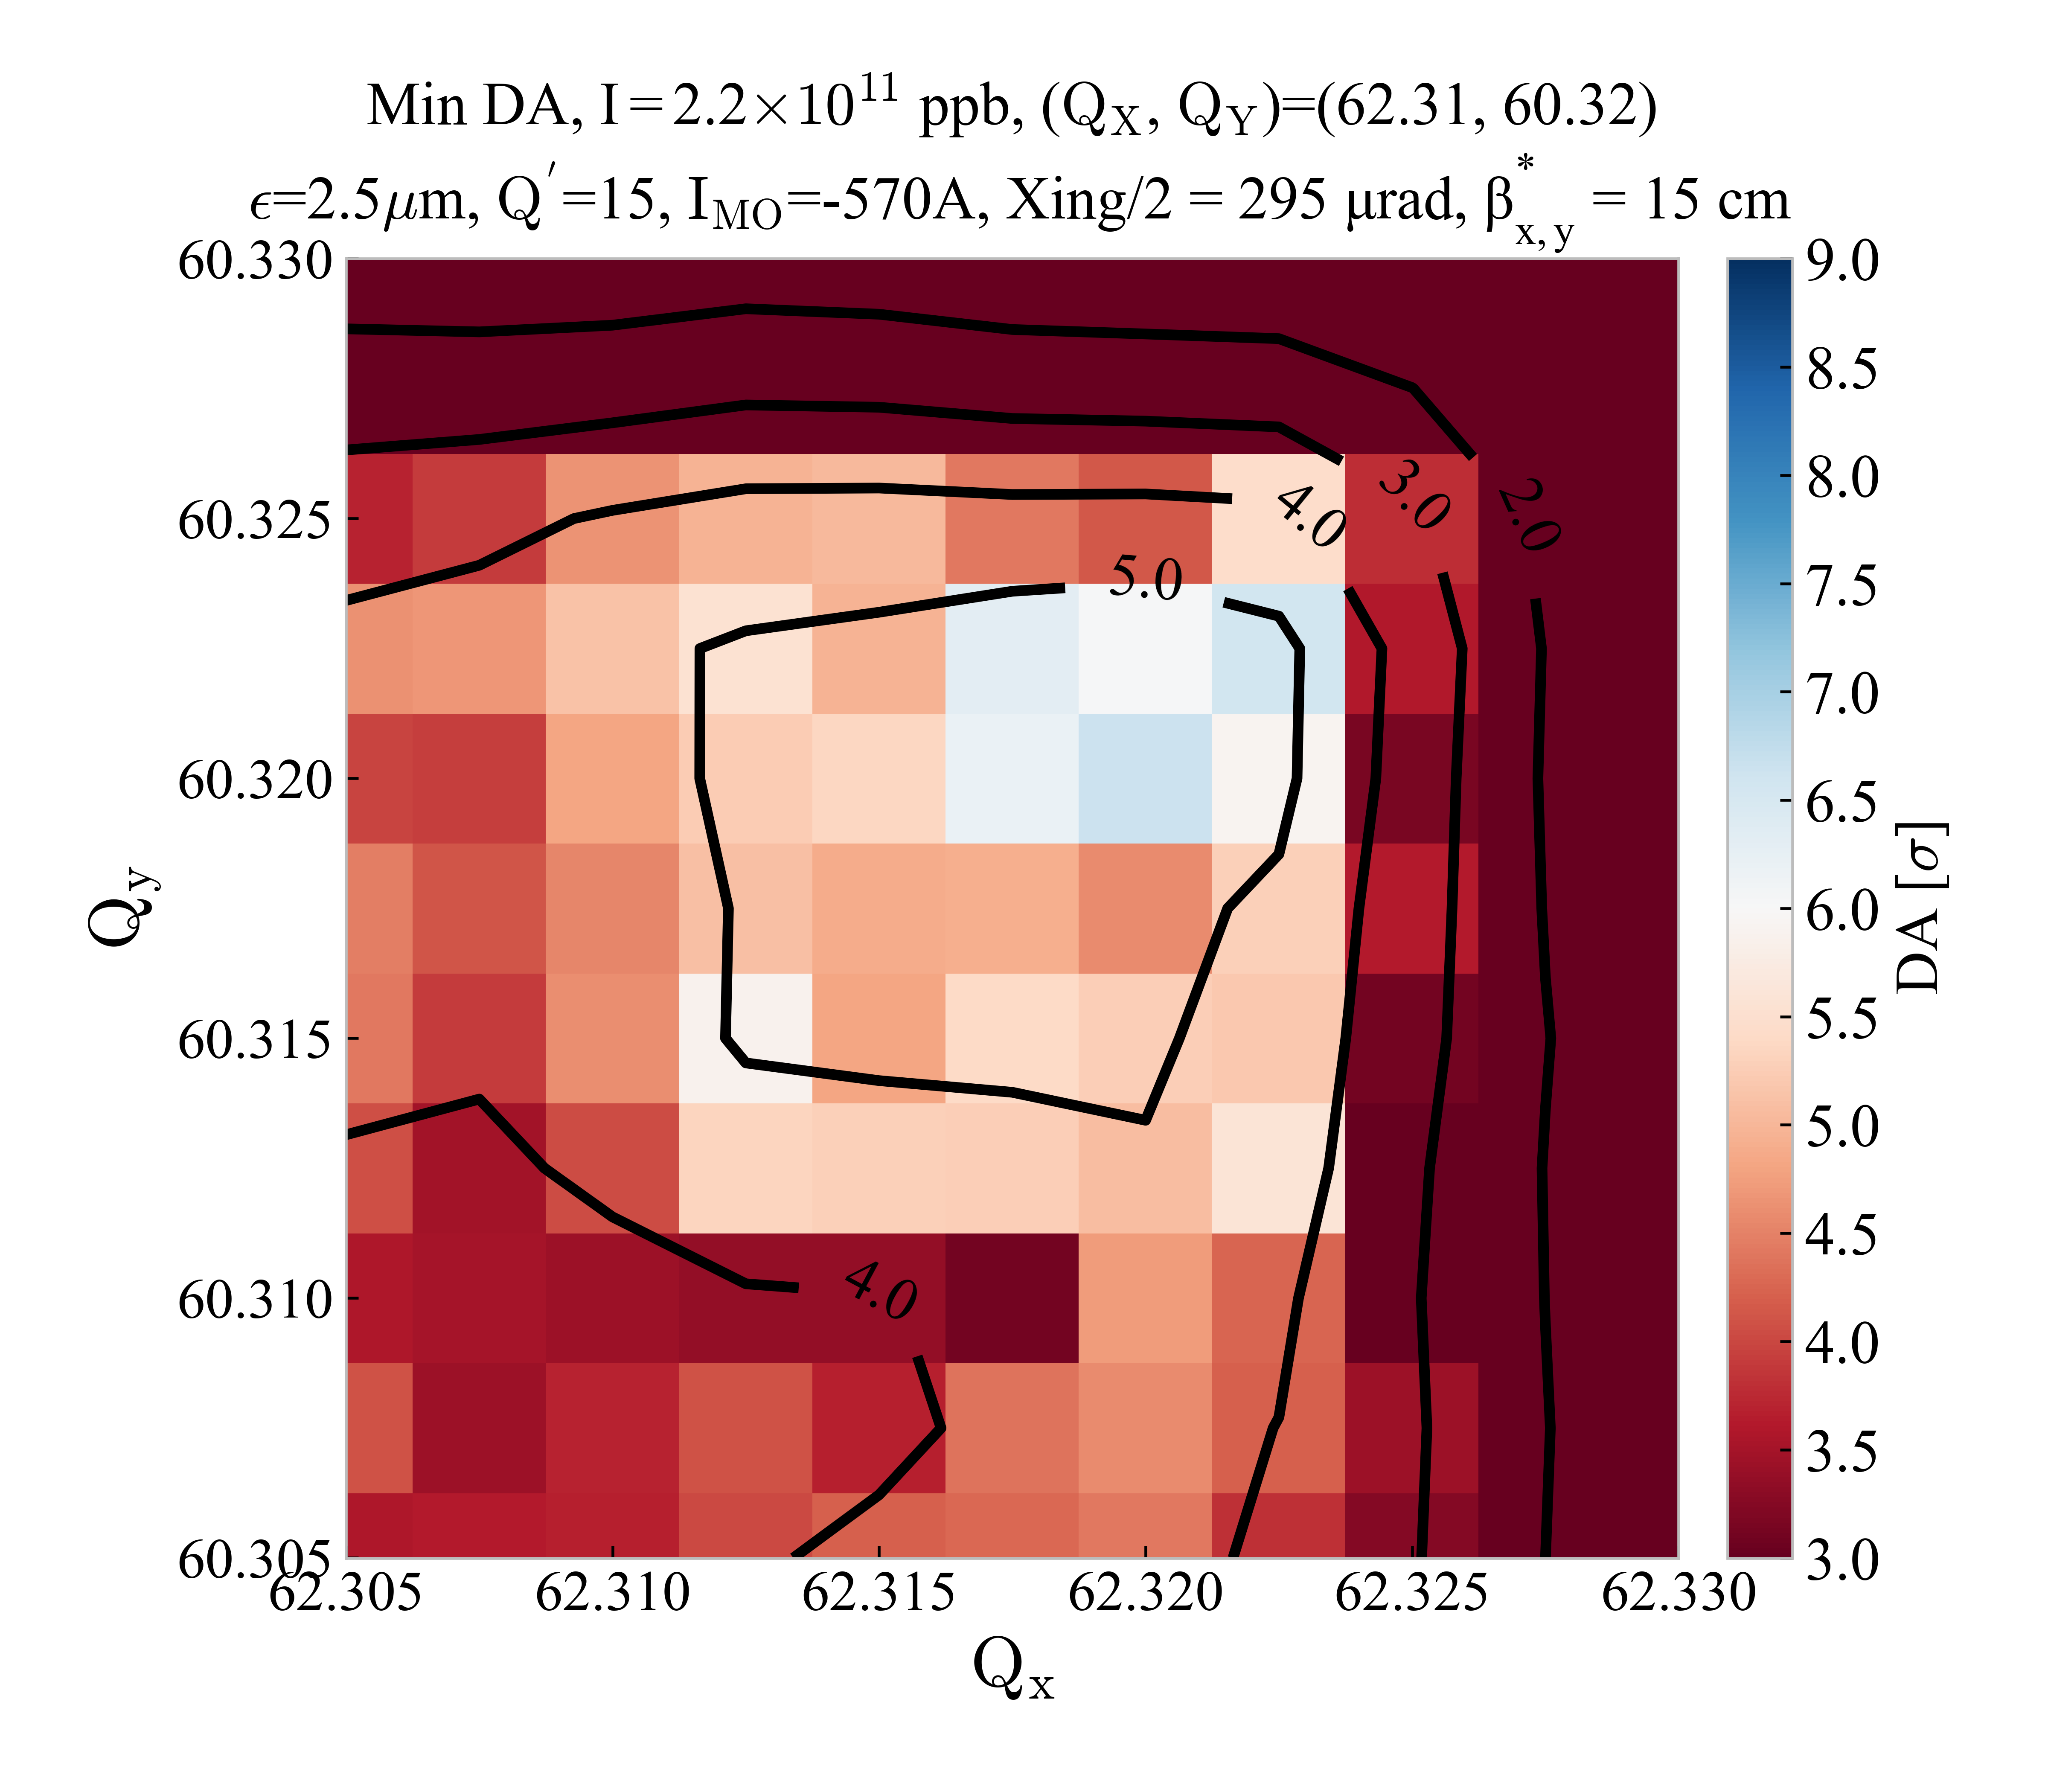
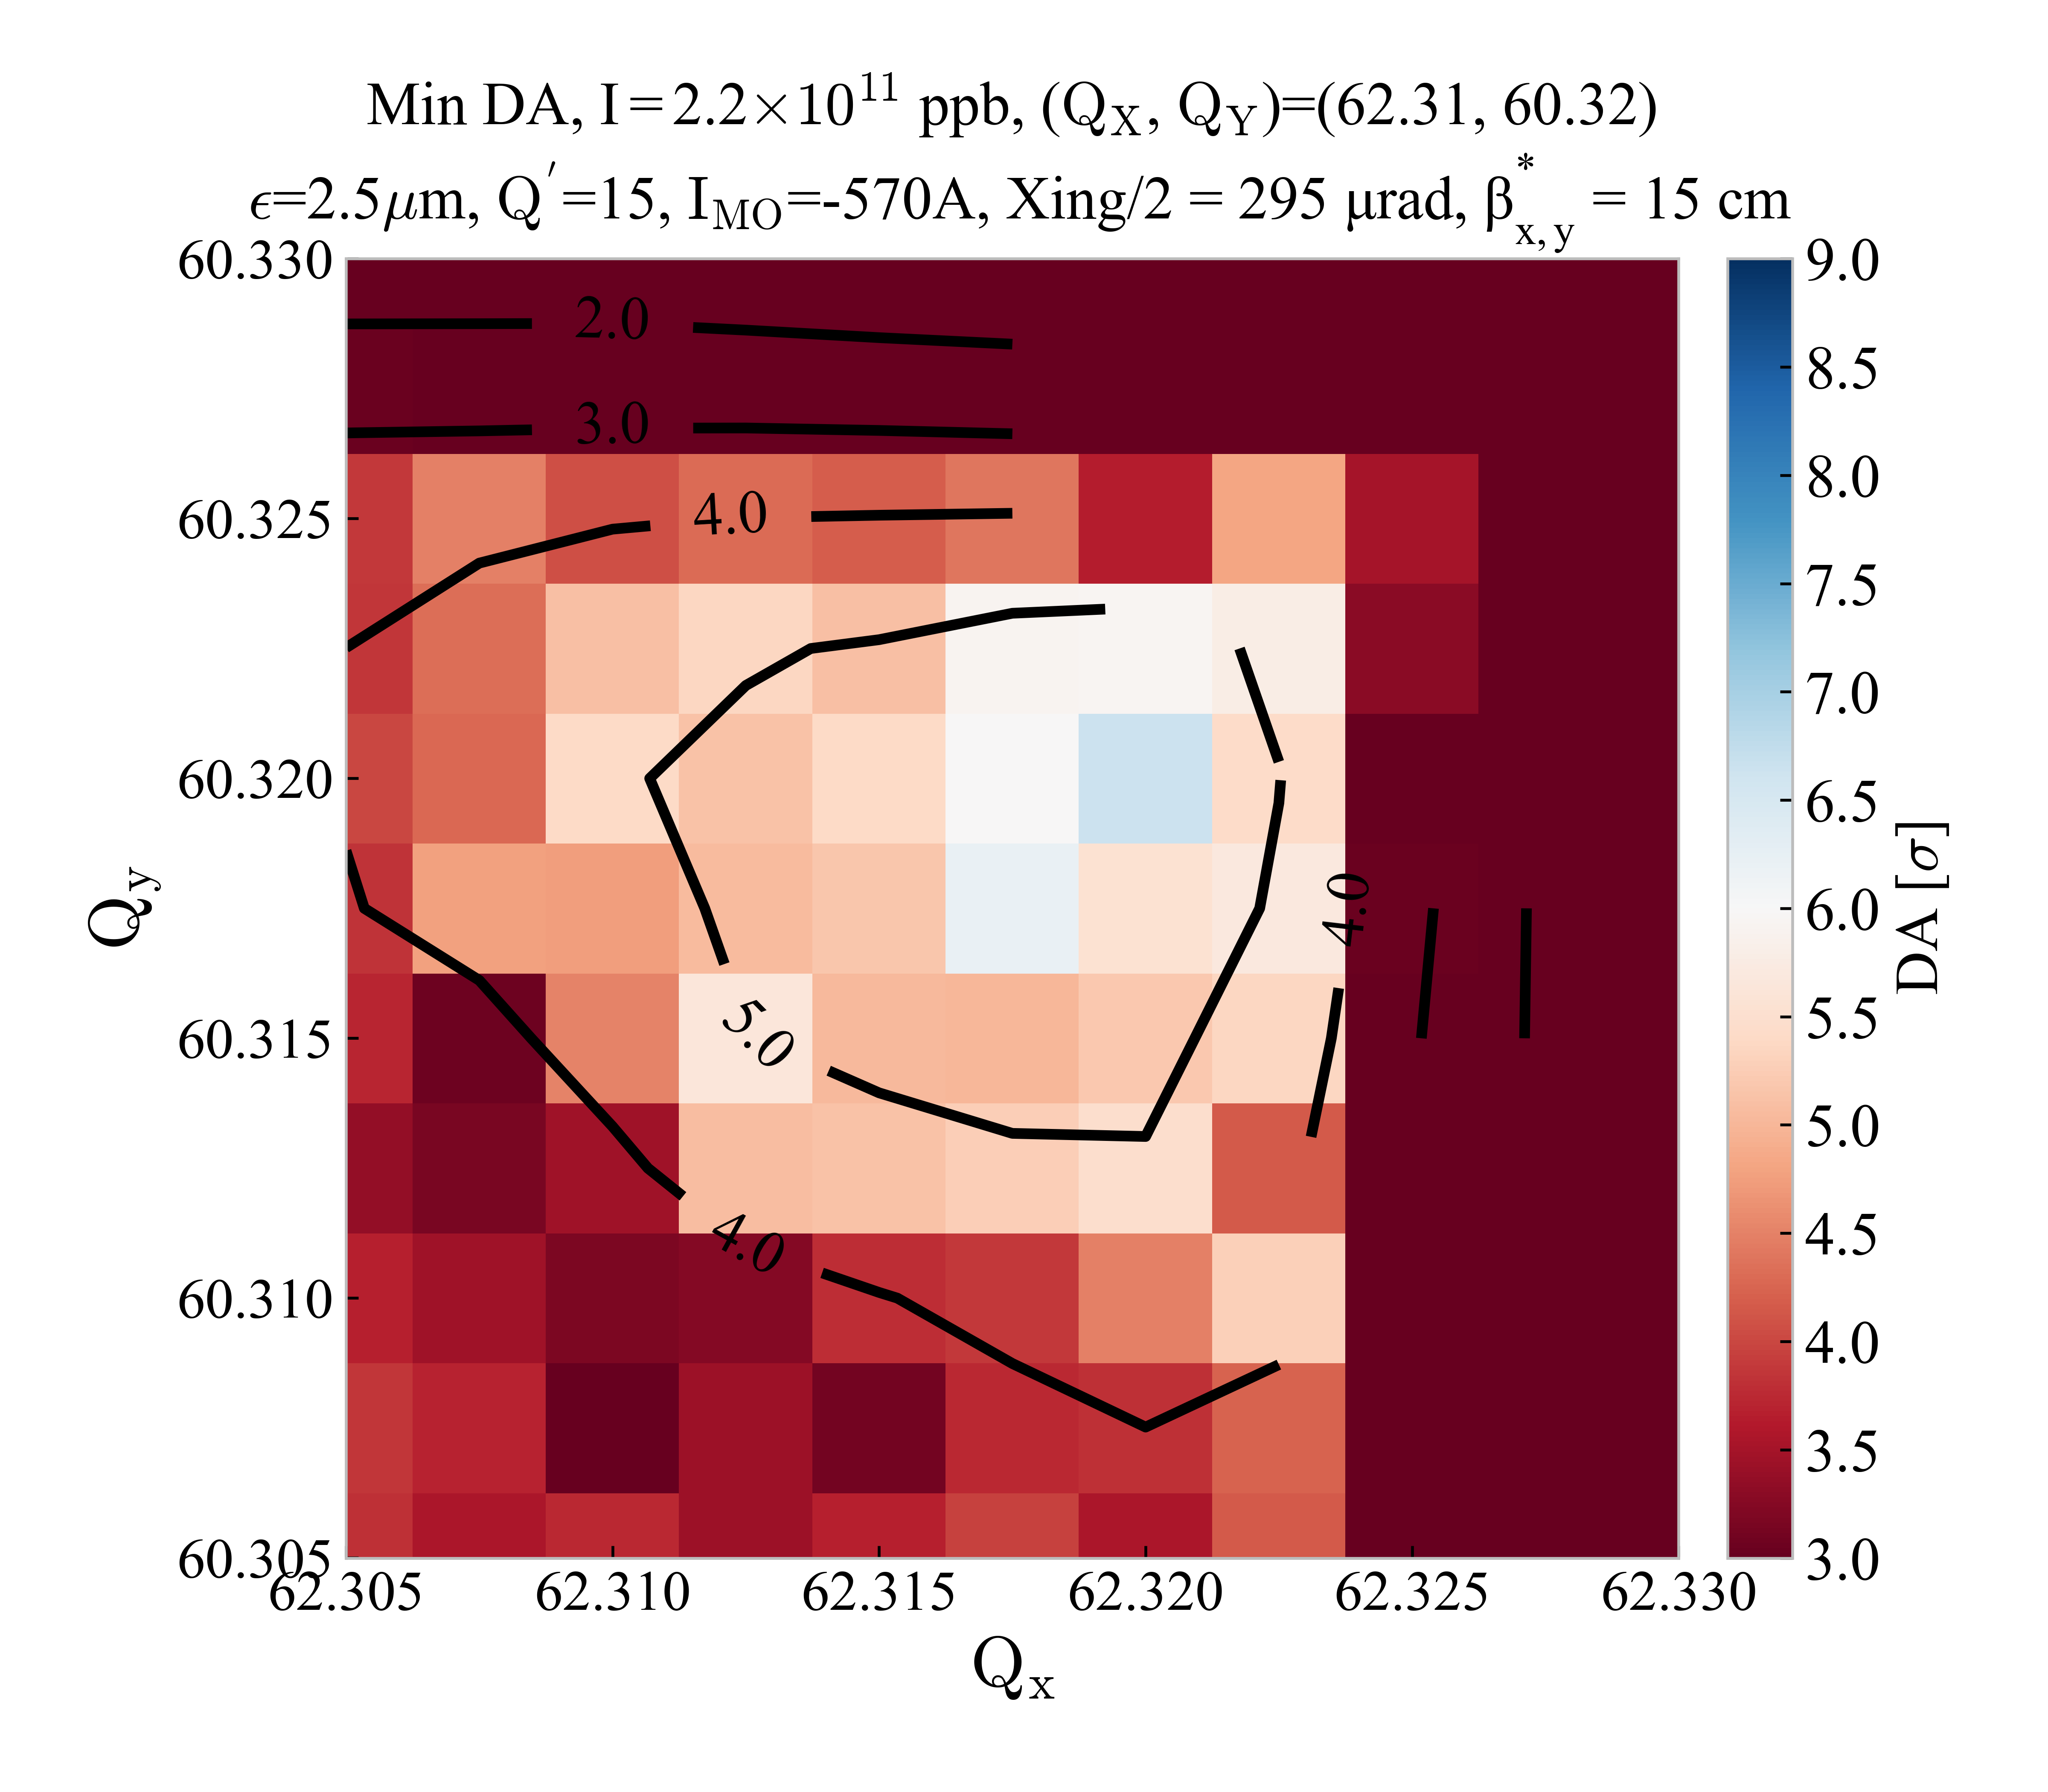



DA comparison after phase ${Δµ}_{x,y}^{IP1→5}$ optimization including weak-strong beam-beam effects
BASELINE
DA before ${Δµ}_{x,y}^{IP1→5}$ optimization
DA after ${Δµ}_{x,y}^{IP1→5}$ optimization
No DA improvement or large degradation after phase optimization in the case of the Baseline when beam-beam is included
Both show a small tune area above the 6σ target close to the coupling lines

Slide 10
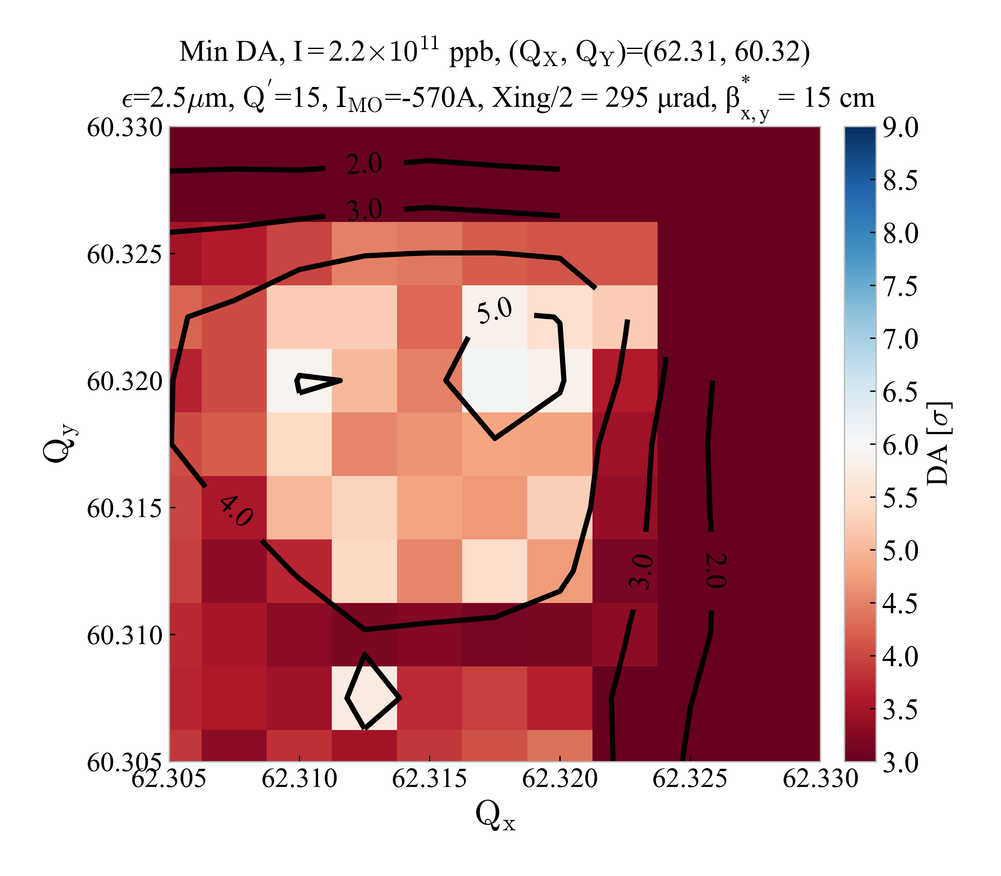
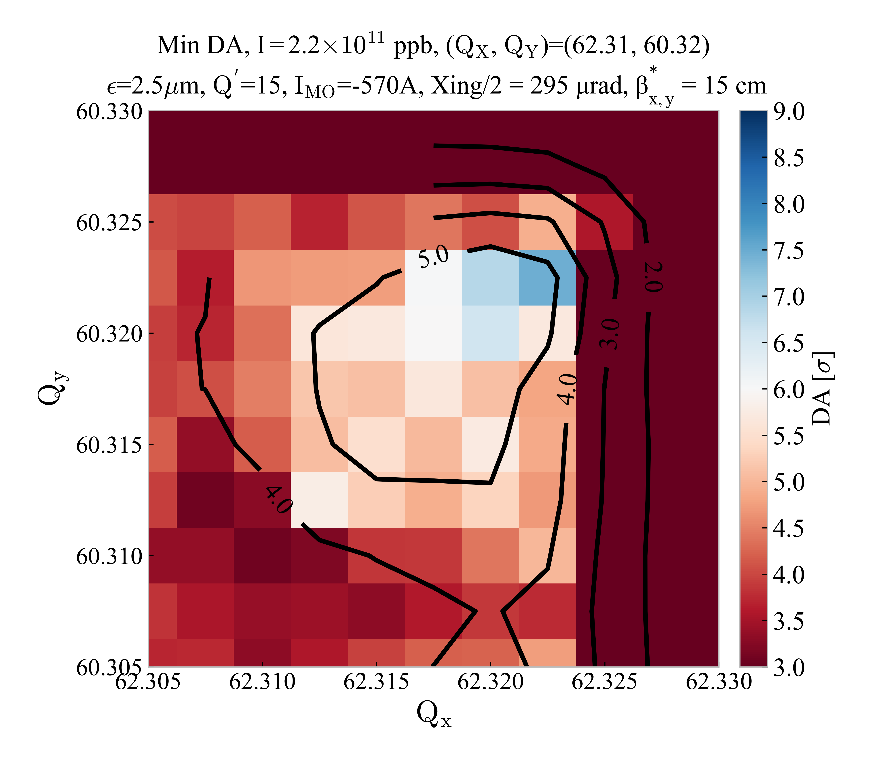


DA comparison after phase ${Δµ}_{x,y}^{IP1→5}$ optimization including weak-strong beam-beam effects
No MS10
DA before ${Δµ}_{x,y}^{IP1→5}$ optimization
DA after ${Δµ}_{x,y}^{IP1→5}$ optimization
Clear DA improvement after phase optimization in the case of the No MS10 when beam-beam is included
Small tune area above the 6σ target close to the coupling lines after optimization

Slide 11
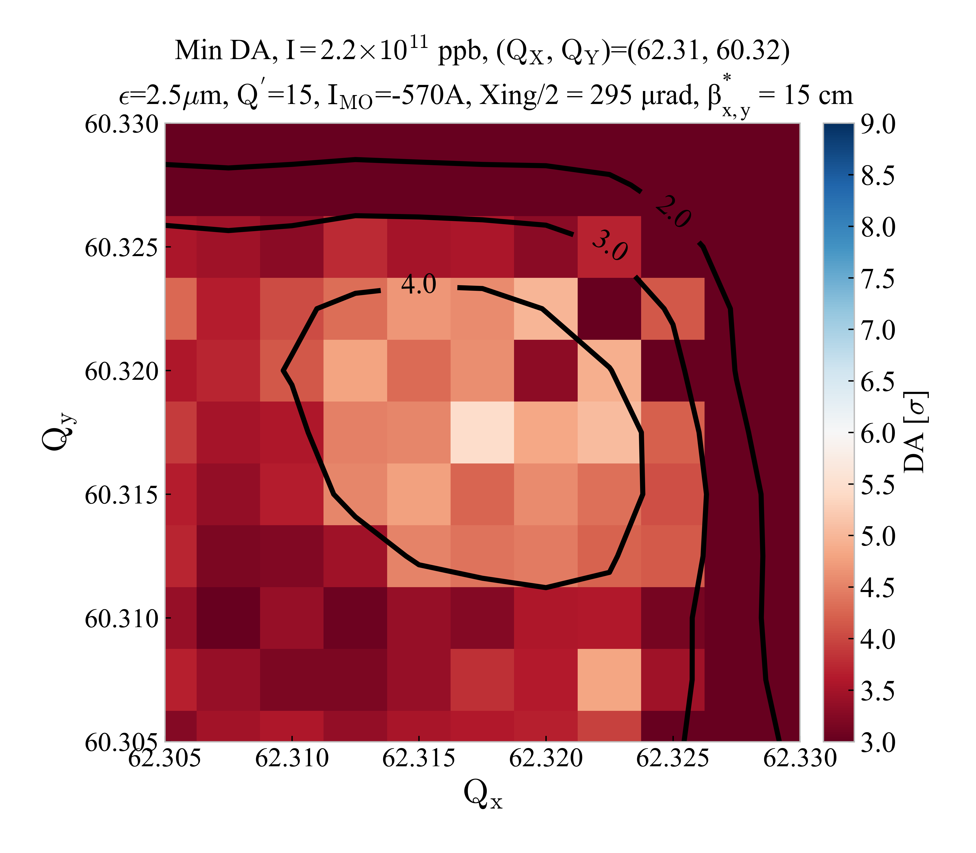
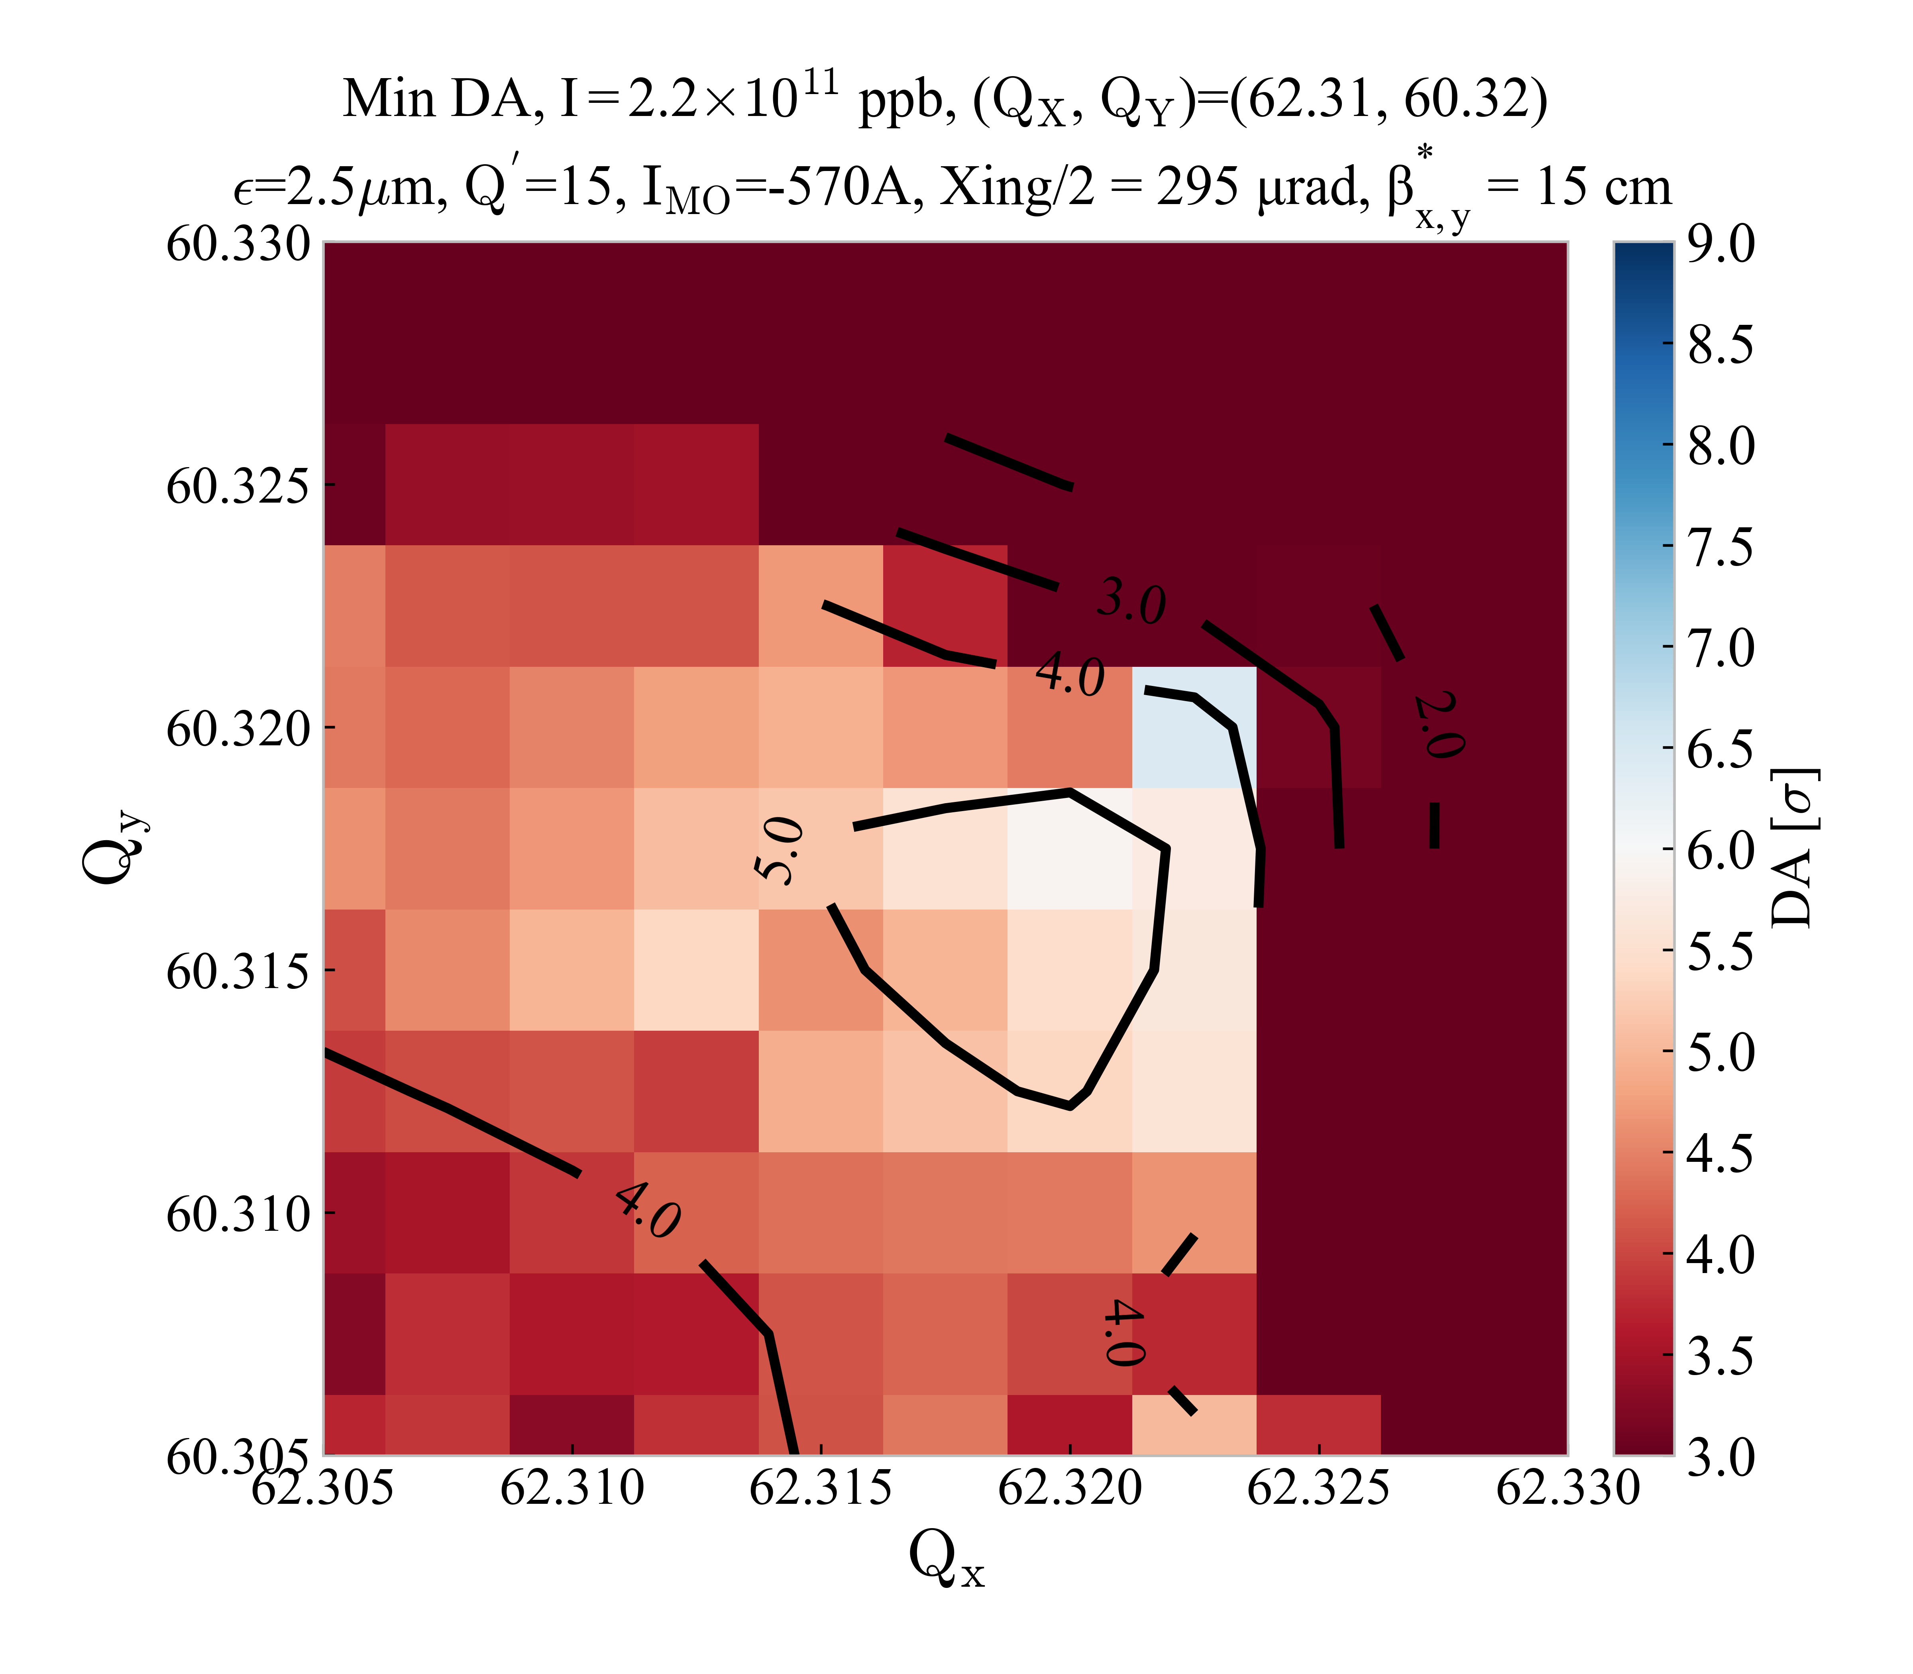


DA comparison after phase ${Δµ}_{x,y}^{IP1→5}$ optimization including weak-strong beam-beam effects
No MS14F
DA before ${Δµ}_{x,y}^{IP1→5}$ optimization
DA after ${Δµ}_{x,y}^{IP1→5}$ optimization
Clear DA improvement after phase optimization in the case of the No MS14F when beam-beam is included
Small tune area above the 6σ target close to the coupling lines after optimization

Slide 12
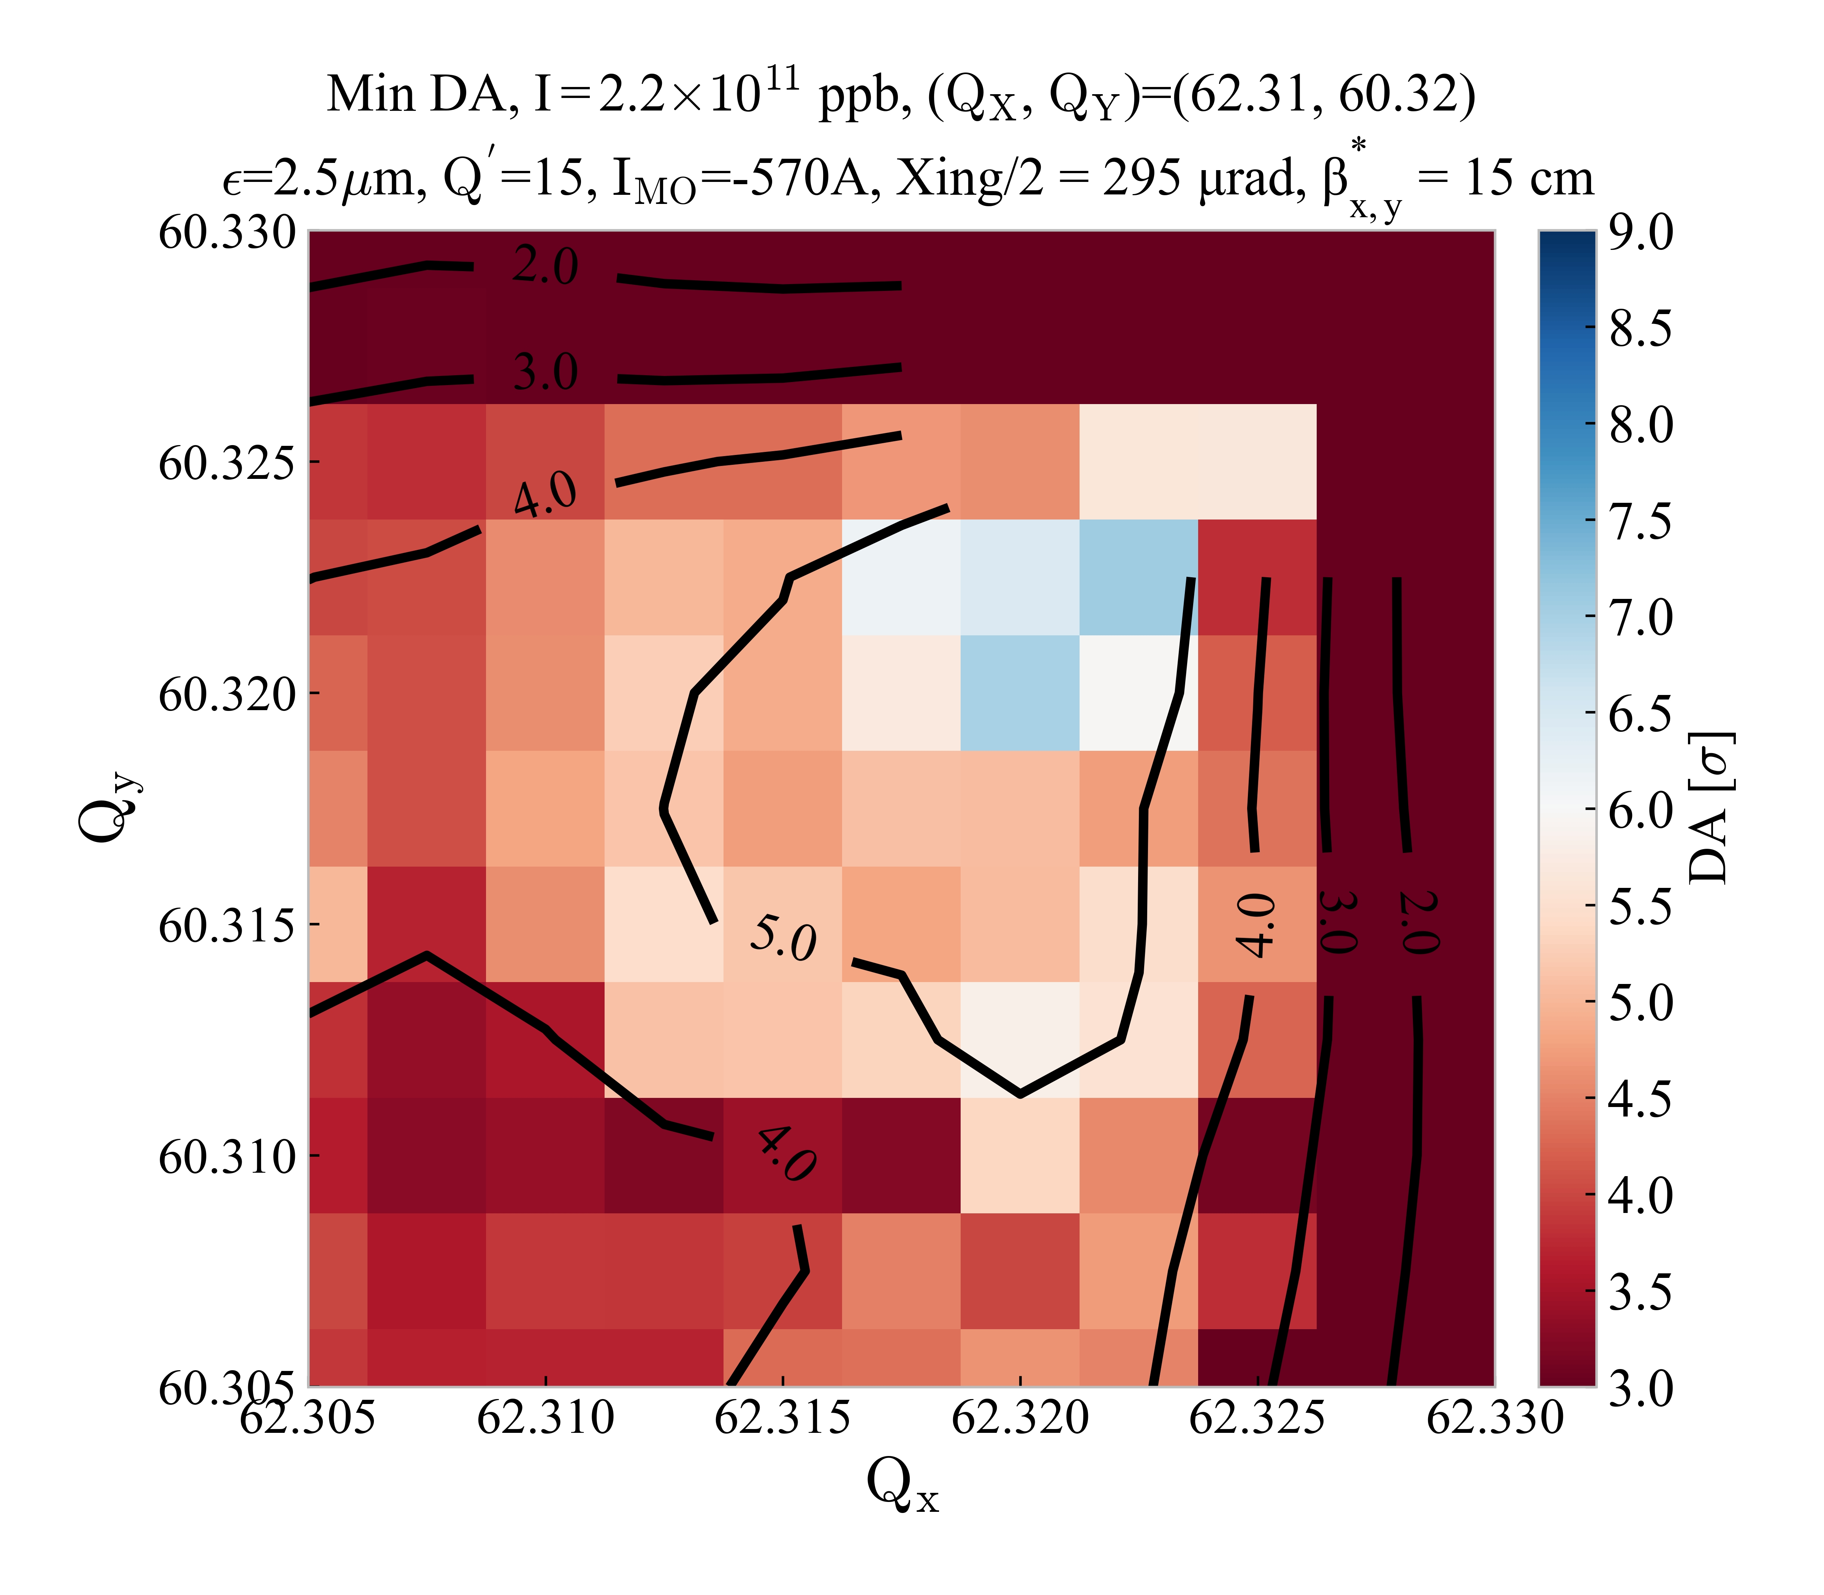
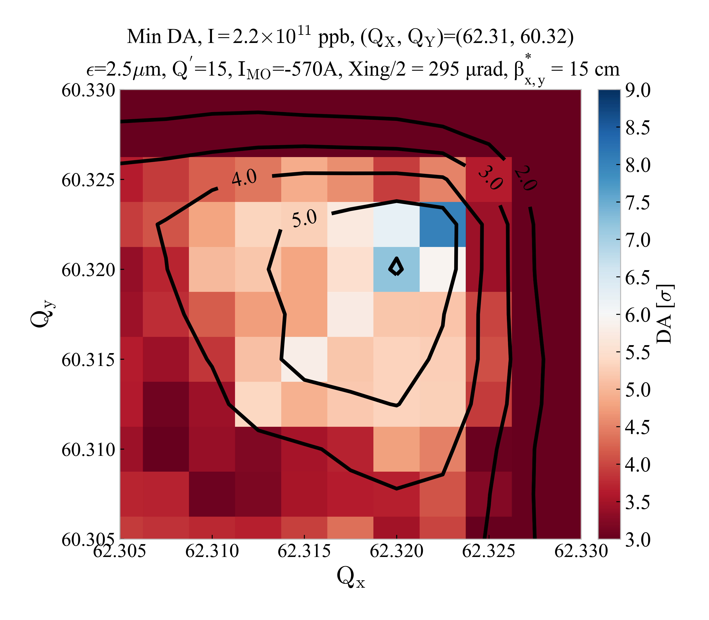


DA comparison after phase ${Δµ}_{x,y}^{IP1→5}$ optimization including weak-strong beam-beam effects
No MS14F & MS14D
DA before ${Δµ}_{x,y}^{IP1→5}$ optimization
DA after ${Δµ}_{x,y}^{IP1→5}$ optimization
Clear DA improvement after phase optimization in the case of the No MS14F & MS14D when beam-beam is included
Small tune area above the 6σ target close to the coupling lines after optimization

Slide 13
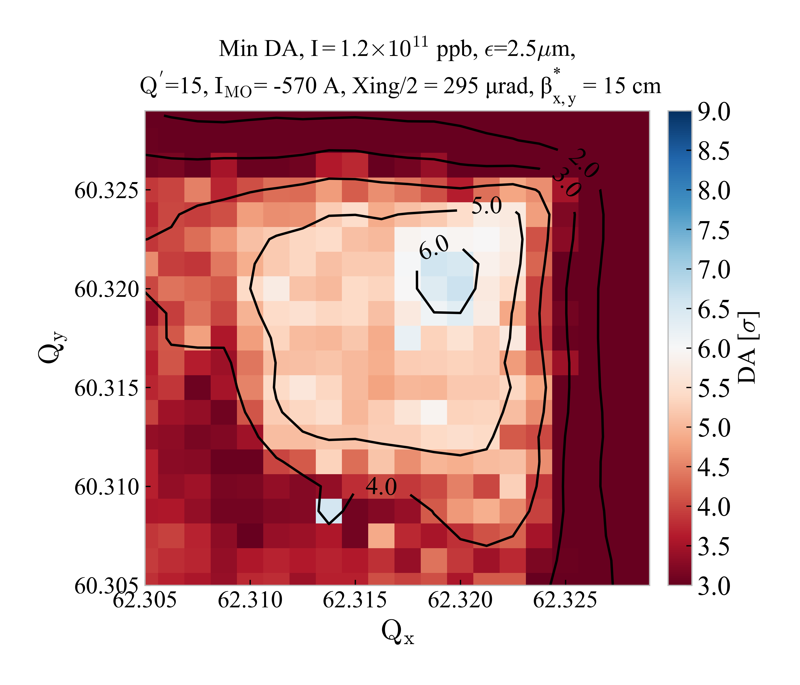
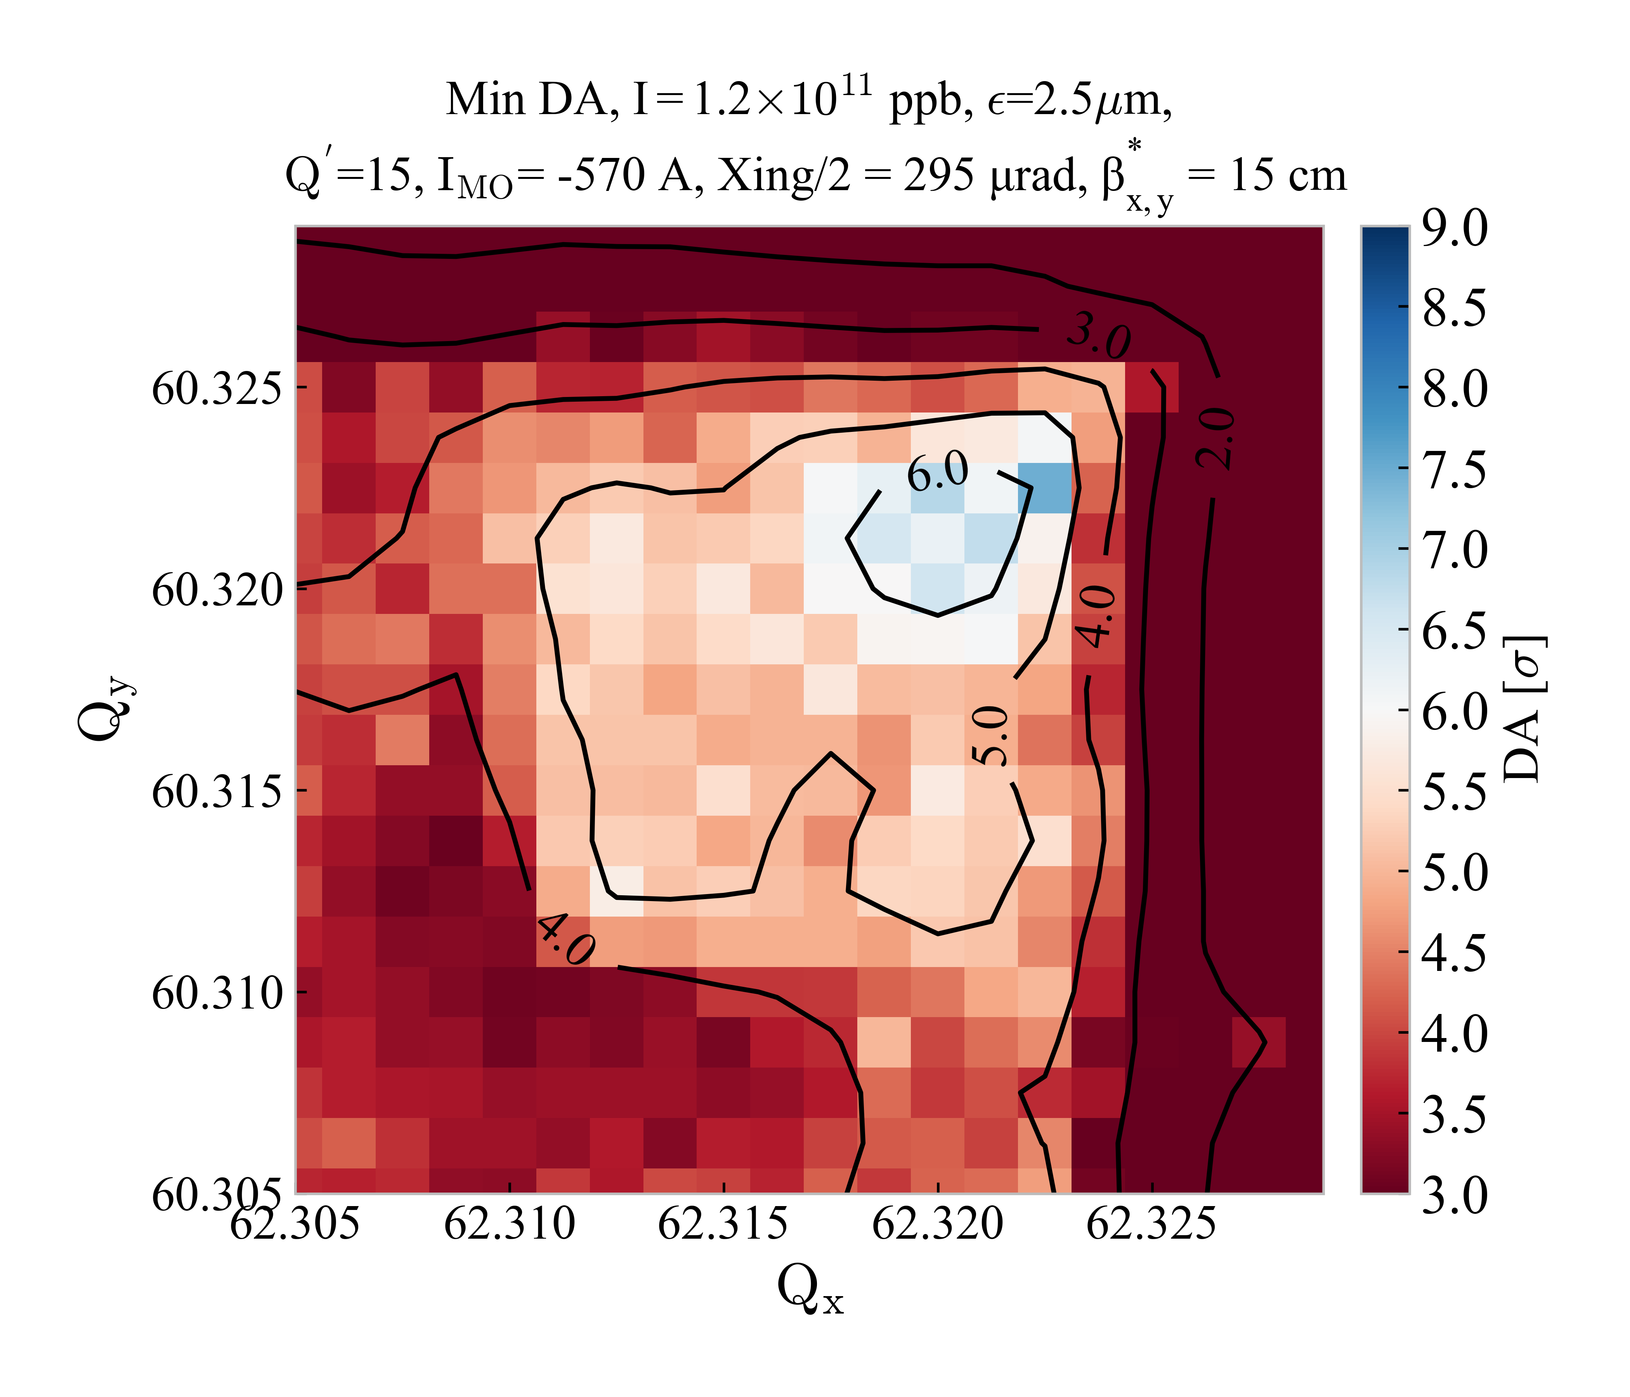
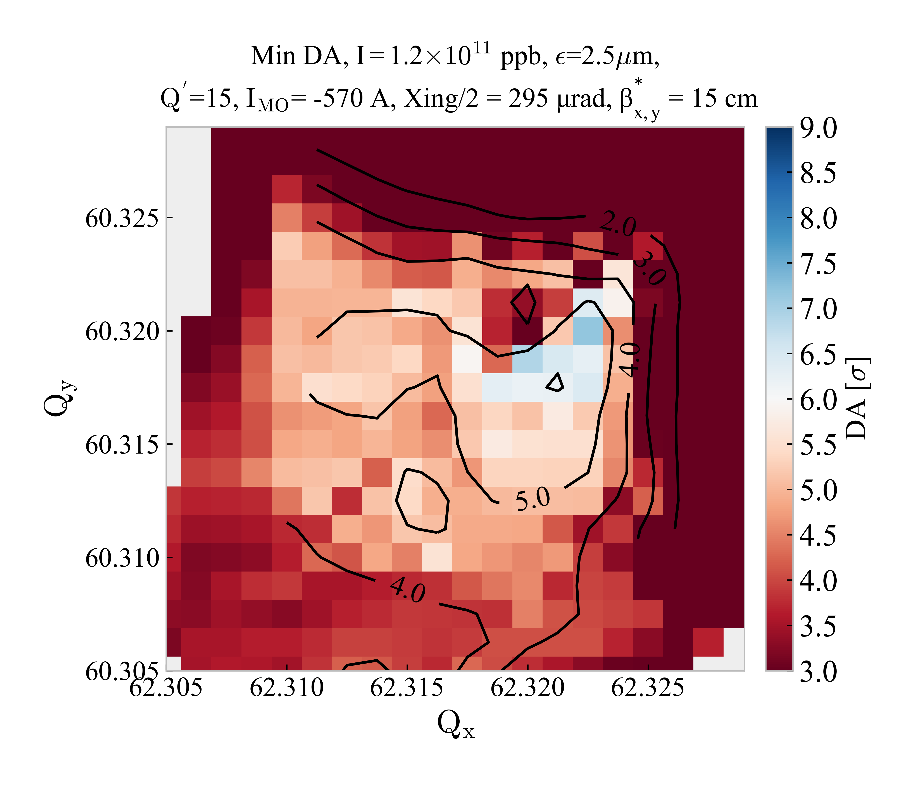
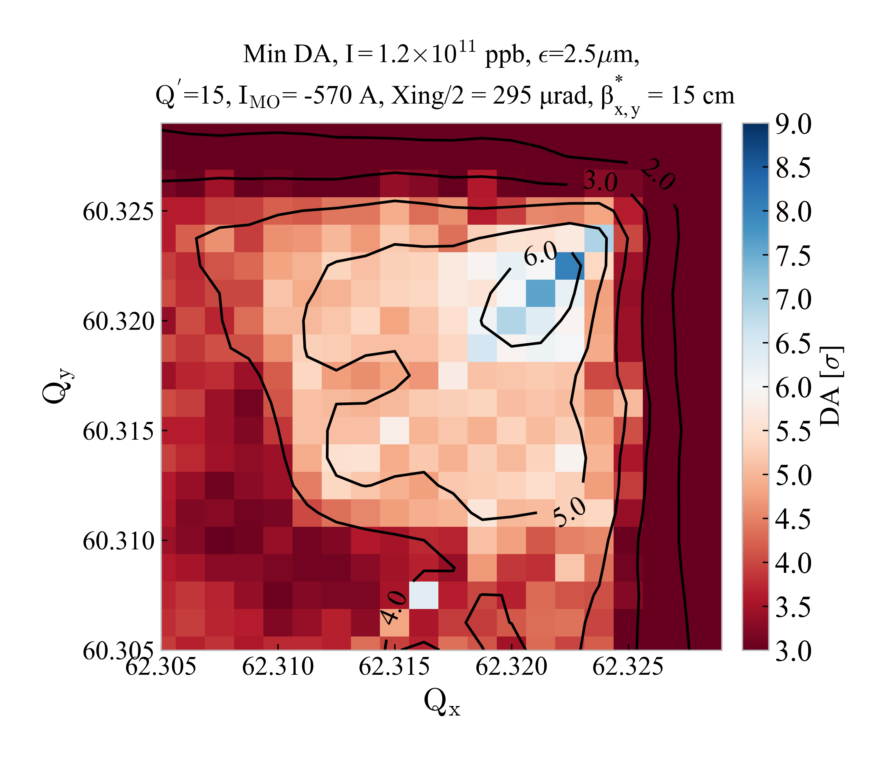
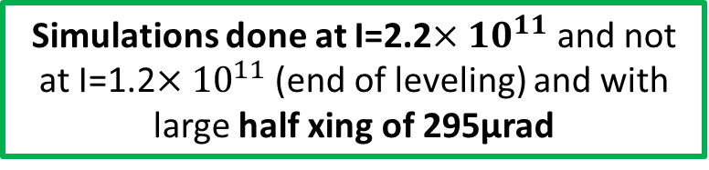
DA comparison with beam-beam after optimization
BASELINE
2.2
No MS10
2.2
Simulations done at I=2.2${×10}^{11}$ and not at I=1.2${×10}^{11}$ (end of leveling) and with large half xing of 295µrad
No MS14F
2.2
No MS14F & MS14D
2.2

Slide 14
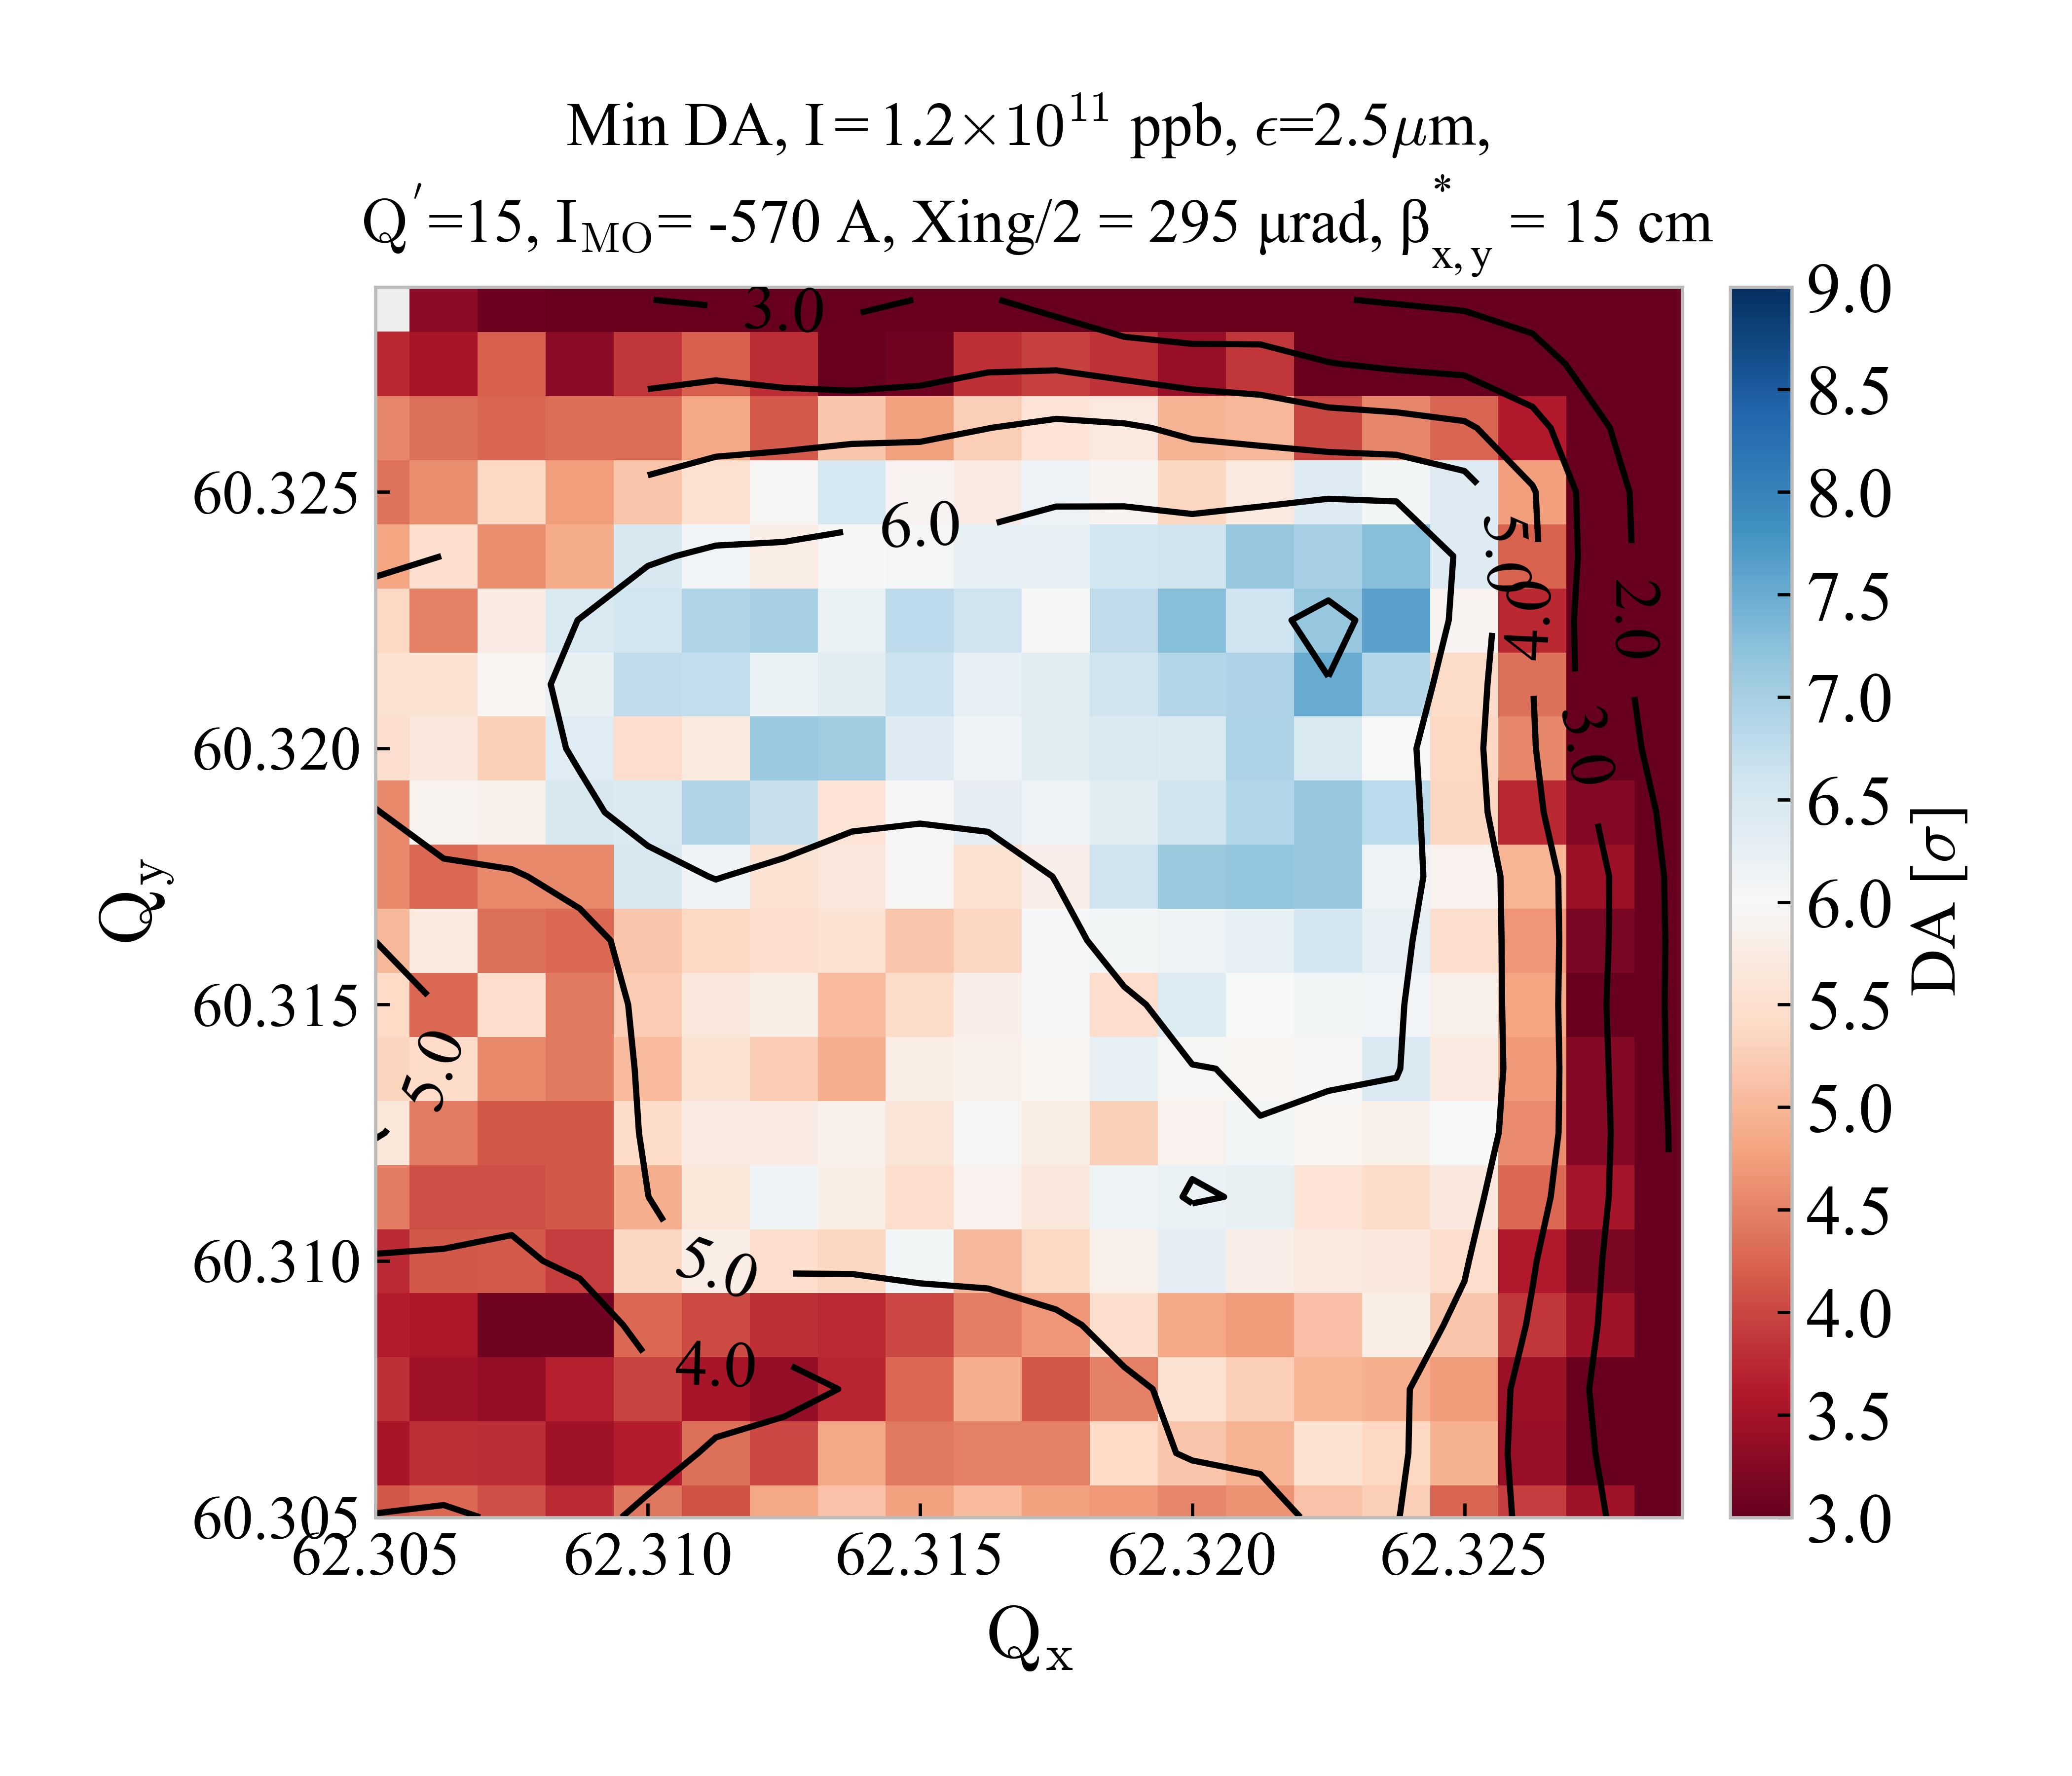
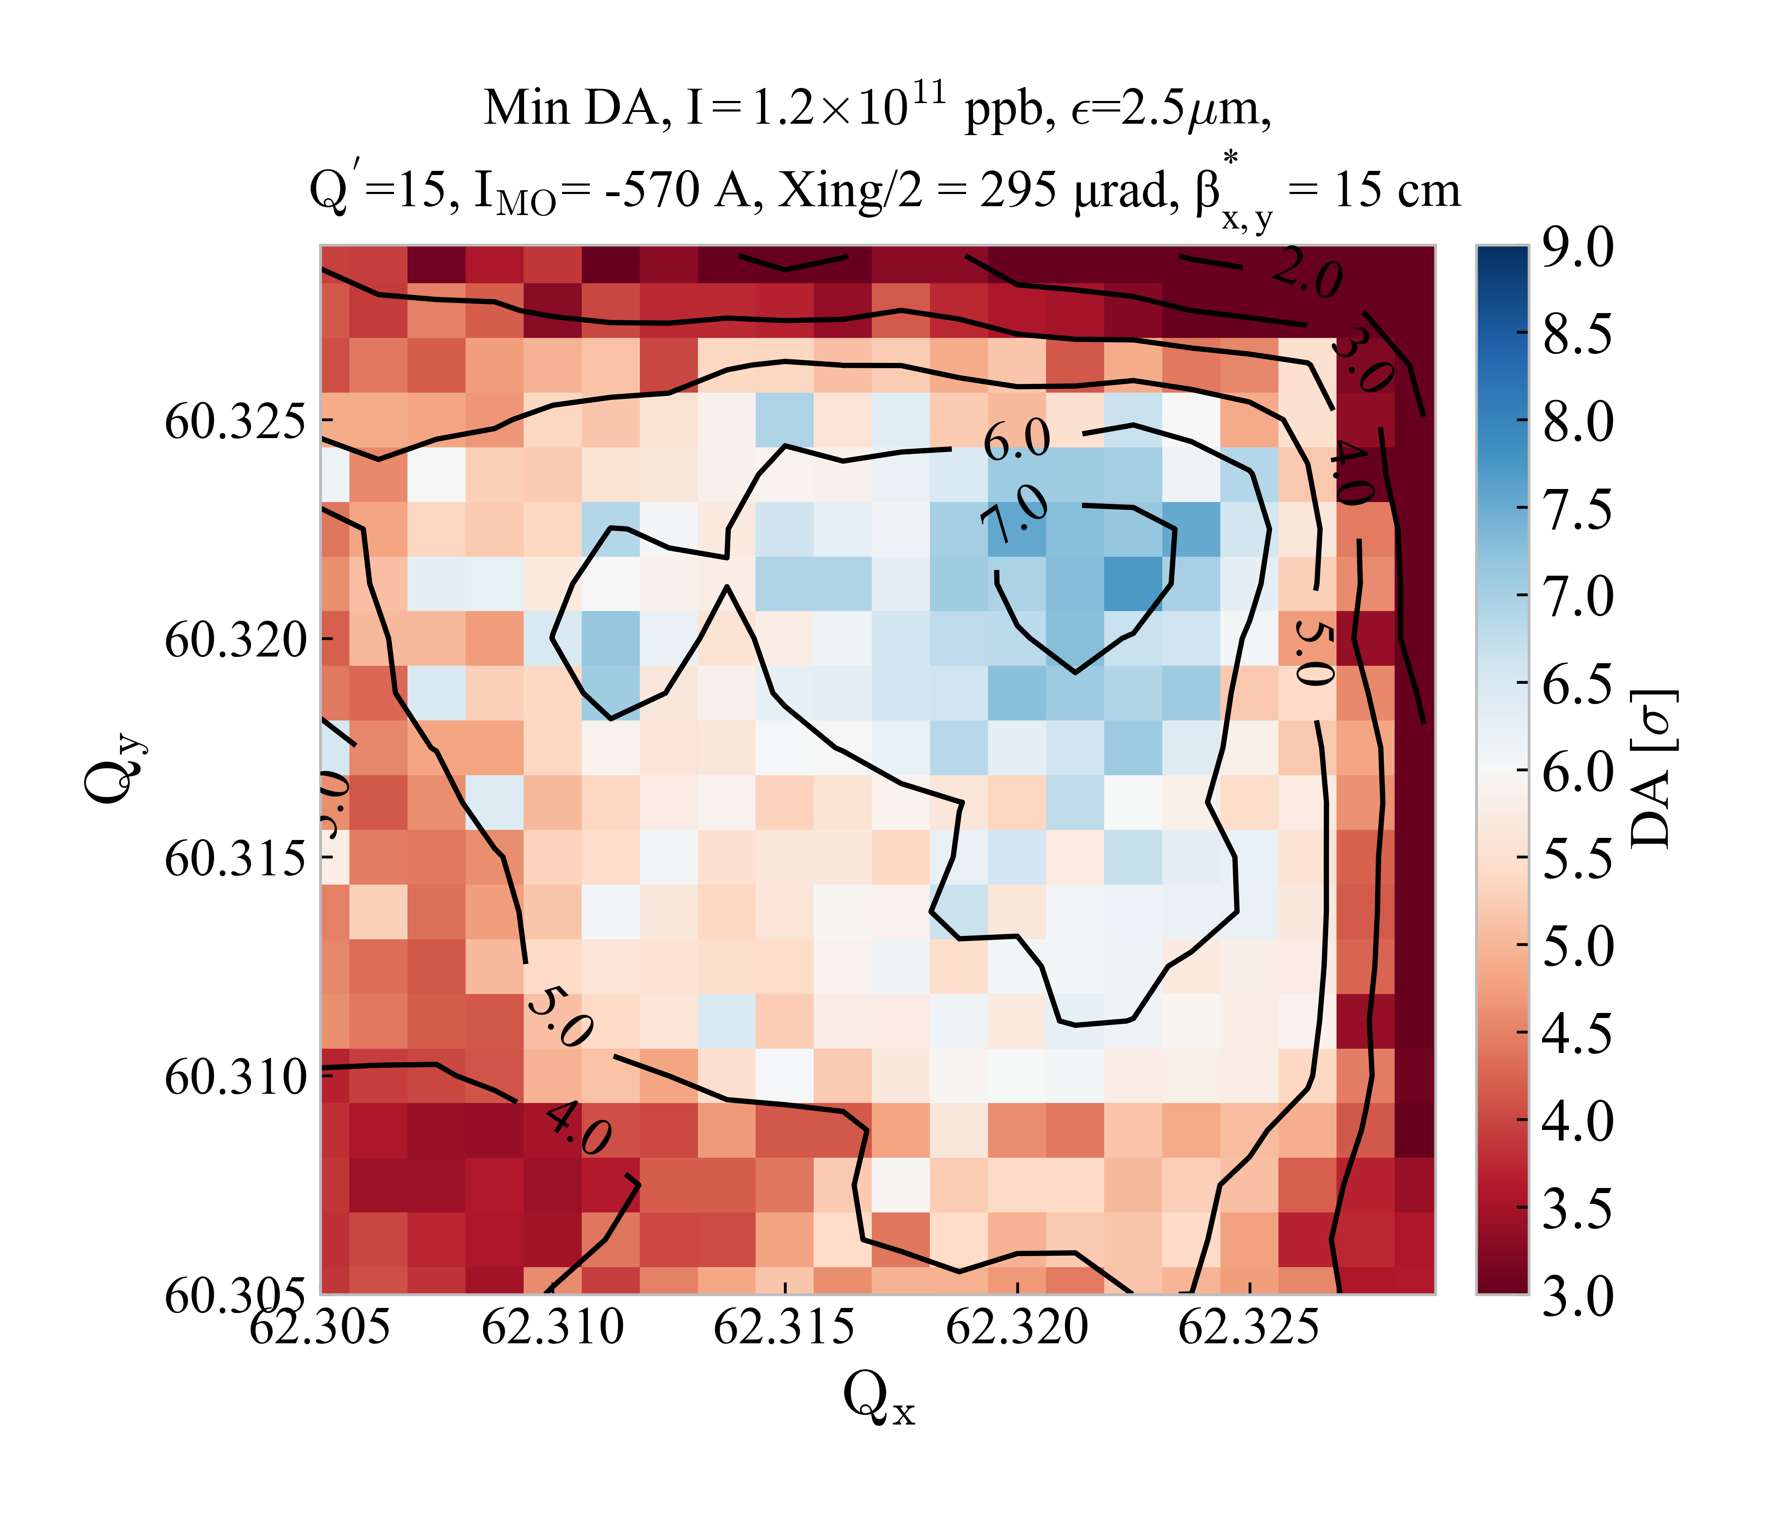
DA comparison with beam-beam after optimization
No MS10
2.2
2.2
No MS14F & MS14D

Slide 15
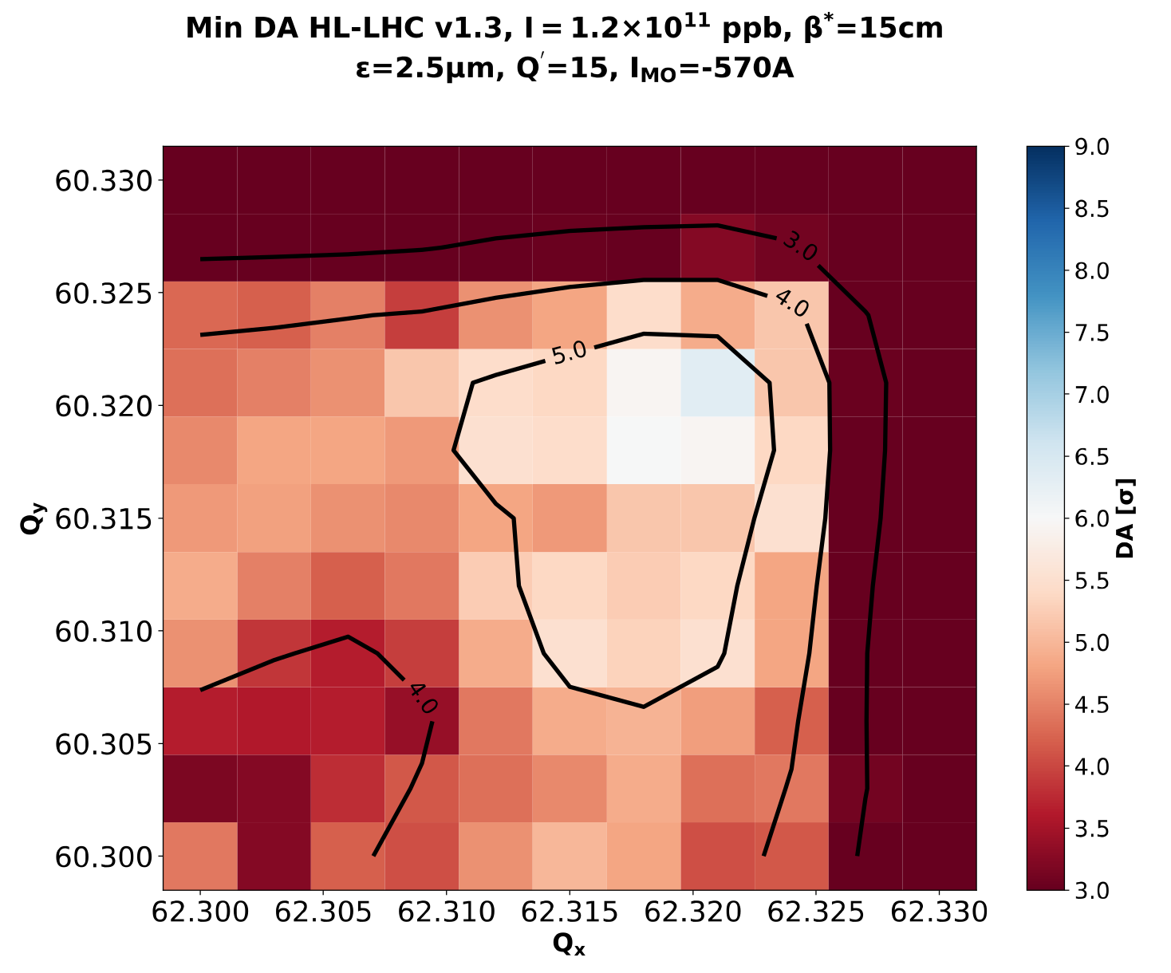
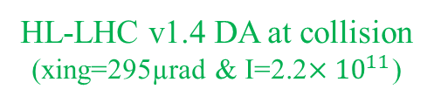
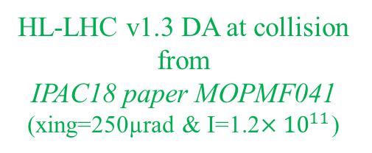

DA comparison for different intensity and crossing angle
HL-LHC v1.3 DA at collision from
IPAC18 paper MOPMF041
(xing=250µrad & I=1.2${×10}^{11}$)
HL-LHC v1.4 DA at collision (xing=295µrad & I=2.2${×10}^{11}$)
Comparable tune scan for the HL-LHC for (xing=250µrad & I=1.2${×10}^{11}$) and for (xing=295µrad & I=2.2${×10}^{11}$) on the Baseline optics

Slide 16

Conclusions
DA comparison between 4 different sextupole lattices proposed for HL-LHC including the impact of field imperfections and weak-strong beam-beam effects
The phase advance between IP1 and IP5 has been optimized for each error-free lattice with the goal of maximizing DA
The positive impact of the ${Δµ}_{x,y}^{IP1→5}$ optimization on the DA can be important even when adding field imperfection or by including beam-beam effects
After ${Δµ}_{x,y}^{IP1→5}$ optimization the LHC-like sextupole configuration (or No MS10) seems to be a viable option for HL-LHC
The No MS14F & MS14D is a robust alternative as the DA is comparable to the Baseline (with MS10) before and after ${Δµ}_{x,y}^{IP1→5}$ optimization but requires to push the strength of the strong defocusing sextupole to 95% of their max current to keep chromatic β-beating to the same level

Slide 17
BACKUP

Slide 18
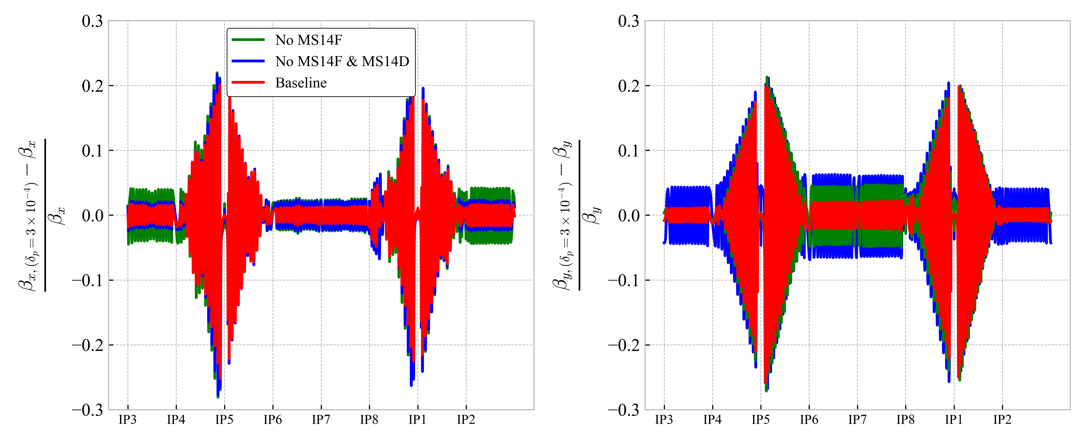
Properties of the proposed alternative options
 | Baseline | No MS10 | No MS14F | No MS14F & MS14D
Horizontal chrom. β-beating (Beam 1) IP 1/2/5/8 IP 3/4/6/7 | 0.6/ 0.005/ 1.0/ 1.7 0.9/ 0.4/ 1.8/ 1.1 | 0.8/ 0.003/ 1.3/ 1.7 0.9/ 0.3/ 1.2/ 1.5 | 0.2/ 0.3/ 1.8/ 0.8 1.5/ 2.0/ 1.8/ 2.4 | 0.1/ 0.5/ 0.9/ 2.2 1.2/ 1.0/ 0.5/ 2.2
Vertical chrom. β-beating (Beam 1) IP 1/2/5/8 IP 3/4/6/7 | 0.3/ 0.7/ 0.8/ 1.9 0.7/ 0.5/ 2.4/ 0.2 | 1.4/ 2.3/ 2.5/ 2.2 2.4/ 1.4/ 3.6/ 3.0 | 2.3/ 0.08/ 0.5/ 2.7 0.3/ 0.8/ 3.0/ 4.2 | 3.7/ 4.0/ 4.6/ 2.8 4.2/ 1.0/ 6.4/ 5.8

Slide 19
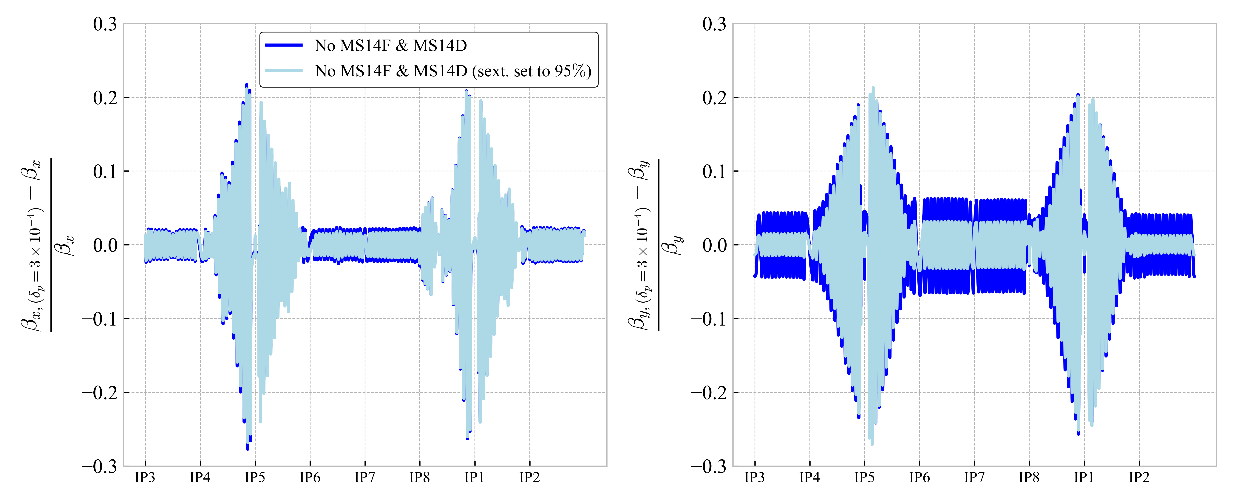
Properties of the proposed alternative options
Increase the current of the defocusing strong sextupole in R5,L1,R1 to 95% of the maximum strength (instead of 90%) restore similar chromatic-β beating as Baseline
 | No MS14F & MS14D | No MS14F & MS14D (k_MS_IR1 ↗ 95% )
Horizontal chrom. β-beating (Beam 1) IP 1/2/5/8 IP 3/4/6/7 | 0.1/ 0.5/ 0.9/ 2.2 1.2/ 1.0/ 0.5/ 2.2 | 0.1/ 0.5/ 0.9/ 2.2 1.2/ 1.0/ 0.5/ 2.2
Vertical chrom. β-beating (Beam 1) IP 1/2/5/8 IP 3/4/6/7 | 3.7/ 4.0/ 4.6/ 2.8 4.2/ 1.0/ 6.4/ 5.8 | 1.3/ 1.2/ 1.6/ 2.4 1.2/ 0.005/ 3.2/ 3.3

Slide 20
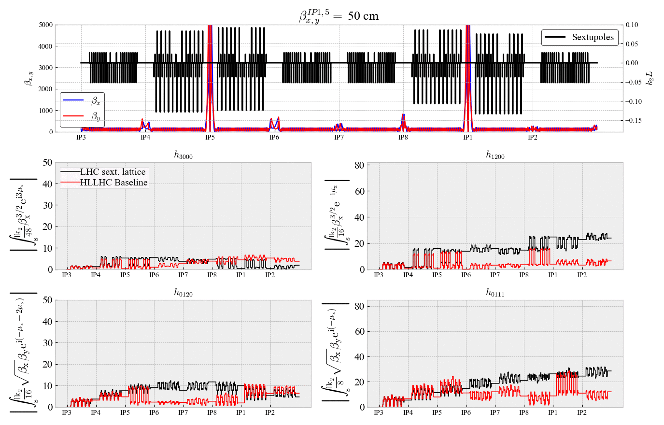

Slide 21
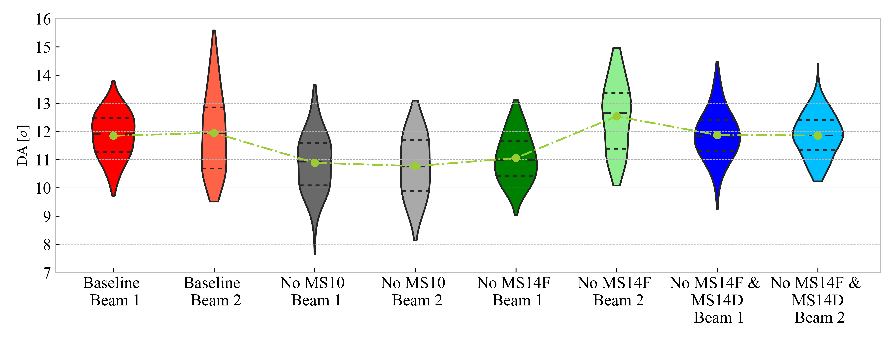
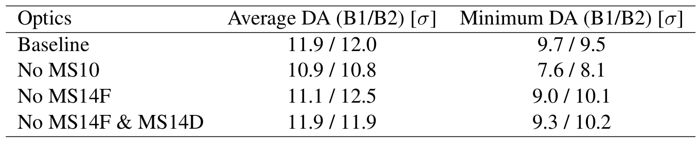

DA comparison before phase ${Δµ}_{x,y}^{IP1→5}$ optimization
DA simulated for ${10}^{5}$ turns over 7 angles including field imperfections (60 seeds) and with $I_{MO}$=-570 A
DA before ${Δµ}_{x,y}^{IP1→5}$ optimization

