Slide 1
40/80MHz auto tuning with new cavity controller
Ben Woolley
Heiko Damerau
Nathan Pittet
Florian Bertin

Slide 2
Outline
Lab tests to reproduce Florian’s results with new combined firmware.
Synoptic of cavity controller with auto-tuning added.
Technical Issues.
New firmware block.
Status and next steps.
Restart proposal.

Slide 3
Repeat Florian’s results in the lab
In order to learn the behaviour of the system and perform sanity checks.
Test cavity (40 MHz LC resonator), calibrate for the cavity transfer function, adjust feedback phase and activate for all 11 harmonics.

Slide 4
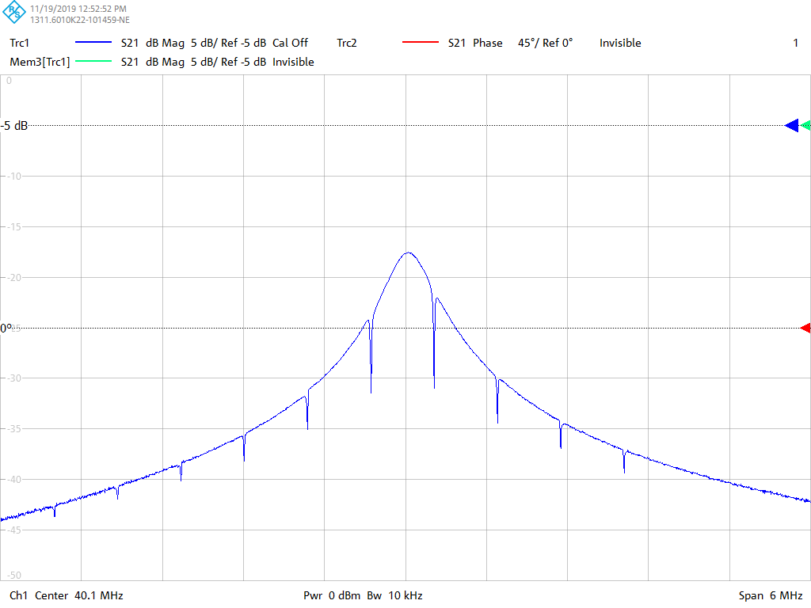
Repeat Florian’s Results: Closed Loop (Small LC Cavity)
Need to give the board a sweeping clock and enable calibration mode.
  A calibration table of phase against frequency is written.
Then lock the clock to a single frequency, then switch on each FB harmonic one at a time and adjust the e-delay until the feedback notch has maximum gain. (Script automated).
Once all are adjusted then turn all FB harmonics on.

Slide 5
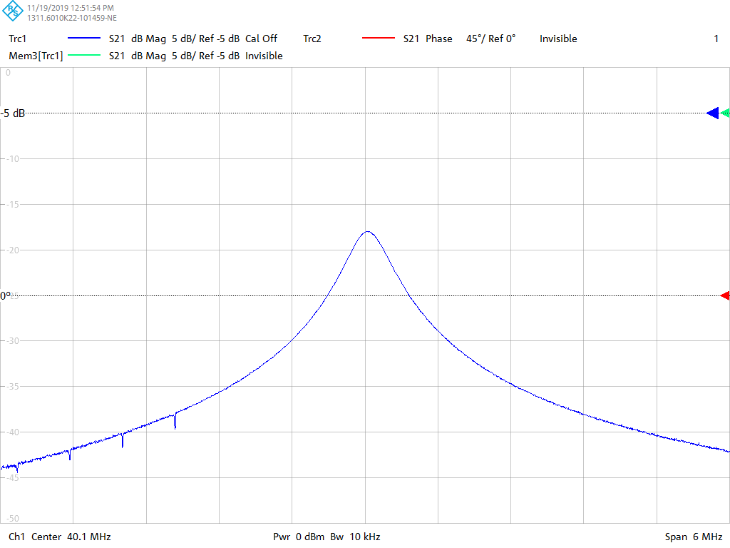
Swept Clock

Slide 6
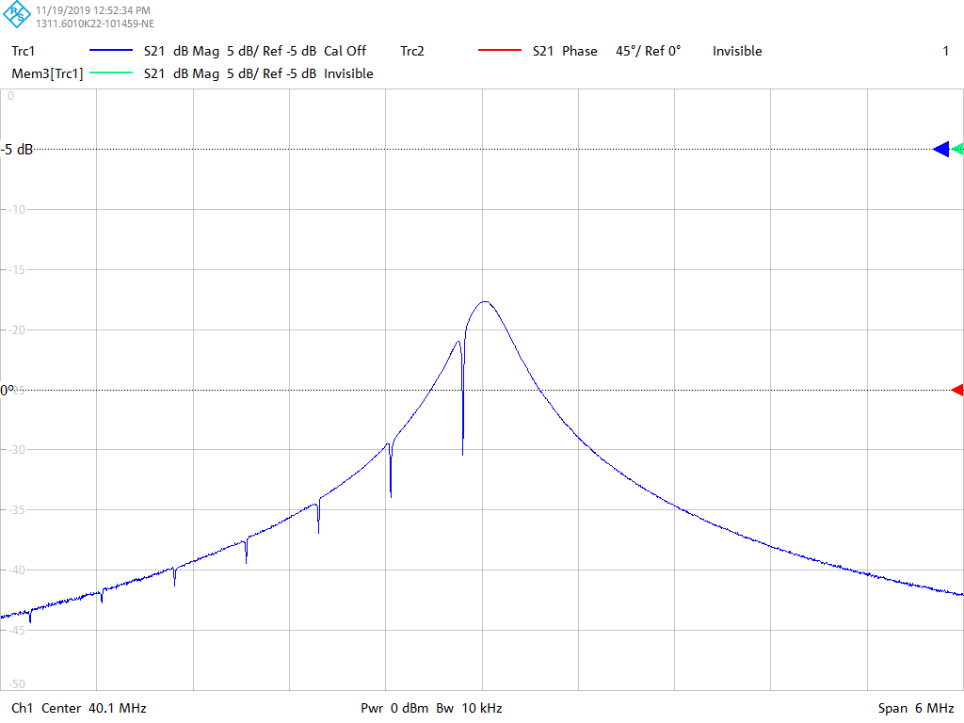
Swept Clock

Slide 7
Swept Clock

Slide 8
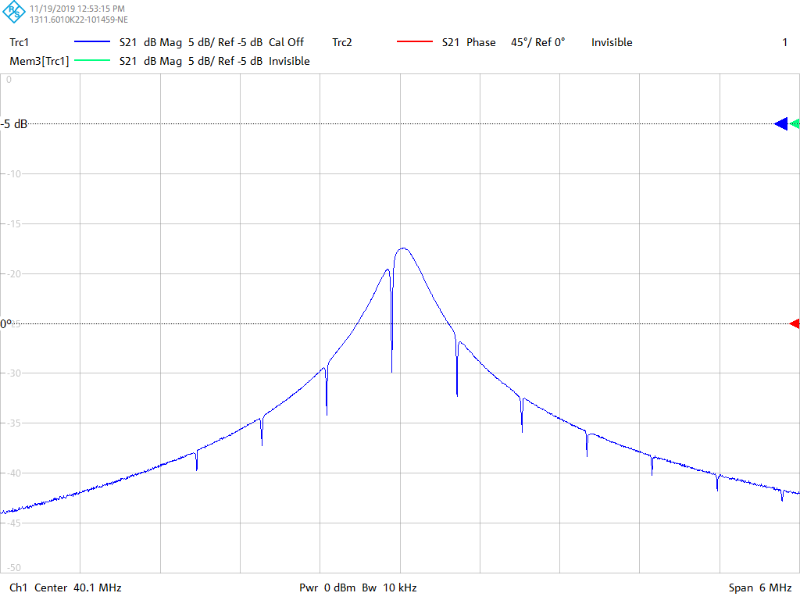
Swept Clock

Slide 9
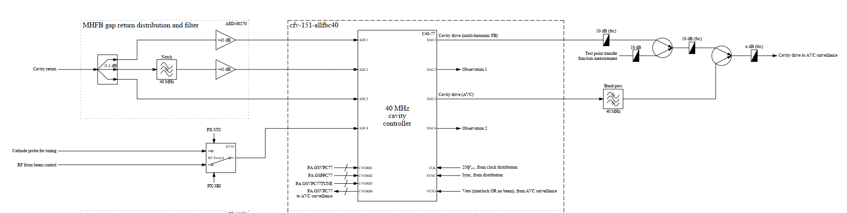
Auto-tuning function in cavity controller
Cavity controller
  Pulses the cavity corresponding to the external voltage program for tuning (tuning pulse).
  Provides phase between cavity return and cathode probe.
Implementation
  Additional CVORB channel provides voltage program for tuning pulse.
  Phase measurement published as a FESA field.
  Tuning VETO received as FESA field from PLC.

Slide 10
Technical issues
Cavity controller has insufficient inputs for all required RF signals.
  Add external RF MUX to switch between RF from beam control and cathode probe voltage.
Distributed RF clock in early part of cycle is only 25.6 MHz.
  Sample rate insufficient to pulse at 40/80 MHz.
  Firmware development → Produce clock internally.

Slide 11
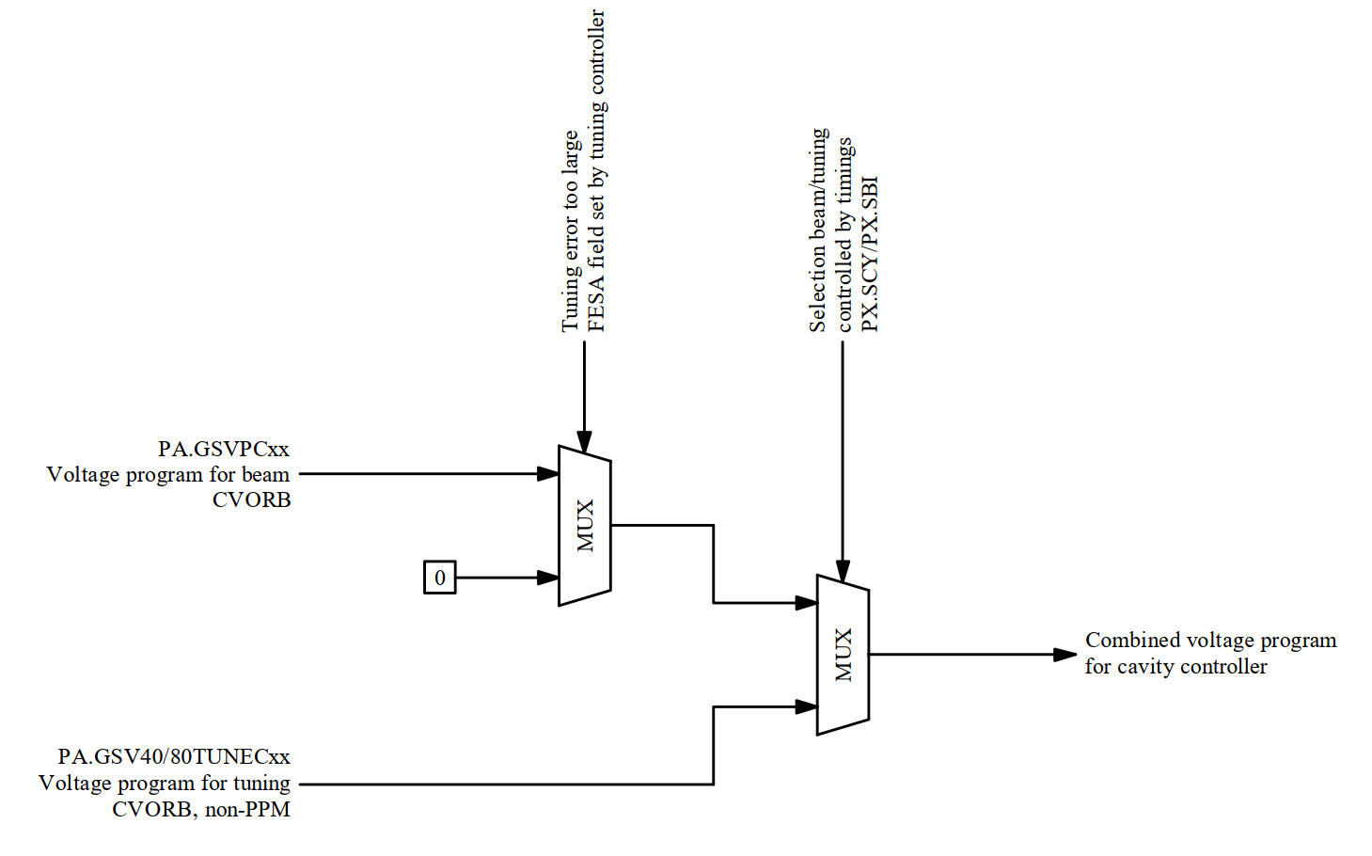
Voltage program internal logic (Firmware)
Outcome of discussion April 2019.
Implemented as a firmware block in cavity controller.

Slide 12
Status and next steps
Status
  Firmware tests in lab.
    Multi-harmonic feedback part is re-validated in the lab.
    Live phase and amplitude measurement added to the mem-map (FESA).
  Prototype hardware available.
Next Steps
  Test AVC part of the firmware in lab.
  Firmware development:
    Add internal fixed frequency clock.
    Add logic for phase measurement and voltage program selection.
  Re-Commission entire system on a single cavity.

Slide 13
Proposal for restart
Baseline:
Keep existing phase measurement and voltage program available for restart.
Review situation following recommissioning of one cavity with new cavity controller and multi-harmonic feedback.

