Slide 1

UPDATE ON
DRUPAL MIGRATION
Andrea Stano

Slide 2
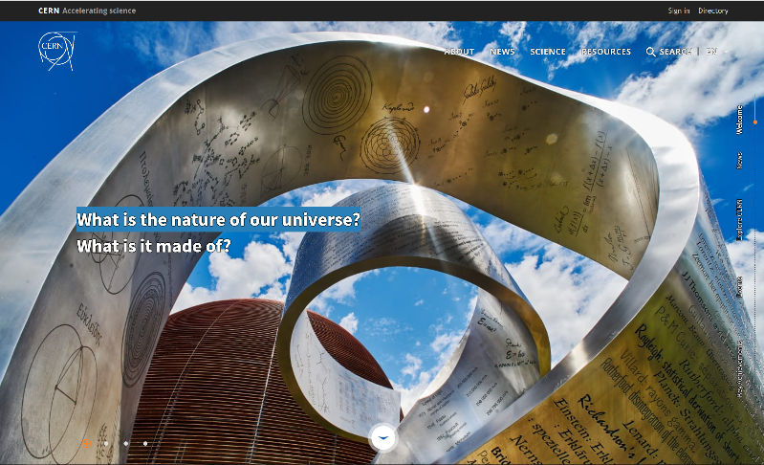
TIMETABLE
Nov 2015:
Nov 2018:
Drupal 8 release date
Symfony 3
TWIG
Views, WYSIWYG Editor, various field types
CERN first Drupal 8 website

Slide 3
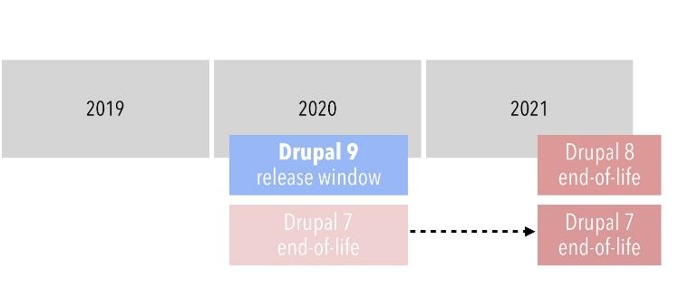
TIMETABLE
Summer 2020:
Nov 2021:
June 2020:
Drupal 7 EOL at CERN
EOL of the Drupal 7 infrastructure November 2020
Drupal 7 AND Drupal 8 EOL by the Drupal community
Drupal 9 release date

Slide 4
Migration to Drupal 9 should be easy.
As long as modules and themes stay up-to-date with the latest Drupal 8 APIs.
Dries Buytaert, founder and project lead of Drupal

Slide 5
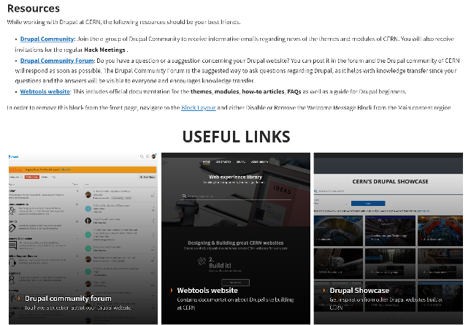
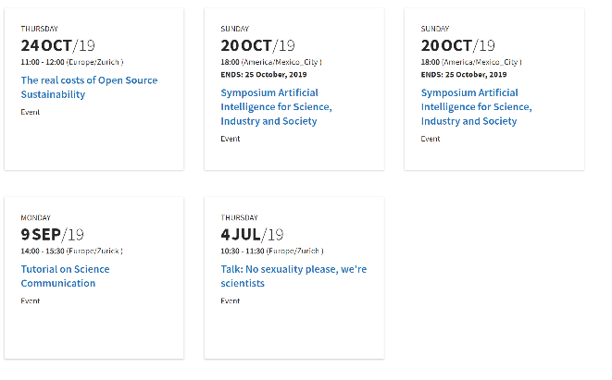
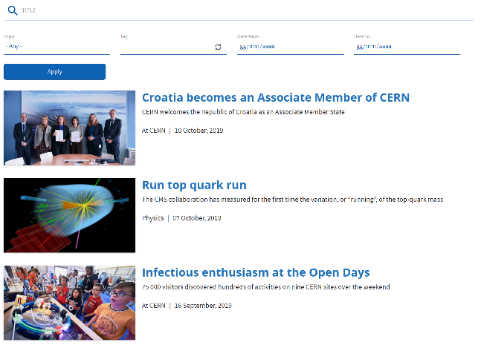
Migrate to Drupal 8
Small websites ( < 10 pages )
Start from a blank site or use the Easy start template

Slide 6
Migrate to Drupal 8
Bigger or complex websites
Request from the Drupal Infrastructure team to start the migration on a Drupal 8 development site
Retouch
the Drupal 8 development site
Publish your Drupal 8 development site
under the original name.

Slide 7
Retouch process
Manually redo all the views
Replace blocks in the new template regions
and/or create new custom blocks
Take the chance to review the website structure
Get rid of unused content, add new content types, review Drupal 7 modules,
polish menus, add or remove vocaboularies and taxonomy terms
Try to be consistent with the look of the
main website home.cern

Slide 8


Styling Options
CERN Theme ( 2.5.0 )
Basic personalization
Use of CERN Display Modes
Will be ported to Drupal 9
CERN Override Theme ( 2.0.3 )
Full CSS/JS personalization
More info: webtools.web.cern.ch

Slide 9
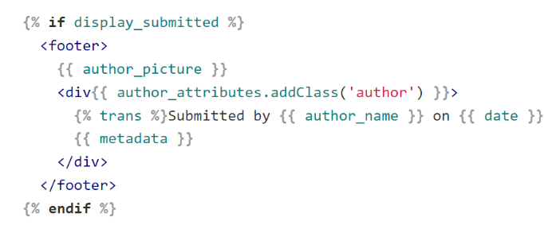
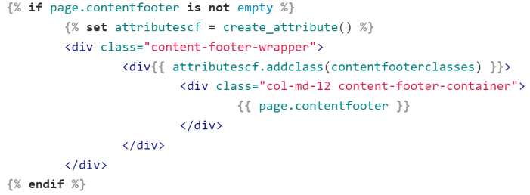
Styling Options
For further customization
override TWIG templates
Bootstrap
template/layouts/page.html.twig
CERN
template/layouts/page.html.twig

Slide 10
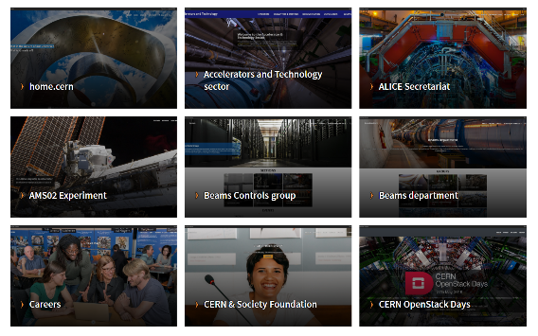
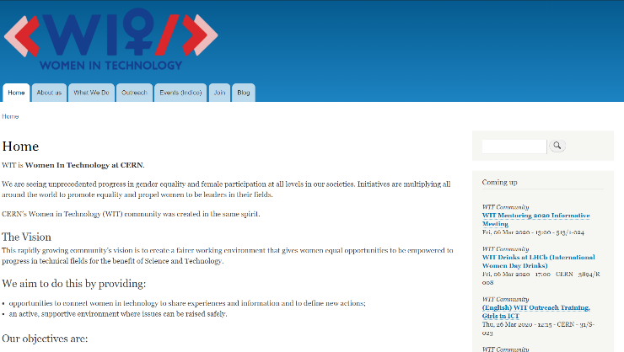
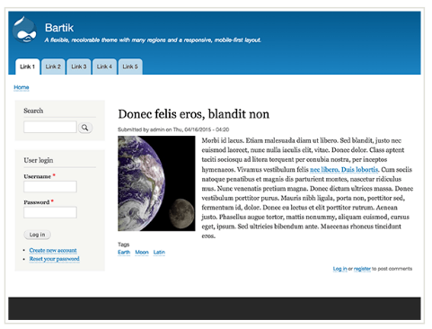
Styling Options
Get inspired by Drupal 8 websites already in production:
Drupal Showcase
Bartik Theme ( 8.8.1 )

Slide 11
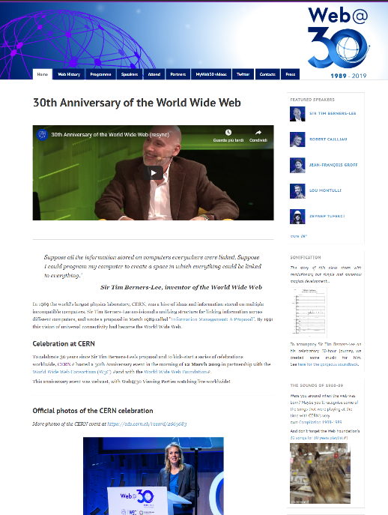
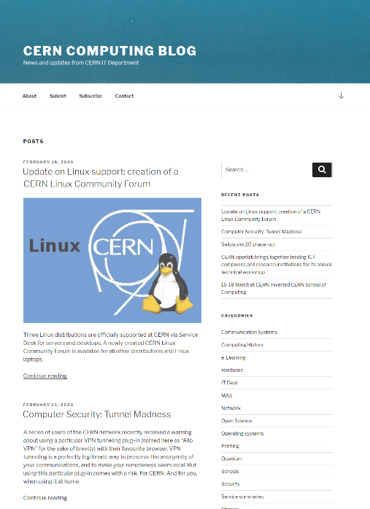
Use a different technolog
Static HTML version
Wordpress

Slide 12
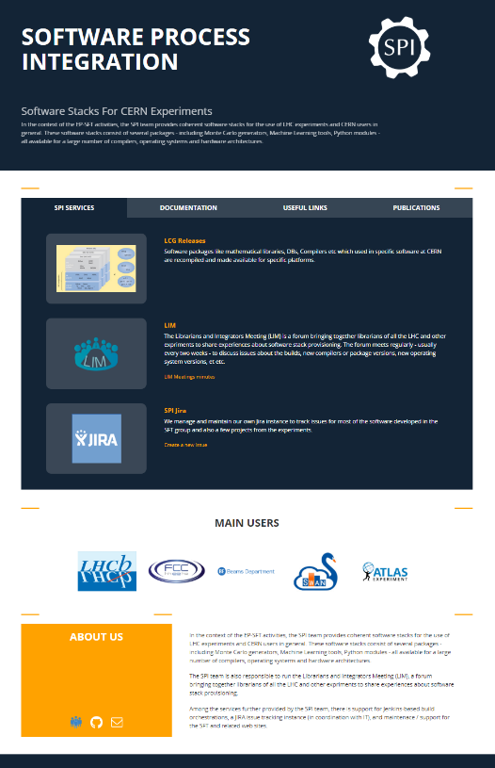
Use a different technology
Static site generator
(Jekyll, Hugo…)
Hosting for Jekyll websites:
GitHub Pages
GitLab Pages
PaaS Web Application Hosting Service

Slide 13
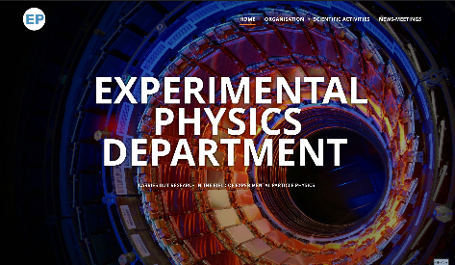
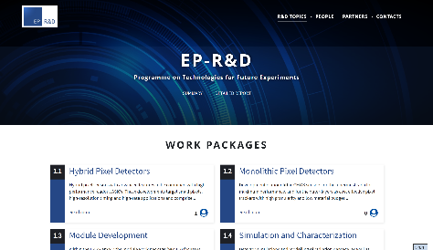
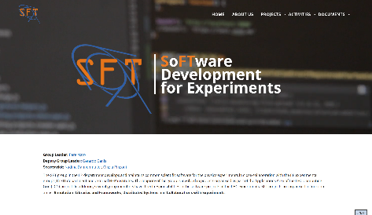
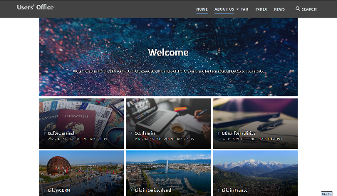
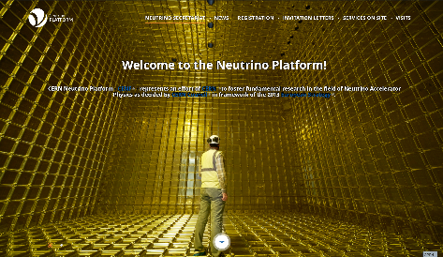
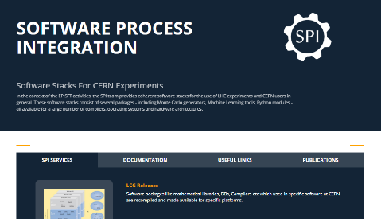
Showcase
EP-DEP
EP-RnD
EP-SFT
Users’Office
Neutrino Secretariat
EP-SFT-SPI

Slide 14
Thank you

