Slide 1
RAL QoS
Alastair Dewhurst

Slide 2
Ceph Object Store
Question: Are Object stores fundamentally different from traditional Grid storage?
  Answer: With WLCG use cases not really.
Ceph uses algorithmic data placement:
  No central catalogue for meta data queries.
  Vector reads not supported.
Very few WLCG use cases need a file system and it is mostly about educate user / fixing bugs due to invalid assumptions.

Slide 3
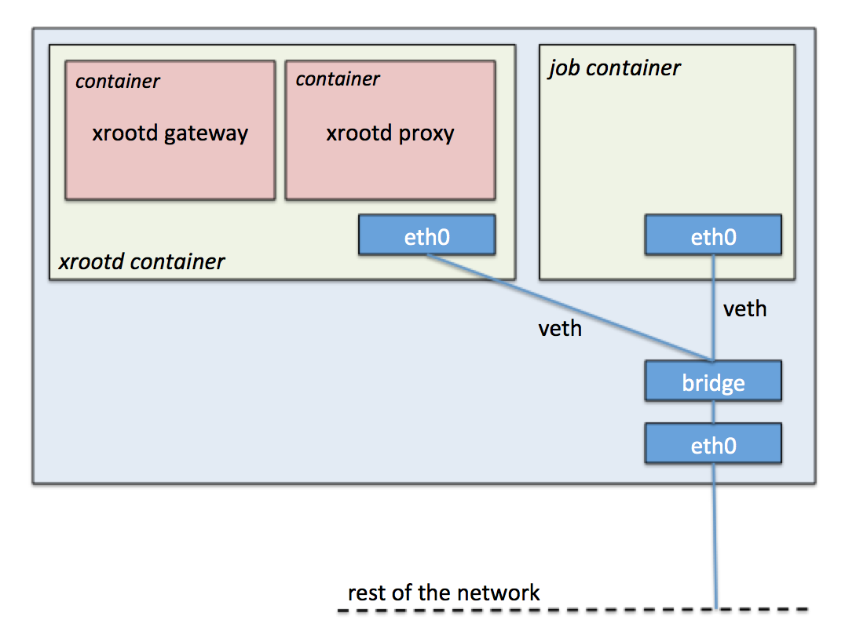


Echo
Regional Redirector
External Gateway
(XRootD, GridFTP, S3)
XRootD Manager
WN
WN
WN
XRootD
XRootD
XRootD
Proxy Cache
Proxy Cache
Ceph Backend
WN
WN
WN
XRootD
XRootD
XRootD

Slide 4
Erasure Coding
Echo uses Erasure Coding rather than Replication
8 + 3 profile that spreads data across 11 hosts.
  73% RAW storage usage.
  We can survive the loss of any 3 hosts without losing data.
  Due to the number of hosts we have, we can operationally lose a rack.
EC does mean that data needs to be sent to “re-assembled” one one host before being sent to the client.
  Minimum size 8MB.

Slide 5
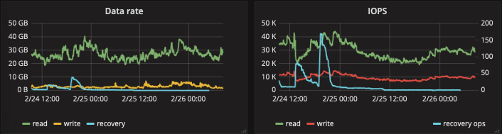
Operations
Ceph has been extremely reliable.
  Averaging one outage a year.
  One data loss incident since 2017 due to a bug, which resulted in operator error.
Vast majority of issues with XRootD plugin which are slowly being resolved.

Slide 6
Tape
RAL currently provides a Tape Archive via Castor.
  Large (2PB) disk buffer externally accessible.
In 2021 we should be migrating to CTA.
  Small SSD buffer that will only allow transfers to internally accessible storage.
  External experiments will need to transfer via Echo and use multi-hop FTS transfers.
New Tape Robot installed today!
  6500 media slots, 20 x TS1160 drives.

Slide 7
SSD Caching
RAL jobs have been observed to have lower efficiency compared to other Tier-1s.
Evidence points to IOPs limits on the WN.
  New WN will have SSD storage.
Will use CTA testing to decide if SSD caches are sensible to deploy more widely.

Slide 8
S3 and DynaFed
FTS
DynaFed
ssh
GridFTP, XRootD,
S3
Site A Storage
Echo S3
Gateway
S3
Ceph backend
RAL are trying to use DynaFed to provide access to the S3 storage provided by Ceph.
  Much easier to maintain than XRootD / GridFTP.
  S3 buckets can easily have different replication policies.

Slide 9
Multi-VO Rucio
RAL is developing and deploying a Multi-VO Rucio instance.
  Aim for production from June 2020 onwards.
In future, RAL will need to provide data management tools for a large number of HEP, Astronomy and Space experiments.
Aim to encourage small VOs to use Rucio which will manage data between Echo (Grid / S3 Storage), Castor / CTA, UK sites and the rest of the world.

Slide 10
QoS Classes
Start with 4 types:
  Archival Storage.
  High availability and reliability disk storage.
  Disk storage.
  High performance storage.

Slide 11
Backup

Slide 12
Erasure Coding
MyFile.root
Large files are split into 64MB objects.
MyFil
e.roo
t
Each object is split into 8 x 8MB chunks.
3 x 8MB parity chunks are calculated.
Each of the 11 chunks are written to different storage nodes.
How do we know which disks are written too?

Slide 13
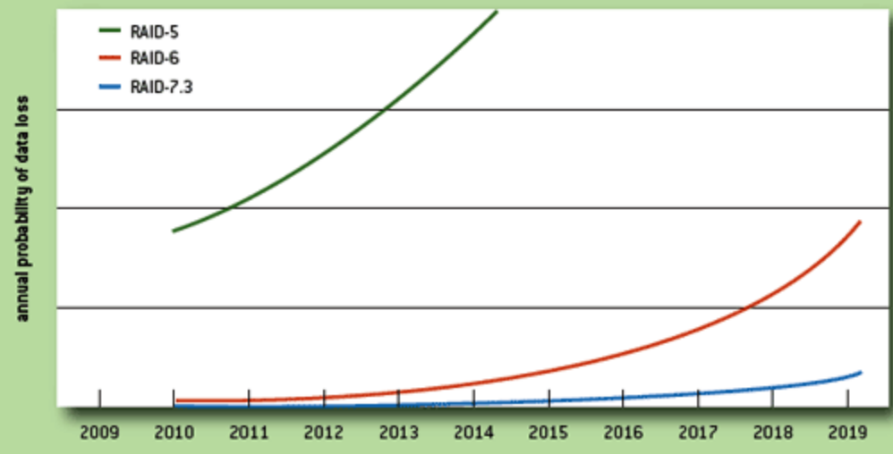
RAID & Erasure Coding
Hardware RAID has provided us with resilience against disk failure for decades.
  As disks continue to grow but their performance stays relatively constant, risk of data loss increases.
Erasure Coding (EC) can be seen as an extension to RAID and is becoming significantly more popular.
  EC is done in software - data is spread across storage devices.
  Requests for partial data from an object may result in storage re-assembling entire object.
Plot shows theoretical failure rate as storage grows for different RAID configurations.
9 years
http://queue.acm.org/detail.cfm?id=1670144

