Slide 1
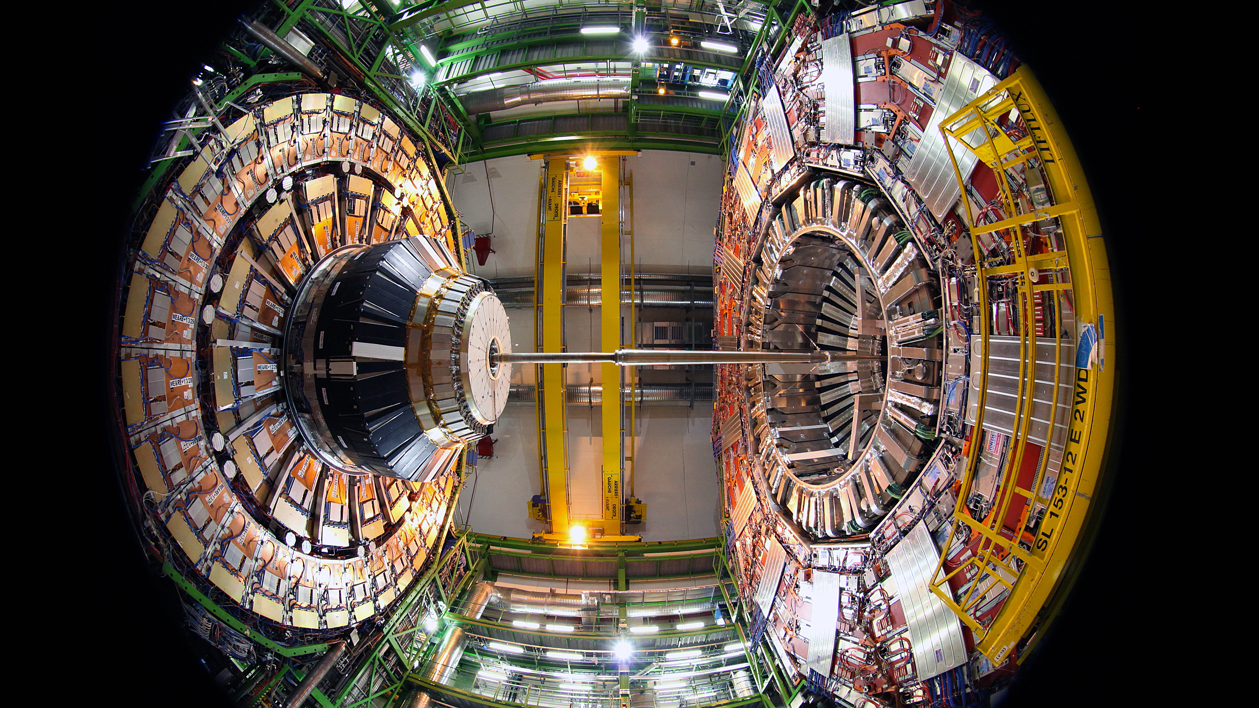
SCOAP3 Tender Working Group
F2F Meeting 2-3 March 2020

Slide 2
Useful information
How to get to CERN
There is a free CERN shuttle bus operating between 8:30 am and 8:30pm. You will need to have your badge printed at home and show it to the shuttle driver. For more information, please go here: https://smb-dep.web.cern.ch/en/ShuttleService/Circuit4
If you want to use public transport, you can use buses 23, 28, 56 or 57 until station “Blandonnet” and then change to tram line 18 direction CERN. Please do not forget to pick up your free public transport ticket at the vending machine in the arrival hall of the Geneva airport.
Tram 18
Internet Access
The easiest might be to use the eduroam network if you have a respective account.
There is a Guest-WiFi in most public areas such as the CERN restaurant. This WiFi does not require a pre-registration.
If you want to use the CERN WiFi outside the public areas, please register your device here: https://landb.cern.ch/landb/selfregistration/visitor/index
Tram 18
Centre Genève
Gare Cornavin,
Tram 18
direction CERN
4
SCOAP3
TWG Meeting
(bld. 4-3-001)
33
18

Slide 3
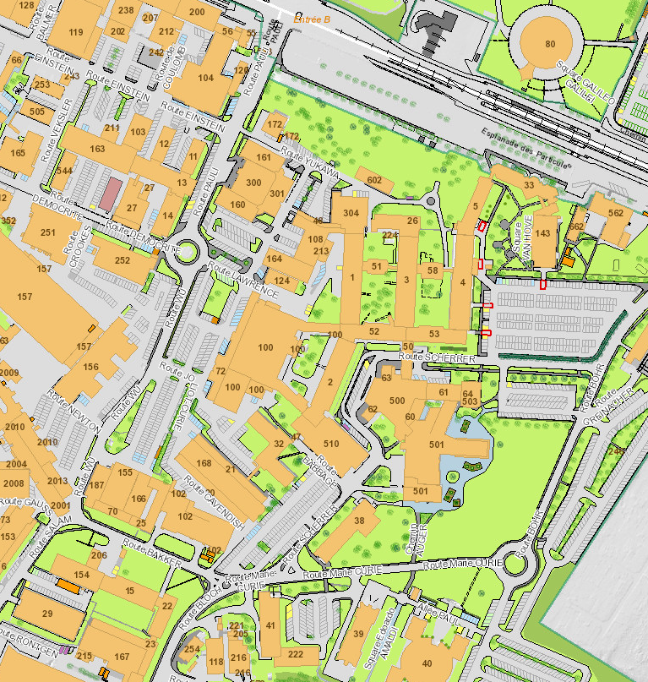
Map of CERN
CERN reception
Entrance B
CERN Hotel
CERN Restaurant
Alex’ & Kamran’s & Jelena’s
offices
Meeting room
4/3-001
CERN shuttle and ATMs
B
33
B
39
33
501
160
3
3
4
4
500
501
500
39

