Slide 1
TCLD RF finger issue
21 Feb 2020
Many thanks to Inigo for the help and the information!

Slide 2
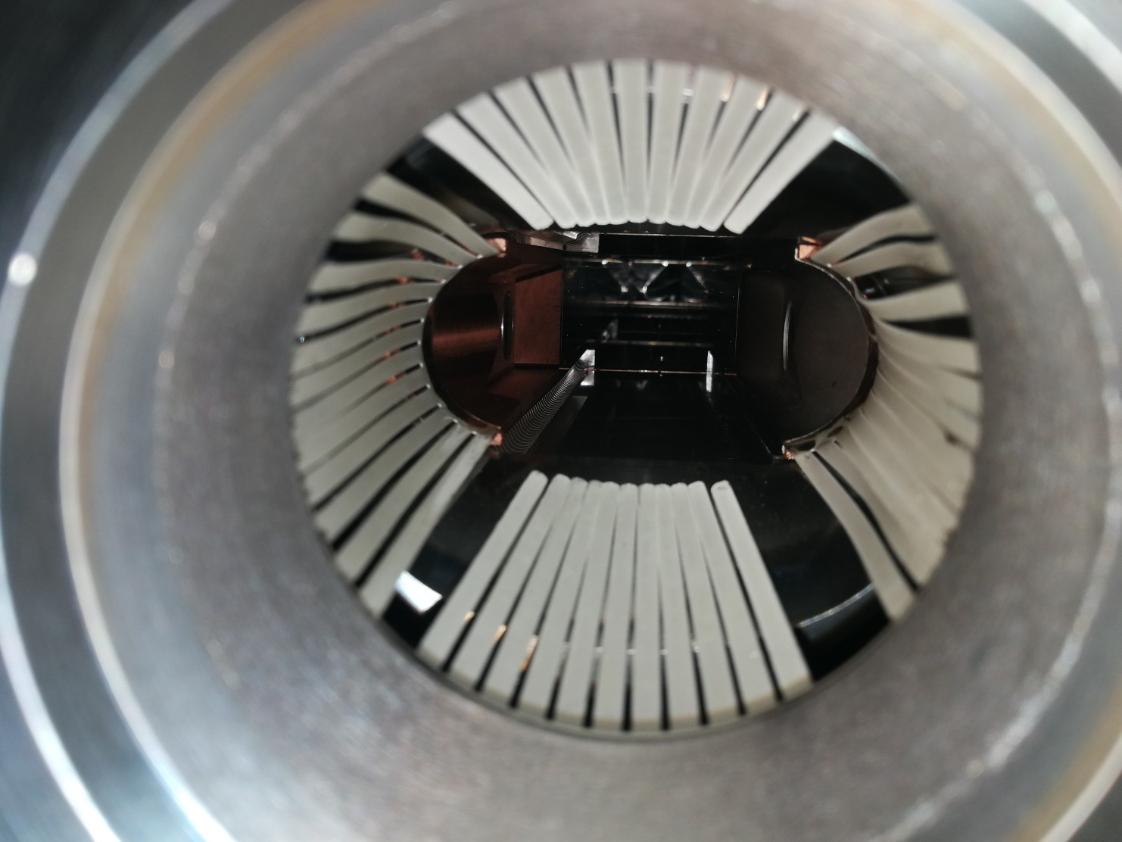
TCLD measurements
4 TCLD planned for installation
+ 1 spare
1 proto and 1 pre-series already delivered and measured by impedance team (Lorenzo, Francesco, Nicolo, Adnan et al)
IWG#31: proto measurements
(https://indico.cern.ch/event/808587/ )
AOB at IWG#37: per-series
(https://indico.cern.ch/event/879306/ )
1 of the 4 remaining TCLDs (that did not come to CERN and wasnot measured) presented an issue with RF fingers and Stefano asked us to follow this up.
Measured TCLD

Slide 3
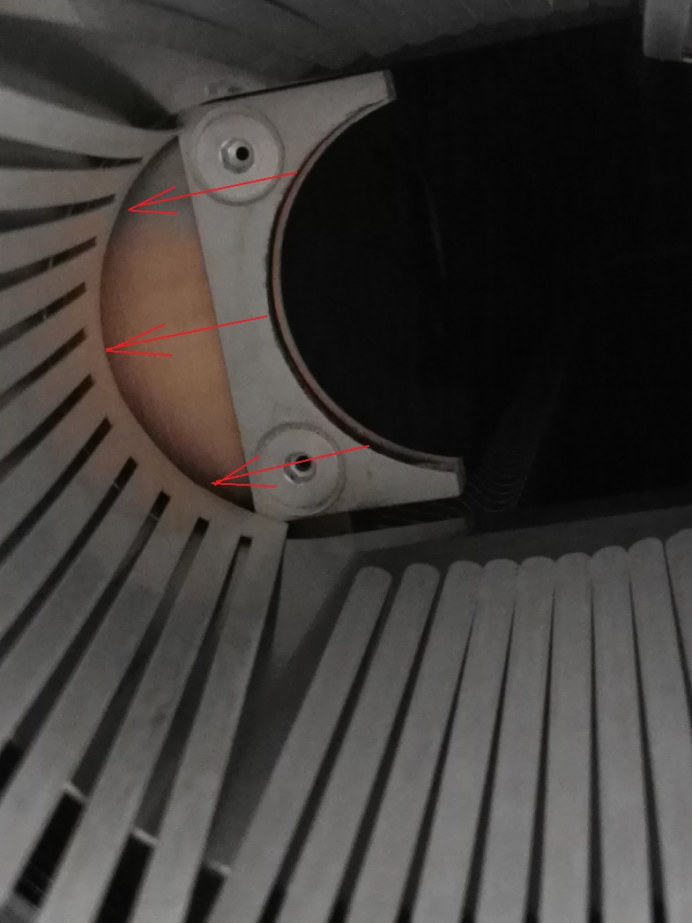
TCLD measurements
Measured TCLD
TCLD with RF finger issue at Cinel

Slide 4
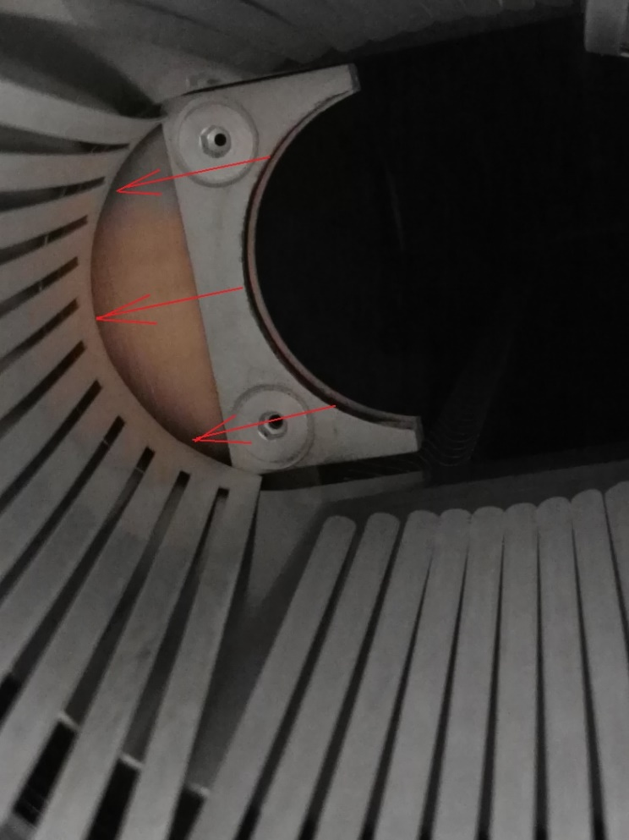
TCLD measurements
Measured TCLD (zoom)
TCLD with RF finger issue at Cinel
Broken welding seam at the base of the finger foil
Very obvious for measurement team to identify, was clearly not present for the two previous TCLDs

Slide 5
Next steps
Issue very obvious from the outside of the collimator
Such an issue on other TCLDs would not have been missed
Solution agreed by CINEL and CERN -> to produce new RF fingers without the welding seam grinded and including a CuBe shim of 0.33mm to assure the lack of interference against the jaw surface. Electrical contact is assured.
→ IWG got assurance from EN-STI that the electrical contact will be preserved.
All TCLDs (including those already measured will be retrofitted with the new solution)
2 more pairs of TCLDs to be measured in the next weeks (in principle, no wire allowed).

