Slide 1

Physics Meeting
20 March 2020

Slide 2
Today’s Agenda
-- FCC-IS implementation study (Michael Benedikt)
→ Physics meeting 9-13 November with FCC-IS kick-off
-- other news (AB)
-- status of software and web site
-- DELPHES: Michele Selvaggi
-- progress in FCC physics and simulations software (Clément Helsens)
-- more on detector requirements at FCC-ee (Mogens, AB)
-- A.o.b.

Slide 3
Actions
-- if we want to leave it open, 4 IP issue is urgent.
-- FIVE specific physics topics for which a factor in luminosity makes a big difference
were communicated to M. Benedikt. Action has been followed to organize effort
-- create task force to investigate s-channel Higgs production
Theoretical Motivation / Experiment/ Monochromator design
Started. contact: David d’Enterria
Job description drafted -- to be circulated.
-- investigate need to run from 30 to 90 GeV for alpha_s measurement, compare with
e+e- → gamma+ hadrons(√s ∈30-90 GeV)
Action pending Bogdan Malaescu bogdan.malaescu@cern.ch who has done similar task
at b-factory is interested.
-- need to generate table of benchmark measurements for detector requirements
→ (see talk by Alain/Mogens later today)
-- connect with «case studies» -- see list later in this talk.

Slide 4
FCC-physics Reaching out
-- FCC-IS approved
-- ITN proposals submitted (we will know in May 2020)
-- Theory calculations Gluza
-- Physics tools (Azzi)
Create national efforts towards FCC
-- FCC-Italy contact F. Bedeschi
-- FCC-France contacts G. Bernardi and R. Aleksan
-- FCC-CH informal, under discussion
-- FCC-UK informal, contact: G. Wilkinson, C. Leonidopoulos, D. Bortoletto, I. Shipsey
-- more ? (let us know if you are interested etc..)

Slide 5
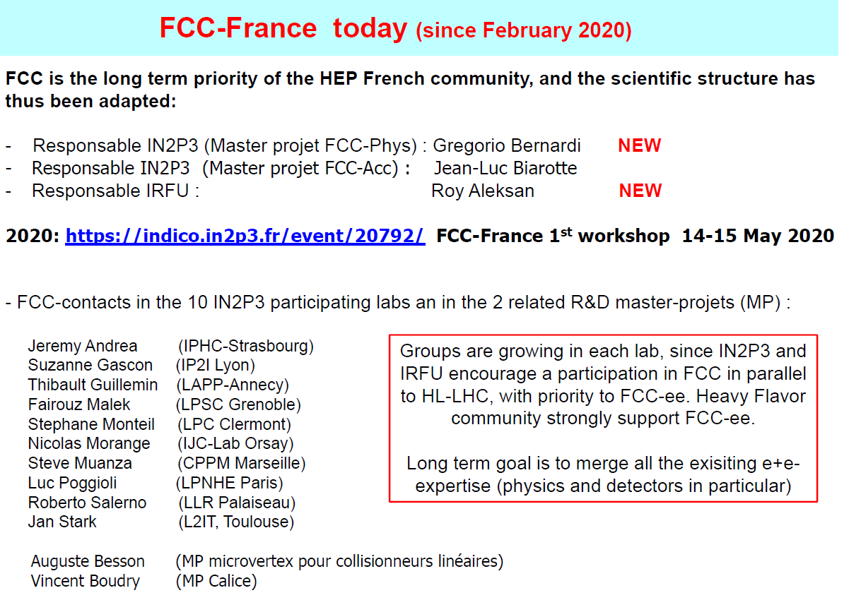

Slide 6
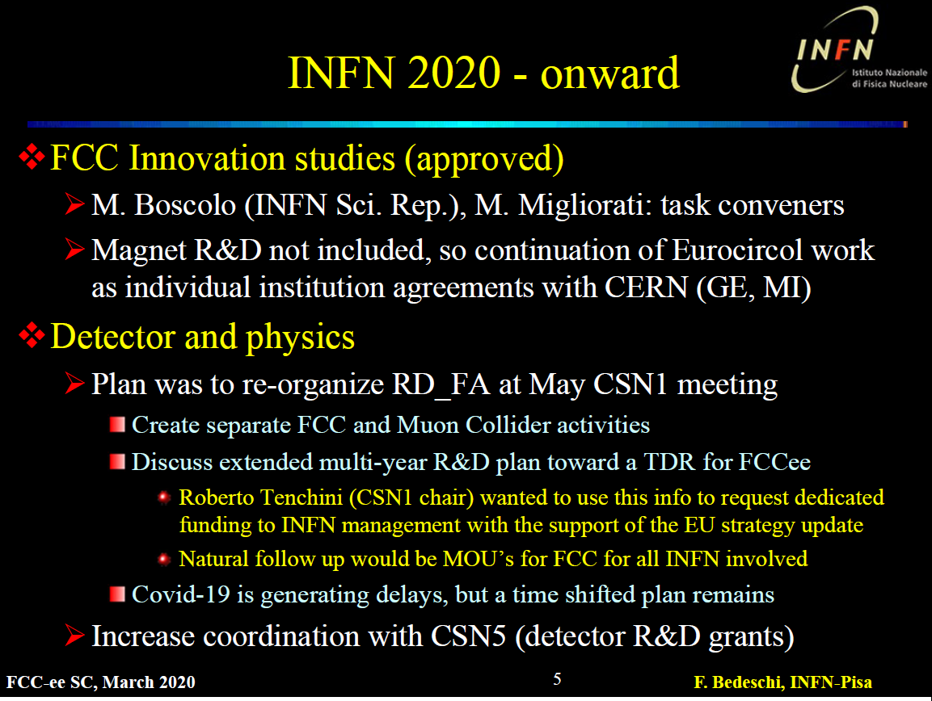

Slide 7
CASE STUDIES
FCC-ee Physics coordination
21-11-2019 + rev. 29-01-2020
Important: names are those who suggested the case study
live document
https://docs.google.com/document/d/1obwT_QMM0S1LfmRR698fnwoIR_nBwyiVzxN8bjBDb4E/edit

Slide 8
muon momentum resolution (and scale stability) Patrick/Alain
charm tagging performance (development and optimization)
Markus, Patrizia and Freya (Higgs, also Z,W,t)
tracking and vertexing of displaced particles Markus, Patrizia and Freya (Higgs, also Z,W,t)
photon identification in tau decays ; separation/identification of tau decay channels
Markus/Mogens (Higgs, Z, also W, t)
time resolution of the ecal / do we need a timing layer for displaced photons detection?
Maurizio (?)
angular acceptance definition for <<10-5 precision measurement of R_l at the Z pole
Alain (see also W)
7. Four-momentum reconstruction of e+ e- scattered at very low angles,
even inside the beam pipe (upstream and downstream tunnel) after beam optics deflection,
and detected in “Roman Pots” type of detectors. David d’Enterria

Slide 9
8. acceptance for <<10-4 precision measurement of sigmaWW at threshold (and
related delta M_{W} = 300 KeV) Paolo/Elizabeth
9. e/mu/tau lepton identification performances (W, also Z and tau decays) Paolo/Elizabeth
10. quark flavor tagging performances in hadronic W decays Paolo/Elizabeth
11. Angular resolution/biases of reconstructed jets and leptons Paolo/Elizabeth
12. efficiency/acceptance for low energy particles Paolo/Elizabeth
13 Isolated photon eff/acceptance Paolo/Elizabeth
14 Identification of exclusive and semi-exclusive B hadron decays Roberto?
15 missing energy resolution (calorimeter) Stéphane
16 p / K / pi identification performance Stéphane
16b p/K/pi ID implementation studies Guy Wilkinson et al.
17 Identification of semi-leptonic B and C hadron decays Roberto
18 Beam transverse polarization integration in acc. SW Ghislain Roy, F. Zimmermann, et al
NB this is more an accelerator integration task
19 MDI and Beam Backgrounds Manuela & Nicola
20 Feasibility of Hee measurement (d’Enterria)
21 summary of detector benchmark processes
22 Low energy QCD event shape studies vs radiative returns

Slide 10
Strawman timeline of the study
-- will *not* know ESPP recommandations mid March.
more likely to be end of May or June
however we assume/know that
-- FCC study will be strongly supported.
-- complementarity of FCC-ee and ILC has been noted
-- High field magnet R&D will be strongly supported
let us prepare ahead
-- FCC-IS kick-off 9-13 November)
-- relationship with ECFA under discussion.
-- FCC general meeting in April 2021
«Higgs factory as first step towards hadron collider»

Slide 11
Compare with LEP/LHC
76
81 <- construction ->
89
2000
2010
2038
12 years operation
8+2 years installation
28 years operation
64
2020
2038
15 years operation
1
2
3
4
5
6
7
8
9
10
11
12
13
14
15
16
17
18
15 years operation
34
35
36
37
38
39
40
41
42
43
~ 25 years operation
70
Project preparation &
administrative processes
Permis-sions
Update
Permissions
Funding strategy
Funding and
in-kind contribution agreements
Funding and
in-kind contribution agreements
Geological investigations, infrastructure detailed design and tendering preparation
Tunnel, site and technical infrastructure construction
FCC-ee dismantling, CE & infrastructure adaptations FCC-hh
FCC-ee accelerator R&D and technical design
FCC-ee accelerator construction, installation, commissioning
FCC-hh accelerator R&D and technical design
FCC-hh accelerator construction, installation, commissioning
Set up of international experiment collaborations, detector R&D and concept development
FCC-ee detector technical design
FCC-ee detector
construction, installation, commissioning
FCC-hh detector R&D,
technical design
FCC-hh detector
construction, installation, commissioning
Superconducting wire and magnet R&D
SC wire and 16 T magnet R&D, model magnets, prototypes, preseries
16 T dipole magnet
series production

Slide 12

FCC main goals for 2020 - 2026
Overall goal:
Perform all necessary steps and studies to enable a definitive project decision by 2025/26, at the anticipated date for the next ESU, and a subsequent start of civil engineering construction by 2028/29.
This requires successful completion of the following four main activities:
Develop and establish a governance model for project construction and operation
Develop and establish a financing strategy, including in-kind contributions
Prepare and successfully complete all required project preparatory and administrative processes with the host states (debat public, EIA, etc.)
Perform site investigations to enable CE planning and to prepare CE tendering..
In parallel development preparation of TDRs and physics/experiment studies:
Machine designs and main technology R&D lines
Establish user communities, work towards proto experiment collaboration by 2025/26.

