Slide 1
Detector requirements
---
Alain Blondel, Mogens Dam
One of the main outcome of recent discussions is the request for clear
detector requirements or specifications

Slide 2
Detector Requirements Links
11th FCC-ee workshop: Theory and Experiments, January 2019
https://indico.cern.ch/event/766859/
Physics requirements: Z and WW electroweak; Roberto Tenchini
Physics requirements: flavour physics; Stephane Monteil
Physics requirements: Higgs and top; Krisztian Peters
WG11 meetings https://indico.cern.ch/category/5668/
3rd FCC Physics and Experiments Workshop, January 2020
https://indico.cern.ch/event/838435/
PID: Introduction and discussion of physics goals and required momentum range, Guy Wilkinson
AIDA++ Open Meeting, September 2019
https://indico.cern.ch/event/838460/
Detector Requirements for Higgs Factories; Mogens Dam
CDR presentation 4-5 March 2019 talk by Mogens Dam
https://indico.cern.ch/event/789349/

Slide 3
These studies were aimed at evaluating ‘possible uncertainties’ based on experience (LEP, SLD)
Generally quite conservative and assuming detector improved wrt LEP/SLD/ILD/CLD
but not designed specifically for the FCC-ee statistics and exp. conditions
Here :
1. starts from statistical errors as precision reference (rather than starting from LEP/SLD)
2. attempt to indentify the places were detector design esp. construction
can/will be the limiting factor.
3. identify places where further input requires full simulation results
4. ignore theory systematics or algorithmic systematics
IMPORTANT : this is a start and a template, not definitive answers.
An important message already is that «resolution» is not all that matters, we need to address
alignment and stability issues.
The next 5 years will be dedicated to solving the many ‘challenges’
that FCC-ee presents to the detector builders.
Anybody with knowledge, competence or interest on these issues should manifest themselves

Slide 4
Standard Z «line shape» measurements + Z-γ interference
QTY | unit | stat | syst? | _{origin} | ref | to do | ready?
m_{Z} | keV | 4 | 100 | E_{beam} | EPOL paper |  | → TDR
Γ_{z} | keV | 4 | 25 | E_{ptp ,} σ_{E} | EPOL paper | Muon pair mass reconstruction → det. construction, mon, stab Selection wrt non resonant bkg
R_{l} R_{μ} R_{e} R_{τ} | 10⁻⁶ | 3 (μμ) | 10-50? | _{lepton evt acceptance for} _{μμ, more difficult for ee, ττ} | no study | study lepton evt acceptance define fid volume and stabilty → det. construction, mon, stab
σ_{had}^{peak} | 10⁻⁶ | 1 | 14 (γγ stat) 100(ee)? | lumi meast ee, γγ, had sel. | CDR, M. Dam | study of ee-> γγ and hadron selection → det. construction, mon, stab.
A_{FB} on-off pk μμ, ee, ττ | 10⁻⁶ | 3 (μμ) | --? (μμ) | lepton evt charge def. for μμ, more difficult for ee, ττ | no study | study lepton charge def. → det. construction
comments: statistical errors are well known. Systematics from ECM are documented, and
‘reliable’ except the ptp error from muon pair mass reconstruction which must be studied further.
Low angle Bhabha abs luminosity errors have been studied by Mogens with constraints on
LCAL construction (CDR), but γγ normalization errors must be studied.
Errors on R_{l} in particular are (5x?)too large and should be worked on (→ α_{s} (m_{Z}))
Requirements on detector alignement and stability are typically 2 orders of magnitude better
than LEP and require dedicated effort.

Slide 5
Physics from taus at the Z peak (Dam, Monteil, Dam)
Tau-lepton Physics at FCC-ee - Dam, Mogens SciPost Phys.Proc. 1 (2019) 041 arXiv:1811.09408 [hep-ex]
QTY | unit | stat | syst? | _{origin} | ref | to do | ready?
branching ratios | 10⁻⁵ | 0.2 | 3? | channel mixing e/μ/π/K, π⁰ |  | review LEP measts, synergies w. R_{l} constraints on e/γ/π⁰ sep.
P_{τ}(cosθ): A_{τ} A_{e} | 10⁻⁵ | 1.6 1.6 | 15? 3? | channel mixing e/μ/π/K, π⁰ +mom. scale, charge, angle | LEPEW hep-ex/0509008 | review LEP measts, synergies w. R_{l} constraints on e/γ/π⁰ sep. momentum scale definition
τ lifetime | 10⁻⁶ | 3 | 140? | impact parameter syst and correlations |  | vertex detector radial alignment Δτ_{τ} /τ_{τ} ~ ΔR/R 1cm x 3.10⁻⁶ → ΔR =0.030 microns. Belle vtx aligned to 0.25 microns
mass m_{τ} | keV | 4 | 100? | momentum scale, acollinearity syst. |  | momentum scale and acollinearity systematics.
Z→τe, τμ | 10⁻¹⁰ | 10 | ? | momentum resolution ECM energy spread |  | ideally want momentum resolution less than 0.5 ECM spread= 0.5 10⁻³ for 45 GeV particle.
comment: taus at FCC-ee investigate the charged current in similar way as muons at PSI,
not quite as precise but more varied; most sensitive lepton flavour violation in sight.
Much to gain from highly segmented e/γ/π⁰ calorimeter and vertex detector, to be quantified
Exact needs for π/K is unclear (evt by evt or statistical?)
Systematic (and even some stat.) errors are unknown at this point.

Slide 6
Heavy Quark EW physics
QTY | unit | stat | syst? | _{origin} | ref | to do | ready?
R_{b} R_{c} | 10⁻⁶ 10⁻⁶ | 1.5 6 | 300? ?? | hemisphere correlations, (admittedly conservative) | LEPEW SLD | need calculation of b-tagging efficiency and of correlations at small inefficiency
A_{FB}^{b} A_{FB}c | 10⁻⁶ 10⁻⁶ | 3 6 | 300? 200? | QCD effects on angular dist. | LEPEW SLD | LEP DAFBb = 0.00165 (b-tagging x charge_eff≡εχ=0.12) FCC-ee stat: 0.0015/500 *(εχ_{LEP})/(εχ_{FCC}) 3.10⁻⁶
Comments: statistical errors are extrapolated from LEP/SLD *not* accounting for improvement
in tagging efficiency.
syst on asymmetries dominated by QCD corrections
to be studied in detail before asymmetry precision can be predicted.

Slide 7
more on b&c EW Physics and Flavour physics
Here fundamental inputs are missing:
-- the b/c/(q,g) tagging efficiency vs purity curves
One expects an improvement by a factor 4 or more wrt LEP (was 10-20%) or even 2x SLD (40%)
which will have considerable impact on statistical error and even systematics (via purity)
-- the b-jet charge tagging efficiency&purity also missing. Should improve with vertex charge.
-- impact of vertex detector design on b-tagging
A_{FB}^{b} , R_{b} : even statistical uncertainties cannot be ascertained at this point.
secondary vertex reconstruction (secondary vertex mass and charge) essential
A_{FB}^{c} , R_{c} : largely identical, in addition D*→π⁺D⁰ chain is a powerful tag ‘soft pion’
for both, charged K tagging might is additional bonus
+ Life time, B oscillations etc…
-- tracker resolution
-- low momentum threshold for charged and neutral (photon) particles
momentum and e/γ momentum resolution
-- b/c/q,g tagging performance with vtx detector performance

Slide 8
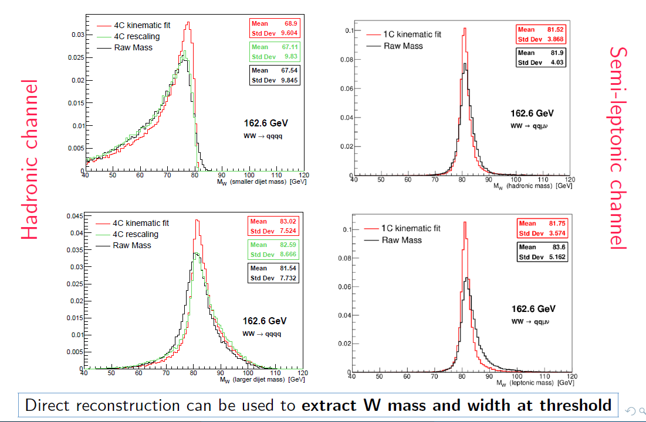
see P. Azzuri for threshold cross-section
and more recently
M. Beguin PhD thesis for direct reconstruction
http://www.theses.fr/2019SACLS393
W mass and width

Slide 9
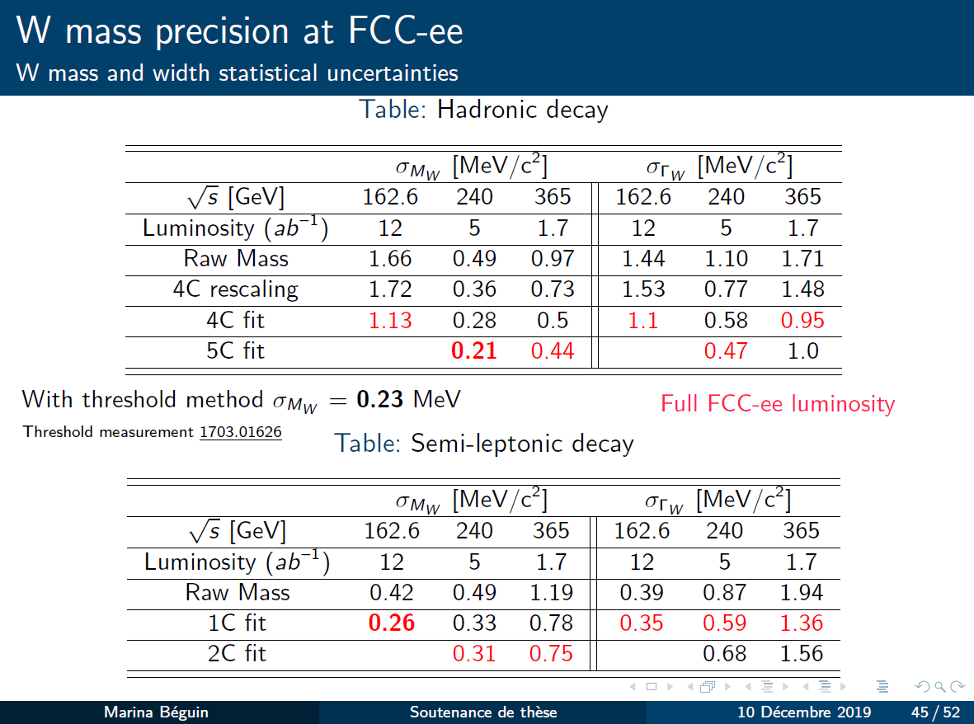

Slide 10
High Energies (this table is to be completed)
QTY | unit | stat | syst? | _{origin} | ref | to do | ready?
M_{w} | keV keV | 600 300 | 300 300? | cross-section at threshold direct reconstruction | EPOL paper, | revisit EPOL paper advertised precision not sufficient wrt direct reconstruction at threshold understand syst. from -- lepton energy scale -- jet and missing momentum angular and energy resolution
ee→ Z γ |  |  |  | this channel is critical for energy calibration, neutrino counting and for nu_e coupling meast | See Roy Aleksan at sept 2019 phys. meet | 15-200 GeV photon energy calibration, resolution and stability.
σ_{ZH} (μμH) σ_{ZH} (qq H) | % | 0.5 | negl. | Higgs peak in missing mass to muon pairs. |  | sensitive to muon momentum resolution with Pμ ~ 50-70 GeV FCC-ee should really look into hadronic channel
m_{H} | MeV | 10 |  | FCC-ee should really look into this as this is a critical input for the e+e- → H s-channel study.
m_{top} Hvv |  |  |  | invariant mass reconstruction with jets -- Jet angles and momentum, energy resolution -- no-cracks and hermiticity are essential -- hadron calorimeter granularity, resolution? -- (anti) baryon identification useful/needed?

