Slide 1
Future Circular Collider Innovation Study FCC-IS
Project submitted in the frame of the H2020 Research Infrastructure Development Call on 12 November 2019
Co-financing for planned FCC activities relation to the project preparation phase between 2020 and 2024
Proposal accepted in March 2020, as the only physics project in this call.
Total budget
8.6 M€
EC co- financing
3.0 M€
Duration
48 mois
Start
autumn
2020

Slide 2
FCC Schedule with FCCIS

Slide 3
Participants with EC co-funding

Slide 4
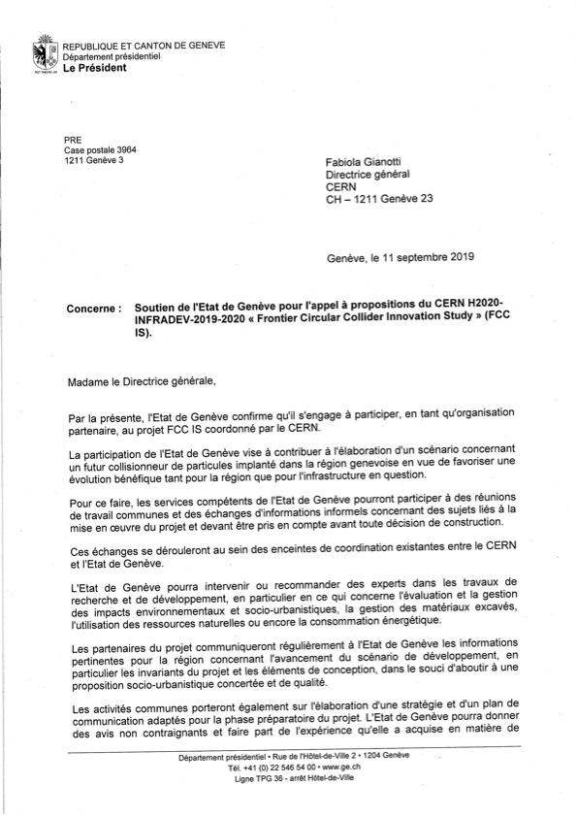
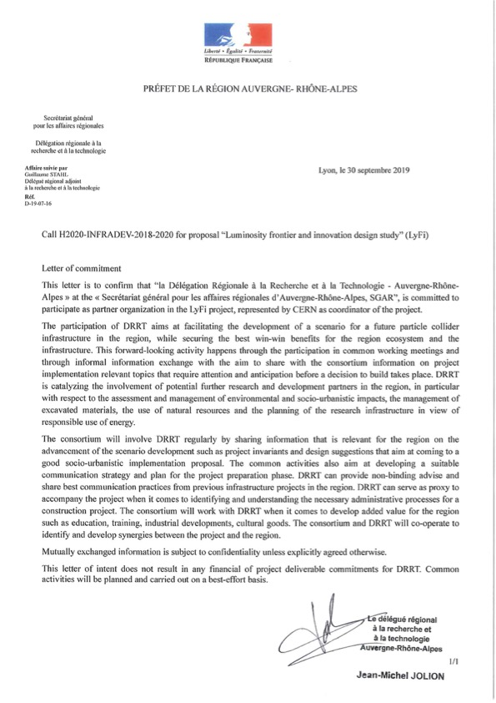
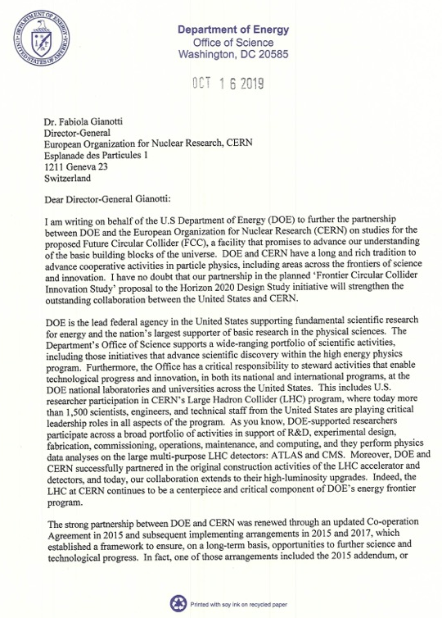
Partners without EC co-funding
Host state authorities

Slide 5

WP2
Design of electron-positron collider
Goal: infrastructure construction start by 2028
Operation start of FCC-ee: 2038
Operation with stepwise energy upgrade: 15 years
Validation of concepts to achieve the required performance with existing accelerators
DAFNE, INFN, Rome, Italy
KARA, KIT, Germany
PETRA, DESY, Germany
VEPP, BINP, Russian Federation
Optimisation of the energy consumption and resource use as requested by host states (e.g. performance per kW, cooling water consumption, cryogenic cooling capacity, electric energy conversion and distribution)
Collider Design
Extreme luminosity > 10³⁶
1 000 000 Higgs bosons
Leading-edge RI on the forefront of research
Performance
Resource needs
Optimise performance & resource use

Slide 6



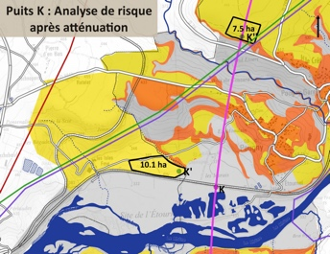
Optimisation of placement in transboundary context together with the host states
Keeping the surface site footprints under control
Application of an «ecodesign» concept, respecting the «Eviter-Réduire-Compenser» process prescribed by law and implementing it with a risk management process
Documentation of various scenarios that permits a political validation as a pre-requisite to continue administrative processes that require public engagement
Definition of a requirements document and concept for the ”environmental evaluation” in a transboundary context
Development of an “innovative excavation materials management plan”
Work with host state decentralised services to develop a legal framework that permits the use of a fraction of excavated materials (“waste”) as resources for selected cases
Includes an international competition to identify credible and economically viable pathways to commercially use some of the excavated materials
WP3
Integrate Europe
Ecodesign and
resource efficiency
Territorial
compatibility

Slide 7



Socio-economic impact analysis
Application of a quantitative method as recommended by the EC
Based on the results of the studies carried out for the LHC + HL-LHC between 2016 and 2019
Cost estimate
Design – construction – transition to operation – operation
Development of a funding strategy
In cash + in kind
Development of regional benefit potentials in a global project
For the host states
For some member states as examples
Considering the «EU smart specialisation» paradigm
WP4
Impact & Sustainability
In-cash / in-kind
co-construction
Economics of innovation and public value

Slide 8

Development of the communication strategy
Development of the communication plan
Institutional communication
Communication and engagement of the population in the host states in view of the “débat public” in France (2023) and on the expected, voluntary engagement in Switzerland, as documented in the administrative procedure scenario that was developed in the scope of the “Structure de Concertation Permanente”
Creation of a community of engaged physicists for the development of concepts for the experiments
Sustainability of FCC comes from a community of some 10’000 users that will need to be linked to the infrastructure for the coming decades with a long-lasting research programme
Development of a community agreed research programme for the FCC-ee
as a basis to form world-wide scientific research collaborations for the experiments
WP5
Leverage & Engage
Build a user community through a programme
Circular Collider Even better when I participate
Communication and public engagement

Slide 9
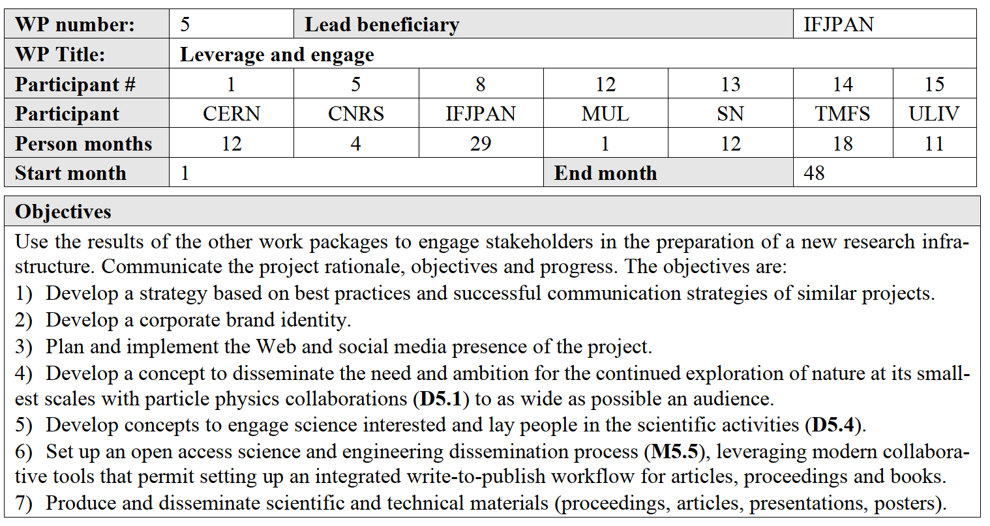
FCC-IS WP5 main elements

Slide 10
FCC-IS WP5 main elements
Outreach to public
Organisation of experiment physics workshops
Community forming
Documentation of physics opportunities and experiment programs
FCC-IS kick-off
Kick-off meeting prel. date 9 – 11 November 2020, at CERN
Proposed parallel organization of FCC experiment & physics workshop, 9 – 13 November 2020 at CERN
Note that FCCW 2020 Paris displaced to April 2021.

