Slide 1

Physics Meeting
27 April 2020

Slide 2
Recall from last meeting
-- FCC-IS design study has been approved.
-- This includes a physics part aimed at reaching out and enlarging community.
-- Discussion of establishing detector requirements should begin in earnest based on case studies of physics measurements.
-- we expect answers to the ITN proposals in May
-- National efforts
France, Italy on going
In discussion (CH, UK) somewhat delayed due to COVID-19
Please let us know if you have possibility in mind in your country
-- Detector requirements
-- at the Z a number of measurements are very demanding on detector alignment or construction precision rather than resolution!

Slide 3

FCC main goals for 2020 - 2026
Overall goal:
Perform all necessary steps and studies to enable a definitive project decision by 2025/26, at the anticipated date for the next ESU, and a subsequent start of civil engineering construction by 2028/29.
This requires successful completion of the following four main activities:
Develop and establish a governance model for project construction and operation
Develop and establish a financing strategy, including in-kind contributions
Prepare and successfully complete all required project preparatory and administrative processes with the host states (debat public, EIA, etc.)
Perform site investigations to enable CE planning and to prepare CE tendering..
In parallel development preparation of TDRs and physics/experiment studies:
Machine designs and main technology R&D lines
Establish user communities, work towards proto experiment collaboration by 2025/26.

Slide 4
News
-- Matthew, Patrizia and Patrick are back in action!
-- Snowmass effort begins in the USA (see contribution by Markus)
US DOE committment to FCC was a very important input to ESPP. * →
Also an opportunity to publicize and gather new effort for FCC
-- European Strategy was not made public at last council in March
➔ Public strategy endorsement meeting in May has been cancelled (COVID-19)
➔ Strategy made public
hopefully end of May
in June or possibly even September
Direct and indirect effects of COVID-19 pandemic.
Meanwhile: refrain to take steps that would appear to presume of the strategy content
but approval of FCC-IS gives perfect legitimity to deepening of FCC physics studies.

Slide 5
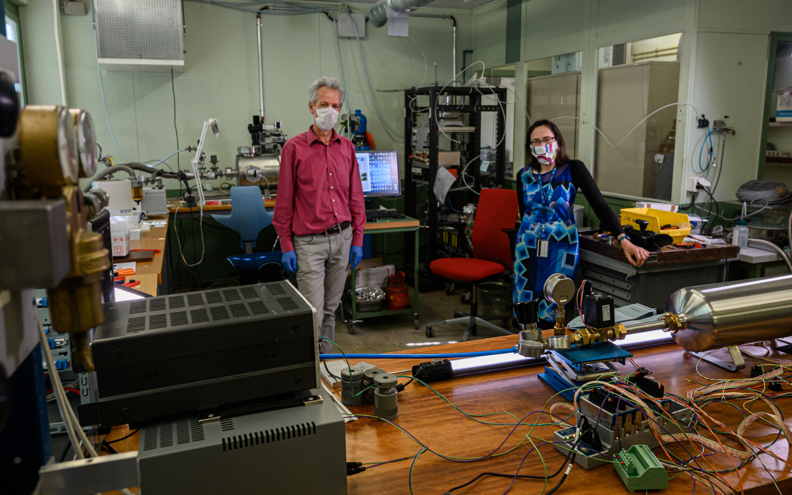
Novel streamlined ventilator against COVID-19 called HEV.
BRAVO!
Paula Collins from FCC P&E steering group

Slide 6
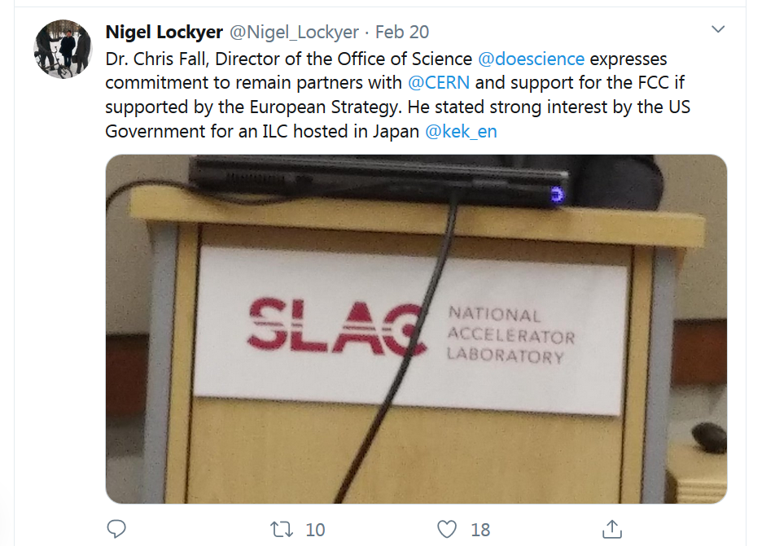
Important US input to ESPP:
-- *committment* expressed for CERN and FCC if supported by ESPP
-- strong *interest* for an ILC hosted in Japan.

Slide 7
Actions
-- if we want to leave it open, 4 IP issue is urgent.
-- FIVE specific physics topics for which a factor in luminosity makes a big difference
were communicated to M. Benedikt. Action has been followed to organize effort *→
-- create task force to investigate s-channel Higgs production
Theoretical Motivation / Experiment/ Monochromator design
Started. contact: David d’Enterria
-- investigate need to run from 30 to 90 GeV for alpha_s measurement, compare with
e+e- → gamma+ hadrons(√s ∈30-90 GeV)
Action pending Bogdan Malaescu bogdan.malaescu@cern.ch (LPNHE Paris) similar work
at b-factory is interested + MPI Group (Andrii Verbytskyi andriish@mpp.mpg.de,
Gabor Somogyi <gabor.somogyi@cern.ch> , Stefan Kluth <skluth@mpp.mpg.de> )
-- need to generate table of benchmark measurements for detector requirements
→ (see talk by Alain/Mogens later today)
-- connect with «case studies» -- see list later in this talk.
Patrick and Patrizia are back in action!

Slide 8
Physics results that would benefit greatly from increasing FCC-ee luminosity
The determination of the Higgs self-coupling
from the measurement of ZH cross-sections (around 240 GeV)
and in the tt threshold region (340 to 365 GeV) where it is statistically limited
2. The direct measurement of α_{QED} (m_{Z} ) using lepton pair A_{FB}(s)
This measurement is limited by the statistics of muon pairs off peak, and it is
a limitation for the sensitivity to (or interpretation in terms of) new physics of
both the W mass and of all the effective weak mixing angle measurements.
3. The investigation of Hee coupling from the s-channel e+e- → H search
increase of luminsity makes it possible to change from a limit to a measurement.
The search for right-handed neutrinos and other feebly coupled particles.
It is critical to reach the see-saw mixing range, and this is «just missed» in a sample
of 5 10¹² produced Z (or 3.5 10¹² hadronic Z).
5. Top EW couplings.
Essential measurement as input to ttH,/ttZ at FCC-hh, and consequently
for the Higgs self coupling at FCChh – with 2IP the FCC-ee measurement is
close to be limiting.

Slide 9
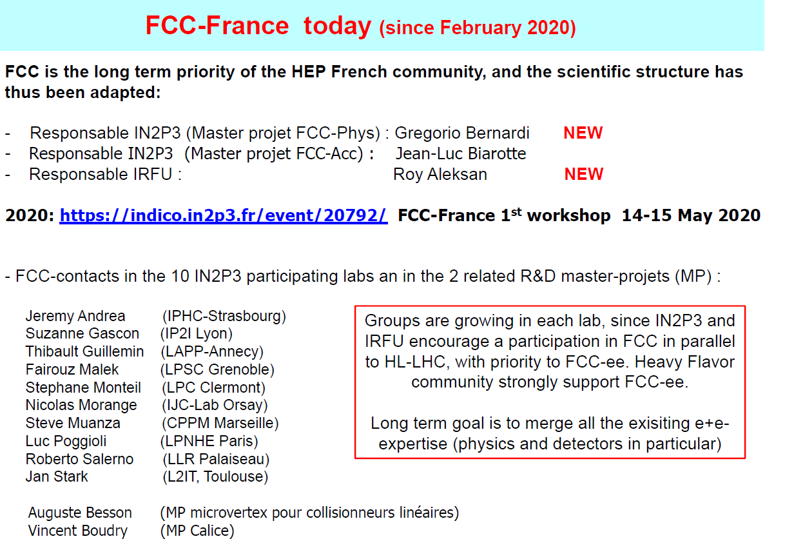
FCC-France meeting 14-15 May 2020
Meeting ‘remote’. Very nice agenda. Non-france participants welcome, must register

Slide 10
CASE STUDIES
FCC-ee Physics coordination
21-11-2019 + rev. 29-01-2020
Important: names are those who suggested the case study
live document
https://docs.google.com/document/d/1obwT_QMM0S1LfmRR698fnwoIR_nBwyiVzxN8bjBDb4E/edit
A new list will be issued with the names of contact persons after the coordination meeting on
Wednesday 29 April
PLEASE CONTACT Alain Blondel or Patrick Janot if you are interested in contributing
or if you have another item propose

Slide 11
muon momentum resolution (and scale stability) requirements Patrick/Alain
charm tagging performance (development and optimization)
Markus, Patrizia and Freya (Higgs, also Z,W,t)
tracking and vertexing of displaced particles Markus, Patrizia and Freya (Higgs, also Z,W,t)
photon identification in tau decays ; separation/identification of tau decay channels
Markus/Mogens (Higgs, Z, also W, t) (important for ECAL design)
time resolution of the ecal / do we need a timing layer for displaced photons detection?
Maurizio Pierini
angular acceptance definition for <<10-5 precision measurement of R_l at the Z pole
Alain (see also W)
measurement of tau lifetime with 1.5 10¹¹ tau pairs at the Z. Important for VTX alignment
(Alain, Mogens)
Four-momentum reconstruction of e+ e- scattered at very low angles,
even inside the beam pipe (upstream and downstream tunnel) after beam optics deflection,
and detected in “Roman Pots” type of detectors. (two-photon physics) David d’Enterria

Slide 12
8. acceptance for <<10-4 precision measurement of sigmaWW at threshold (and
related Δ M_{W} = 300 KeV) Paolo/Elizabeth
9. e/mu/tau lepton identification performances (W, also Z and tau decays) Paolo/Elizabeth
10. quark flavor tagging performances in hadronic W decays Paolo/Elizabeth
11. Angular resolution/biases of reconstructed jets and leptons Paolo/Elizabeth
12. efficiency/acceptance for low energy particles Paolo/Elizabeth
13 Isolated photon eff/acceptance Paolo/Elizabeth
14 Identification of exclusive and semi-exclusive B hadron decays Roberto
15 missing energy resolution (calorimeter) Stéphane
16 p / K / pi identification performance Stéphane
16b p/K/pi ID implementation studies Guy Wilkinson et al.
17 Identification of semi-leptonic B and C hadron decays Roberto
18 Beam transverse polarization integration in acc. SW Ghislain Roy, F. Zimmermann, et al
NB this is more an accelerator integration task
19 MDI and Beam Backgrounds Manuela & Nicola
20 Feasibility of Hee measurement (d’Enterria)
21 summary of detector benchmark processes
22 Low energy QCD event shape studies vs radiative returns

Slide 13
Let us prepare ahead
-- FCC-IS kick-off 9-13 November 2020
-- 4th FCC Physics workshop 9-13 November
will be in person (or remote, to be decided in September)
-- for FCC-ee emphasis on:
-- precision measurements and calculations.
-- BSM aspects of precision, flavour (τ,b), and direct search program
-- flavour program
-- detector requirements and ideas
Possible synergy with the snowmass program, how to contribute etc… will be posted.
-- FCC general meeting in Paris, April 2021

