Slide 1
MUON SHIELD
Current status and plans

Slide 2
CURRENT STATUS
1 Ton of GOS was purchased last year.
The contract with MPEI was relaunched in 2019, but it is still on Evsuykova in DIRECTUM (task 6769674).
It was established new contacts with St. Petersburg State Marine Technical University (SPbGMTU). Contact person - Mikhail Kuznetsov, Head of Production Division, The Institute of Laser and Welding Technologies (Институт лазерных и сварочных технологий).
New geometry of MS utilizing Co-based alloy in the 1st section (field 2.2 T) and conventional steel (1.6 Т) at the rest was proposed. The idea is considering from the magnetic fields point of view (calculating magnetic fields for the new configuration).
The Study of new tool from Sergey Shirobokov for muon paths simulation.
Anastasiya Kalashnikova is performing calculation magnetic field in frame of educational program.
Prototype from UK should be delivered to CERN. Properties to be measured. Equipment is required: bipolar power source, fluxmeter (integrator).

Slide 3
GO STELL
Clarification of material properties in different directions to sophistication of the simulation model.
It was purchased 1 ton of GO steel which is enough to make several prototypes with different welding technologies:
1) MPEI prototype using Electron Beam Welding technology (cost 3 mln Rub)
Should be produced 700 x 500 mm frames (3 units). The muon scattering could be measured during testbeam.
2) SPbGMTU prototype using Laser Welding technology (cost to be determined)
The frame of the same size should be produced for magnetic properties measuring. If it is Ok, could be compared with EBW.

Slide 4
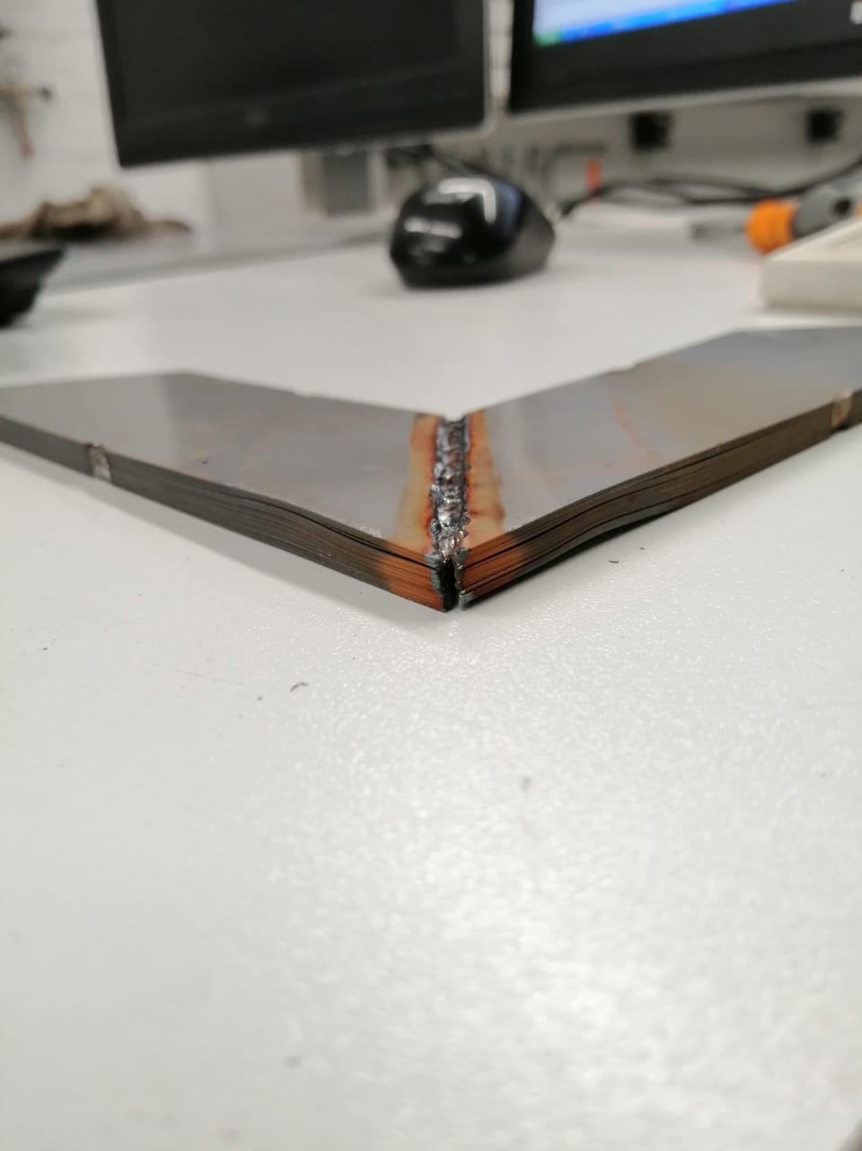
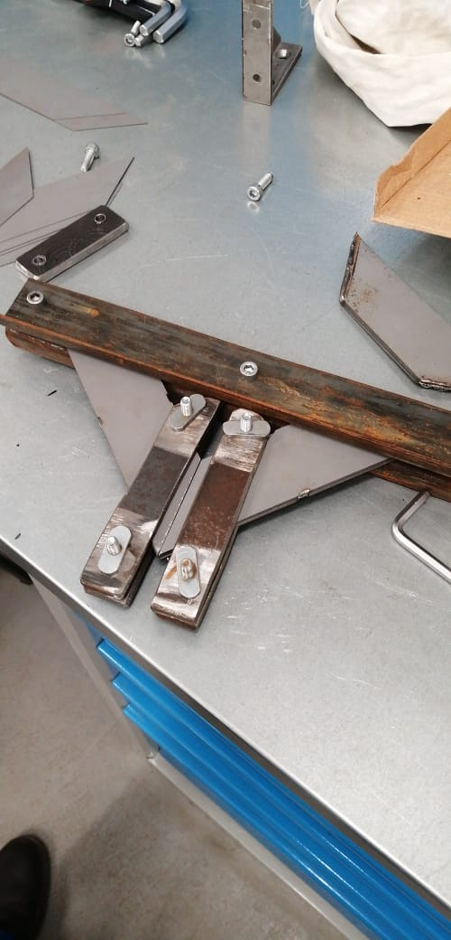
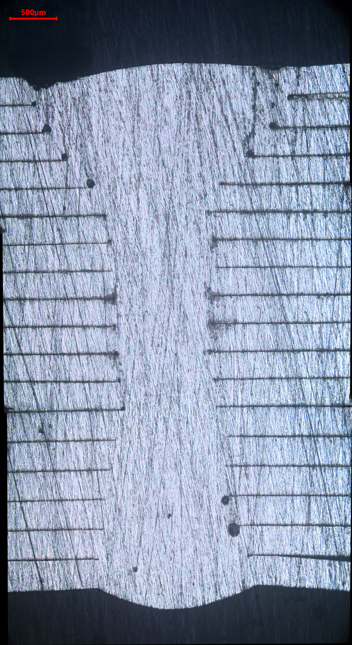
St. Petersburg State Marine Technical University (СПбГМТУ)
First experiments have been done by the end of 2019.
The pack made of 15 plates, the total thickness of the frame was 5 cm.
The welding revealed some problems with joints due to the assembly and fixing tools.
Currently we are developing new tools.

Slide 5
EDUCATIONAL PART
Anastasiya Kalashnikova is bachelor student of 4th year.
1) Experimental investigation of angular distribution of the magnetic hysteresis of the GO steel (experimental set-up in MPEI). The characteristics should be taken for the samples with a resolution of about 5-15 degrees.
2) Implementation of experimental data for the raw materials to the simulations of magnetic construction in COMSOL software. Setting up more accurate model for calculation of anisotropic alloys.

