Slide 1


Welcome - Velkommen
to Accelerating Science and Innovation
Notes:
1

Slide 2
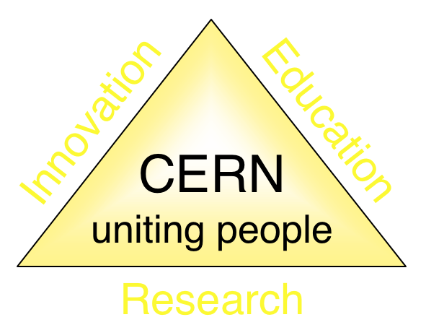
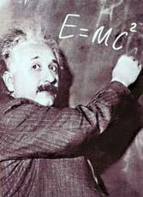



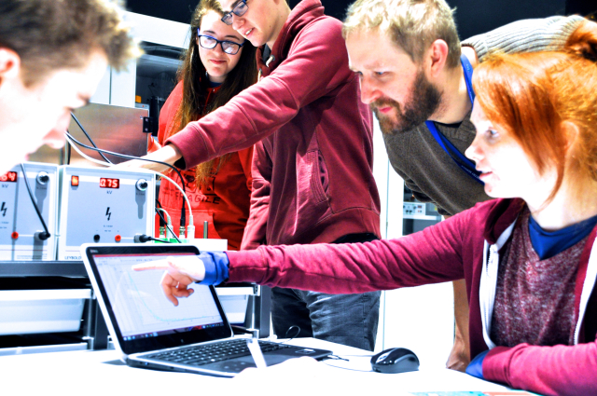
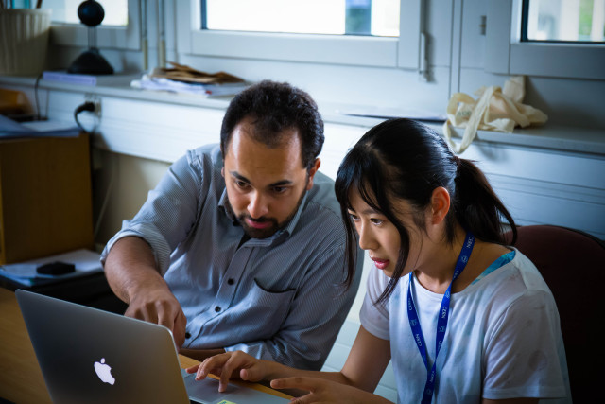
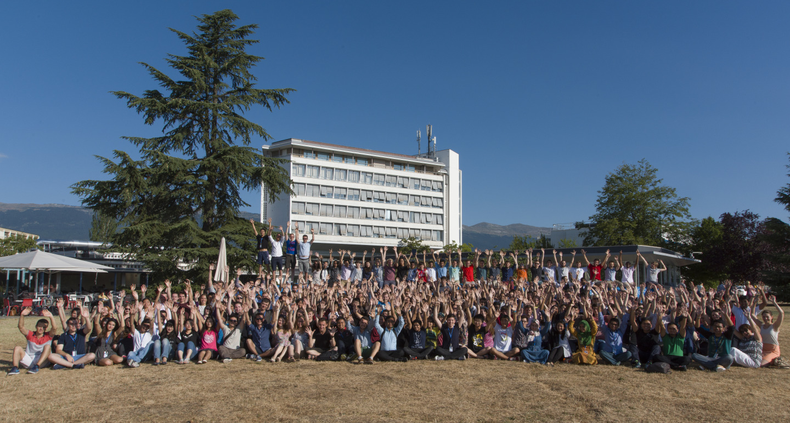
The Mission of CERN
Push back the frontiers of knowledge
E.g. the secrets of the Big Bang …what was the matter like within the first moments of the Universe’s existence?
Develop new technologies for accelerators and detectors
Information technology - the Web and the GRID
Medicine - diagnosis and therapy
Train scientists and engineers of tomorrow
Unite people from different countries
and cultures
Notes:
2

Slide 3
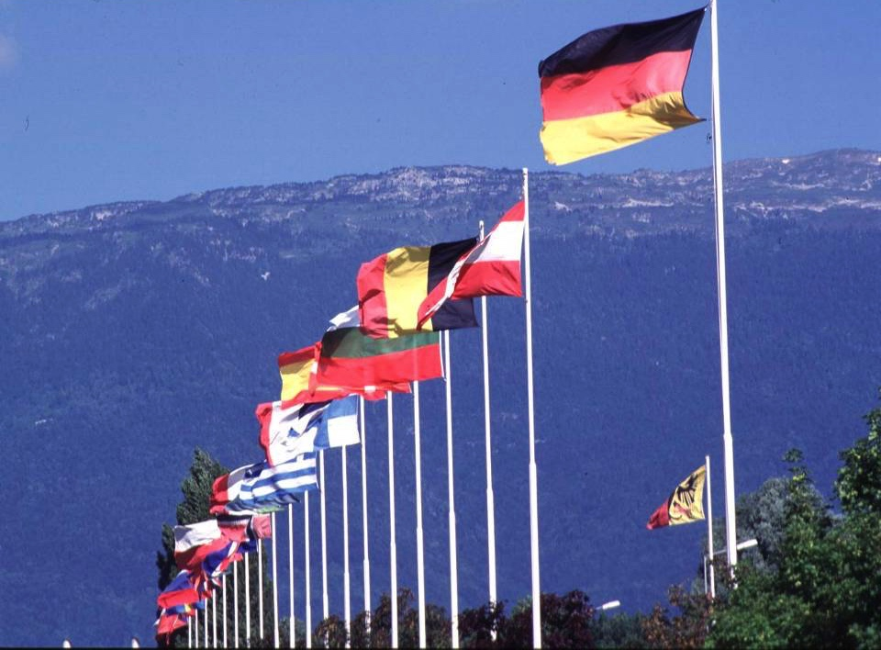

CERN: founded in 1954: 12 European States
“Science for Peace”
Today: 23 Member States
Employees: ~2700 staff, 800 fellows
Associates: ~12600 users, 1800 others
Budget (2019) ~ 1200 MCHF
Member States: Austria, Belgium, Bulgaria, Czech Republic, Denmark, Finland, France, Germany, Greece, Hungary, Israel, Italy, Netherlands, Norway, Poland, Portugal, Romania, Serbia, Slovak Republic, Spain, Sweden, Switzerland and
United Kingdom
Associate Members in the Pre-Stage to Membership: Cyprus, Slovenia
Associate Member States: Croatia, India, Lithuania, Pakistan, Turkey, Ukraine
Applications for Membership or Associate Membership: Brazil, Estonia
Observers to Council: Japan, Russia, United States of America;
European Union, JINR and UNESCO
3
Notes:
3
----- Meeting Notes (09/01/2013 14:16) -----
nnn

Slide 4
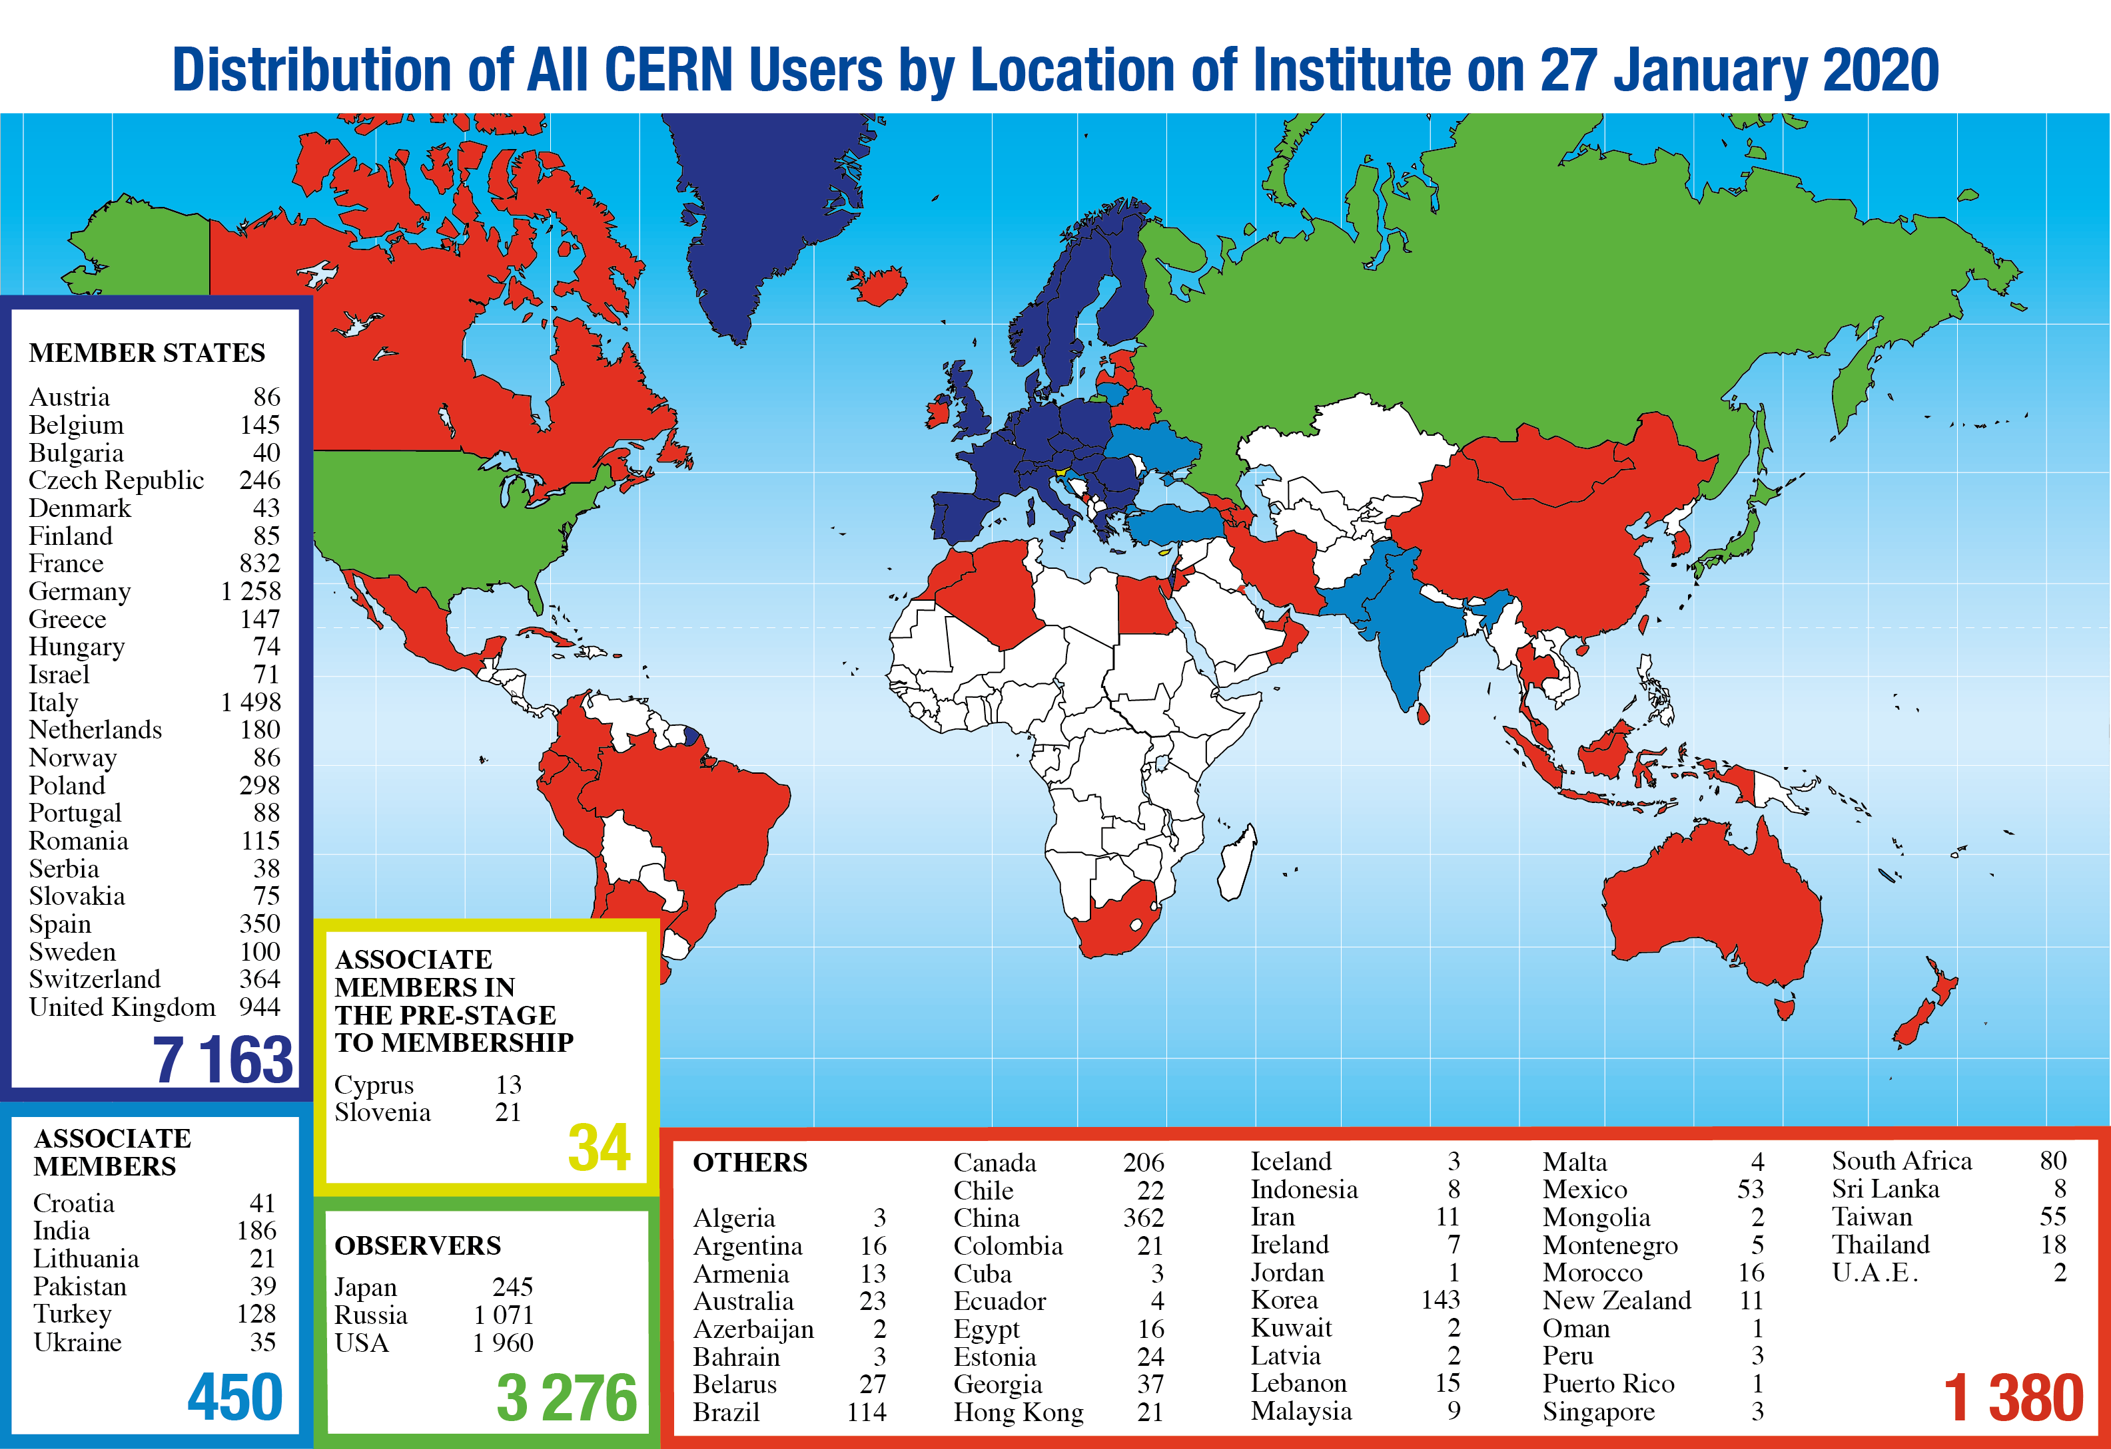
Science is getting more and more global
CERN: 17 staff, 8 fellows, 2 doctoral and 8/3 tech./adm. students, 10 TTE students
Notes:
4
4

Slide 5
Age Distribution of Scientists
- and where they go afterwards
27
Today:
>3000 PhD students
in LHC experiments
65
They do not all stay: where do they go?

Slide 6
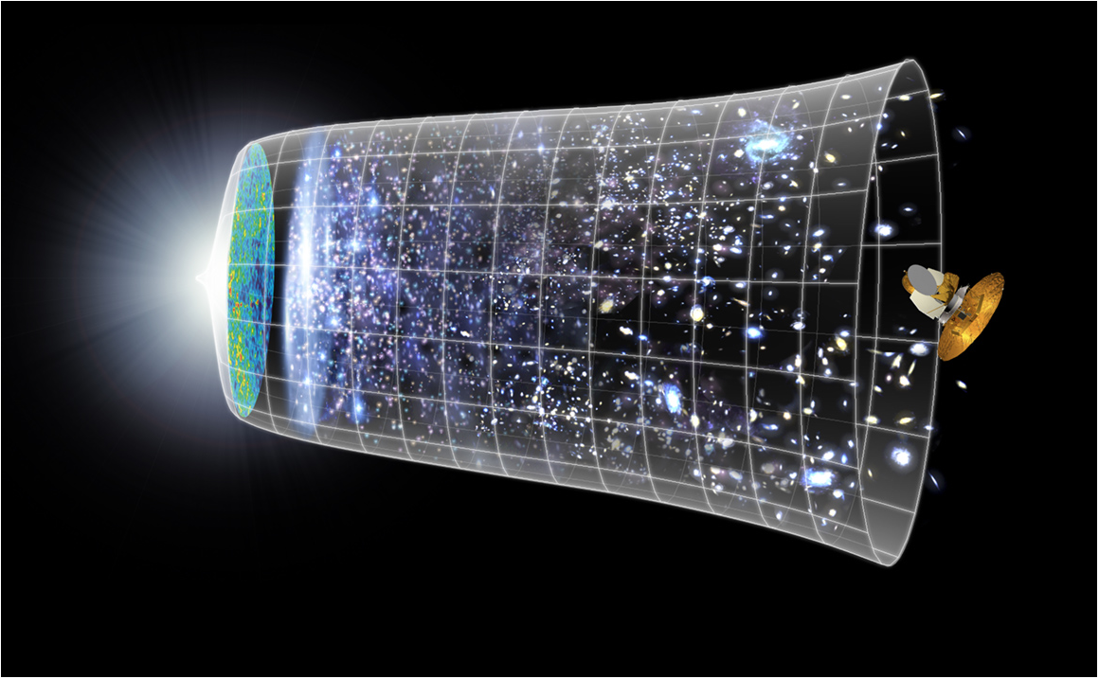
Next Scientific Challenge:
to understand the very first moments of our Universe after the Big Bang
Big Bang
WMAP
380,000 years
13.8 Billion Years
Today
10²⁸ cm

Slide 7
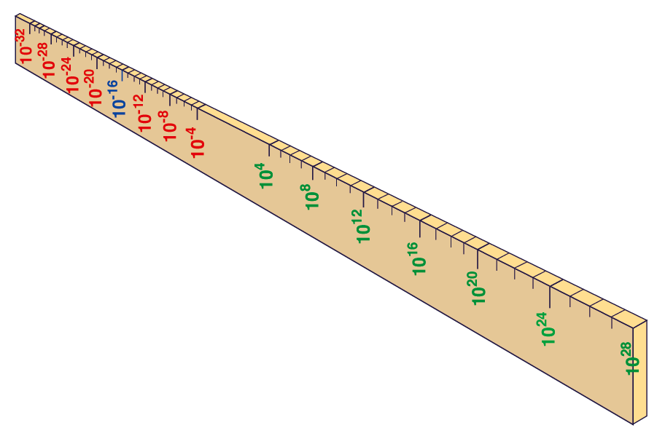
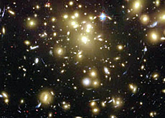
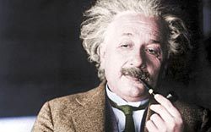


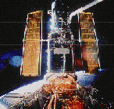
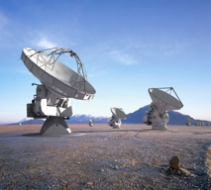

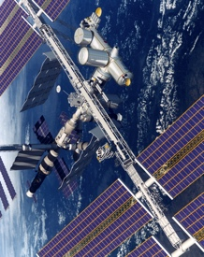
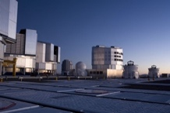
Big Bang
Proton
Atom
Radius of Earth
Earth to Sun
Radius of Galaxies
Universe
LHC
Super-Microscope
Hubble
ALMA
cm
Reproducing conditions
Looking back
AMS
VLT
Notes:
7

Slide 8
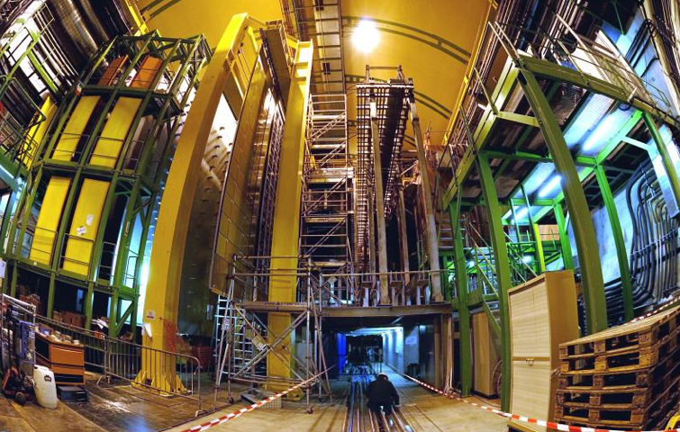


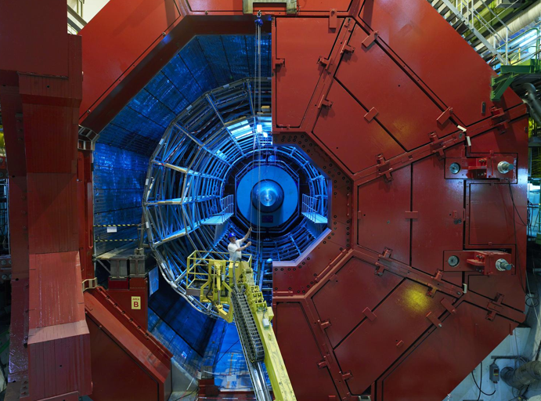

2010: a New Era in Fundamental Science
LHCb
CMS
ATLAS
Exploration of a new energy frontier
in p-p and Pb-Pb collisions
ALICE
LHC ring:
27 km circumference
Notes:
8

Slide 9
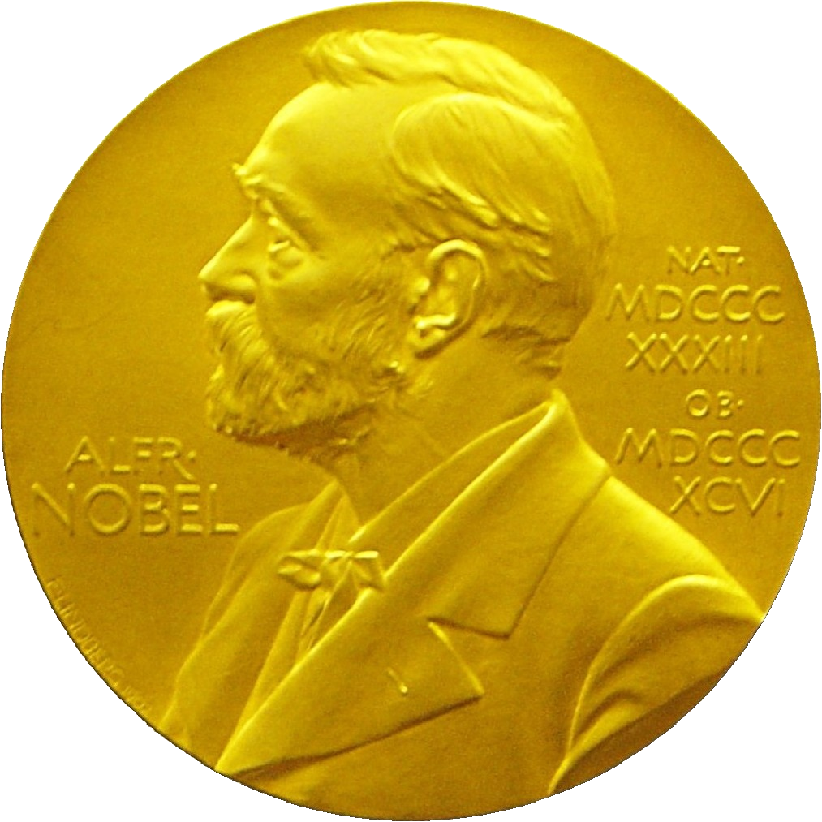
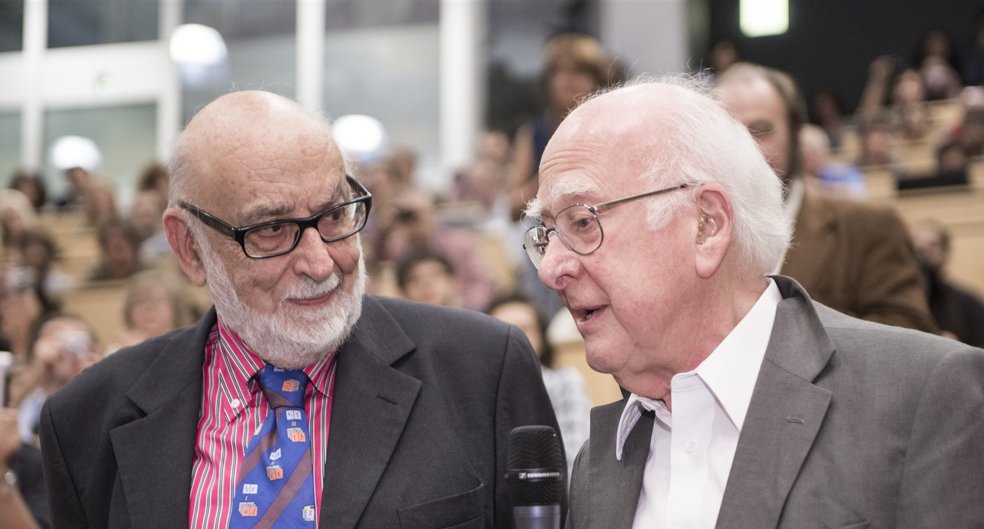
Discovery 2012, Nobel Prize in Physics 2013
The Nobel Prize in Physics 2013 was awarded jointly to François Englert and Peter W. Higgs "for the theoretical discovery of a mechanism that contributes to our understanding of the origin of mass of subatomic particles, and which recently was confirmed through the discovery of the predicted fundamental particle, by the ATLAS and CMS experiments at CERN's Large Hadron Collider”.

Slide 10
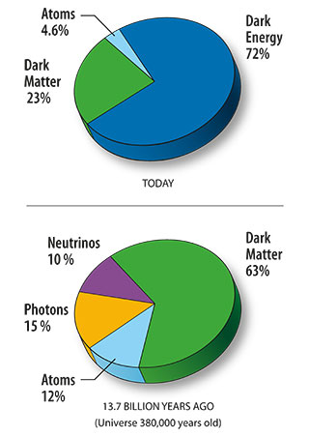


The landscape
“Unknowns:
Flavour structure
Matter-antimatter
Why is the Higgs boson so light
Neutrino sector
Forces merging ?
Gravity
… and ….
Dark Matter/Energy
Notes:
Update Livingstone plot

Slide 11
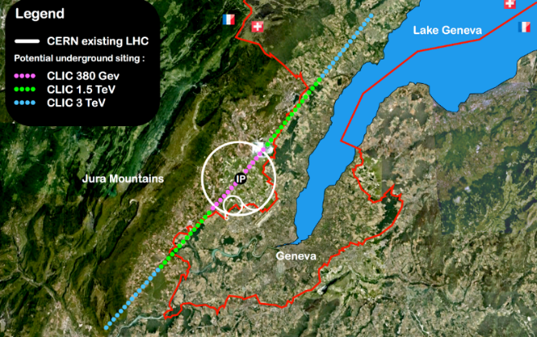

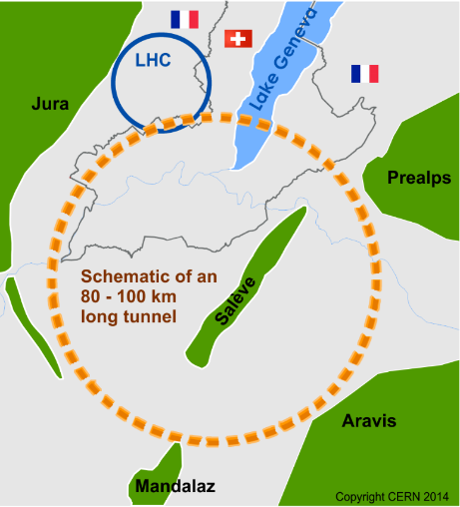

Future of particle physics
High Luminosity LHC until 2040
Ten times more collisions than
the original design
Studies in progress:
Compact Linear Collider (CLIC)
Linear e⁺e⁻ collider √s up to 3 TeV
Future Circular Collider (FCC)
New technology magnets →
100 TeV pp collisions in 100km ring
e⁺e⁻ collider (FCC-ee) as 1st step?
European Strategy for Particle Physics
Preparing next update in 2020

Slide 12
Norway and CERN

Slide 13
Going back to Norway and CERN
CERN: 17 staff, 8 fellows, 2 doctoral and 8/3 tech./adm. students, 10 TTE students
Notes:
13
13

Slide 14
Norwegians at CERN- 17.9.2019
ADMIN: Administrative student
CASS: Cooperation Associates
COAS: Corresponding Associate
DOCT: Doctoral Student
FELL: Fellow
PJAS: Project Associate
STAF: Staff member
TECH: Technical Student
TRNE: Trainee
SASS: Scientific Associate
VISC: Visiting Scientist
USER: User

Slide 15

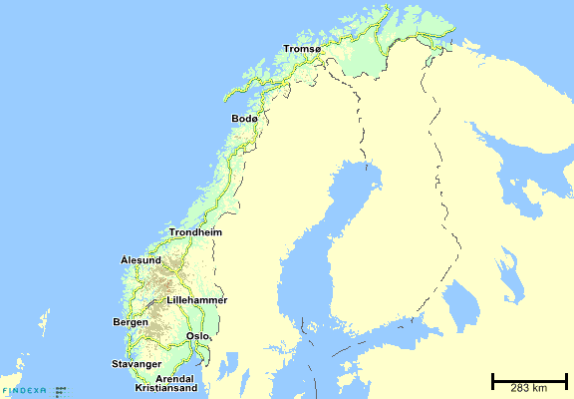
High Energy Physics in Norway
Blue: Oslo, Bergen, Trondheim: Traditional Universities involved at CERN – UiO, UiB dominates the experimental activities
Red plus NTNU: Main recruitment ground for technical and TTE students
Today around 120-140 Norwegian researchers, engineers, postdocs, PhD students, and master students are involved in the CERN activities:
  Around 90 Norwegian researchers (of all categories above) are registered as users travelling frequently to CERN
  The rest travelling are less frequently or working in Norway within the CERN related research programmes
  The Norwegians directly paid/supported by CERN come in addition

Slide 16
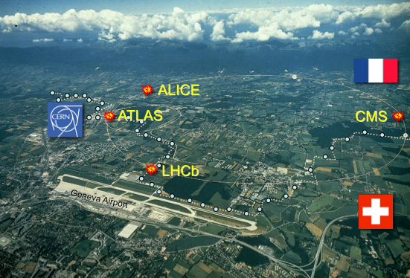


Norway, CERN and LHC
Strong involvement in the ATLAS and ALICE experiments
ALICE:
University of Bergen
Bergen University
College
University of Oslo
ATLAS:
University of Bergen
University of Oslo
+ participation in smaller projects (CLIC, CLEAR, AWAKE, ISOLDE, AEGIS)
Notes:
16

Slide 17
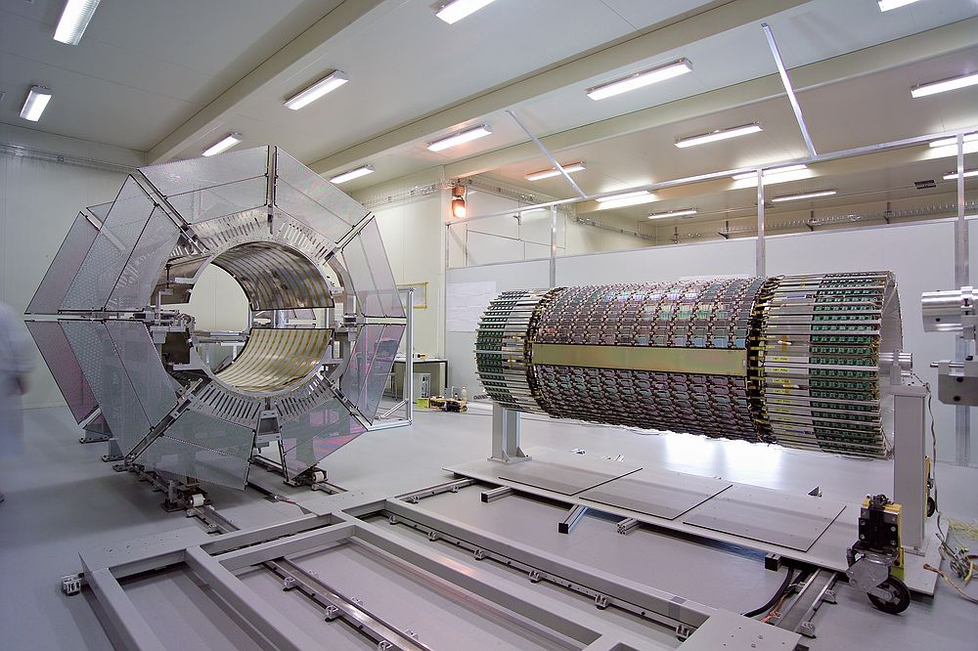
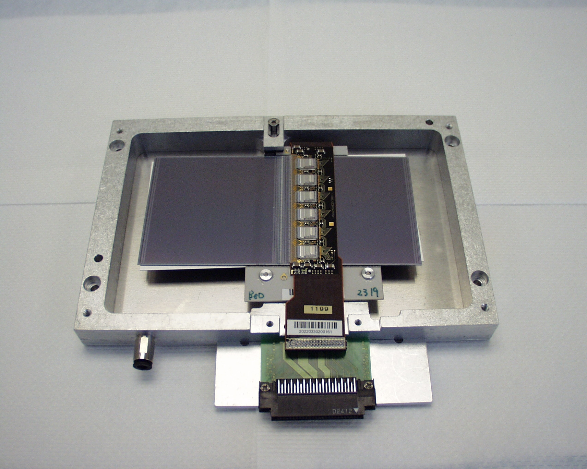
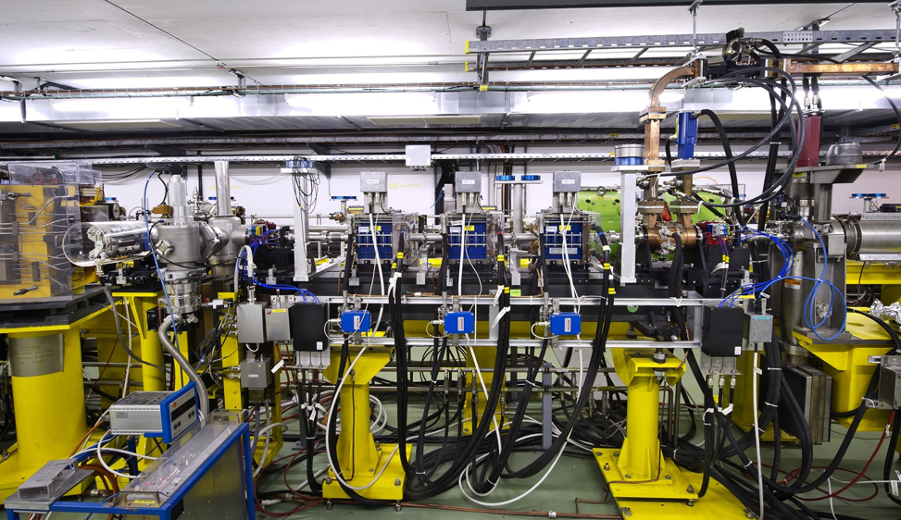
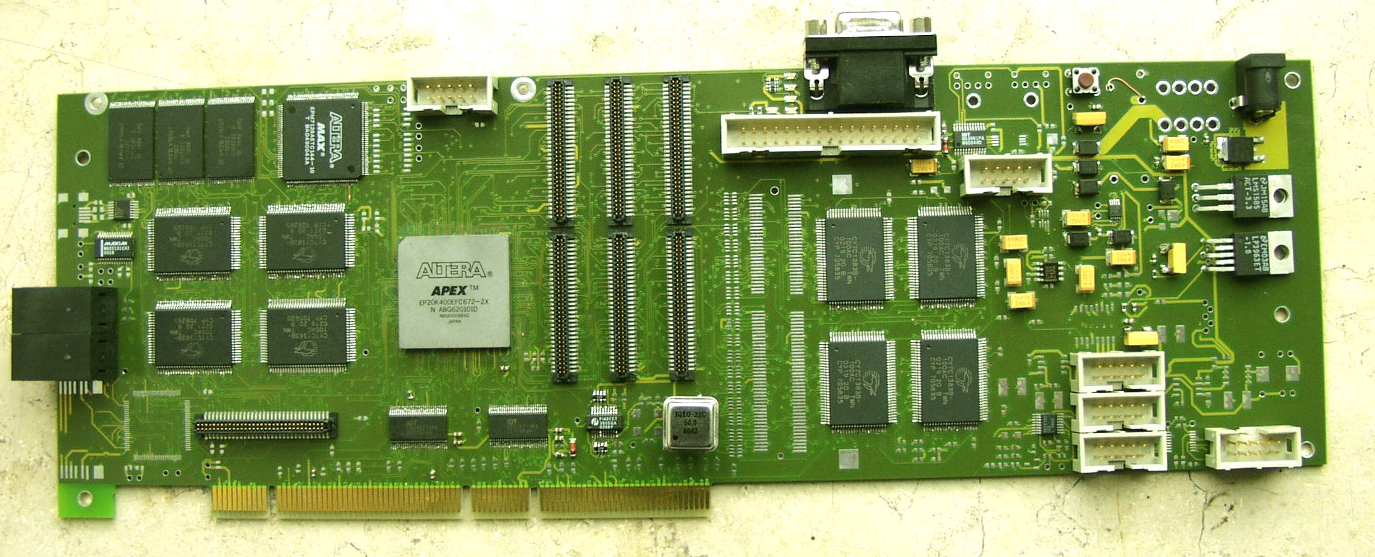
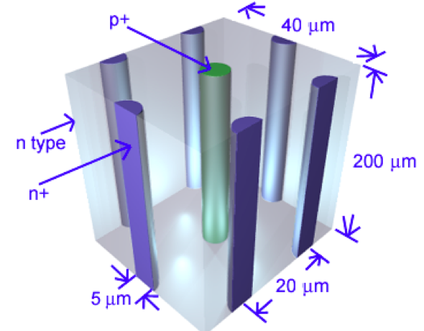
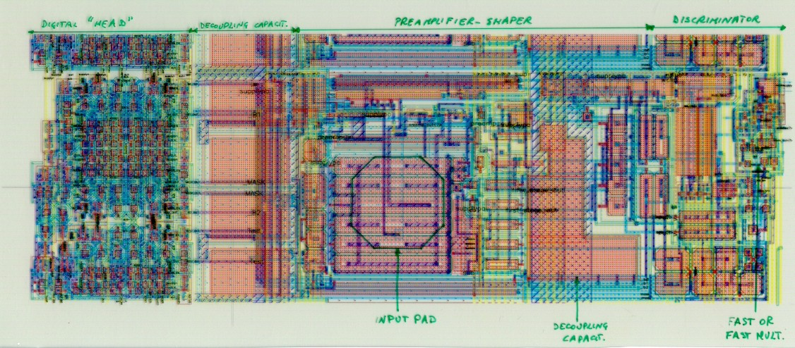

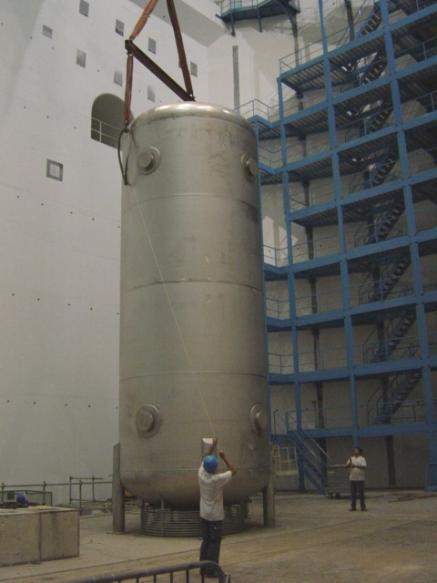

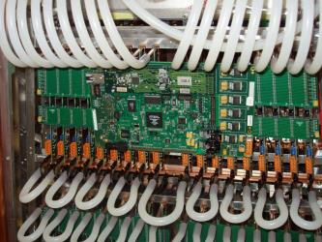
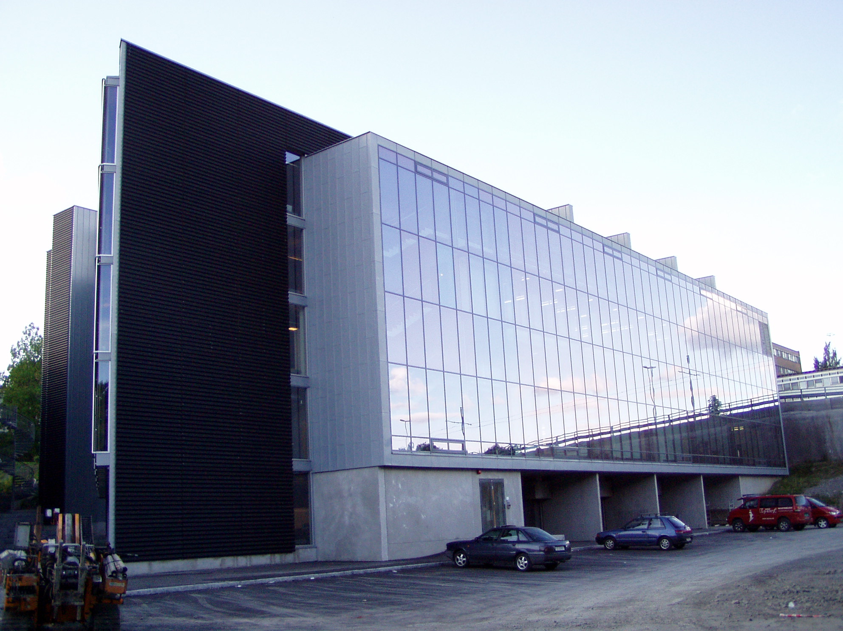
Norway and CERN
The major technology activities at CERN by Norwegian groups:
Construction of silicon modules for ATLAS (UiB, UiO)
PHOS detector readout for ALICE (UiB, UiO)
High Level Trigger development for ALICE (UiB, HiB, UiO)
Construction of cryogenics tanks for ATLAS (NTNU, UiO, Industry)
R&D work for future detector systems and LHC upgrades (UiO, UiB, SINTEF)
GRID development and deployment (UiO, HiB, UiB, computer centres)
CLIC, CLEAR and AWAKE accelerator studies (UiO)
Notes:
17

Slide 18
High Energy Physics in Norway
Blue: Oslo, Bergen, Trondheim: Traditional Universities involved at CERN – UiO, UiB dominates the experimental activities
Red plus NTNU: Main recruitment ground for technical and TTE students
Today around 120-140 Norwegian researchers, engineers, postdocs, PhD students, and master students are involved in the CERN activities:
  Around 90 Norwegian researchers (of all categories above) are registered as users travelling frequently to CERN
  The rest travelling are less frequently or working in Norway within the CERN related research programmes
  The Norwegians directly paid/supported by CERN come in addition

Slide 19
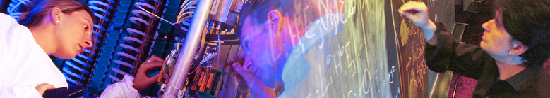

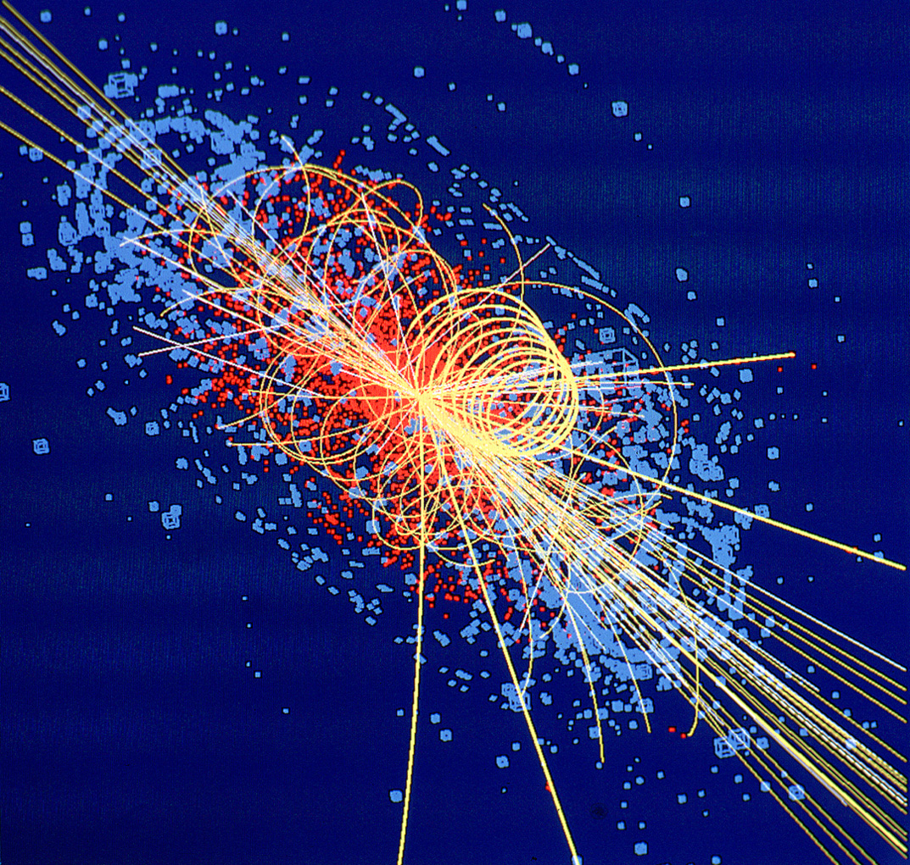
CERN: Particle Physics and Innovation
Interfacing between fundamental science and key technological developments
CERN Technologies and Innovation
Accelerating particle beams
Detecting particles
Large-scale computing (Grid)
Notes:
19

Slide 20
Total sales of accelerators is ~US$5B annually
About 47,000 systems have been sold,
> 40,000 still in operation today
More than 100 vendors worldwide are in the accelerator business.
Vendors are primarily in US, Europe and Japan, but growing in China, Russia and India
R. Hamm, Accelerator-Industry Co-Innovation Workshop, Feb 6, 2018, Brussels, Belgium

Slide 21
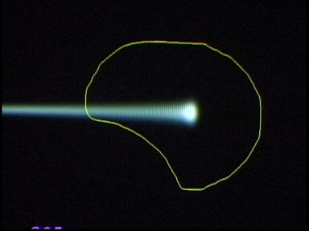
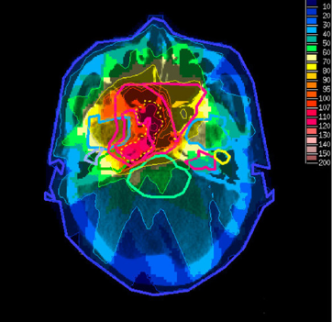
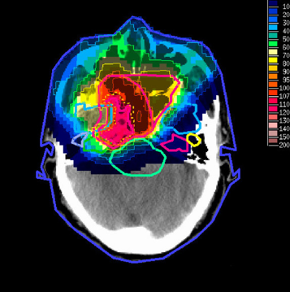
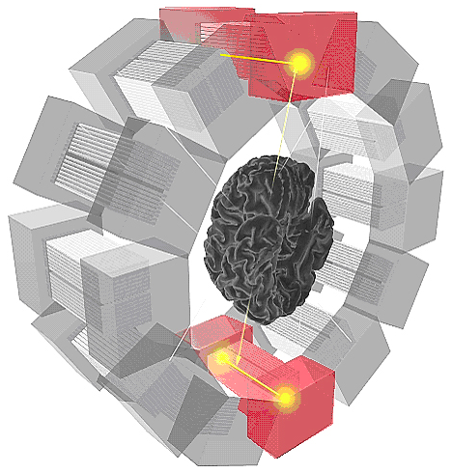
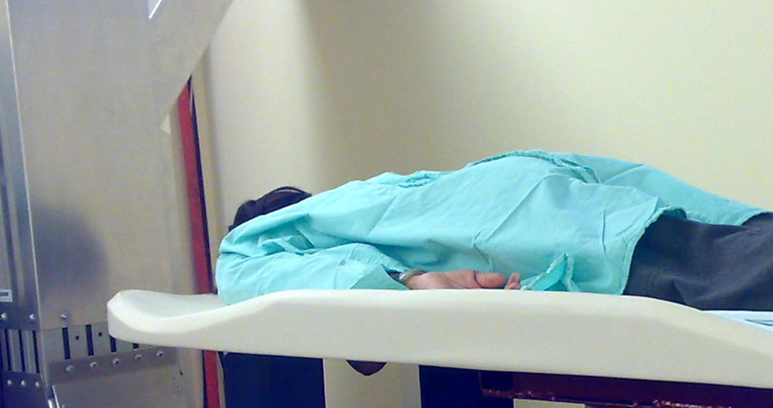
Medical Application as an Example of Particle Physics Spin-off
Combining Physics, ICT, Biology and Medicine to fight cancer
Hadron Therapy
Tumour Target
Leadership in Ion Beam Therapy now in Europe and Japan
Protons
light ions
Accelerating particle beams
~40’000 accelerators worldwide
~1/3 of them used for medicine
X-ray
protons
>100’000 patients treated worldwide (45 facilities)
>50’000 patients treated in Europe (14 facilities)
Imaging
PET Scanner
Clinical trial in Portugal, France and Italy for new breast imaging system (ClearPEM)
Detecting particles
Notes:
21

Slide 22
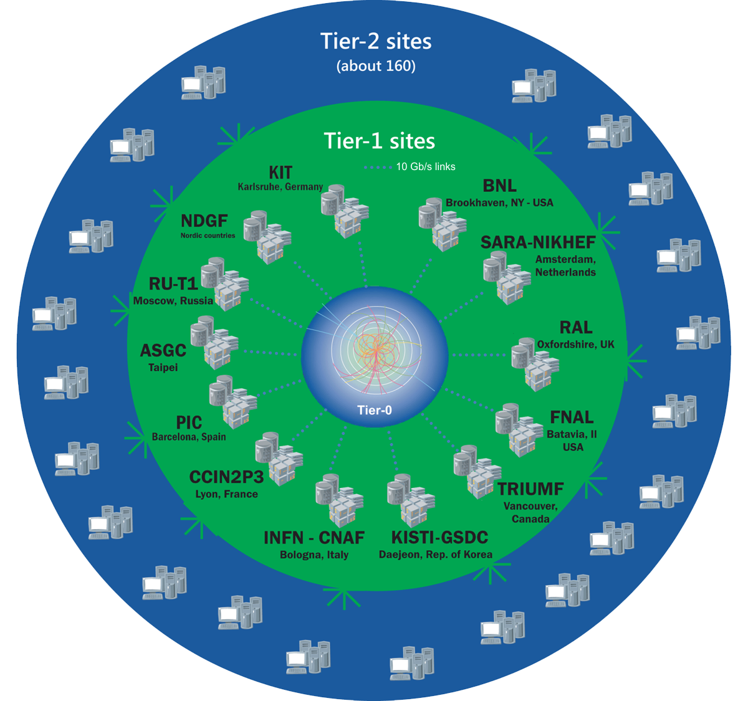
The Worldwide LHC Computing Grid
Tier-0
(CERN):
data recording, reconstruction and distribution
~ 170 sites in
> 40 countries
1 million CPU cores
1000 PB of storage
Tier-1: permanent storage, reprocessing,
analysis
> 2 million jobs/day
Tier-2: simulation,
end-user analysis
50 GB/s global transfers
WLCG:
An International collaboration to distribute and analyse LHC data
Integrates computer centres worldwide that provide computing and storage resource into a single infrastructure accessible by all LHC physicists

Slide 23
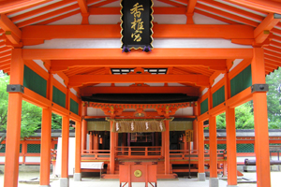
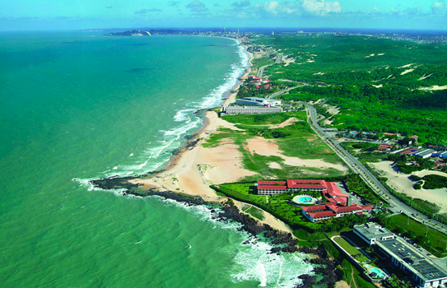
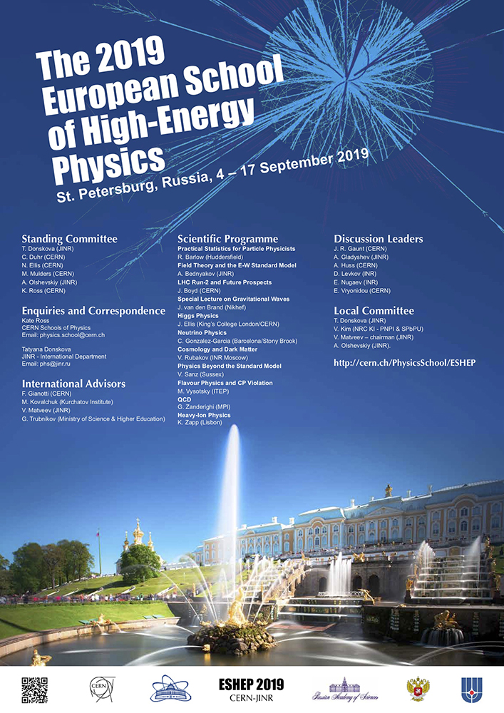
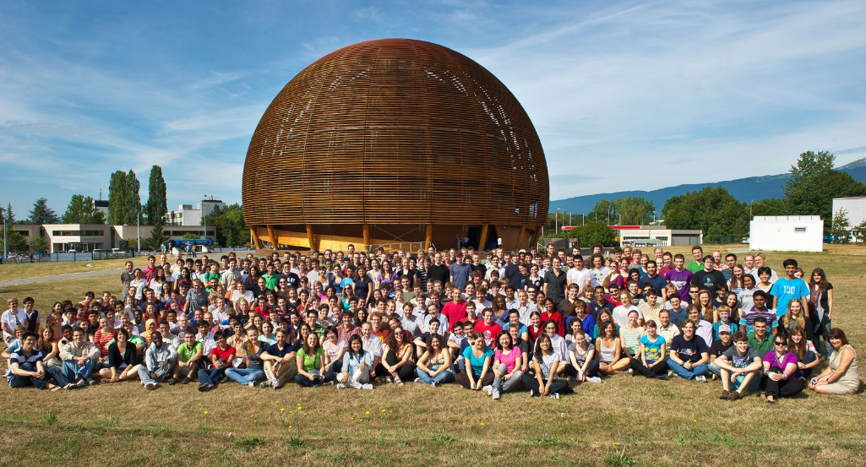
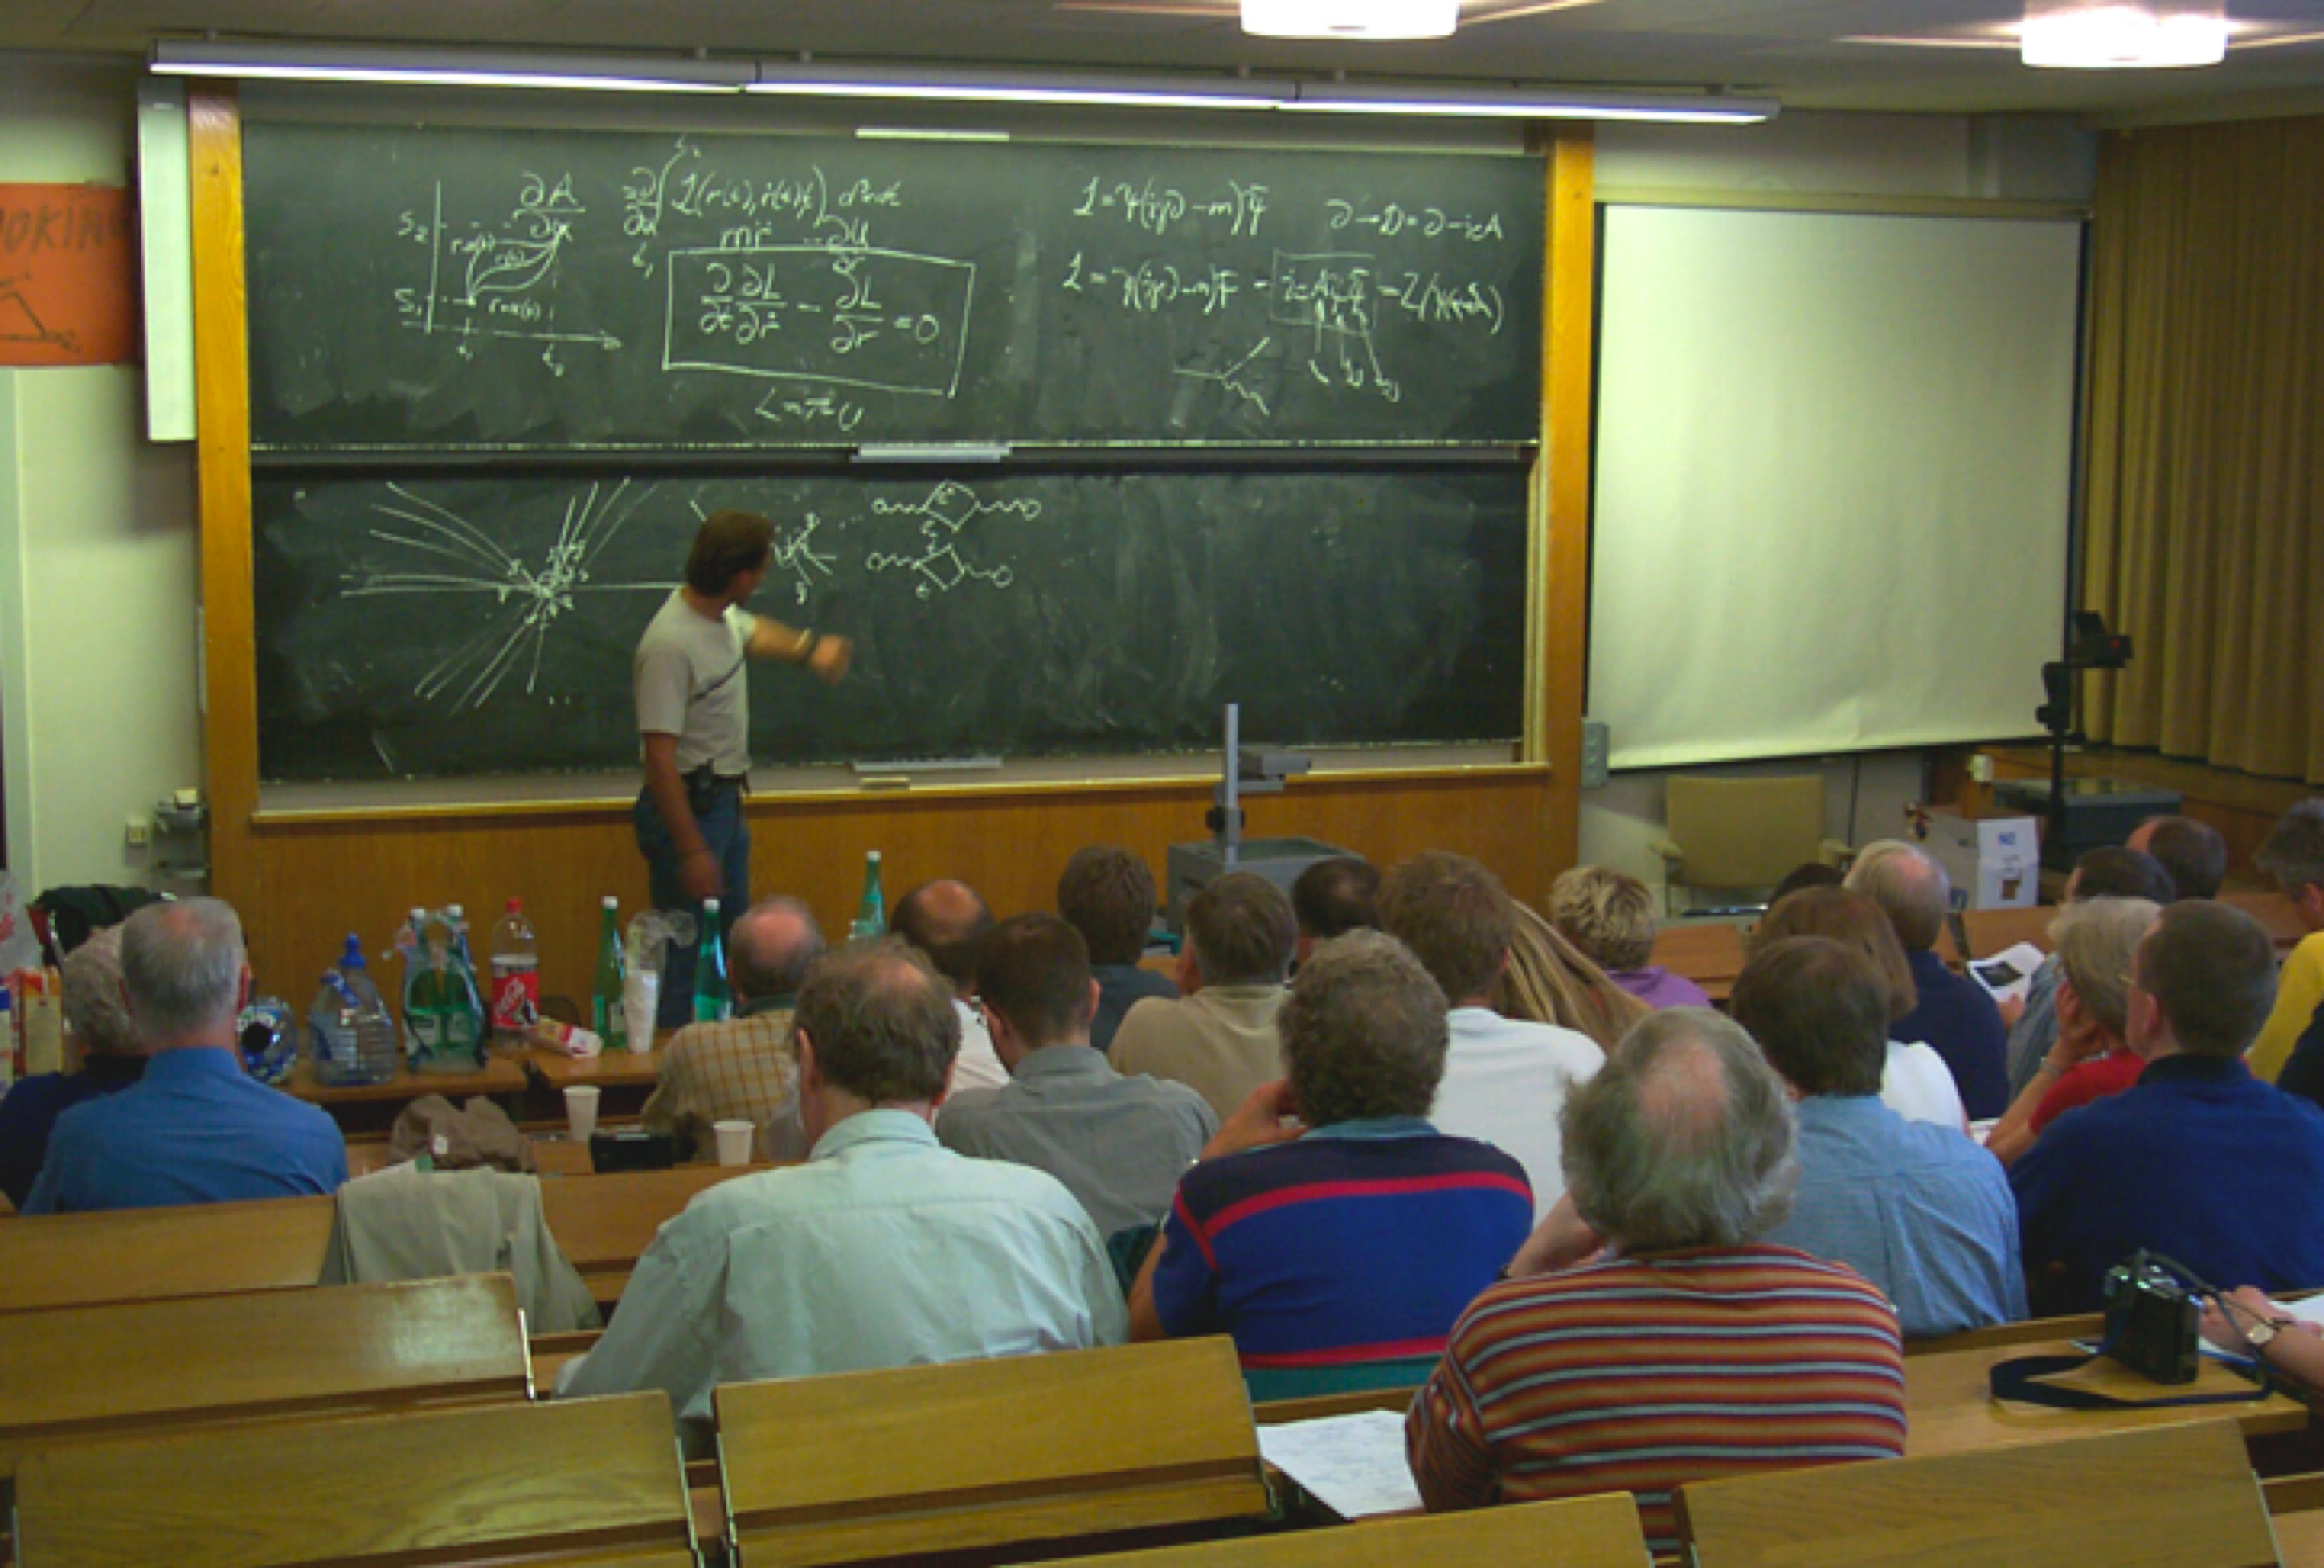
CERN Education Activities
Scientists at CERN
Academic Training Programme
Asia-Europe-Pacific School of High-Energy Physics
Fukuoka, Japan, 2012
Puri, India, 2014
2016 Beijing, China
2018 Quy Nhon, Vietnam
Latin American School of High-Energy Physics
Ibarra, Ecuador, 2015
San Juan del Rio, Mexico, 2017
Córdoba, Argentina 2019
Young Researchers
CERN School of High Energy Physics
CERN School of Computing
CERN Accelerator School
Undergraduates
Summer Students
Programme
CERN
School of Physics
Russia, September 2019
CERN Teacher Schools
International and National Programmes
Public visitors
150 thousand per year

Slide 24
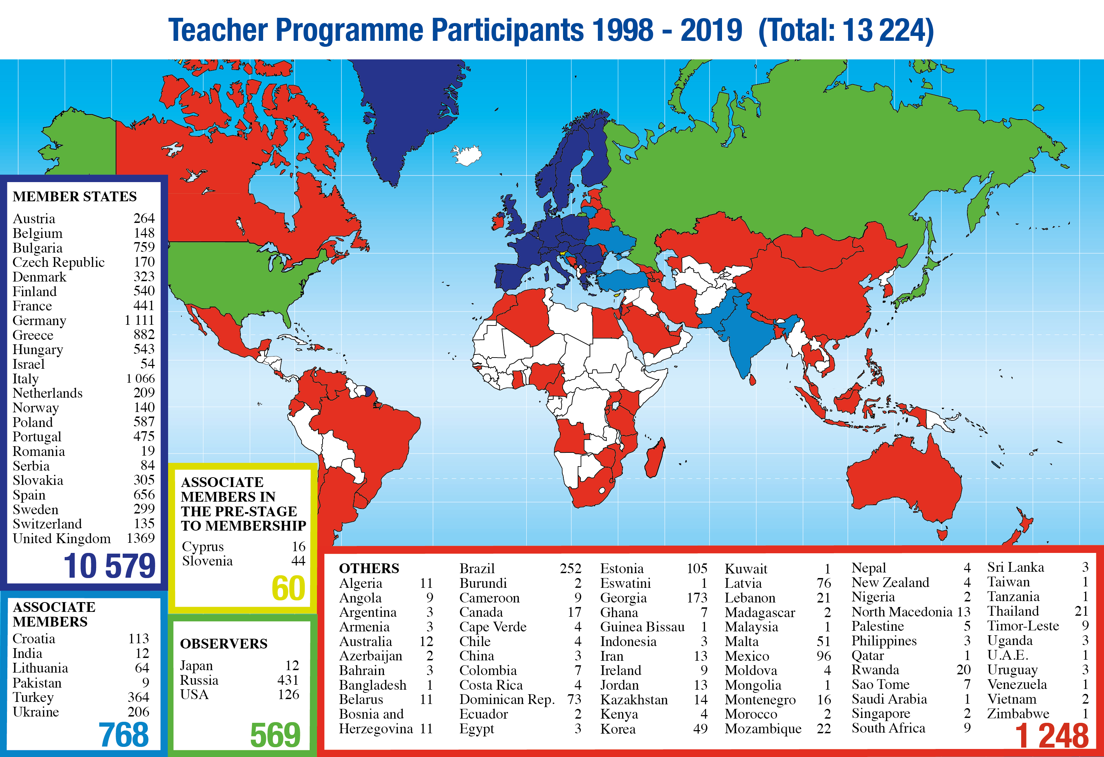
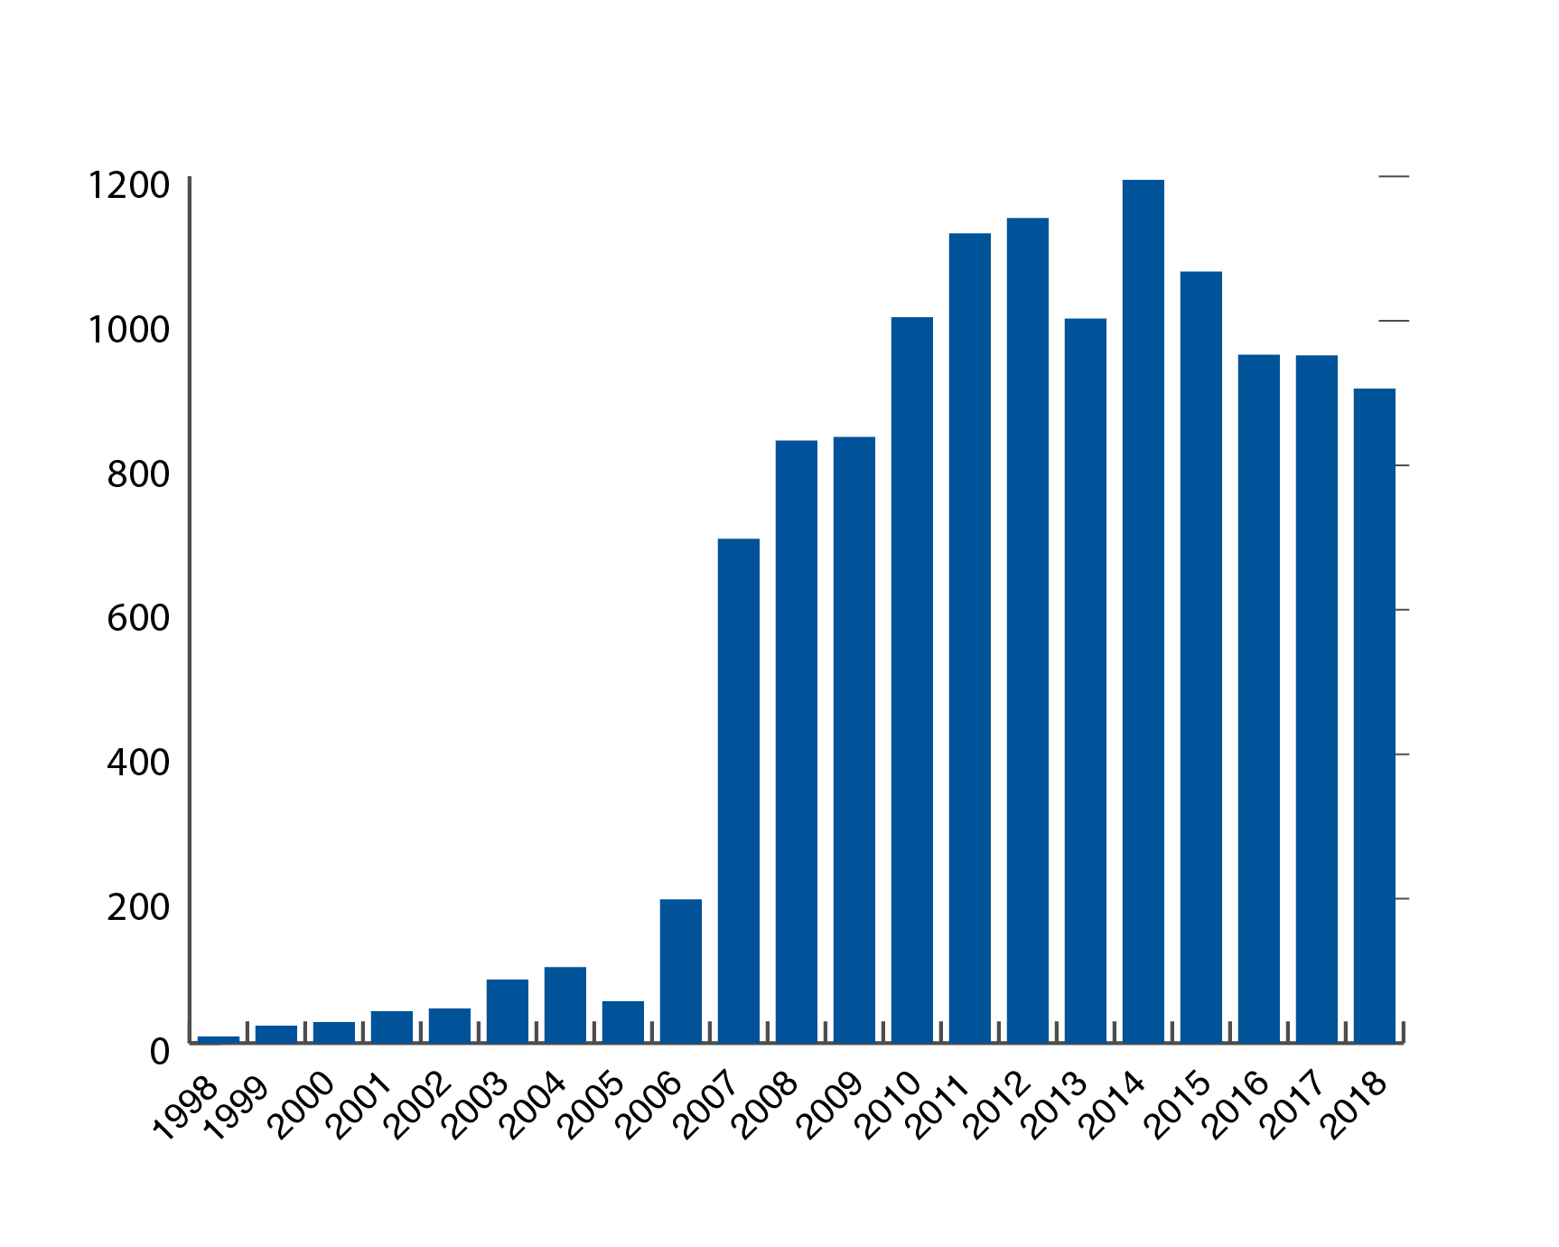
CERN Teacher Programme

Slide 25
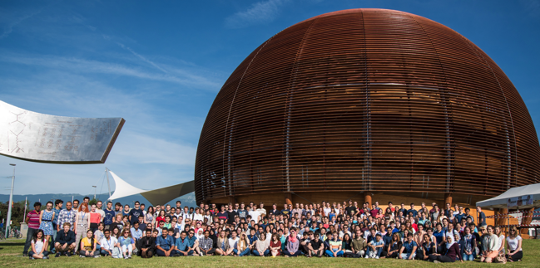
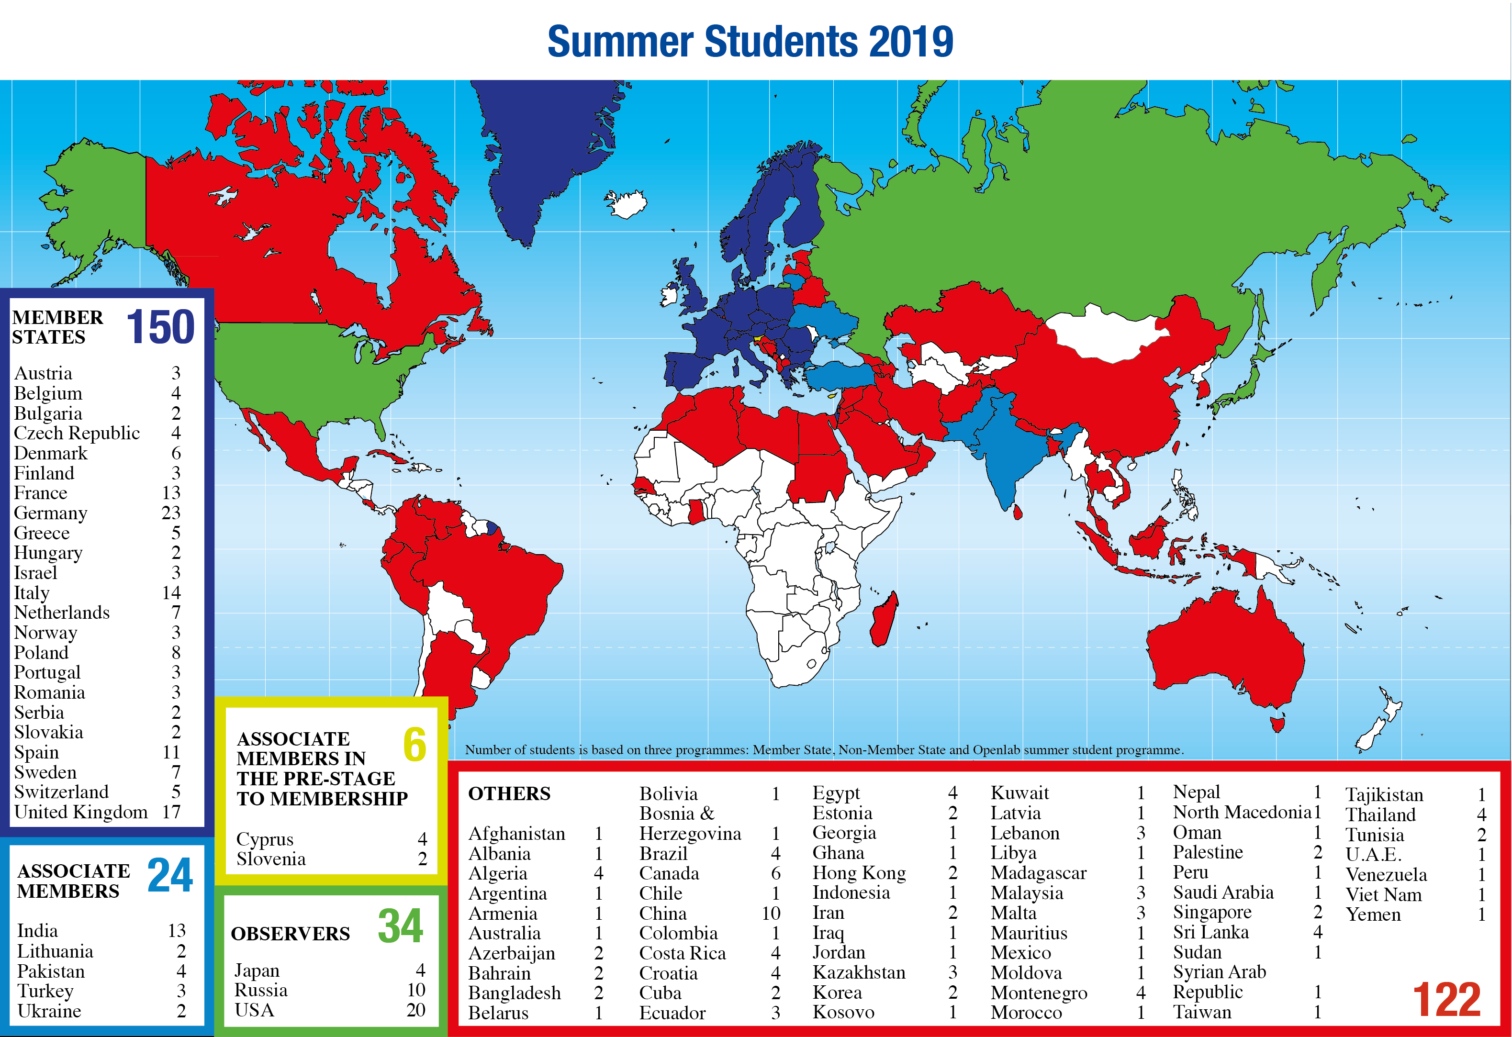
Summer Students 2019

Slide 26



TTE programme
Notes:
Haram har dominert norsk deltakelse ved TTE programmet, men gamle Ladejarlen skole i Trondheim (nå Byåsen VGS) er også en viktig aktør på dette feltet. Arne Sigvard er i dag på masterprogrammet ved NTNU mens Pål går på EPFL.

Slide 27
UiA
Have used and continue to use Technical Student programme (individuals or strategic)
Now member of the CMS collaboration – identify key areas of collaboration

Slide 28
Thank you!
Mange takk!
Accelerating Science and Innovation
Notes:
28

Slide 29

Safety Information for Visitors
Safety is our highest priority
We are confident that you have read the Safety Information provided prior
to the visit and ask that you take the time to read the document placed
in front of you once more before embarking on the site visit.
By taking part in the site visit you are deemed to have understood and accepted the Safety Information provided to you.
Please always follow the instructions given by your guide
and do not hesitate to ask if you have any questions.

