Slide 1
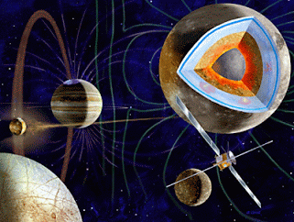
Persistency of Geant4 Phase-Space Information for Radiation Effects and Instrument Background Analysis
Pete Truscott, Fan Lei, Sergio Ibarmia Huete, Valentina Fioretti, Simone Lotti, Andrea Bulgarelli, Giovanni Santin, Marco Vuolo
Kallisto Consultancy (UK), RadMod Research (UK), INTA (ES), INAF (IT), ESA ESTEC/Rhea (NL)
Geant4 Space Users Workshop, Sikyon Coast Hotel, Sykia, Greece , 21st October 2019
Original work sponsored by ESA Contracts 4000108668/13/NL/MV (CIRSOS Project) and 4000116655/16/NL/BW (AREMBES), with some ideas drawn from 4000111684/14/NL/AK (GTREFF) [led by RadMod Research, INAF and TRAD]

Slide 2
Outline
Two-stage / multi-stage Geant4 simulations (CIRSOS)
Use of phase space data retention for non-Geant4 post-processing (AREMBES)
Lessons learned, discussion and recommendations
Some random thoughts based on experiences with implementing phase-space information retention in GRAS …

Slide 3
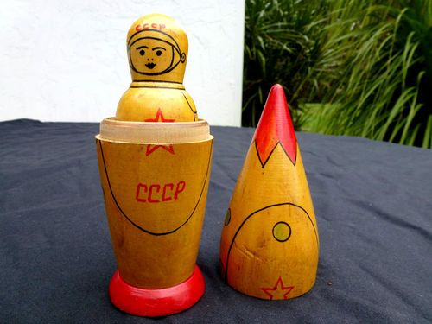
2-Stage / Multi-Stage Analysis (“Matryoshka”)
Environment information needed by collaborators and subsystem developers
Often defined using 6-faces sector shielding approach (e.g. commercial COMSAT)
Greater detail required without needing to pass on full spacecraft design or component-level design to commercial competitors
2-stage / multi-stage Geant4 simulation:
Transport particles to surfaces of equipment boxes
Store the phase-space information
Use subsequent simulation to resample the particles too sub-box/board/component level
Improve statistics of simulations at component levels

Slide 4
Basic Modules for 2-Stage Analysis in GRAS
Stage 1:
GRASTwoStage DetectManager
(singleton)
GRASTwoStage BiasingOperator
G4VBiasingOperator
(Associated with G4LV)
GRASTwoStage BiasingOperation
G4VBiasingOperation
Persistency (ROOT, CSV or CSV-”zip”)
(Function performed on particle which strike volume)
GRASVPhase SpaceFile
Stage 2:
GRASTwoStage SourceManager
(singleton)
GRASTwoStage ParticleSource
(Associated with volume[s])

Slide 5
Key Features
Stage 1:
Several Bias Operators can be created and allocated to one or more Phase-space files
Each Bias Operator associated with one or more detection G4Logical volumes
Particles are killed outright at surface (may introduce Russian Roulette in future developments)
ROOT, CSV or compressed-CSV file outputs
Specify by PV, but bias operation applied to LV
/gras/twoStage/detect/addModule mod1
/gras/twoStage/detect/mod1/selectVolume v1_out_PV
/gras/twoStage/detect/mod1/selectVolume v2_out_PV 1
/gras/twoStage/detect/addPSFile PSFile1 test_mod1.csv CSV
/gras/twoStage/detect/mod1/setPSFile PSFile1
/gras/twoStage/detect/PSFile1/dumpInterval 1000
/gras/twoStage/detect/addModule mod2
/gras/twoStage/detect/mod2/selectVolume v3_out_PV

Slide 6
Key Features
Stage 2:
Can apply splitting to each event in the 1st stage simulation
To augment splitting there, there are options to “dither” position and angle of particles
Can record events striking sub-volumes: 3-stage analysis, etc
Full management of normalisation back to original number of events in Stage 1
/gras/twoStage/source/selectPSFile PSFile1 test_mod1.csv CSV /gras/twoStage/source/selectPSFile PSFile2 test_mod2.root ROOT
/gras/twoStage/source/addSource sourceVol1 PSFile1 v1_out_PV 0
/gras/twoStage/source/PSFile1/split 10 1 true true 1
/gras/twoStage/source/sourceVol1/resample/position UNIFORM 1.0 cm
/gras/twoStage/source/addSource sourceVol2 PSFile2 v3_out_PV 0
/gras/twoStage/source/sourceVol2/targetVolume v2_out_PV 0
/gras/twoStage/source/sourceVol2/resample/angle uniform 5.0 deg
/gras/twoStage/source/sourceVol2/resample/grid 5 5 5

Slide 7
“Dithering” Options for Position and Angle
/gras/twoStage/source/<source_module>/resample/grid 3 4 2
Position “dither” on grid (for G4Box, G4Tubs and G4Sphere):
Position “dither” around point of entry (any volume type)
Angle “dither” Uniformly sampled in solid angle within a cone of half-angle, α, defined by the user
x
y
original
r
α
resampled

Slide 8
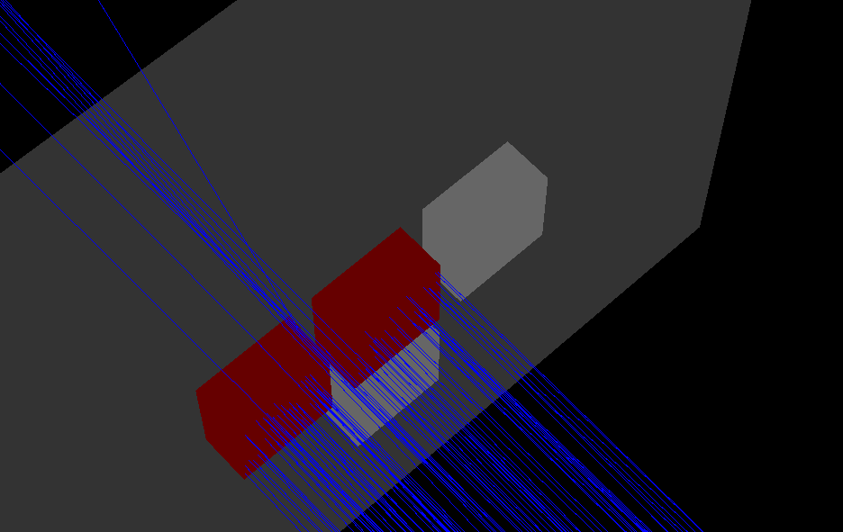
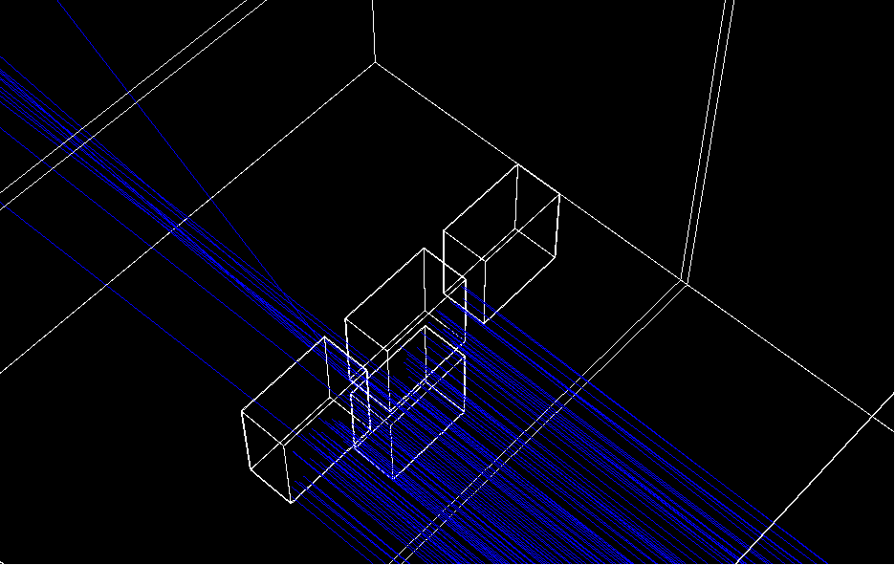
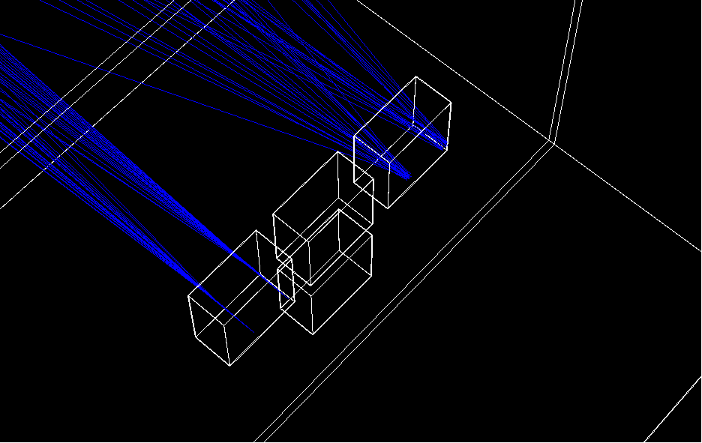
Example 1st Stage simulation: Four electronics boxes (200mm × 200mm × 100mm) mounted on plate in satellite. Two of these (in red) are irradiated. In solid (A) and wireframe representation (B).
(A)
(B)
(C)
(C): Example 2nd Stage simulation: The source is generated on one of the original red volumes with no position nor angular “dithering”, but split (samples=20). The source is also used for one of the PVs irradiated in the first stage: grid resampling (gridded in 10x10x10), and angular dither with α=15º, samples=20. Only 2 of the original 1st stage events are used for each PV

Slide 9
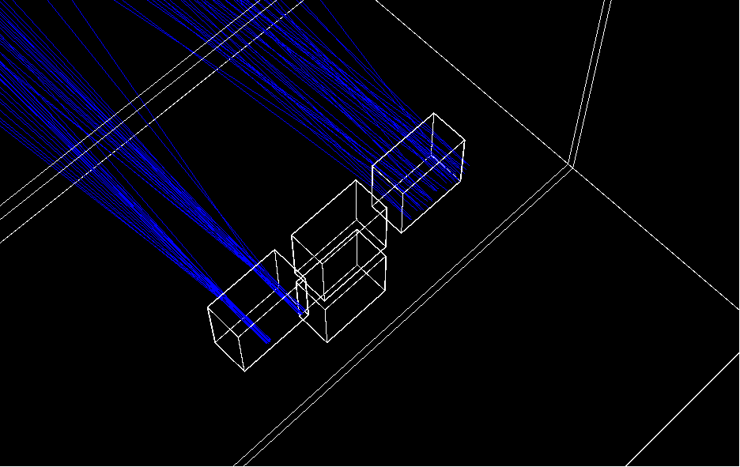
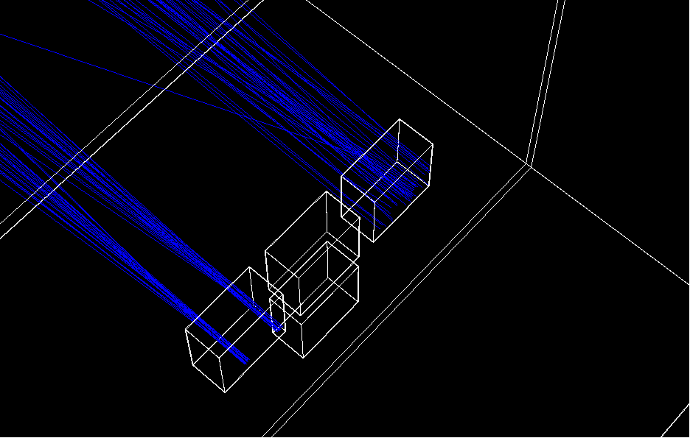
(A)
Example of 2nd stage simulation: 2 1st-stage events are sampled 20 times (samples=20). For left box , events are sampled uniformly over disc radius 1cm, no angular dithering. Right box, events are sampled uniformly over disc radius 7cm, with α=5º angular dithering.
Sampling conditions and acceptance/ rejection criteria for the sampled particle are different
(B)

Slide 10
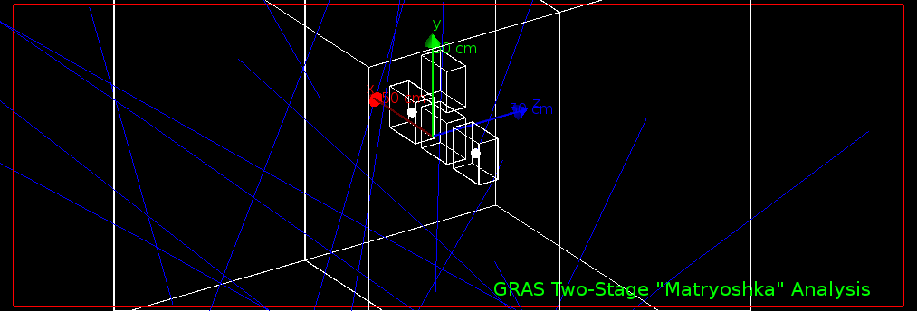
Example
Test case with 2cm radius Si spheres, 50 MeV protons isotropic
(1.44 ± 0.10) x10⁻¹² rad(Si)/event (conventional)
(1.41 ± 0.02) x10⁻¹² rad(Si)/event (2-stage with splitting)

Slide 11
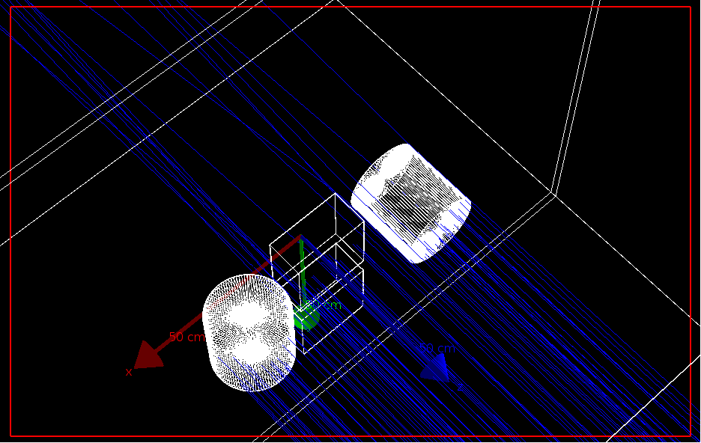
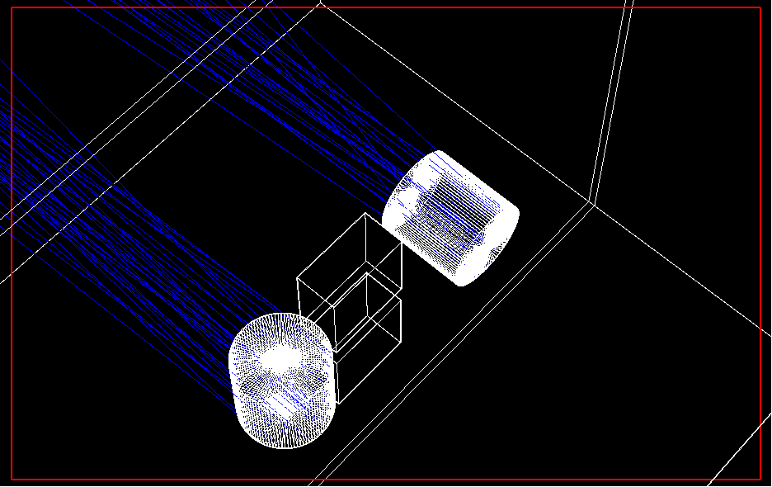
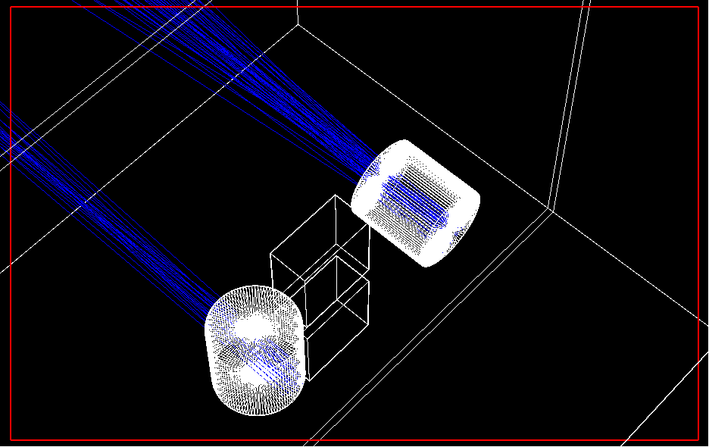
(A)
(B)
(C)
As with previous examples, but systems two enclosures are cylindrical.
(A) 1st stage simulation with particle stopping on enclosures.
(B) 2nd stage simulation, no splitting (samples=1) and position resampled on uniform disc radius 4cm (left cyl) and using grid resampling (right cyl). Right cyl also includes α=5º angular dithering
(C) Same as for (B), but with samples=20, and only first 3 events from 1st stage simulation shown.

Slide 12
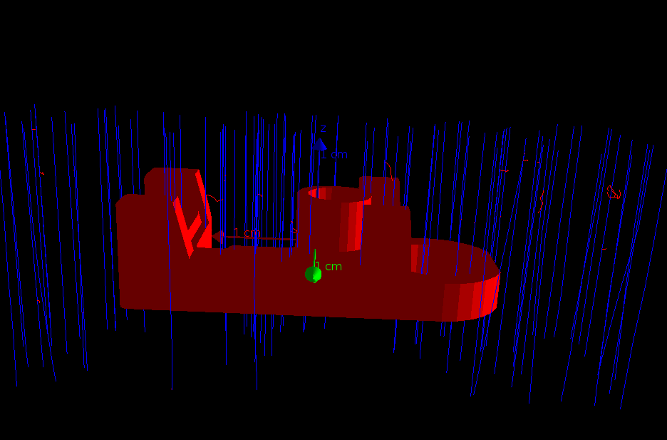
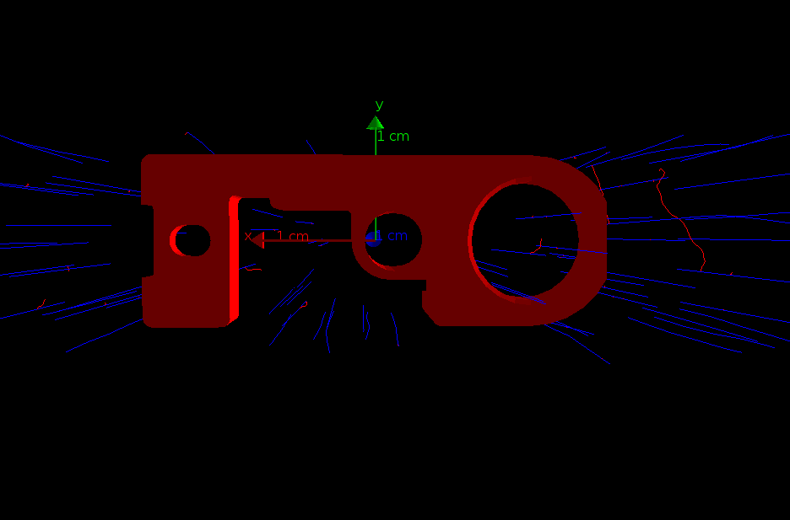
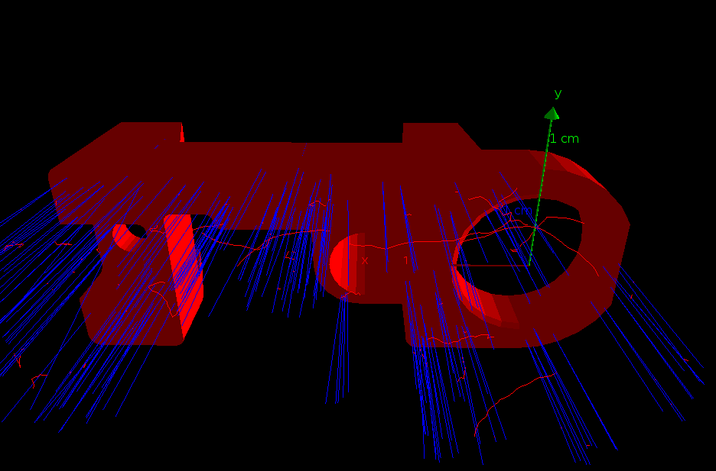
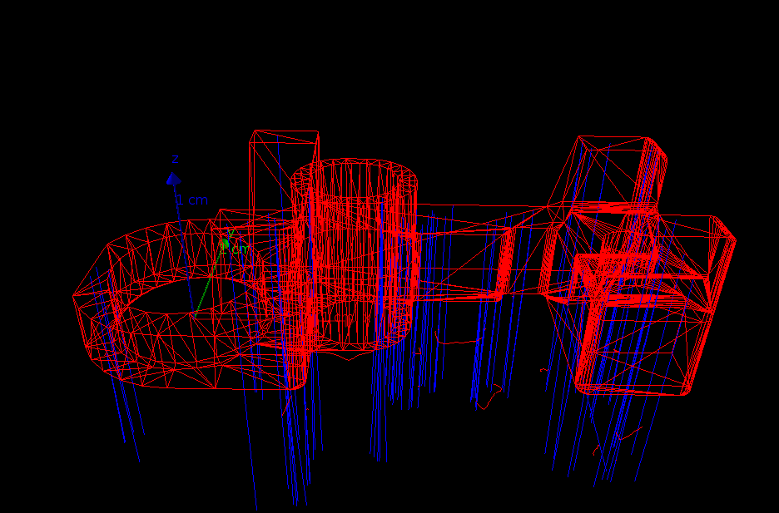
Example Two Stage simulation for arbitrary Al geometry in air irradiated in –z-direction by protons. (A) & (B) 1st stage simulation. (C) and (D) 2nd stage simulation, with each 1st-stage event split into 5, and uniform repositioning within a disc radius 2mm.
(A)
(B)
(C)
(D)

Slide 13
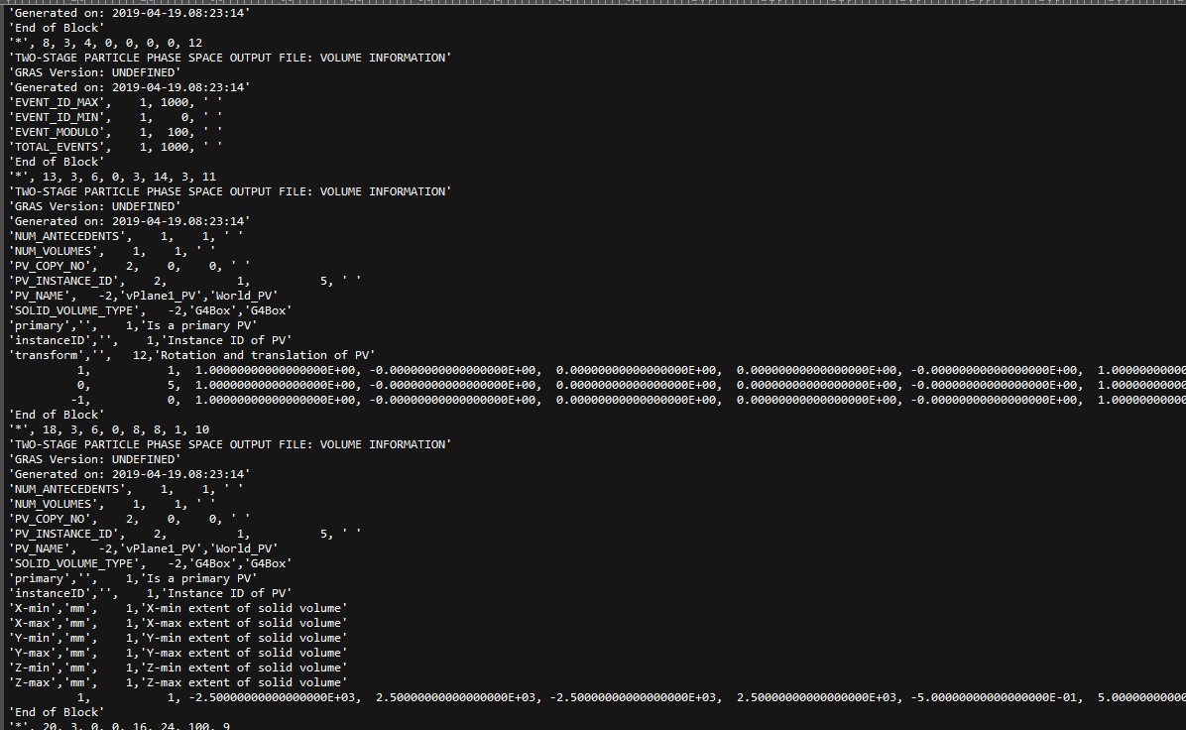
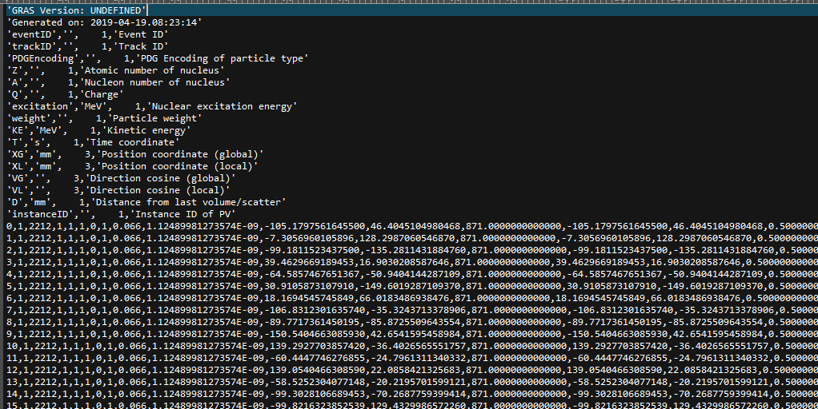
Phase Space File Example Output (CSV)

Slide 14
Phase Space Files
Output file formats currently root, CSV and Qt-compressed CSV
Note
Qt compress each CSV block first before writing - result not compatible with other general zip utilities
ROOT PS files appear to have slightly better compression ≅ ×6.3 over CSV files compared with Qt-compressed files ≅ ×5.5 for the same events
Generic interface to base Phase-Space Classes which can be easily extended to other file-types which implement serialisation of classes (e.g. HDF5, Python Pickle)
File can be passed – with primary particle numbers – to subsystem contractor or instrument designer

Slide 15
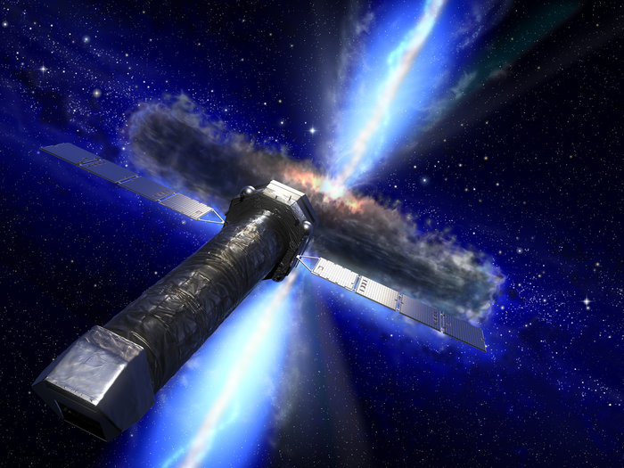
Phase-Space Data Retention for AREMBES Project
Requirement to produce FITS format file with phase space data
3D grid of pixel-type detectors
Post-process the data to examine effects of different background reduction methods
Required more detailed PS info:
eventID, trackID, stepID, iVertex, particleID
particleName, PDGEncoding, Z, A, Q, excitation
Statistical weight, KE, time, global & local position, global momentum
Edep in current volume
Process which created particle
Parent trackID
PV name, instance # and copy #
Mother PV name, instance # and copy #
All primary particle details
True analysis application, not Variance Reduction

Slide 16
Data Storage and Commands
Data are first recorded by GRAS into a ROOT file
Uses GRAS Histo classes to store as tuples of int, double and std::strings
Converter to translate ROOT PS data into one or more FITS files
Some are post-processing using FITS, some using ROOT scripts
Simple macro instruction format:
/gras/analysis/PSTrack/addModule PST1
/gras/analysis/PSTrack/PST1/addVolume vSiDetectors1_PV -1
/gras/analysis/PSTrack/PST1/addVolume vScintillators1_PV -1
/gras/analysis/PSTrack/PST1/minEvent 0
/gras/analysis/PSTrack/PST1/maxEvent 10000
/gras/analysis/PSTrack/PST1/stepLength vSiDetectors1_PV 100.0 nm
/gras/analysis/PSTrack/addModule PST2
/gras/analysis/PSTrack/PST2/addVolume vSiDetectors2_PV -1
/gras/analysis/PSTrack/PST2/minEvent 3000
/gras/analysis/PSTrack/PST2/maxEvent 8000
/gras/analysis/PSTrack/PST2/saveModulo 2000
/gras/analysis/PSTrack/PST2/stepLength vSiDetectors2_PV 1.0 km

Slide 17
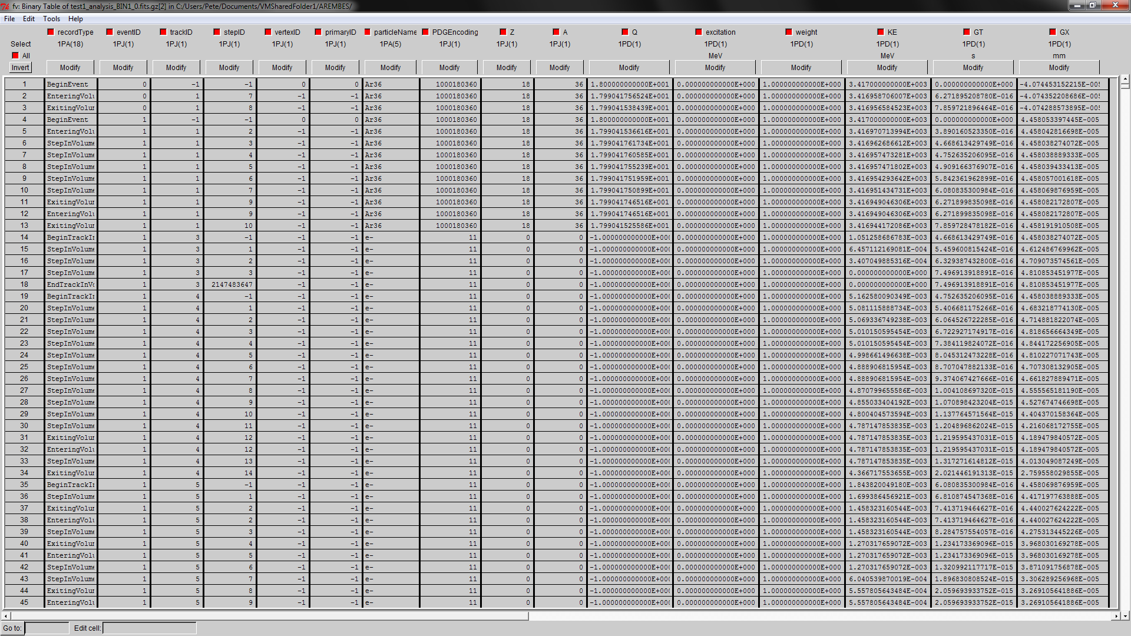
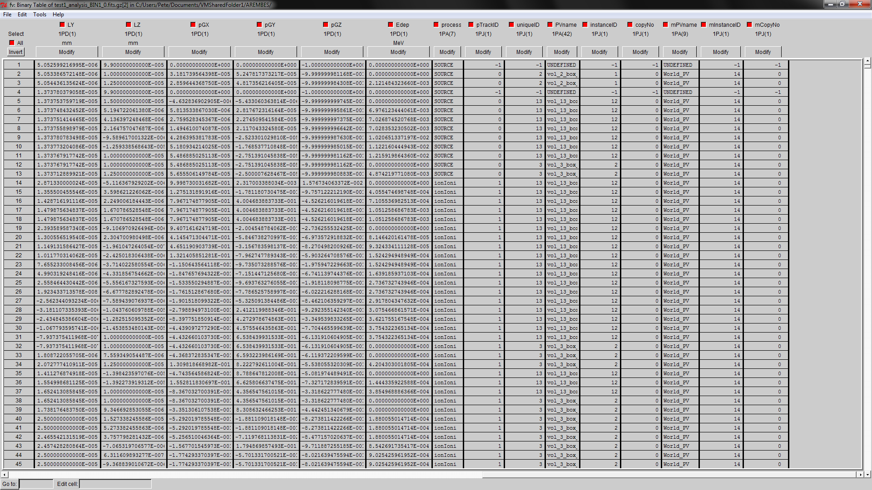
Example Output in FITS File Viewer

Slide 18
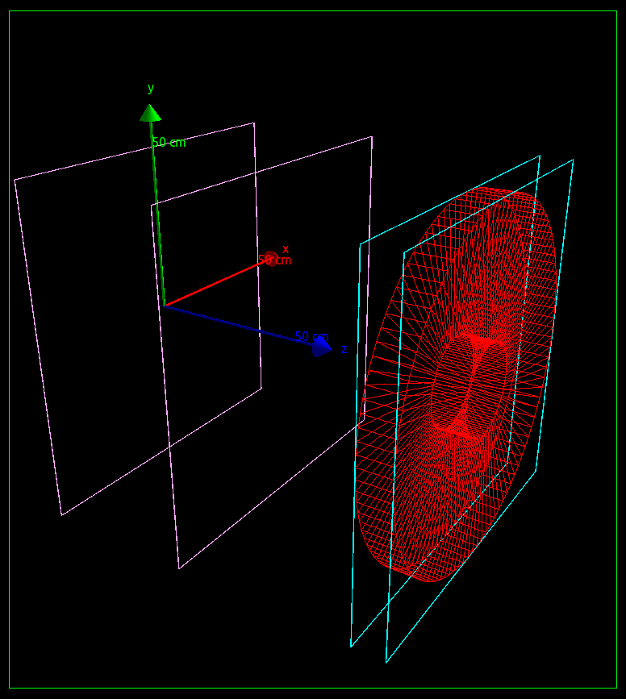
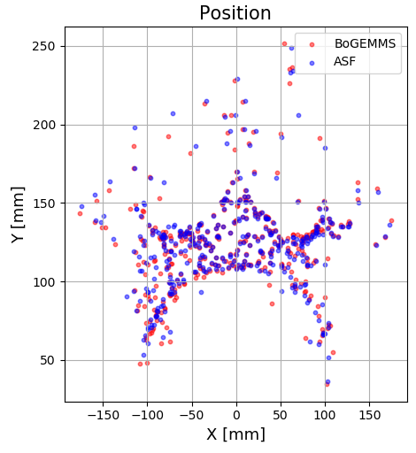
Effectiveness of Magnetic Deflector in ATHENA
66 keV protons scattered through ATHENA mirrors, collimated by annular shield (red) then deflected by shielding magnet (plot courtesy of Valentina Fioretti)
Plot compares BoGEMMS and AREMBES Simulation Framework results (latter using GRAS PSTrack analysis)

Slide 19
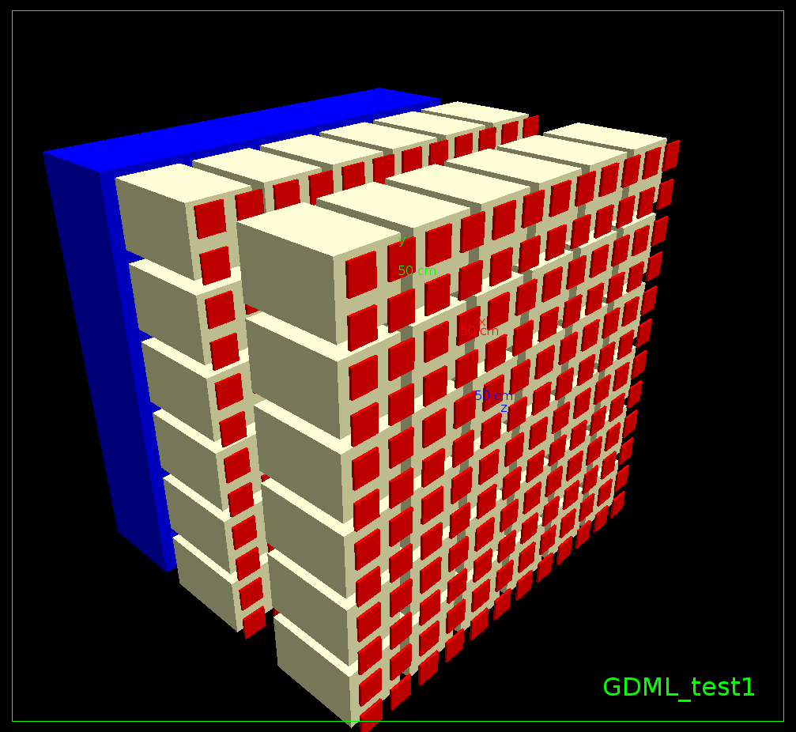
Lessons Learned – Unique volume identification
Name and copy # of PV and parent PV do not uniquely identify volumes
Problem for 3D parametrised volumes or cases where volume names reused by the user
Inherent G4 problem including in GRAS for analysis
GRASGeometryHierarchy and GRASGeometryHierarchyNode created
Scans hierarchy of complete geometry structure
Allows unique identification of a volume within a G4 geometry, and associated tag is stored in PS file
Need to transplant the use of these methods back into other GRASAnalysisModule classes

Slide 20
Lessons Learned / Discussion
“Whoa! The files are too big!!”
Flexible format to include only those parameters needed for post-processing
Combine GRAS 2-stage and PSTrack functions into consistent but flexible file format
Need to introduce possibility to kill particles in analysis or create analysis/bias overlap?
Response function design (idea of Giovanni Santin / Martina Giraudo)
Save PS results for each primary and a specific input spectrum
Resample results of simulation for different primary spectra
ROOT file interface for GRAS (Histo.cc) should be updated with improved/more-flexible design
Need to consider wider range of output files types for PS persistency (HDF5, Python object files [Pickle], etc) which may be used for post-processing

Slide 21
Summary & General Recommendations
The conventional IAEA PS file definition is often too restrictive - better to seek more flexible approach to record PS information
2-Stage Analysis developed for ESA CIRSOS Project in GRAS application
Easily to:
Record boundary-crossing events from one simulation
Retrieve the events
Displace to the same or another volume(s)
Split and/or perturb (“dither”) in space and angle
GRAS analysis class GRASPSTrackModule implements facilities to record PS information to ROOT and FITS files
Used for repeated post-processing e.g. to optimise instrument settings
Are some of these techniques/principles more generally useful within Geant4 toolkit, as a combined phase-space persistency option?

