Slide 1

GHM/GLM Consolidation Project
ISOLDE Hall – Building 170

Slide 2
Activities on GHM/GLM beam lines
Regular collection and handling of unsealed radioactive sources at the GLM and GHM beam lines
About 10/15 experiments per year; average time per experiment is about one week
Sample holder in the chamber
Implantation
Samples taken from the chamber
Shielded fume hood to sort the samples

Slide 3
Why a consolidation project?
These activities > 1 LA should be done in Work Sector Type C
ISOLDE Hall is classified as such, but it is not fully compliant with Swiss ordinances
Visit from OFSP in 2016 pointed out the weak points of this area
Risk of coactivity with visitors and the other experiments present in the hall
Risk of contamination and radiation in the surrounding of the working area
Ergonomics to be improved

Slide 4
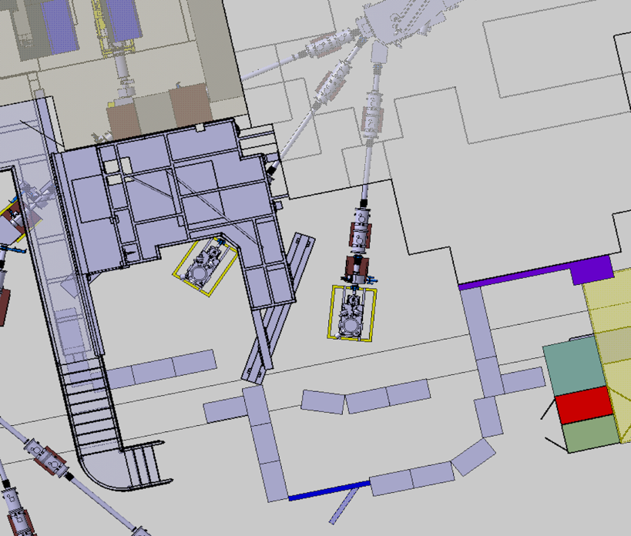
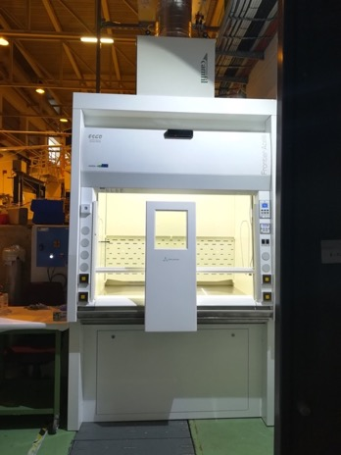
Current layout of GHM and GLM
Fume hood
GLM
GHM
Conform fume hood already implemented in 2018

Slide 5
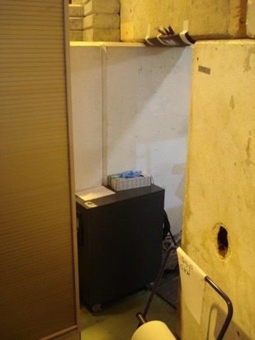
Main expected improvements
Improve delimitation of the zone (lack of fully closed perimeter, no access control)
  Specific PPE might be required
  Classification as Limited Stay Controlled Area (IMPACT, DMC)
Improve ergonomics of the zone (narrow working spaces and not easy access)
160 cm

Slide 6
Consolidation project
“Isolate” the collection and handling activities to protect the surrounding area (other experiments, visitors): fixed perimeter plus shielding blocks
Increase the working space inside the area (no permanent working area, only temporary activities)
Enclose activities (GHM, GLM plus the fume hood) with highest contamination risk in a specific, safe, access controlled area, classified as Limited Stay and Work Sector Type C

Slide 7
Consolidation project
Perimeter barriers: poles every 1.5 m, plates between two poles (possibility to open the perimeter)
Door with access control system (reading IMPACT + Training)
Local shielding for the collection chambers and a general shielding of the area (concrete blocks)
Installation of:

Slide 8
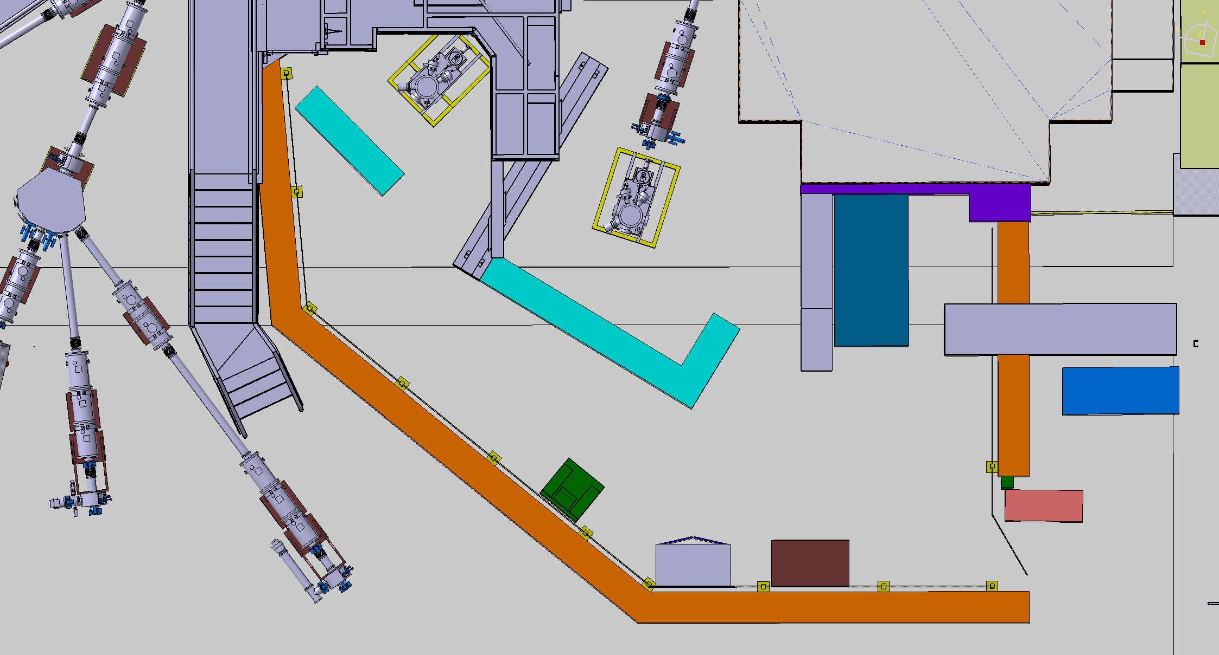
Proposed layout of the area
GLM
GHM
Fume hood
Metallic plates (decontamination)
Floor painting (decontamination)
Concrete blocks
Hand and foot monitor
Door with access control

Slide 9
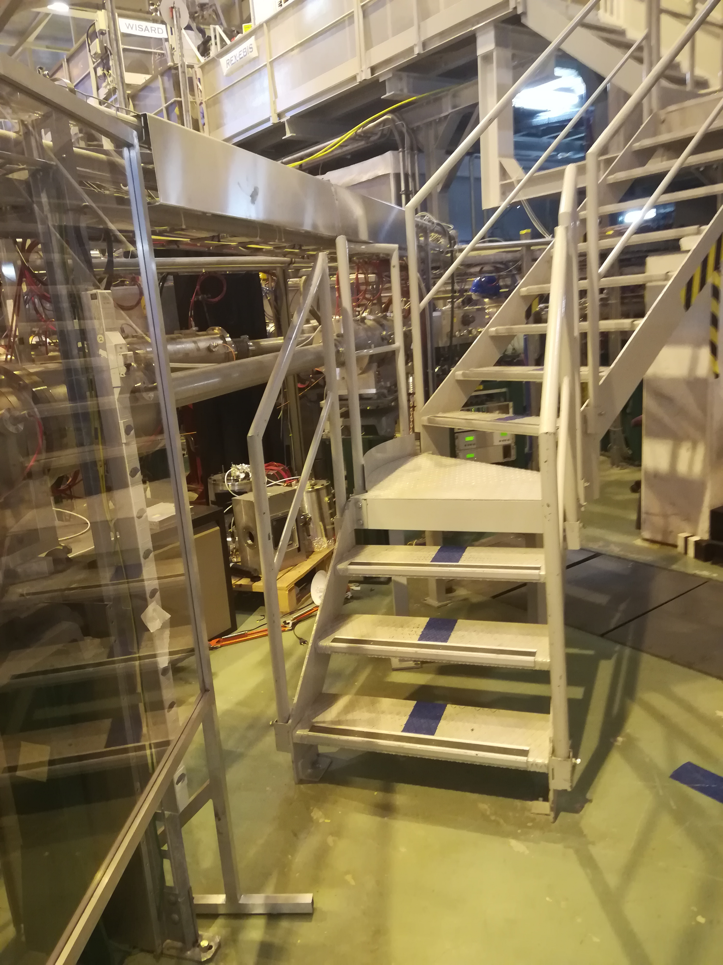
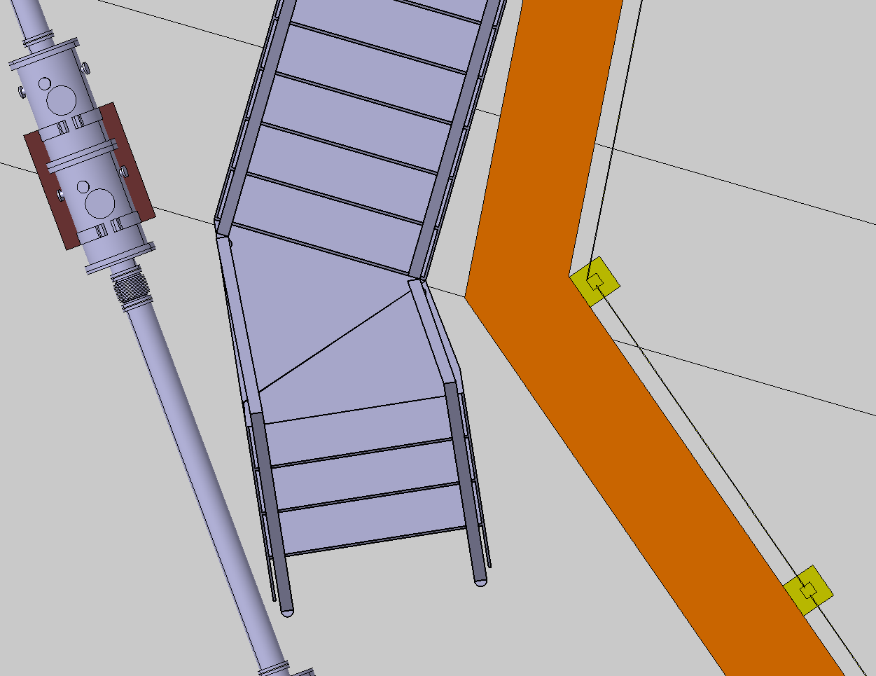
The new stairs

Slide 10
Conclusion
ISOLDE Hall has numerous and various activities (multiple experiments, visits)
A consolidation project for the GHM/GLM area (higher radiation and contamination risks) is necessary
“Compromise” between the Swiss ordinance and the feasibility on site/budget available for the moment

