Slide 1
Ayesha
By Ayesha

Slide 2
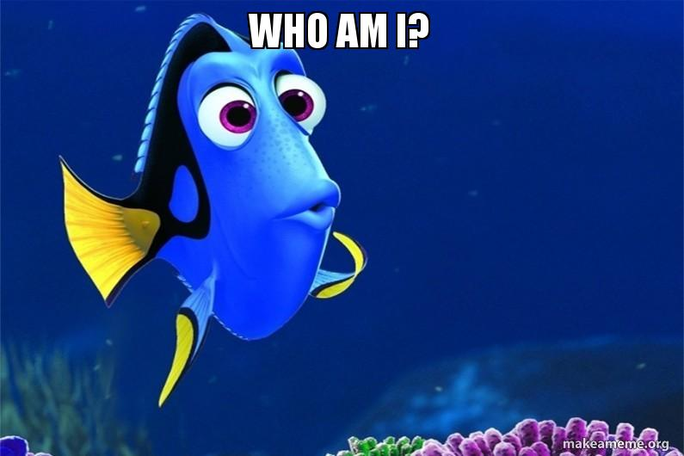
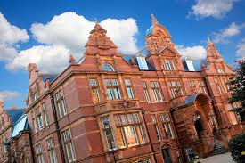
Ilford, UK
Pakistan
16 years old
Newham Collegiate Sixth Form
Art, henna, camping

Slide 3
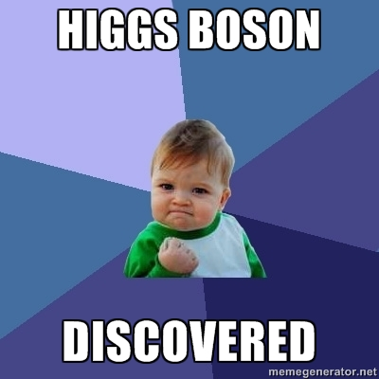

What I enjoyed
Using data from detectors
Learning how fire extinguishers work
Chocolate

Slide 4
Anything I’d change?
Absolutely fantastic week
Learnt a lot about CERN and how researchers work
Maybe have more opportunities to talk to people in different roles?

Slide 5
Future plans
Plan to study Physics or Engineering at university
Hope to maybe one day return to CERN as an employee!

Slide 6
