Slide 1
Hello! :)

Slide 2
01
About me
03
Likes
02
04
dislikes
In 5 years

Slide 3
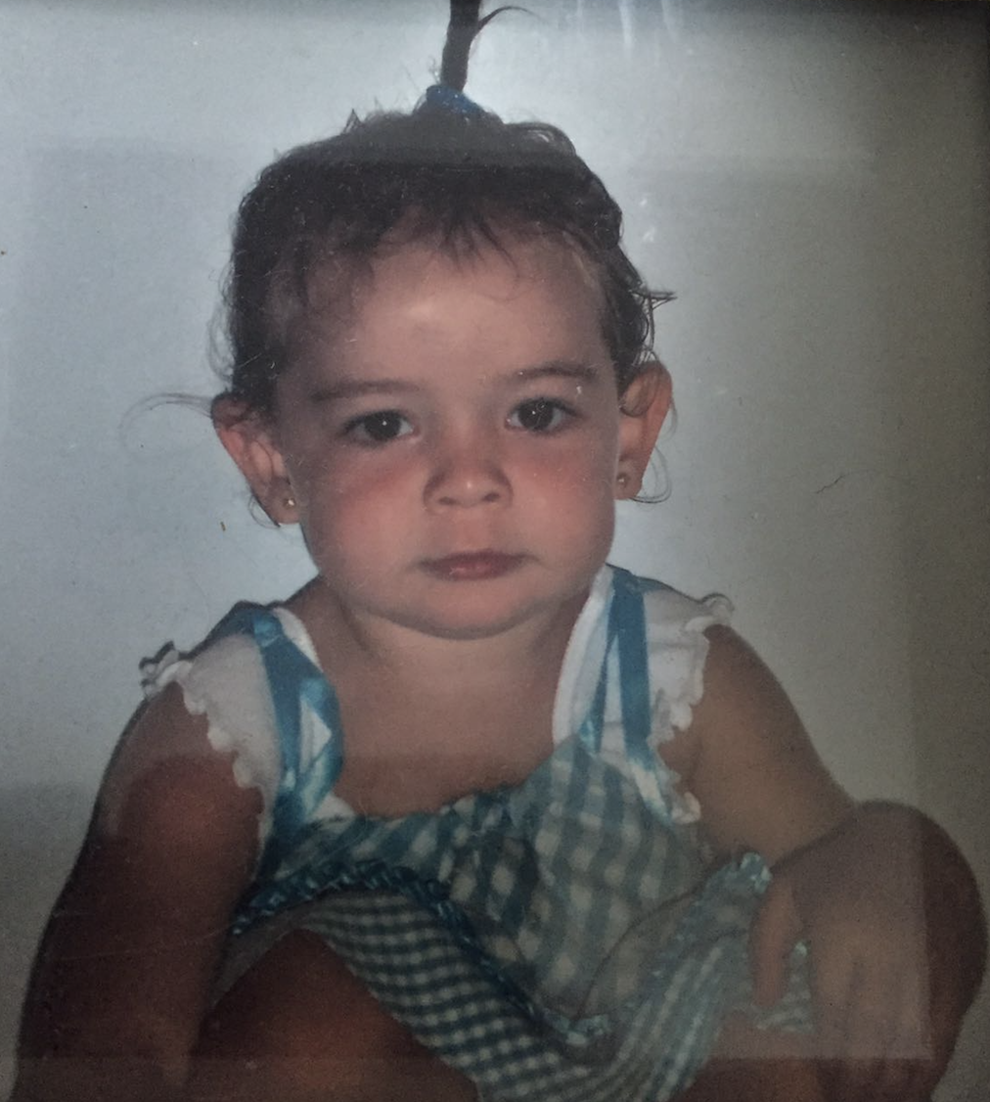
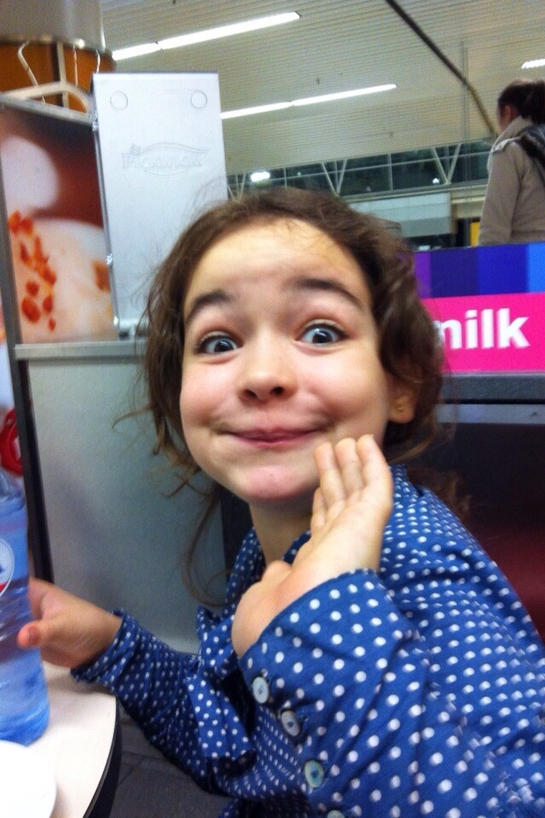
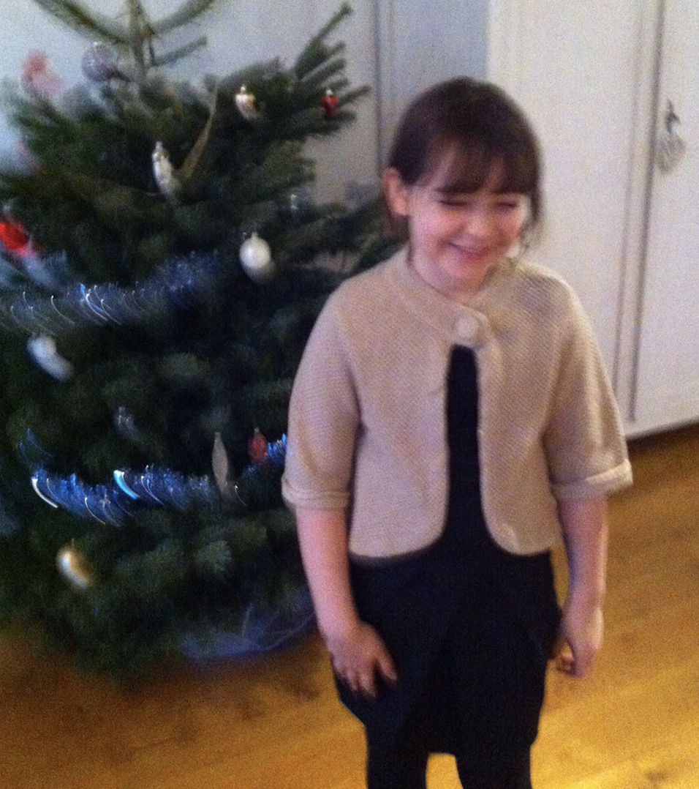
Anna Luna Bakker Ortola

Slide 4
Walking
Chaos
Standing

Slide 5
Museum
Cloud chamber
Escape room
AMS control room

Slide 6
Me in 5 years
Graduated
Medicine?
University
Amsterdam

