Slide 1
Fermilab & QuarkNet:
Remote Learning in Action
Rebecca Thompson and Spencer Pasero
International Particle Physics Outreach Group Collaboration Meeting
7 May 2020

Slide 2
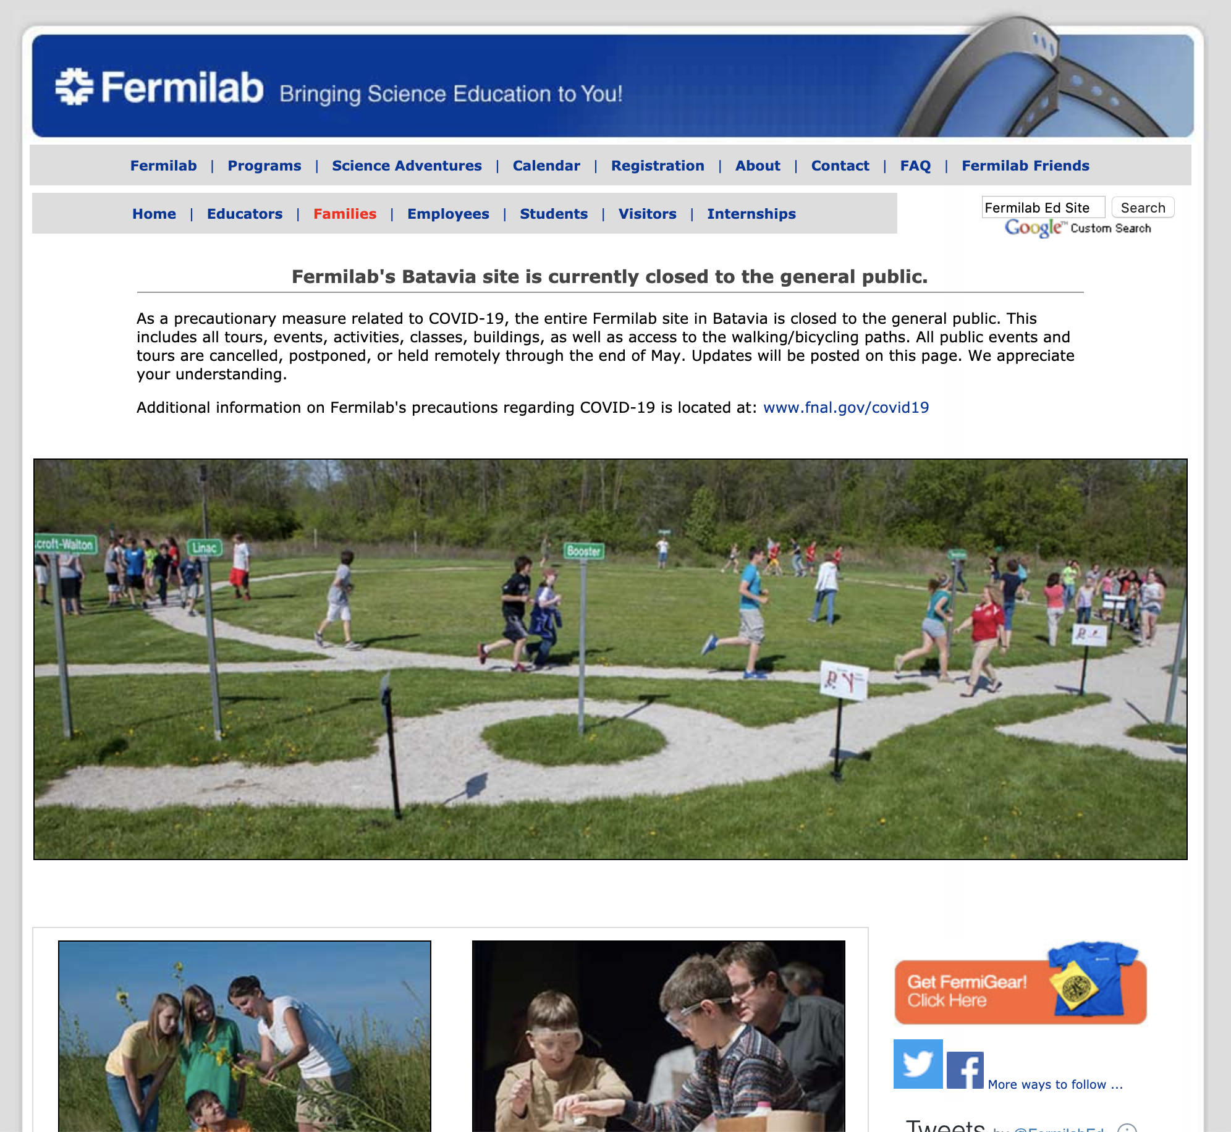
Helping Teachers and Parents
In the transition to the current remote learning environment, the Fermilab Education and Outreach office and QuarkNet determined:
We were already well-placed
to start supporting teachers
and parents in the work of
remote learning, and
We would be expanding our
online offerings.
Teachers have long seen
us as a reputable resource.

Slide 3
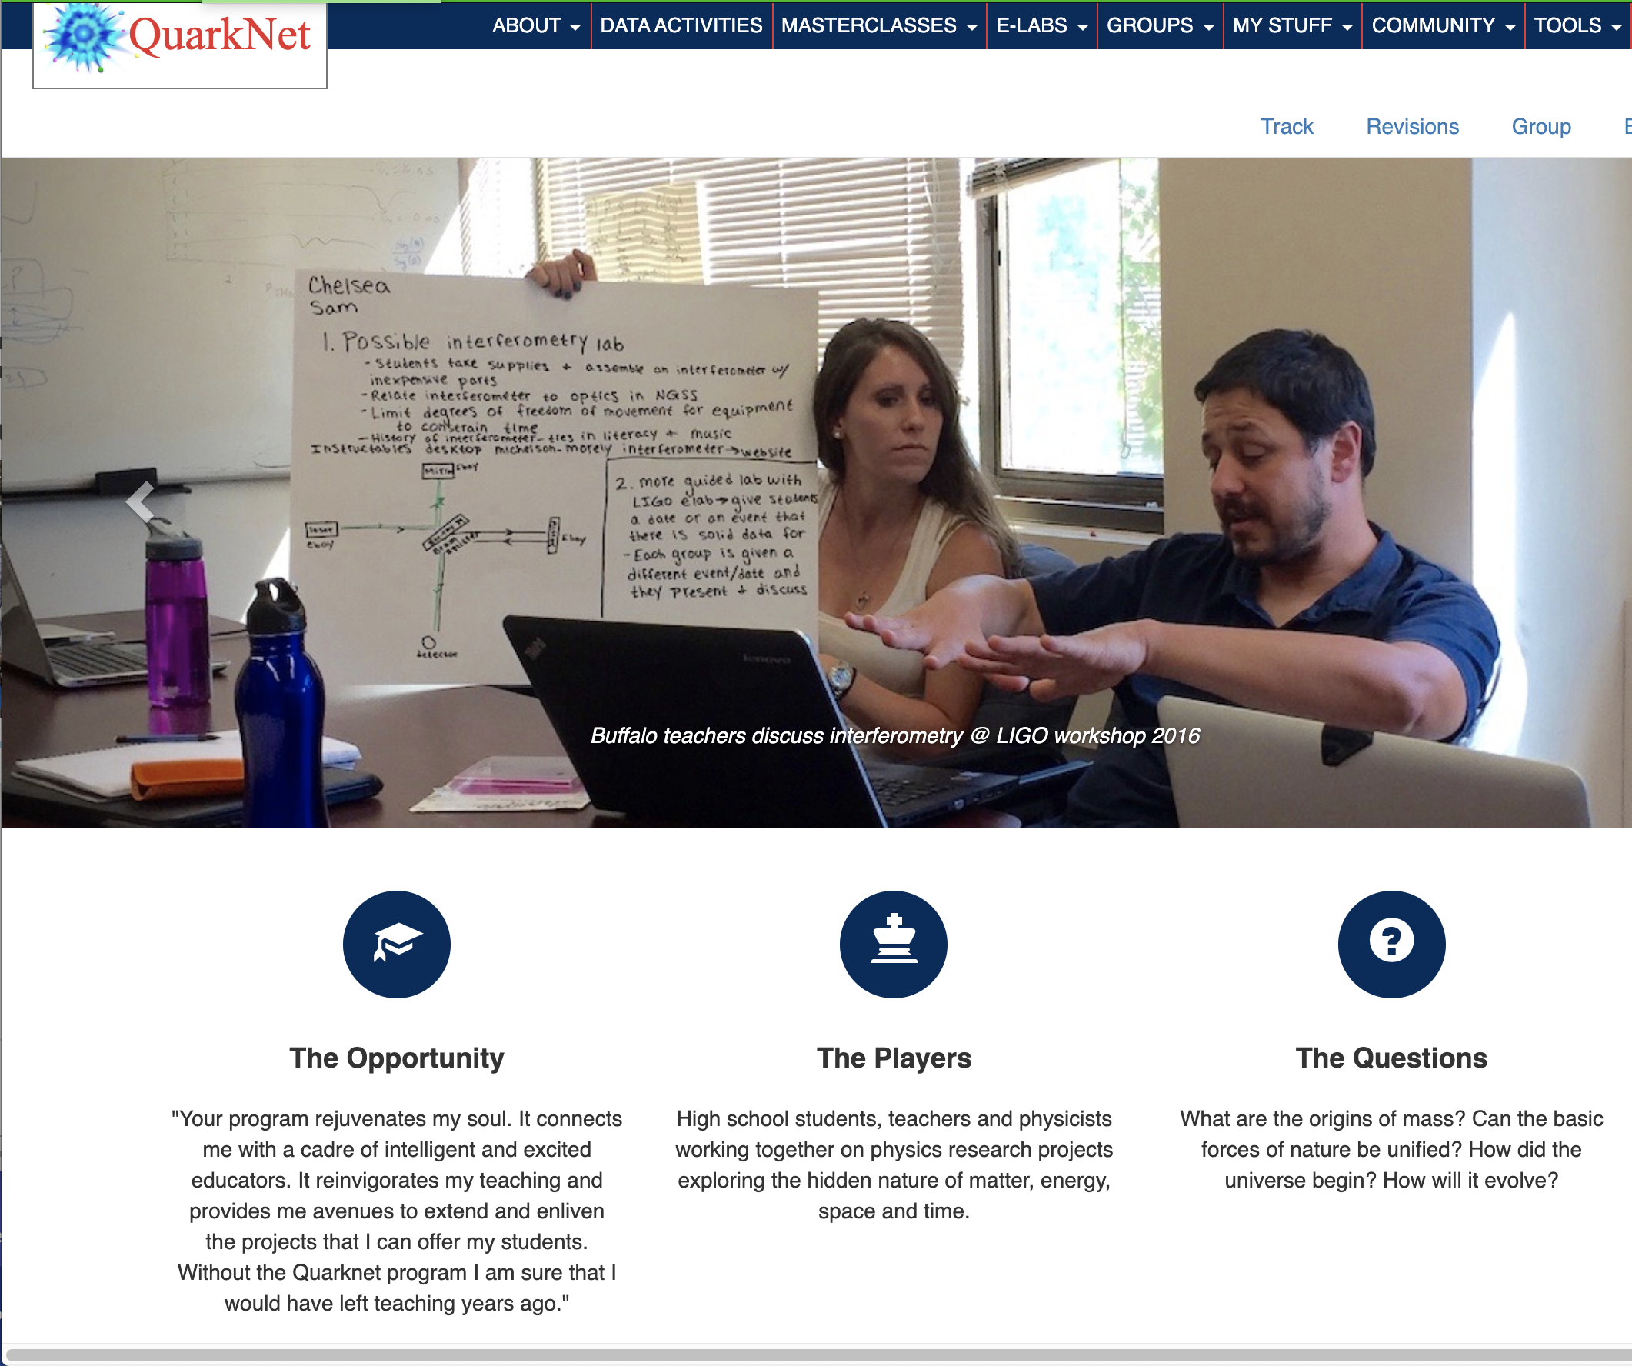
Helping Teachers and Parents
Both Fermilab and QuarkNet have rolled out new remote support for teachers, students, and parents.
In this talk, we’ll describe new
and expanded efforts rolled out
over recent months and some
future plans.

Slide 4
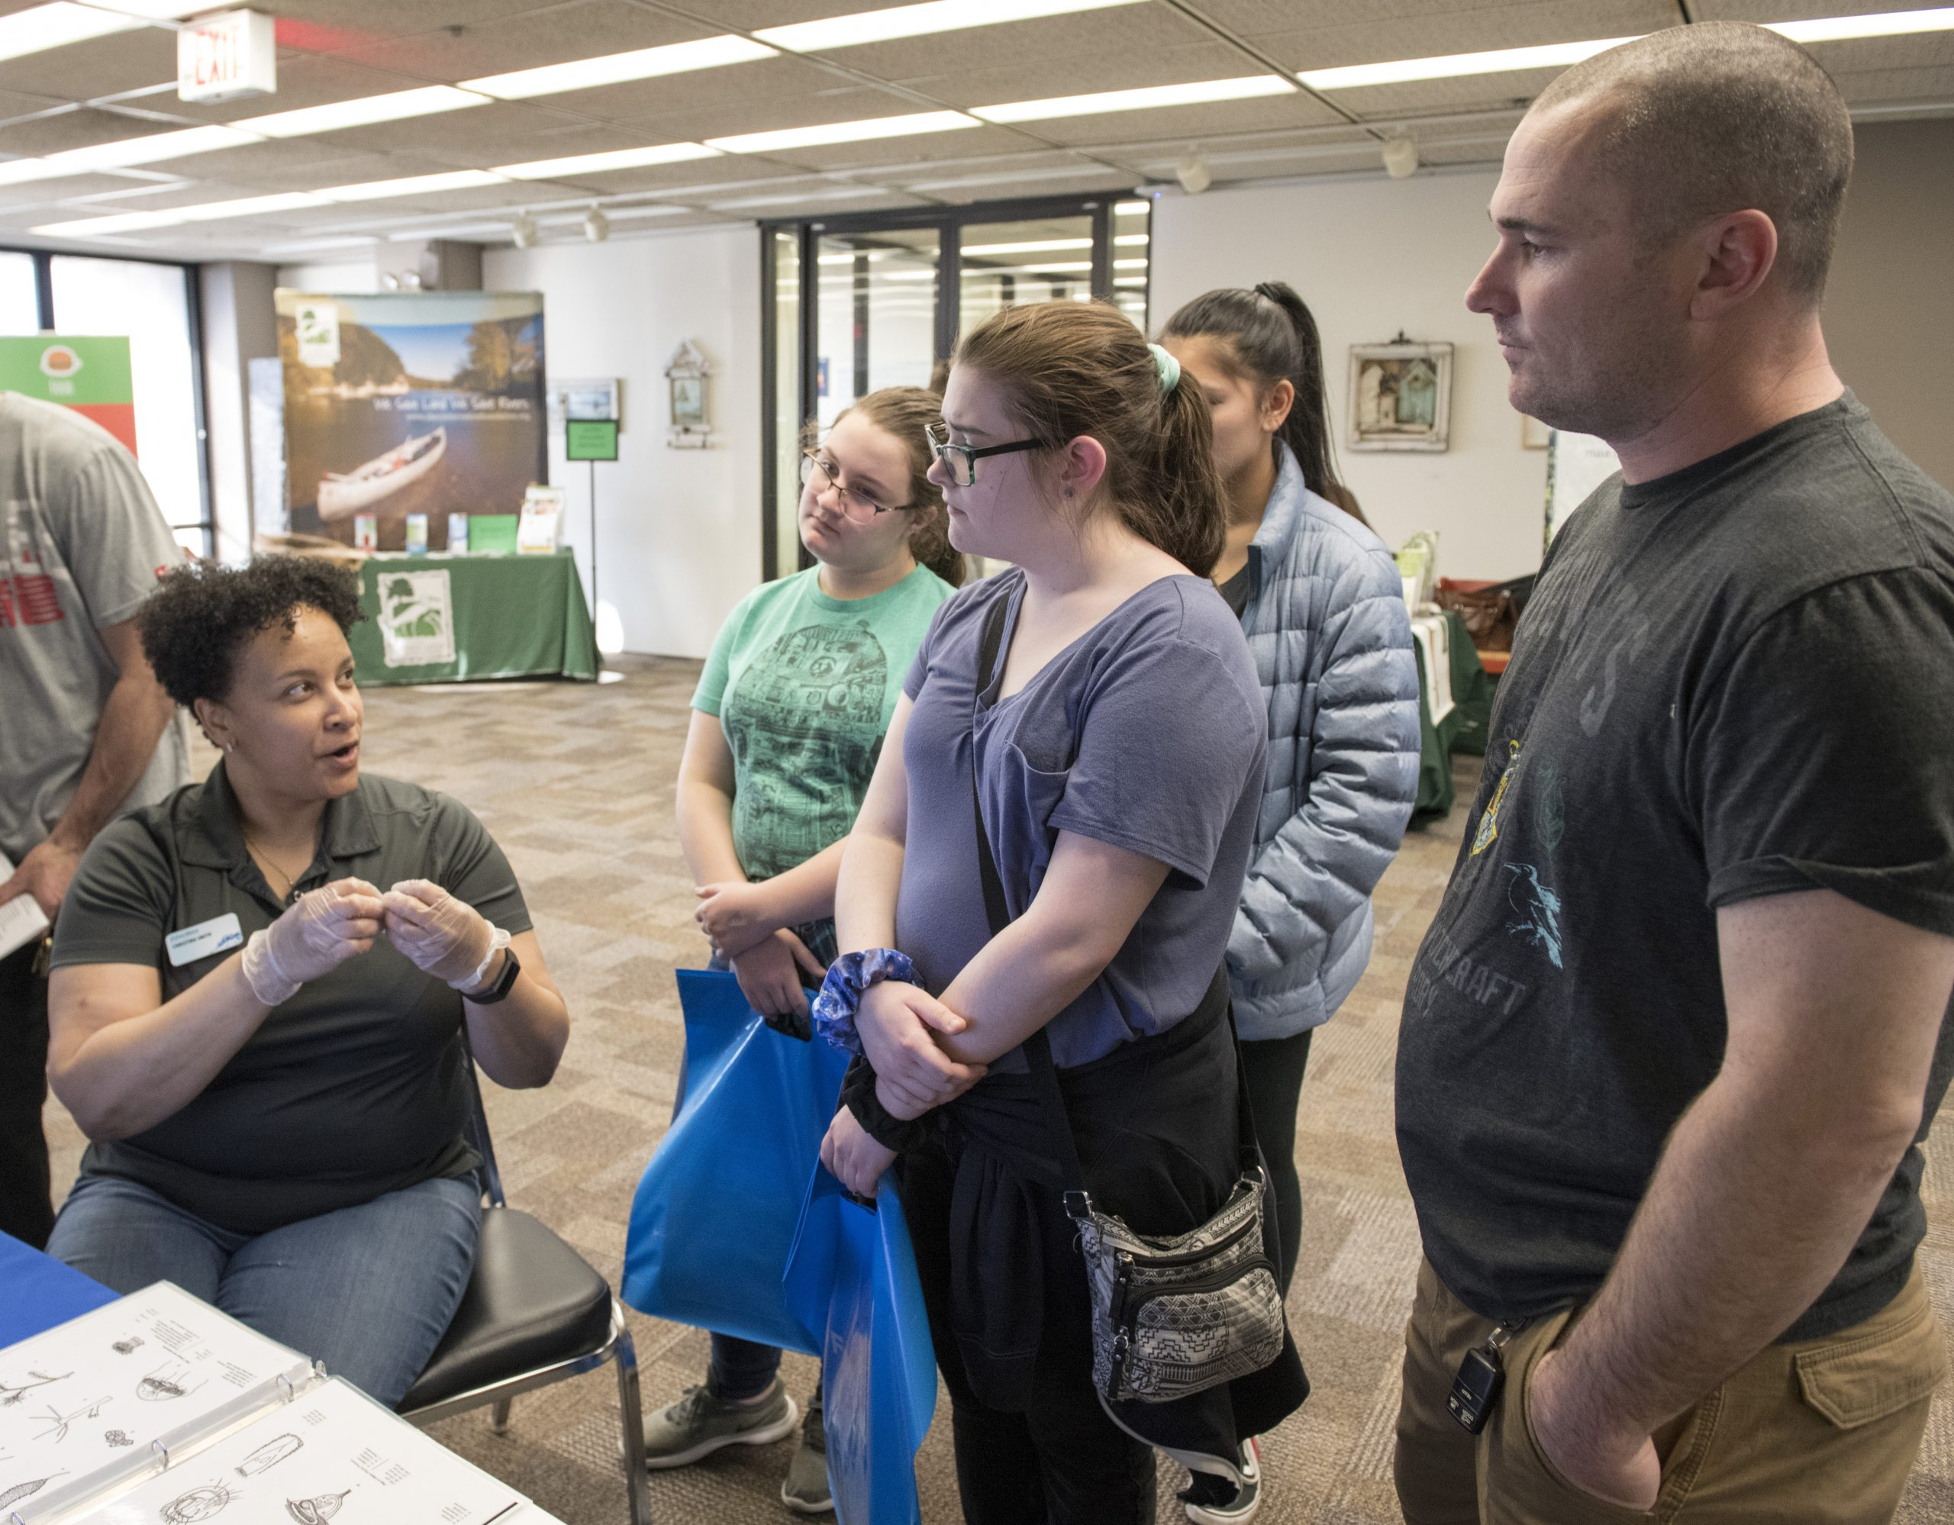
Fermilab
Who have been the Fermilab education office’s core audiences and how have we reached them?
  Teachers bringing students for field trips and attending teacher workshops
  High school students attending like the STEM Career Expo and Saturday Morning Physics
  Young students who come for Science Adventure classes
    And their parents!
  The general public interested in learning
  more physics or about Fermilab

Slide 5
Fermilab
What are the best ways to reach those audiences virtually and what new audiences might we now have?
  Teachers: Looking for high quality online content for students learning from home
  High school students: Virtual learning opportunities like those previously available in person
  Young students and their parents: Fun and engaging at home science and information on how to help kids learn.
  Everyone: Use of social media and looking for interactive educational opportunities.

Slide 6
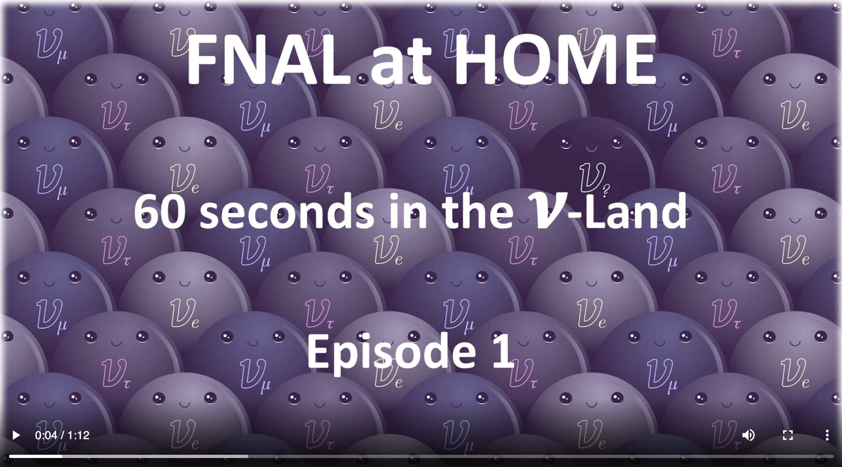
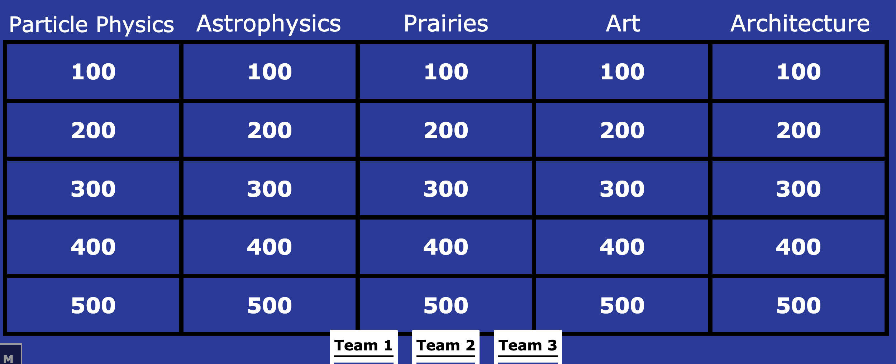
What is Fermilab offering?
New ways to virtually connect to the lab
Resources gathered at our new “Families” webpage:
  Grid of activities for students from grades 3–12, using the 5E education model to connect them into coherent strands. Helpful for those learning from home.
  Recreating in person experience with virtual resources from the Lederman Science Center
  Guidance for parents new to working with
  students at home
Notes:
Activities based on exhibits at the LSC
Online quizzes based on Fermilab physics, prairie science, architecture, and art
A video tour of the exhibits
A series of short videos on neutrinos

Slide 7
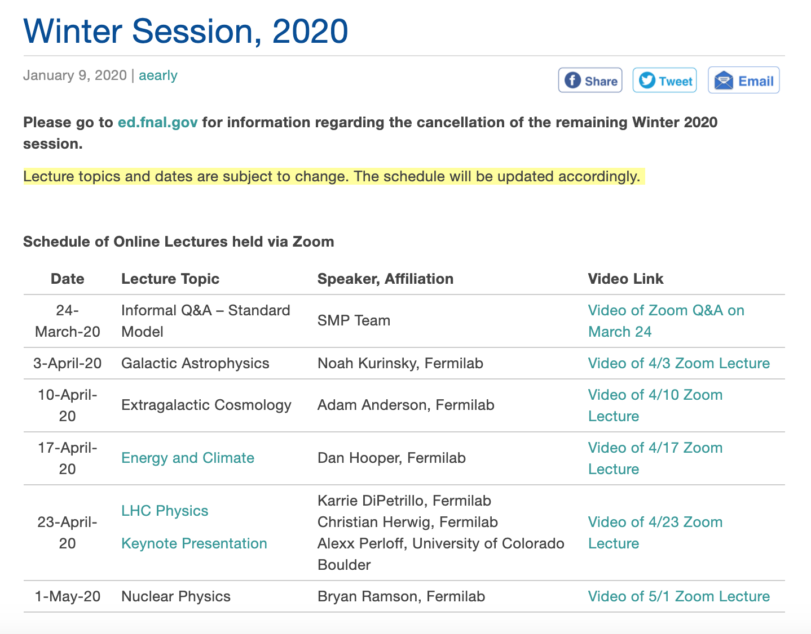
What is Fermilab offering?
Online versions of Fermilab Education Office events:
The remaining classes from the Winter Saturday Morning Physics session were held on later dates as online events
The STEM Career Expo for
high school students will be
held virtually; the office has
recorded five panels to date
and will be posting them soon.

Slide 8
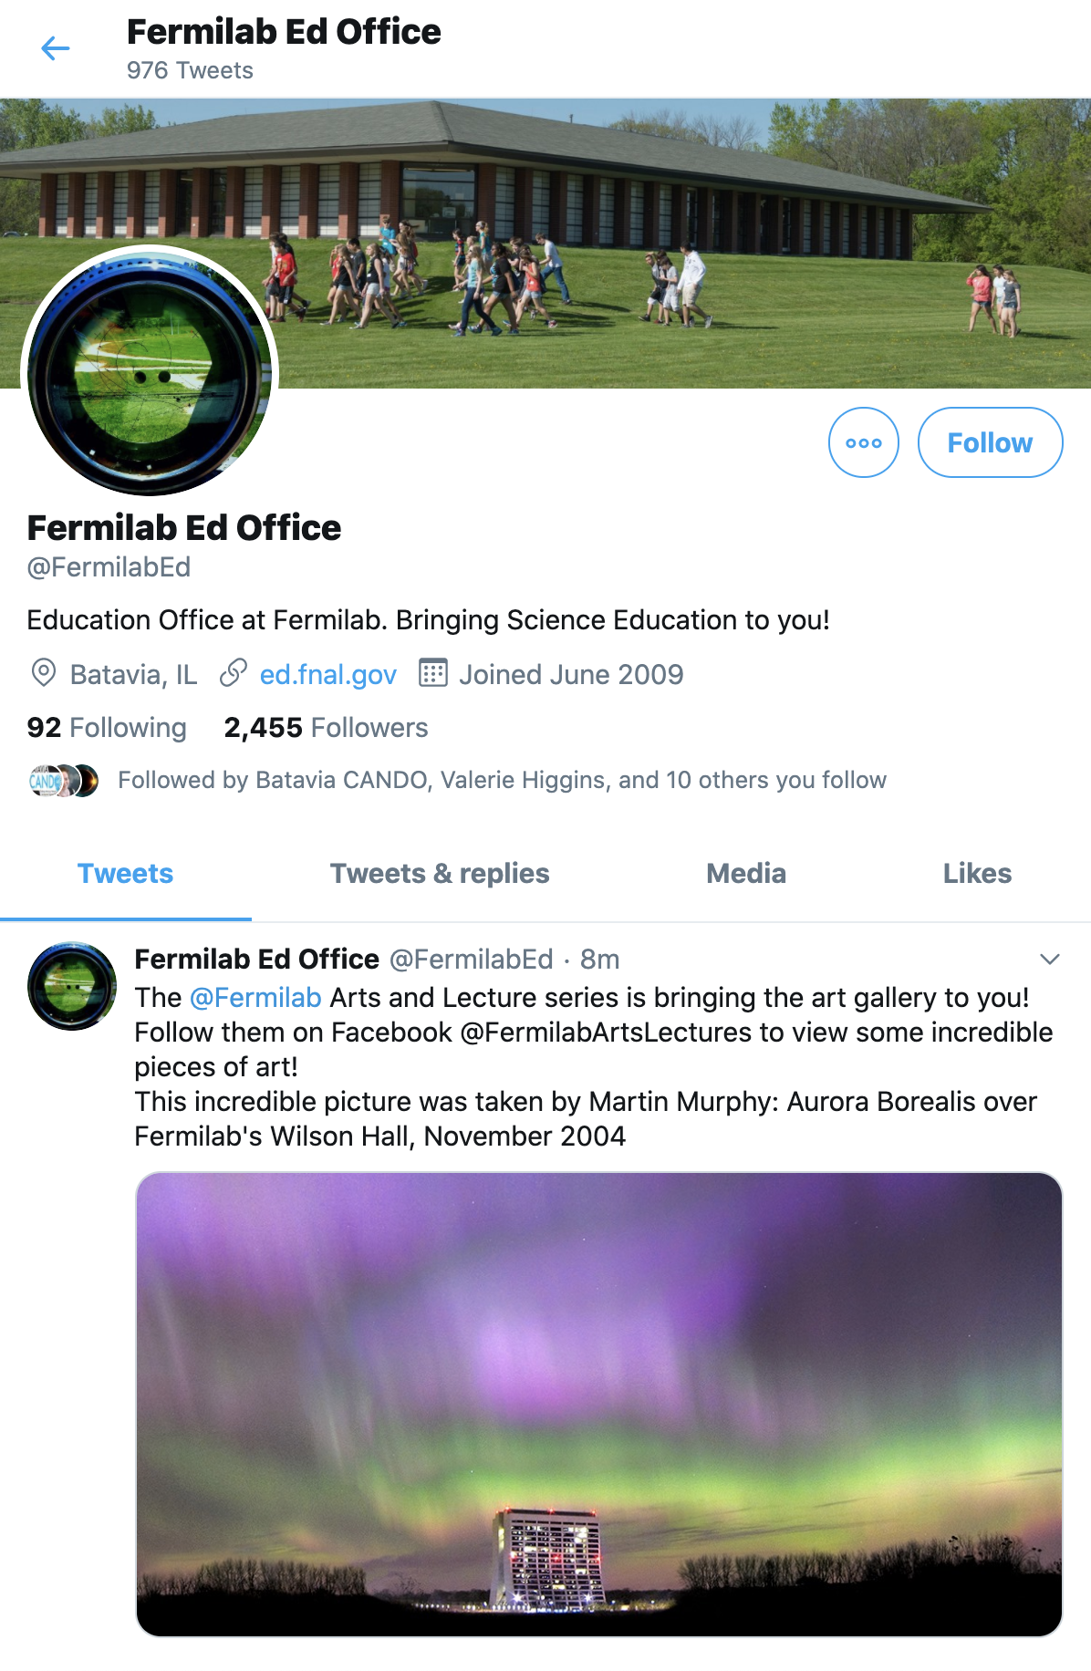
What is Fermilab offering?
Social media engagement:
We have ramped up our Twitter
offerings to include the very popular
“#CanYouGuess” feature, in which we
ask our followers a question about
particle physics, as well as:
  #FNALFieldFinds and #FNALTreeID:
  natural science features captured in
  our backyards
  #FNALatHome: activities for parents
  and kids to do together
  #DidYouKnow: facts about Fermilab
  science and education

Slide 9
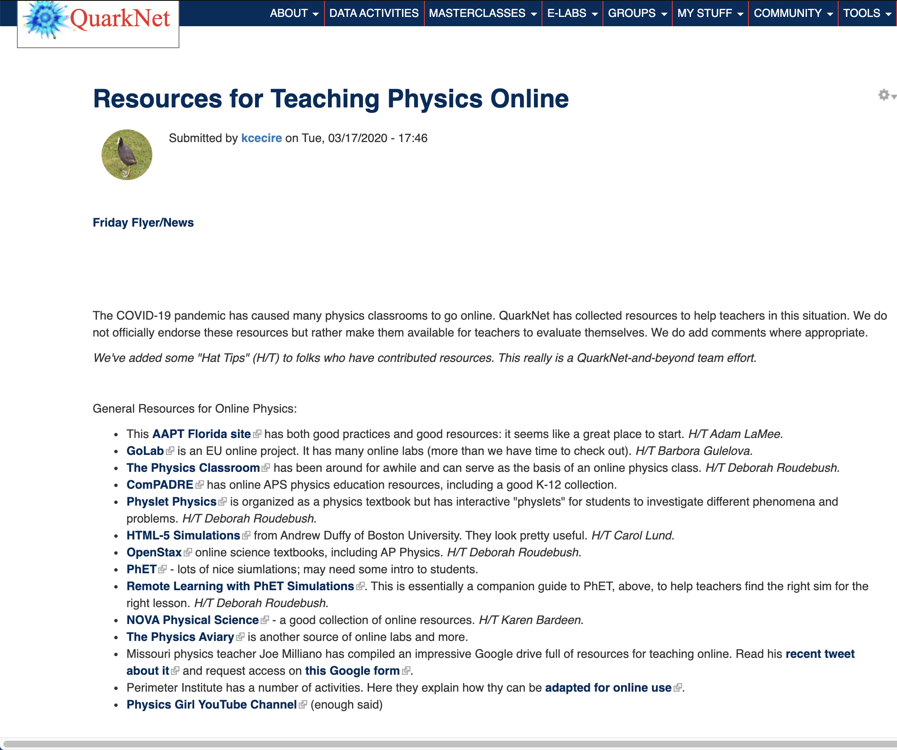
QuarkNet
QuarkNet’s audience is primarily high school physics teachers; the QuarkNet program is focusing on providing them resources to enhance their teaching:
Created a central page of resources from QuarkNet, Fermilab, and a wide variety of organizations dedicated to physics education; updated often:
  General Resources for Online
  Physics
  Resources from Fermilab
  Particle Physics Resources
Notes:
Mark added the cosmics page
Also a central page of data portfolio comments
And online simulation of Rolling with Rutherford

Slide 10
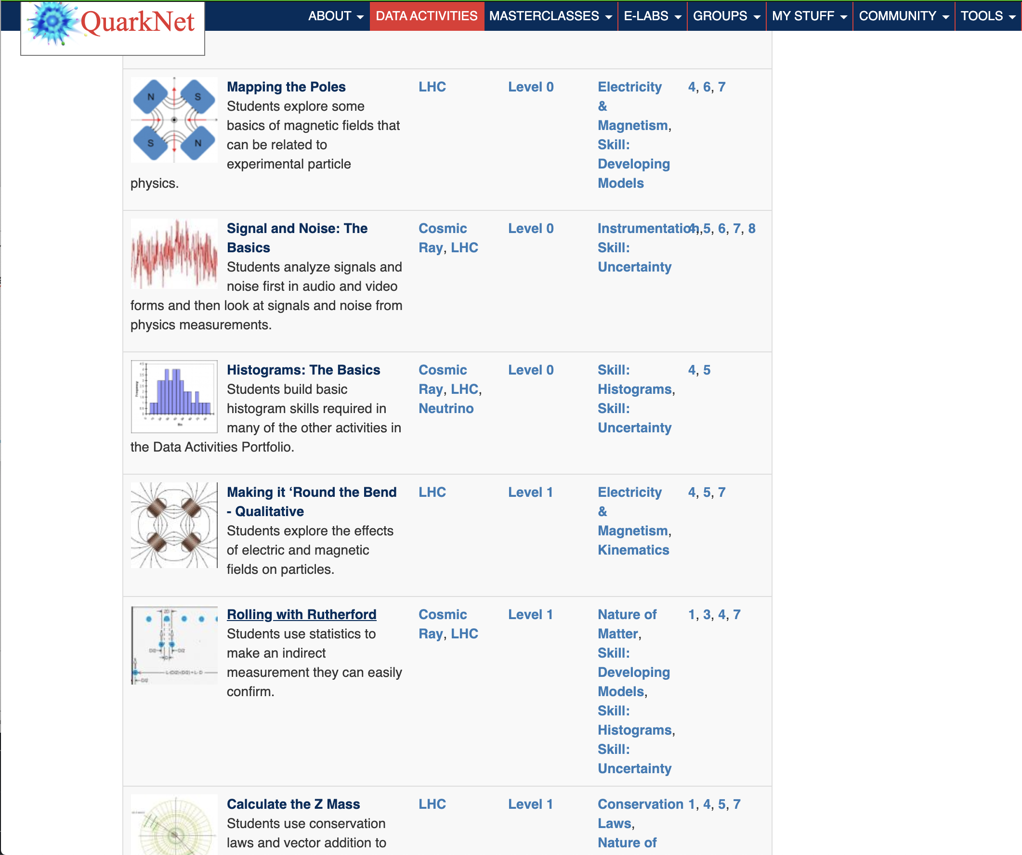
QuarkNet
QuarkNet’s audience is primarily high school physics teachers, so the QuarkNet program is focusing on providing them resources to enhance their teaching:
Added a page of resources to help teachers and students do cosmic ray analyses online and another for CMS data
Encouraging teachers to share
ideas in the Data Activities
Portfolio for adapting activities
for online use
  Staff wrote up their own ideas
  Added comments in the portfolio
  Made a centralized page to collect
  it all and make it public
Notes:
Mark added the cosmics page – and has a detector running at home to continually add data
Also a central page of data portfolio comments
And online simulation of Rolling with Rutherford

Slide 11
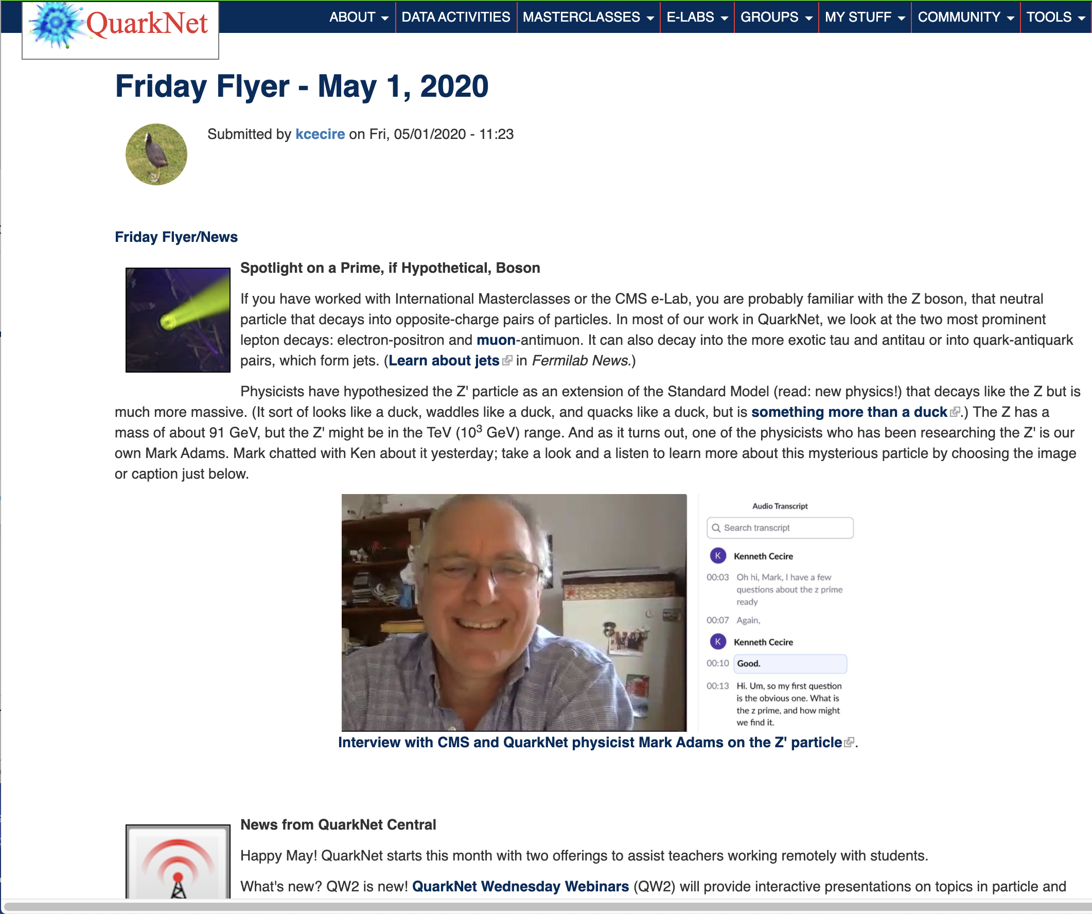
QuarkNet
QuarkNet’s audience is primarily high school physics teachers, so the QuarkNet program is focusing on providing them resources to enhance their teaching:
Have modified the focus of the Friday Flyer:
  ”Spotlight” section has moved away from focus on QuarkNet centers to more topical items
  ”Resources” section points to
  external items of interest
BAMC – covered in IMC talk
Kicked off QW2 this week: a
webinar series for teachers and
students about particle physics
Notes:
Fellows workshop previously planned to work on how we could enhance in-person workshops; now focused on helping centers transition to online.

Slide 12
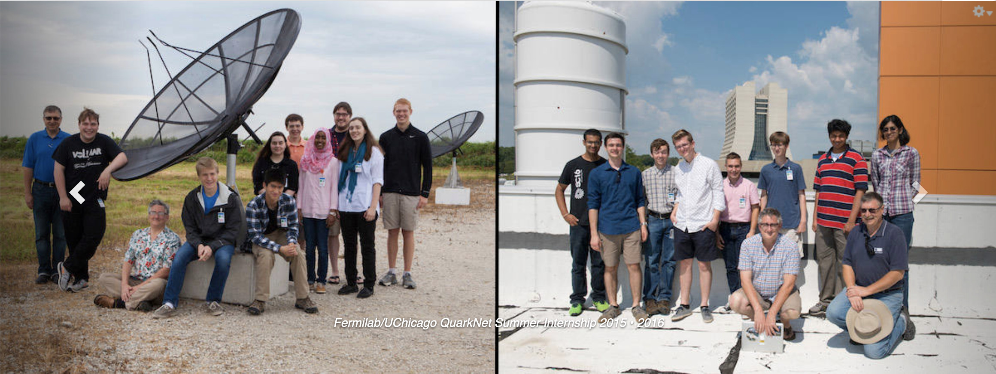
QuarkNet
QuarkNet’s audience is primarily high school physics teachers, so the QuarkNet program is focusing on providing them resources to enhance their professional development:
Retooled an upcoming workshop for QuarkNet fellows:
  Initially planned to help fellows better support in-person workshops at centers this summer
  Now focused on working with fellows to help them help centers transition to remote workshops
Creating an online
summer program on
particle physics
topics for teachers
led by a Fermilab
physicist
Notes:
Fellows workshop previously planned to work on how we could enhance in-person workshops; now focused on helping centers transition to online.

Slide 13
Summary
Fermilab and QuarkNet both adding and expanding online and remote learning resources rapidly.
Both serving as both resources and hubs for different audiences (with some overlap).
Continuing to create, and always looking for more to share with teachers and students!

