Slide 1
Remainder of 2020 and Post-LIU
ATS Director
BE DH
IEFC - LMC
OP GL, IEFC
Injectors Performance Panel IPP
FOM
PS MPC
Machine Performance Coordination meeting
(merge of Beam Dynamics, Commissioning and Tech. Coordination)
LIU driven
OP driven
Weekly PS Coordinators Meeting
Coordinators are members of PSMPC
8:30 daily PS OP meeting
(phase out once in stable operation)
Beam dynamics, Equipment groups, Services, Controls groups, ABP, OP, …

Slide 2
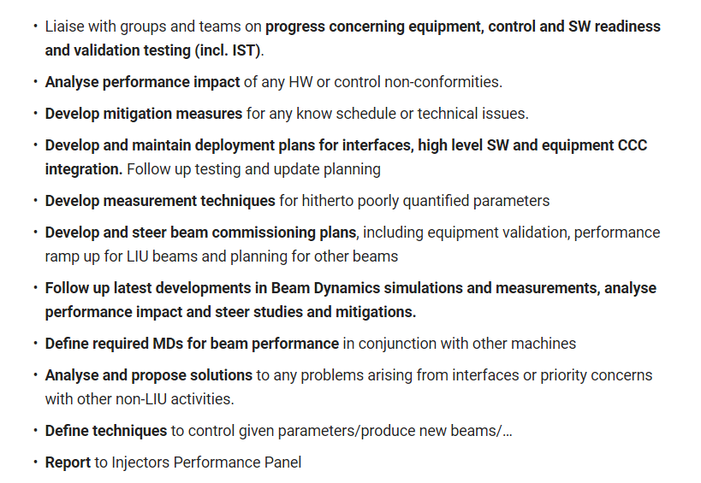
PS-MPC Mandate

Slide 3
PS-MPC Format
Chairs: Klaus, co-chairs, Heiko, Alexander, Alexandre, Matthew, Frank, Denis
Secretary: new OP fellow once he arrives
Membership: new mailing list, merge of the existing mailing lists cleaned up; attendance according to the agenda; machine coordinators list is nested in the new mailing list
Specialists invited as needed
Slot Tuesday 15:30 J. Adams room (advanced by 30 min!) to start with…
Place and time can be re-discussed later during the year
Agenda: can be any technical or beam physics topic, detailed discussion
Attendance: dynamic according to agenda

