Slide 1
PS SWY IST Planning
Fernando Pedrosa

Slide 2
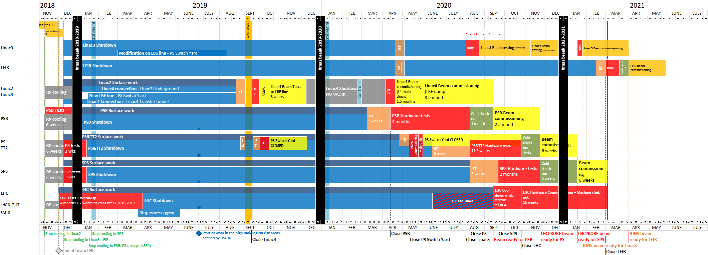
Approved Master schedule (version 2.4)
Week 46
12/11/2018
LHCPROBE beam
available for LHC
Week 9
04/03/2021
Week 19
08/05/2020
Week 31
31/07/2020
Week 43
23/10/2020
Week 15
10/04/2020
Week 38
18/09/2020
Week 8
26/02/2021
Week 32
07/08/2020

Slide 3
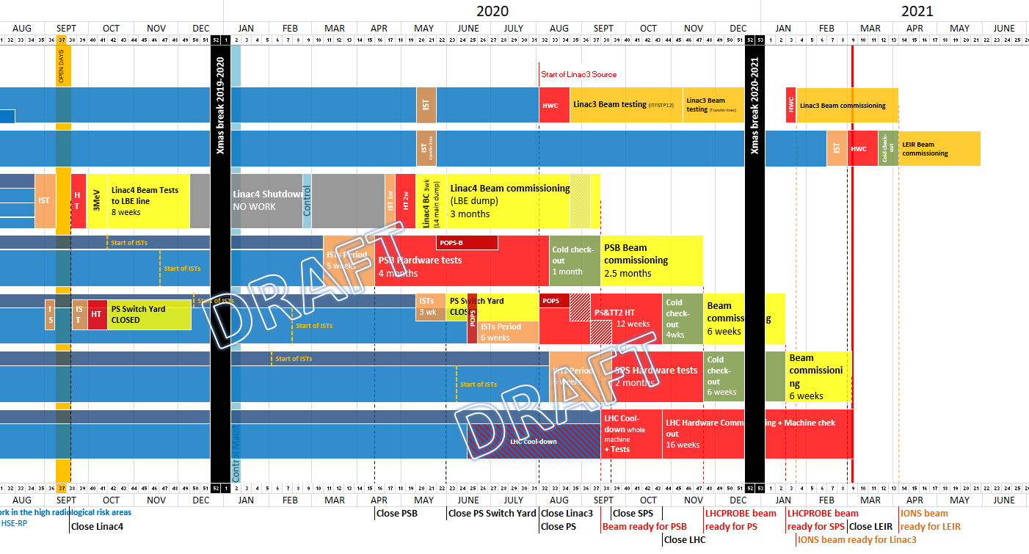
Changes to the Master Schedule
New PS HC start date – 03/08/2020
Access system tests + patrol + DSO tests (19/03 to 24/03) – NO ACCESS to the all PS
TE-EPC tests with current to the magnets (25/03 to 13/04) – NO ACCESS to the PS SWY
PS Main Units POPS tests (15/06 to 19/06) – NO ACCESS to the all PS
TE-EPC tests with current to the magnets (15/04 to 24/04) – NO ACCESS to the PS SWY with the exception of TE-MSC
PS Main Units HV tests (29/05)– NO ACCESS to the all PS

Slide 4
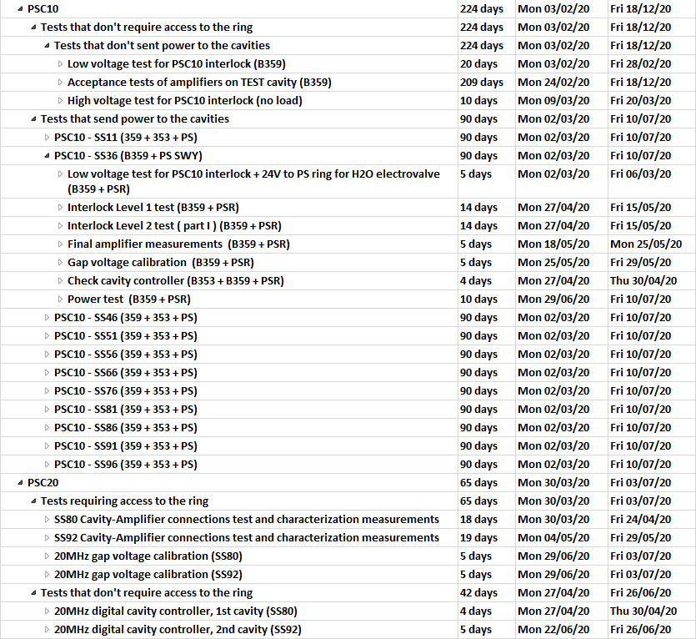
Check results - BE-RF
ISTs planning re-worked with Carlo for the 10, 20, 40, 80, 200 MHz and Longitudinal Damper
Only the PSC10 SS36 is in the PS SWY, but we revised the full planning

Slide 5
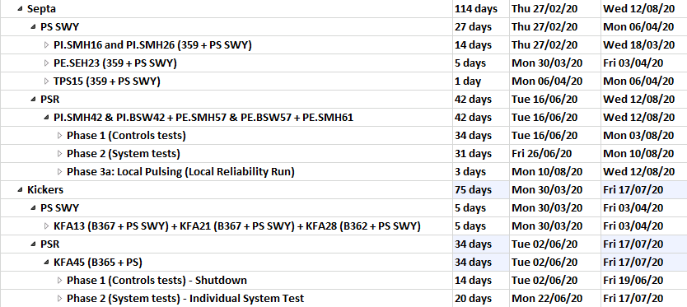
Check results - TE-ABT
ISTs planning checked with Luis and Mike for the Kickers and Septum – No changes required for the PS SWY
No Access required, unless there is a problem, so we have decided to maintain the tests as they were

Slide 6
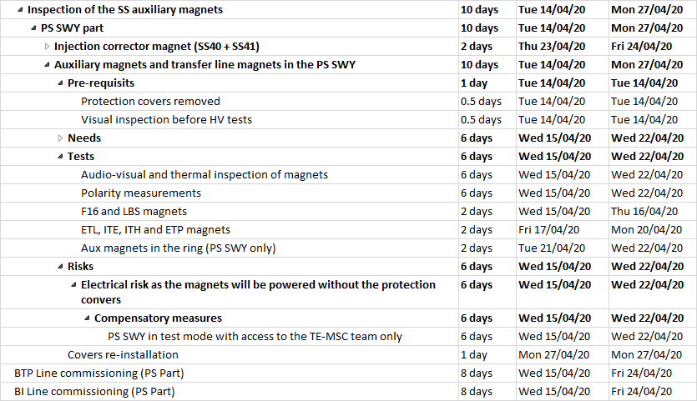
Check results – TE-MSC
ISTs planning revised with Dominique (new version is only 2 days anticipated with respect to the baseline)
Warning: BI and BTP are the only transfer lines in the PS SWY that the ISTs are not managed by the PS Coordinator

Slide 7
Still to be checked
Power converters that cannot be tested before closing the PS SWY and that will have to be teste during the PS HC (equipment in series between different access zones)
BE-BI ISTs
BE-RF transverse feedback
  Note really due to the TE-EPC change request but rather due to the fact that some tests should have been already started and probably new dates will have to be found

Slide 8
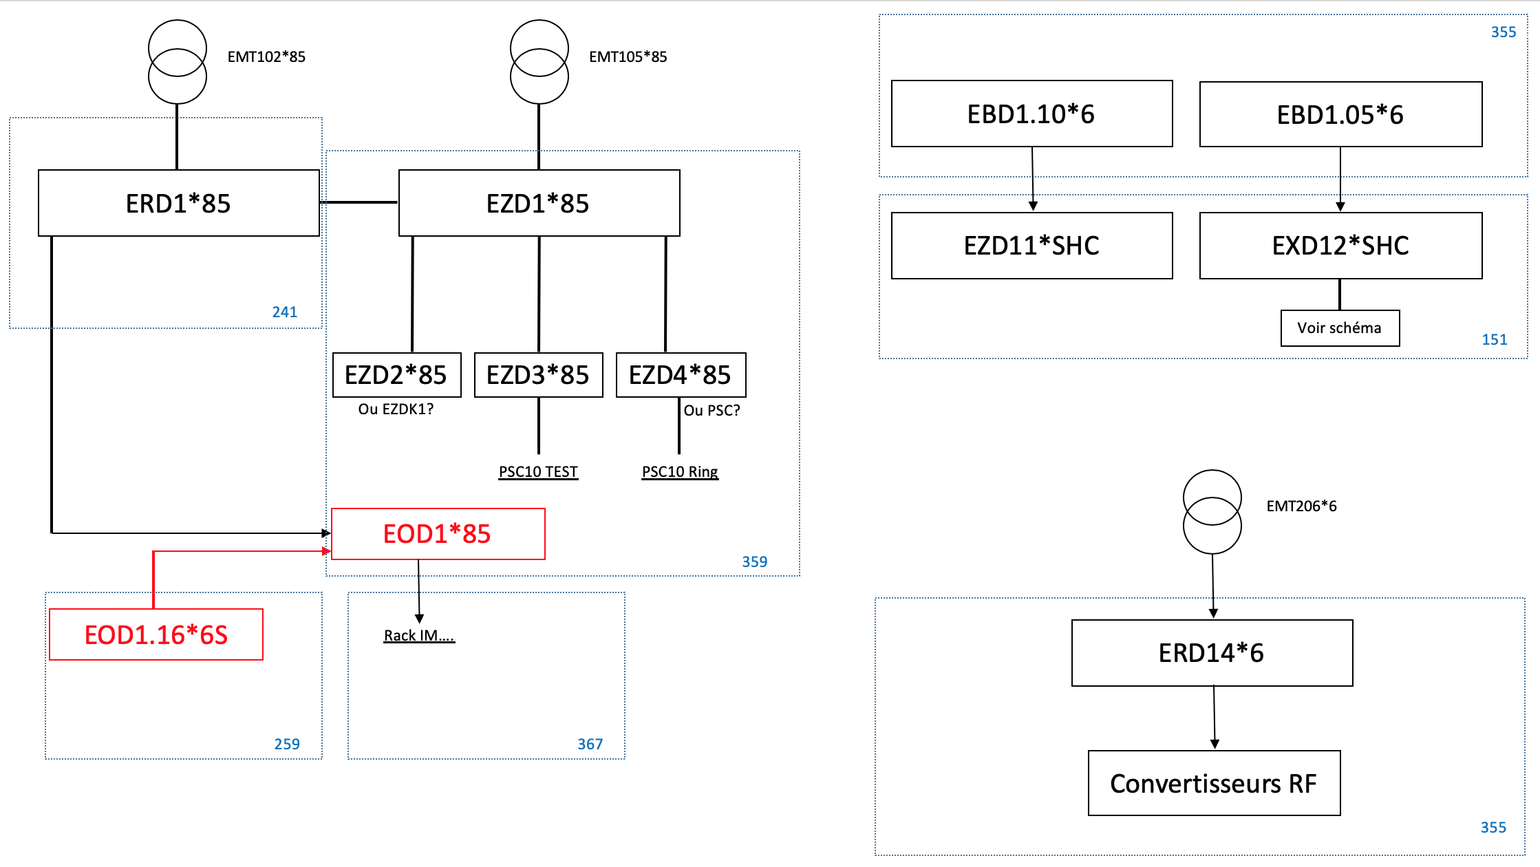
Other ongoing discussions
Readiness for the Access System tests and DSO tests
n_TOF possible impact on the access system and DSO test
Hand-over between EN-EL and TE-EPC
HSE inspections
East Area WIC installation
BE-CO cabling
EN-EL network availability check
…

