Slide 1
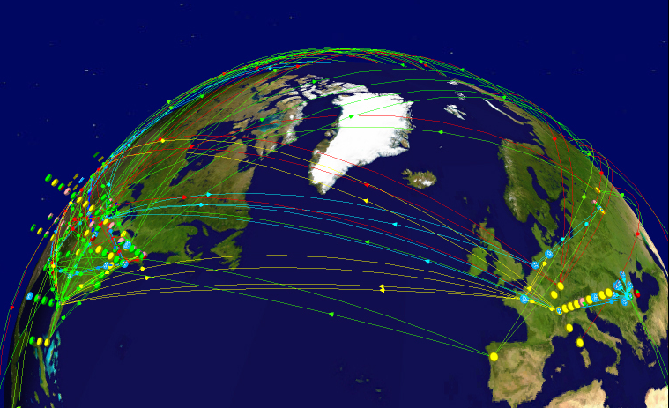
US LHCNet
Harvey Newman
California Institute of Technology
Transatlantic Network Workshop
CERN, June 10, 2010

Slide 2
US LHCNet
Transatlantic mission-oriented network managed by
Caltech and CERN
Funded by DOE/OHEP with contribution from CERN
Program: to provide resilient, cost-effective transatlantic networking adequate to support the principal needs of
the LHC physics program, with a focus on the US
  In partnership with ESnet, Internet2, NLR, SURFnet, GEANT
  and the NRENs in Europe
Primary mission: to provide highly reliable, dedicated, high bandwidth connectivity between the US Tier1 centers and CERN [Uptime goal: 99.9+%]
Further, to support high bandwidth traffic flows between US LHC Tier1 and European Tier2 centers as well as between US Tier2 centers and European Tier1s
Development, deployment and integration of advancing network and high throughput technologies, to meet the advancing needs

Slide 3
US LHCNet Network
US LHCNet is a Multi-vendor, Multi-layer network
  Path-diverse transatlantic links on (currently) five undersea cables,
  with terrestrial interconnects in the US (NY – CHI) & Europe (GVA – AMS)
  Core Equipment: Ciena optical muxes, Force10 switch routers
  Offering Layer 1, 2, 3 resilient services to the users
A Real-time System designed for Non-stop Operation
  Real-time systems for monitoring and some automated operations
  A carefully managed set of virtual circuits with automated fallback provides graceful degradation in case of single or multiple outages
US LHCNet NOC:
  24x7x365 Coverage (on-call 3-line support); Office hours in CET, PDT
  Distributed NOC (main locations: CERN/Geneva, Caltech/Pasadena)
  A small, talented team (4 engineers) with full range of skills
  NOC engineers able to perform tasks from any location world-wide
Equipment and US PoP diversity to mitigate effects of
equipment or site outages

Slide 4
Working Methodology
Production Network
Develop and build next generation networks
High performance
High bandwidth
Reliable network
HEP & DOE Roadmaps
Pre-Production
  Transatlantic testbed
  Lightpath technologies: DCNSS, OSCARS, DRAC, AutoBAHN
  New transport protocols; Interface & kernel settings
  DICE / Ultralight / λStation / Terapaths; Vendor Partnerships
Networks for HEP Research
LHC and Other Experiments; LHC OPN
GRID applications:
WLCG, DISUN, OSG
Interconnection of US
and EU Grid domains
EVO …
Testbed
for Network Services Development
R&D efforts tailored for the specific needs of the HEP community,
with direct feed-back into the high-performance production network.
Notes:
Our working methodology combines R&D efforts tailored for the specific needs of the HEP community,
with direct feed-back into the high-performance production network.

Slide 5
TA Link Capacity vs. “Bandwidth”
Various Colloquial definitions/uses of “Bandwidth”
  Need to better define capacity to set requirements and roadmaps
In reality: what is referred to as “10Gbps” provides data rates lower than the link capacity (9.4 Gbps) !
Application data encapsulated in several layers of network/protocol overhead:
  SONET overhead (fixed)
  Ethernet overhead (fixed per frame, depends on MTU)
  IP (fixed per packet, depends on fragmentation (MTU) )
  TCP (fixed overhead per frame)
  FTP / HTTP / …
Additional inefficiencies due to e.g. TCP Stack and Tuning (especially for long RTT), Transfer-applications, Schedulers, etc.
Achievable application data rate is always less than link capacity.
“10G” SONET link ⇒ ~8 Gbps data throughput rate; usually less!

Slide 6
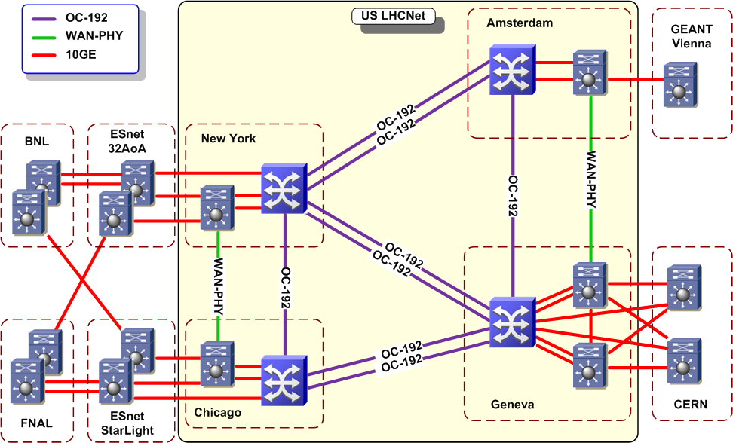
USLHCNet in 2010
Non-stop Operation; Circuit-oriented Services
Core: Optical
multiservice
Switches [*]
that provide
resilience
Performance
enhancing
Standard
Extensions:
VCAT, LCAS
USLHCNet,
ESnet, BNL
& FNAL:
equipment
and link
redundancy
[*] Dynamic circuit-oriented network services with BW guarantees,
with robust fallback at layer 1: Hybrid optical network
Notes:
US LHCNet topology; 4 strategically located PoPs.
Network core is based on optical multi-service switches, providing resiliency
and fast protection-switching for mission critical circuits.
The core devices support dynamic resource allocation.

Slide 7
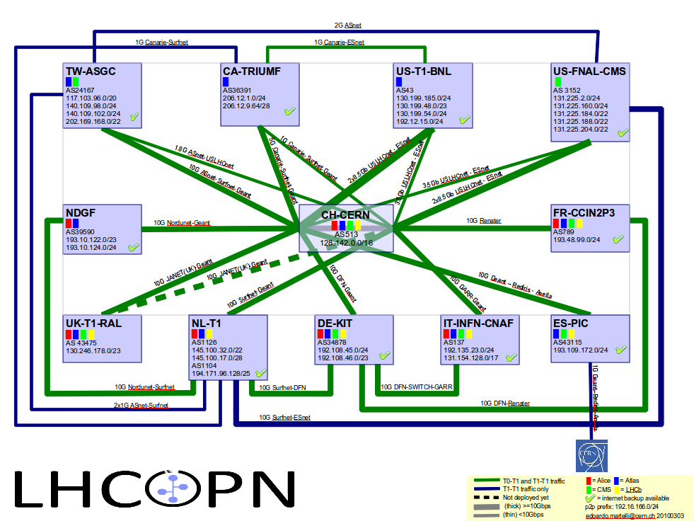
US LHCNet: An Integral
Part of the LHCOPN
“A Network Within a Network”
Notes:
US LHCNet is an integral part of the LHCOPN.
According to the LHCOPN MoU, US LHCNet provides Layer 2 connections
between CERN and the US Tier1s.
Due to the specific need to satisfy the availability requirements on transatlantic
routes, it is constructed as an autonomous network within the LHCOPN network.

Slide 8
Bandwidth Allocation
Primary Mission (virtual) Circuits
US LHCNet provides to each US Tier1:
  One primary circuit ( 8.567 Gbps, or STS-3c-57v )
  One secondary circuit ( 8.567 Gbps, or STS-3c-57v )
  One explicit backup circuit ( 3 Gbps guaranteed,
  expandable up to 4.1 Gbps )
Other Virtual Circuits
  ESnet-GEANT peering support (4.810 Gbps, STS-3c-32v)
  Dedicated FNAL-DE-KIT virtual circuit
  (1.050 Gbps, STS-3c-7v)
US Tier1 Circuits are Protected in US LHCNet
  Single link outage is transparent to the LHCOPN

Slide 9
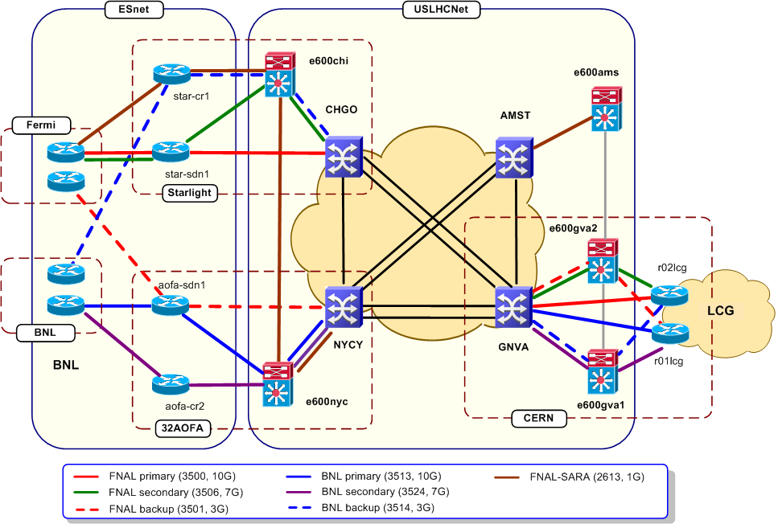
US LHCNet + ESnet:
Redundant Tier1 Paths
Primary and secondary FNAL circuits on shortest path
Backup FNAL path, completely path, device, and facility diverse between CERN and FNAL
Same setup also for BNL
Notes:
9
While the US LHCNet segments of each CERN-US Tier1 circuit are protected within US LHCNet, additional dedicated backup circuits are constructed in collaboration with ESnet, CERN and the Tier1 sites. To protect against device or even facility outages, US LHCNet and ESnet guarantee the backup circuits to be completely path, device and facility diverse.

Slide 10
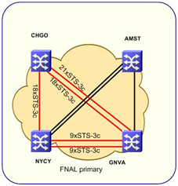
Increasing Efficiency:
Advanced protocol features
Mesh protection using Ciena OSRP
VCAT: Virtual Circuits Across
Multiple Links
  Only a fraction of a virtual circuit
  is affected by an outage
  End-sites see only lower capacity
  in case of a link outage
LCAS: Dynamic VC Adjustment
  VC capacity-adjustment leads to a
  “smaller hit” during extended outages
FNAL Primary
CHI
AMS
NYC
GVA

Slide 11
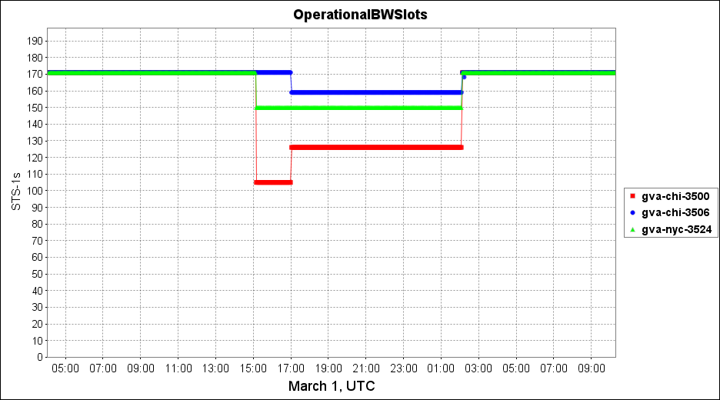
VCAT/LCAS in use
Provides hit-less capacity adjustment
Operational BW during simultaneous outage
on two physical links lasting 11 hours
[Gbps]
9
8
7
6
5
Double cut,
Virtual circuits automatically
re-routed and resized
4
Operator intervention, adjusting “blue” and “red” circuits’ capacity
3
2
1

Slide 12
Granular Bandwidth Allocation
Available Capacity is Divided in Virtual Circuits
Purpose |  | Endpoint A | Endpoint B | Allocated Bandwidth [OC-192 links] | Allocated Bandwidth [Gbps]
Tier0-Tier1 Tier1-Tier1 (primary, secondary) | CERN-FNAL | Geneva | Chicago | 2×0.9 | 2×8.567
 | CERN-BNL | Geneva | New York | 2×0.9 | 2×8.567
 | FNAL-FZK | Chicago | Amsterdam | 0.1 | 1.050
Tier1-Tier2 | ESnet-GEANT peering | New York | Amsterdam | 0.5 | 4.810
 | Internet2-GEANT peering | New York | Amsterdam | 0.3 | 3.156
Tier1 backup, GPN and other peerings | GPN / FNAL backup | Geneva | New York | 0.4 | 4.208
 | GPN / BNL backup FNAL-TIFR | Geneva | Chicago | 0.4 | 4.208
TOTAL ALLOCATION |  |  |  | 5.3 | 51.700
Notes:
All US LHCNet provided connections are constructed as virtual circuits within our domain. While all our WAN links are OC-192, in each Virtual circuit, US LHCNet is offering bandwidth granularity finer than a full OC-192 link’s capacity. This provides the necessary flexibility in bandwidth allocation for each requested virtual circuit.
Please note that less than one OC-192 link is available for protection of the entire transatlantic capacity. This is very efficient, as compared to standard SONET 1:1 protection scheme, which leaves 50% of capacity unused.
Note that in our current topology, with 2 OC-192 links between pairs of PoPs, SONET N:1 cannot be used without additional costs.

Slide 13
High Service Availability
SIMULTAN-EOUS No. of Failed TA links | Effect on US Tier1 services (primary and secondary) | Effect on Tier2 and other unprotected services | Expected average duration within one year
1 Link | No impact, service protected 16.8 Gbps operational per Tier1 | Degraded, operational | 22 Days/year
2 Links | Degraded, available bandwidth per Tier1: 9.4 – 16.8 Gbps | Degraded OR not operational | 6 Days/year
3 Links | Degraded, at least 8.4 Gbps bandwidth available per Tier1 | Degraded OR not operational | < 1 Hour/year (8 minutes/year observed)
Primary services:
Small amount of protection capacity in US LHCNet is enough to
protect its highest priority services against single link outages
Notes:
The small amount of protection capacity in US LHCNet is enough to protect against single outages on any of the transatlantic routes. A single outage goes unnoticed by the end-sites.
Concurrent outages on more than one link lead only to service degradation: with 2 outages, US LHCNet will still provide at least the capacity of a full OC-192 circuit to each of the Tier1s (depending on which circuits are affected, the symmetry between Tier1s might not be maintained).
With only 3 links operational, we guarantee each of the US Tier1s will have at least one primary circuit operational. This condition is highly unlikely to last for an extended period of time.

Slide 14
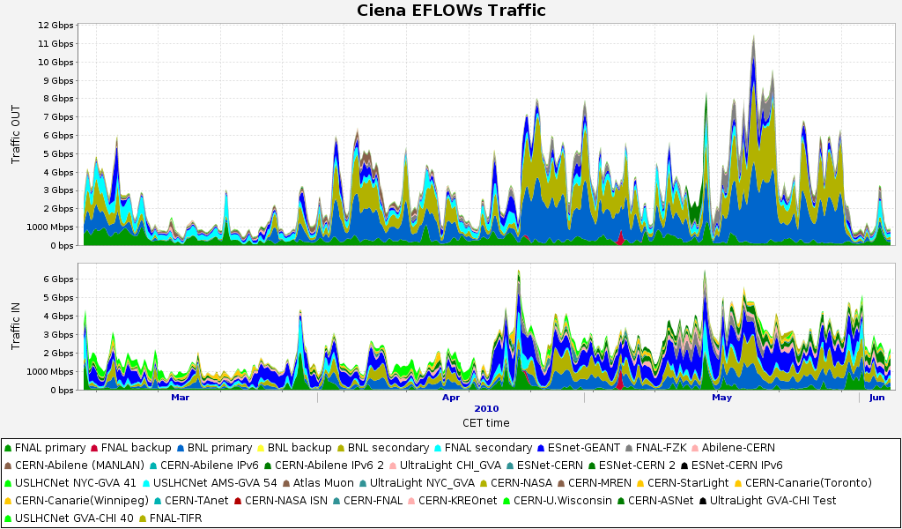
Flow Based Traffic Statistics
Lumi: 10²⁹
LHC start at 7 TeV
Lumi: 10²⁶ -10²⁷
Lumi: 10²⁸
Clearly visible correlation between luminosity and data rates
Notes:
This plot shows the bandwidth utilization in US LHCNet during the past 3 months, which includes the LHC startup at 7 TeV. Indicated are the major steps in luminosity increase. Clearly visible is the correlation between luminosity and data rates. (The period after 10²⁹ includes unfortunately extended down time of the accelerator, hence shows less utilisation.)

Slide 15
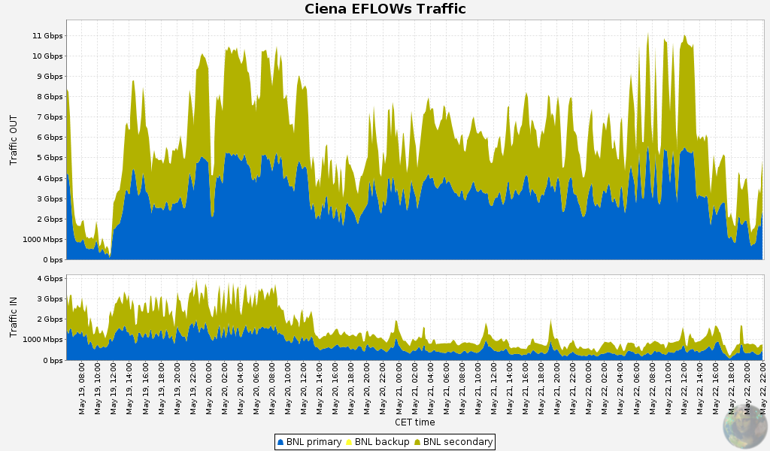
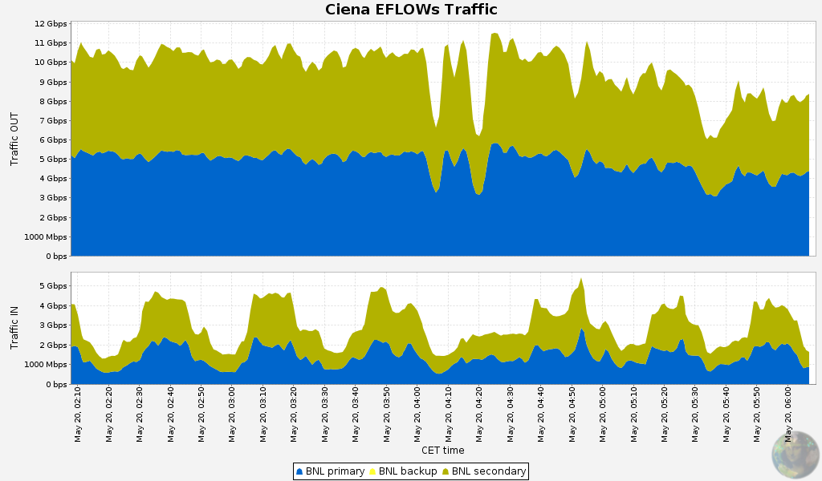
BNL Traffic: May 19-22
Extended periods of high network utilization
4 Day Average
6.7 Gbps
11 G
10 G
9 G
8 G
7 G
Traffic Out
6 G
5 G
4 hour average: 9.6 Gbps
4 G
3 G
2 G
1 G
0
4 G
3 G
Traffic In
2 G
1 G
0
Ceiling observed at ~11 Gbps: due to end-system limitations ?
Notes:
This is a zoom-in to on of the longer periods of high utilisation on the BNL primary (blue) and secondary (yellow-green), the average throughput between CERN and BNL was 6.7 Gbps during 4 days.
<click>
On several occasions we observe the ceiling reached at ~11 Gbps, like in these 4 hours with an average network throughput of 9.6 Gbps.
(The theoretical network limitation in this case, potentially reachable with additional
end-system tuning, is ~14 Gbps.)

Slide 16
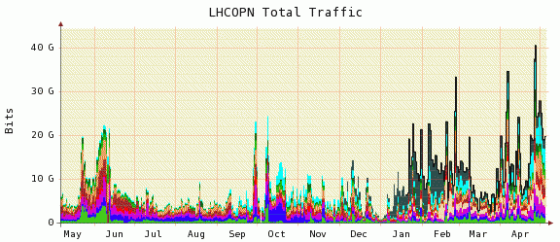
LHCOPN 2009/10 Statistics
LHC Data Taking 2010
STEP09
Fermilab
“Data Challenge”
LHC Data Taking 2009
LHC Luminosity still ramping up, but observed
data rates well above previous estimates !
Notes:
Looking at the broader picture of the LHCOPN, we see already today higher overall network utilzsation than expected from the STEP’09 challenge, previously believed (by some) to be a realistic representation of data movements during LHC operation.

Slide 17
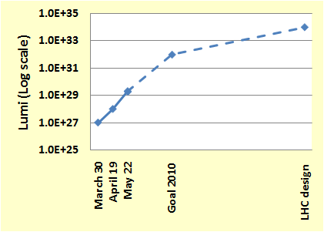
Future LHC Data Rates?
March 30, 2010: LHC started at 7 TeV collision energy
  Low Luminosity, 10²⁶ to 10²⁷, i.e. Low Data Rates
April 19, 2010: 10-fold increase in luminosity (10²⁸)
May 22: another 10-fold increase (10²⁹)
Goal for 2010: 10³² !
[LHC design lumi: 10³⁴]
Design at 14 TeV: ~2014
~100X
End 2010
There is still a 3 order of magnitude improvement expected THIS YEAR
But we need to understand how it will translate into network utilization!
~1000X
May 2010

Slide 18
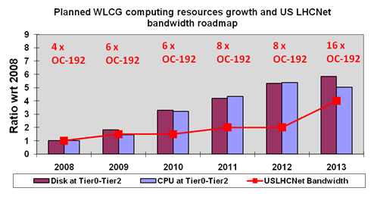
USLHCNet 2008-13 Bandwidth Roadmap
Versus WLCG CPU and Disk Storage Roadmap
40G in 2008
to
400G in 2015
10X in 7 Yrs.
Slower than
historical
trends
[~50X]
 | 2008 | 2009 | 2010 | 2011 | 2012 | 2013 | 2014 | 2015
Disk at Tier0-Tier2 (PB) | 39 | 70 | 127 | 162 | 206
CPU at Tier0-Tier2 (kHEP-SPEC06) | 400 | 577 | 1281 | 1733 | 2158
USLHCNet Bandwidth (OC-192s) | 4 | 6 | 6 | 8 | 12 | 16 | 28 | 40
US LHCNet BW Roadmap shifted to respond to delay in LHC Startup
Outlook: now lags behind disk storage and CPU roadmap
Notes:
The original US LHCNet bandwidth roadmap was designed to match the evolution of the storage
and CPU resources at the WLCG sites. With the delay in LHC startup, we have shifted

Slide 19
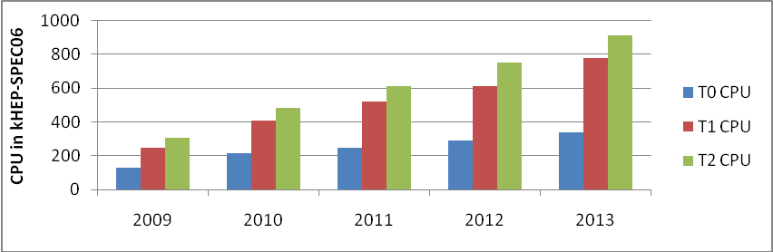
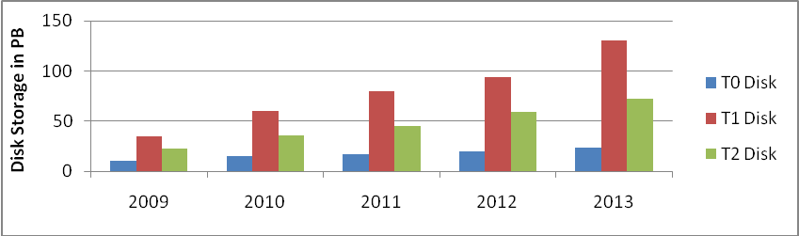
WLCG CPU and Disk Storage Roadmap:
Tier0 vs Tier1s vs Tier2s
WLCG CPU Resources Growth
More Significant
CPU and Disk Increase
At Tier1s and Tier2s
 Increased Reliance
On, and Need for
Additional National,
Regional, and
Transatlantic
Network Resources
WLCG Disk Resources Growth
http://lcg.web.cern.ch/LCG/Resources/WLCGResources-2009-2010_24FEB10.pdf
Notes:
As visible in this plots, resource growth rate is stronger at remote sites. This indicates higher reliance on high performance networking to support the experiments’ operation. It is an indicator that the network resources deployment should not lag behind storage, in order to avoid the
network to become a bottleneck in operations.

Slide 20
Do Tier2s Matter for Transatlantic Networks?

Slide 21
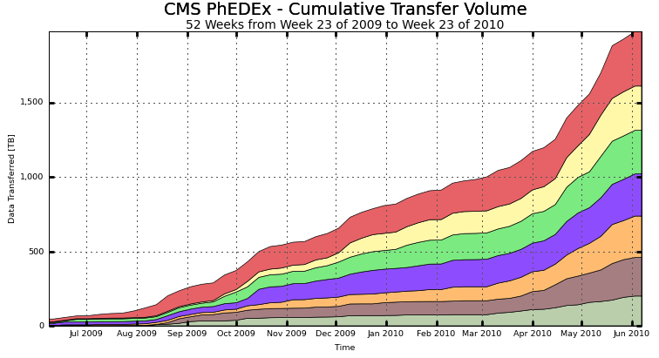
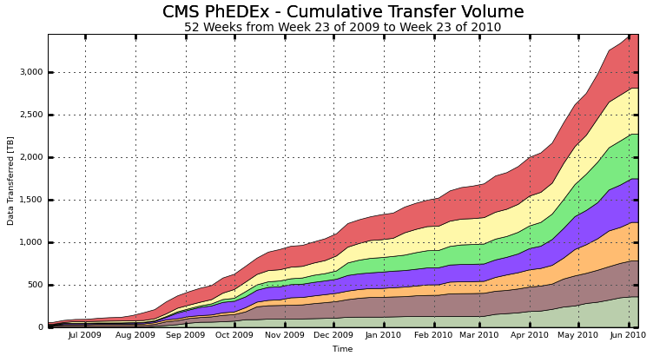
US CMS Tier2s
US National vs Transatlantic Traffic
All traffic to US Tier2 sites
(from all Tier1s and Tier2s)
1.46 Gbps
44% of Traffic to US Tier2s from
Non-US Sites
0.39 Gbps
3.7 Times
Outlook: More TA Traffic From Tier2s
Hope for Insights from This Workshop
Jul09 Aug09 Sep09 Oct09 Nov09 Dec09 Jan10 Feb10 Mar10 Apr10 May10 Jun10
Traffic to US Tier2s from Non-US sites
(from Non-US Tier1s and Tier2s)
2.5
2.59 Gbps
2
1.5
3.8 Times
Data Transferred (PB)
0.67 Gbps
1
0.5
0
Jul09 Aug09 Sep09 Oct09 Nov09 Dec09 Jan10 Feb10 Mar10 Apr10 May10 Jun10
Notes:
In particular, comparing the US Tier2’s traffic between US and non-US sites, we observe that about 44% of the data comes from non-US sources, most of them located in Europe. We can therefore expect more transatlantic network utilisation related to Tier2 operation.
We hope to get a better understanding in this respect during this workshop.

Slide 22
Scheduling Network Resources in US LHCNet
(a.k.a. Dynamic Circuits)

Slide 23
Dynamic Resource Allocation for HEP
US LHCNet has deployed the Internet2 DCN Software Suite since April 2008 as part of our R&D efforts
Dynamic circuit allocation optimizes bulk data transfers
  Guaranteed bandwidth between source-destination sites
  for a requested time period
  Traffic isolation
  Predictable transfers
  User/application control [eventually also system-level controls]
Several US Tier2s as well as Tier1s are reachable
via Internet2 ION and ESnet OSCARS Services
Works with LambdaStation (CMS) and Terapaths (Atlas)
US LHCNet is collaborating with European partners to bring dynamic resource allocation also to LHC sites in Europe
  Which are the European LHC (Tier1/Tier2) sites willing to connect ?

Slide 24
Managing Storage & Network Resources
US LHCNet Progressive Approach
Hadoop:
Distributed File System
FDT:
High-performance data transfer tool
MonALISA:
Distributed Monitoring Framework
DCNSS:
Dynamic Circuit capability
High performance data transfers between LHC sites
ION:
DCN-based service in Internet2
Managed high performance
data transfers between LHC sites over user-controlled, dedicated infrastructure
Notes:
Several components playing a role in managed end-to-end bulk data transfers:
Distributed file system + high performance transfer tools result in high performance data movement
For true manageability, proper hardware awareness is necessary, through monitoring of all components (including network and storage elements), as well as user-control over resource allocation.
US LHCNet approaches this challenge in a systematic way through components like Hadoop, FDT and MonALISA (developed by Caltech) and the DCN software (developed by ESnet and Internet2) for network resource control.

Slide 25
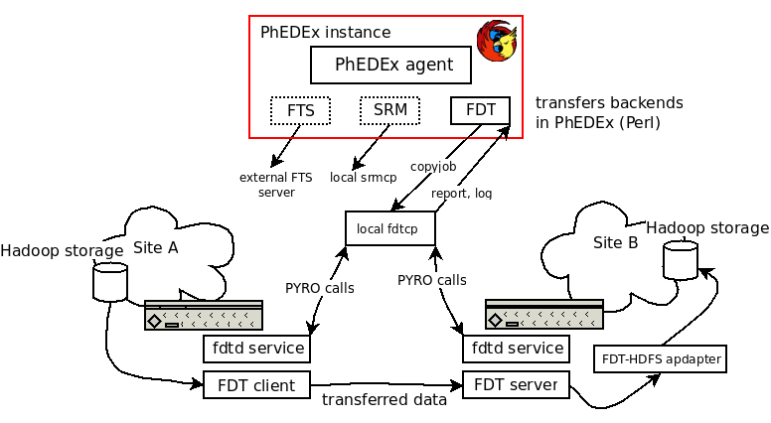
FDT-PhEDEx Integration
FDT uses the IDC API to request dedicated bandwidth between end-systems for the duration of a bulk transfer
  Demonstrated at GLIF 2009 conference in Daejeon
Work ongoing on integrating FDT as transfer tool in PhEDEx
Will allow PhEDEx to transparently reserve network resources in the future, leading to truly managed transfers

Slide 26
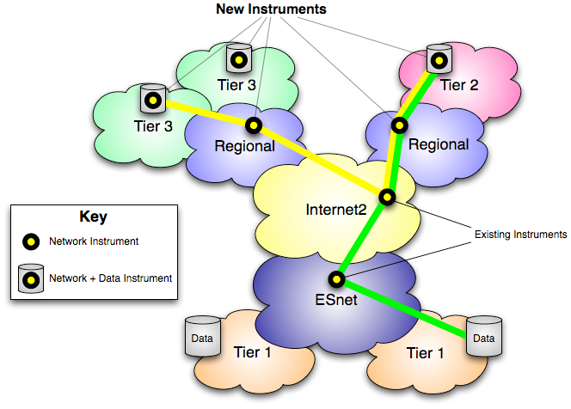
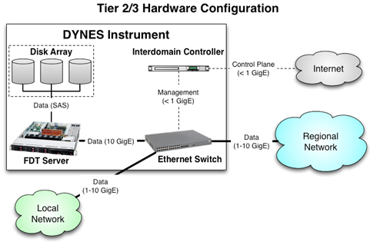
DYNES Project (US NSF)
Internet2, Caltech, Michigan, Vanderbilt
Goal: Connect US LHC sites to the
Dynamic Circuit Infrastructure
  Deploy enabling hardware at
    ~39 campuses (LHC Tier2
    and Tier3 sites) in the US
    Involving ~16 regional networks
Deploy ION-enabled software at sites
  IDC server, FDT server + Ethernet switch
Support dynamic circuit operation
and integration with higher-level
tools through provided API
  Terapaths, LambdaStation,
  PhEDEx, …
Scheduling for optimal use of limited dynamic resources: follow-on project
Notes:
DYNES is a proposal submitted to the NSF as reply to the MRI solicitation in 2009,

Slide 27
Architectural Considerations

Slide 28
Transatlantic Issues
High-Availability solutions require multiple links
with carefully planned path redundancy
TA links more complex than purely terrestrial ones
  Longer distance - more fibre, more equipment
  Typically constructed from segments from multiple owners
Submarine segments: hostile environment, hard access
Comparative Remarks on Outages
Terrestrial spans: more frequent, shorter TTR
  “Easier access” for repairs; but also for diggers, copper thieves,…
  Complex equipment – from amplifiers to add/drop
  multiplexers
Submarine segments: less frequent, much longer TTR
  “Difficult access”  longer repair time; Potential hazards:
  ship anchors, trawlers, geological events, sharks
  Repair speed depends on Time to Arrival of repair fleet,
  problem location, weather conditions

Slide 29
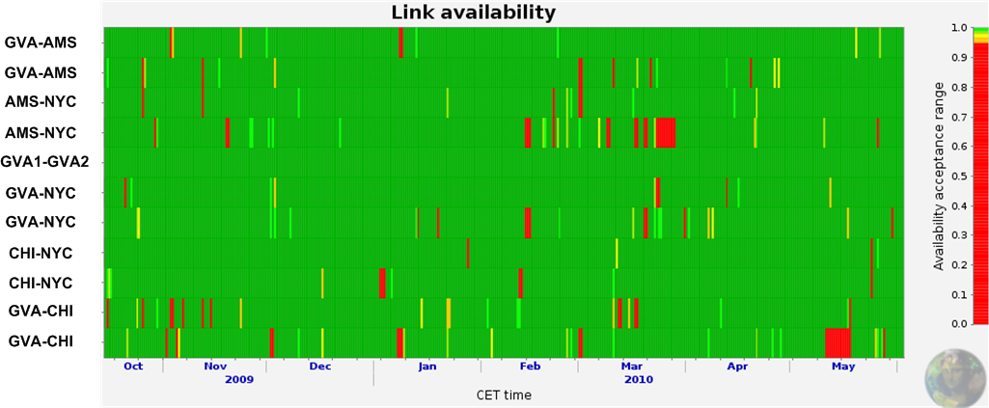
US LHCNet Transatlantic Link Availability and Cuts
99.62 %
Cut in English Channel: 5.5 days
99.62 %
99.63 %
96.19%
100.0 %
99.45 %
98.86 %
Cut in Atlantic, 400 km off US coast – carrier rerouted to alternate path after 7 days
99.90 %
99.18 %
99.33 %
96.24 %
NB: a single submarine cut can reduce availability significantly !
Two options to provide real robustness:
  Buy protected circuits (expensive)
  Construct protected services from unprotected elements
Cost and efficiency mandates the second approach!

Slide 30
Technology Choices
Current US LHCNet design matches well LHC requirements
Best Practices Guidelines:
  E.g. “Switch where you can, route where you must”
We started evaluation of the next generation
architectural design
  Evaluating new and emerging technologies and standards:
  functionality and features, performance and cost
  Fit new developments with future requirements
  In Collaboration with partners
  (ESnet, Internet2, NLR, SURFnet, … )

Slide 31
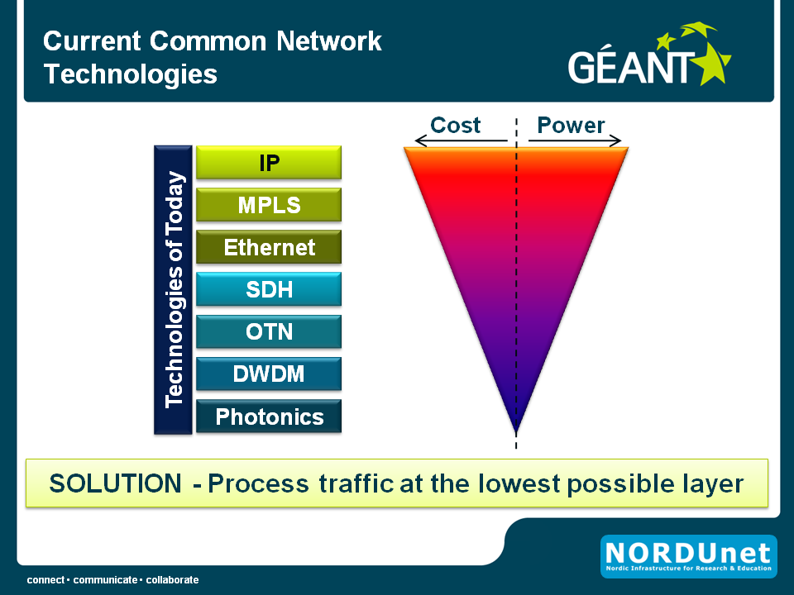
Technology Choices
Tony Breach, GN3 JRA1: Presented
at TNC2010 Conference
Last week
Of main interest
for deployment
in
US LHCNet
Technologies we concentrate on for cost/ performance optimization
!
Notes:
There’s several technology directions we are currently investigating for the potential next generation platform. The higher the level of operation, the higher the associated costs as well as power consumption, as nicely summarized in this slide from Tony Breach’s presentation at the TNC2010 last week. E.g. to optimise on costs as well as performance, switching (at as low level as possible) is preferred to routing.
DWDM and below is not applicable for US LHCNet’s services, while with most services provided at Layer 2, routing becomes expensive solution.

Slide 32
Technology Roadmap
Main requirement: Fast and Robust Protection Switching
  Candidate technologies: SONET, OTN, Carrier Ethernet (G.8031)
Upgrade to 40G/100G
  Ethernet: 40 and 100Gb Ethernet will already be available in 2010
  Transport 40G (OTN-3) is already available and deployed
  in some networks – transatlantic by 2011/2012
  Transport 100G: transatlantic routes probably by 2013/2014
Main Challenge: Cross the Atlantic
End-to-end Dynamic Circuit Support
  Continued use of Dynamic Circuit Control Plane
  Build-out of dynamic network resources on both sides
  of the Atlantic: work with partners (DICE, SURFnet, …)
  Connecting to Tier2 sites: collaborate with regional network
  and local site admins (Expanded direction in DYNES)

Slide 33
US LHCNet Bandwidth Roadmap
Current US LHCNet bandwidth matches CMS and ATLAS requirements for 2010/2011 LHC run period
US LHCNet is prepared for an upgrade in 2011
  If LHC reaches the 2010-11 luminosity goals
  Depending on the Experiments’ Data Model evolution
 | 2009 | 2010 | 2011 | 2012 | 2013
No. of OC-192 links (or equivalent) | 4 – 6 | 6 | 8 | 8 | 16
Line rate [Gbps] | 37.6 – 56.4 | 56.4 | 75.2 | 75.2 | 150.4
Expected Application Payload Bandwidth [Gbps] | 32-48 | 48 | 64 | 64 | 128

Slide 34
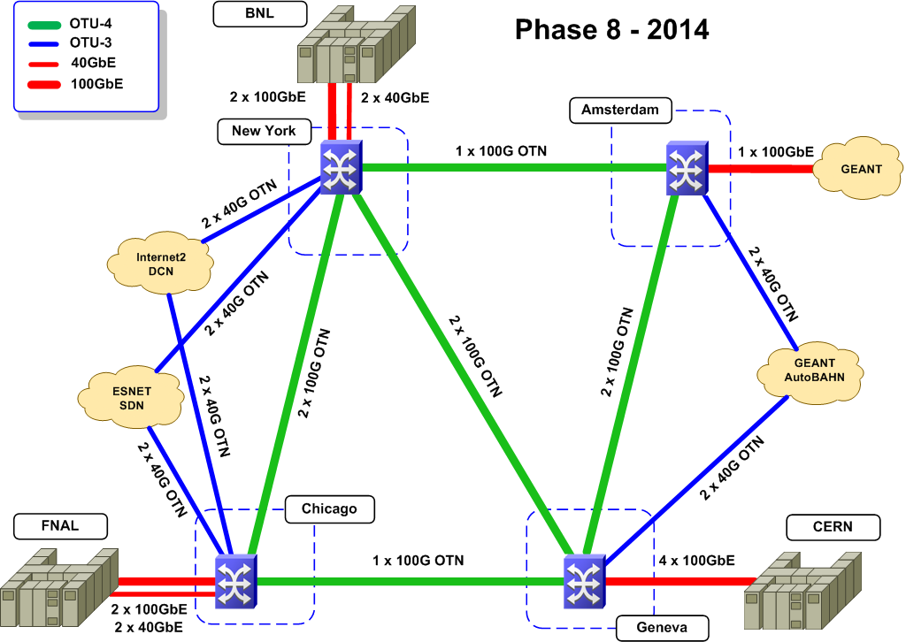
Implementation Scenario: USLHCNet Phase 8
(2015 or 2014 ?): Transition to Full Use of 100G
4 X 100G
Trans-Atlantic
+2 NY-CHI
+ 2 AMS-GVA
Following
an 8 Phase
Plan
2007-2014
Using OTU-4
(100G) Links
+ Next-Gen.
Optical Muxes
Total 25 100G and 16 40G Mux. ports
Notes:
By 2014, potentially earlier depending on deployment status and cost factors, US LHCNet will use 100G throughout its core, and 40/100GE as client interfaces. A possible layout is shown in this picture.

Slide 35
US LHCNet: More than a Carrier
US LHCNet is not “just a carrier”, added value:
  Proximity to the HEP community
    Understand requirements from direct involvement
    Expertise in high throughput data transport,
    global scale real-time monitoring infrastructures,
    LHC Computing Model issues, etc.
  Fast response to (changing) requirements
  Active R&D for HEP networking
    Ultralight and PLaNetS (past NSF-funded projects)
    End-to-end resource monitoring (MonALISA)
    Dynamic resource allocation (e.g. DYNES)
Mission orientation results in cost optimized
high-performance, high-availability services
to HEP, and in particular to the LHC Community
Notes:
US LHCNet is more than just a carrier used by the HEP community. Added value comes from the close collaboration with the LHC experiments, and with other research and education networks. US LHCNet collaborates on implementation of major advanced networking concepts, tailored to the needs of the LHC community.

Slide 36
Conclusions
US LHCNet provides high-availability, high-performance transatlantic networking to the LHC program
  Mission Orientation Coupled to a Multi-layer View
  ➔ Best value for investment
LHC has started 7 TeV operation, expected to last to late 2011, with data rates expected to increase significantly still in 2010
US LHCNet’s Technology roadmap is tailored to provide the
services & availability required by the LHC experiments
US LHCNet’s Bandwidth roadmap is designed to match the LHC experiments’ requirements [just adequate for this run]
  Need to stay agile; respond to the evolving needs
Trends indicate: Tier2 networking is growing in importance
  We need to consider a coordinated effort, led by the
  HEP community, working with the network community

Slide 37
Backup Slides

Slide 38
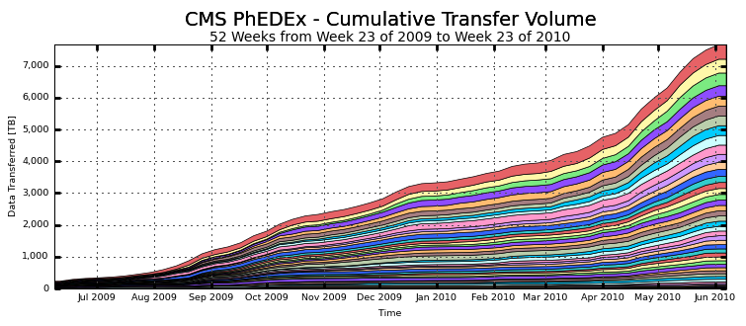
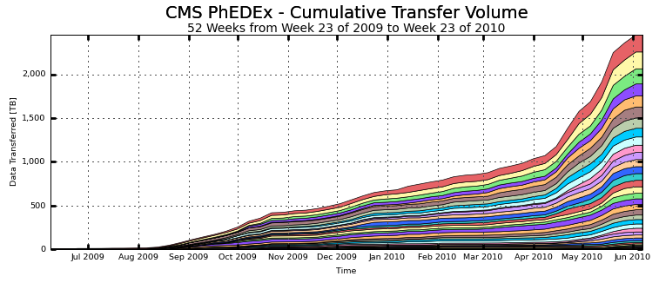
Tier2 – Recent Trends:
Average Throughput Numbers
7
CMS All Tier1 – Tier2 traffic
5.05 Gbps
6
5
4
1.45 Gbps
Data Transferred (PB)
Factor 3.5
3.5 Times
3
2
1
0
Jul09 Aug09 Sep09 Oct09 Nov09 Dec09 Jan10 Feb10 Mar10 Apr10 May10 Jun10
2.5
CMS All Tier2 – Tier2 traffic
2.57 Gbps
2
1.5
Data Transferred (PB)
0.38 Gbps
1
Factor 3.5
6.7 Times
0.5
0
Jul09 Aug09 Sep09 Oct09 Nov09 Dec09 Jan10 Feb10 Mar10 Apr10 May10 Jun10
Notes:
Networking to Tier2s seem to be playing an increasing role, as indicated by the steep raise in throughput to Tier2s in CMS. In particular the Tier2-Tier2 traffic has seen a steep increase by a factor of 6.7 since mid-April, as compared to earlier period.

Slide 39
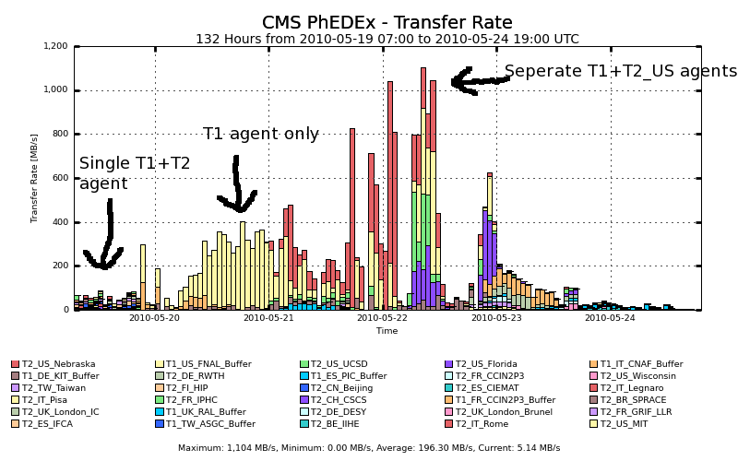
Application Level (PhEDEx)
Tuning Example: Caltech Tier2

Slide 40
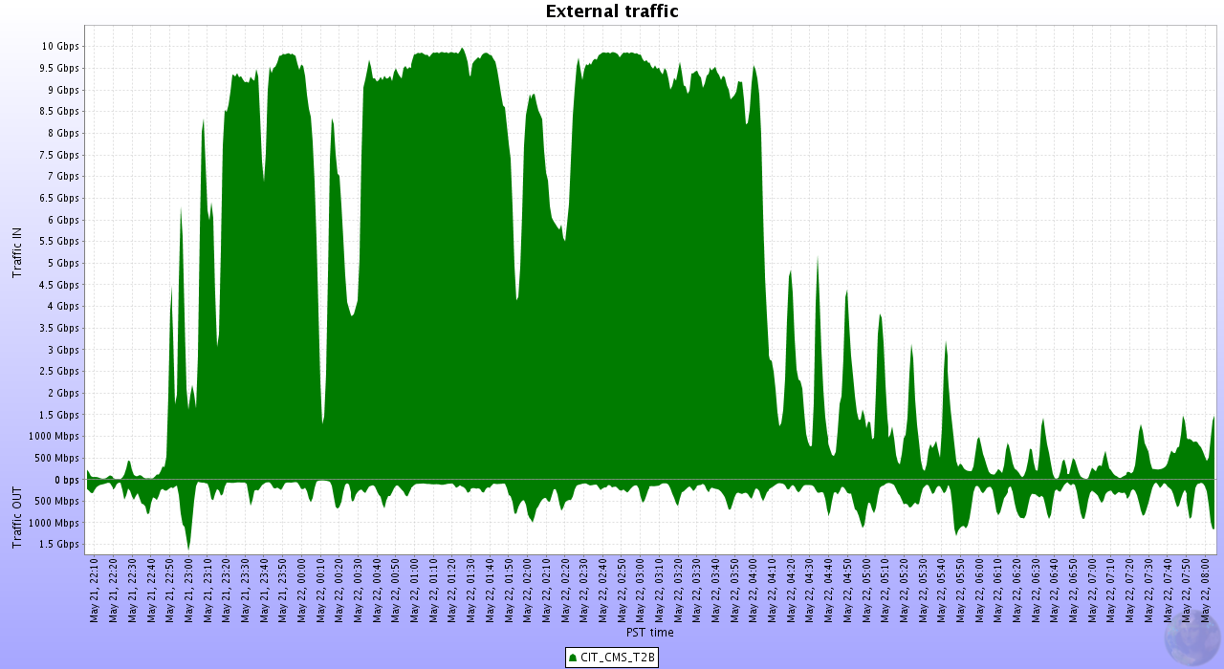
Tuned Tier2 Data Rates
Well-tuned Tier 2 cluster (after Phedex tuning) can saturate a
10 Gbps link over an extended period of time:
10 Gbps
Traffic IN
0 Gbps
OUT
22:50
04:00
Notes:
A single well tuned Tier2 is capable of transferring data at rates saturating its 10Gbps connection

Slide 41

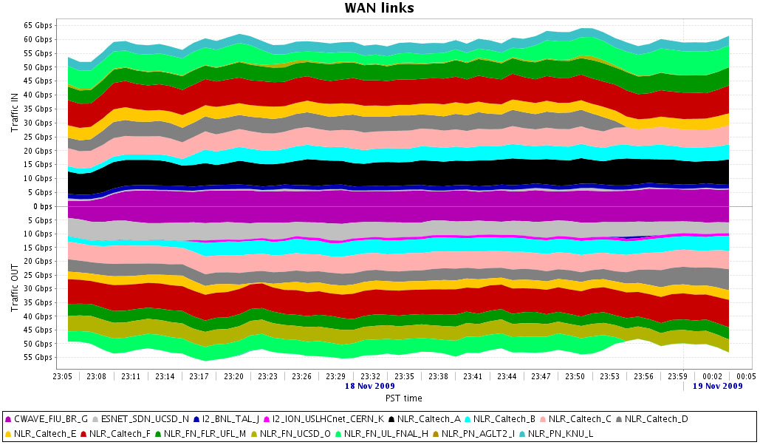
Tier2 Capabilities
SC09
~616 CPU Cores and
38 10GE NICs
in 1 Rack of Servers
53 10GE Switch Ports ~100 TB Disk
Example: Tier 2 Sized Setup
at SuperComputing 2009
Bandwidth Challenge:
70
50
In (Gbps)
30
10
Research Partners: Caltech, FNAL, BNL, Florida, Michigan, Brazil, Korea; ESnet, NLR, FLR, Internet2, ESNet, CWave, AWave, IRNC, KREONet
0
10
30
Traffic: Out
50
60
Max. 119 Gbps; 110 Gbps Sustained; 65 Gbps Outbound
Using FDT and FDT/Hadoop Storage to Storage
NB: Sun
Limitations
Notes:
…and if equipped with multiple WAN uplinks can reach very high throughput rates,
as demonstrated during the SC09 conference (and previous conferences).

