Slide 1
MBHA-001 test program discussion
G. Willering
G. Ninet
F. Mangiarotti
V. Desbiolles
M. Bajko
Magnet test program in EDMS 2330821
2020 February 18 – 11T technical meeting

Slide 2
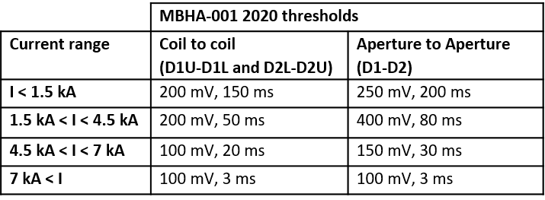
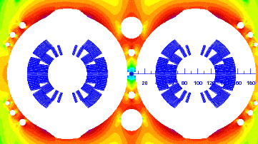
Quench Detection changes (uQDS cards)
Observations:
4 coils voltages measured: D1U, D1L, D2U, D2L
Coil to coil flux jumps (signals D1U-D1L and D2L-D2U) are < half the size of aperture-aperture signal (D1-D2) flux jumps.
Optimization:
Tighter thresholds for coil-coil comparison: lower QI
Larger thresholds for aperture-aperture comparison: Reduce flux jumps trips, but still tight enough for symmetric quenches.
Additional advantage:
Optimized to have single set of thresholds/validation times for both 4.5 K and 1.9 K.
This is also feasible and proposed for uQDS in the LHC.
A-symmetric (Single turn) quenches
Symmetric quenches
D1U
D2U
D1L
D2L

Slide 3
Changes compared to earlier cool down
New in test program
Each “splice cycle” becomes “VI+Splice cycle”.
After 6 kA test, add 1 kA steps to 9 kA (VI). (10 minute plateaus)
Then QH firing at 9 kA to check “spikes”.
Train with 1 kA steps and measure VI (10 minute plateaus)
  Discuss in this meeting “massage training”
QPS optimized: No drift from 1.9 K to 4.5 k, but “normal” 4.5 K operation.
4.5 K single test: VI-splice cycle to 11.95 kA
Magnetic measurement with priority: Machine cycle. Transfer function during VI+splice cycle.
200 K, 3 bar, 1kV QH-coil insulation test, last warm-up.
QH firing at 200 A
No change
ΔT = 30 K
Repeat trim lead test
Repeat RRR
Question mark:
Current cycling?

Slide 4
Overview low current powering up to 6 kA

Slide 5
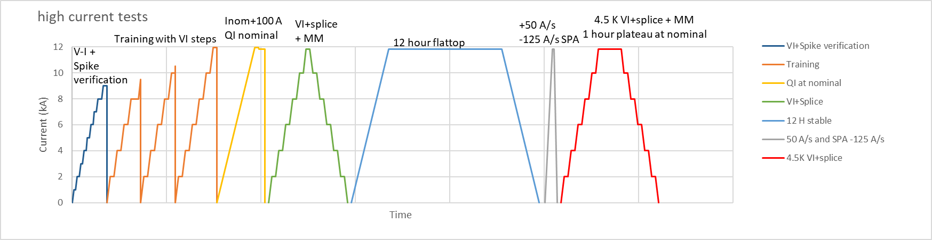
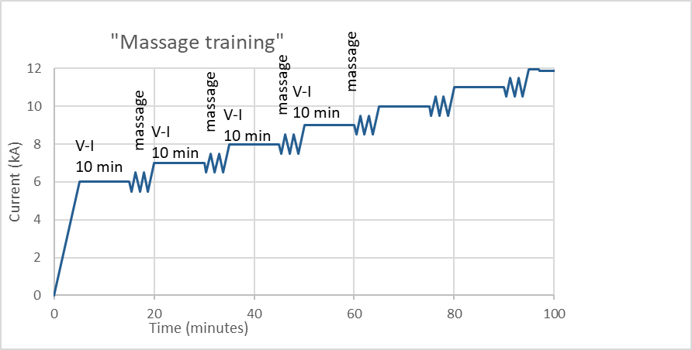
Overview high current powering > 6 kA
Massage training?
When training advances, skip lower current level massages.
Current cycling needed?
25 cycles per hour from 5 kA to 11.85 kA.
If yes, how many?

Slide 6
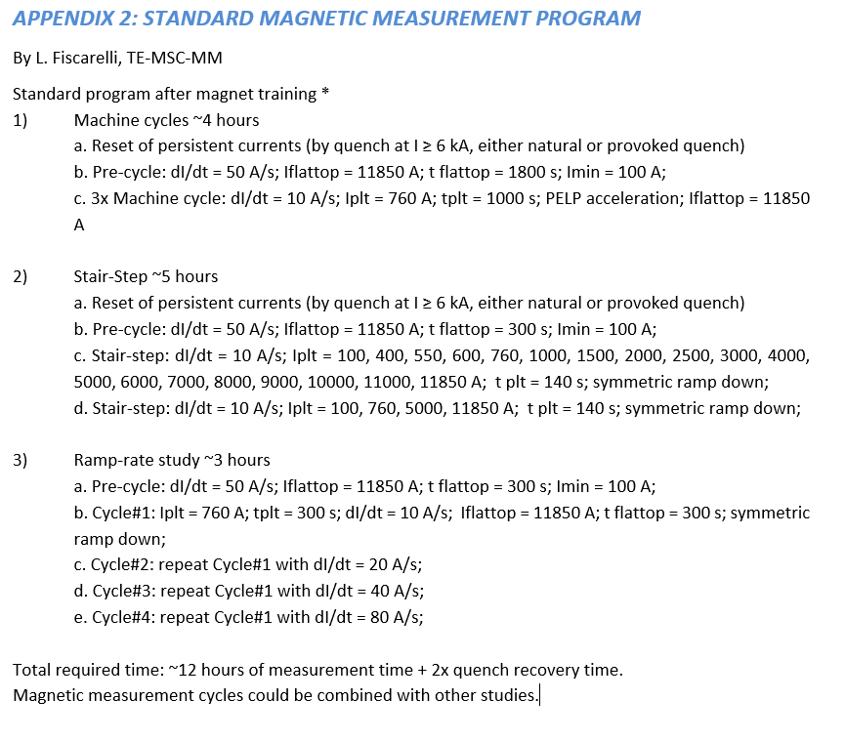
Magnetic Measurements
Time needed: about 1 to 1.5 day
Complete

Slide 7
Quench Heater current
Earlier magnets:
Nominal 150 A was also maximum heater discharge current.
Proposal:
All verification tests and training I_{QH} = 150 A
Additional tests
CD1: 3 discharges of all heaters with I_{QH}= 200 A at I_{magnet} = 0 A
CD1: 1 discharge of all heaters with I_{QH}= 200 A at I_{magnet} = 11.85 kA
CD2: 3 discharges of all heaters with I_{QH}= 200 A at I_{magnet} = 0 A

Slide 8
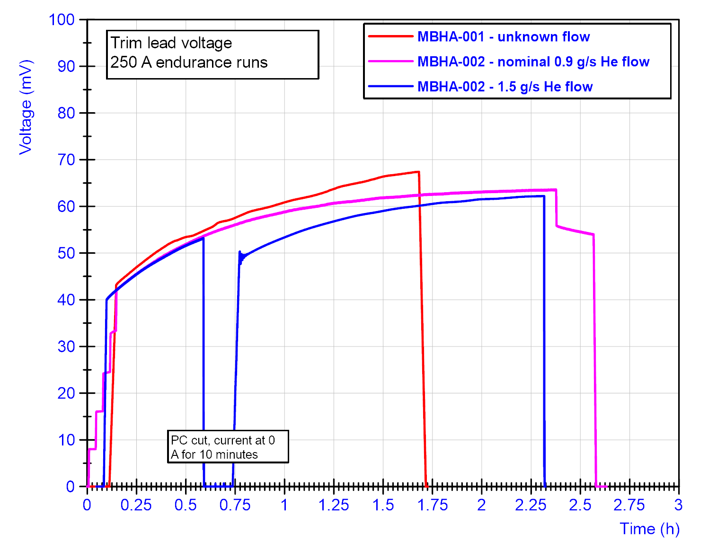
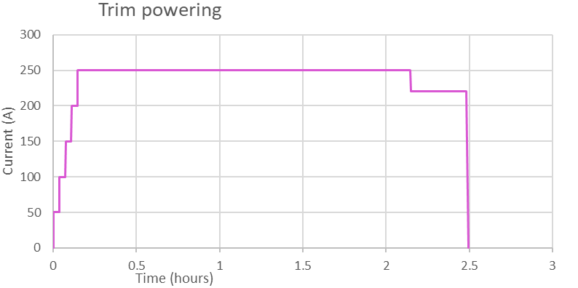
Trim test
Trim already has been tested.
Propose single cycle (to compare with nominal cycle in MBHA-002)
50 A steps to 250 A, stay 2 hours
Reduce to 220 A, stay 20 minutes
Ramp down.

Slide 9
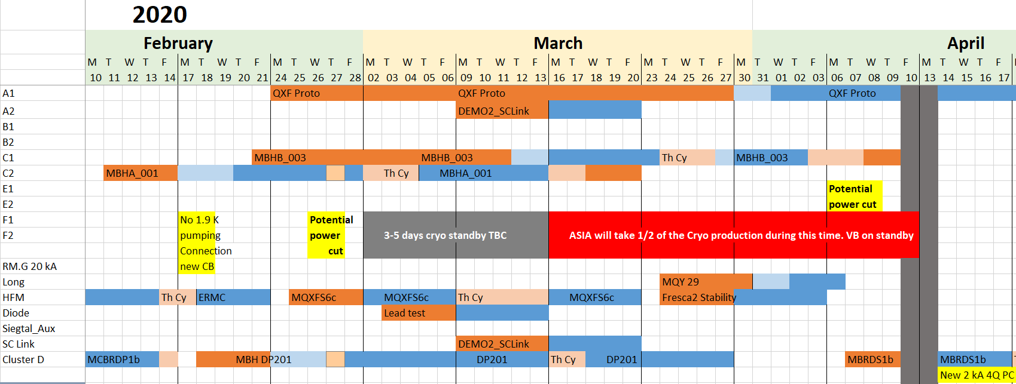
Planning

