Slide 1
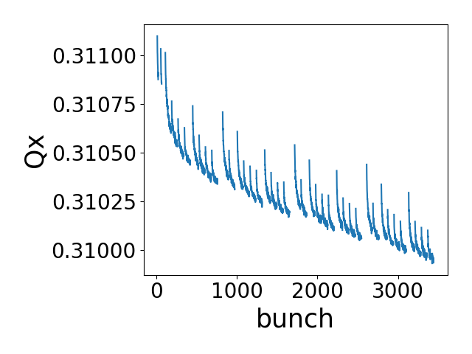
HL-LHC bunch by bunch tune shift: PyHEADTAIL multi-bunch simulation
Flat top
N=2.3e11 ppb
Nbunches=2760

Slide 2
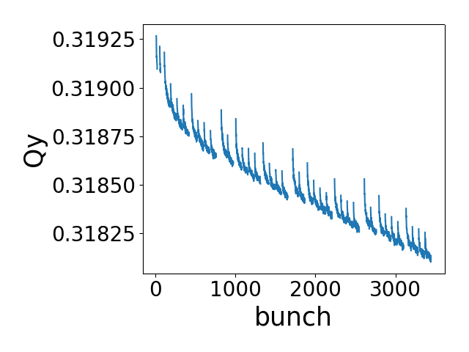
HL-LHC bunch by bunch tune shift: PyHEADTAIL multi-bunch simulation
Flat top
N=2.3e11 ppb
Nbunches=2760

