Slide 1
Update on impedance considerations for HL-LHC equipment
Benoit
On behalf of many colleagues:
Francisco, Jaime, Jan, Nicolo, Adnan, Nicolas, Francesco, Elias, Carlo, Mike, Vasileios, Christine, Branko, Lorenzo
WP2 meeting - March 10th, 2020

Slide 2
New equipment for the HL-LHC era
Equipment installed during LS2
  Low impedance collimators in IR7
  MKI-COOL (1 prototype/8)
  2 TDIS
  New experimental chambers
  TCLD and 11 T dipole (how many?)
Equipment installed during LS3
  IR1 and IR5
    New collimators
    Crab cavities
    Coated triplets
    VAX
    New vacuum transitions and deformable RF fingers
    Y chambers
    BPMs
  IR7:
    Remaining low impedance collimators in IR7
    Electron lens
    Crystal collimators
  7 MKI-COOL
Main question marks:
  Impact of radiation on resistivity for collimators
  Roman pot plans
  Can we design crystal collimators without replacement chamber

Slide 3
New equipment for the HL-LHC era
Equipment installed during LS2
  Low impedance collimators in IR7
  MKI-COOL (1 prototype/8)
  2 TDIS
  New experimental chambers
  TCLD and 11 T dipole (how many?)
Equipment installed during LS3
  IR1 and IR5
    New collimators
    Crab cavities
    Coated triplets
    VAX
    New vacuum transitions and deformable RF fingers
    Y chambers
    BPMs
  IR7:
    Remaining low impedance collimators in IR7
    Electron lens
    Crystal collimators
  7 MKI-COOL
Main question marks:
  Impact of radiation on resistivity for collimators
  Roman pot plans
  Can we design crystal collimators without replacement chamber
Review last week
Precise list of bellows provided
by TE-VSC end of January
Being added to the model

Slide 4
New collimators (N. Biancacci et al)
Major activity for the ABP-HSC team driven by Nicolo
  Validation of batches of absorber blocks
  Impedance acceptance of collimators going in the machine
  Understanding and improving resistivity measurements
  Adapting to constant changes of planning and configuration

Slide 5
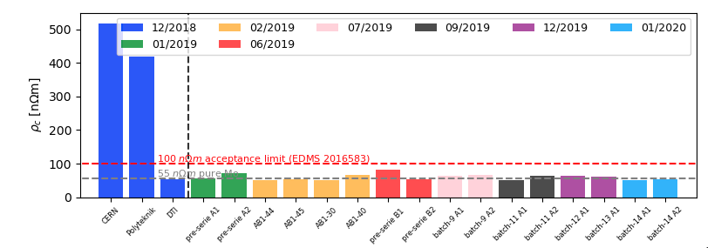
Validation of batches for HL-LHC collimators
Adnan Kurtulus, Nicolo Biancacci et al
All batches are compliant with the acceptance limit.
Lot of work from many colleagues across CERN!

Slide 6
Impedance acceptance of HL-LHC collimators going into the machine during LS2
4 TCLDs
3 TCPPMs
TCSPMs to come

Slide 7
Understanding and improving resistivity measurements
Comparison between several methods (4-point DC method, eddy current testing and resonant cavity)
Understanding the impact of bulk material and coating process on resistivity (roughness, microstructure)
→ Paper submitted
Understanding the impact of radiation on resistivity (need for new cavity design for smaller samples)

Slide 8
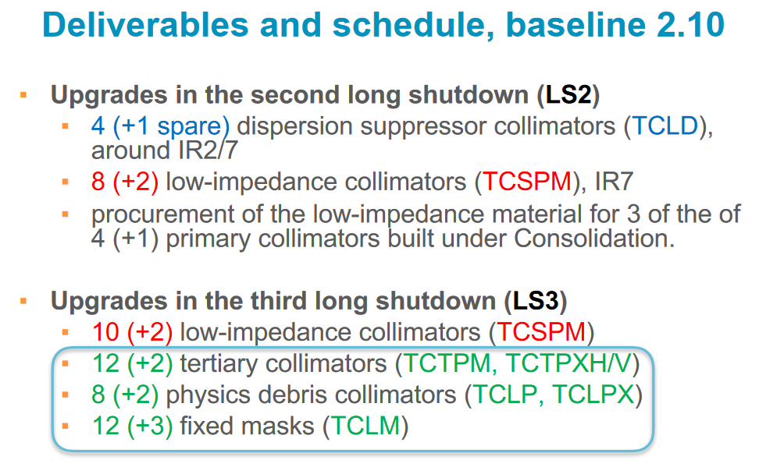
Baseline
S. Redaelli, IR collimator design: WP5 internal review Introduction, 4th March 2020
https://indico.cern.ch/event/892297/
Subject of review on 4th March 2020

Slide 9
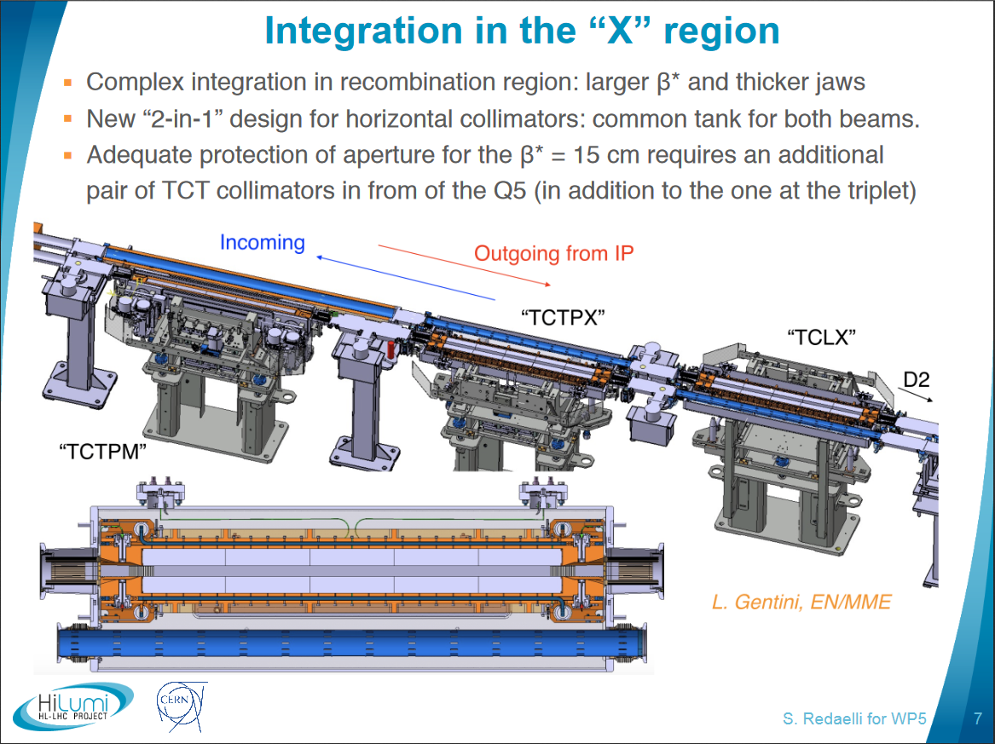
New string of collimators in cell 4
→ Initial design seemed well optimized with RF contacts everywhere
→ Design discussed at IWG#36 and recommendation to smoothen one taper implemented.

Slide 10
What happens to the current collimators?
New primaries and secondaries in IR7 are installed in the slot next to the current collimators :
  Current collimators are planned to stay at parking during Run 3
  They may be removed for Run 4, depending on the experience of Run 3.
New string of IR collimators (TCTPXH, TCTPXV, TCLPX) replace the existing collimators in cell 4
Existing collimators with ferrite are planned to be relocated as TCTs in cell 6 and TCLs in cells 5 or 6.
→ optimal choice will be discussed with collimation team

Slide 11
MKI
New MKI-COOL design to relocate ferrites to the avoid temperature increase of the MKIs.
One prototype will be installed during LS2 and the remaining 7 MKIs should be installed.
Transverse modes added to the impedance model (see last talk at WP2).

Slide 12
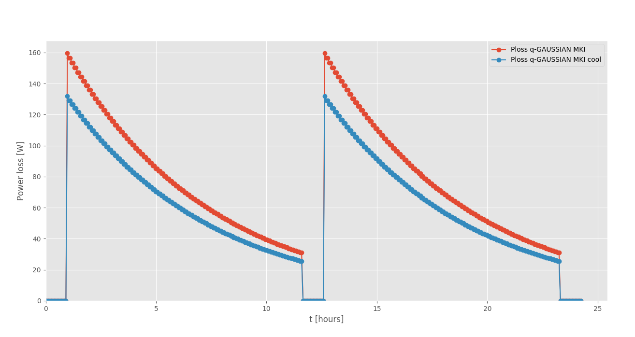
Power loss to MKI versus time for standard HL-LHC fill (as per operational scenario, E. Métral et al, )
Power loss decreases fast with time during the fill.
Dynamic thermal simulations assuming such non-constant power loss is very difficult
and time consuming

Slide 13
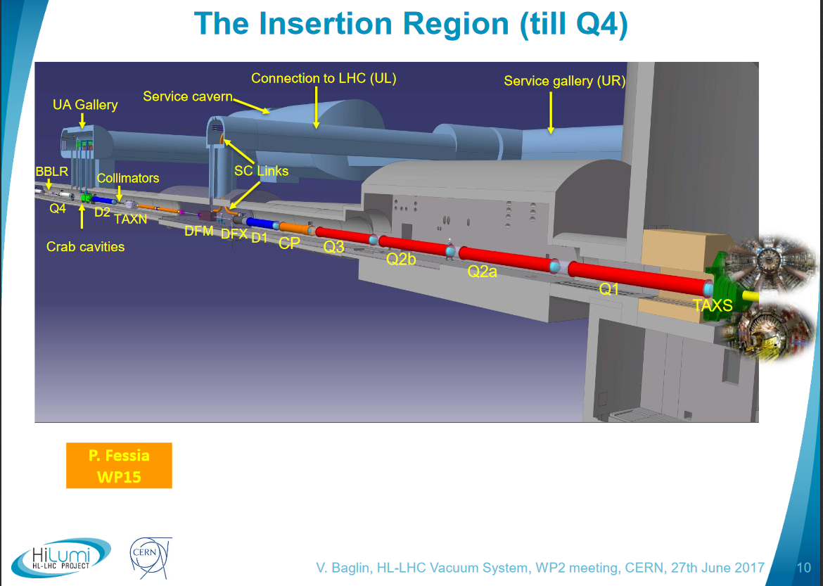
IR vacuum layout

Slide 14
New TDIS
Small changes of design were followed up (glassy sheet)
TDIS prototype (which should finally go into the machine) was measured both to look for non conformities and to see coupling to temperature probes

Slide 15
New experimental chamber
LHCb VELO

Slide 16
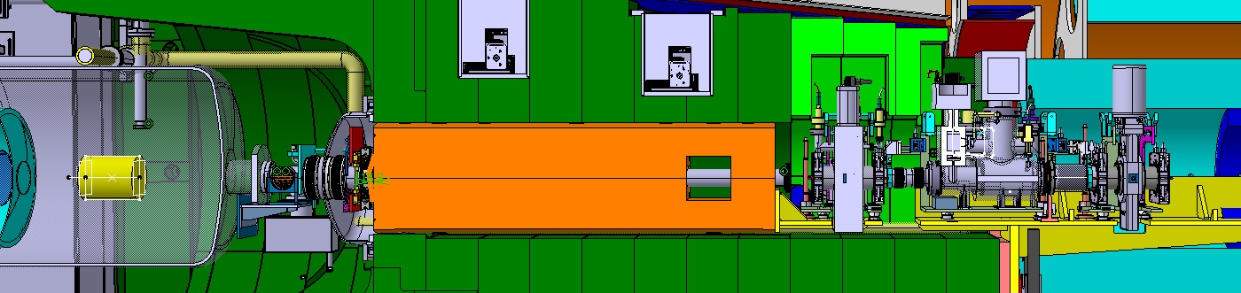
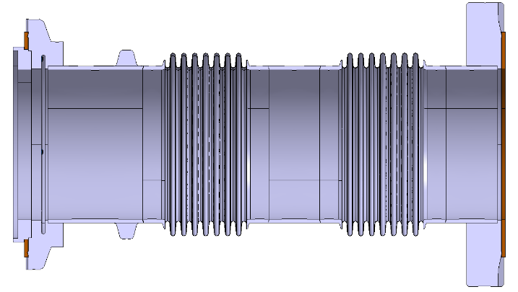
VAX and TAXS/Q1 region
Q1
TAXS
VAX
Request to install 3 unshielded double bellows to:
Allow for 10 mm transverse offset (which sounds large for 41 mm radius)
Allow remote handling
Avoid intervention in confined high radiation area
Request from IWG to install new ID80 valve to minimize transitions → confirmed by Jaime
→ Presentations at WP2

Slide 17
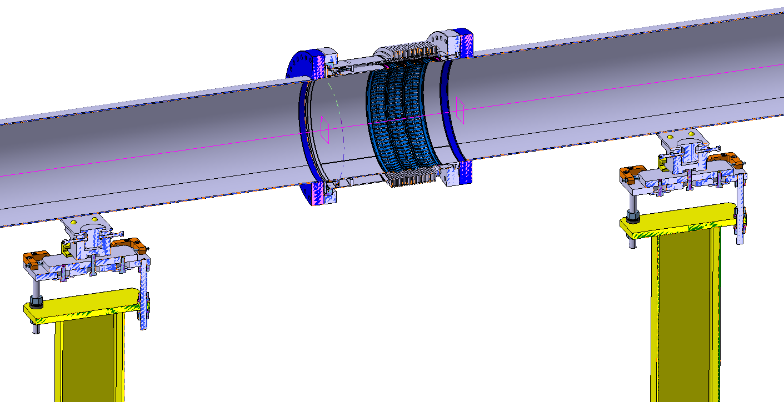
Distances from the IP for the positions of the DRF Modules
Ref. | DCUM (warm) | DCUM (cold) | High of the convolution | Unfolded Length of one cavity | Length DRF (mm) | Length one oblong hole | Diameter of the module (mm)
IP
VAX
Q1
Q1/Q2a | 32895.500 | 32898.80 | 3.637 | 34.927 | 134.708 | 34.033 | 132
Q2a/Q2b | 43680.500 | 43684.00 | 3.637 | 34.927 | 134.708 | 34.033 | 132
Q2b/Q3 | 54465.500 | 54469.30 | 3.637 | 34.927 | 134.708 | 34.033 | 132
Q3/CP | 65565.500 | 65564.90 | 3.637 | 34.927 | 134.708 | 34.033 | 132
CP/D1 | 73519.500 | 73517.75 | 3.637 | 34.927 | 134.708 | 34.033 | 132
End D1
 | 82783.560 | 82775.56 | 3.637 | 34.927 | 134.708 | 34.033 | 150
 | 83404.444 | / | 3.637 | 34.927 | 134.708 | 34.033 | 150
 | 114804.356 | / | 3.637 | 34.927 | 134.708 | 34.033 | 250
 | 121024.356 | / | 3.637 | 34.927 | 134.708 | 34.033 | 250
 | 127267.846 | / | 3.637 | 34.93 | 134.708 | 34.033 | 250
D2
 | 155037.651 | / | 10.766 | 70.302 | 227.037 | 66.877 | 80
 | 156325.75 | / | 10.766 | 70.302 | 225.339 | 66.877 | 80
 | 157541.856 | / | 10.766 | 70.302 | 226.552 | 66.877 | 80
 | 158810.651 | / | 10.766 | 70.302 | 227.037 | 66.877 | 80
 | 160098.75 | / | 10.766 | 70.302 | 225.339 | 66.877 | 80
 | 161314.856 | / | 10.766 | 70.302 | 226.552 | 66.877 | 80
END CRAB
 | 172,397.621 | / | 3.637 | 34.927 | 134.708 | 34.033 | 80
 | 172,923.918 | / | 3.637 | 34.927 | 134.708 | 34.033 | 63
Start Q4
 | 183,286.657 | / | 3.637 | 34.927 | 134.708 | 34.033 | 63
 | 202,554.621 | / | 3.637 | 34.927 | 134.708 | 34.033 | 80
 | 203,080.918 | / | 3.637 | 34.927 | 134.708 | 34.033 | 63
Start Q5
 | 211,506.657 | / | 3.637 | 34.927 | 134.708 | 34.033 | 63
Q6

Slide 18
Distances from the IP for the positions of the DRF
Ref. | DCUM (warm) | DCUM (cold) | High of the convolution | Unfolded Length of one cavity | Length DRF (mm) | Length one oblong hole | Diameter of the module (mm) | angle (height/(hole length/2)) | Ng Formula longitudinal Im(Z/n) in mOhm | CST Im(Z/n) in mOhm | Ng Formula transverse in Ohm/m | CST Im(Zt) in Ohm/m
IP
 | 17597.5 |  | 8 |  | 32.2 |  | 82 |  | 0.081 |  | 345
VAX
 | 18872.5 |  | 8 |  | 32.2 |  | 82 |  | 0.081 |  | 345
TAXS
 | 21248.5 |  | 8 |  | 32.2 |  | 82 |  | 0.081 |  | 345
Q1
Q1/Q2a | 32895.5 | 32898.8 | 3.6 | 34.9 | 134.7 | 34.0 | 132 | 12.1 | 0.077 | 0.0064 | 143 | 14
Q2a/Q2b | 43680.5 | 43684.0 | 3.6 | 34.9 | 134.7 | 34.0 | 132 | 12.1 | 0.077 | 0.0064 | 143 | 14
Q2b/Q3 | 54465.5 | 54469.3 | 3.6 | 34.9 | 134.7 | 34.0 | 132 | 12.1 | 0.077 | 0.0064 | 143 | 14
Q3/CP | 65565.5 | 65564.9 | 3.6 | 34.9 | 134.7 | 34.0 | 132 | 12.1 | 0.077 | 0.0064 | 143 | 14
CP/D1 | 73519.5 | 73517.8 | 3.6 | 34.9 | 134.7 | 34.0 | 132 | 12.1 | 0.077 | 0.0064 | 143 | 14
End D1
D1/DFXJ | 82783.6 | 82775.6 | 3.6 | 34.9 | 134.7 | 34.0 | 150 | 12.1 | 0.068 | 0.0054 | 98 | 8
DFXJ/? | 83404.4 | / | 3.6 | 34.9 | 134.7 | 34.0 | 150 | 12.1 | 0.068 | 0.0054 | 98 | 8
? | 114804.4 | / | 3.6 | 34.9 | 134.7 | 34.0 | 250 | 12.1 | 0.041 | 0.0034 | 22 | 0.8
? | 121024.4 | / | 3.6 | 34.9 | 134.7 | 34.0 | 250 | 12.1 | 0.041 | 0.0034 | 22 | 0.8
?/TAXN | 127267.8 | / | 3.6 | 34.9 | 134.7 | 34.0 | 250 | 12.1 | 0.041 | 0.0034 | 22 | 0.8
Y chamber | 130467.0 |  |  |  |  |  |  |  |  | 0.1125 |  | 102.5
D2 |  |  |  |  |  |  |  |  |  |  |  | 166
/CA1 | 155037.7 | / | 10.8 | 70.3 | 227.0 | 66.9 | 80 | 17.9 | 0.676 | 0.0625 | 2854 | 280
CA1/CA2 | 156325.8 | / | 10.8 | 70.3 | 225.3 | 66.9 | 80 | 17.9 | 0.676 | 0.0625 | 2854 | 280
CA2/ | 157541.9 | / | 10.8 | 70.3 | 226.6 | 66.9 | 80 | 17.9 | 0.676 | 0.0625 | 2854 | 280
/CA3 | 158810.7 | / | 10.8 | 70.3 | 227.0 | 66.9 | 80 | 17.9 | 0.676 | 0.0625 | 2854 | 280
CA3/CA4 | 160098.8 | / | 10.8 | 70.3 | 225.3 | 66.9 | 80 | 17.9 | 0.676 | 0.0625 | 2854 | 280
CA4/ | 161314.9 | / | 10.8 | 70.3 | 226.6 | 66.9 | 80 | 17.9 | 0.676 | 0.0625 | 2854 | 280
END CRAB
? | 172,397.6 | / | 3.6 | 34.9 | 134.7 | 34.0 | 80 | 12.1 | 0.126 | 0.0092 | 612 | 52
/Q4 | 172,923.9 | / | 3.6 | 34.9 | 134.7 | 34.0 | 63 | 12.1 | 0.158 | 0.0119 | 1213 | 120
Start Q4
Q4/ | 183,286.7 | / | 3.6 | 34.9 | 134.7 | 34.0 | 63 | 12.1 | 0.158 | 0.0119 | 1213 | 120
? | 202,554.6 | / | 3.6 | 34.9 | 134.7 | 34.0 | 80 | 12.1 | 0.126 | 0.0092 | 612 | 52
/Q5 | 203,080.9 | / | 3.6 | 34.9 | 134.7 | 34.0 | 63 | 12.1 | 0.158 | 0.0119 | 1213 | 120
Start Q5
/Q5 | 211,506.66 | / | 3.6 | 34.9 | 134.7 | 34.0 | 63 | 12.1 | 0.158 | 0.0119 | 1213 | 120

Slide 19
Some remarks
Why are the crab DRF angle and length significantly larger?
→ being checked with TE-VSC and EN-MME
→ apparently to accommodate +/- 10 mm transverse offset. Not clear it is feasible.

Slide 20
Distances from the IP for the positions of the DRF
Ref. | DCUM (warm) | DCUM (cold) | High of the convolution | Unfolded Length of one cavity | Length DRF (mm) | Length one oblong hole | Diameter of the module (mm) | angle (height/(hole length/2)) | Ng Formula longitudinal Im(Z/n) in mOhm | CST Im(Z/n) in mOhm | Ng Formula transverse in Ohm/m | CST Im(Zt) in Ohm/m
IP
 | 17597.5 |  | 8 |  | 32.2 |  | 82 |  | 0.081 |  | 345
VAX
 | 18872.5 |  | 8 |  | 32.2 |  | 82 |  | 0.081 |  | 345
TAXS
 | 21248.5 |  | 8 |  | 32.2 |  | 82 |  | 0.081 |  | 345
Q1
Q1/Q2a | 32895.5 | 32898.8 | 3.6 | 34.9 | 134.7 | 34.0 | 132 | 12.1 | 0.077 | 0.0064 | 143 | 14
Q2a/Q2b | 43680.5 | 43684.0 | 3.6 | 34.9 | 134.7 | 34.0 | 132 | 12.1 | 0.077 | 0.0064 | 143 | 14
Q2b/Q3 | 54465.5 | 54469.3 | 3.6 | 34.9 | 134.7 | 34.0 | 132 | 12.1 | 0.077 | 0.0064 | 143 | 14
Q3/CP | 65565.5 | 65564.9 | 3.6 | 34.9 | 134.7 | 34.0 | 132 | 12.1 | 0.077 | 0.0064 | 143 | 14
CP/D1 | 73519.5 | 73517.8 | 3.6 | 34.9 | 134.7 | 34.0 | 132 | 12.1 | 0.077 | 0.0064 | 143 | 14
End D1
D1/DFXJ | 82783.6 | 82775.6 | 3.6 | 34.9 | 134.7 | 34.0 | 150 | 12.1 | 0.068 | 0.0054 | 98 | 8
DFXJ/? | 83404.4 | / | 3.6 | 34.9 | 134.7 | 34.0 | 150 | 12.1 | 0.068 | 0.0054 | 98 | 8
? | 114804.4 | / | 3.6 | 34.9 | 134.7 | 34.0 | 250 | 12.1 | 0.041 | 0.0034 | 22 | 0.8
? | 121024.4 | / | 3.6 | 34.9 | 134.7 | 34.0 | 250 | 12.1 | 0.041 | 0.0034 | 22 | 0.8
?/TAXN | 127267.8 | / | 3.6 | 34.9 | 134.7 | 34.0 | 250 | 12.1 | 0.041 | 0.0034 | 22 | 0.8
Y chamber | 130467.0 |  |  |  |  |  |  |  |  | 0.1125 |  | 102.5
D2 |  |  |  |  |  |  |  |  |  |  |  | 166
/CA1 | 155037.7 | / | 10.8 | 70.3 | 227.0 | 66.9 | 80 | 17.9 | 0.676 | 0.0625 | 2854 | 280
CA1/CA2 | 156325.8 | / | 10.8 | 70.3 | 225.3 | 66.9 | 80 | 17.9 | 0.676 | 0.0625 | 2854 | 280
CA2/ | 157541.9 | / | 10.8 | 70.3 | 226.6 | 66.9 | 80 | 17.9 | 0.676 | 0.0625 | 2854 | 280
/CA3 | 158810.7 | / | 10.8 | 70.3 | 227.0 | 66.9 | 80 | 17.9 | 0.676 | 0.0625 | 2854 | 280
CA3/CA4 | 160098.8 | / | 10.8 | 70.3 | 225.3 | 66.9 | 80 | 17.9 | 0.676 | 0.0625 | 2854 | 280
CA4/ | 161314.9 | / | 10.8 | 70.3 | 226.6 | 66.9 | 80 | 17.9 | 0.676 | 0.0625 | 2854 | 280
END CRAB
? | 172,397.6 | / | 3.6 | 34.9 | 134.7 | 34.0 | 80 | 12.1 | 0.126 | 0.0092 | 612 | 52
/Q4 | 172,923.9 | / | 3.6 | 34.9 | 134.7 | 34.0 | 63 | 12.1 | 0.158 | 0.0119 | 1213 | 120
Start Q4
Q4/ | 183,286.7 | / | 3.6 | 34.9 | 134.7 | 34.0 | 63 | 12.1 | 0.158 | 0.0119 | 1213 | 120
? | 202,554.6 | / | 3.6 | 34.9 | 134.7 | 34.0 | 80 | 12.1 | 0.126 | 0.0092 | 612 | 52
/Q5 | 203,080.9 | / | 3.6 | 34.9 | 134.7 | 34.0 | 63 | 12.1 | 0.158 | 0.0119 | 1213 | 120
Start Q5
/Q5 | 211,506.66 | / | 3.6 | 34.9 | 134.7 | 34.0 | 63 | 12.1 | 0.158 | 0.0119 | 1213 | 120

Slide 21
Some remarks
Why are the crab DRF angle and length significantly larger?
VAX unshielded bellows have a comparable impedance to the shielded crab bellow (same constraint of very large transverse offset)

Slide 22
Distances from the IP for the positions of the DRF
Ref. | DCUM (warm) | DCUM (cold) | High of the convolution | Unfolded Length of one cavity | Length DRF (mm) | Length one oblong hole | Diameter of the module (mm) | angle (height/(hole length/2)) | Ng Formula longitudinal Im(Z/n) in mOhm | CST Im(Z/n) in mOhm | Ng Formula transverse in Ohm/m | CST Im(Zt) in Ohm/m
IP
 | 17597.5 |  | 8 |  | 32.2 |  | 82 |  | 0.081 |  | 345
VAX
 | 18872.5 |  | 8 |  | 32.2 |  | 82 |  | 0.081 |  | 345
TAXS
 | 21248.5 |  | 8 |  | 32.2 |  | 82 |  | 0.081 |  | 345
Q1
Q1/Q2a | 32895.5 | 32898.8 | 3.6 | 34.9 | 134.7 | 34.0 | 132 | 12.1 | 0.077 | 0.0064 | 143 | 14
Q2a/Q2b | 43680.5 | 43684.0 | 3.6 | 34.9 | 134.7 | 34.0 | 132 | 12.1 | 0.077 | 0.0064 | 143 | 14
Q2b/Q3 | 54465.5 | 54469.3 | 3.6 | 34.9 | 134.7 | 34.0 | 132 | 12.1 | 0.077 | 0.0064 | 143 | 14
Q3/CP | 65565.5 | 65564.9 | 3.6 | 34.9 | 134.7 | 34.0 | 132 | 12.1 | 0.077 | 0.0064 | 143 | 14
CP/D1 | 73519.5 | 73517.8 | 3.6 | 34.9 | 134.7 | 34.0 | 132 | 12.1 | 0.077 | 0.0064 | 143 | 14
End D1
D1/DFXJ | 82783.6 | 82775.6 | 3.6 | 34.9 | 134.7 | 34.0 | 150 | 12.1 | 0.068 | 0.0054 | 98 | 8
DFXJ/? | 83404.4 | / | 3.6 | 34.9 | 134.7 | 34.0 | 150 | 12.1 | 0.068 | 0.0054 | 98 | 8
? | 114804.4 | / | 3.6 | 34.9 | 134.7 | 34.0 | 250 | 12.1 | 0.041 | 0.0034 | 22 | 0.8
? | 121024.4 | / | 3.6 | 34.9 | 134.7 | 34.0 | 250 | 12.1 | 0.041 | 0.0034 | 22 | 0.8
?/TAXN | 127267.8 | / | 3.6 | 34.9 | 134.7 | 34.0 | 250 | 12.1 | 0.041 | 0.0034 | 22 | 0.8
Y chamber | 130467.0 |  |  |  |  |  |  |  |  | 0.1125 |  | 102.5
D2 |  |  |  |  |  |  |  |  |  |  |  | 166
/CA1 | 155037.7 | / | 10.8 | 70.3 | 227.0 | 66.9 | 80 | 17.9 | 0.676 | 0.0625 | 2854 | 280
CA1/CA2 | 156325.8 | / | 10.8 | 70.3 | 225.3 | 66.9 | 80 | 17.9 | 0.676 | 0.0625 | 2854 | 280
CA2/ | 157541.9 | / | 10.8 | 70.3 | 226.6 | 66.9 | 80 | 17.9 | 0.676 | 0.0625 | 2854 | 280
/CA3 | 158810.7 | / | 10.8 | 70.3 | 227.0 | 66.9 | 80 | 17.9 | 0.676 | 0.0625 | 2854 | 280
CA3/CA4 | 160098.8 | / | 10.8 | 70.3 | 225.3 | 66.9 | 80 | 17.9 | 0.676 | 0.0625 | 2854 | 280
CA4/ | 161314.9 | / | 10.8 | 70.3 | 226.6 | 66.9 | 80 | 17.9 | 0.676 | 0.0625 | 2854 | 280
END CRAB
? | 172,397.6 | / | 3.6 | 34.9 | 134.7 | 34.0 | 80 | 12.1 | 0.126 | 0.0092 | 612 | 52
/Q4 | 172,923.9 | / | 3.6 | 34.9 | 134.7 | 34.0 | 63 | 12.1 | 0.158 | 0.0119 | 1213 | 120
Start Q4
Q4/ | 183,286.7 | / | 3.6 | 34.9 | 134.7 | 34.0 | 63 | 12.1 | 0.158 | 0.0119 | 1213 | 120
? | 202,554.6 | / | 3.6 | 34.9 | 134.7 | 34.0 | 80 | 12.1 | 0.126 | 0.0092 | 612 | 52
/Q5 | 203,080.9 | / | 3.6 | 34.9 | 134.7 | 34.0 | 63 | 12.1 | 0.158 | 0.0119 | 1213 | 120
Start Q5
/Q5 | 211,506.66 | / | 3.6 | 34.9 | 134.7 | 34.0 | 63 | 12.1 | 0.158 | 0.0119 | 1213 | 120

Slide 23
Some remarks
Why are the crab DRF angle and length significantly larger?
VAX unshielded bellows have a comparable impedance to the shielded crab bellow (same constraint of very large transverse offset)
Y chamber included

Slide 24
Distances from the IP for the positions of the DRF
Ref. | DCUM (warm) | DCUM (cold) | High of the convolution | Unfolded Length of one cavity | Length DRF (mm) | Length one oblong hole | Diameter of the module (mm) | angle (height/(hole length/2)) | Ng Formula longitudinal Im(Z/n) in mOhm | CST Im(Z/n) in mOhm | Ng Formula transverse in Ohm/m | CST Im(Zt) in Ohm/m
IP
 | 17597.5 |  | 8 |  | 32.2 |  | 82 |  | 0.081 |  | 345
VAX
 | 18872.5 |  | 8 |  | 32.2 |  | 82 |  | 0.081 |  | 345
TAXS
 | 21248.5 |  | 8 |  | 32.2 |  | 82 |  | 0.081 |  | 345
Q1
Q1/Q2a | 32895.5 | 32898.8 | 3.6 | 34.9 | 134.7 | 34.0 | 132 | 12.1 | 0.077 | 0.0064 | 143 | 14
Q2a/Q2b | 43680.5 | 43684.0 | 3.6 | 34.9 | 134.7 | 34.0 | 132 | 12.1 | 0.077 | 0.0064 | 143 | 14
Q2b/Q3 | 54465.5 | 54469.3 | 3.6 | 34.9 | 134.7 | 34.0 | 132 | 12.1 | 0.077 | 0.0064 | 143 | 14
Q3/CP | 65565.5 | 65564.9 | 3.6 | 34.9 | 134.7 | 34.0 | 132 | 12.1 | 0.077 | 0.0064 | 143 | 14
CP/D1 | 73519.5 | 73517.8 | 3.6 | 34.9 | 134.7 | 34.0 | 132 | 12.1 | 0.077 | 0.0064 | 143 | 14
End D1
D1/DFXJ | 82783.6 | 82775.6 | 3.6 | 34.9 | 134.7 | 34.0 | 150 | 12.1 | 0.068 | 0.0054 | 98 | 8
DFXJ/? | 83404.4 | / | 3.6 | 34.9 | 134.7 | 34.0 | 150 | 12.1 | 0.068 | 0.0054 | 98 | 8
? | 114804.4 | / | 3.6 | 34.9 | 134.7 | 34.0 | 250 | 12.1 | 0.041 | 0.0034 | 22 | 0.8
? | 121024.4 | / | 3.6 | 34.9 | 134.7 | 34.0 | 250 | 12.1 | 0.041 | 0.0034 | 22 | 0.8
?/TAXN | 127267.8 | / | 3.6 | 34.9 | 134.7 | 34.0 | 250 | 12.1 | 0.041 | 0.0034 | 22 | 0.8
Y chamber | 130467.0 |  |  |  |  |  |  |  |  | 0.1125 |  | 102.5
D2 |  |  |  |  |  |  |  |  |  |  |  | 166
/CA1 | 155037.7 | / | 10.8 | 70.3 | 227.0 | 66.9 | 80 | 17.9 | 0.676 | 0.0625 | 2854 | 280
CA1/CA2 | 156325.8 | / | 10.8 | 70.3 | 225.3 | 66.9 | 80 | 17.9 | 0.676 | 0.0625 | 2854 | 280
CA2/ | 157541.9 | / | 10.8 | 70.3 | 226.6 | 66.9 | 80 | 17.9 | 0.676 | 0.0625 | 2854 | 280
/CA3 | 158810.7 | / | 10.8 | 70.3 | 227.0 | 66.9 | 80 | 17.9 | 0.676 | 0.0625 | 2854 | 280
CA3/CA4 | 160098.8 | / | 10.8 | 70.3 | 225.3 | 66.9 | 80 | 17.9 | 0.676 | 0.0625 | 2854 | 280
CA4/ | 161314.9 | / | 10.8 | 70.3 | 226.6 | 66.9 | 80 | 17.9 | 0.676 | 0.0625 | 2854 | 280
END CRAB
? | 172,397.6 | / | 3.6 | 34.9 | 134.7 | 34.0 | 80 | 12.1 | 0.126 | 0.0092 | 612 | 52
/Q4 | 172,923.9 | / | 3.6 | 34.9 | 134.7 | 34.0 | 63 | 12.1 | 0.158 | 0.0119 | 1213 | 120
Start Q4
Q4/ | 183,286.7 | / | 3.6 | 34.9 | 134.7 | 34.0 | 63 | 12.1 | 0.158 | 0.0119 | 1213 | 120
? | 202,554.6 | / | 3.6 | 34.9 | 134.7 | 34.0 | 80 | 12.1 | 0.126 | 0.0092 | 612 | 52
/Q5 | 203,080.9 | / | 3.6 | 34.9 | 134.7 | 34.0 | 63 | 12.1 | 0.158 | 0.0119 | 1213 | 120
Start Q5
/Q5 | 211,506.66 | / | 3.6 | 34.9 | 134.7 | 34.0 | 63 | 12.1 | 0.158 | 0.0119 | 1213 | 120

Slide 25
New deformable RF fingers

Slide 26
Y chambers
New IR Y chambers
  Simulations redone with double Y chamber, as simulating only one leads to ambiguous results (too large difference between input and output radius)
    Using such a setup, modes disappear
  Request to modify the geometry and remove copper lamination
  Computations presented at IWG and proposal to replace lamination by copper coating (additional advantage that the weld is then covered by the coating)
  Accepted by IWG and added to HL-LHC model
IR2 and IR8 Y chambers
  simulations redone with double chamber

Slide 27
Electron lens:
  Design has not changed since last iteration (Diego Perini, 4 March 2020).
  2 BPM + BGC not yet integrated.
  Deadline for input: 6 months, before sending the design to collaborating institute. Review planned to fix the design in 1 year.
Crystal collimators:
  Collaboration with Sapienza (Danilo Quartullo and Mauro Migliorati)
  Improvement in understanding the measurements, but there are still discrepancies.
  Still major question marks: not clear that a design without replacement chamber can be made transparent for protons.

