Slide 1
A walk on the weld side of HL-LHC beam screens
N. Mounet, S. Antipov, E. Métral, B. Salvant, C. Zannini.
Acknowledgements: D. Amorim, G. Arduini, S. Arsenyev, N. Biancacci, R. de Maria, N. Kos, R. Tomas.

Slide 2
The context
In the HL-LHC triplets (and beyond, up to the D2 magnet), beam screens exhibit a new octagonal shape, with two longitudinal welds all along.
HL-LHC triplet layout
R. De Maria et al, 157th WP2 meeting (03/09/2019)

Slide 3
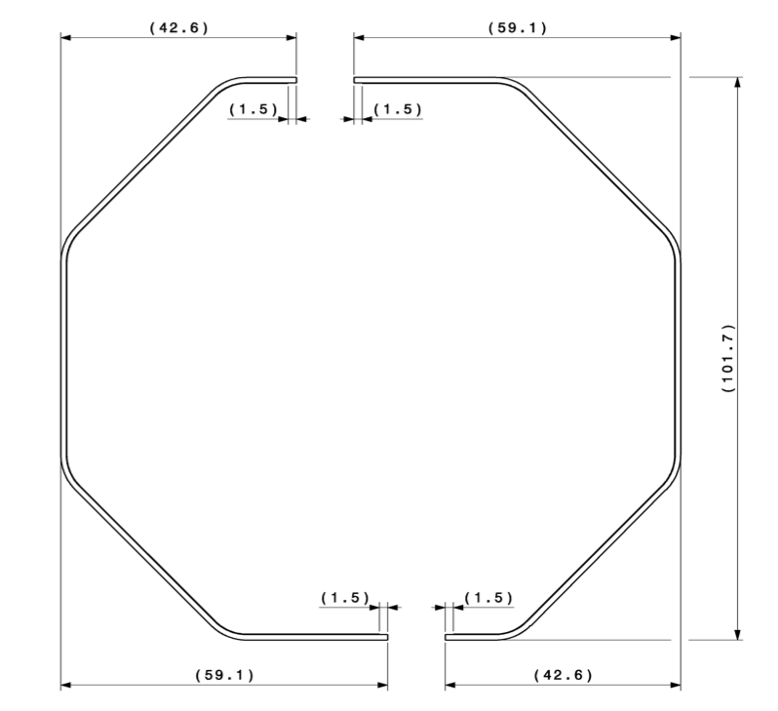
The context
The triplet zone is a sensitive region for transverse stability because of the magnitude of the beta functions when strongly squeezed (both round and flat optics).
There are two options to position the beam screens: with the weld on the top/bottom facets, or on the left/right ones:
Q1 beam screen before assembly
From N. Kos

Slide 4
The context and the question
The welds are in stainless steel, NOT copper-coated (but with aC coating), and up to 4mm-large.
→ this is seen by the beam and introduce a significant detrimental factor on the resistive-wall impedance.
The plane on which the weld is located can matter, depending on the difference between x and y beta functions
→ an impedance optimization is in principle possible (question by N. Kos), with 90° weld rotation.
→ But is it worth the effort?

Slide 5
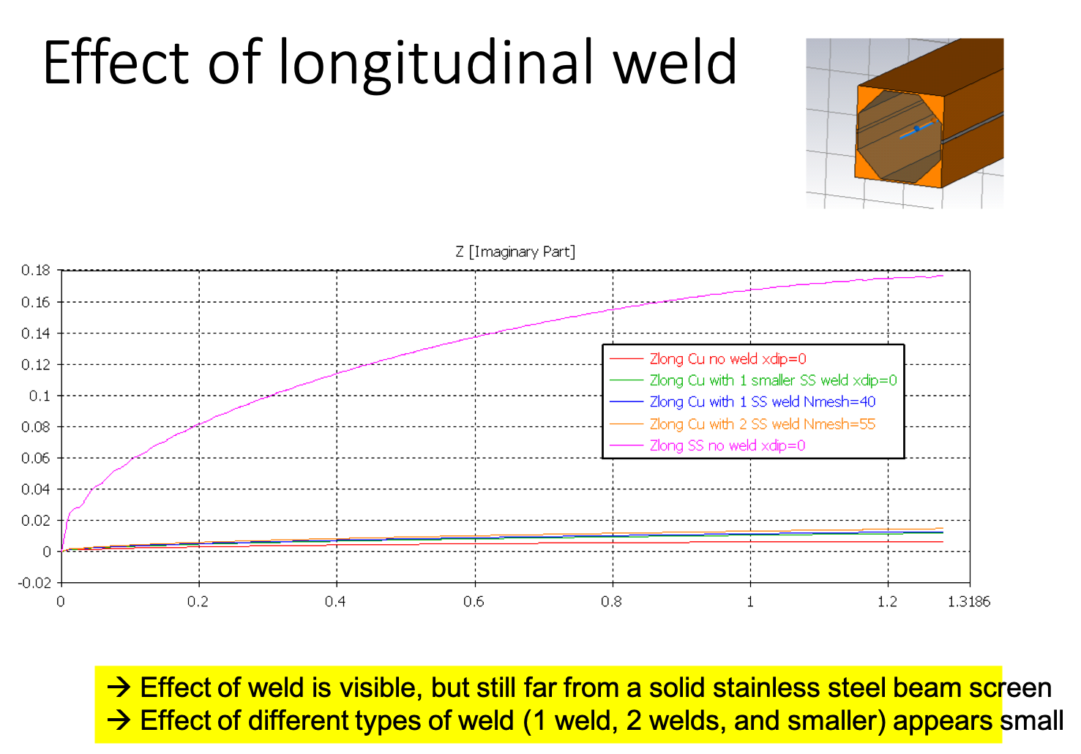
The weld factor(s)
Previous works to compute this factor, by Carlo Zannini and Benoît Salvant:
B. Salvant, N. Wang, C. Zannini (14/12/2015)

Slide 6
The weld factor(s)
Carlo Zannini is currently computing the most up-to-date weld factors.
In the meanwhile, I have made estimates based on Carlo’s 2013 computations, taking into account the larger weld width (4mm instead of 2), and the fact they are now in two opposite facets, also using Benoît Salvant’s past computations.
In the end, “my” weld factor in the plane of the weld (applied on top of a cylindrical resistive-wall impedance with the radius defined as the smallest distance to the beam screen facets) is:
  2.3 for the D2 beam screen (called BS_88 in the impedance model)
  2.15 for the other beam screens (BS_101 and BS_121, for resp. Q1 and Q2-Q3-CP-D1, see drawings in backup).
In the other plane, the factor is 1.

Slide 7
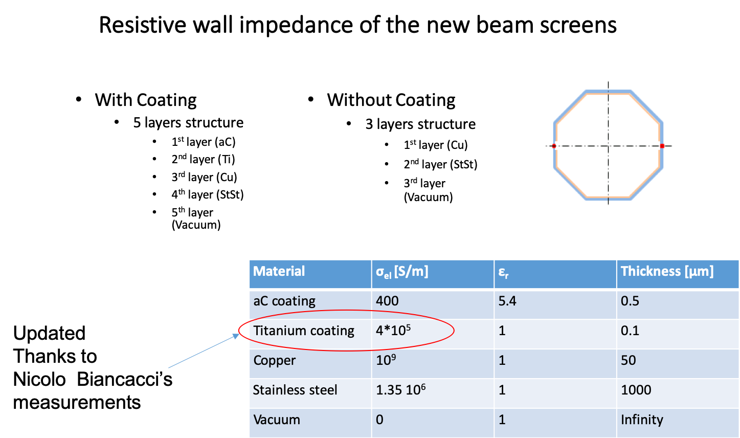
Beam screen resistive-wall impedance
On top of the weld, the beam screen is also a complex multilayer conductive object with no less than 4 layers: aC /Ti / Cu / stainless steel
Only Cu and stainless steel really matter for stability.
Cu is also magneto-resistant and its conductivity depends a lot on temperature and purity (beam screens are at cryogenic temperatures).
From B. Salvant, N. Wang, C. Zannini (14/12/2015)

Slide 8
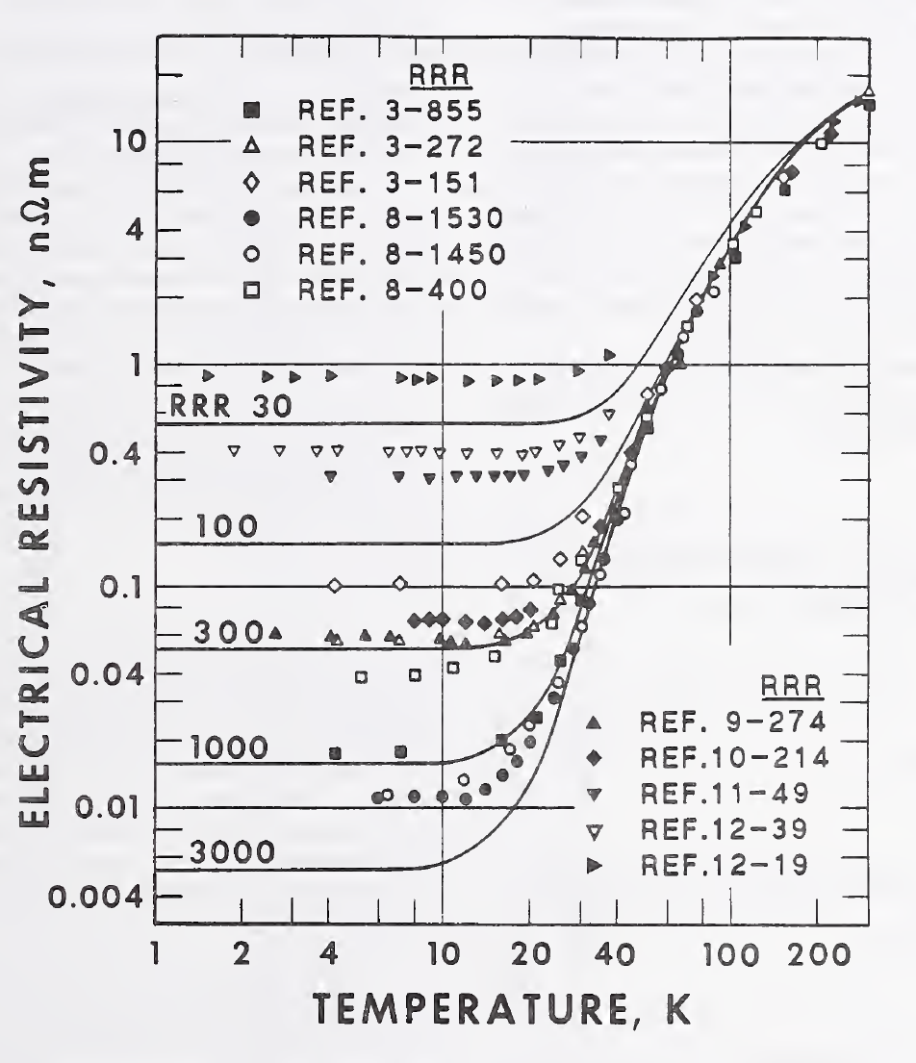
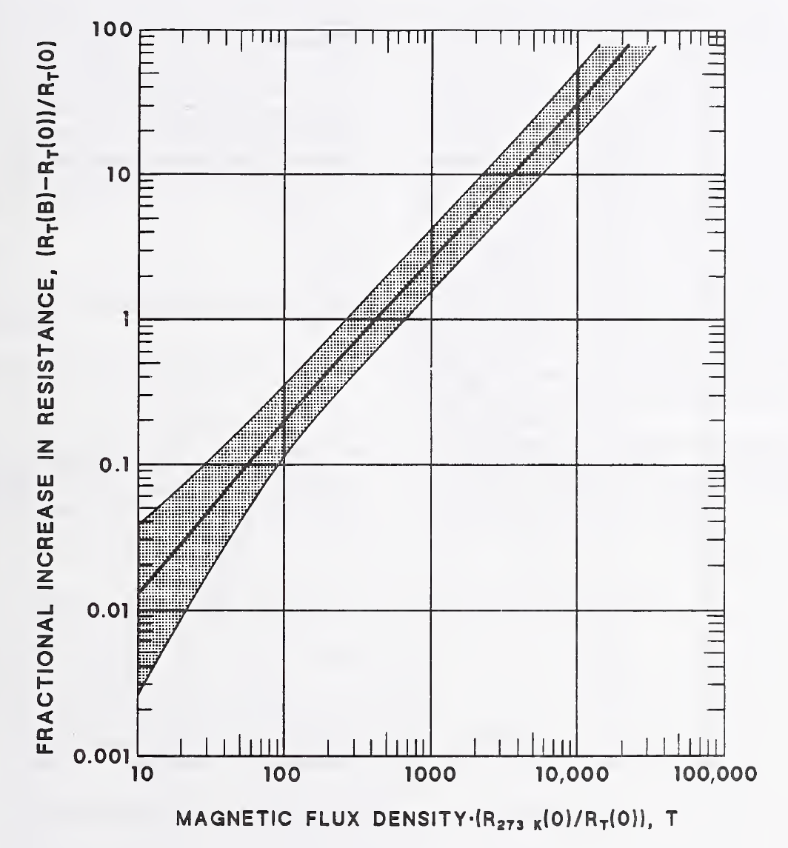
Beam screen resistive-wall impedance
The impedance model got significant updates to allow:
  to choose the temperature, RRR, B field and weld factor of different beam screens – they are not all the same nor at the same temperature (T=75K for Q1/Q2/Q3/CP/D1 beam screens, 20K for all the others, RRR=70 for all),
  to get the resistivity for any kind of copper, thanks to two general laws implemented in the Python library of IW2D (function Cu_layer):
RRR and T dependence
Kohler plot for magnetoresistance (taking the maximum line)
Many thanks to E. Métral, S. Antipov and S. Arsenyev.
Courtesy of N. J. Simon, E. S. Drexler, and R. P. Reed, NIST Monograph 177 (1992)

Slide 9
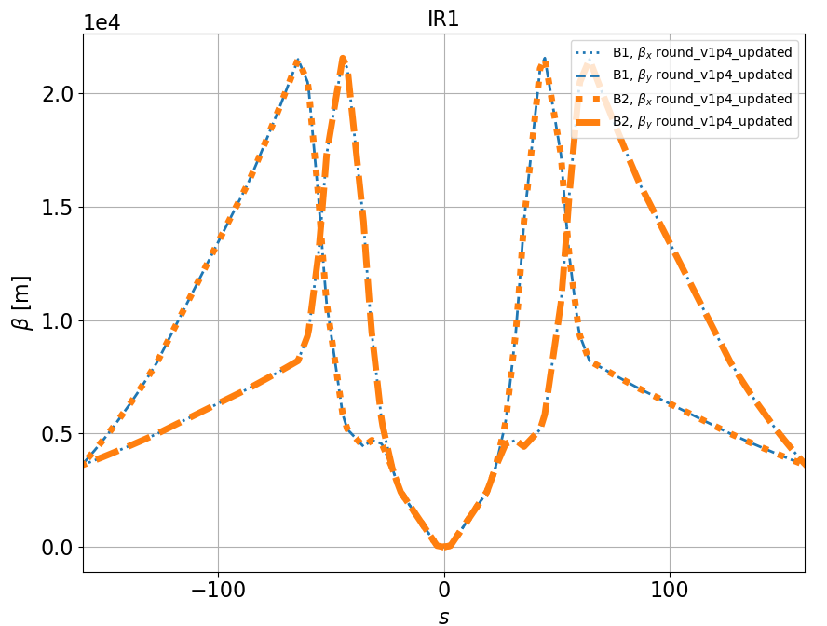
Can we optimize the beam screen orientation?
In principle we only have to look at the beta functions.
BUT most beam screens contain the two beams (up to D1, i.e. ~80m from IP).
Only D2 beam screen (from ~140m to ~155m) is single-beam.
Round optics (IR1 and 5 are similar):
when e.g. 𝛽_{x}< 𝛽_{y} for B1, it is the opposite for B2
→ one cannot gain anything in total on the two-beam BS,
we could gain in D2 only, but the two beta functions are almost the same
→ very small impact.

Slide 10
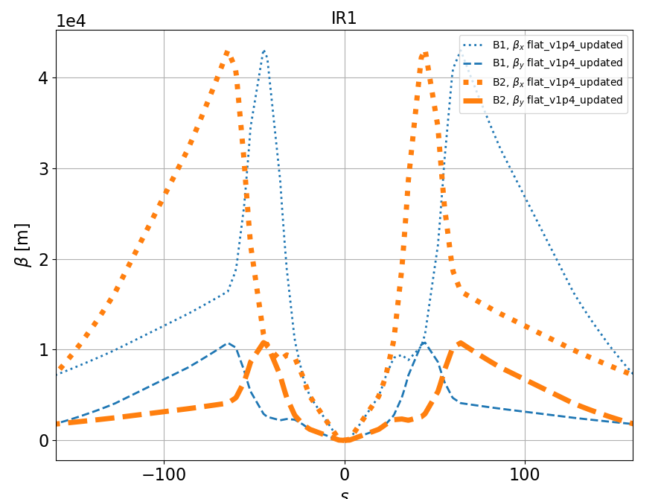
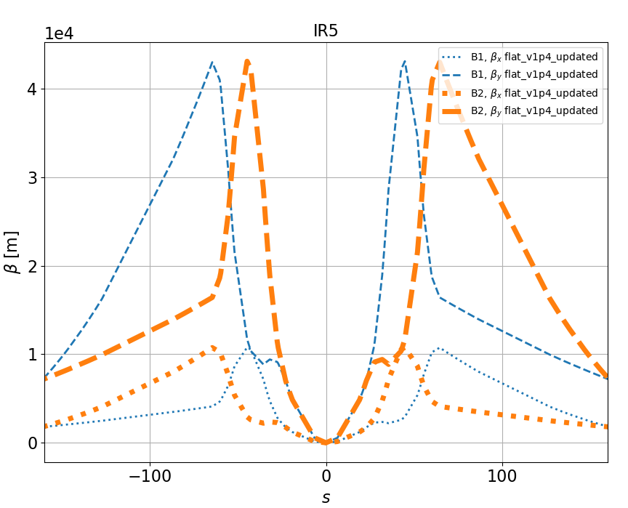
Can we optimize the beam screen orientation?
For flat optics the situation is different: the same plane has a lower beta for both beams
We can optimize if we choose the facets where to put the weld as:
  Top/bottom for IR1
  Left/right for IR5

Slide 11
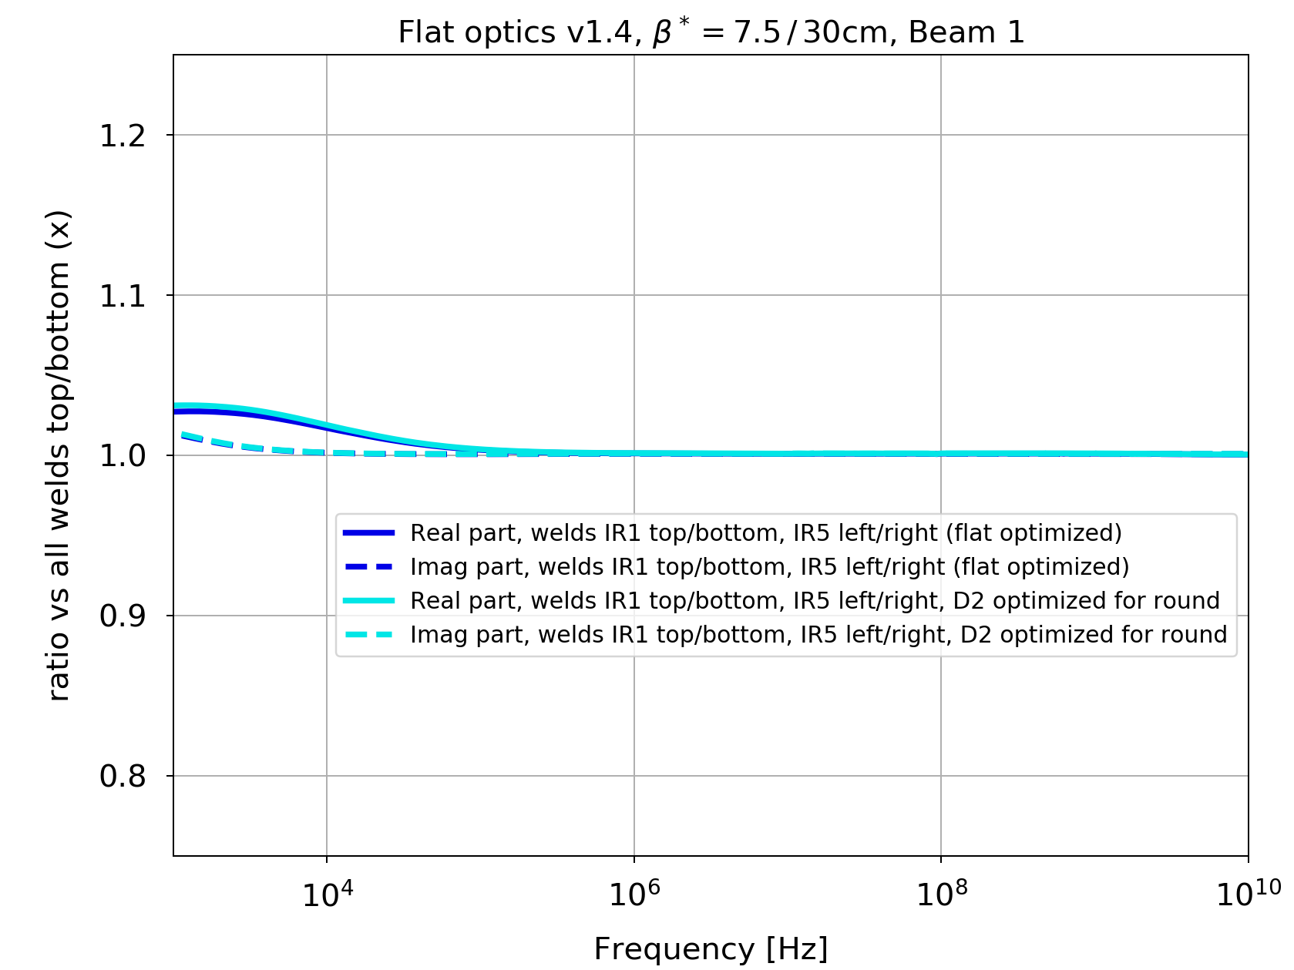
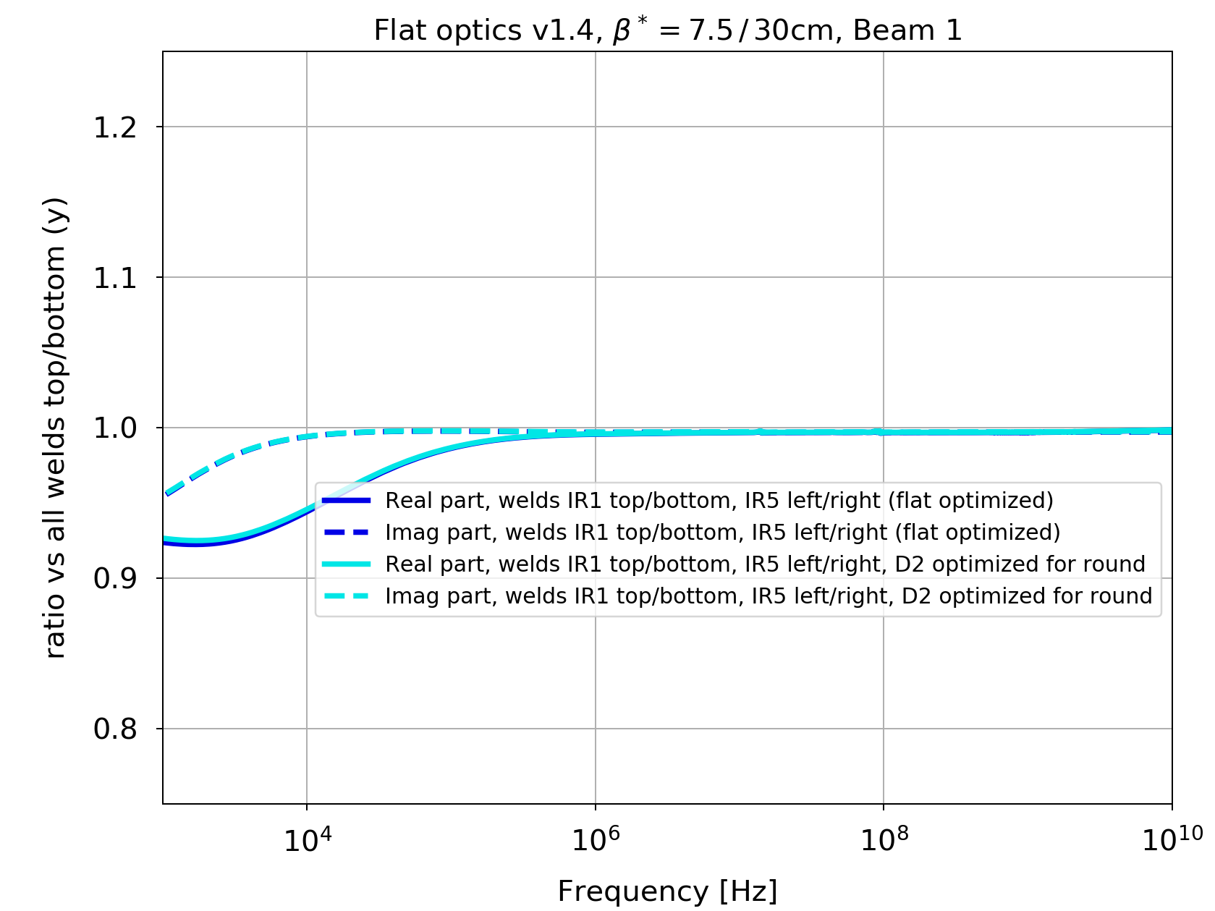
Is it worth the effort?
Ratio of total dipolar impedances vs. case when all welds are top/bottom (flat optics):
Dipolar horizontal
Dipolar vertical
→ One loses a little in x but gains significantly in y, but only at low frequencies.
→ Negligible impact on stability when the damper is on?

Slide 12
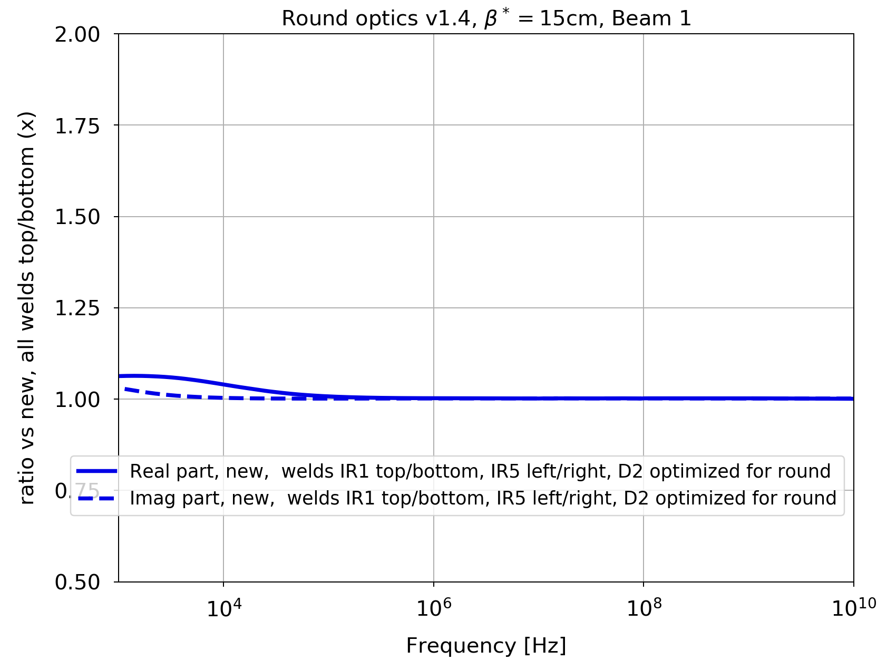
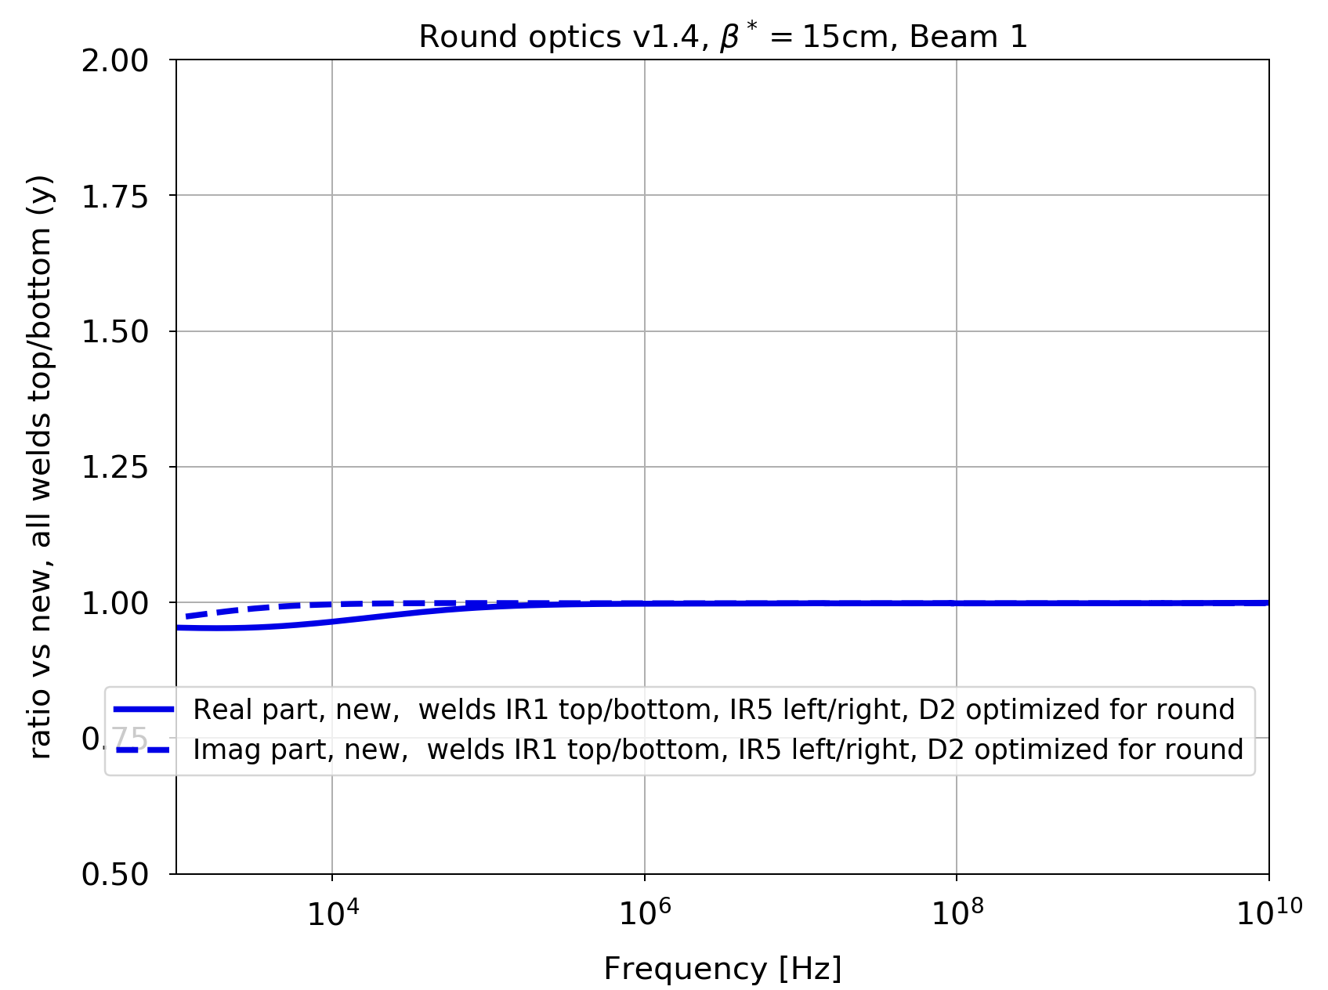
Is it worth the effort?
Ratio of total dipolar impedances vs. case when all welds are top/bottom (round optics):
Dipolar horizontal
Dipolar vertical
→ The optimization of the D2 beam screen orientation is not worth it…

Slide 13
Is it worth the effort?
Octupole thresholds with HL-LHC parameters (N_{b}=2.3e11 p+/bunch, emittances 2.1𝜇m.rad), for flat optics:
  Resistive-wall from collimators only: 55A
  Resistive-wall from beam screens (including welds): < 0.01 A
→ The optimization of the weld orientation is not really worth it.

Slide 14
Backup slides

Slide 15
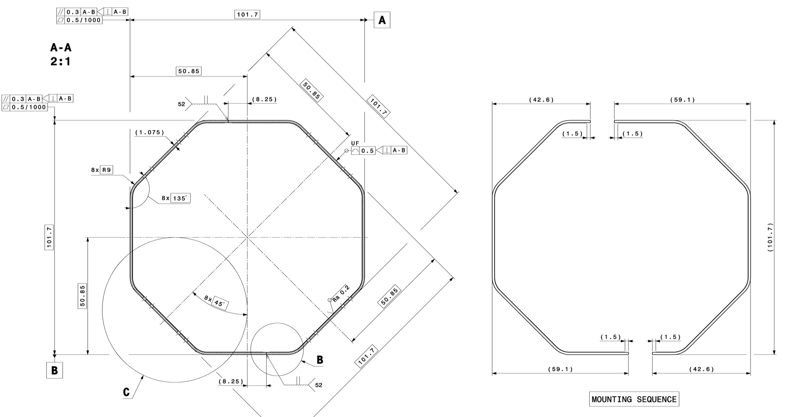
Octogonal beam screens in HL-LHC triplets (N. Kos)
Three different shapes, depending on the magnet cold bore aperture:
Q1 beam screen (“BS_101” in the impedance model, drawing LHCVSMSH0003)

Slide 16
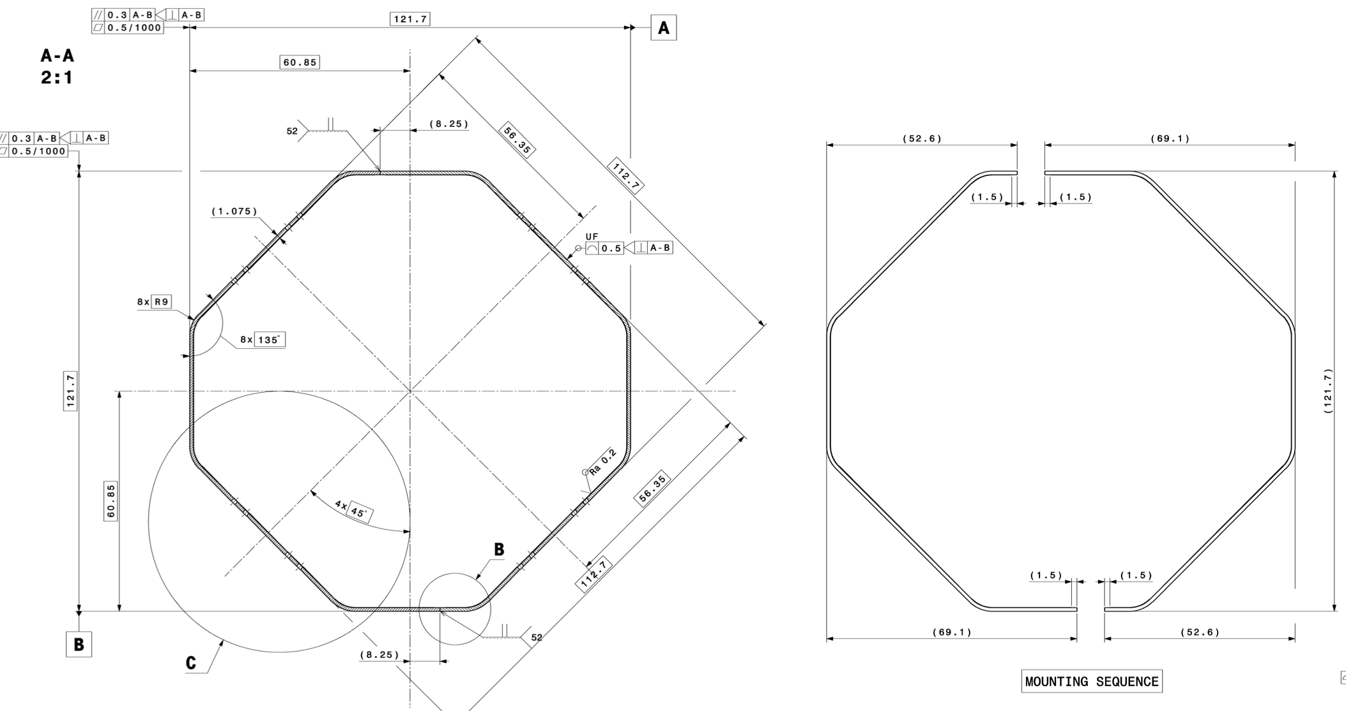
Octogonal beam screens in HL-LHC triplets (N. Kos)
Q2/Q3/CP/D1 beam screen (“BS_121” in the impedance model, drawing LHCVSMSL0001)

Slide 17
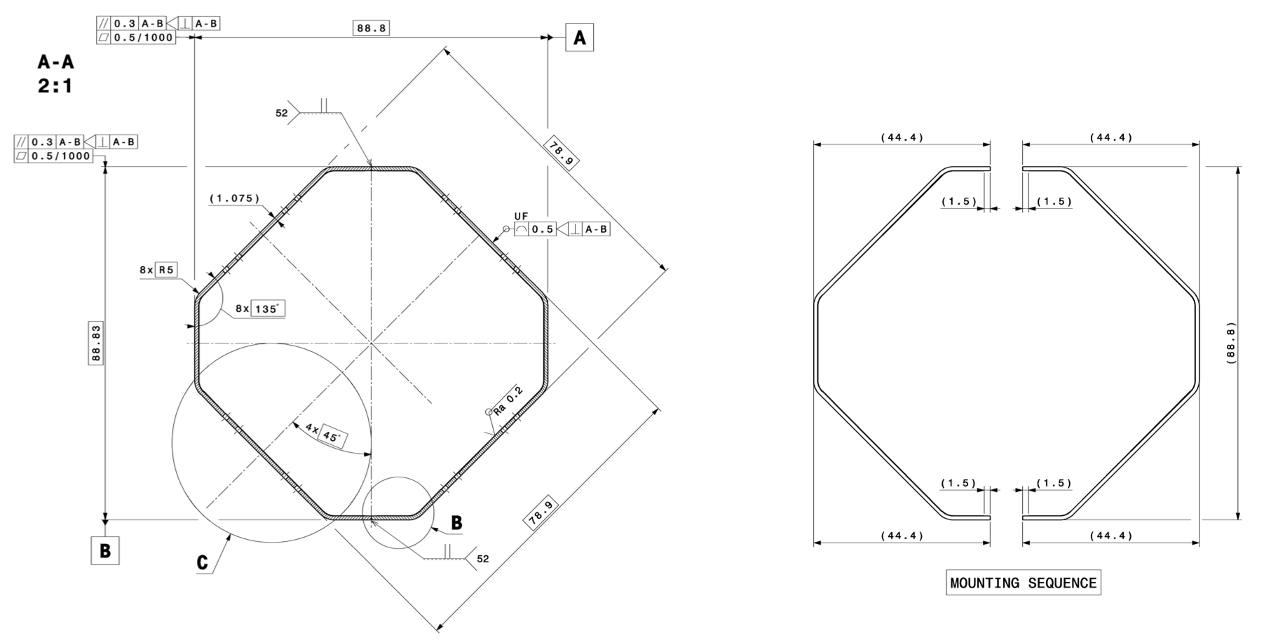
Octogonal beam screens in HL-LHC triplets (N. Kos)
D2 beam screen (“BS_88” in the impedance model, drawing LHCVSCS_0001) – single beam

Slide 18
HL-LHC – Collimator settings
Collimator settings (𝜎 computed with 𝜀 = 2.5 𝜇m.rad) at top energy:
Collimators | Half-gap [#𝜎]
TCP/TCS/TCLA(D) IR7 | 6.7 / 9.1 / 12.7 (16.6)
TCP/TCS/TCLA IR3 | 17.7 / 21.3 / 23.7
TCDQ/TCS IR6 | 10.1
TCT IR1/5 | 10.4
TCL (IR1/5) Q4/Q5/Q6 | 14.2
TCT IR2/8 | 43.8 / 17.7
Note: injection protection collimators are always in parking position at top energy.

Slide 19
HL-LHC impedance model
Changes w.r.t. the LHC that are included in the HL model:
  Collimator at almost full upgrade (jaws of 2 TCPs and all but 2 TCSs in IR7 replaced by Mo-graphite ones, Mo-coated for the TCSs); some TCTs in Cu-coated copper-diamond; tungsten TCLD absorber in IR7,
  Updated collimator tapers,
  Beta functions in the arcs and triplets (optics v1.4),
  TDIS (with graphite, Ti₆Al₄V and CuCr1Zr),
  New MKI-cool – 4 of them,
  New octogonal beam screens in triplets, with up-to-date dimensions, aC-coating, 75K copper, pumping holes and welds (rough estimate for the welds),
  Updated experimental chambers (ATLAS & CMS),
  Tapers and BPMs in the triplets region,
  Crab cavities.

Slide 20
HL-LHC impedance model
Modifications that are not (yet) in the model:
  Y-chamber (negligible) and VELO,
  experimental chambers ALICE and LHCb, possibly also CMS,
  updated longitudinal weld factor in the triplets beam screens,
  deformable RF-fingers (ongoing work),
  new instrumentation,
  possible aC-coating in some sectors,
  possible additional collimators in IR1 & 5, TCLD in IR2 (in parking for protons) and updated design of all tertiaries and TCLs, old CFC collimators in parking?
  crab cavities HOMs as measured in real cavities,
  electron lens and crystal collimators (recently added to baseline),
  new roman pots,
  “SMOG3” in LHCb.

