Slide 1
Ions are forever
A glimpse into the stability of lead ions for Run III and HL-LHC
N. Mounet
Acknowledgements: D. Amorim, S. Antipov, N. Biancacci, R. Bruce, E. Carideo, J. Jowett, A. Mereghetti, E. Métral, B. Salvant, R. Tomas.

Slide 2
LHC & HL-LHC impedance model for ions
Changes during LS2 and updates w.r.t. the LHC Run II (proton) model:
  Low-impedance collimator upgrade (jaws of 2 TCPs and 4 TCSs in IR7 replaced by Mo-graphite ones, Mo-coated for the TCSs),
  Addition of TCLD absorber (tungsten) in IR7 and in IR2 (ions specific),
  Updated collimator tapers (thanks to E. Carideo & S. Antipov),
  Beta functions for ion (2018) optics (𝛽* = 0.5m in all IPs except IP8 where 𝛽* = 1.5m),
  TDIS (with graphite, Ti₆Al₄V and CuCr1Zr).
Run III and HL-LHC are considered more or less identical for ions.
Not included in the model:
  Changes in the triplets for HL-LHC – but 𝛽 functions are much less than HL-LHC protons @ full squeeze,
  New MKI.

Slide 3
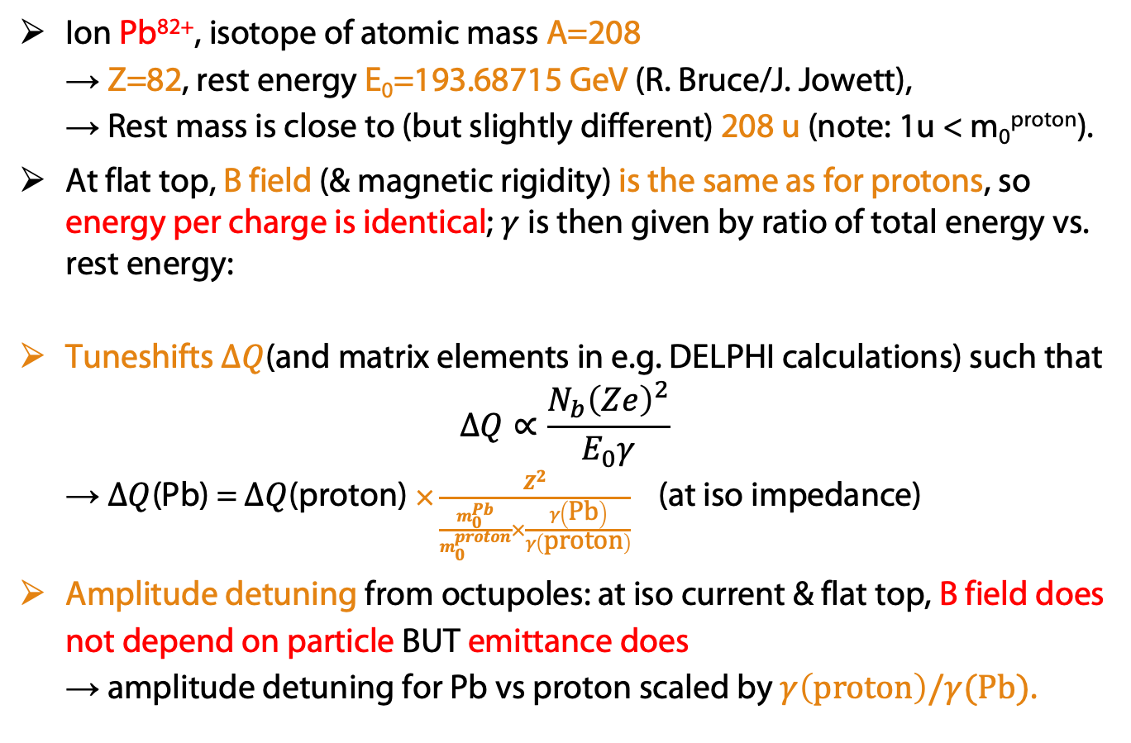
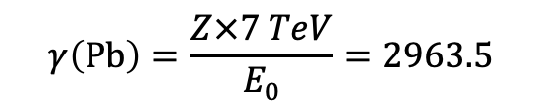
Particularities of lead ions in the LHC
Ion Pb⁸²⁺, isotope of atomic mass A=208
→ Z=82, rest energy E₀=193.68715 GeV (R. Bruce/J. Jowett),
→ Rest mass is close to (but slightly different) 208 u (note: 1u < m₀^{proton}).
At flat top, B field (& magnetic rigidity) is the same as for protons, so energy per charge is identical; $γ$is then given by ratio of total energy vs. rest energy:
Tuneshifts $ΔQ$(and matrix elements in e.g. DELPHI calculations) such that
$ΔQ∝\frac{N_{b}{\left(Ze\right)}^{2}}{E_{0}γ}$
→ $ΔQ$(Pb) = $ΔQ$(proton) $×\frac{Z^{2}}{\frac{m_{0}^{Pb}}{m_{0}^{proton}}×\frac{γ\left(\text{Pb}\right)}{γ\left(\text{proton}\right)}}$ (at iso impedance)
Amplitude detuning from octupoles: at iso current & flat top, B field does not depend on particle BUT emittance does
→ amplitude detuning for Pb vs proton scaled by $γ\left(\text{proton}\right)/γ(\text{Pb})$.
$$γ\left(\text{Pb}\right)=\frac{Z×7 TeV}{E_{0}}=2963.5$$

Slide 4
Collimator settings for ions (R. Bruce)
Collimator settings at flat top (𝜎 computed with 𝜀 = 3.5 𝜇m.rad and 𝛾=7460.5 – i.e. as for protons at top energy):
Collimators | Half-gap [#𝜎]
TCP/TCS/TCLA(D) IR7 | 5 / 6.5 / 10 (14)
TCP/TCS/TCLA IR3 | 15 / 18 / 20
TCDQ/TCS IR6 | 7.4
TCT IR1/5 | 9
TCL (IR1/5) Q4/Q5/Q6 | 15 / 15 / 20
TCT IR2/ TCT IR8 / TCLD IR2 | 9 / 15 / 25
Note: the same half-gaps would be just 10% lower in #𝜎, if 𝜎 is computed instead at 𝜀 = 1.65 𝜇m.rad and 𝛾=2963.5 (ions @ flat top).
(Injection protection collimators are always in parking position.)

Slide 5
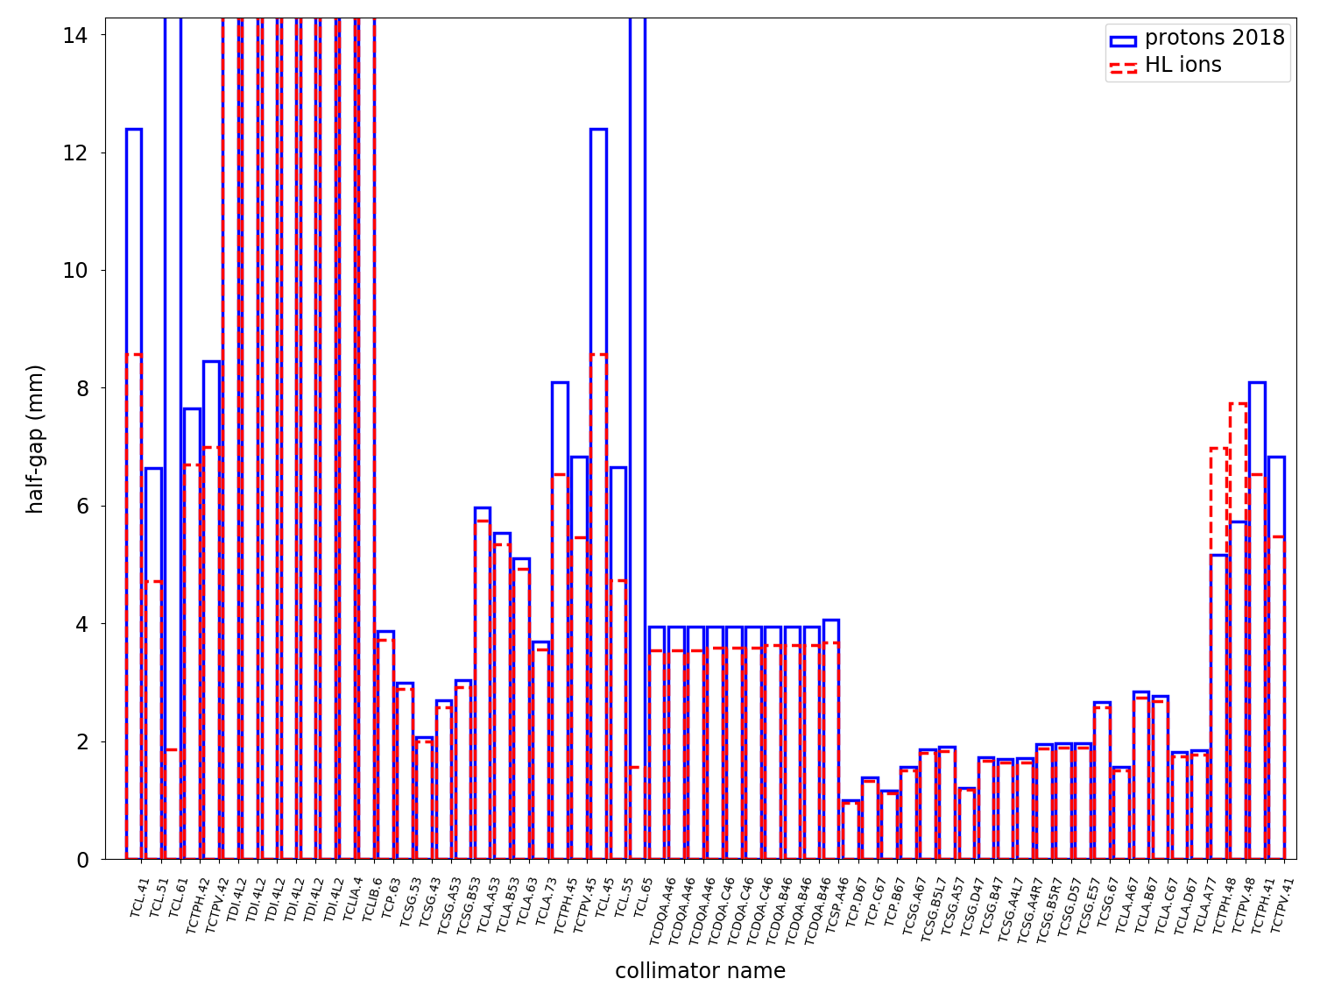
LHC ions vs. protons – collimator half-gaps
Collimator settings in mm, protons vs. ions:
→ main impedance contributors have very similar half-gaps than for protons.

Slide 6
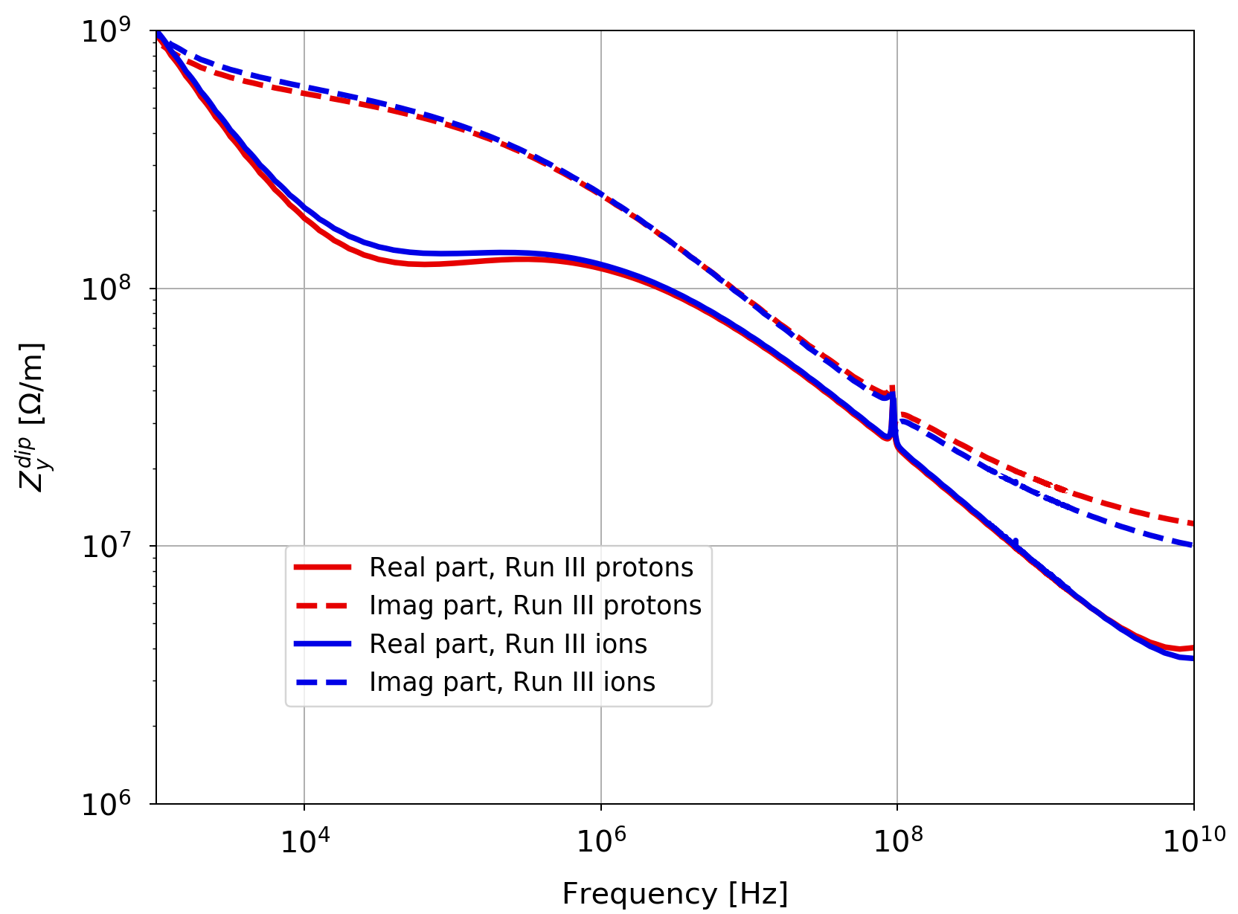
LHC ions vs. protons – impedance @ flat top
Impedances are very similar (with LS2 collimator upgrade):
Dipolar vertical

Slide 7
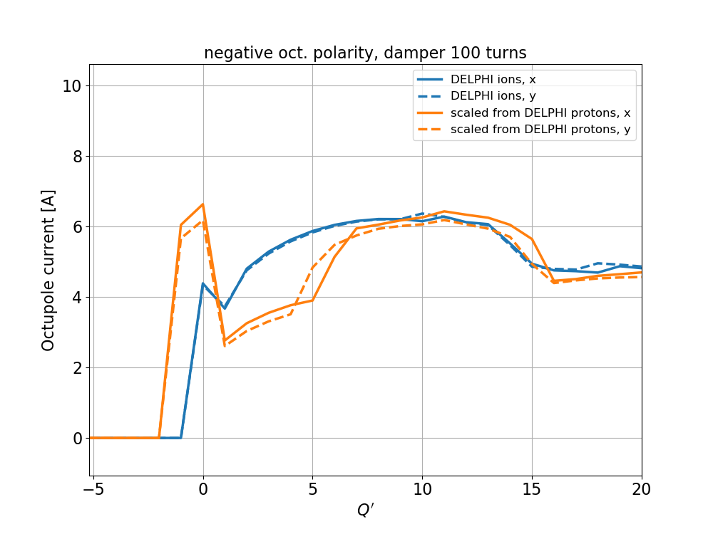
LHC ions – checking the scaling
Run III octupole threshold vs. chromaticity, directly from DELPHI applied to ions, compared to what would be obtained by re-scaling DELPHI results on protons:
V = 14 MV, 𝜎_{z} = 8.2 cm,
N_{b} = 1.8e8 ions/bunch,
𝜀 = 1.65 mm.mrad
⇒ DELPHI seems to work for ions (note: impedance is not exactly the same, hence the remaining differences).

Slide 8
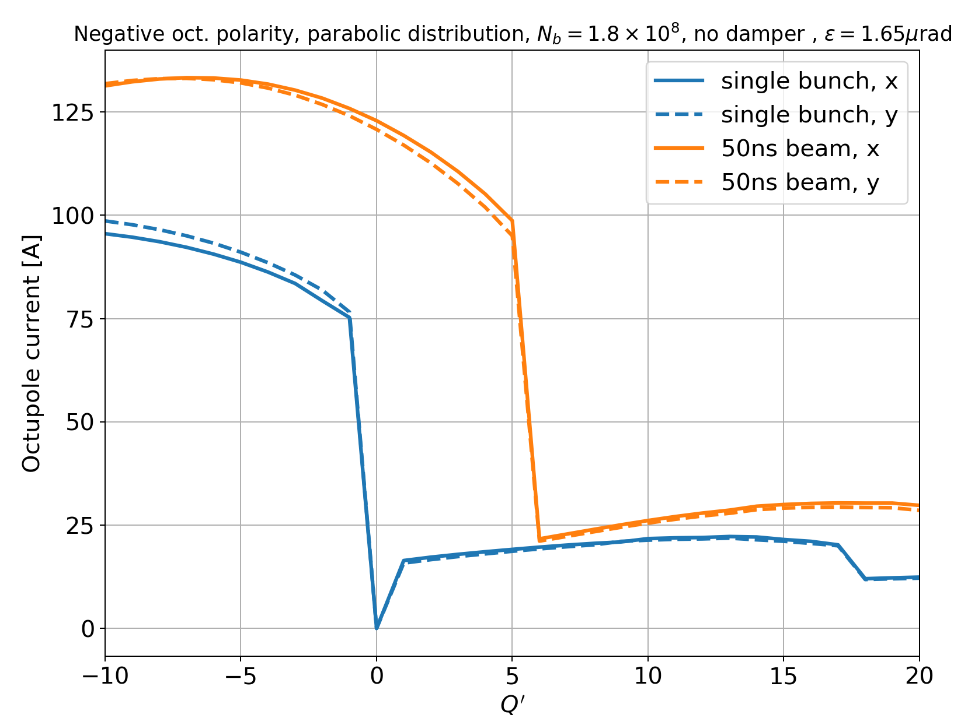
LHC ions – worst case situation for stability
Run III octupole threshold vs. chromaticity, directly from DELPHI applied to ions, with transverse distribution cut at 3.2𝜎, no damper (single bunch and 50ns).
V = 14 MV, 𝜎_{z} = 8.2 cm,
N_{b} = 1.8e8 ions/bunch,
𝜀 = 1.65 mm.mrad
⇒ at worst 30A needed (for Q’ > 10)

Slide 9
Conclusions
DELPHI for ions seems to work fine
… but one still needs to define manually each kind of particle (rest mass, Z).
Pb⁸²⁺ ions are quite stable in the LHC (Run III and HL): 30A in the octupoles are sufficient (for Q’ higher than 10) in the worst case (transverse distribution cut at 3.2 𝜎, no damper, LS2 upgrade, full 50ns beam).
→ Even multiplying this by the usual factor of 2 (current discrepancy factor between model & measurements), we have a comfortable margin.

Slide 10
Backup slides

Slide 11
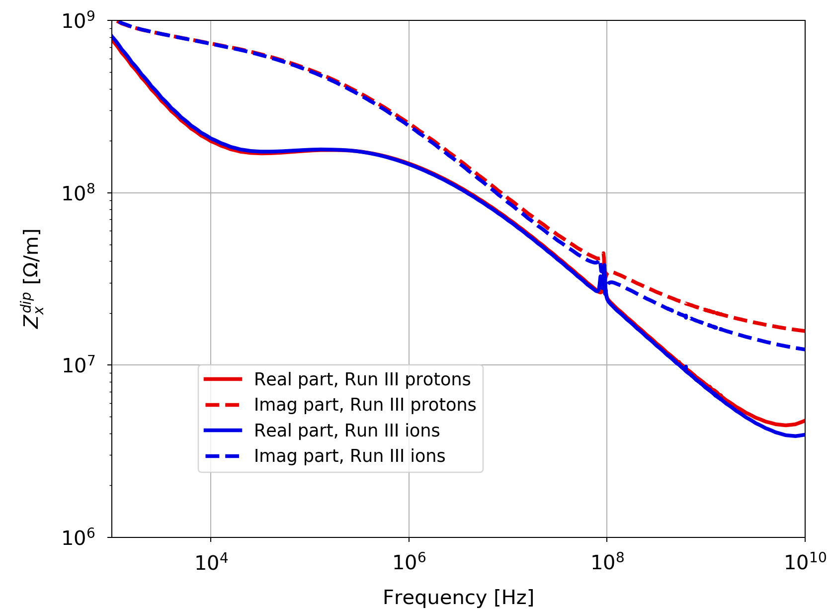
LHC ions vs. protons – impedance @ flat top
Impedances are very similar (with LS2 collimator upgrade):
Dipolar horizontal

Slide 12
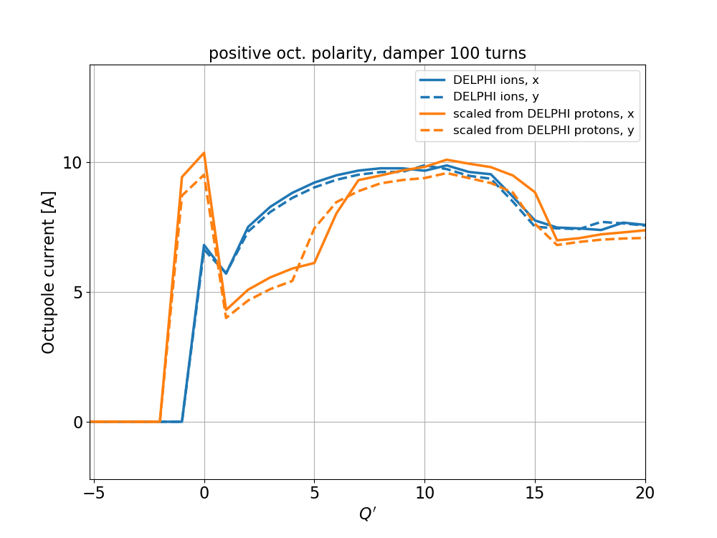
LHC ions – checking the scaling
Run III octupole threshold vs. chromaticity, directly from DELPHI applied to ions, compared to a scaling from DELPHI on protons.
V = 14 MV, 𝜎_{z} = 8.2 cm,
N_{b} = 1.8e8 ions/bunch,
𝜀 = 1.65 mm.mrad

Slide 13
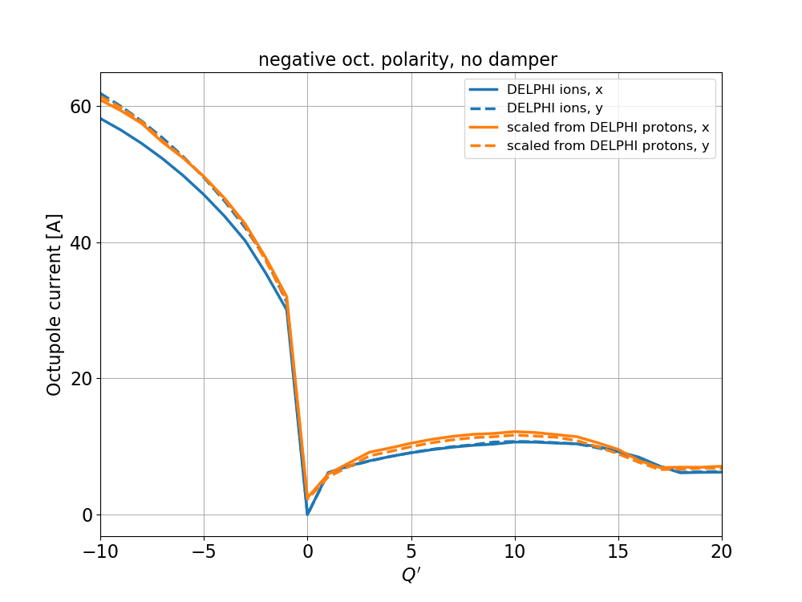
LHC ions – checking the scaling
Run III octupole threshold vs. chromaticity, directly from DELPHI applied to ions, compared to a scaling from DELPHI on protons.
V = 14 MV, 𝜎_{z} = 8.2 cm,
N_{b} = 1.8e8 ions/bunch,
𝜀 = 1.65 mm.mrad

Slide 14
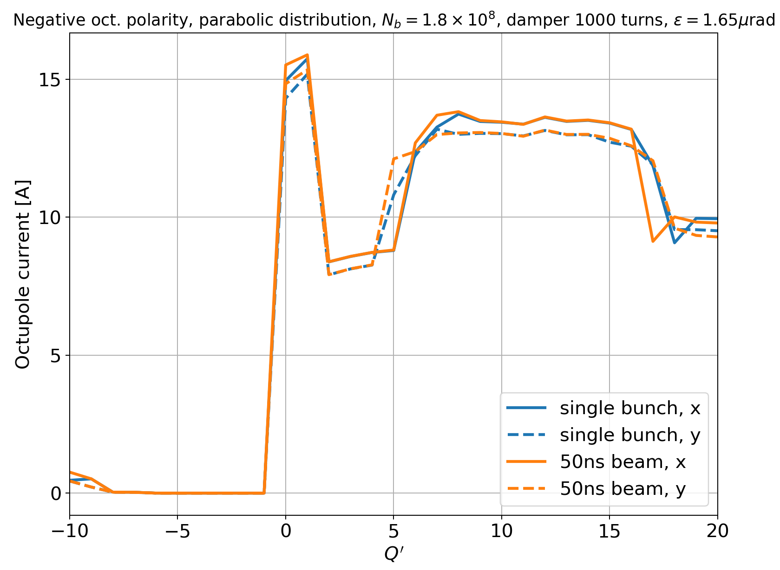
LHC ions – stability in various conditions
Run III octupole threshold vs. chromaticity, directly from DELPHI applied to ions, with transverse distribution cut at 3.2𝜎, with damper (single bunch and 50ns).
V = 14 MV, 𝜎_{z} = 8.2 cm,
N_{b} = 1.8e8 ions/bunch,
𝜀 = 1.65 mm.mrad

Slide 15
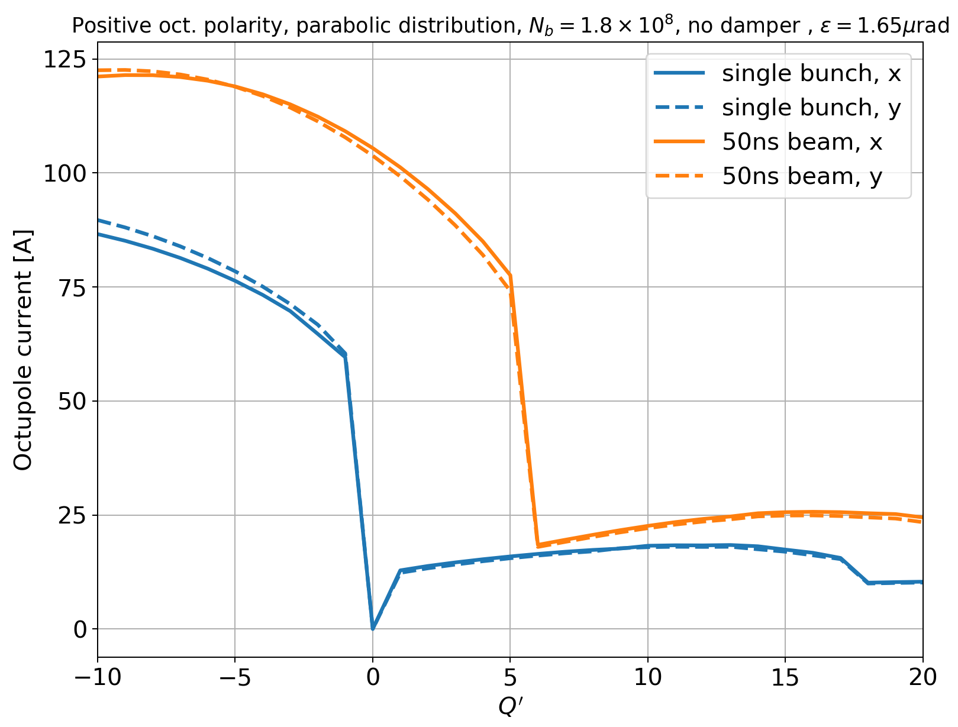
LHC ions – stability in various conditions
Run III octupole threshold vs. chromaticity, directly from DELPHI applied to ions, with transverse distribution cut at 3.2𝜎, no damper (single bunch and 50ns).
V = 14 MV, 𝜎_{z} = 8.2 cm,
N_{b} = 1.8e8 ions/bunch,
𝜀 = 1.65 mm.mrad
Positive polarity

Slide 16
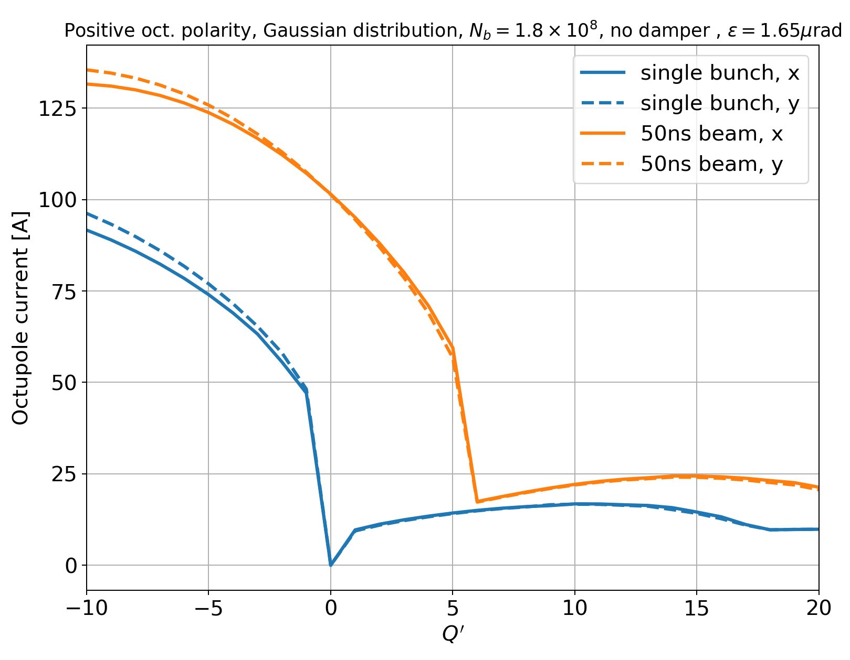
LHC ions – stability in various conditions
Run III octupole threshold vs. chromaticity, directly from DELPHI applied to ions, with Gaussian transverse distribution, no damper (single bunch and 50ns).
V = 14 MV, 𝜎_{z} = 8.2 cm,
N_{b} = 1.8e8 ions/bunch,
𝜀 = 1.65 mm.mrad
Positive polarity

