Slide 1
Description of the DFX device, scope & interfaces
P. Cruikshank on behalf of the WP6a team at CERN & SOTON
3 March 2020
Production Readiness Review of the DFX

Slide 2
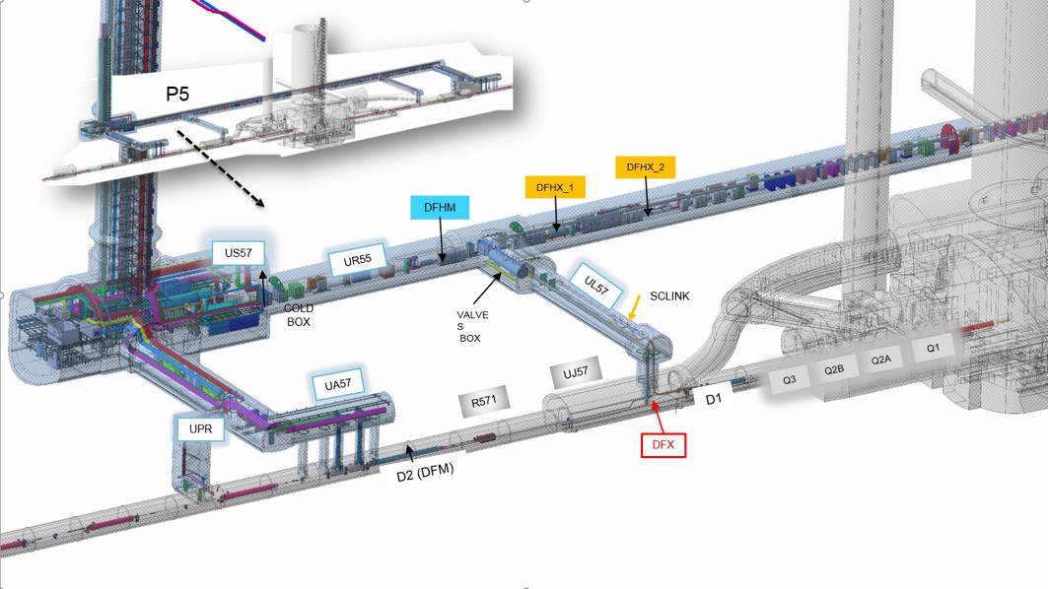
WP6a - DFX
DFX
4 DFX devices to be installed
(5L, 5R, 1L, 1R)
Interface between SC Link and Diodes Cold Module
of the HL-LHC Inner Triplets

Slide 3
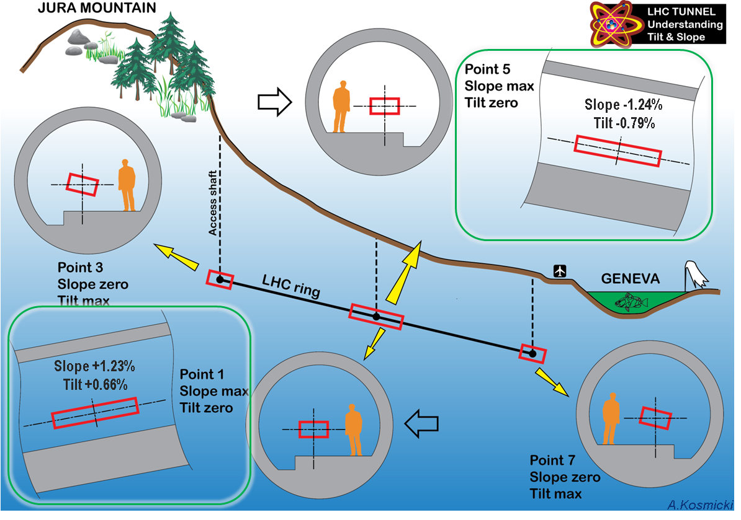
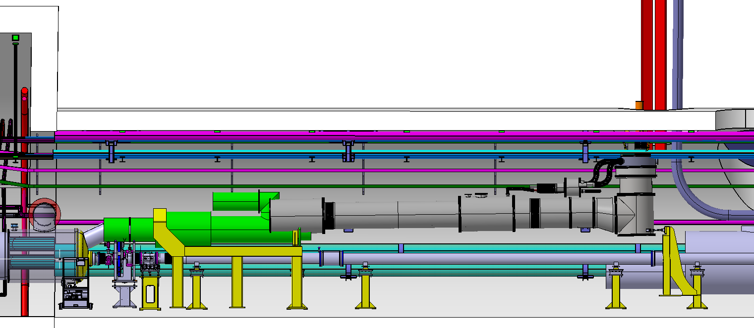
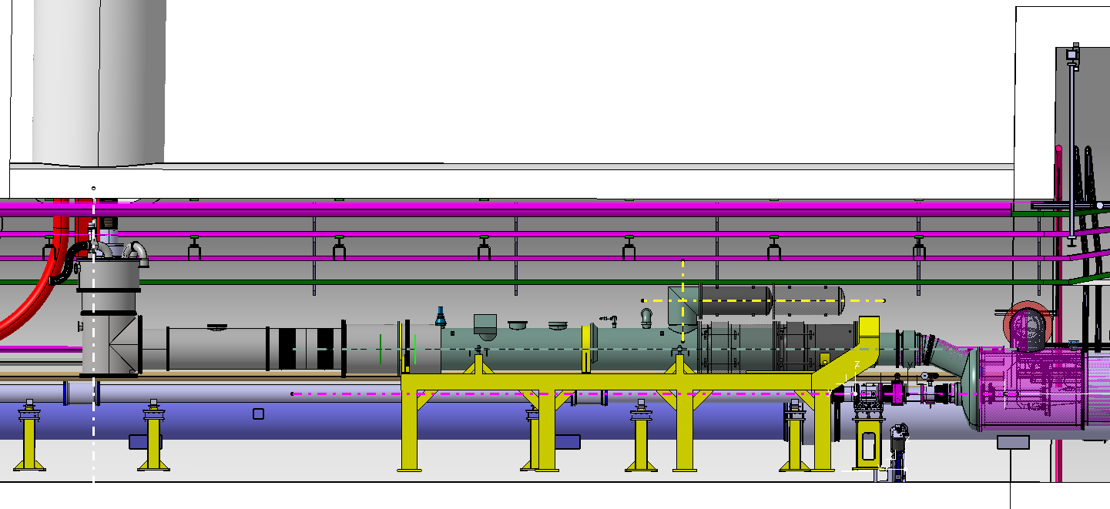
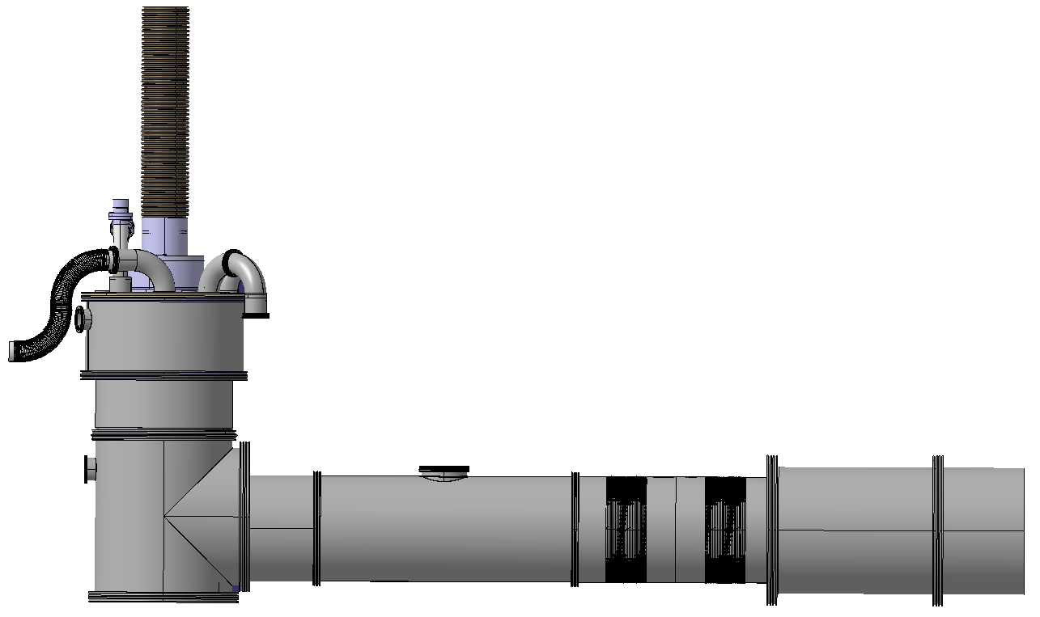
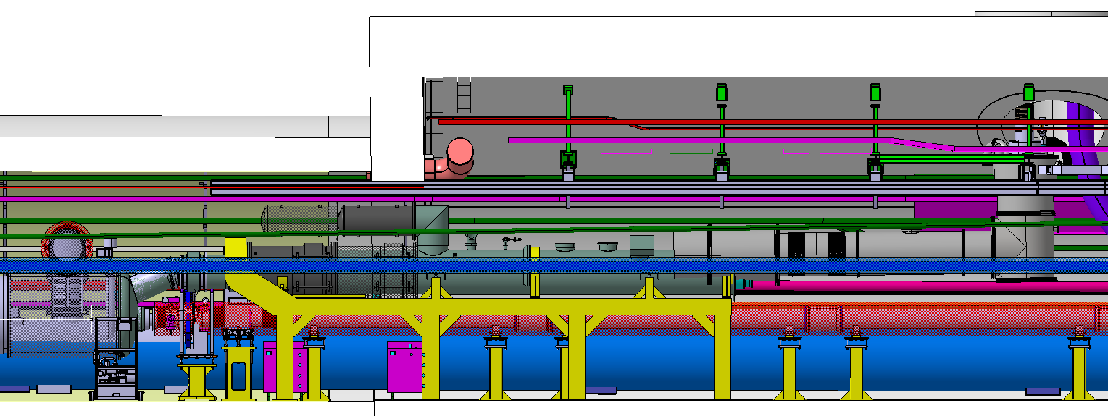
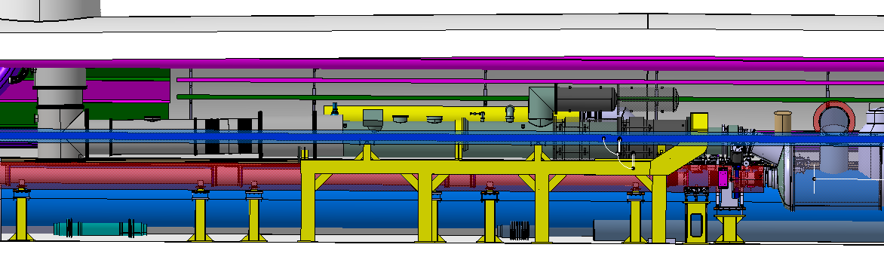
1. INTRODUCTION: Direction of the slope P1 vs P5
R1: DFX follows the slope
(Requirement coming from DFX cryo design)
L1: DFX has to compensate the slope
POINT 1
Horizontal ref
Extract from DFX integration review June 2019
R5: DFX has to compensate the slope
POINT 5
L5: DFX follows the slope
Horizontal ref

Slide 4
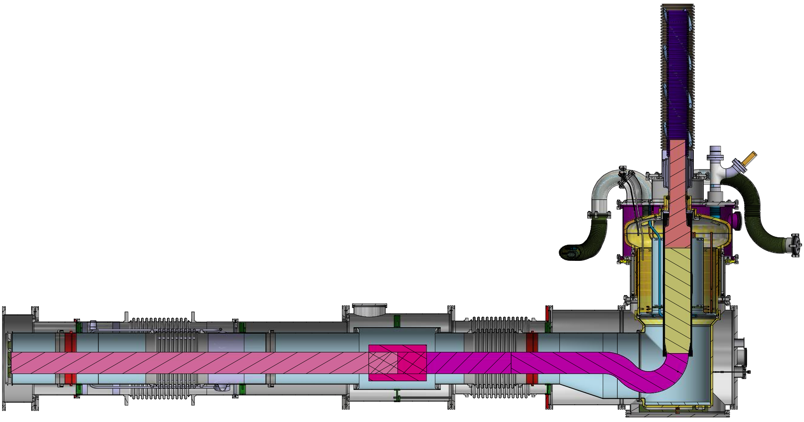
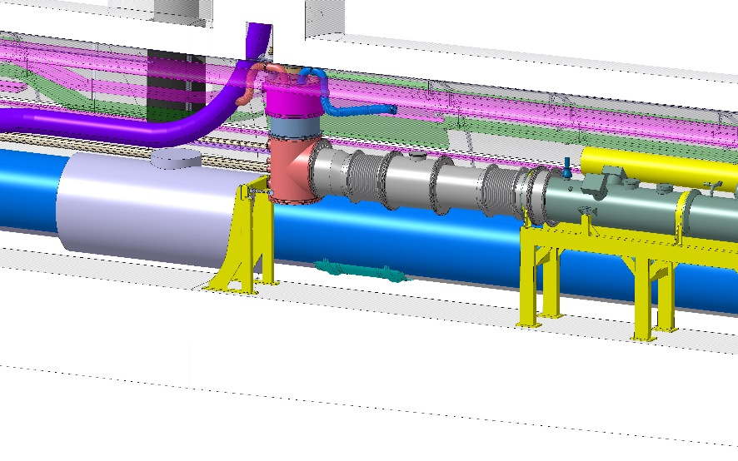
DFX – recall of main components
Superconducting
Link (~ 80m)
Helium
Vessel
safety
devices
MgB2 cables
Helium
supply
DFX in the HL-LHC tunnel
Cryo instrumentation
(heaters, temp sensors)
Lambda
plate (WP3)
Horizontal
helium vessel
Vacuum
vessel
Vacuum vessel
safety valve
MgB2 to NbTi
cable splices
Vertical
helium
vessel &
fountain
To DCM &
triplet
cryostat
NbTi cables from triplet
NbTi to NbTi
cable splices
NbTi cables of SC link

Slide 5
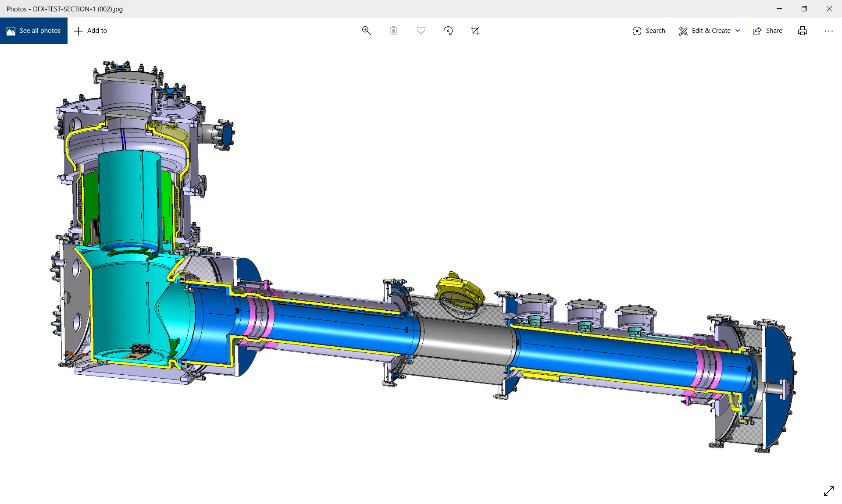
WP6a DFX prototype
…fully assembled configuration of the UK1 in-kind supply

Slide 6
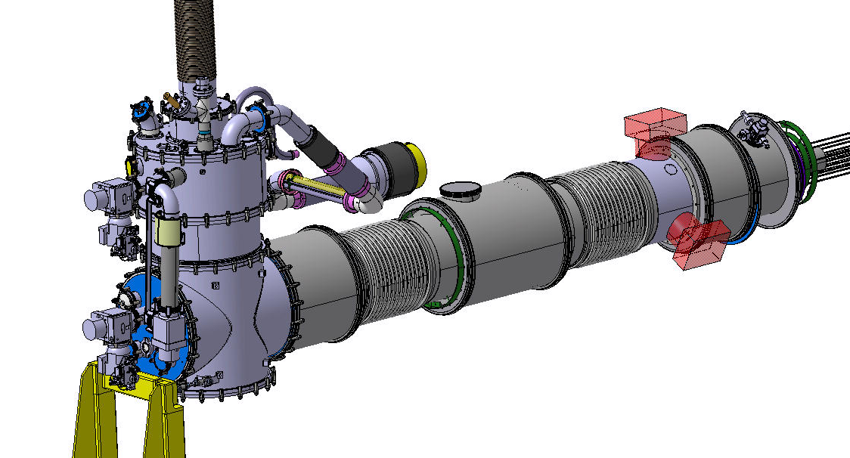
DFX - WP6a
5 DFX & 5 DFM cryostats required:
Connection of MgB2 SC link to NbTi leads of cryomagnets in LHC tunnel
In-kind contribution from UK via collaboration with Southampton University (design & manufacture).
Design & supply of DFX prototype within UK1
4 DFX series & 5 DFM series in UK2 (not yet signed)
DFX prototype usage at Cern:
Prototype test of cold power system (SC link, DFHX)
HL String
Stored as HL operational spare.
DFX CDR – 31/01/2019
DFX DDR – 20/06/2019
DFX PRR – 03/03/2020
DFX #1 delivery – Q4, 2020
Design & Manufacturing:
According to harmonized standards EN 13445
According to IS0-GPS drawing standards
Compliance with PED 2014/68/EU.
CE marking.
MIPs and quality records to be put in MTF.

Slide 7
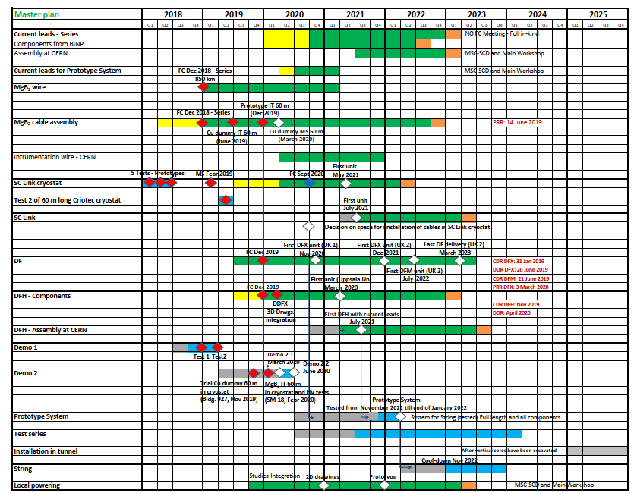
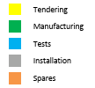

WP6a
Master Plan

Slide 8
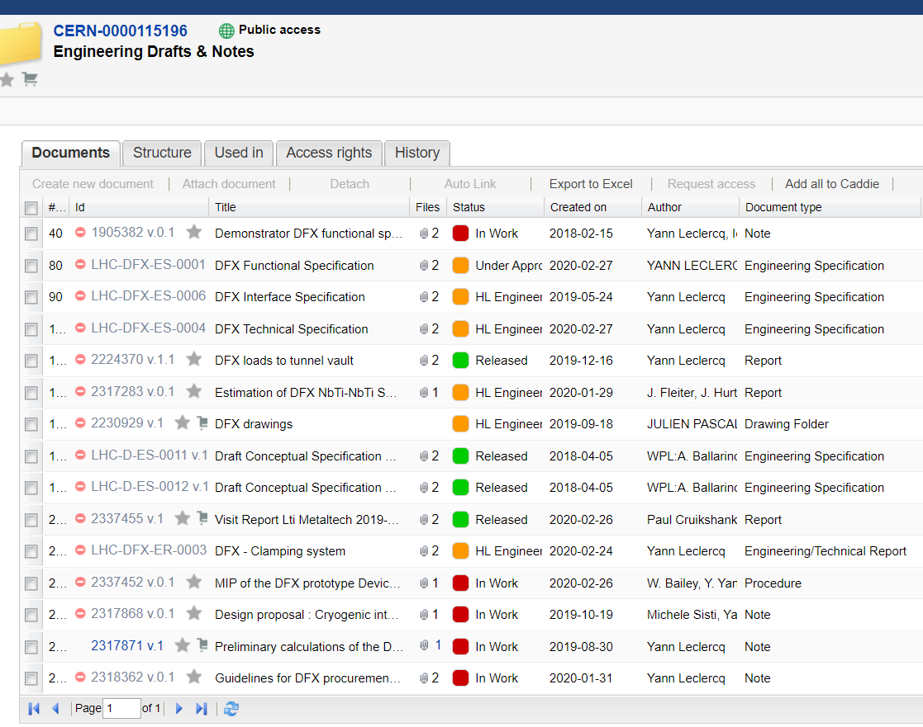
DFX documentation for PRR
….with many thanks to Simon & Beatriz for all their support over the last week
DFX Engineering Specifications and Drawings will be in released status prior to start of production

Slide 9
Interfaces overview
Tunnel Vault
SCLink
Tunnel, supports & Beam
SCLink interface
  Leads + Instru
  Jackets flanges
DCM interface
  Leads + Instru
  Jackets flanges
QXL interface
  Vacuum jacket flange
  Cryogenic lines
Instrumentation
  Sensors supports + IFS
  Splices + bus bars support
External services
  Vacuum equipment
  Pressure relief devices
DFX interfaces
  Outer & Inner jackets
  Cryogenics
  Supports
  External accessories
  Instrumentation & cables/splices
He Safety device
Jumper
Cryogenic lines
V
Vacuum equipment
IFS
NbTi leads
DCM
NbTi leads
Splice
T&H
Beam reservation

Slide 10

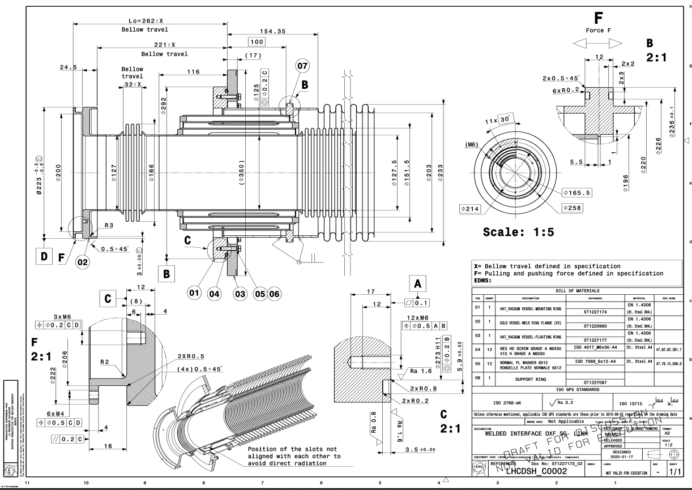
SCLink interfaces
SCLink Vacuum Jacket flange
Bolted to DFX vacuum vessel
Vacuum & Helium jackets
  LHCDSH_C0002
Helium jacket end
  Ø200 x 700 mm + NbTi bus bars
Bus bars
  Design of supports between bus bars de-scoped from prototype deliverables
  DFX mechanical interfaces in helium vessel
    LHCLDQD_0003
NbTi-NbTi splices
  Fixed to helium vessel mechanical interfaces
    LHCLDQD_0003
    Edms 2317283
SCLink Helium Jacket flange
Welded to DFX He vessel
Ø 200
700
MgB2-NbTi
rigid protection
NbTi
bus bars
Ø 150

Slide 11
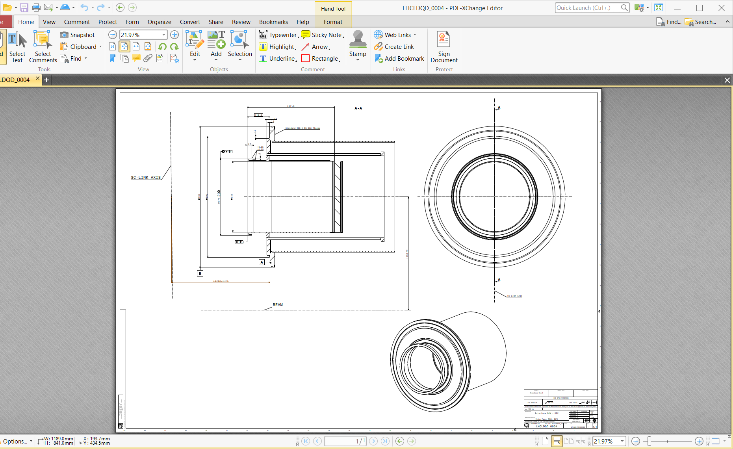
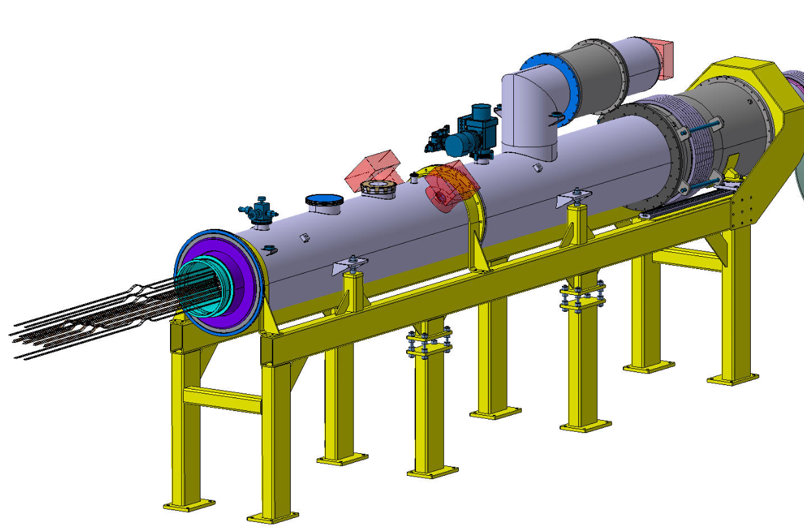
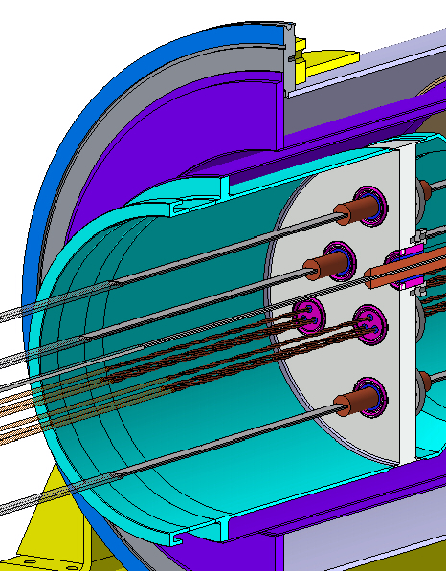
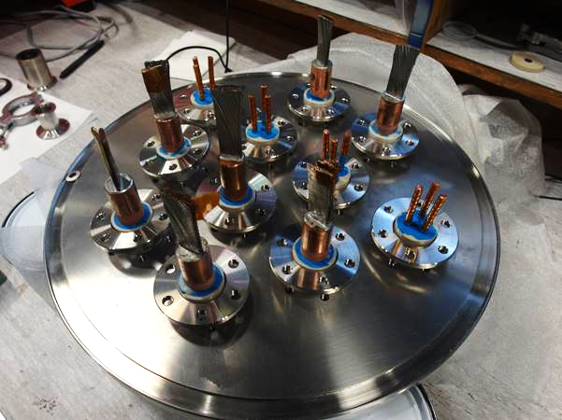
DCM interface
Core
axis
D1-DFX Connection Module (DCM)
Vacuum & Helium Jackets
  ISOK-DN630 with standard O-ring
  Lip weld
  Interface Drawing: LHCLDQD_0004
Bus bars
  Part of WP3 lambda plate
3.6 m
555

Slide 12
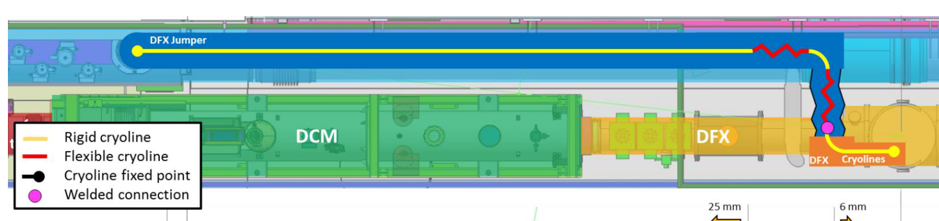
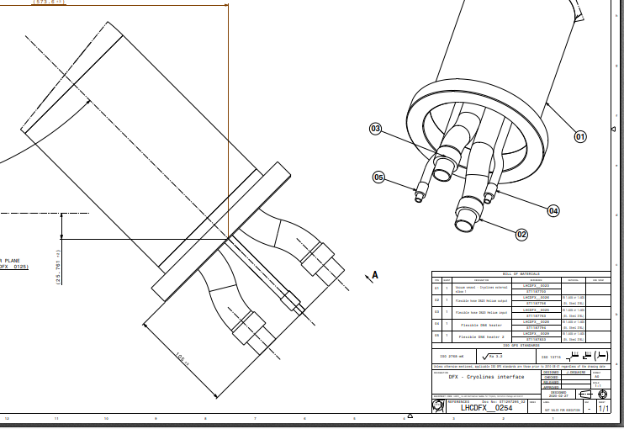
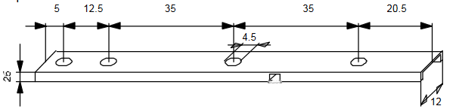
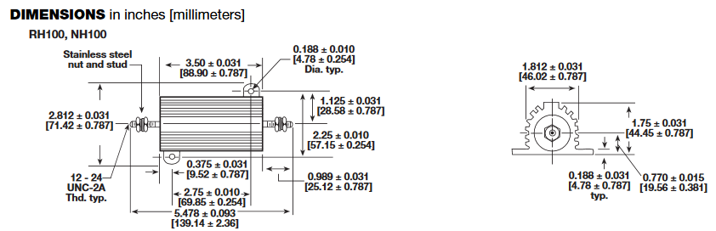
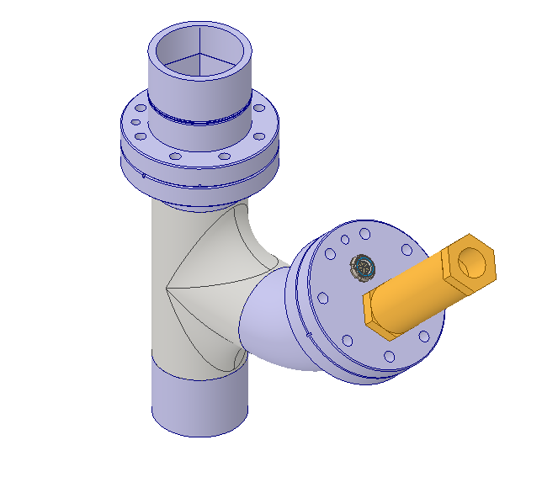
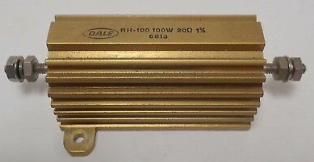
Cryogenic interfaces
Jumper & DFX interfaces
  Cryogenic interface for DFX, edms 2317868
  Semi-flexible link from DFX to QXL jumper to be detailed.
Temperature sensors supports
  Interface long CERNOX
Heaters Vishay® RH100 interfaces
Level gauges & DeltaP gauge interfaces agreed
Pressure relief devices

Slide 13
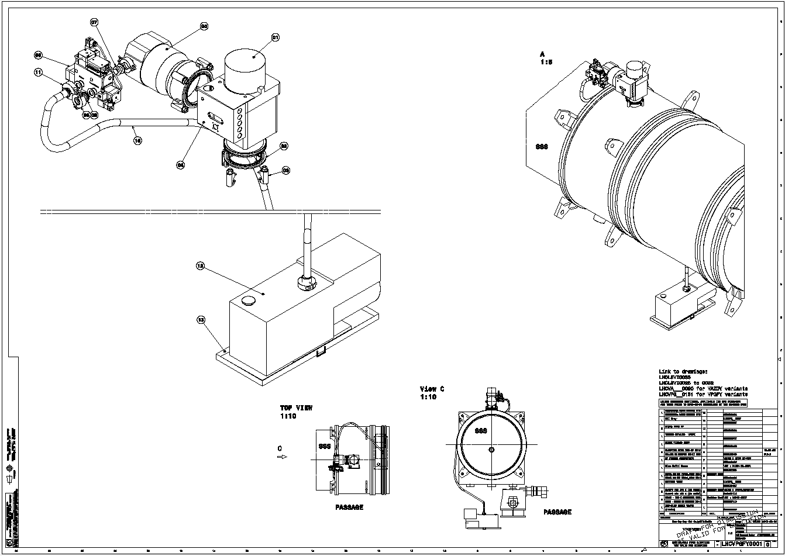
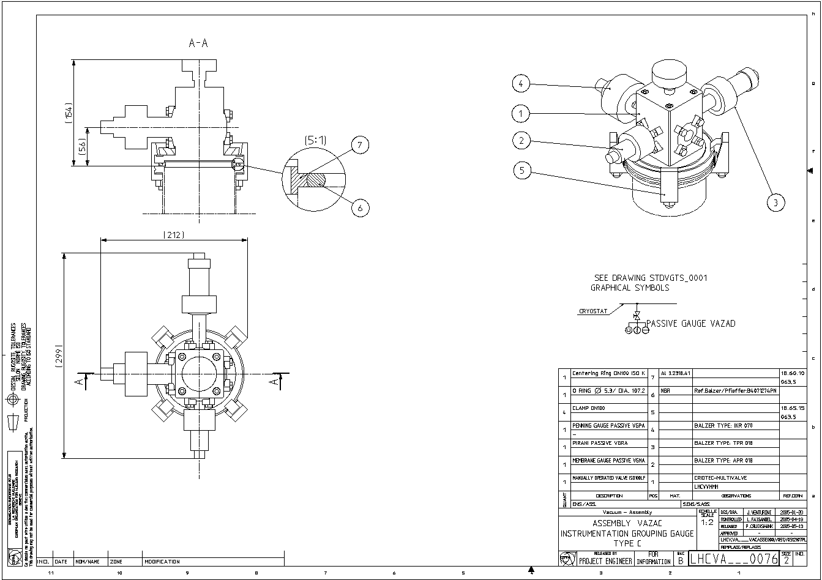
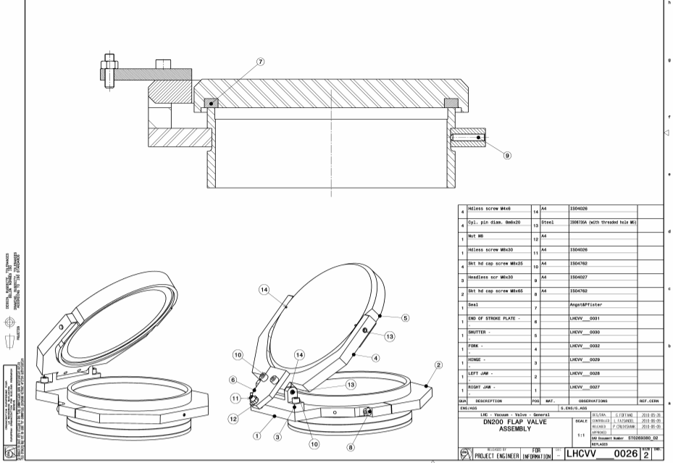
Insulation vacuum interface
SCLink insulation vacuum volume
  Pumping equipment :
    valve + turbopump + primary pump
    LHCVPGFY0001
  Gauges interface
    3 gauges on one ISO DN100
    LHCVA___0076
  Relief plate interface
    ISO-K DN100
    LHCVV___0011
DFX insulation vacuum volume
  Pumping equipment
    Valve + Turbopump + Primary Pump
    LHCVPGFY0001
  Gauges interface
    3 gauges DN100
    LHCVA___0076
  Self-closing flap valve
    On DN200 nozzle
    ST0705009_01

Slide 14
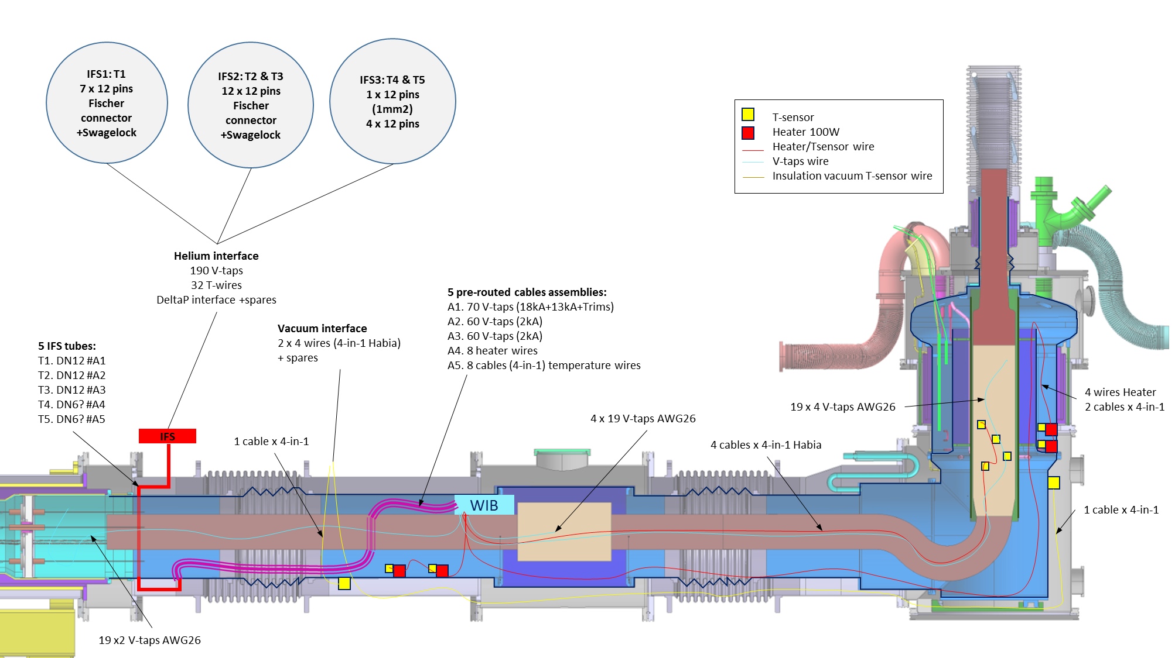
DFX Instrumentation,
Edms 2087413
Mechanical supports
Wire Instrumentation Box (WIB)
IFS
  CERN supply
  3 external flanges
  5 tubes sorted by functions
    190 V-taps
    32 T-wires
    8 power wires
Vacuum instrumentation feedthrough ISO DN100
DFX Instrumentation Layout
14

Slide 15
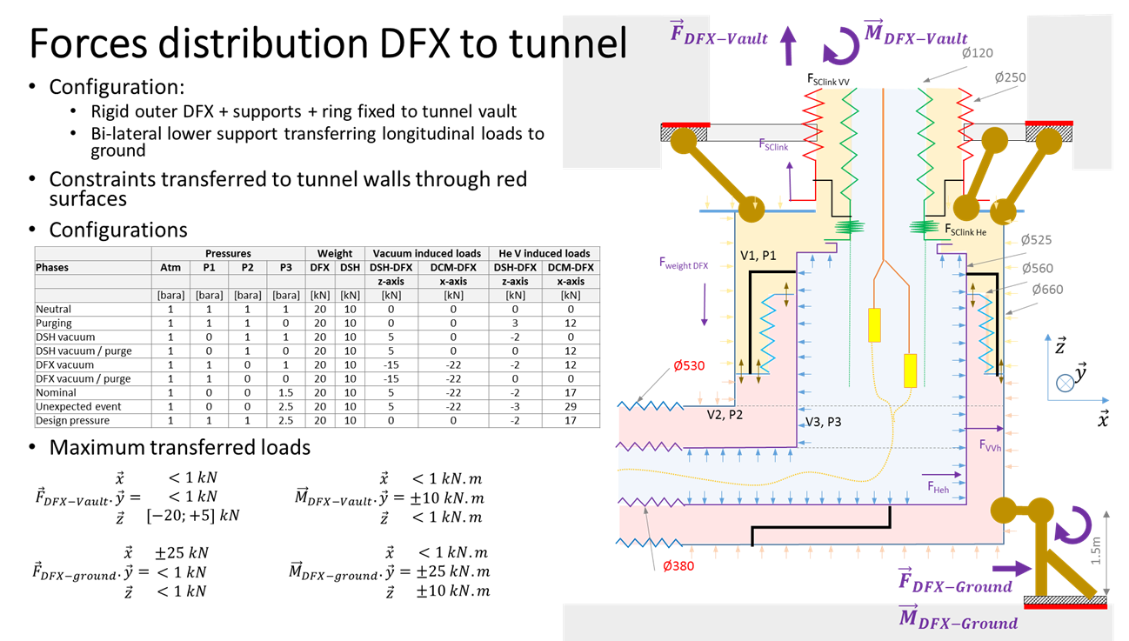
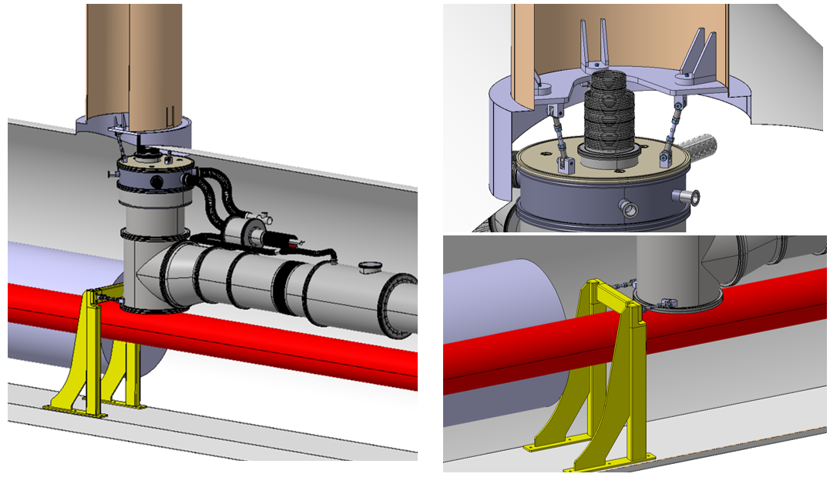
Civil Engineering & Transport Interfaces
CERN responsible for support to ground & ceiling in the LHC tunnel
Integration model validated
Ceiling loads, Edms 2224370
DFX support interfaces
  Threaded blocks in upper plate
  Transport lifting points
  Installation tooling TBD
Confirmed load transfer to civil engineering core
15

Slide 16
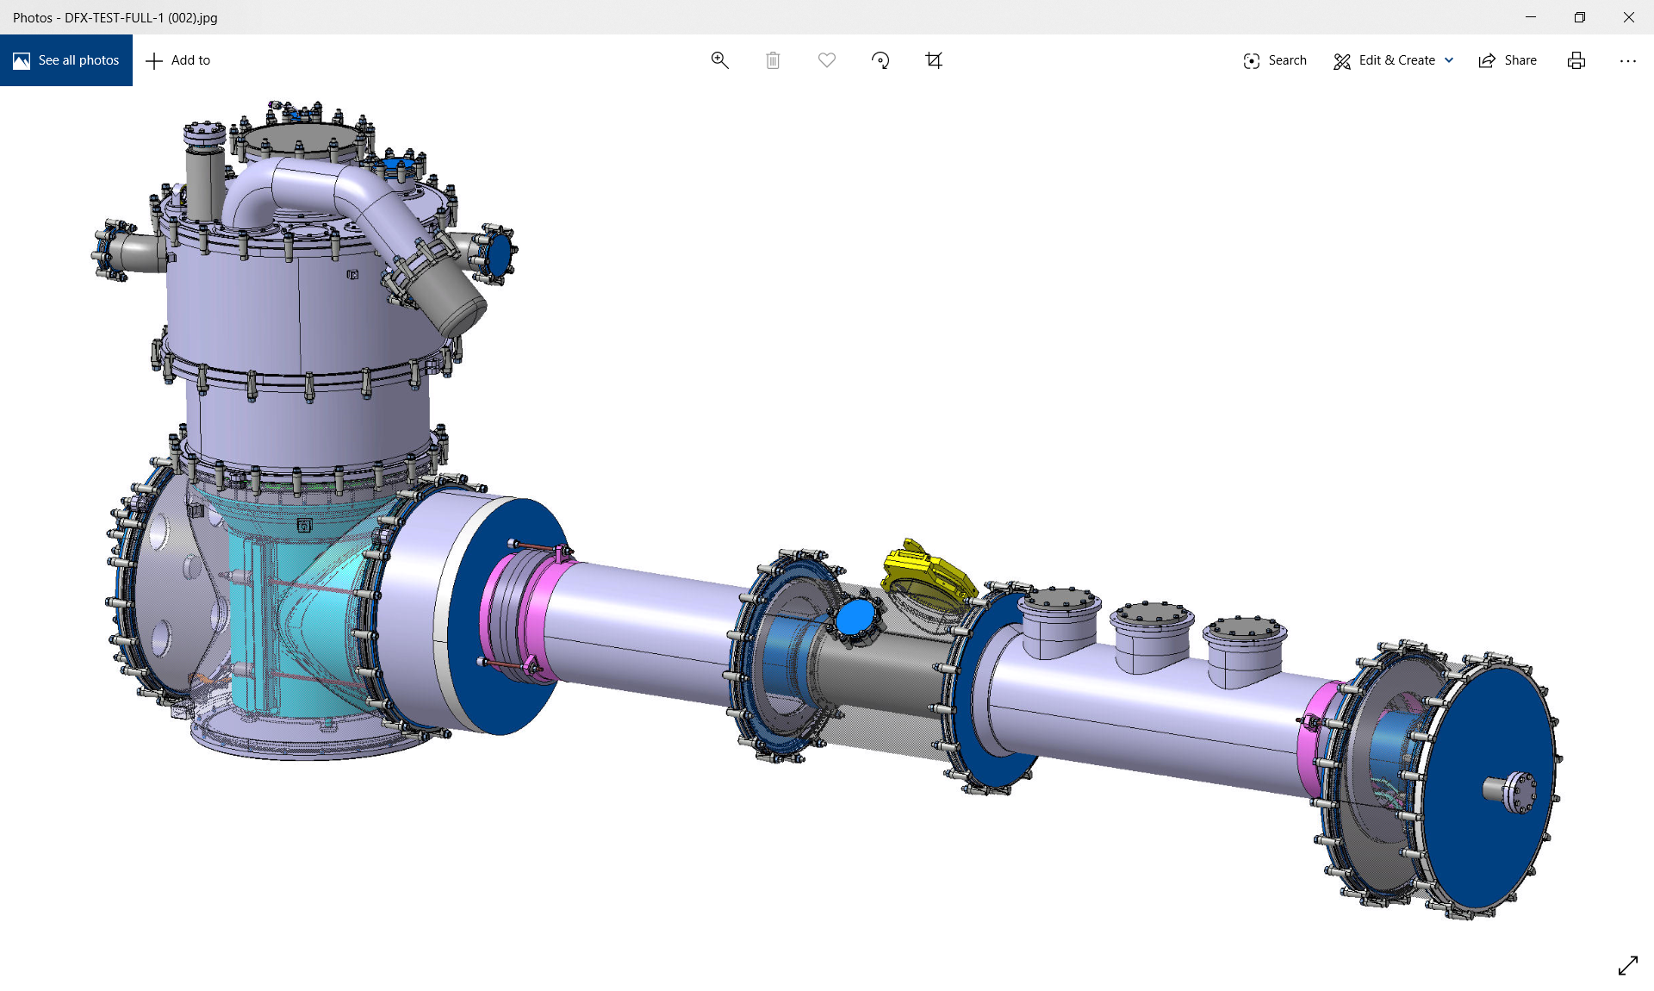
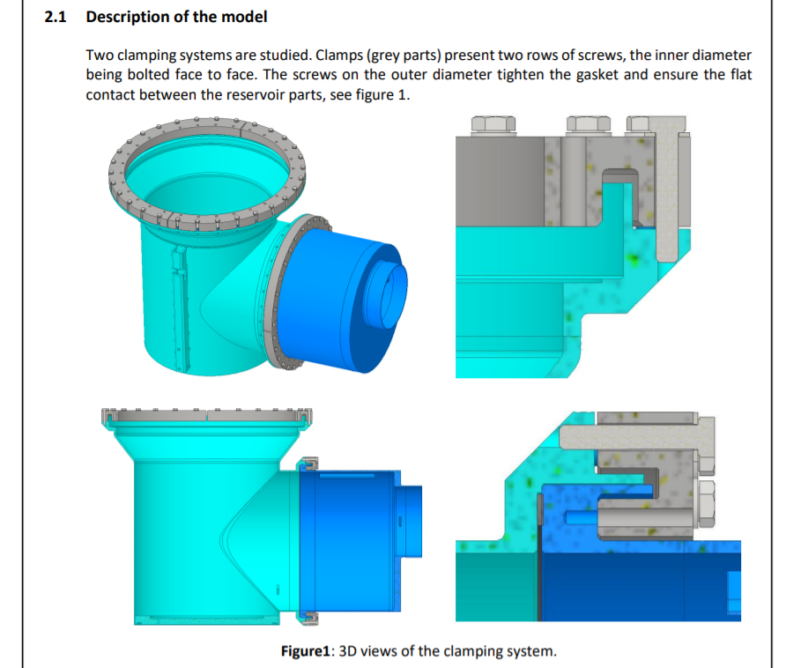
Assembly and P.Test configuration in UK
SOTON design according to EN 13445 – Edms 2301702.
Compliance with PED 2014/68/EU.
System fully assembled in UK to validate assemblability, perform pressure test and validate behaviour for all pressure configurations.
To avoid welding/cutting operations at lip welds in UK, the design permits the closing of the helium vessel with elastomer seals (Edms 2332938) prior to cable integration at Cern.
Manufacture and pressure test conformity assessement (presence of UK NoBo) and receives CE marking.
Execution of lip welds at Cern during final assembly with SC cables (CE marking removed)

Slide 17
Thanks for your attention !

