Slide 1
Component procurement plan - CERN
Y.Leclercq on behalf of the DF development team WP6a
3 March 2020
Production Readiness Review of the DFX

Slide 2
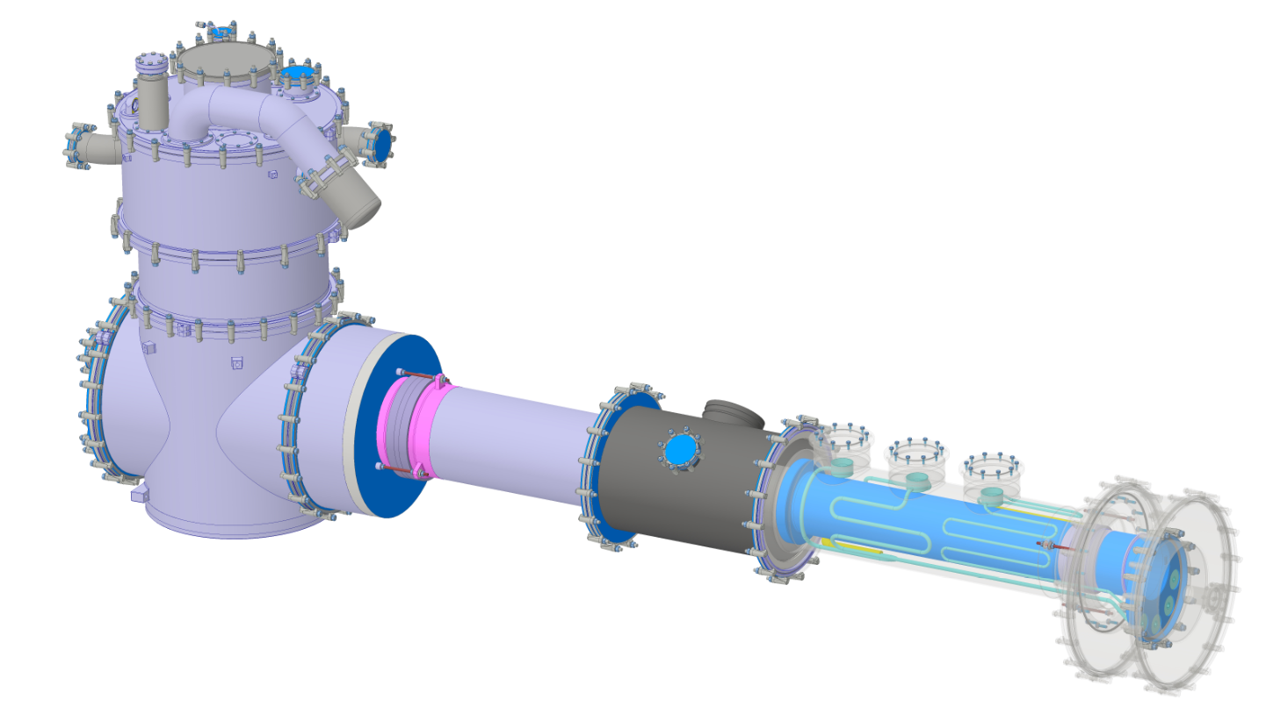
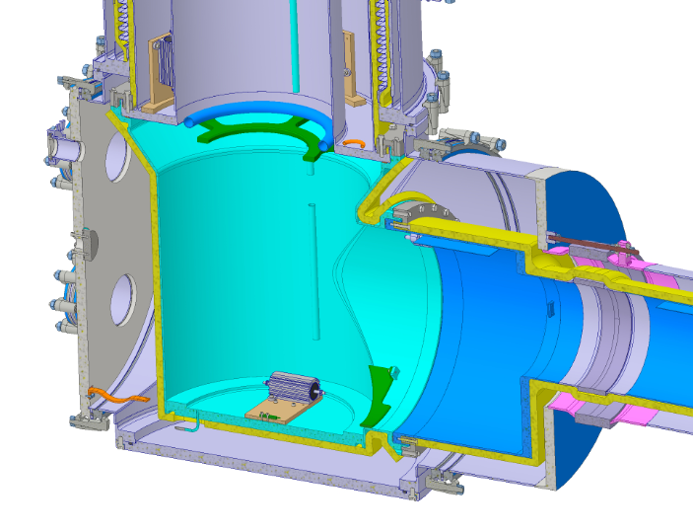
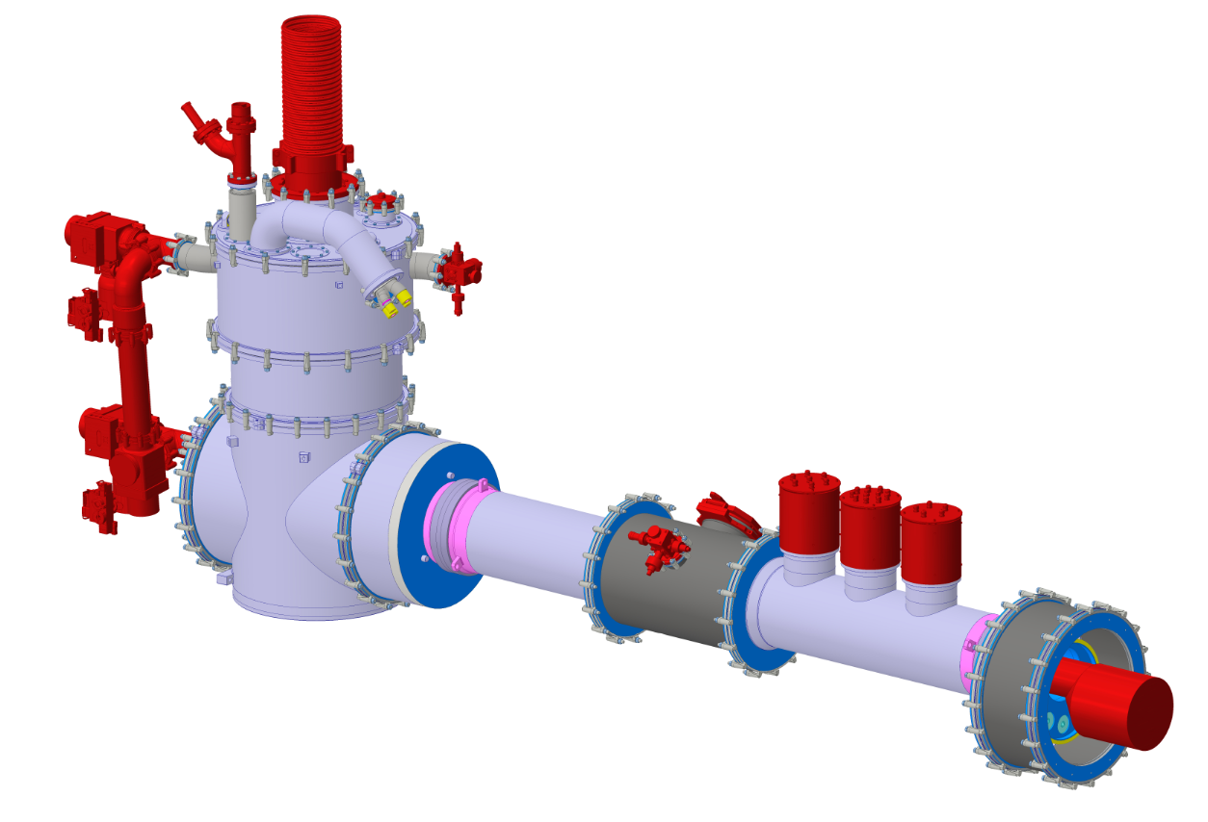
Items supplied by CERN
Electrical heaters + thermometers
Assembly in UK (DFX clamped design)
  All items which won’t be accessible at CERN
  All items needed part of NoBo qualification
  Items :
    IFS inner tubes
    2 x (Electrical Heaters+therm. protection)
Assembly at CERN (DFX tunnel design)
  Vacuum equipment
  IFS feedthroughs
  Pressure relief devices
  Cryogenic instrumentation
DFX clamped design
IFS inner tubes
Pressure relief
devices
SCLink
Vac. Equip.
Pumps
&
bypass
Flap valve
IFS feedthroughs
Bus bars
Temp. sensors
Level gauges
Vac. gauges
DFX tunnel design

Slide 3
Procurement plan (schedule to be adapted)
IFS development in progress
Electrical heaters procurement triggered
 | 2019
 | J | F | M | A | M | J | J | A | S | O | N | D
IFS inner tubes | Devlpt |  |  |  | Manuf.
Elec. Heat. |  |  | Procurement
CERN intervention
CERN intervention
Item | Assembly Location | DFX Sub-assembly | Assembly date | Procurement Source : CERN | Installed by
What | Where | Where | When | Who | How
IFS inner tubes | UK | Horizontal section Outer helium vessel | July 2020 | TE-MSC | TE-MSC
Electrical heaters | UK | Vertical section Inner helium vessel | July 2020 | TE-CRG | TE-MSC
Vacuum equipment Pumps & Gauges | CERN | Vacuum vessels Outer envelope | Q1-2021 | TE-VSC | TE-MSC
IFS feedthroughs | CERN | Vacuum vessel Outer envelope | Q1-2021 | TE-MSC | TE-MSC
Pressure relief devices Burst disc, Rated valve Flap valve, Relief plate | CERN | DFX outer envelope | Q1-2021 | TE-CRG TE-MSC TE-VSC | TE-MSC
Cryo. instrumentation Temperature sensors Level gauges | CERN | Helium vessel outer envelope Vacuum vessel outer envelope | Q4-2020 | TE-CRG | TE-MSC

Slide 4
Summary
Most of the CERN supplied items installed at CERN
Items required for NoBo qualification and non accessible items are installed in UK by CERN personnel

