Slide 1
Field penetration experiment
Daniel Turner

Slide 2
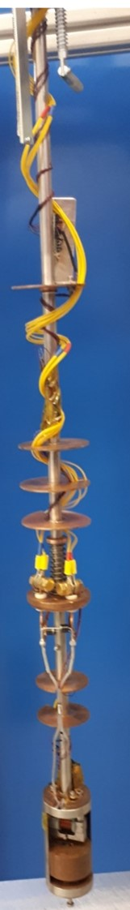
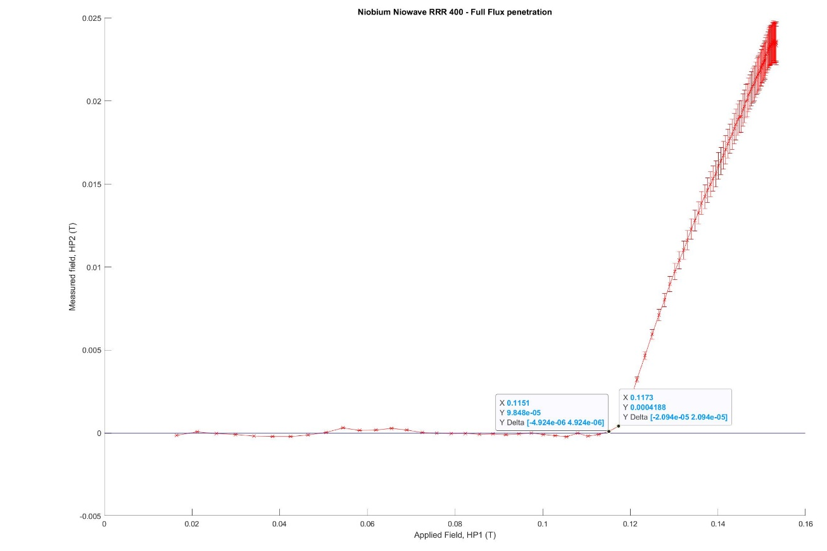
Previous facility

Slide 3
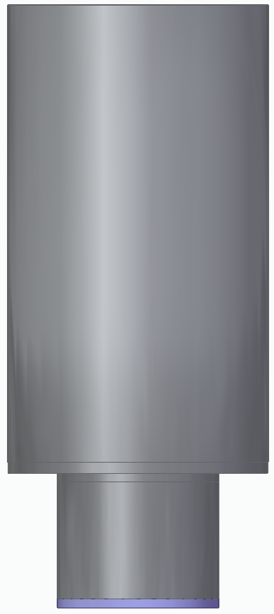
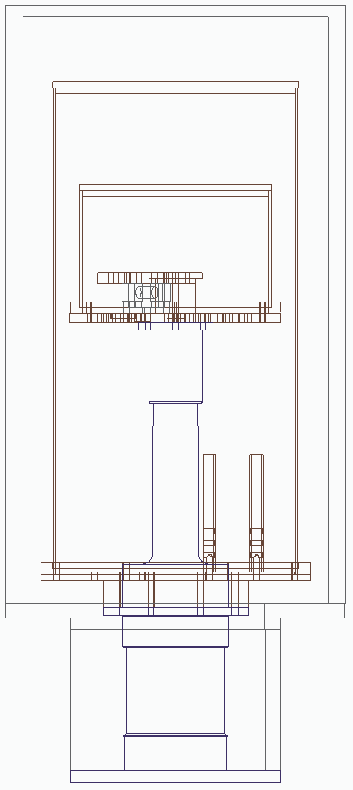
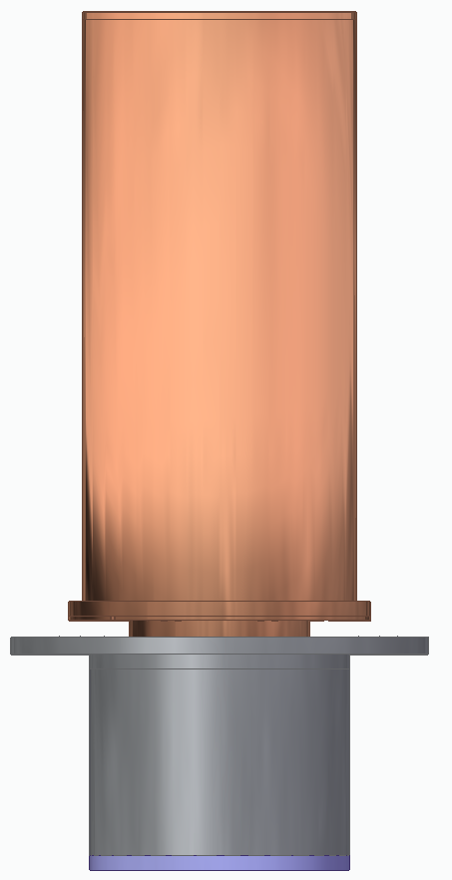
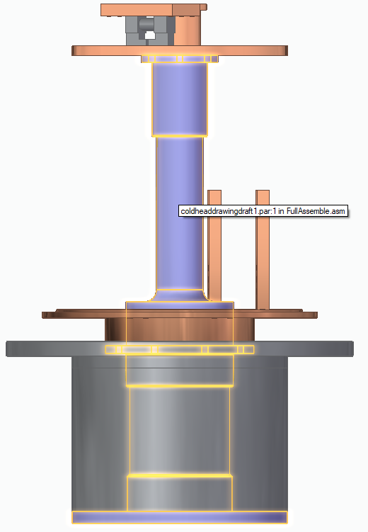
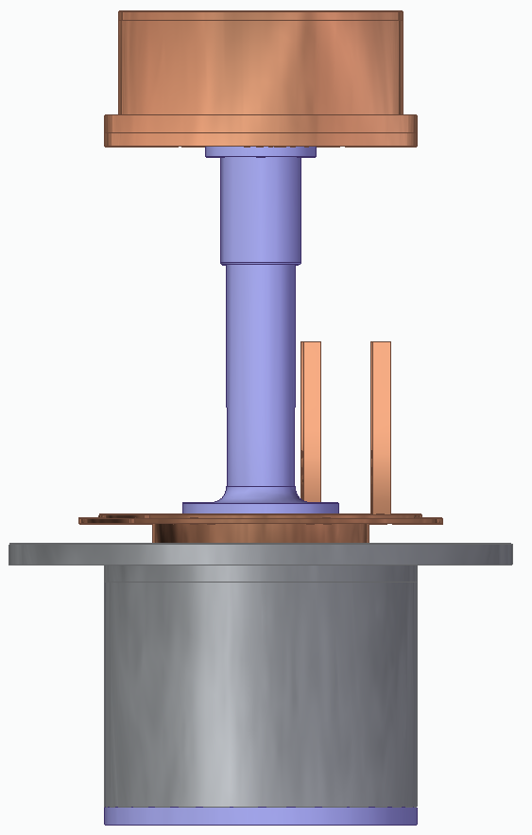
New facility
Stage 2
Stage 1

Slide 4
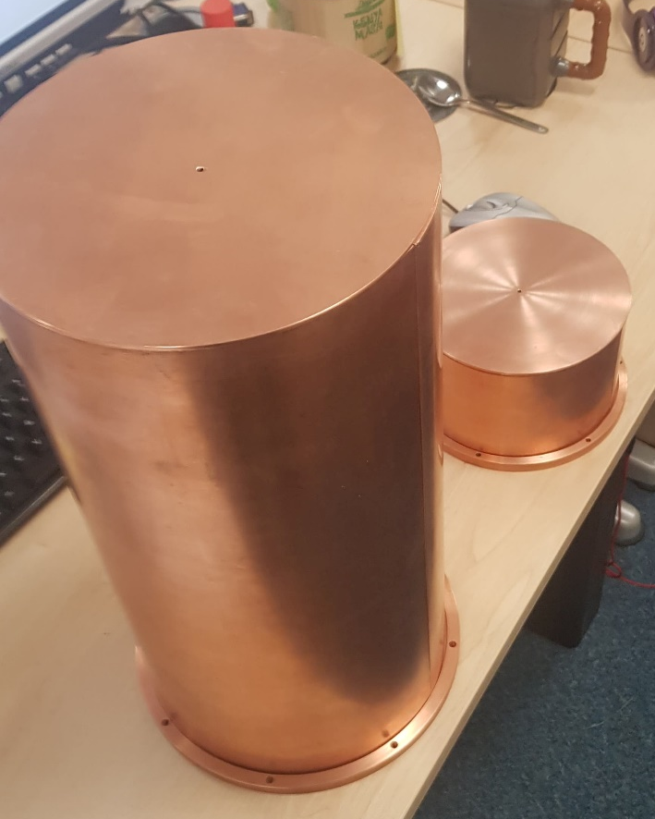
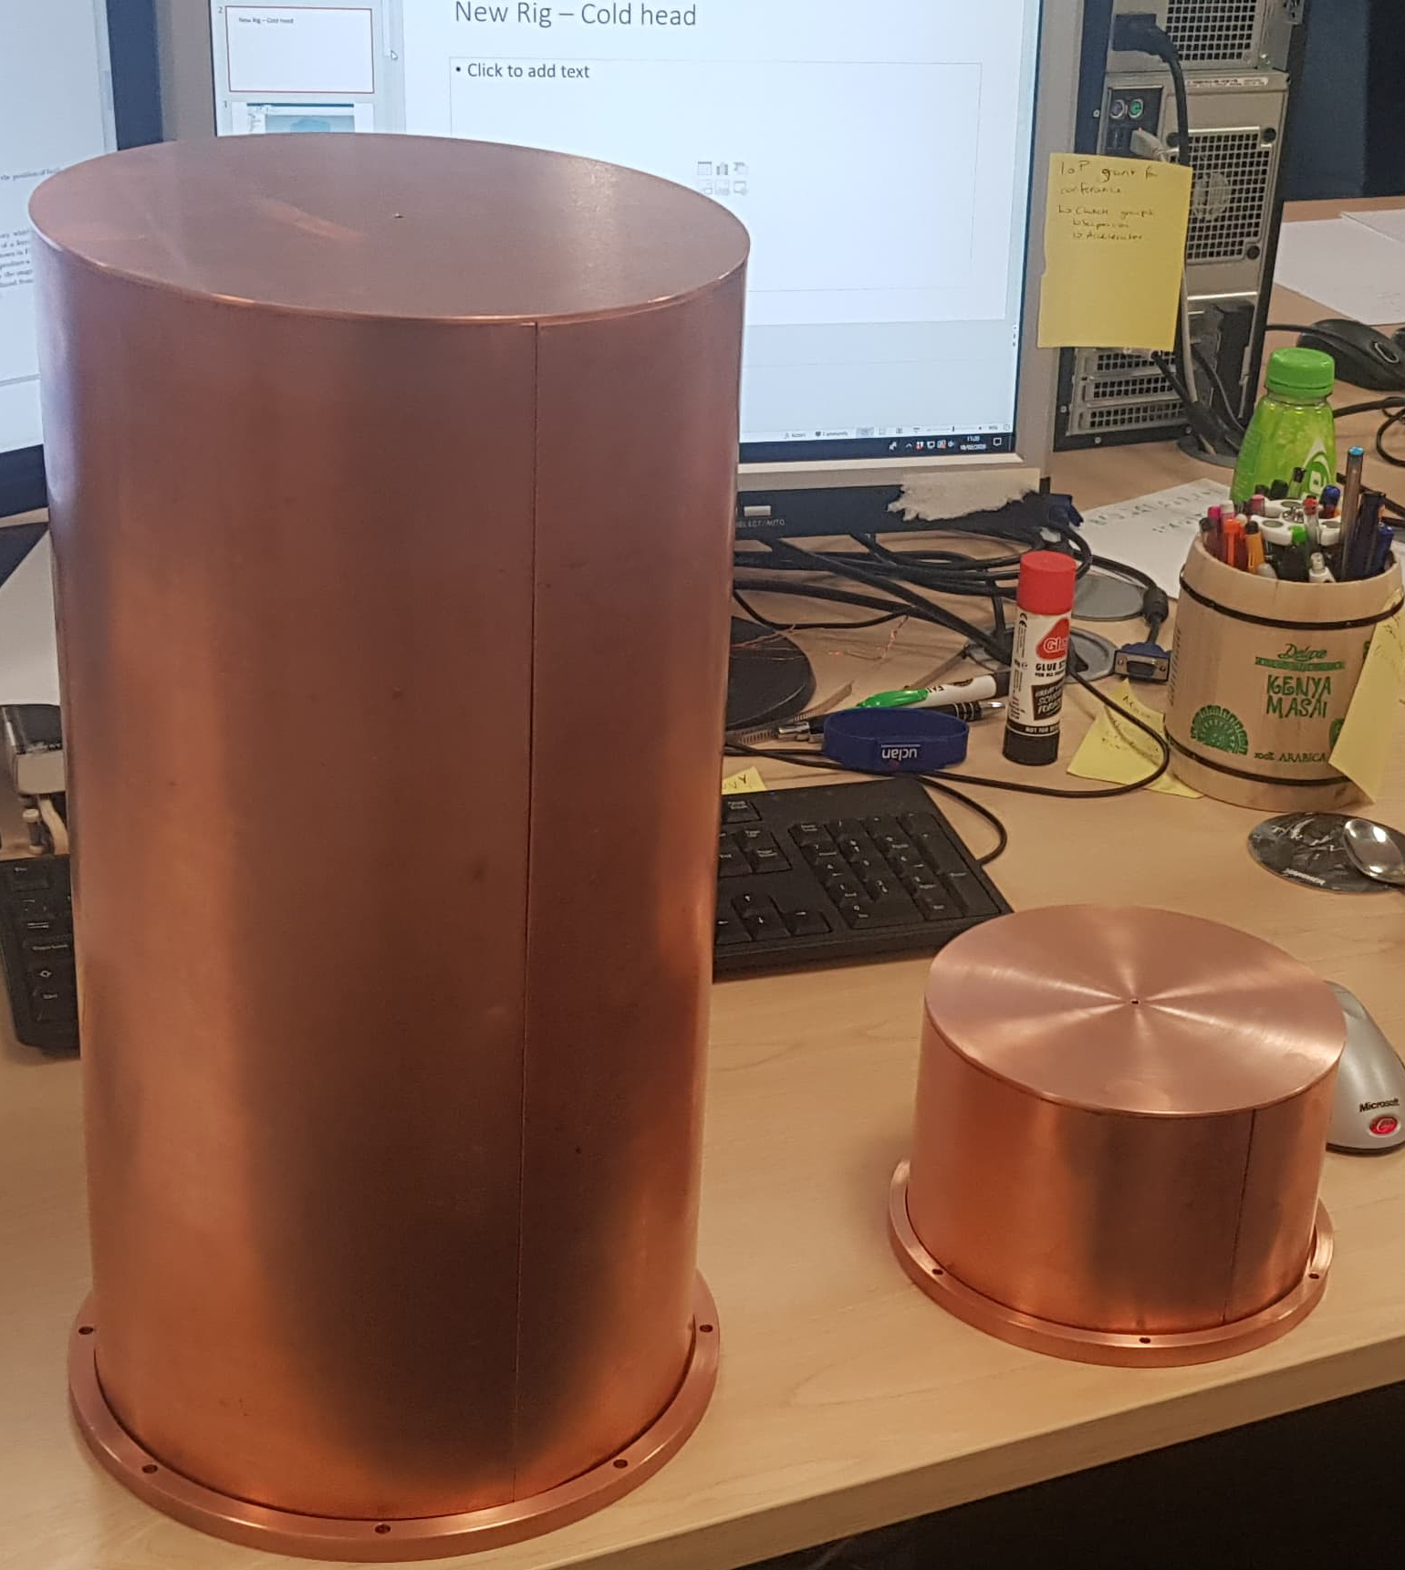

Slide 5
Next Steps
All parts have been machined
  Thermal radiation shields need to be soldered then cleaned.
Joins from Low temperature superconducting magnet -> High temperature superconducting magnet -> Normal conducting power supply
  Will be taken to Rutherford Appleton Laboratory for this.
Electronics need to be wired

