Slide 1
Progress with QPR at CERN
Lorena VEGA CID, G. Rosaz, G. Vandoni, W. Venturini
On behalf of all the colleagues from BE-RF, TE-VSC and TE-CRG contributing to the QPR studies.

Slide 2
Thin film studies
Type of test
QPR
New QPR
1.3 GHz cavity
Research lines
Nb: ECR/ HiPIMS
Nb₃Sn
Bulk Nb
Institutes
CERN
JLab
HZB
Test 2019 | Starting date | Type of test | Type of coating | Fabrication
1 | 24 January | 1.3 GHz cavity | HiPIMS Nb | CERN
2 | 08 March | 1.3 GHz cavity | HiPIMS Nb | CERN
3 | 20 March | New QPR | Bulk Nb | JLab
4 | 05 June | QPR | Nb₃Sn | CERN
5 | 18 June | QPR | ECR Nb | JLab
6 | 17 July | QPR | HiPIMS Positive pulse Nb | CERN
7 | 24 July | New QPR | Bulk Nb | HZB
8 | 08 August | QPR | HiPIMS Positive pulse Nb (second part) | CERN
9 | 11 September | QPR | Nb₃Sn | CERN
10 | 17 October | QPR | Bulk Nb | HZB
11 | 21 November | 1.3 GHz cavity | HiPIMS Nb | CERN +JLab
12 | 2 December | 1.3 GHz cavity | HiPIMS Nb | CERN +JLab
Test 2020 | Starting date | Type of test | Type of coating | Fabrication
1 | 7 January | QPR | ECR Nb | JLab
2 | 10 February | QPR | HiPIMS Nb | CERN + HZB

Slide 3
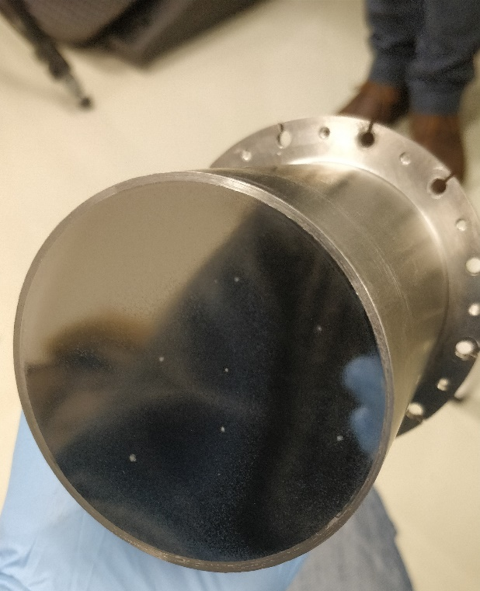
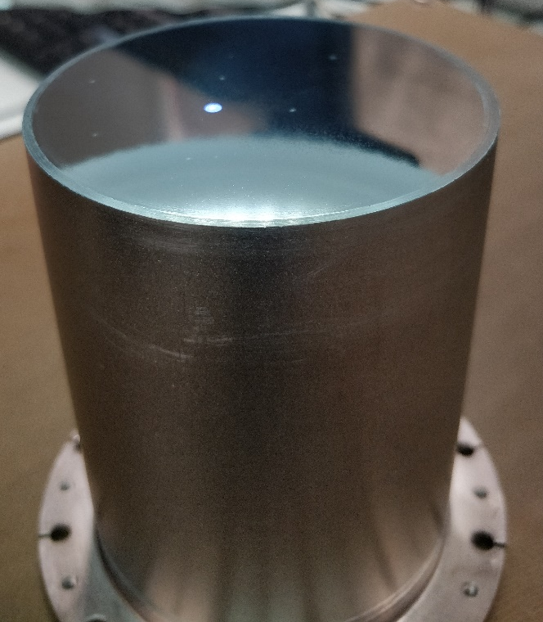
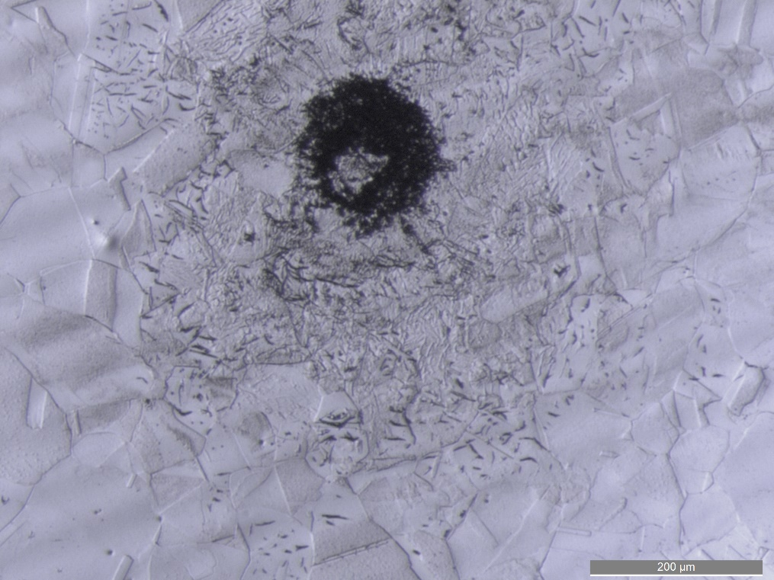
  Preparation of a HZB QPR sample within EASITrain program
Defects observation
Few bright spots observed
Optical microscopy
Courtesy of A.-T. Fontenla
Massive defects. Covered by the coating.

Slide 4
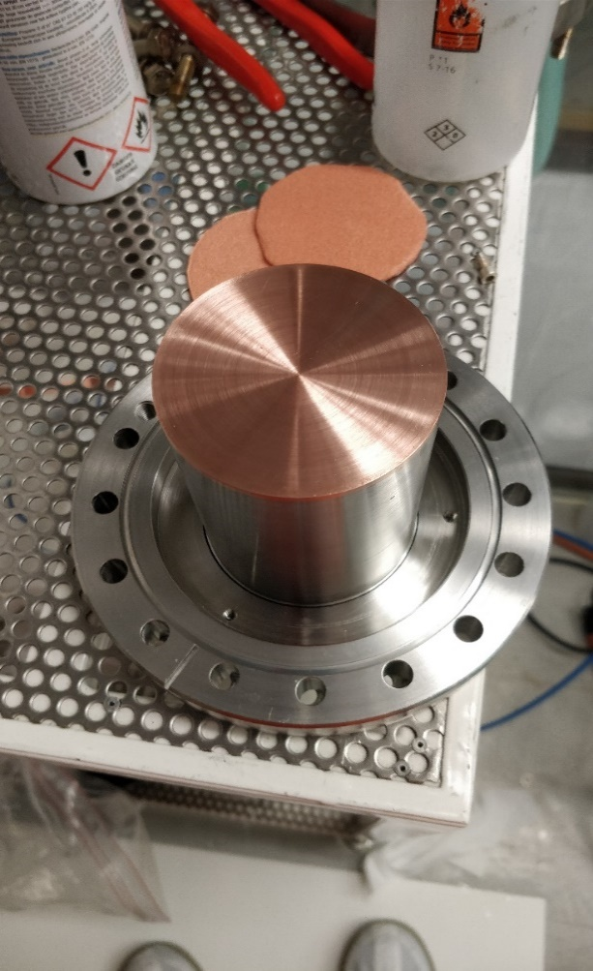
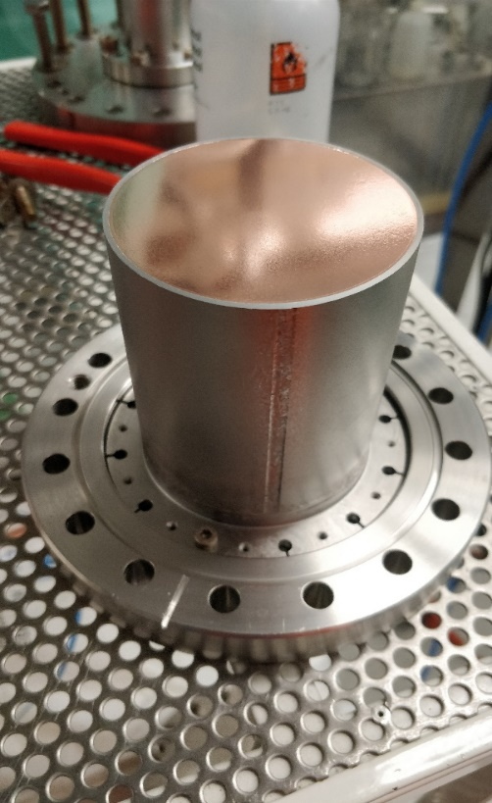
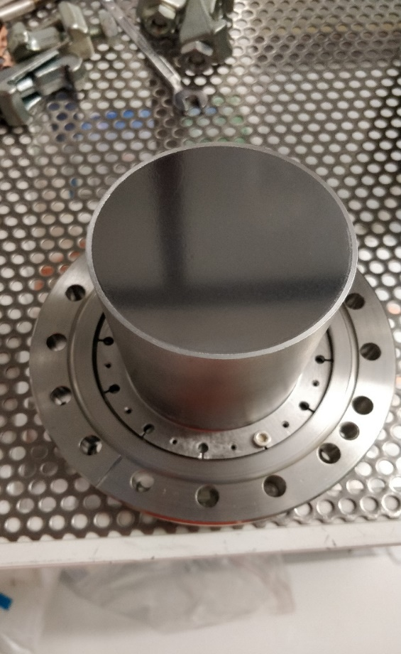
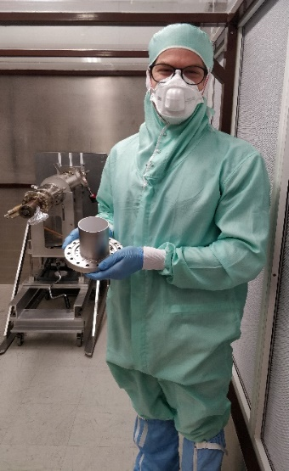
  Preparation of a HZB QPR sample within EASITrain program
Coating
Sample striped
SUBU (20min)
HPWR
Coating – HiPIMS / -50V bias.
Final thickness ~ 8um
QPR sample holder
QPR sample mounted
After coating
A happy ESR ☺

Slide 5
Planning
 | February |  |  | March
Measure HZB sample (Nb/Cu) on QPR
Measure HZB sample (Nb/Cu) on QPR2
To be added…
Current status:
There was a leak in the indium seal.
At warm, good pressure levels by placing the thermometry chamber.
However, the pressure rises when we reach the superfluid transition: cold leak in thermometry chamber. Measurements performed with the helium bath just above the transition temperature: high resistance and transition temperature at 9K.
Currently: Warming up to fix the leak.
Future plan:
If the sample is good, then the idea is to test it with the new QPR for commissioning.

Slide 6
Thanks for your attention.

Slide 7
Spare slides

Slide 8
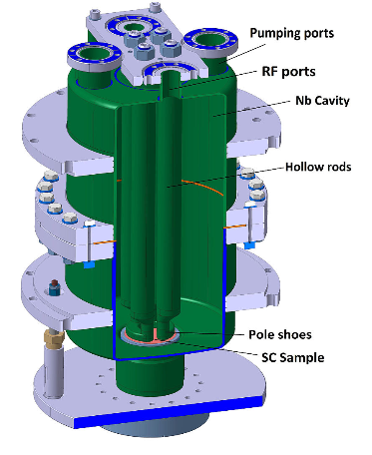
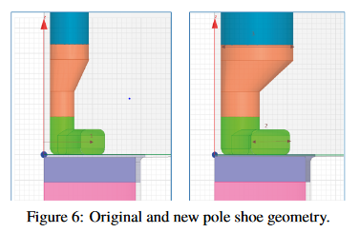
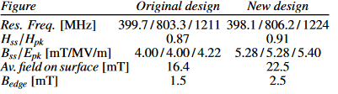
Commissioning of new QPR
Main design modifications
In 2017 a new version of the QPR was built: An electromagnetic and mechanical re-design of the existing QPR to optimize the measurement range and resolution
Modification | Impact | Benefits
↓ gap | ↑ Hs/Hpk | Higher field is illuminated in the sample: More homogeneus field distribution over the sample, better resolution
↑ diameter of rods | ↑ Bs/Epk | Electric field is reduced in the rod’s surface: Lower risk field emission
↑ width of rods | ↑ Average Bs | More homogeneus field distribution over the sample: Better resolution
Material | ↑ RRR | Better cooling: Lower the risk of thermal breakdown
V. del Pozo Romano et al, “Redesign of CERN's Quadrupole Resonator for Testing of Superconducting Samples”, in Proc. 18th Int. Conf. on RF Superconductivity (SRF'17), Lanzhou, China, July 2017, https://doi.org/10.18429/JACoW-SRF2017-TUPB016, 2018.

Slide 9
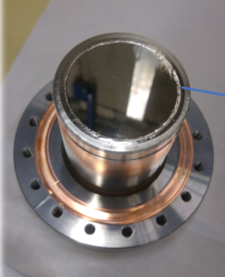
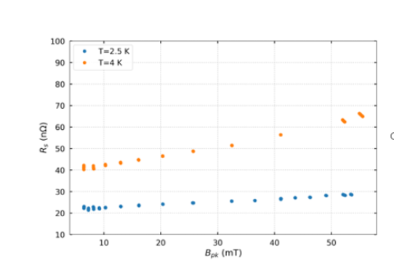
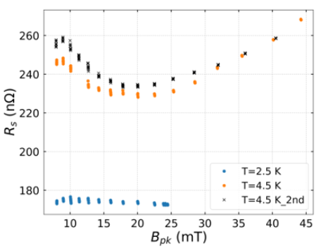
Commissioning of new QPR
First benchmark with bulk Nb sample
A bulk Nb sample RRR>100 (JN1) was tested with old and new QPR for commissioning (April 2019).
Rs vs Bpk @400MHz
Old QPR
New QPR
General comments (courtesy: M. Arzeo):
Output: Overestimation of surface resistance with new QPR.
Possible cause: In new QPR the magnetic field is more distributed in the sample surface. The weld might be affecting the dissipation.
To do next: Measure another bulk Nb sample without welds on the top surface to confirm the theory.

Slide 10
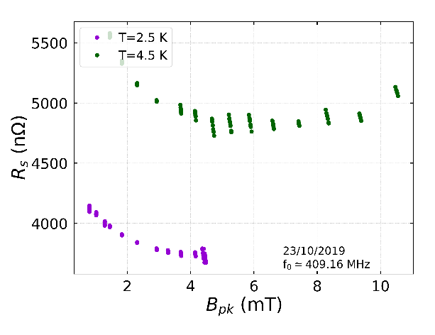
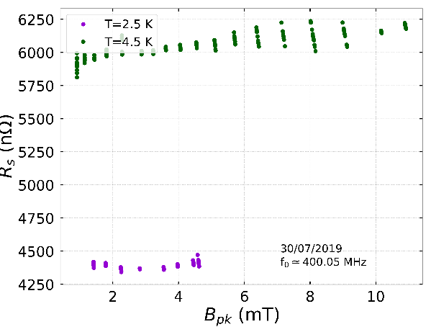
Commissioning of new QPR
Second benchmark with bulk Nb sample
A second bulk Nb sample has been tested with old and new QPR.
The sample was produced in HZB and it was e-beam welded on the Nb cylinder support.
Rs vs Bpk @400MHz
Old QPR
New QPR
Output: Discrepancies in the results with old and new QPR.
Possible cause: The sample quality was very low, which could be attributed to the high roughness of the surface (Ra~30-40 um). Dissipation was evident even at low fields. Results cannot be fully trusted as there might be heat leaks.
To do next: Repeat process using a good sample for benchmarking.

