Slide 1
13th WP15 meeting
Thin Film for Superconducting RF (TF-SRF)
Oleg Malyshev
WP15 coordinator

Slide 2
Agenda
Focus on two main activities:
Quadrupole resonator (QPR)
Development and characterising of new SC coatings on small samples

Slide 3
Schedule of milestones and deliverables
 |  | Year 1 |  |  |  | Year 2 |  |  |  | Year 3 |  |  |  | Year 4
Task | Description | Q1 | Q2 | Q3 | Q4 | Q1 | Q2 | Q3 | Q4 | Q1 | Q2 | Q3 | Q4 | Q1 | Q2 | Q3 | Q4
1 | 1st WP meeting. | M1
2 | Evaluation of cleaning process for surface preparation for Cu and Nb substrate for Nb coating -(INFN). |  | M2 |  | D1
2-4 | Evaluation of system 1 & 2 (e.g. NbN and Nb₃Sn coating) - STFC |  |  |  |  | M3 |  |  | D2
2-4 | Evaluation of system 3 (e.g. MgB₂ and SIS multilayer coating) |  |  |  |  |  |  |  |  | M4 |  |  | D3
1-4 | Final report. |  |  |  |  |  |  |  |  |  |  |  |  |  |  |  | D4
now

Slide 4
List of milestones and deliverables
Type | Delivery date | Lead beneficiary | Related task/ responsible | Description | Status
M1 | m1 | STFC | Task 15.1 | 1st WP meeting. Analysing outcome from EuCARD2 and current state of the field, finalising a detailed plan for WP | Competed
M2 | m6 | INFN | Task 15.2 | First sample substrates cleaned at INFN for depositing at partners (Report to StCom) | Completed
D1 | m12 | INFN | Task 15.2 | Evaluation of cleaning process. Report defining an optimum cleaning and polishing procedure for surface preparation for Cu and Nb substrate for Nb coating minimising the substrate effect on the final film properties. | Completed
M3 | m14 | STFC | Task 15.3, 15.4 | First samples exchanged (system 1 and 2) and deposited at partners (Report to StCom) | Completed
D2 | m24 | STFC | Task 15.3, 15.4 | Evaluation of systems 1 and 2. Report on deposition, surface and structural analysis, DC and RF superconductivity evaluation of systems 1 and 2 (e.g. NbN and Nb₃Sn) and Superconductor-Insulator-Superconductor (SIS) multilayer coating | Completed
M4 | m26 | HZB | Task 15.3, 15.4 | First samples exchanged (system 3 and SIS) and deposited at partners (Report to StCom) | Completed
D3 | M36 31/03/2020 | HZB | Task 15.3, 15.4 | Evaluation of system 3. Report on deposition, surface and structural analysis, DC and RF superconductivity evaluation of system 3 (e.g. NbTiN or MgB₂) and SIS multilayer coating | Started?
D4 | M46 31/03/2020 | STFC | Task 15.3, 15.4 | Final report on thin film technology [46] Report summarizing the results on the evaluation of cleaning and coating procedures for highest Q₀ and E_{a}

Slide 5
Preparation of the 2nd Periodic Report
Time to start preparation of the 2nd Periodic Report covering M18 to M36 (November 2018 – April 2020).
Schedule:
30.11.2019: Template ready, to be presented to WP coordinators at the December SC meeting.
15-28.2.2020 : templates sent to all WP coordinators.
31.3 : deadline for Task leaders to send their part to WP Coordinators
30.4 : deadline for WP Coordinators to send their chapter to CERN
30.5 : first complete draft ready.
15.6 : final draft sent to SC for comments.
30.6 : deadline for submission.

Slide 6
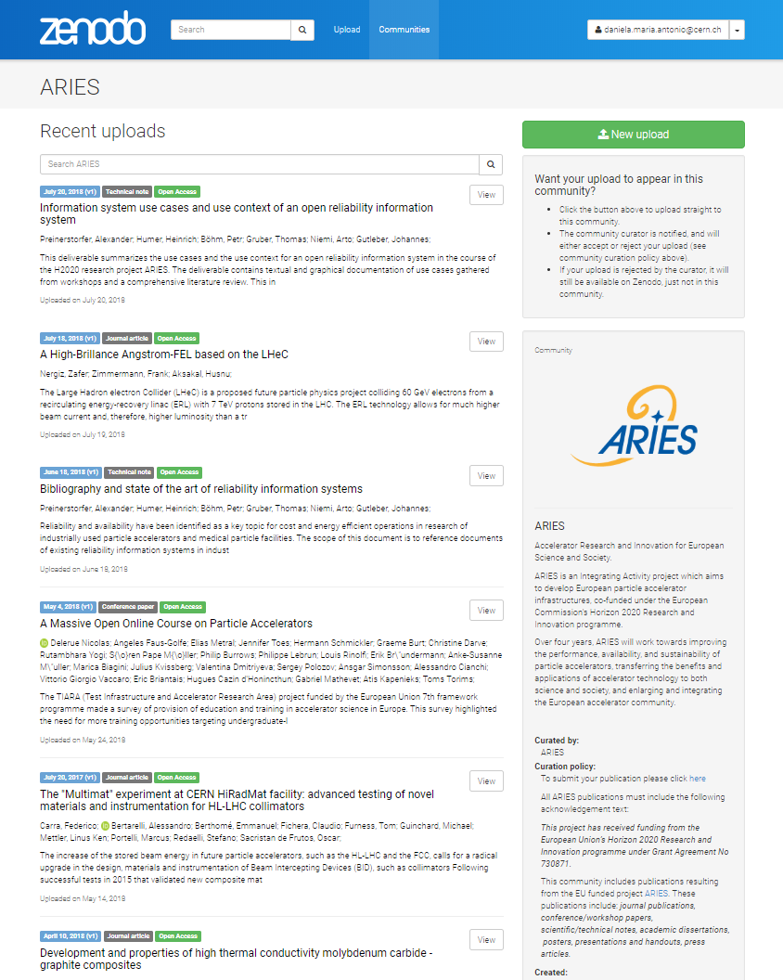
Publications
From 7 publications in September 2018 to 42 publications in April 2019.
  Article (22)
  Report (7)
  Conferencepaper (4)
  Technicalnote (4)
  Other (2)
  Thesis (2)

Slide 7
3rd ARIES Annual Meeting
20-24 April 2020 at IST Congress Center, Lisbon, Portugal
Monday and Tuesday WP parallel sessions.
  Monday – arrival day
  Tuesday – whole day 14th ARIES WP15 meeting
Plenary sessions:
  Wednesday 22 April, afternoon, 4 hours
  Thursday 23 April, morning and afternoon, 8 hours
  Friday 24 April, morning and afternoon, 4 hours (end at 14:00).
2 highlight talks for each JRA:
We should give 2 x 20 min talks on Thursday:
  WP15 overview progress – me
  QPR RF tests of samples deposited within WP15 – Oliver
  ALD talk from Claire on Tuesday

Slide 8
ARIES-II
Check finance table
Scientific and Financial contacts
TIMELINE:
Call opened (for accepted bids) 28 November 2019
Meeting at CERN on 9th January 2020 for all WP and Task leaders
Deadline for submission 17 March 2020
Result of EC evaluation 17 August 2020
Consortium Agreement preparation Oct. 2020 – Mar. 2021
Project start: 1 May 2021 (at end of ARIES)
Duration 4 years (2021 – 2025)

