Slide 1


Muon detection
Alexia, Anna and Markus

Slide 2
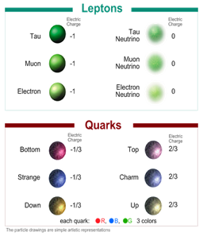

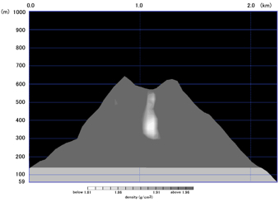

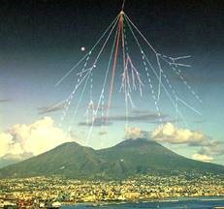

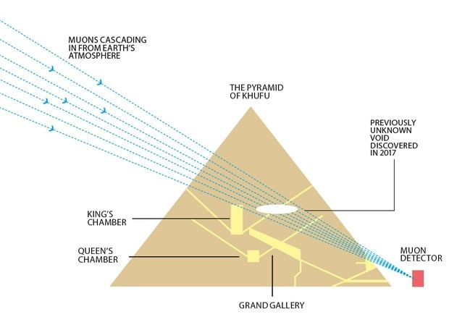
Muons
What are they? Why would we try to detect them?
A more massive version of the electron with a lifetime of 2,2µs
Cosmic radiation hitting Earth’s atmosphere
Particle accelerators
Curiosity
Applications

Slide 3
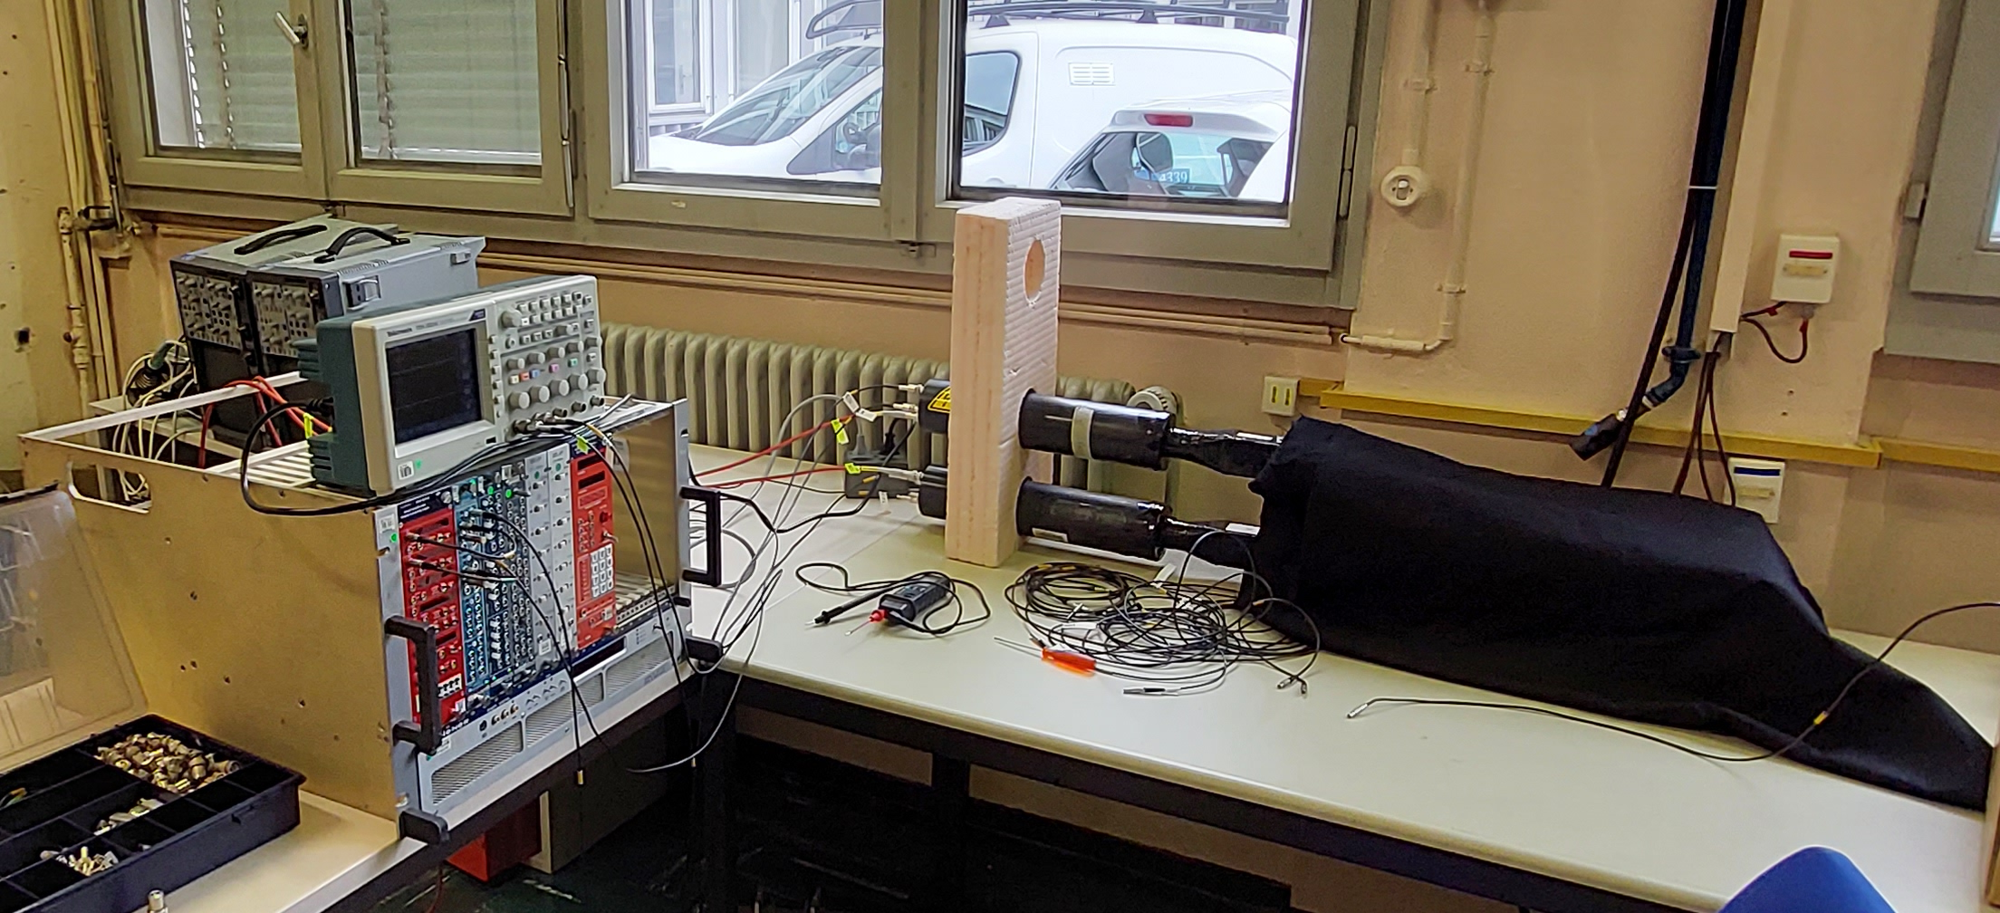
The set-up
Oscilloscope
Photomultiplier tubes (PMT)
Scintillators
NIM system

Slide 4
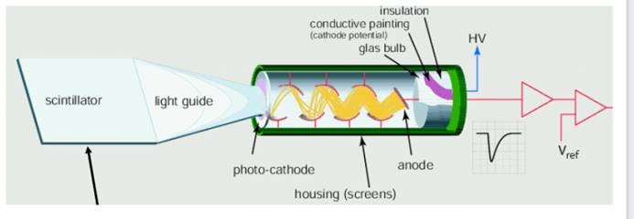
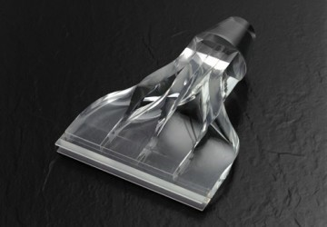

Slide 5
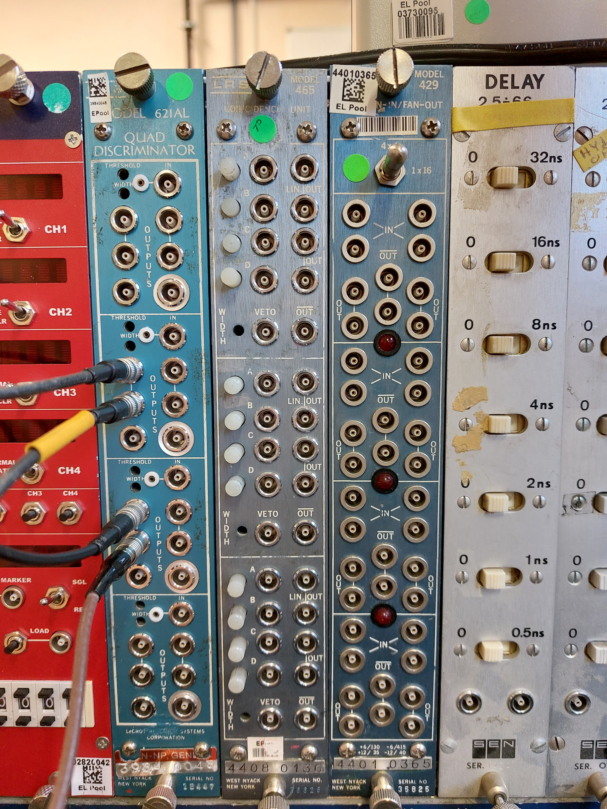
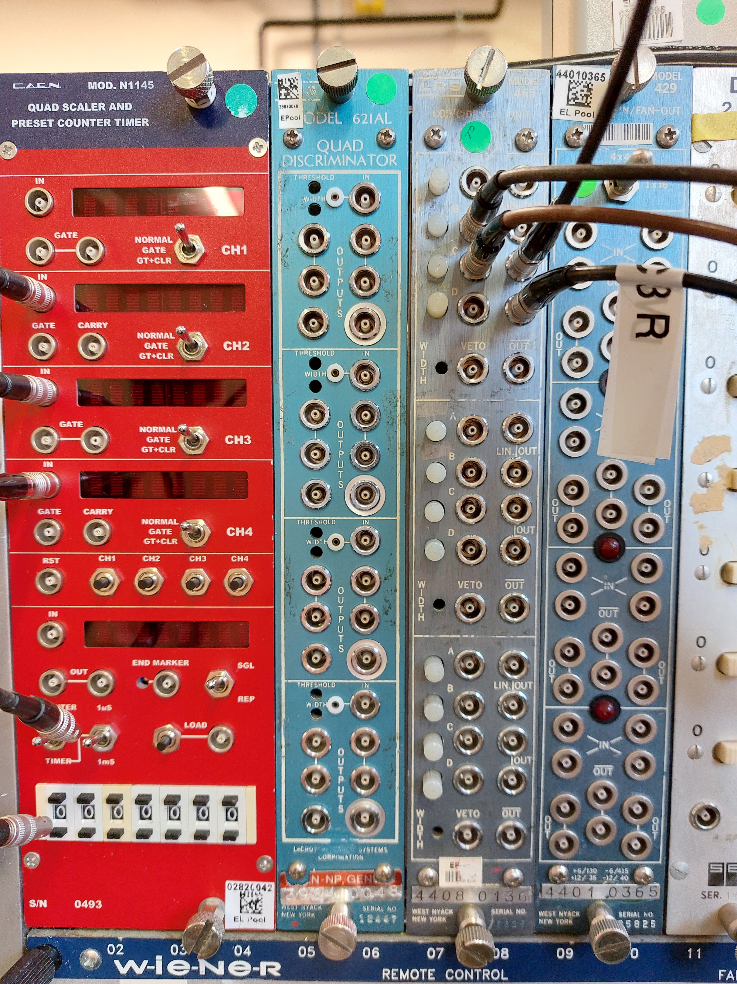
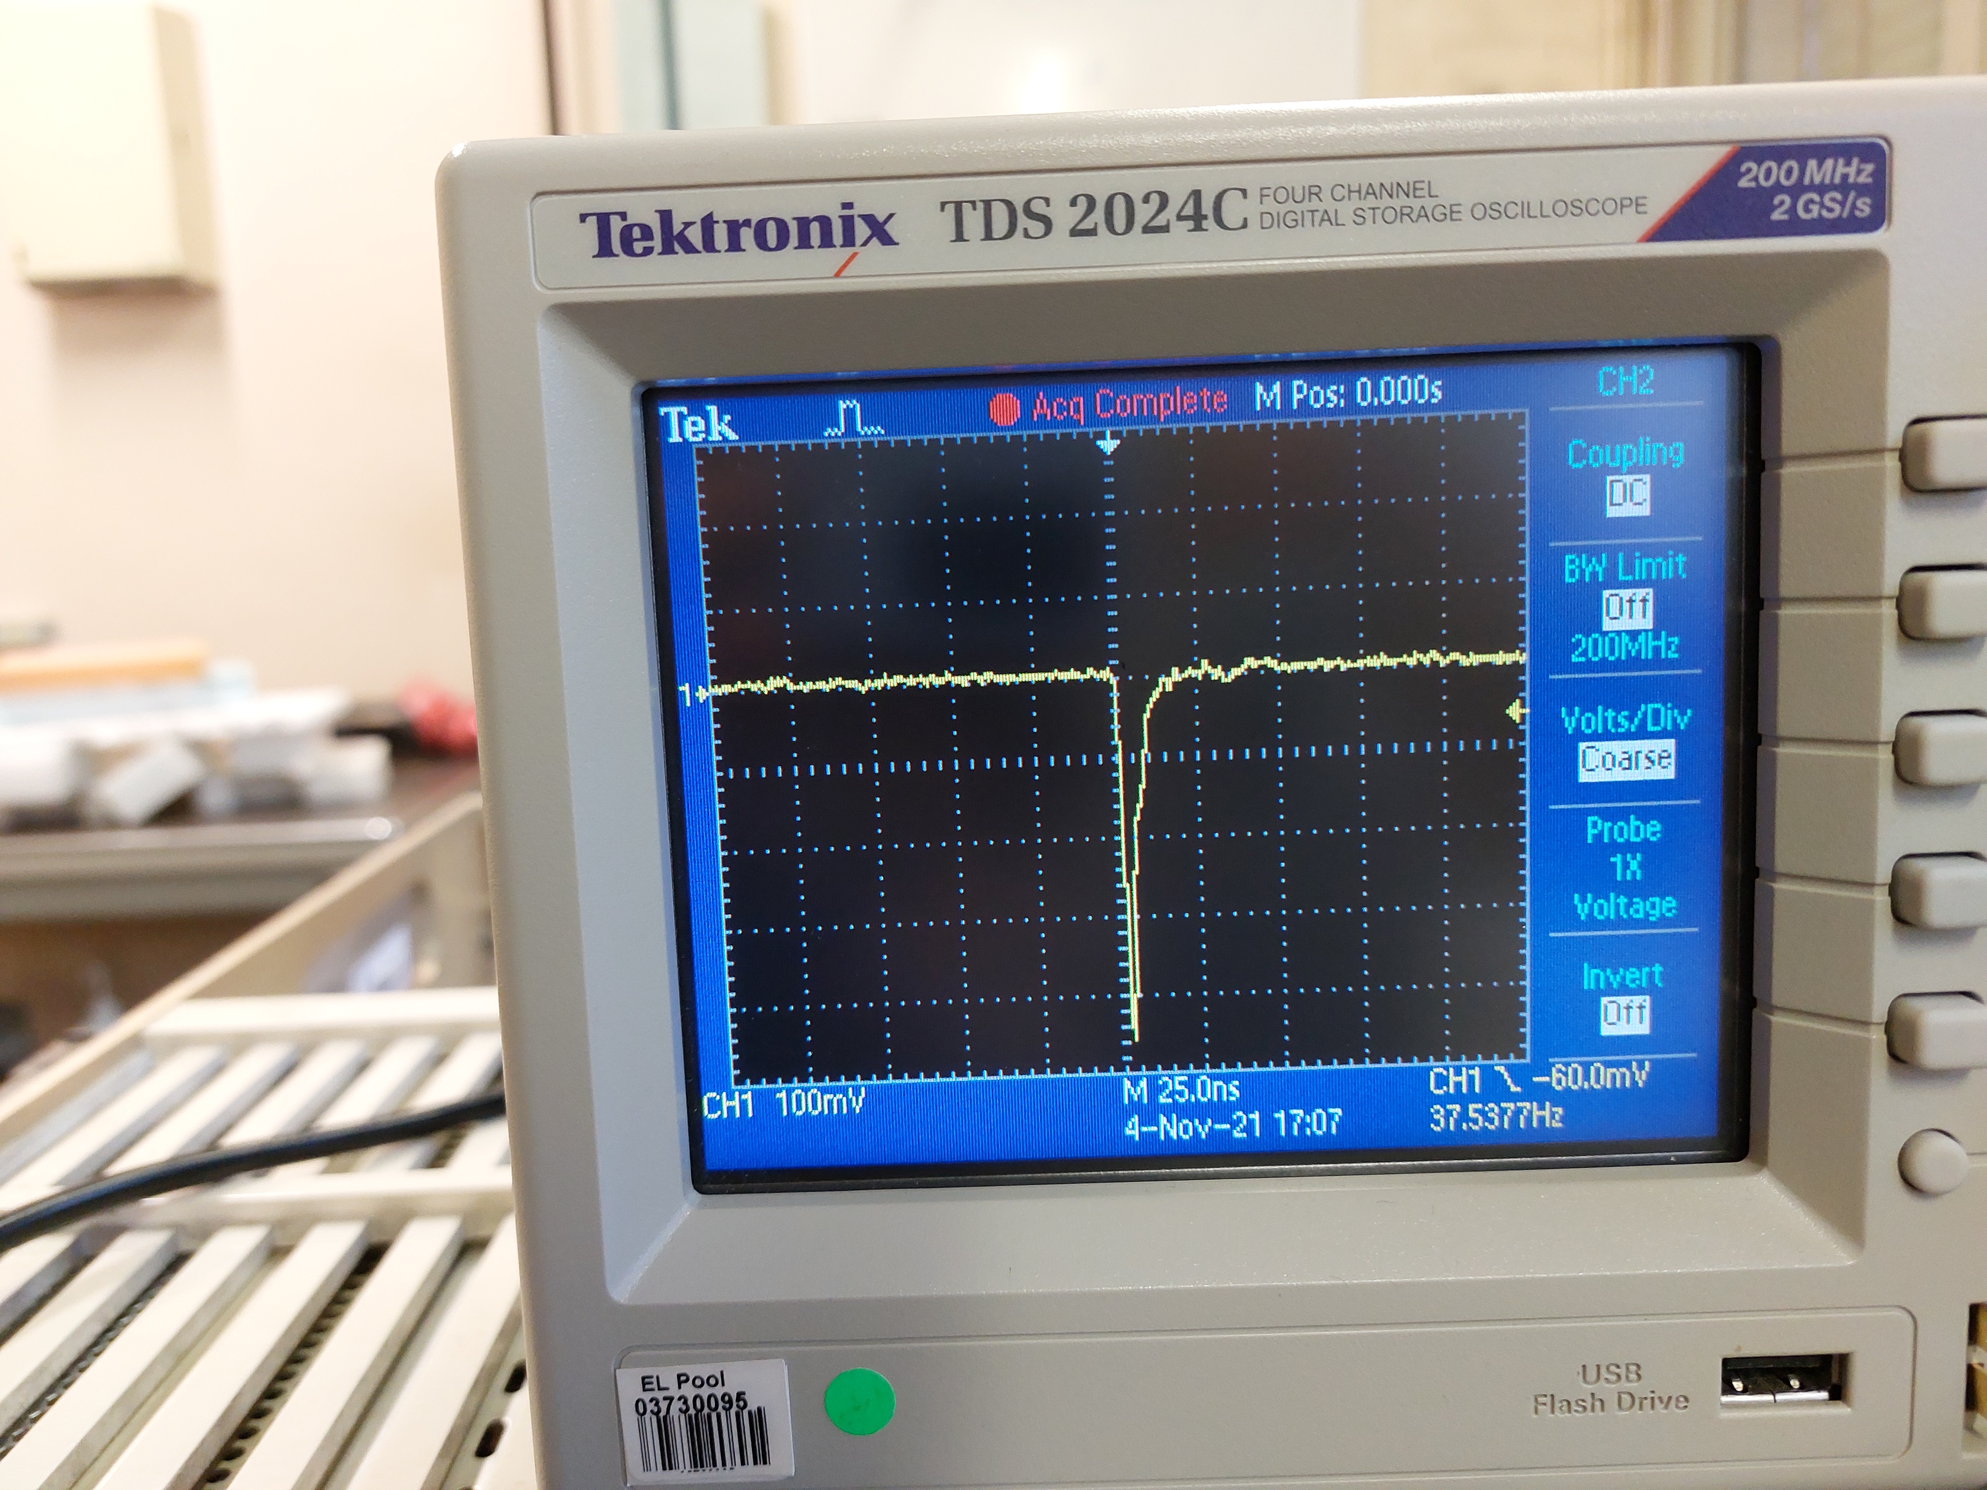
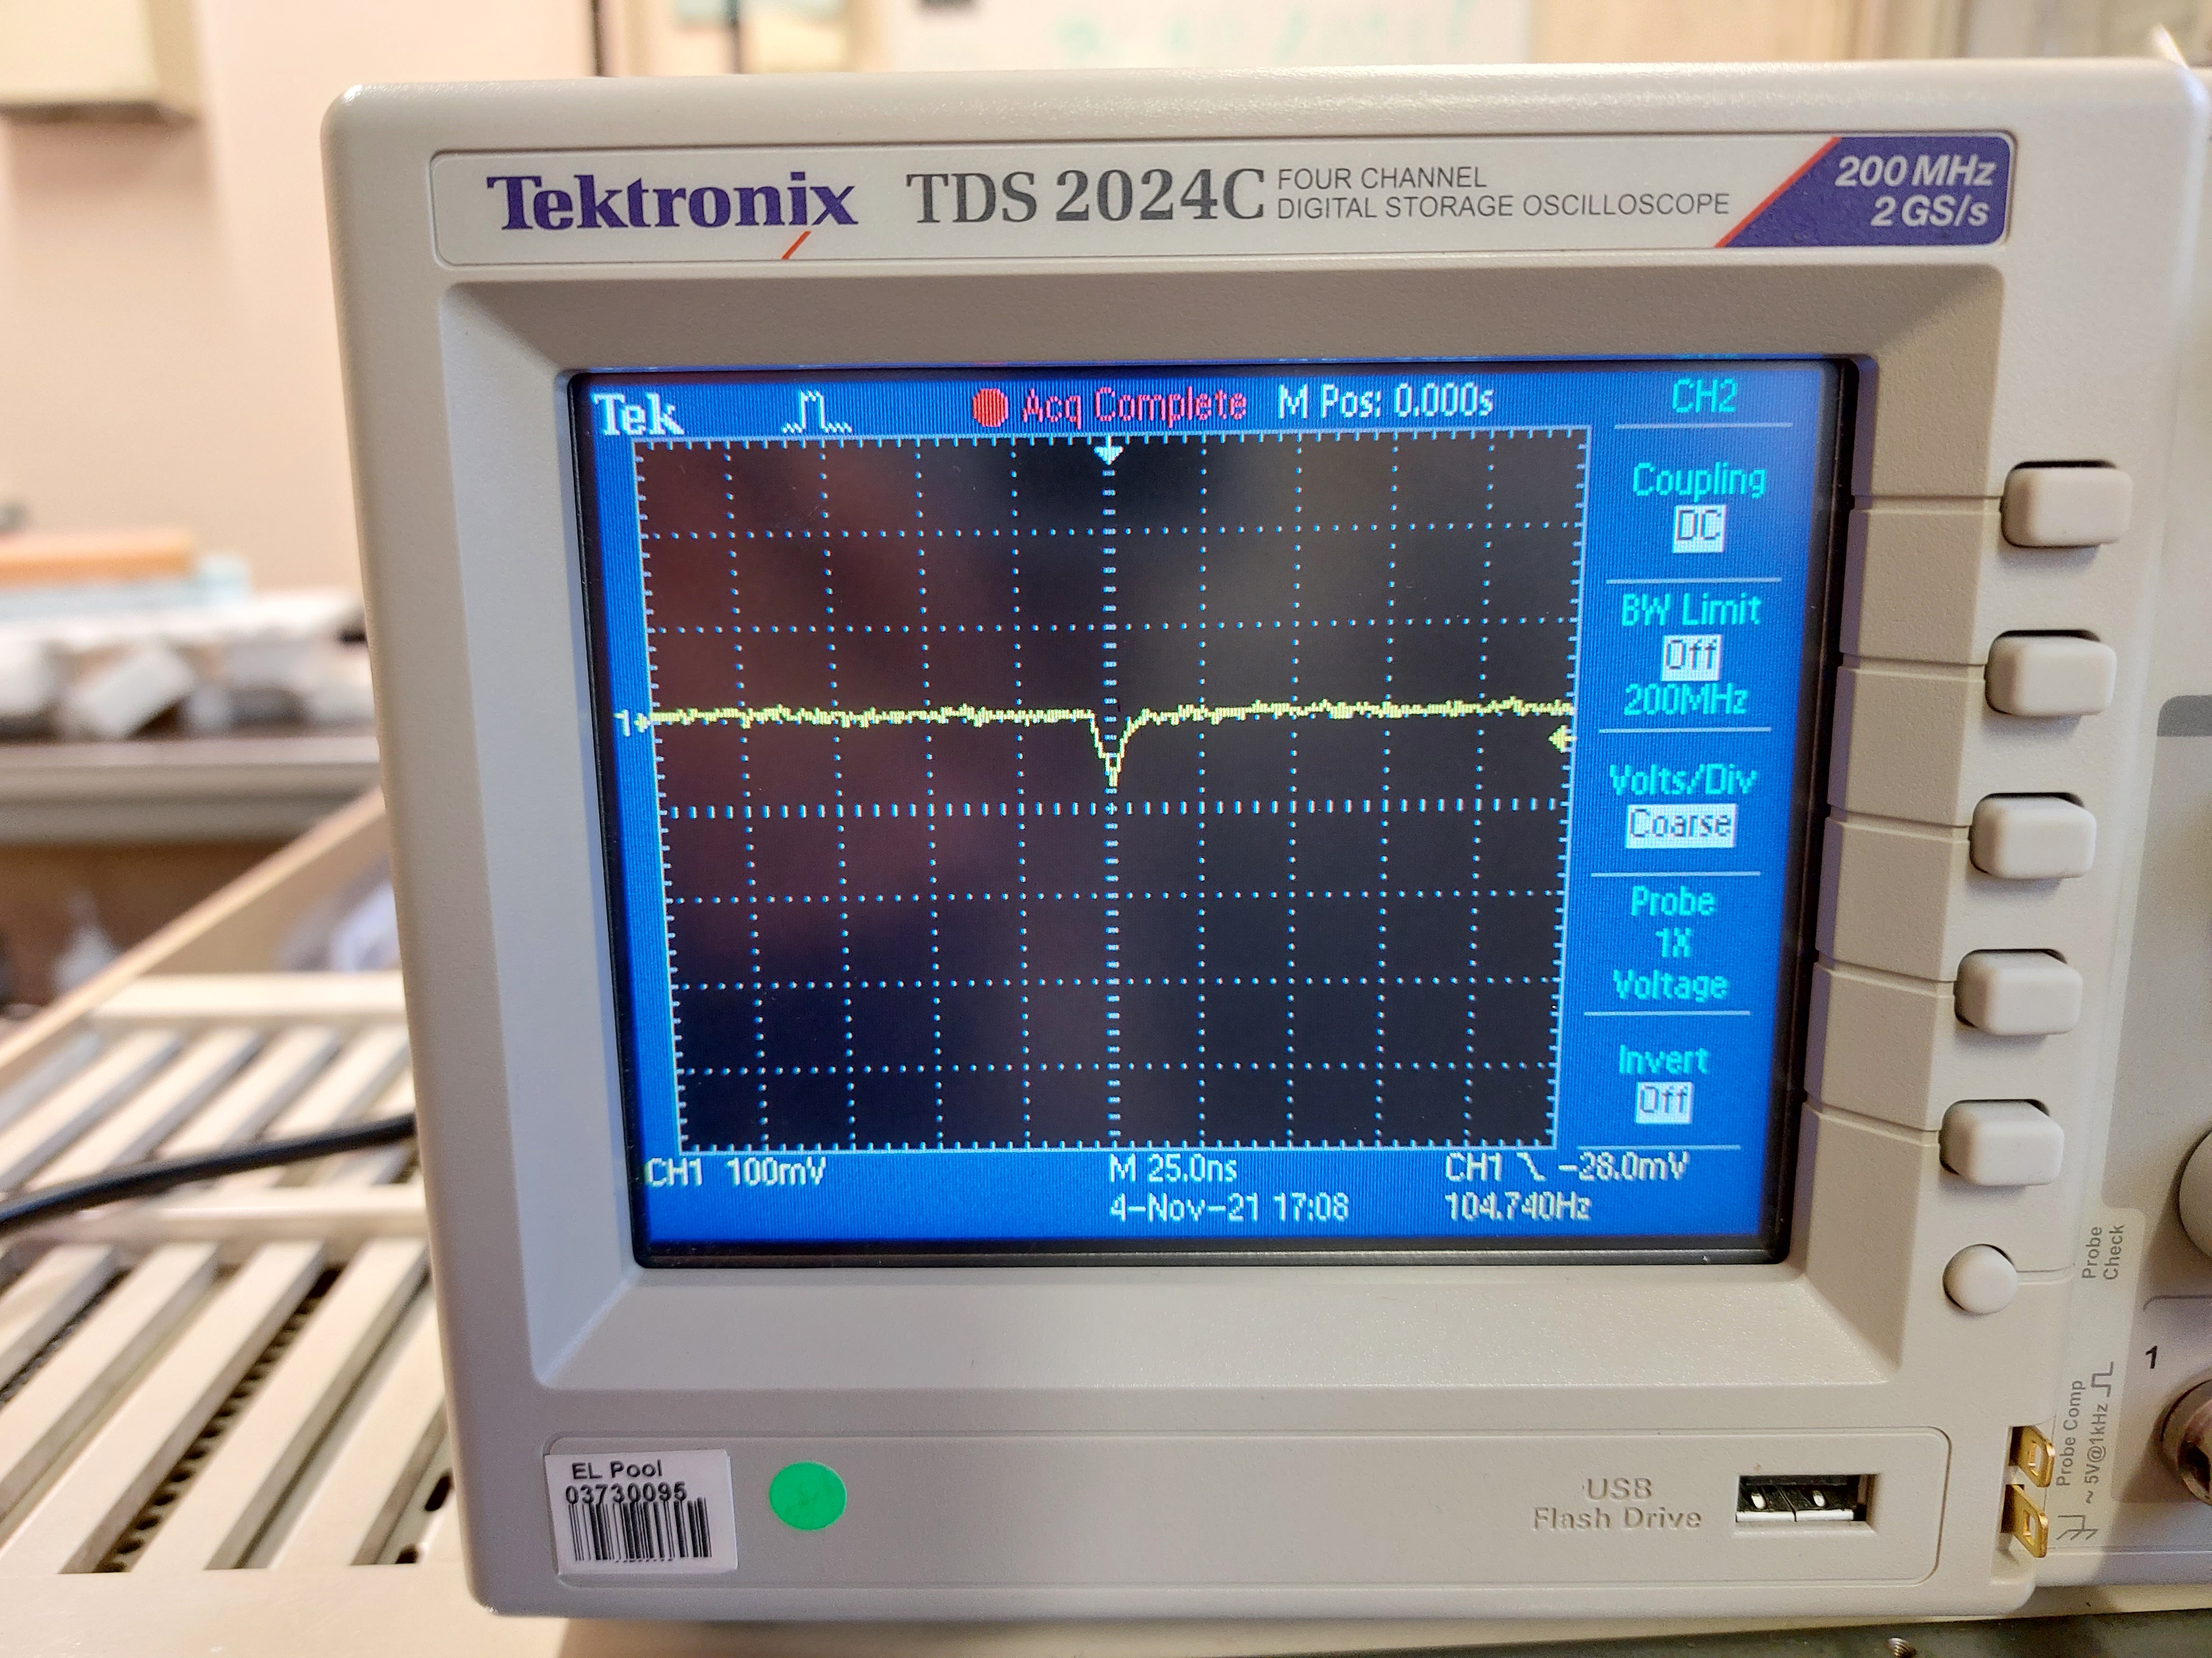
Noise
What is it? How to get rid of it?
1. Discriminator unit –> trigger limit
= signals that aren’t caused by a muon going through the detector
Causes?
- thermal emission
- light leak
Discriminator unit
=> trigger limit: 50mV
Coincidence unit
= emits signal when receiving
simultaneous signal from both detectors
BUT random coincidences still exist!
Analog signals from PMT

Slide 6
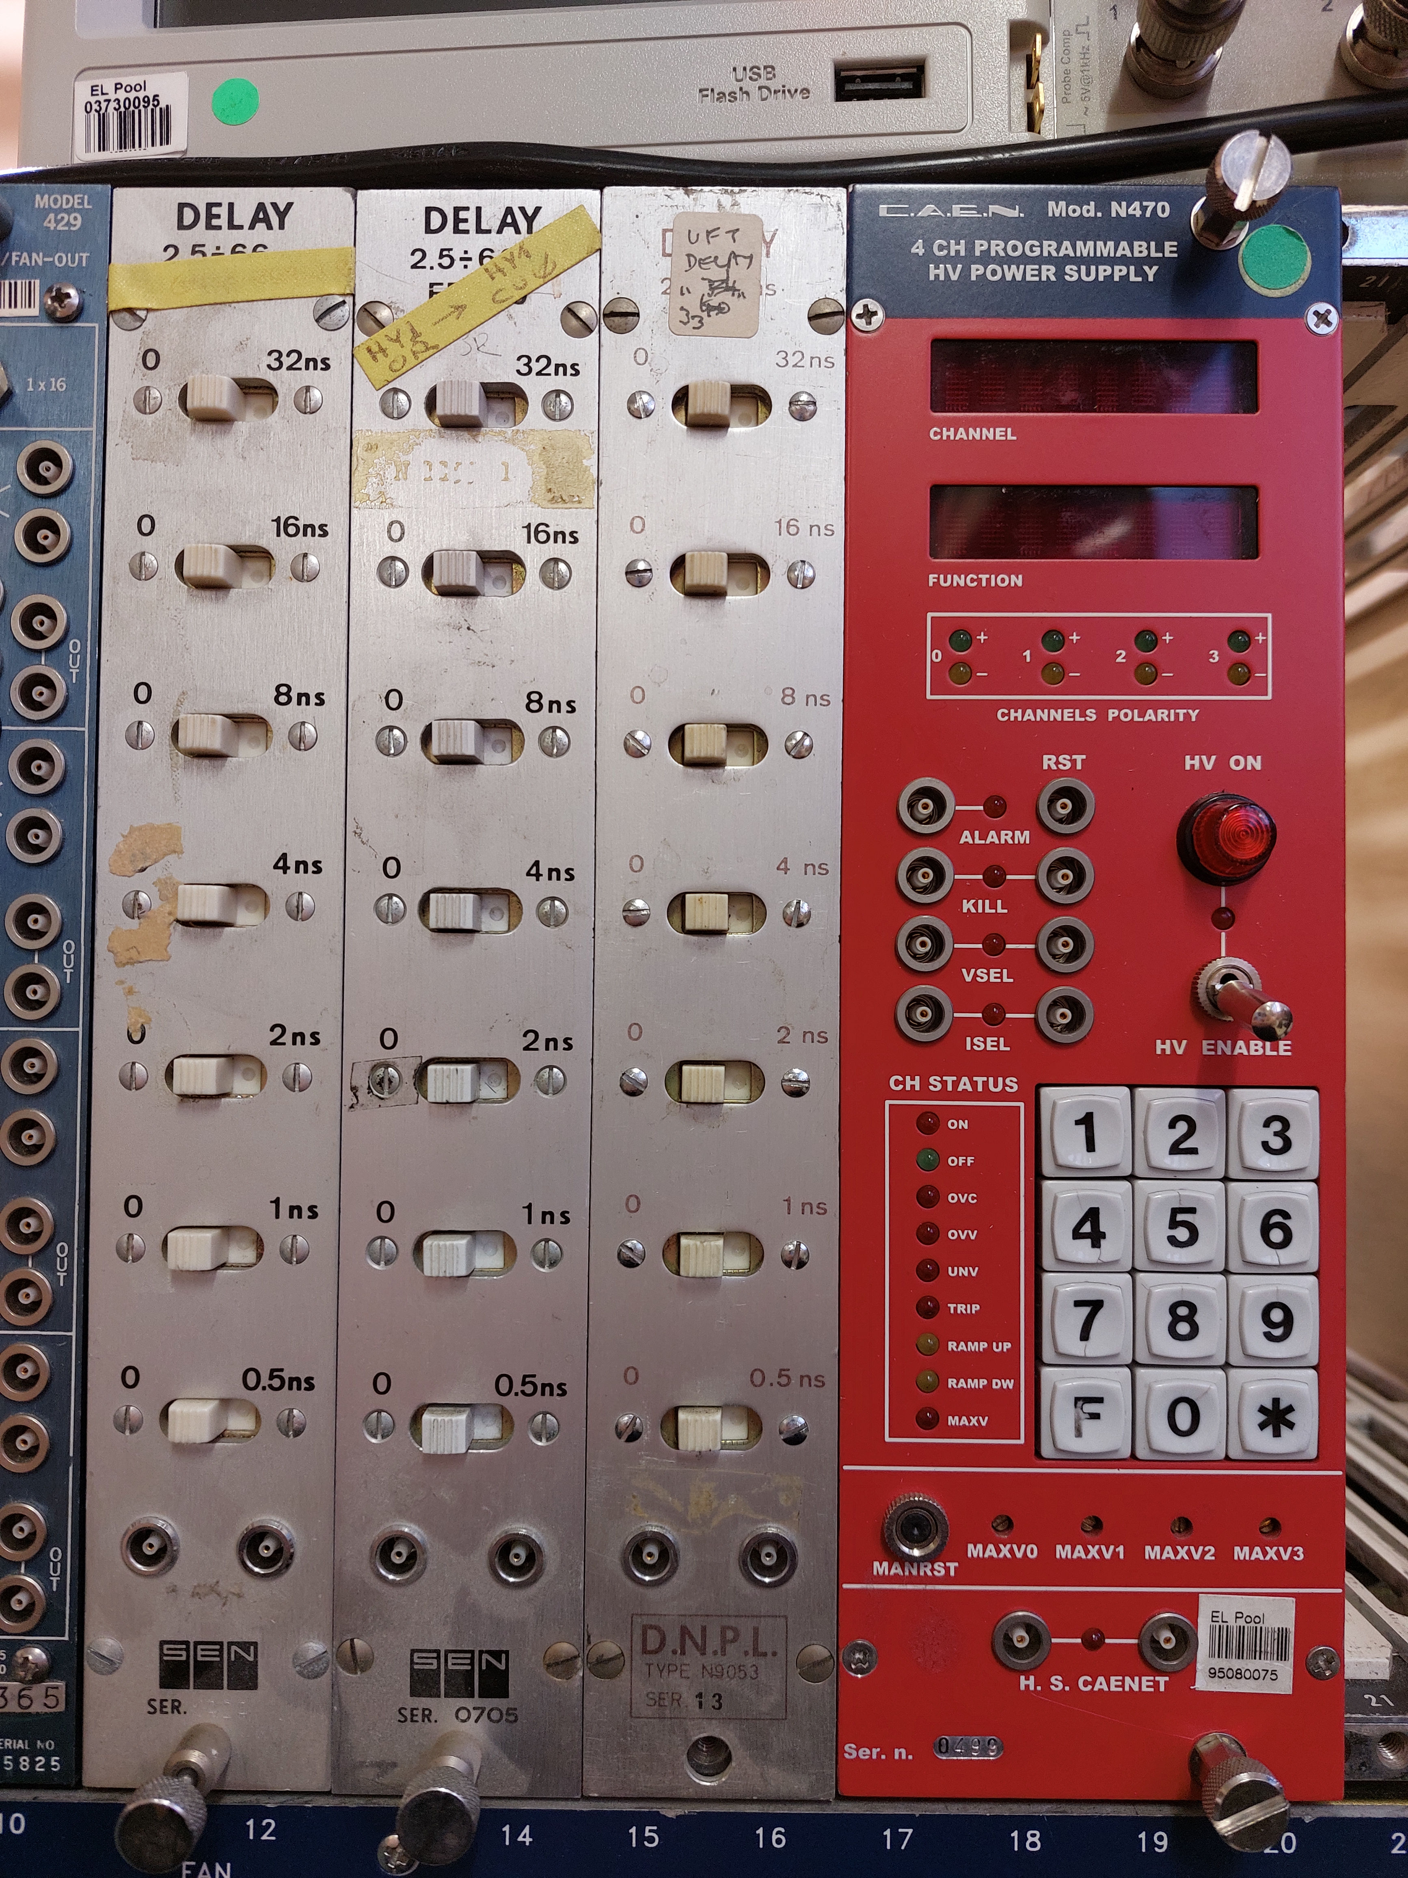
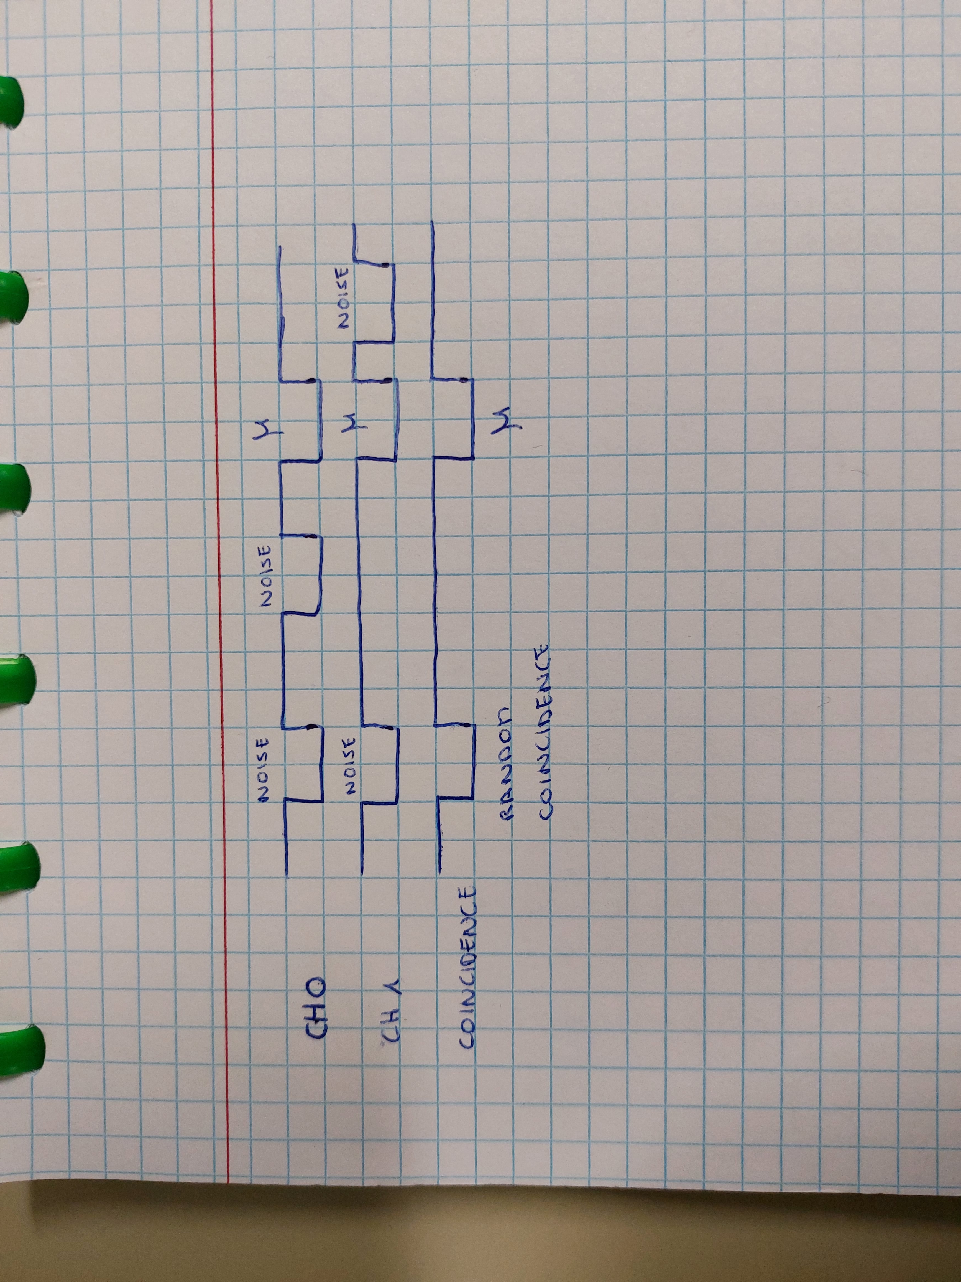

Random coincidences
What are they? How to rule them out?
Theoretical
$$f\left(RC\right)= \frac{N_{0}∗N_{1}∗\left(W_{0}+W_{1}\right) ns}{1 000 000 000 ns}$$
=> 1 RC/45 minutes
= two simultaneous noise signals that are interpreted as a muon by the coincidence unit
Experimental
Put the detectors away from each other
=> results: 4, 5 or 27 per hour
Delay unit
=> results: 0, 4 or 9 per 15 minutes

Slide 7
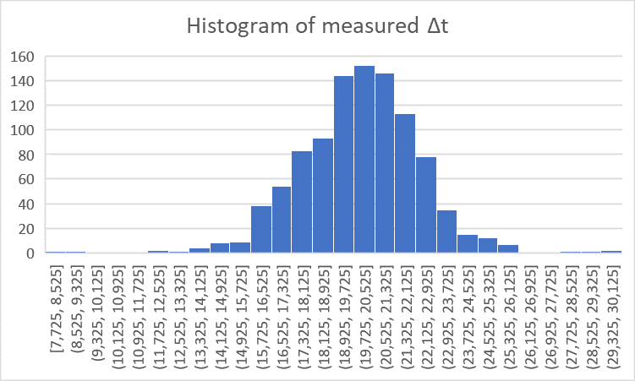
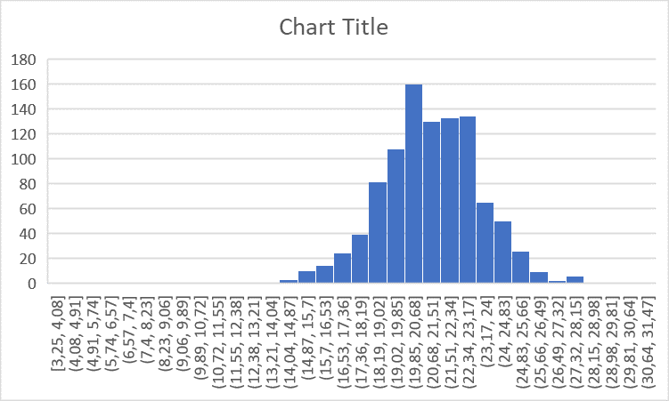
Data acquisition system (DAQ)
A small computer programme in plain C
Purpose?
Calculating the velocity of the muons and comparing the data from the different measurements
=> result: muons move at the speed of light
How?
1) Two detectors at a certain distance on top of each other
2) Time to Digital Converter (TDC) records the time between signals from each detector when muon passes through
3) This data is put into a file via the DAQ
4) We put this data in an Excel histogram => Gaussian distribution

Slide 8
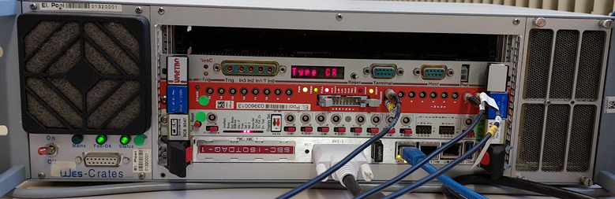

FILE *out_file;
u_short value0;
int loop, event_number;
u_int wtype, vme32;
printf("This is a very simple piece of code to acquire timestamps from the TDC\n");
out_file = fopen("time_stamps", "w+");
if (out_file == 0)
{
printf("Can't open output file\n");
exit(0);
}
fprintf(out_file, "event_number; channel; time in ps\n");
printf("Enter the number of events to record\n");
event_number = getdecd(100);
for (loop = 0; loop < event_number; loop++)
{
printf(" processing event %d\n", loop);
//Wait for data
while(1)
{
value0 = v1290->status_register;
if (value0 & 0x001)
break;
VME crate
Embedded computer
TDC (precision clock)

Slide 9
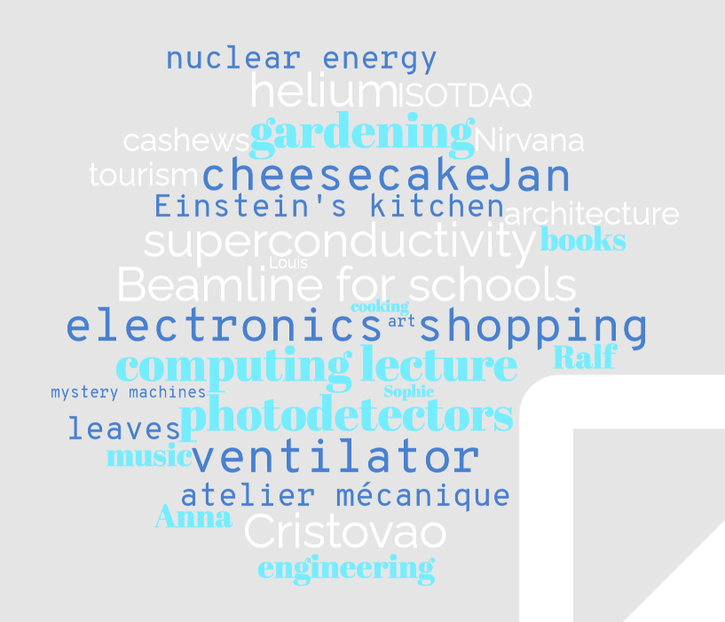
And so much more…
What did we learn about CERN?
There is your job, but there is also a lot of space for your own project ideas, your own interests, creativity and self-development.

Slide 10
Thank you!
Thank you François, Jean-Pierre, Cédric, Margherita, Feza … for making this internship possible
Thank you Cédric and Marijke for accompanying us
Thank you Markus for being an incredible supervisor
Thank you Anna, Jan, Ralf, Sophie, Cristovao and all other CERN employees that talk with passion about their job
Thank you weather for being quite nice ☺
Thank you Xander, Wout, William, Tim, Seppe, Satya, Runa, Robin, Petar, Michiel, Laurens, Kaat, Julie, Holy, Faye, Esteban, Emma, Elke, Elena, Charles, Amy and Margot for creating so much unforgettable memories
Thank you to all the others that made this happen from behind the scenes!

