Slide 1
Welcome
Good bye
Welcome

Slide 2
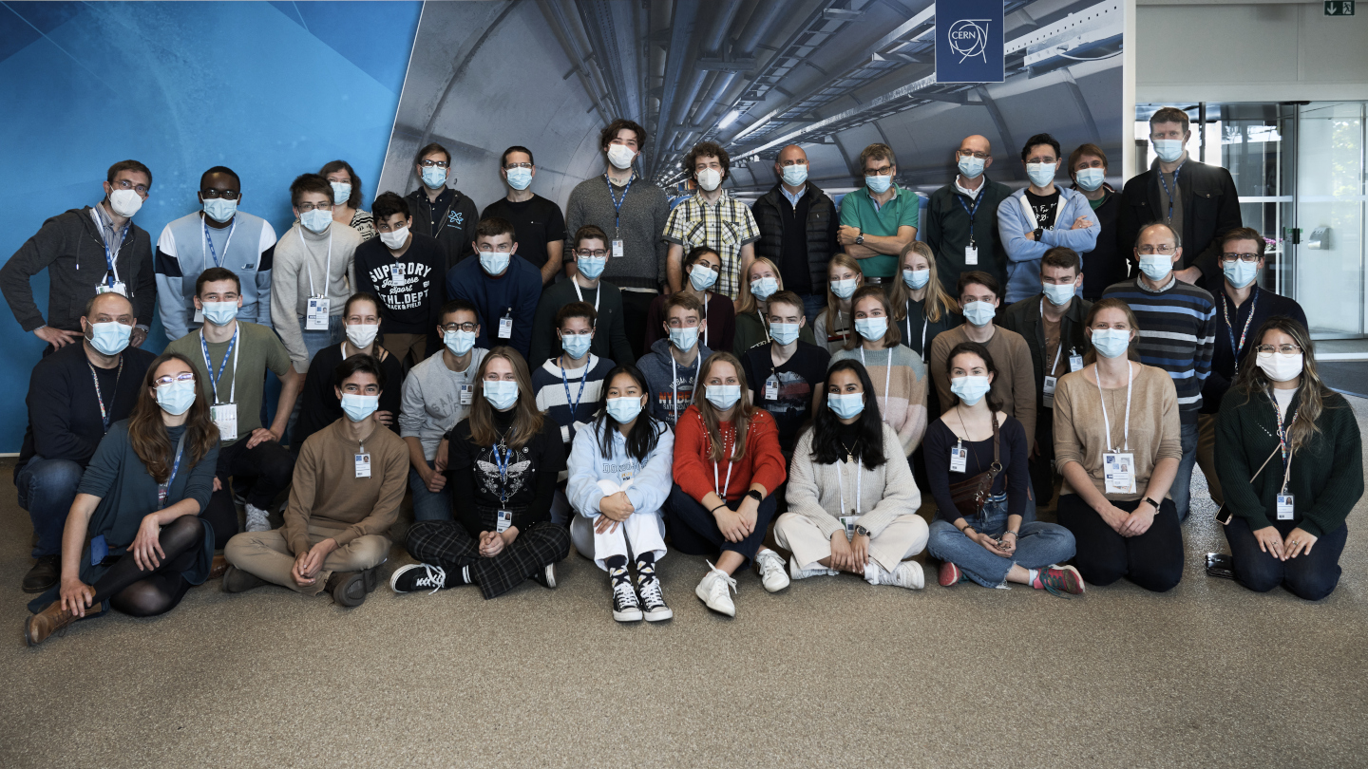
It was a pleasure to have you here!!
… and share some of our experience with you!

Slide 3
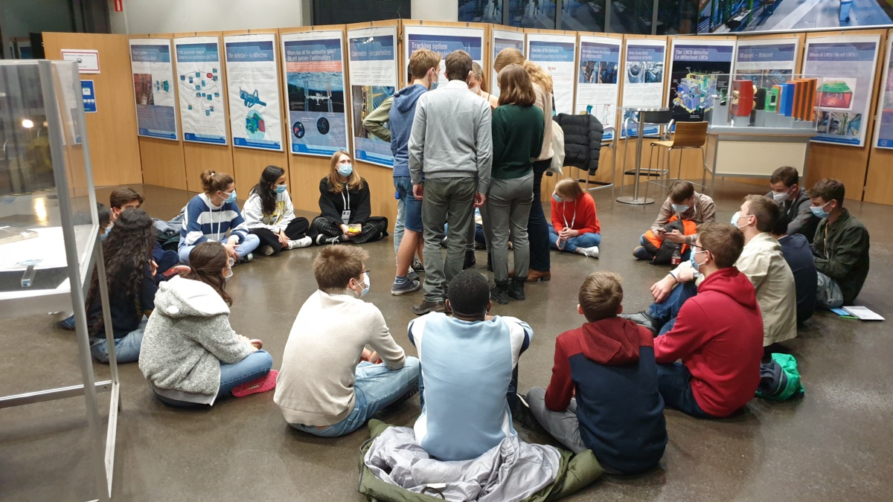
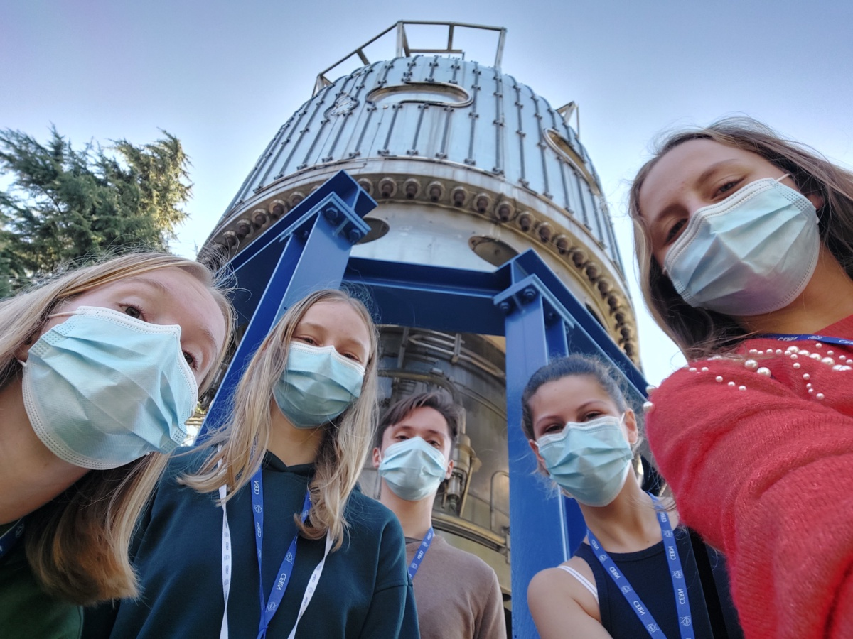
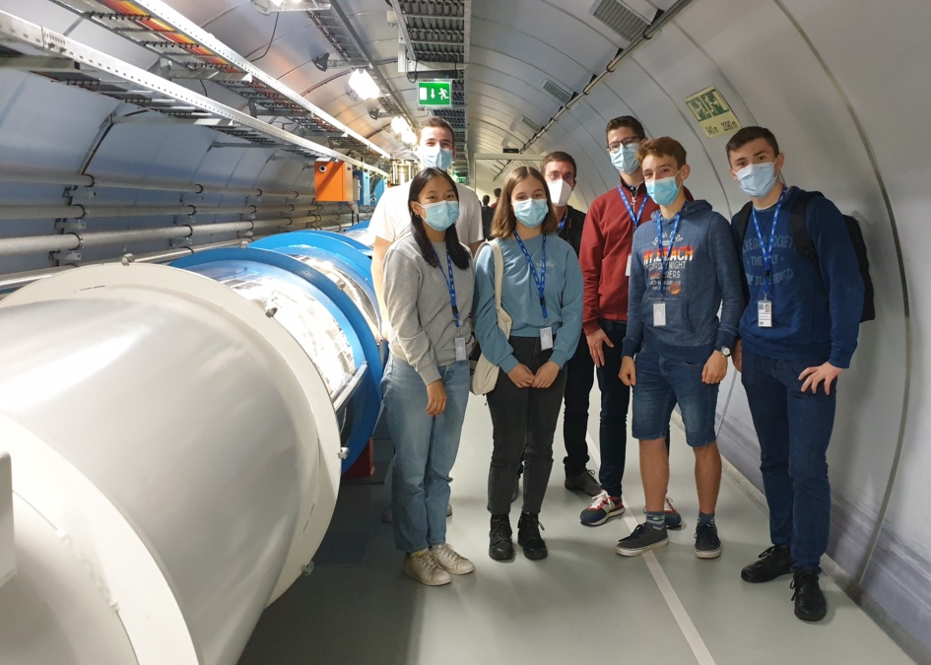
Would you like to come back?
https://careers.cern/
https://cern.ch/bl4s
https://teacher-programmes.web.cern.ch/
19/09-02/10/2021
Danish HSSIP 2021

Slide 4
Congratulations
There are very nice pics of your journey at :
https://cernbox.cern.ch/index.php/s/kJ42pujFcrT4LPa

Slide 5


Slide 6
Administrative matters

Slide 7
Hostel check out
You have to check out by 10 am!
There is the possibility to leave your luggage in a safe space at the hostel reception.

Slide 8

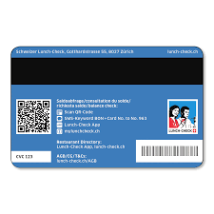
Lunch cards
Leave them at the Hostel reception, before you leave CERN.

Slide 9



Laptops – we collect them NOW
chargers & cables

Slide 10
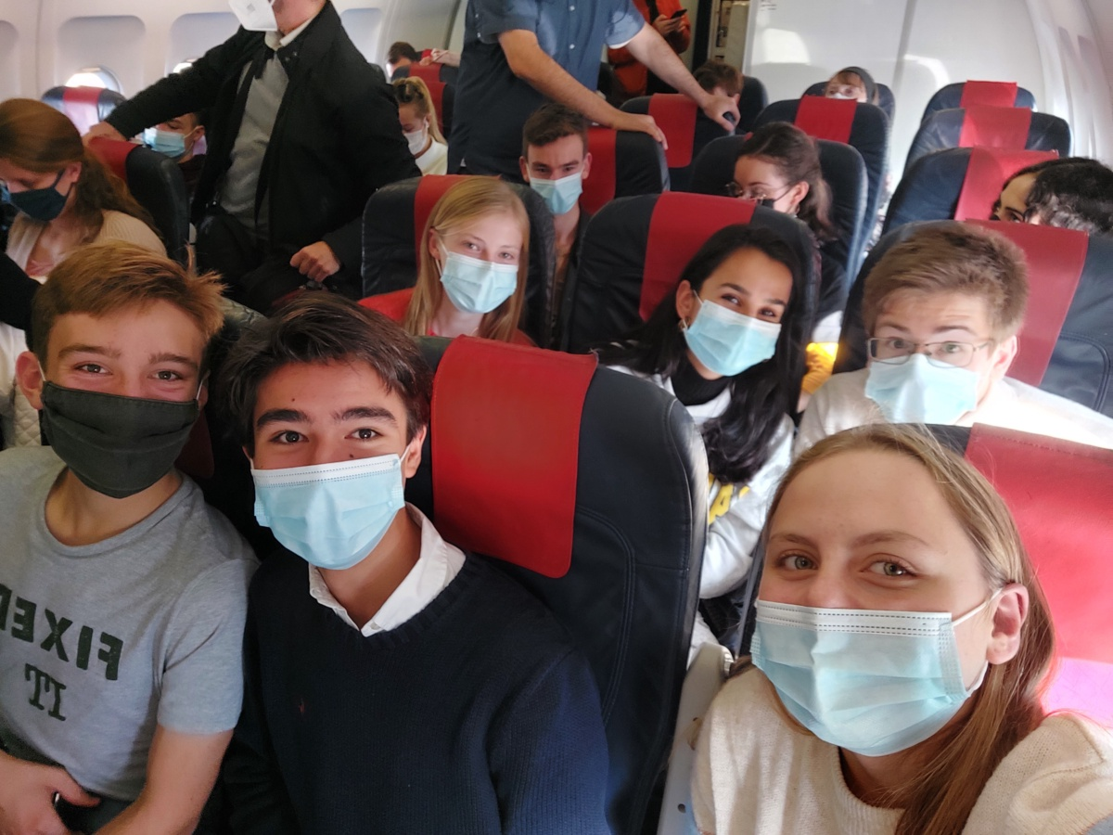

Have a safe trip home!
We hope, to see you back in the future!

