Slide 1
Notes:
Slide 1: Company Logo Full Page
Before you start editing the slides of your talk change to the Master Slide view:
Microsoft Office :Menu: View > Slide Master;
Macintosh – View > Master > Slide Master
Edit the following items:
On the Slide Master (first master slide) – lower area
a) On the left Delete the text and write the title of the event/Conference, Location
b) On the right delete the text and write the name and surname of the speaker and the date (day, month , year)
Close Master View

Slide 2
An Interactive Tool to BPM design
Notes:
More than 10 years ago we started the design of the Beam Position Monitors for the new FEL source "FERMI"
The more resolution demanding ones was based on Cavity BPM pickup while the more common Linac ones measurement was based on stripline BPMs

Slide 3
Introduction
To design the stripline BPM, used on FERMI Linac, a LabVIEW software, simulating BPM response, has been developed.
Now it is under review to cover also "button type" BPM simulation to be designed for ELETTRA 2.
It’s an interactive tool with easy to change parameters in order to test the changes.
Notes:
To correctly design the stripline we developed a LabVIEW software to calculate impedence and resonance frequency starting from mechanical dimensions.
At present we have just started the design of the new high brilliance "ELETTRA 2" storage ring
So the software is under review to be able to design button type BPMs

Slide 4
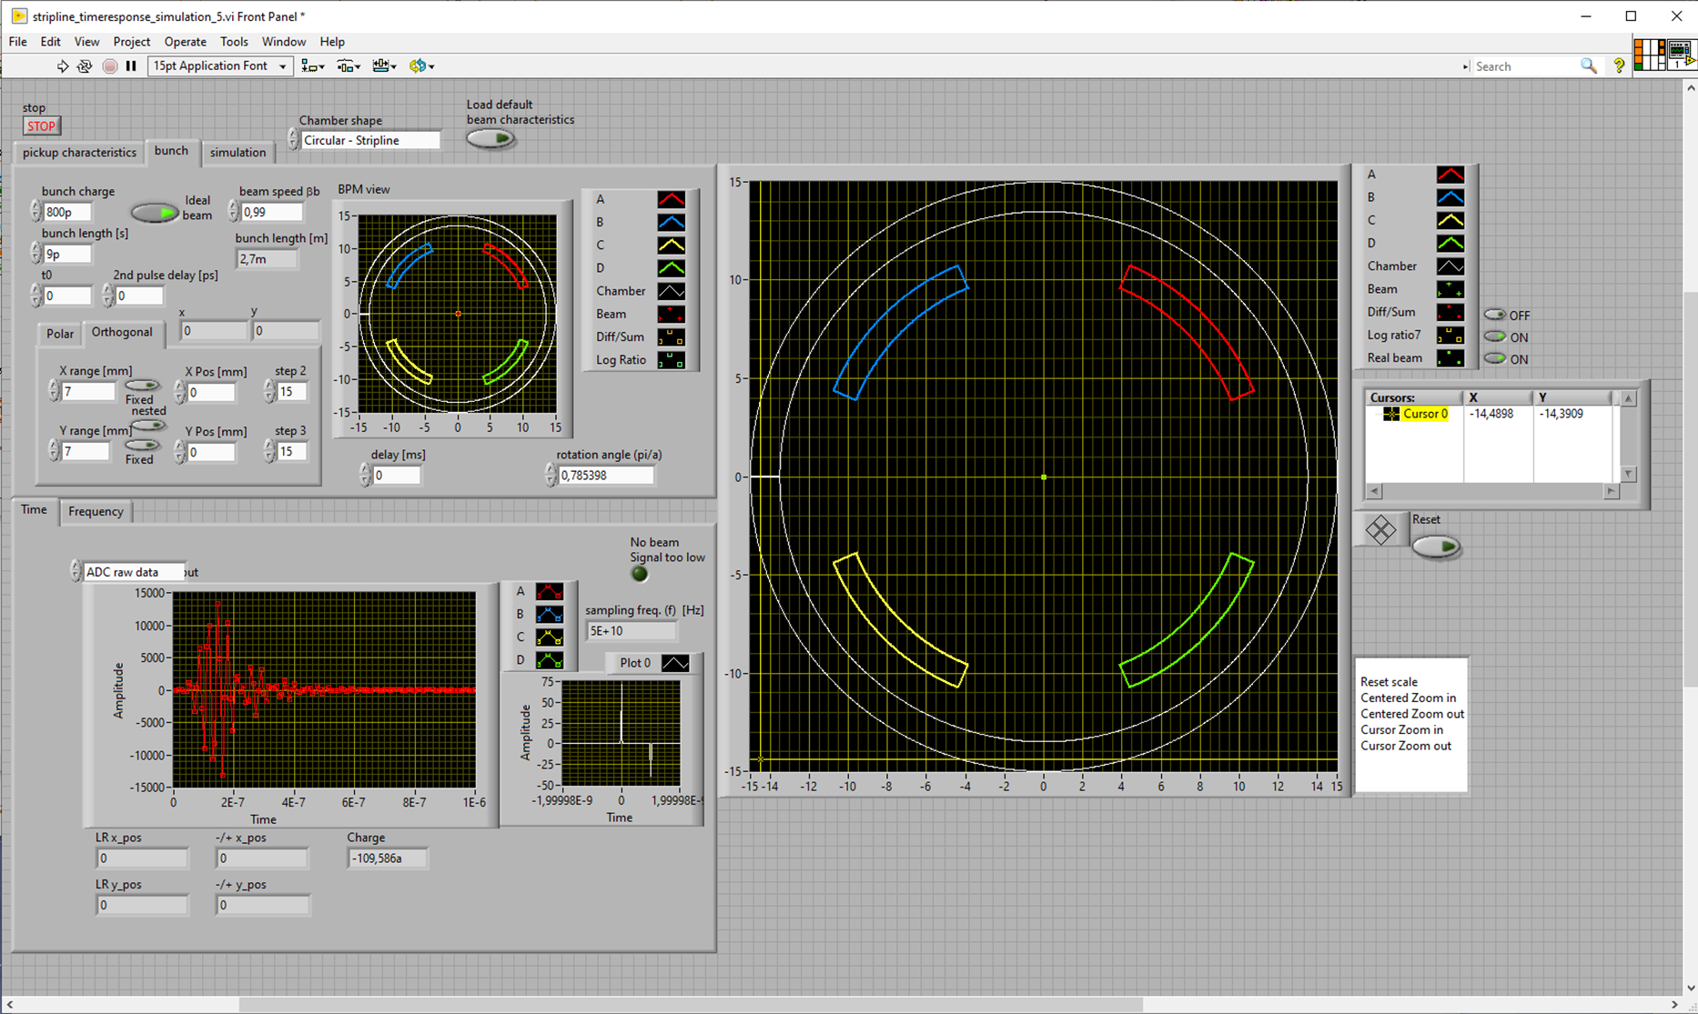
Features
It simulate:
  BPM Response to electron beam;
  Front-end response to signals;
  ADC undersampling
  Signal amplitude estimation;
  Different algorithms ( - / + Log/Log …);
Notes:
The software calculate the stripline impedence and resonance frequency from mechanical dimensions,
It calculate the response of each stripline to a gaussian beam of given charge and length,
It calculate the response of the RF front-end of the acquisition equipment
It calculate the output of the undersampling ADC
It estimate the amplitude of each signal
It apply different algorithm to the four amplitude such as Difference over Sum or Log ratio

Slide 5
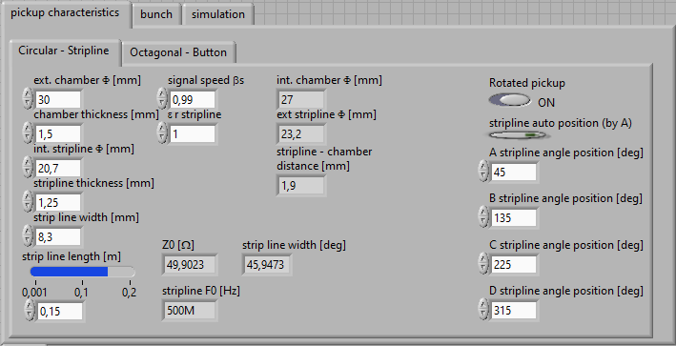
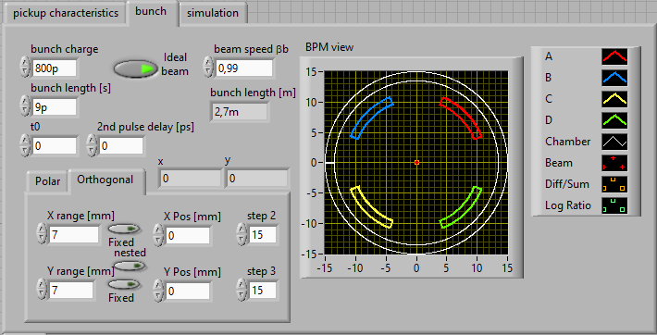
BPM Response to electron beam
The signal induced in each electrode is calculated with respect to a Gaussian beam in a circular chamber. (R.E.Shafer AIP Conf. Proc. 212, 1990)
The SW calculate the stripline parameter Z₀ and f₀ from the geometric dimensions
Notes:
The response of each stripline to a generic beam is calculated using the formula’s from R.E. Shafer published in 1990 on the AIP 212 Conference Proceedings.
In this panel we can choose each stripline parameter, evaluate characteristics impedence and resonance frequency, then we can choose the stripline angular position.
The simulation of the beam is done choosing beam charge, position and length

Slide 6
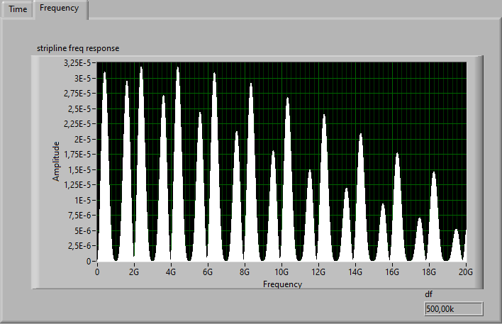
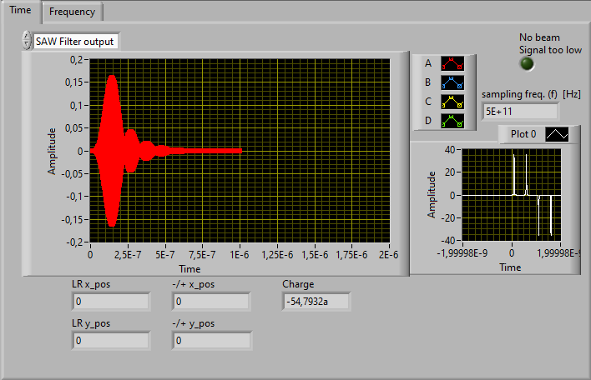
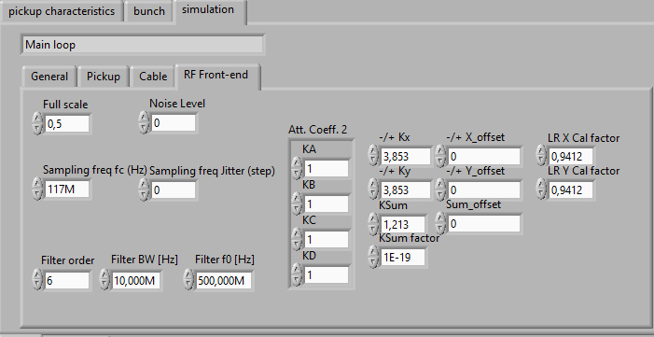
Front-end response to signals
The SW calculate the time response of a front end to the beam signal choosing filter’s order, center frequency and Bandwidth. Noise can be added.
The output can be seen in time or frequency domain
Notes:
The second part of the simulation take into account the time response of the RF Front-end presently simulating the response of the Libera single pass conditioning circuit.
We can chose order, center frequency and bandwidth of a butterworth filter, the undersampling frequency and Full scale used in the ADC’s, and of course the calibration factors for difference over sum or Log Ratio algorithms
Then the software shows the time response of the front end in time or frequency domain

Slide 7
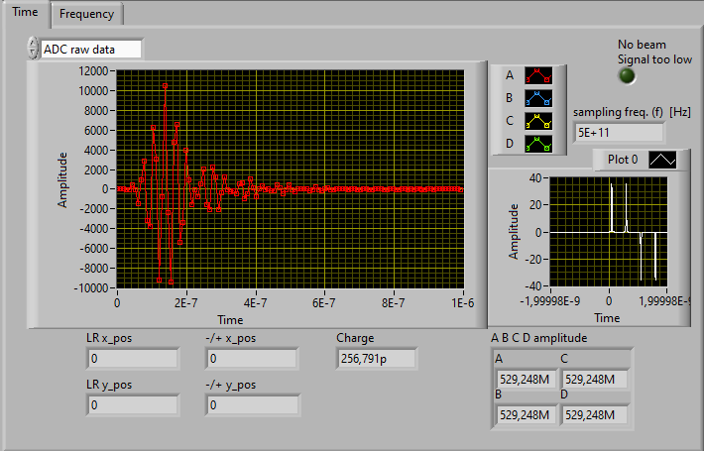
Single pass beam amplitude estimation
The output of the RF front end is then udersampled choosing sampling frequency and bit resolution.
The samples are then used to evaluate each electrode amplitude (sum of squares)
Notes:
In another window, taking into account sampling frequency and resolution, the output of the ADC is shown.
The samples here shown are used to evaluate each electrode amplitude.

Slide 8
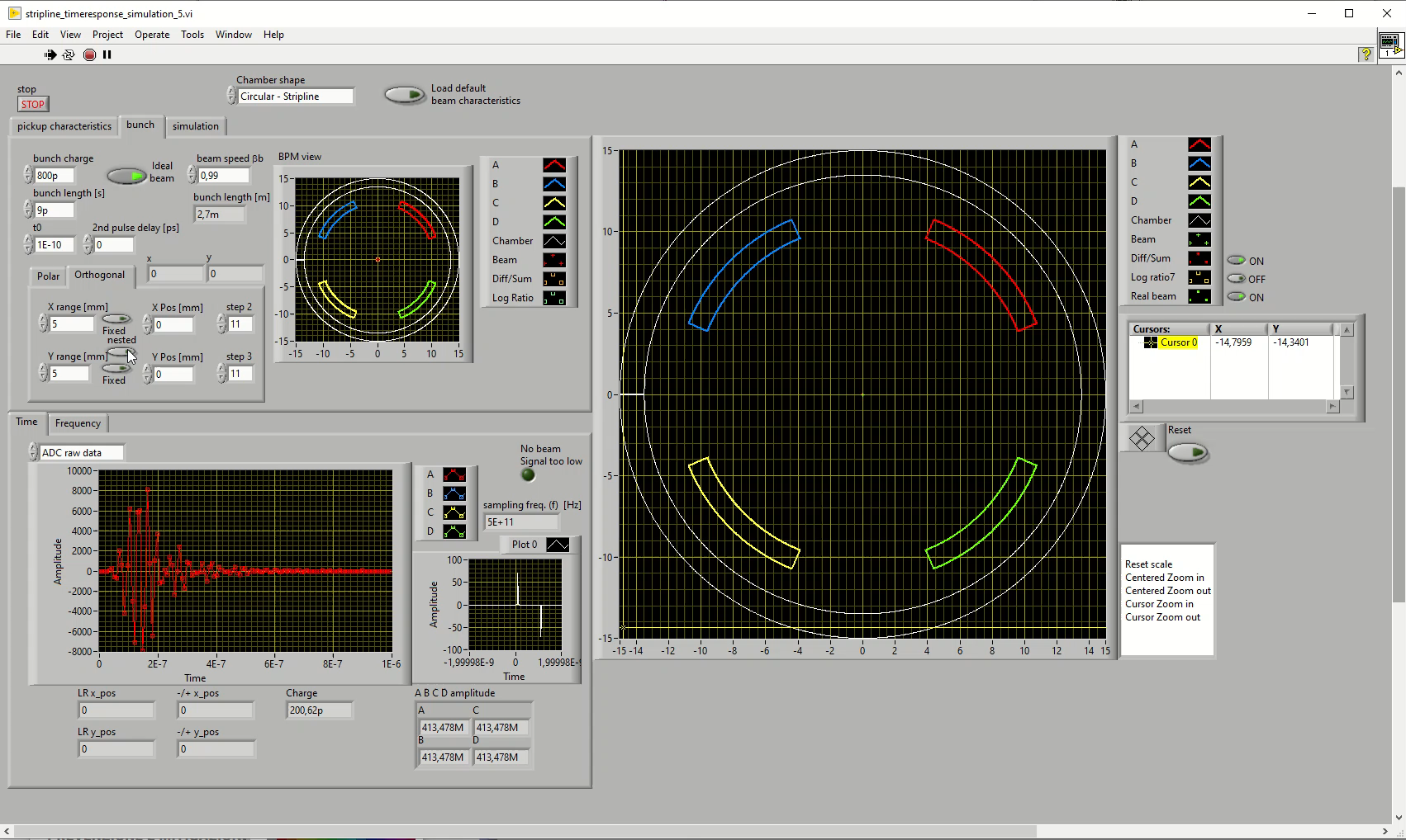
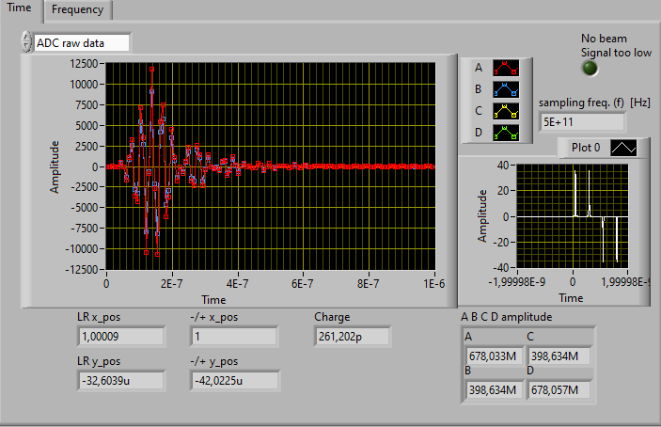
Different algorithms ( - / + Log/Log …)
Moving the beam to the CAL position (i.e 1mm) we can change the calibraton factor of Diff/Sum and Log Ratio algorithms in order to have a correct reading.
Then we can chek the response of the system over the interesting range
Notes:
Simulating a beam displacement to a Calibration position let’s say 1 mm we can read the evaluated position and change the calibration factor in order to obtain a correct reading.
After that we can simulate a beam position pattern and display real position and read ones

Slide 9
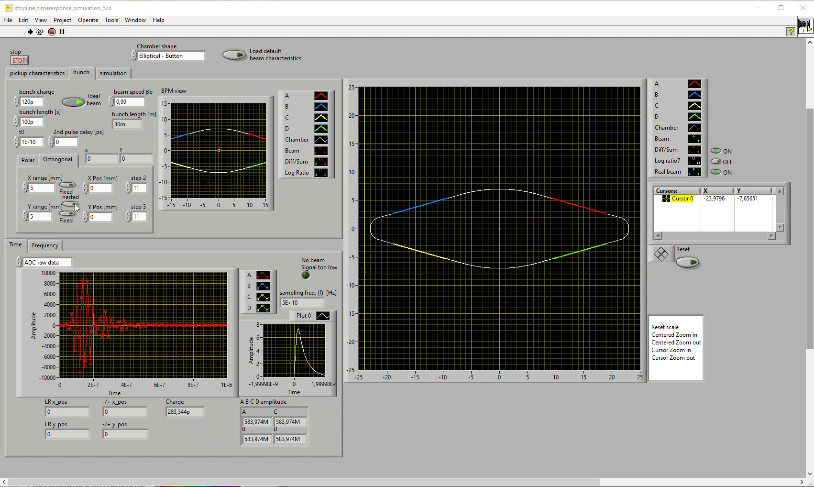
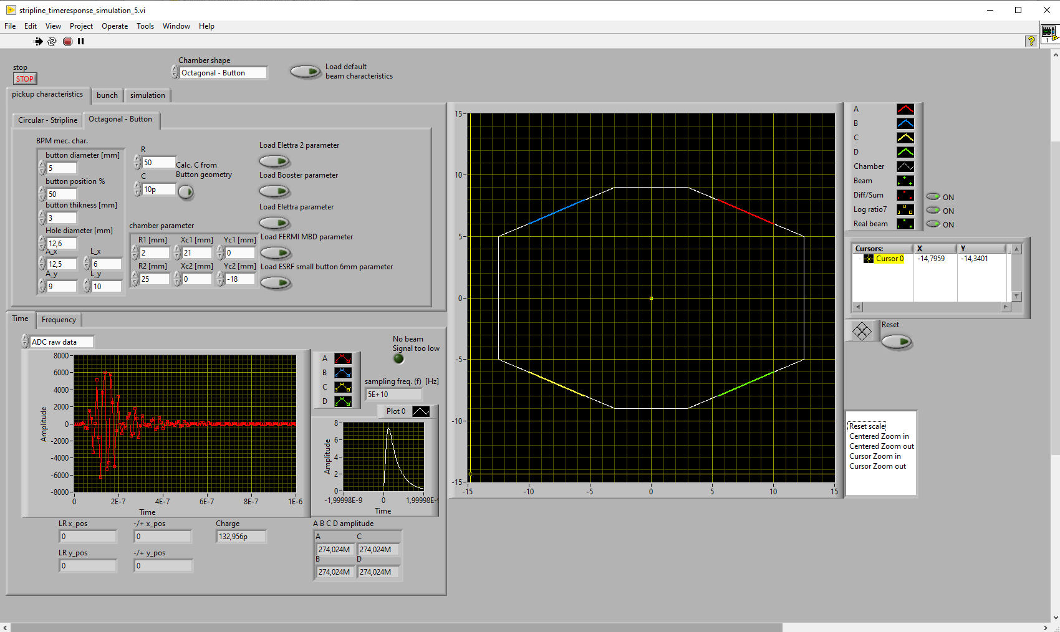
Next improvements
Different chamber shaping (Octagonal – Romboidal)
Button Response calculation (under development)
Polinomial correction (to start)
Notes:
The present review of the software is able to simulate different transverse profiles of the chamber; Octagonal or Romboidal is working,
It’s under development the calculation of the button response, and the Polinomial correction of the position estimation has to start.

Slide 10
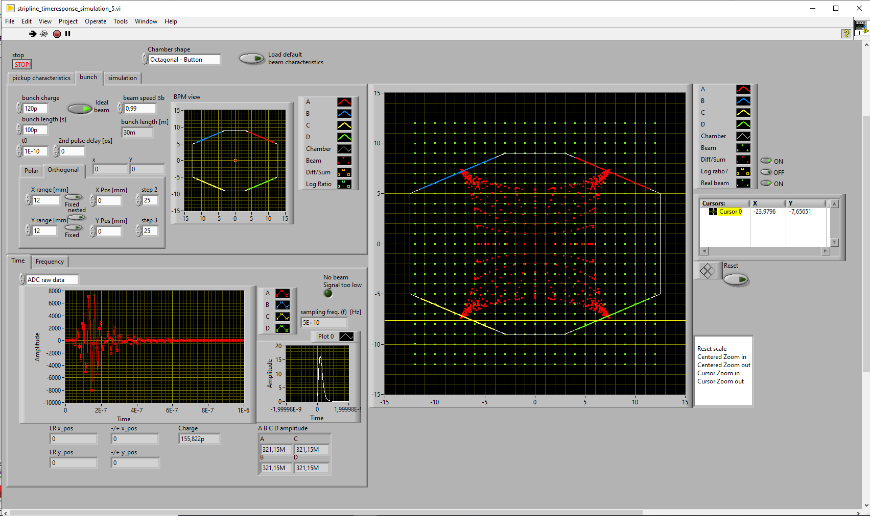
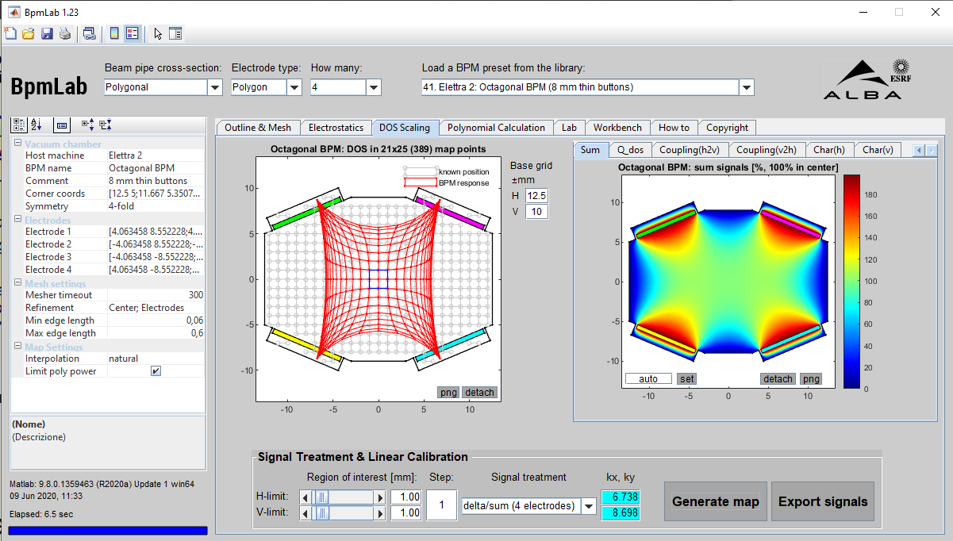
New ELETTRA_2 Button BPM studies
The chamber transverse profile for new ELETTRA storage ring is under final design and some simulation for BPM response has been carried out.
Using two software with the same parameters
Notes:
A preliminary evaluation of the response of button BPMs in an Octagonal chamber with dimension in the range expected for ELETTRA 2 has been carried out using this software and the one developed by ALBA and ESRF’s collegues

Slide 11
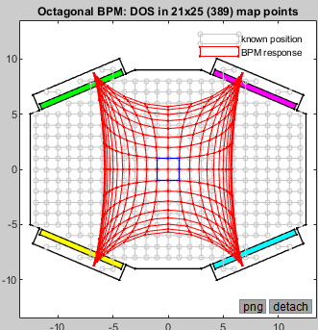
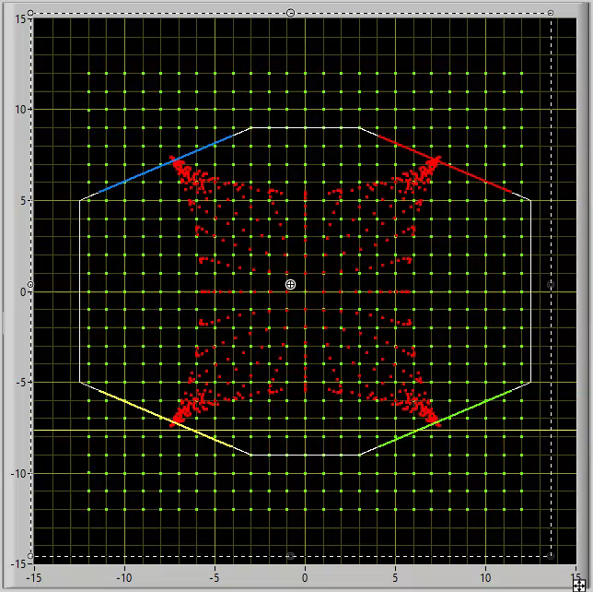
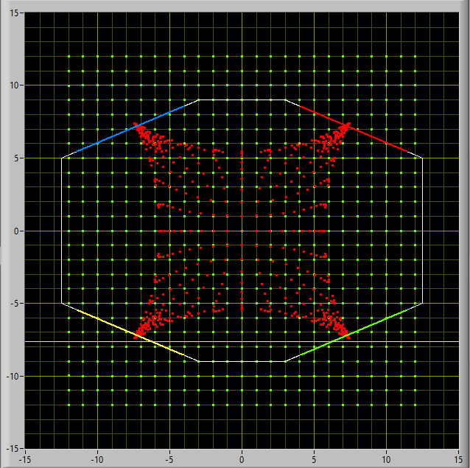
New ELETTRA_2 Button BPM studies
It was interesting to try to compare the two results
The differences between the algorithm used to evaluate the button response are evident far from the center while in the middle region the accordance is quite good
Notes:
The two results are here reported and we tried to compare them.
By superimposing the two images taking care to superimpose the two chambers, you can see a good agreement in the central positions while the difference of the formulas used for positions far from the center is evident

Slide 12
Notes:
Last Slide 1: Thanks to the audience

Slide 13
Notes:
Last Slide 2: Aerial Photo of Elettra

