Slide 1
TE and TE-VSC Location analysis
Usage Buildings Rooms and Surfaces
February 2020
TE and TE-VSC
S. Chandrou

Slide 2
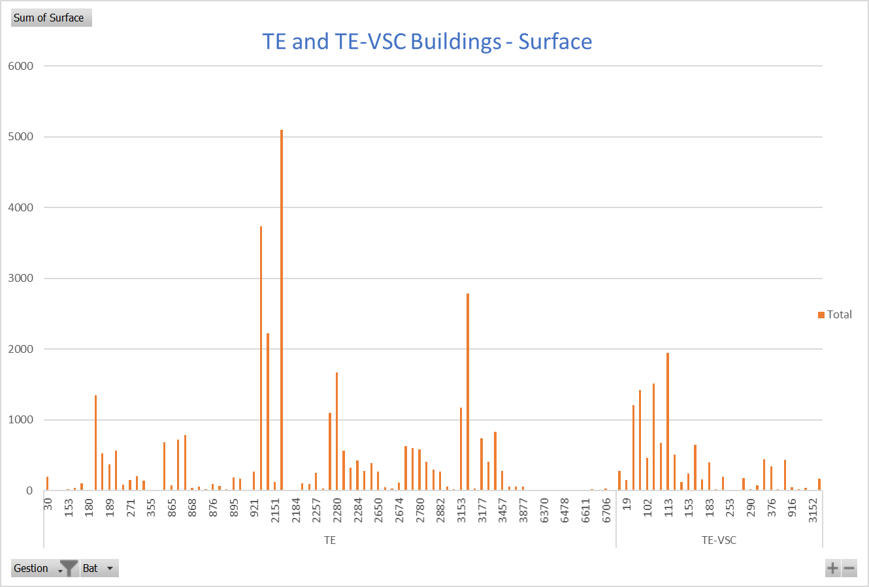
Analysis by Building number and by Surface
February 2020
TE and TE-VSC
S. Chandrou

Slide 3
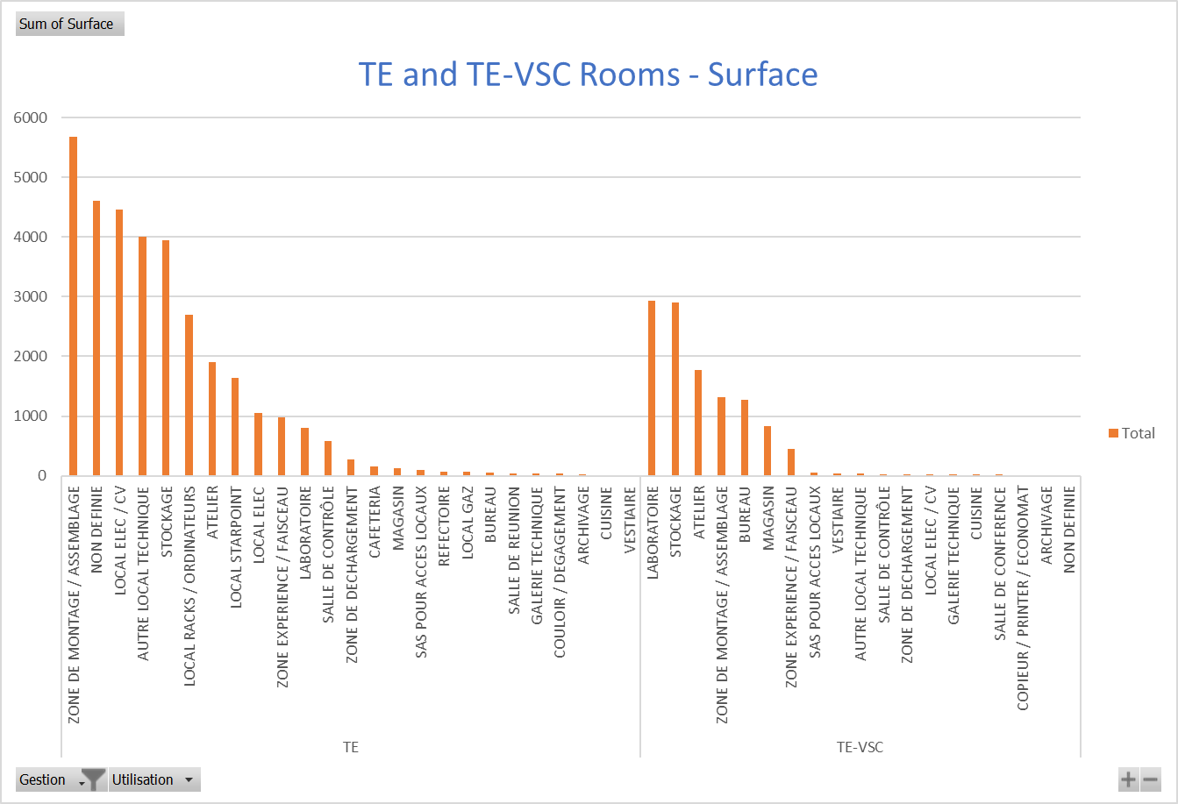
Analysis by Usage Rooms and by Surface
February 2020
TE and TE-VSC
S. Chandrou
3

Slide 4
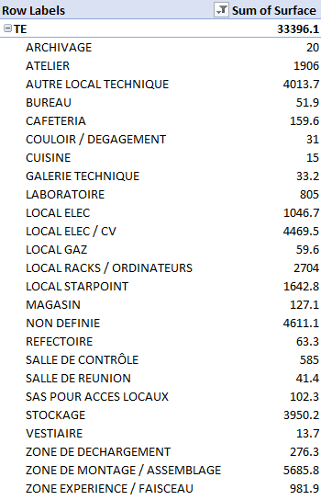
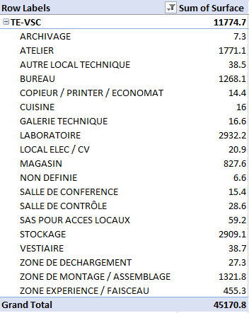
Total Surface 45170.8 m²
February 2020
TE and TE-VSC
S. Chandrou

