Slide 1
The story of
TRANSVERSITY @ COMPASS
Franco Bradamante
Symposium in honour
of Gerhard Mallot
CERN, February 19, 2020

Slide 2
The story of TRANSVERSITY @ COMPASS
My personal interest in transverse spin phenomena in hadronic physics
Spectacular spin effects seen at LEAR 1983-1992
and also at E704 Trieste participation, A. Penzo et al.

Slide 3
The story of TRANSVERSITY @ COMPASS
My personal interest in transverse spin phenomena in hadronic physics
Spectacular spin effects seen at LEAR 1983-1992
and also at E704 Trieste participation, A. Penzo et al.
NEW IDEAS WERE PUT FORWARD IN US: Collins effect and access to
transversity PDF
Sivers effect and Sivers PDF

Slide 4
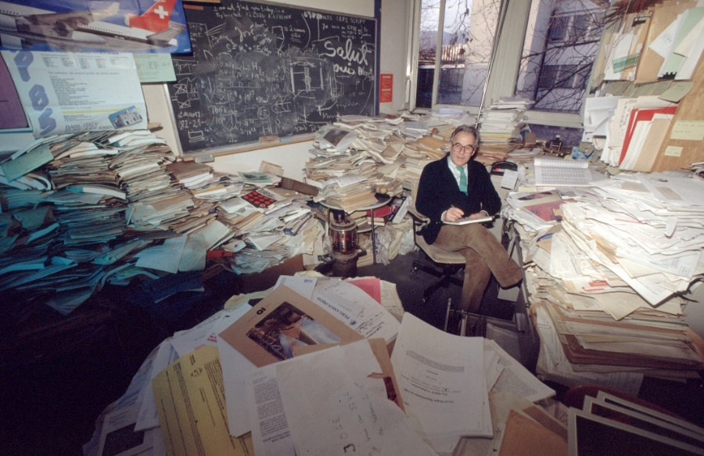
The story of TRANSVERSITY @ COMPASS
My personal interest in transverse spin phenomena in hadronic physics
Spectacular spin effects seen at LEAR 1983-1992
and also at E704 Trieste participation, A. Penzo et al.
NEW IDEAS WERE PUT FORWARD IN US: Collins effect and access to
transversity PDF
Sivers effect and Sivers PDF
1992: Archamp workshop
organized by R. Hess, to finalize the proposal
X. Artru, J. Collins, …, A. Kotzinian
HELP (Hadronic ELectron Production at LEP)
L. Dick, A. Penzo, B. Vuaridel,…..
October 1993: HELP Proposal
Transversity (no Sivers...)

Slide 5
The story of TRANSVERSITY @ COMPASS
My personal interest in transverse spin phenomena in hadronic physics
Spectacular spin effects seen at LEAR 1983-1992
and also at E704 Trieste participation, A. Penzo et al.
NEW IDEAS WERE PUT FORWARD IN US: Collins effect and access to
transversity PDF
Sivers effect and Sivers PDF
1992: Archamp workshop
organized by R. Hess, to finalize the proposal
X. Artru, J. Collins, …, A. Kotzinian
HELP (Hadronic ELectron Production at LEP)
L. Dick, A. Penzo, B. Vuaridel,…..
October 1993: HELP Proposal
Transversity (no Sivers...)
Rejected

Slide 6

TRY AGAIN embedding transverse spin phenomena in a RICHER program
with former SMC collaborators
First HMC 1995 flagship measurement: $Δg/g$ proposed by Dietrich
Then COMPASS 1996 CHEOPS+HMC

Slide 7
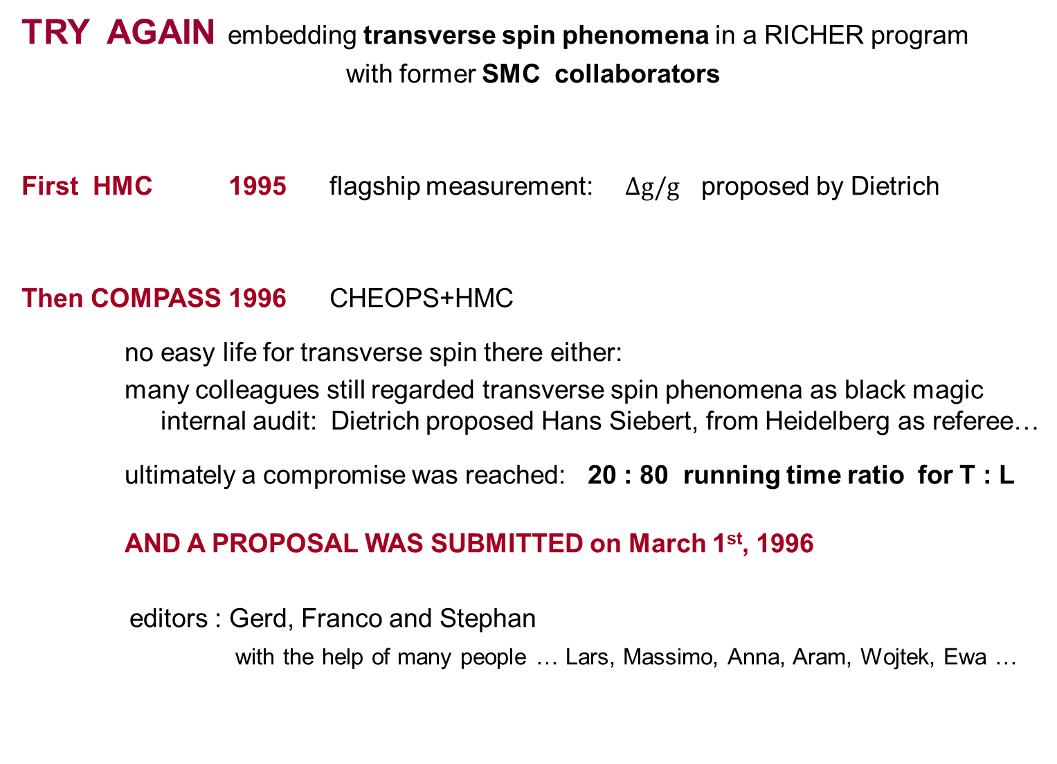
TRY AGAIN embedding transverse spin phenomena in a RICHER program
with former SMC collaborators
First HMC 1995 flagship measurement: $Δg/g$ proposed by Dietrich
Then COMPASS 1996 CHEOPS+HMC
no easy life for transverse spin there either:
many colleagues still regarded transverse spin phenomena as black magic internal audit: Dietrich proposed Hans Siebert, from Heidelberg as referee…
ultimately a compromise was reached: 20 : 80 running time ratio for T : L
AND A PROPOSAL WAS SUBMITTED on March 1st, 1996
editors : Gerd, Franco and Stephan
with the help of many people … Lars, Massimo, Anna, Aram, Wojtek, Ewa …

Slide 8
From my archives…..
mail from Stephan on February 20, 1996
Dear colleagues,
for your convenience you can now also find the newest version of the
joint proposal (former CHEOPS/HMC) on the WEB.
Use the adress :
http://axhyp1.cern.ch/cheops/proposal/
There you find the proposal in different printing formats. As mentioned
in the previous mail by Franco, you can of course also get it on CERNSP.
/afs/cern.ch/user/i/i202/public/proposal/proposal.ps
Please read the document carefully and submit all your comments to
Gerd or Stephan or Franco
(gkm@na47sun05.cern.ch) (snp@vsnhd1.cern.ch) (bradamante@trieste.infn.it)
We still have not yet decided for the name of our common enterprise.

Slide 9
From my archives…..
mail from Stephan on February 20, 1996
Dear colleagues,
for your convenience you can now also find the newest version of the
joint proposal (former CHEOPS/HMC) on the WEB.
Use the adress :
http://axhyp1.cern.ch/cheops/proposal/
There you find the proposal in different printing formats. As mentioned
in the previous mail by Franco, you can of course also get it on CERNSP.
/afs/cern.ch/user/i/i202/public/proposal/proposal.ps
Please read the document carefully and submit all your comments to
Gerd or Stephan or Franco
(gkm@na47sun05.cern.ch) (snp@vsnhd1.cern.ch) (bradamante@trieste.infn.it)
We still have not yet decided for the name of our common enterprise.
The currently best suggestion is :
COMPASS -

Slide 10
From my archives…..
mail from Stephan on February 20, 1996
Dear colleagues,
for your convenience you can now also find the newest version of the
joint proposal (former CHEOPS/HMC) on the WEB.
Use the adress :
http://axhyp1.cern.ch/cheops/proposal/
There you find the proposal in different printing formats. As mentioned
in the previous mail by Franco, you can of course also get it on CERNSP.
/afs/cern.ch/user/i/i202/public/proposal/proposal.ps
Please read the document carefully and submit all your comments to
Gerd or Stephan or Franco
(gkm@na47sun05.cern.ch) (snp@vsnhd1.cern.ch) (bradamante@trieste.infn.it)
We still have not yet decided for the name of our common enterprise.
The currently best suggestion is :
COMPASS - 'Charm Oriented Muon Proton Alternating Spectrometer Setup'
With best regards
The editors

Slide 11

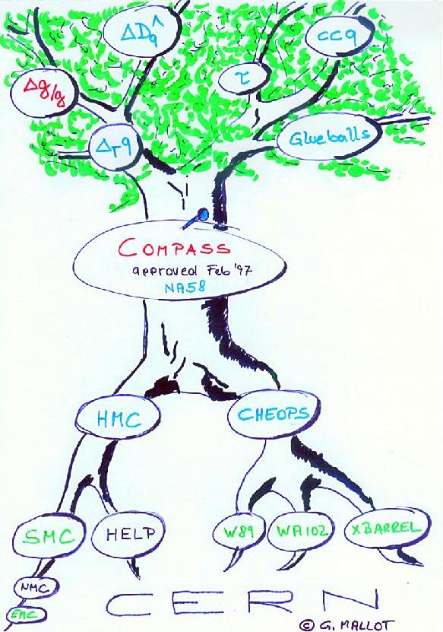

The COMPASS proposal
COmmon Muon and Proton Apparatus for Structure and Spectroscopy
was approved in February 1997
and data taken started in 2002
with muon beam
and polarized deuteron target
for the measurement of $Δg/g$

Slide 12
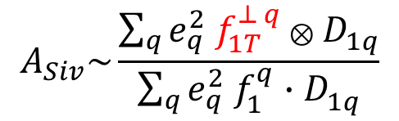


THE DEUTERON DATA
the first SIDIS data with a transversely polarized target in COMPASS
2002: 0.5 effective weeks of data taking
in 2004 first results for the Collins asymmetry
and for the Sivers asymmetries
first publication in 2005
$$⊗$$
$$A_{Coll}\sim \frac{\sum_{q}{e_{q}^{2} h_{1}^{q} { H}_{1q}^{⊥}}}{\sum_{q}{e_{q}^{2} f_{1}^{q}⋅D_{1q}^{ }}}$$

Slide 13
THE DEUTERON DATA
the first SIDIS data with a transversely polarized target in COMPASS
2002: 0.5 effective weeks of data taking
in 2004 first results for the Collins asymmetry
and for the Sivers asymmetries
first publication in 2005
$$⊗$$
$$A_{Coll}\sim \frac{\sum_{q}{e_{q}^{2} h_{1}^{q} { H}_{1q}^{⊥}}}{\sum_{q}{e_{q}^{2} f_{1}^{q}⋅D_{1q}^{ }}}$$
h+
h-
Collins, d
PRL 94, 202002 (2005)
Sivers, d

Slide 14

THE DEUTERON DATA
the first SIDIS data with a transversely polarized target in COMPASS
2002: 0.5 effective weeks of data taking
in 2004 first results for the Collins asymmetry
and for the Sivers asymmetries
first publication in 2005
$$⊗$$
$$A_{Coll}\sim \frac{\sum_{q}{e_{q}^{2} h_{1}^{q} { H}_{1q}^{⊥}}}{\sum_{q}{e_{q}^{2} f_{1}^{q}⋅D_{1q}^{ }}}$$
h+
h-
Collins, d
Luckily, in the mean time, HERMES measurements with a proton target
for the first time
clear signals:
real effects !
Sivers, d
PRL 94, 202002 (2005)

Slide 15
first extractions of the new PDFs
the first extractions of the Sivers functions
from the p and d Sivers asymmetries came
soon after
the HERMES and COMPASS data
could be well described
confirmation that the COMPASS results
could be due to u d quark cancellation
Anselmino et al
Collins et al
Anselmino et al
Feng Yuan
Transversity 2005 proceedings

Slide 16
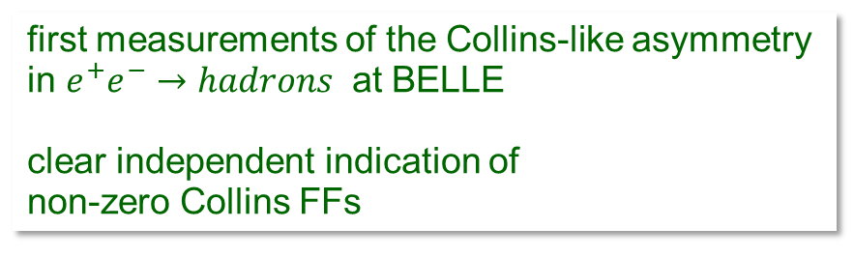


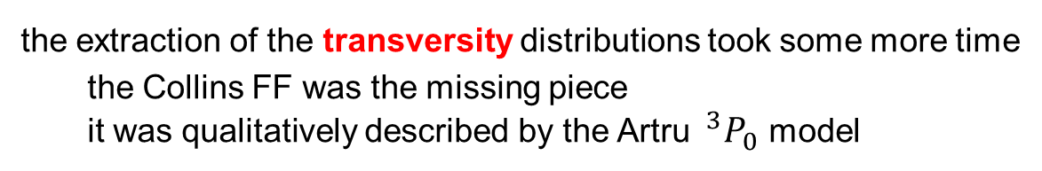
first extractions of the new PDFs
the first extractions of the Sivers functions
from the p and d Sivers asymmetries came
soon after
the HERMES and COMPASS data
could be well described
confirmation that the COMPASS results
could be due to u d quark cancellation
Anselmino et al
Collins et al
Anselmino et al
Feng Yuan
Transversity 2005 proceedings
the extraction of the transversity distributions took some more time
the Collins FF was the missing piece
it was qualitatively described by the Artru $^{3}P_{0}$ model
$$⊗$$
$$A_{Coll}\sim \frac{\sum_{q}{e_{q}^{2} h_{1}^{q} { H}_{1q}^{⊥}}}{\sum_{q}{e_{q}^{2} f_{1}^{q}⋅D_{1q}^{ }}}$$
PRL 96, 232002 (2006)
first measurements of the Collins-like asymmetry
in $e^{+}e^{−}→hadrons$ at BELLE
clear independent indication of
non-zero Collins FFs

Slide 17
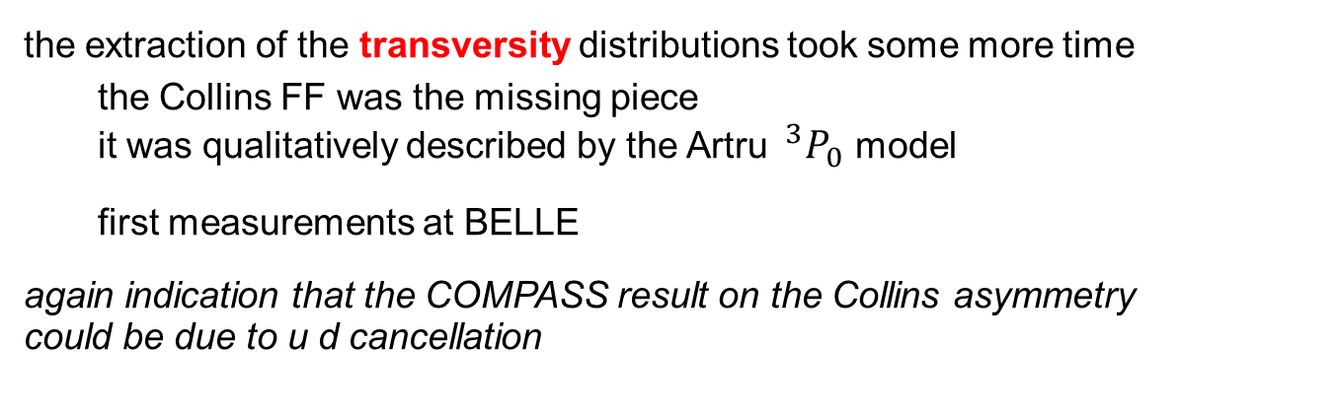
first extractions of the new PDFs
the first extractions of the Sivers functions
from the p and d Sivers asymmetries came
soon after
the HERMES and COMPASS data
could be well described
confirmation that the COMPASS results
could be due to u d quark cancellation
Anselmino et al
Collins et al
Anselmino et al
Feng Yuan
Transversity 2005 proceedings
the extraction of the transversity distributions took some more time
the Collins FF was the missing piece
it was qualitatively described by the Artru $^{3}P_{0}$ model
first measurements at BELLE
again indication that the COMPASS result on the Collins asymmetry
could be due to u d cancellation
$$⊗$$
$$A_{Coll}\sim \frac{\sum_{q}{e_{q}^{2} h_{1}^{q} { H}_{1q}^{⊥}}}{\sum_{q}{e_{q}^{2} f_{1}^{q}⋅D_{1q}^{ }}}$$
to summarize:
clear signals of the new transverse spin effects seen at HERMES and Belle
a consistent picture of transverse spin effects was coming out, which could explain the both the HERMES proton and the COMPASS deuteron data

Slide 18
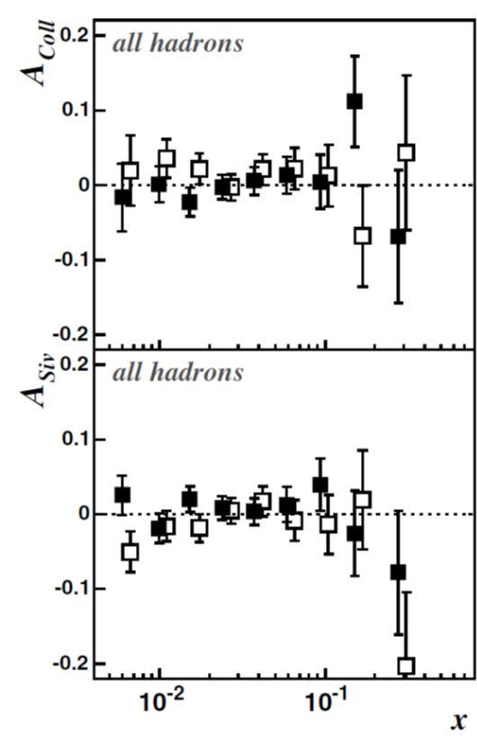
THE FINAL DEUTERON DATA
2002: ~0.5 effective weeks of data taking
2003: 2 weeks of data taking
2004: 2 weeks of data taking
2002 data
2002-2004 data
final results for deuteron
a much more precise
measurements of zero
still, large statistical
uncertainties
Collins, d
Collins, d
h+
h-
Sivers, d
Sivers, d
PRL 94, 202002 (2005)
NPB 765 (2007) 31

Slide 19
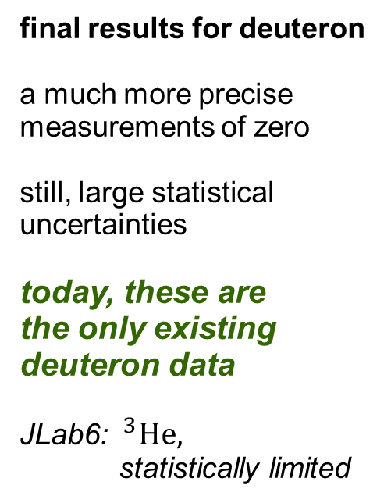
THE FINAL DEUTERON DATA
2002: ~0.5 effective weeks of data taking
2003: 2 weeks of data taking
2004: 2 weeks of data taking
2002 data
2002-2004 data
final results for deuteron
a much more precise
measurements of zero
still, large statistical
uncertainties
today, these are
the only existing deuteron data
JLab6: $^{3}He,$
statistically limited
Collins, d
Collins, d
h+
h-
Sivers, d
Sivers, d
→ 2021 run
PRL 94, 202002 (2005)
NPB 765 (2007) 31

Slide 20
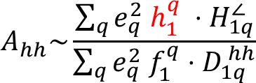
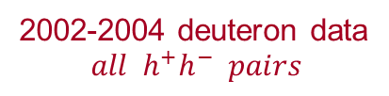
THE FINAL DEUTERON DATA
looking for a signal
di-hadron asymmetries:
a different approach to transversity
$$A_{hh}\sim \frac{\sum_{q}{e_{q}^{2} h_{1}^{q} ⋅{ H}_{1q}^{∠}}}{\sum_{q}{e_{q}^{2} f_{1}^{q}⋅D_{1q}^{ hh}}}$$
Belle
2002-2004 deuteron data
$$all h^{+}h^{−} pairs$$
PLB713 (2012) 10
many tests measurements:
z ordering, leading + or - with sub-leading like or unlike sign
particle identification
….
a lot of expectation for the
COMPASS proton results
(higher energy)

Slide 21
THE PROTON DATA
2007 half year of data taking - the signals are there but ….

Slide 22
THE PROTON DATA
2007 half year of data taking - the signals are there but ….
Collins asymmetry ok
Sivers asymmetry first part of data taking
compatible with zero, at variance with HERMES
second part of data taking
positive for positive hadrons
a long a difficult analysis, without understanding the reason of the discrepancy
results published with large systematic uncertainties
→ strong motivation to ask for one year of data taking
asked in June 2009, approved soon after (.. Elke)
data taking in 2010

Slide 23
THE PROTON DATA
2007 half year, 2010 one year of data taking - the signals are there!
Sivers asymmetry
all proton data
PLB 744 (2015) 250
PLB 717 (2012) 383

Slide 24
THE PROTON DATA
2007 half year, 2010 one year of data taking - the signals are there!
Sivers asymmetry
all proton data
smaller values at COMPASS:
TMD evolution …
PLB 744 (2015) 250
PLB 717 (2012) 383

Slide 25
THE PROTON DATA
2007 half year, 2010 one year of data taking - the signals are there!
Collins asymmetry
all proton data
PLB 744 (2015) 250
PLB 717 (2012) 376

Slide 26
THE PROTON DATA
2007 half year, 2010 one year of data taking - the signals are there!
Collins asymmetry
all proton data
very good agreement !
PLB 744 (2015) 250
PLB 717 (2012) 376

Slide 27
THE PROTON DATA
2007 half year, 2010 one year of data taking - the signals are there!
Collins asymmetry
all proton data
di-hadron asymmetry
study of the interplay between Collins and di-hadron asymmetries
– not independent
PLB 744 (2015) 250
PLB 717 (2012) 376

Slide 28
extractions of transversity
global fits of
Collins asymmetries
SIDIS, e⁺e⁻ data
Z.-B. Kang et al. PRD 2016
M. Anselmino et al.PRD 2015
Anselmino et al PRD 2007
Radici Bacchetta PRL 2018
global fits of
di-hadron asymmetries
SIDIS, e⁺e⁻, pp data

Slide 29
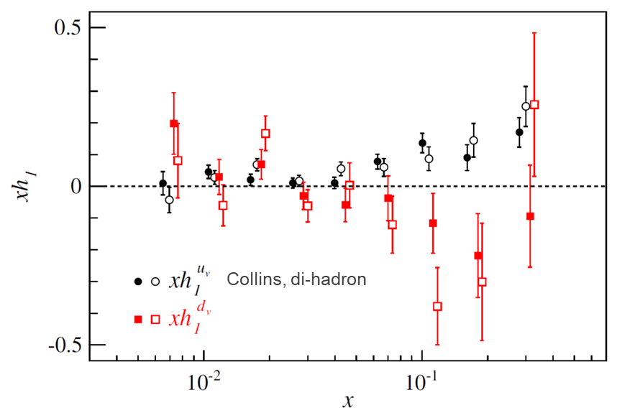
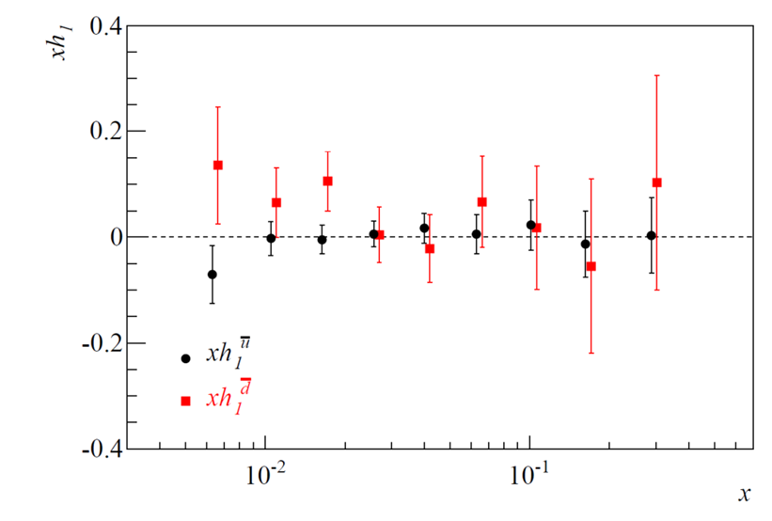
extractions of transversity
global fits of
Collins asymmetries
SIDIS, e⁺e⁻ data
Z.-B. Kang et al. PRD 2016
M. Anselmino et al.PRD 2015
Anselmino et al PRD 2007
A.Martin, F. B., V. Barone PRD 2015
valence
sea
Radici Bacchetta PRL 2018
global fits of
di-hadron asymmetries
SIDIS, e⁺e⁻, pp data
point by point extraction
using COMPASS p and d asymmetries, and e⁺e⁻ data, no Soffer bound
advantage: no Monte Carlo nor parametrisation is needed

Slide 30
extractions of transversity
global fits of
Collins asymmetries
SIDIS, e⁺e⁻ data
Z.-B. Kang et al. PRD 2016
M. Anselmino et al.PRD 2015
Anselmino et al PRD 2007
work still ongoing …
u- and d-quark transversity have opposite sign
d-quark PDF much worse determined than u-quark PDF
because of the scarcity of deuteron (neutron) data
→ 2021 run
A.Martin, F. B., V. Barone PRD 2015
valence
sea
Radici Bacchetta PRL 2018
global fits of
di-hadron asymmetries
SIDIS, e⁺e⁻, pp data
point by point extraction
using COMPASS p and d asymmetries, and e⁺e⁻ data, no Soffer bound
advantage: no Monte Carlo nor parametrisation is needed

Slide 31
SOME PERSONAL MEDITATIONS
in January 1996 Stephan and me were appointed spokespersons by the GLB
it was a logical decision, since we were the majority shareholders
thanks to L. Foa’, to the rules of CERN , and to Ettore Rosso
we could get ONE CERN position, and Stephan and me
agreed it should be given to Gerhard

Slide 32
SOME PERSONAL MEDITATIONS
in January 1996 Stephan and me were appointed spokespersons by the GLB
it was a logical decision, since we were the majority shareholders
thanks to L. Foa’, to the rules of CERN , and to Ettore Rosso
we could get ONE CERN position, and Stephan and me
agreed it should be given to Gerhard
during the following 7 years as spokespersons Stephan and me continuously travelled around to
collect money, collaborators and students,
while Gerd carefully watched the newborn baby, taught it to walk,
and become a fully working spectrometer

Slide 33
SOME PERSONAL MEDITATIONS
in January 1996 Stephan and me were appointed spokespersons by the GLB
it was a logical decision, since we were the majority shareholders
thanks to L. Foa’, to the rules of CERN , and to Ettore Rosso
we could get ONE CERN position, and Stephan and me
agreed it should be given to Gerhard
during the following 7 years as spokespersons Stephan and me continuously travelled around to
collect money, collaborators and students,
while Gerd carefully watched the newborn baby, taught it to walk,
and become a fully working spectrometer
and
in the following years Stephan and me continued to travel around to
collect money, collaborators and students,
while Gerd continued to watch the growth and the performance of our spectrometer

Slide 34
SOME PERSONAL MEDITATIONS
in January 1996 Stephan and me were appointed spokespersons by the GLB
it was a logical decision, since we were the majority shareholders
thanks to L. Foa’, to the rules of CERN , and to Ettore Rosso
we could get ONE CERN position, and Stephan and me
agreed it should be given to Gerhard
during the following 7 years as spokespersons Stephan and me continuously travelled around to
collect money, collaborators and students,
while Gerd carefully watched the newborn baby, taught it to walk,
and become a fully working spectrometer
and
in the following years Stephan and me continued to travel around to
collect money, collaborators and students,
while Gerd continued to watch the growth and the performance of our spectrometer
25 years dedicated to COMPASS, and it is not over

Slide 35
AND … what about Gerd and transversity?

Slide 36
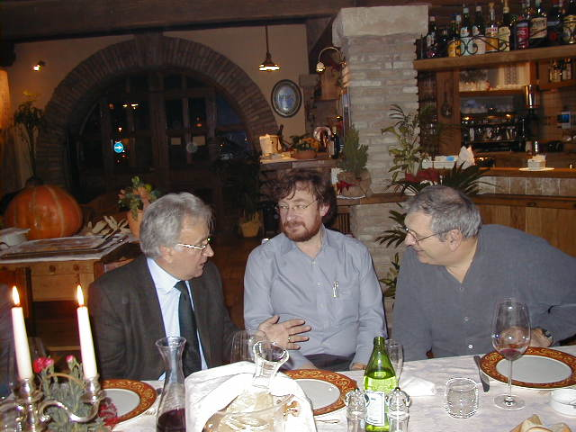
AND … what about Gerd and transversity?
Gerd was a student of Dietrich
→ obviously he was suspicious

Slide 37
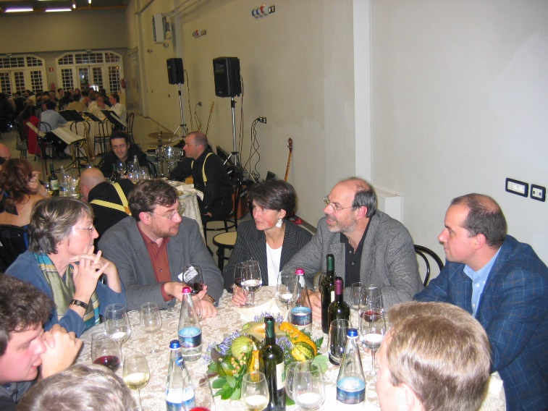
AND … what about Gerd and transversity?
Gerd was a student of Dietrich
→ obviously he was suspicious
at SPIN 2004 he still would seek protection
in a familiar surrounding

Slide 38
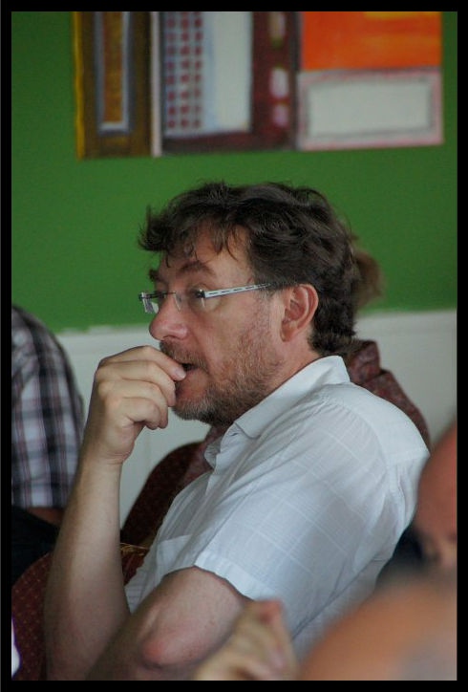
AND … what about Gerd and transversity?
Gerd was a student of Dietrich
→ obviously he was suspicious
at SPIN 2004 he still would seek protection
in a familiar surrounding
we made a special investment on him at Transversity 2011
he did his best, but the result was disappointing

Slide 39
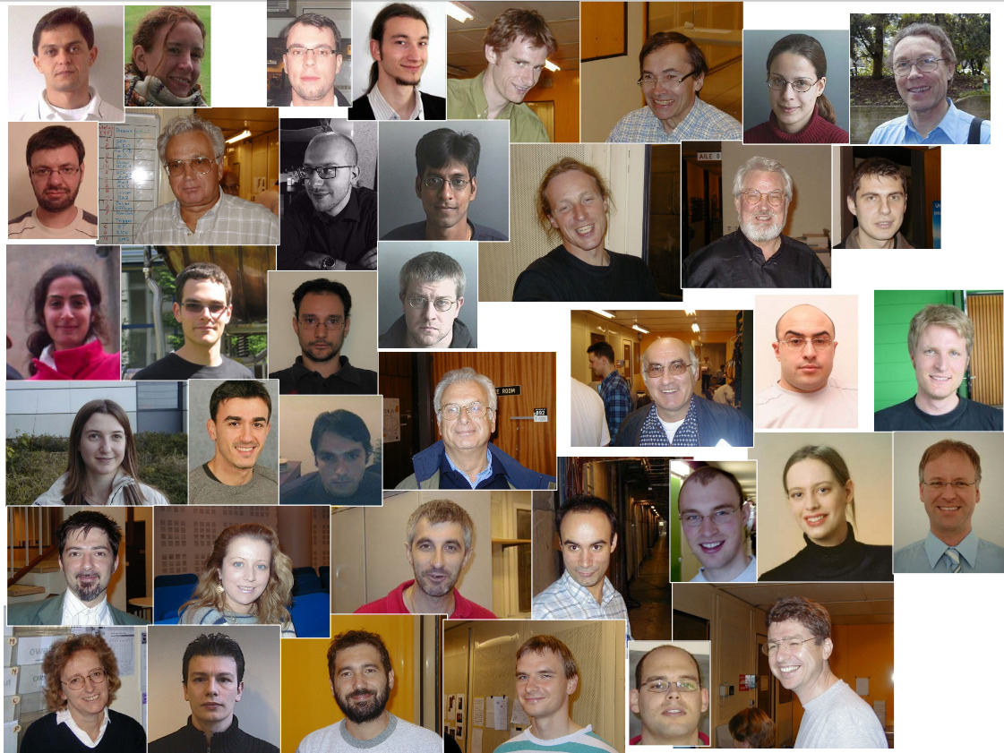
AND … what about Gerd and transversity?
STILL, transverse spin physics owes much to Gerd
It is fair to say that COMPASS could perform so well over so many years thanks to the
great technical expertise and the careful watching of Gerd
Franco
on behalf of the
Transversity Group

Slide 40
AND … what about Gerd and transversity?

