Slide 1

Instrumentation cryogenic Requirements for WP6a
V. Gahier
rev 1 - update 27/02/20

Slide 2
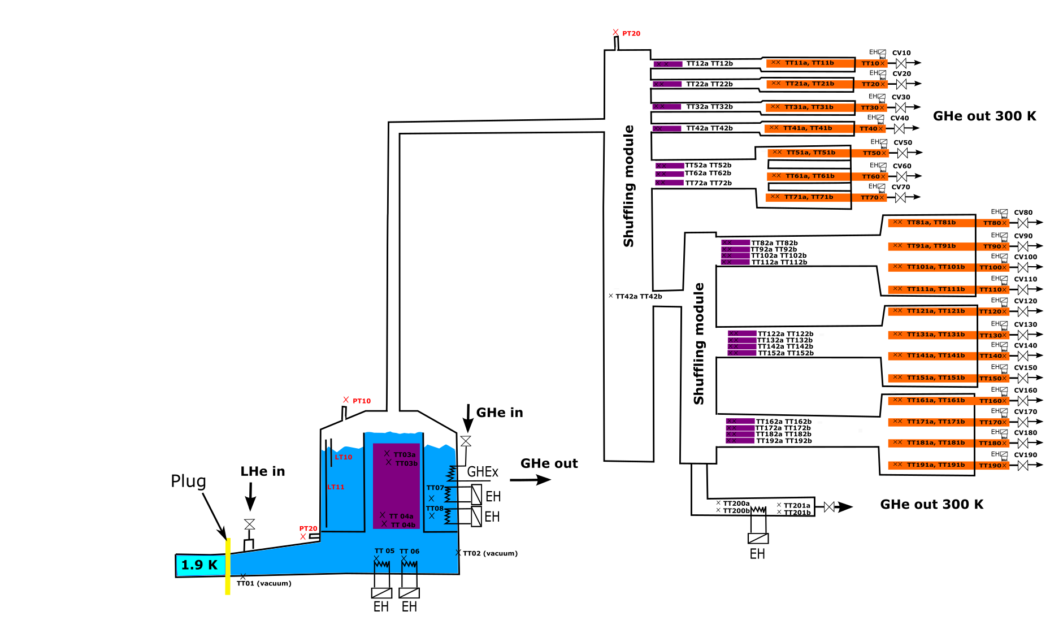
Cryogenic instrumentation of DFX/DFH
DFHx
SC link
DFx
From DFHx Conceptual Design Review
Instrumentation J Fleiter

Slide 3
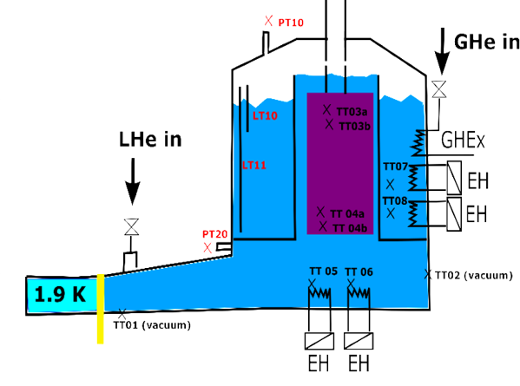
Zoom on DFx
Located in the tunnel in a zone with radiation up to 625 kGy (based on QXL data)
Number | Instrumentation | Normal Op. Range | Application (for thermometer) | Range | accuracy
4 (2+2S) | Process Temperature transmitter* | 4.4-5.5 K | Immersed Monitoring Cernox | 3-325 K | +/- 0.1 K
2 | Vaccum Temperature transmitter | 4.4-300 K | Vacuum Control for transient Cernox | 3-325 K | +/- 0.5-1 K
4 | Electric Heater | 0-100 W | - | 0-300 W | 1 W
2 | Flexible Level transmitter | 365-515 mm | - | 0-615 mm | 10 mm
2 | Pressure transmitter | 1.05-2 bara | - | 0-4 bar | 0.01 bar
1 | Pressure switch (line D) | NA | - | NA | NA
1 | Temp switch (SV) | NA | - | NA | NA
Requirement for P,T measurement in QXL for virtual flow calculation of line C and line E (already provided)
Requirement for T measurement in QXL for duty calculation of gas heater (to be the nearest of the DFx)
3 points calibrated Cernox (free Cernox) provided due to accuracy requested and operating range
* TT for heater protection not included

Slide 4
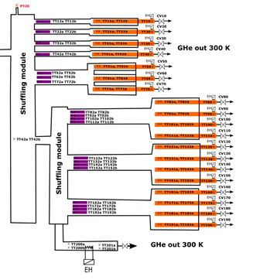
Zoom on DFHx
Located in Service Gallery- No radiation expected
Instrumentation to be provided In purple zone : full calibrated Cernox provided due to requested accuracy. For 1 K accuracy, free Cernox may be provided.
WP6a will provide temperature probes in current leads
Number | Instrumentation | Operating Range | Application (for thermometer) | Range | accuracy
38 (19+19S) | TT on splices | 10-20 K | Immersed Control Cernox calibrated | 3-325 K | +/- 0.5 K (TBC)
2 (1+1S) | TT in DFH (at inlet) | 10-20K | Immersed Control Cernox calibrated | 3-325 K | +/- 0.5 K (TBC)
1 | Electric Heater | 0-1500 W | NA | 0-15000 W | 1 W
2 (1+1S) | TT at bypass inlet | 10-20K | Immersed or finger Monitoring /diagnostic Cernox calibrated | 3-325 K | +/- 0.5 K (TBC)
2 | Temperature transmitter | ambient | PT-100 | 3-325 K | +/- 5 K
1 | Pressure transmitter | 1.05-2 bara | NA | 0-4 bar | 0.01 bar
1 | DPT (TBC) | 0-100 mbar | NA | 0-300 mbar | 1 mbar
1 | Temp switch (SV) | NA | NA | NA | NA

Slide 5
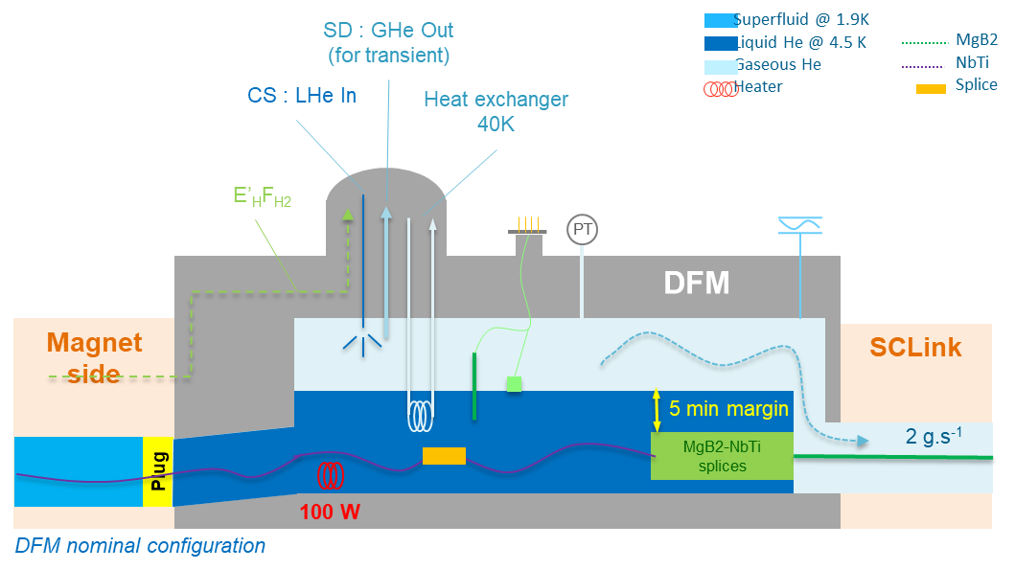
Zoom on DFm
PRELIMINARY
Located in the tunnel in a zone with radiation over 1000 kGy (TBC, based on QXL data)
Number | Instrumentation | Normal Operating Range | Application (for thermometer) | Range | accuracy
4* | Process Temperature transmitter | 4.4-5.5 K | Immersed Monitoring Cernox | 3-325 K | +/- 0.1 K
2 | Vaccum Temperature transmitter | 4.4-300 K | Vacuum Control for transient Cernox | 3-325 K | +/- 0.5-1 K
2 | Electric Heater | 0-100 W |  | 0-300 W | 1 W
2 | Level transmitter | TBC |  | TBC | 10 mm
2 | Pressure transmitter | 1.05-2 bara |  | 0-10 bar | 0.01 bar
1 | Temp switch (SV) | NA |  | NA | NA
Requirement for P,T measurement in QXL for virtual flow calculation of line C and line E
Requirement for T measurement in QXL for duty calculation of gas heater
* TT for heater protection not included

Slide 6
Zoom on DFHm
PRELIMINARY
Located in Service Gallery- No radiation expected
(number of cold TT to be confirmed according to the final number of current leads → 10 currents leads for time being)
Number | Instrumentation | Normal Operating Range | Range | accuracy
24 (TBC) | Temperature transmitter | 10-20 K | 3-325 K | +/- 0.5 K (TBC)
1 | Electric Heater | 0-325 W | 0-7500 W | 1 W
2 | Temperature transmitter | ambient | 3-325 K | +/- 0.1 K
1 | Pressure transmitter | 1.05-2 bara | 0- 4 bar | 0.01 bar
1 | Differential Pressure transmitter | 0-100 mbar | 0-300 mbar | 1 mbar

Slide 7
Total for Cold powering of Inner Triplets
(spare Included)
 | Number | Instrumentation | Normal Operating Range | Range | Total (x5)
DFx | 4 | Process Temperature transmitter | 4.4-5.5 K | 3-325 K | 20
 | 2 | Vacuum Temperature transmitter | 4.4-300 K | 3-325 K | 10
 | 4 | Electric Heater | 0-100 W | 0-300 W | 20
 | 2 | Level transmitter | 365-515 mm | 0-615 mm | 10
 | 2 | Pressure transmitter | 1.05-2 bara | 0-4 bar | 10
DFHx | 42 | Temperature transmitter | 10-20 K | 3-325 K | 210
 | 1 | Electric Heater | 0-1500 W | 0-15000 W | 5
 | 2 | Temperature transmitter | ambient | 3-325 K | 10
 | 1 | Pressure transmitter | 1.05-2 bara | 0-4 bar | 5

Slide 8
Total for Cold powering of matching section
(spare included)
 | Number | Instrumentation | Normal Operating Range | Range | Total (x5)
DFm | 4 | Temperature transmitter | 4.4-5.5 K | 3-325 K | 20
 | 2 | Vacuum Temperature transmitter | 4.4-300 K | 3-325 K | 10
 | 2 | Electric Heater | 0-100 W | 0-300 W | 10
 | 2 | Level transmitter | TBC | TBC | 10
 | 2 | Pressure transmitter | 1.05-2 bara | 0-4 bar | 10
DFHm | 24 (TBC) | Temperature transmitter | 10-20 K | 3-325 K | 120
 | 1 | Electric Heater | 0-325 W | 0-700 W | 5
 | 2 | Temperature transmitter | ambient | 3-325 K | 10
 | 1 | Pressure transmitter | 1.05-2 bara | 0-4 bar | 5

Slide 9
Grand Total
NO MARGIN
Instrumentation in tunnel | Grand Total
Temperature transmitter | 312
Electric Heater | 32
Level transmitter | 16
Pressure transmitter | 24
Differential Pressure transmitter | 8
There will be :
4 DFX / DFHX installed + 1 DFX / DFHX spare (spare used in the proto and in the string)
4 DFM / DFHM installed + 1 DFM / DFHM spare
Instrumentation for spare units | Grand Total
Temperature transmitter | 82
Electric Heater | 6
Level transmitter | 4
Pressure transmitter | 4

Slide 10
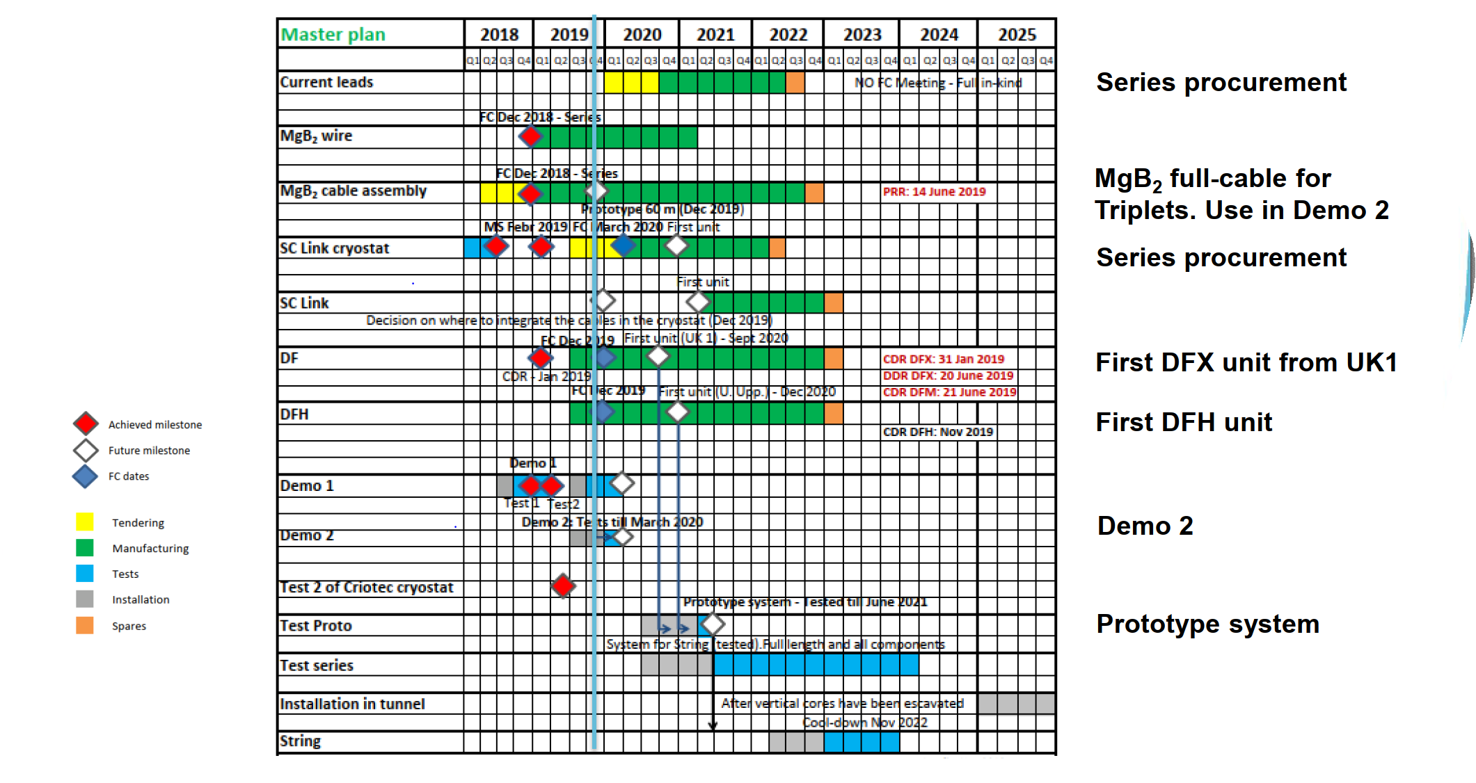
Planning
Instrumentation to be available:
for the test proto in SM18 – Q4 2020
DFx/m – Q2 2021
DFHx/m - Q2 2022

Slide 11
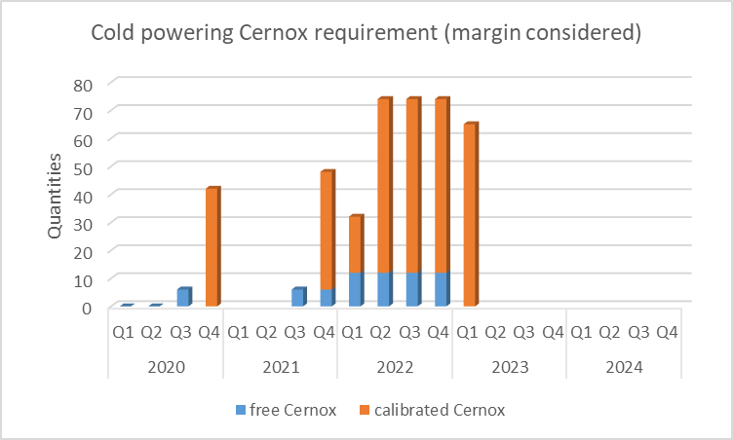
Base case : Schedule and quantity for Cernox
Margin : One supplementary DFX/DFHX considered

Slide 12
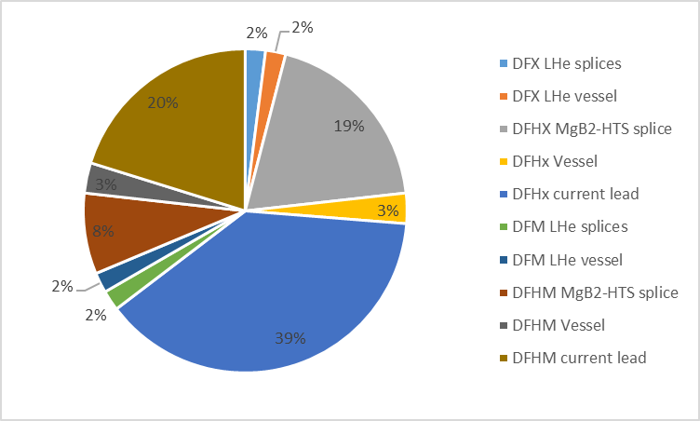
Base Case : Electronical channels
Equipment | location | Electronical signals
DFX | LHe splices | 8
DFX | LHe vessel | 8
DFHX | MgB2-HTS splices | 76
DFHX | Vessel | 12
DFHX | current lead | 152
DFM | LHe splices | 8
DFM | LHe vessel | 8
DFHM | MgB2-HTS splices | 32
DFHM | Vessel | 12
DFHM | current lead | 80
GRAND TOTAL |  | 396

Slide 13
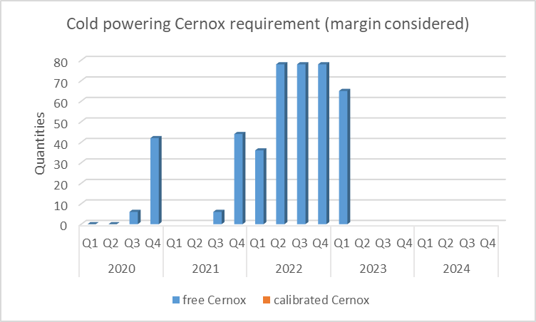
Value engineering 1 : only free Cernox
Requested accuracy on DFH temperature measurement changed to 1 K → Free Cernox can be selected (gain on calibration cost and potentially schedule)

Slide 14
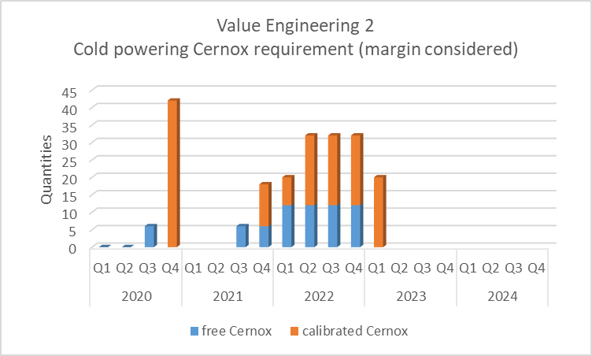
Value engineering 2 : Removal of TT in DFH
After confirmation by prototype, removal on TT on splice if helium flow can be controlled with cold end of current lead.
One Temperature measurement kept on each model of splice (e.g. 18 kA, 13 kA, 2 kA, 2 kA trim…)
Potential savings:
230 Probes
115 electronical channels
This can be cumulated with Value Engineering 1

