Slide 2
Enabling Discovery In Research With Cloud Technologies
CERN
Eric Grancher
eric.grancher@cern.ch
Head of Database Services
IT department, CERN

Slide 3
Brief introduction to CERN
European Council for Nuclear Research
Founded in 1954 for fundamental physics research (initially 12 member states)
Today 23 members states (see https://home.cern/about/member-states) and world-wide collaborations
Missions:
  Fundamental research on matter and forces
  Technological innovation
  Diversity and bringing nations together
  Inspiration and Education
  (More information at https://home.cern/about)
Can be visited, https://visit.cern/

Slide 4

The Large Hadron Collider (LHC)
Probably the largest machine in the world
27 km, 50 types of magnets, 1 232 main dipoles
each 15 m long, 35 tonnes, 8.3 T, 11 080 A
Fastest racetrack on Earth
Protons circulate 11 245 times/s (99.9999991% the speed of light)
Emptiest place in the solar system
104 km of piping under vacuum, pressure below 1.013 × 10⁻¹⁰ mbar
Hottest spot in the galaxy
During lead ion collisions create temperatures 100 000x hotter than the heart of the sun

Slide 5
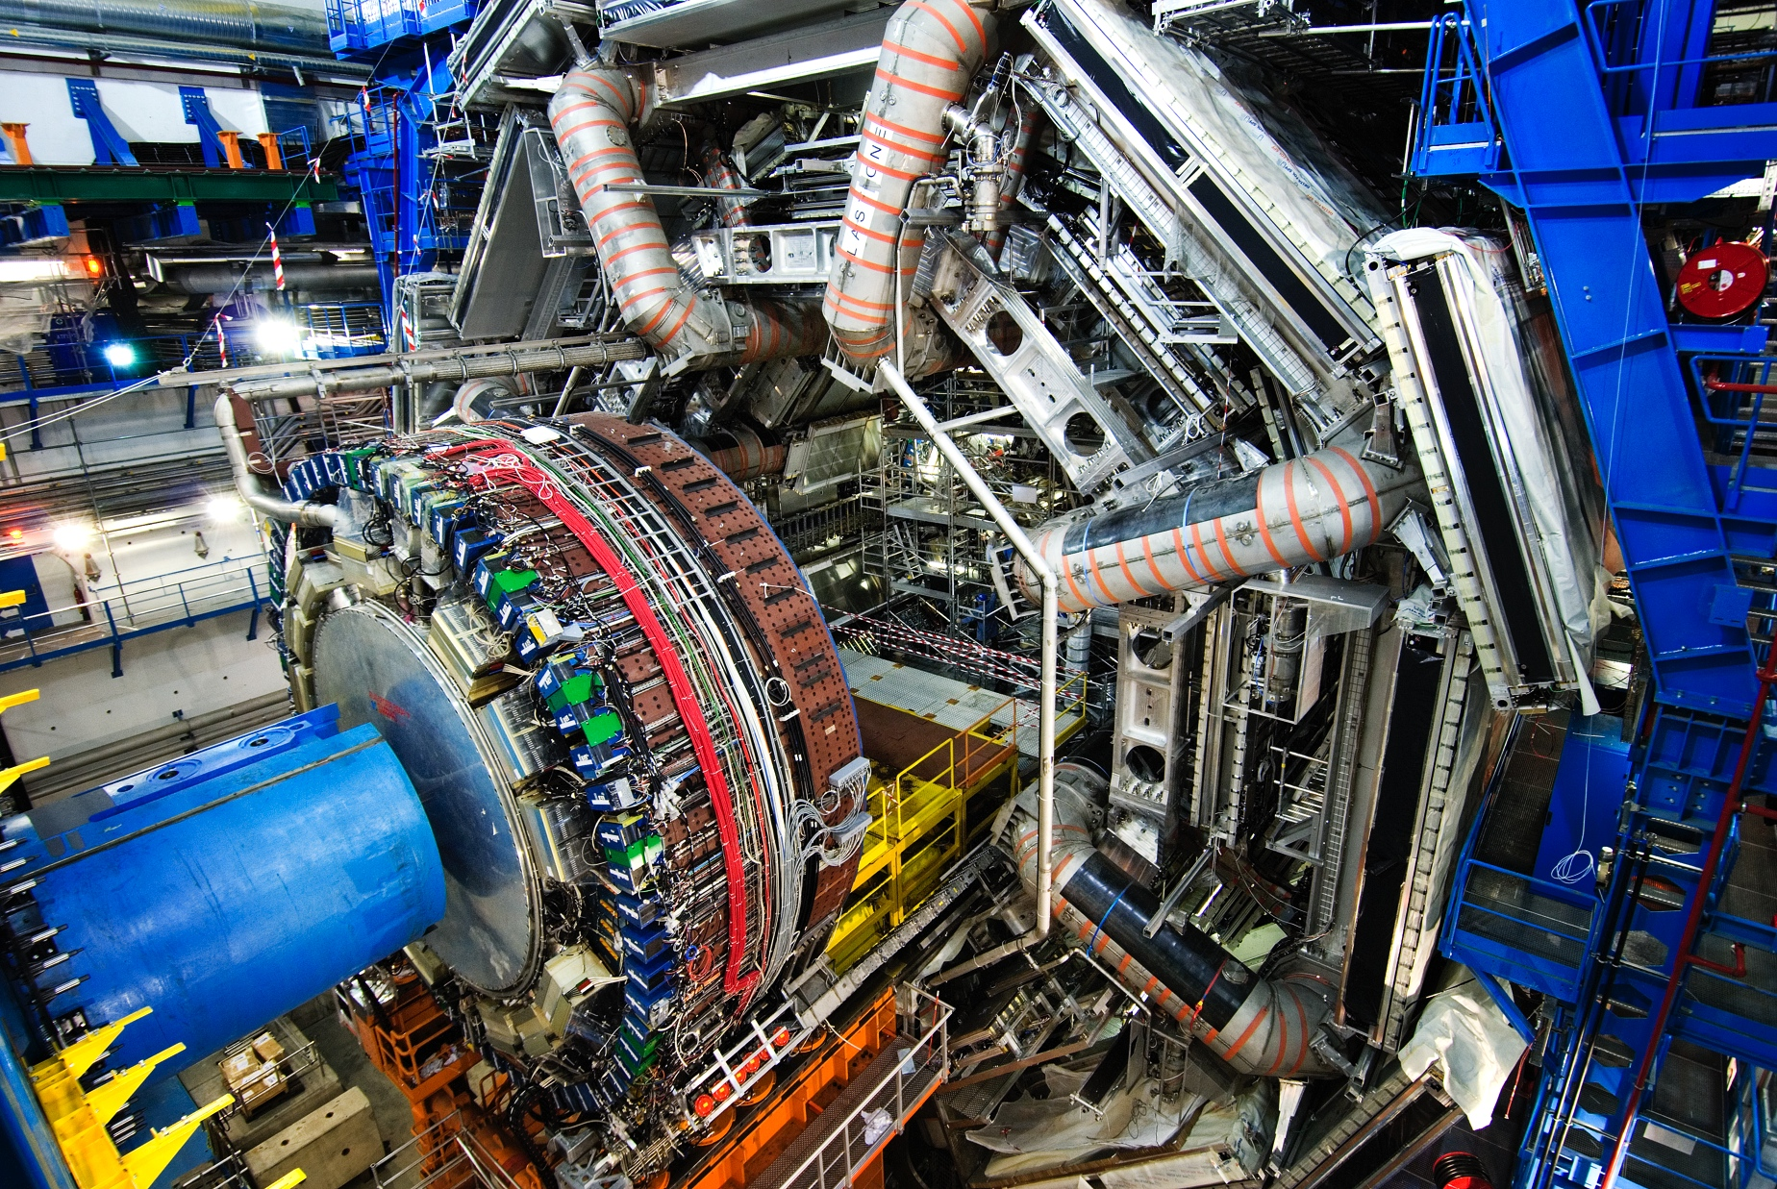
The ATLAS detector (as an example for the 4 LHC experiments)
~100 Million electronic channels
Control and detection sensors
Large amount of data
Capturing 40+ million collisions per second
Several layers of filtering
2018: 88 PB of LHC experiments data

Slide 6
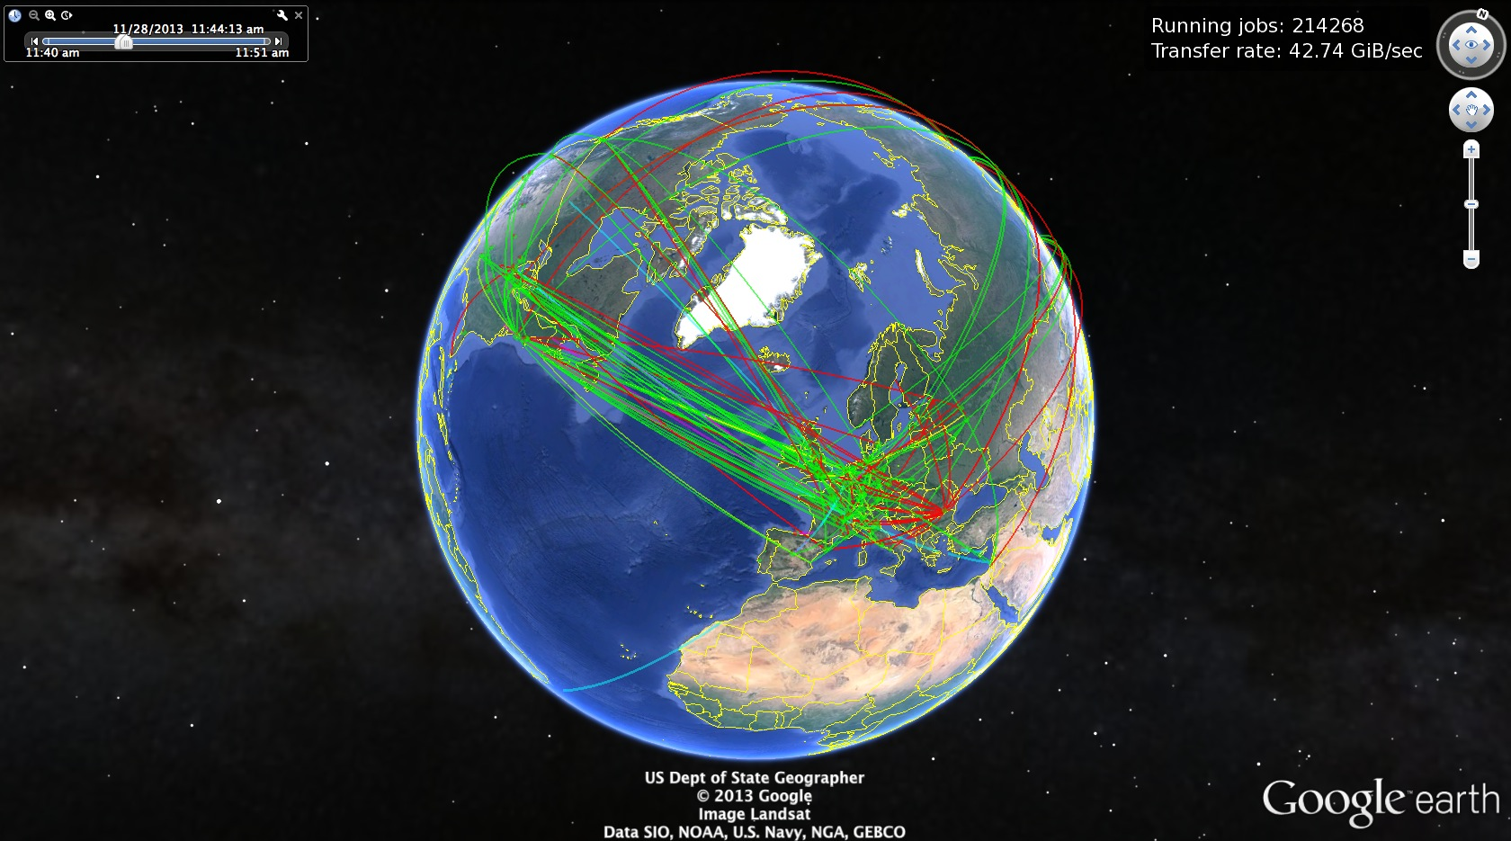
Worldwide LHC Computing Grid
CERN 17k servers, 300k CPU cores
400PB capacity on tape (30k units)
280PB capacity on disk (February 2020)
WLCG more than 170 data centres in more than 40 countries
close to 1 Million CPU cores, 1 Exabyte of storage available to the LHC experiments
>300k jobs run concurrently on the Grid
Global transfer rates regularly exceed 50GB/s (2019)

Slide 7
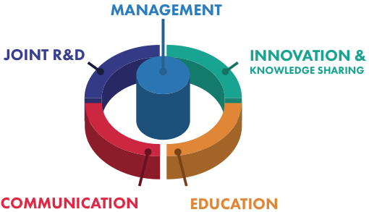
CERN openlab
Public-private partnership, through which CERN collaborates with leading ICT companies and other research organizations
  Evaluate state-of-the-art technologies in a challenging environment and improve them.
  Train the next generation of engineers/researchers.
  Promote education and cultural exchanges.
  Communicate results and reach new audiences.
Oracle is a member since 2003

Slide 8
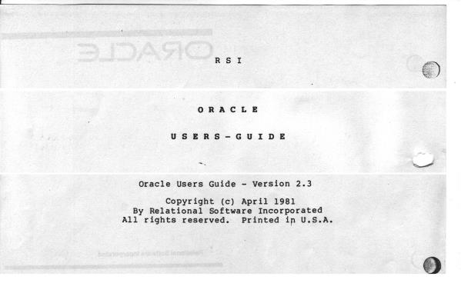
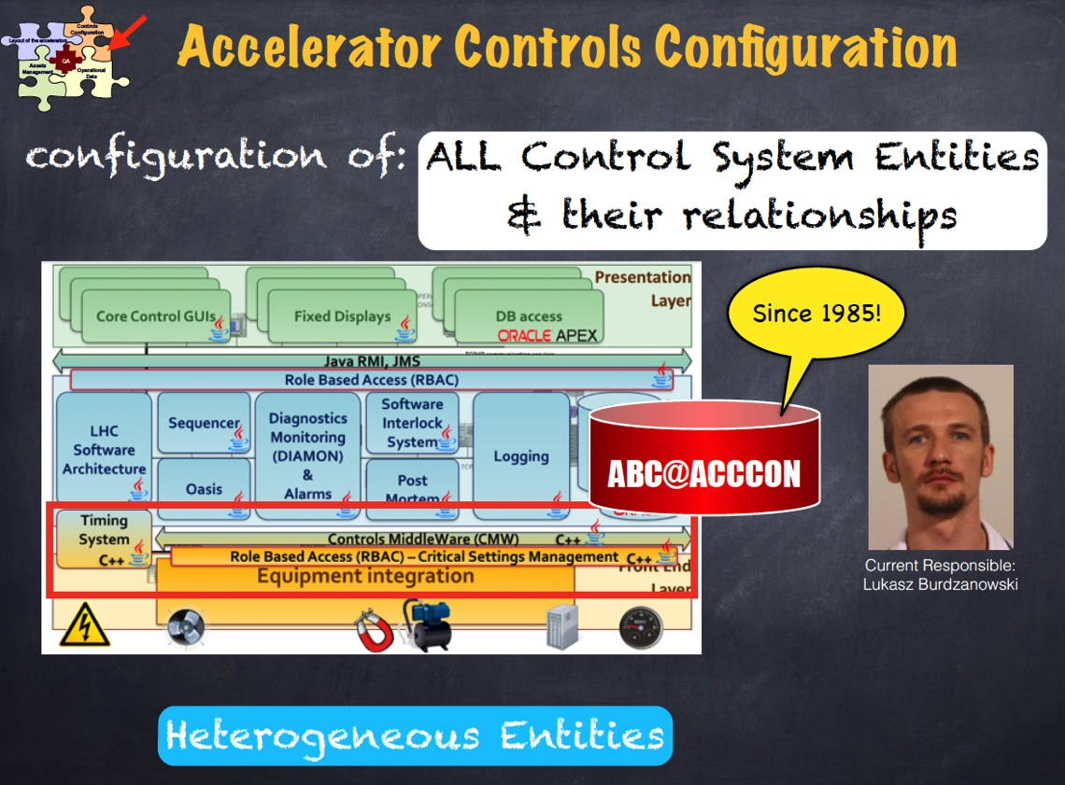
Oracle at CERN
Credit: N. Segura Chinchilla
Since 1982 – version 2.3
  Initially used for accelerator controls
Examples of critical production DBs:
  Quench Protection System: 150’000 changes/s
  QPSr > 150TB redo / month
Credit: C. Roderick
ACCLOG, credit: N. Tsvetkov

Slide 9
Oracle Cloud Infrastructure - WLCG
Credit: Ana Lameiro Fernández, Katarzyna Maria Dziedziniewicz-Wojcik, Eva Dafonte Pérez
Deployment of Oracle Cloud Infrastructure as a site inside Worldwide LHC Computing Grid
Proof of concept, 2017Q3
132 X5 High IO Bare Metal Machines. Around 10 000 cores. 10GB RAM per core

Slide 10
Jobs on OCI
Experiments achieved
~8700 concurrent jobs running on Oracle Cloud Infrastructure
~ 97% success rate, comparable with other grid sites
LHCb workload
Credit: Ana Lameiro Fernández, Katarzyna Maria Dziedziniewicz-Wojcik, Eva Dafonte Pérez

Slide 11

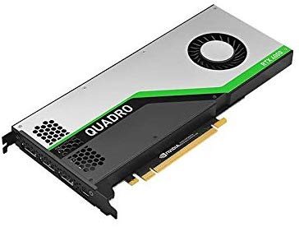









Integration OCI GPUs
Credit: Riccardo Castellotti
Object storage
Experiments storage
HDFS
HEP software
Personal storage

Slide 12
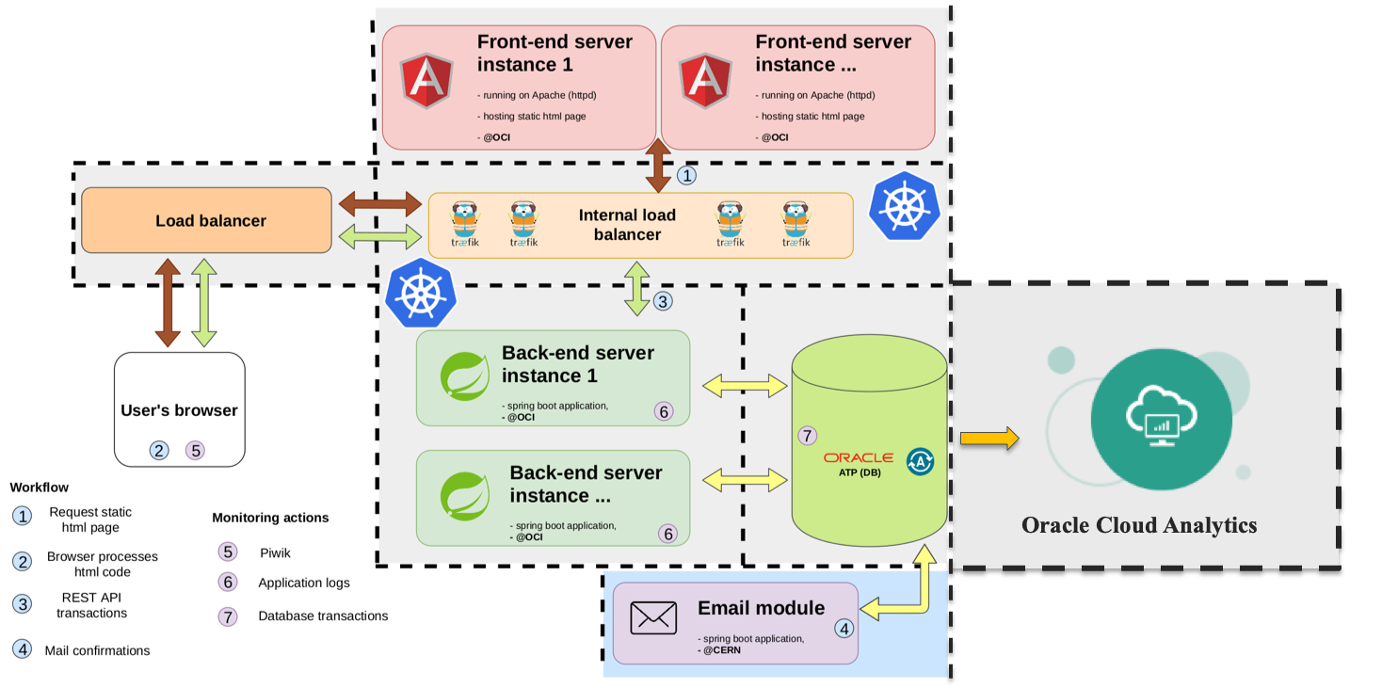
CERN Open Days 2019 registration
Supporting outreach, experience of fast and scalable solutions
to be able to deploy at the needed scale
to save time and benefit from automation using cloud services when possible
  Load balancer aaS, OCI Container Engine for Kubernetes, Autonomous Transaction Processing services, Oracle Management Cloud, Oracle Analytics Cloud
to ease integration with other interfaces (on site organization) with Oracle database as a common repository
to gain time and avoid having to deploy new services for the event
Scalability tests built in the different environments.
Credit: Viktor Kozlovszky
Notes:
Aas => Saas

Slide 13
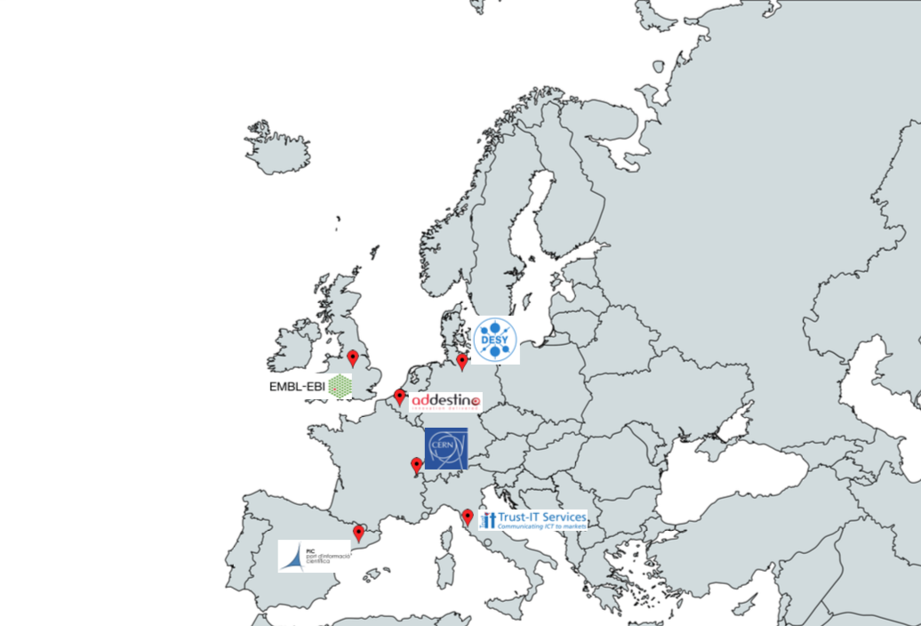


ARCHIVER project objective
Credit: João Fernandes
Focus: Archiving and Data Preservation Services using commercial cloud services to be available via the European Open Science Cloud (EOSC)
Total Budget : 4.8M euro ; Procurement R&D Budget: 3.4M euro
Starting Date: 1st of January 2019
Duration: 36 Months
Coordinator: CERN (Lead Procurer)

Slide 14
References
HEP Software Foundation https://hepsoftwarefoundation.org/
A Roadmap for HEP Software and Computing R&D for the 2020s https://doi.org/10.1007/s41781-018-0018-8
European Strategy for Particle Physics https://europeanstrategyupdate.web.cern.ch/
LHC schedule https://cern.ch/lhc-commissioning/schedule/LHC-long-term.htm
http://opendata.cern.ch/docs/cms-releases-open-data-for-machine-learning
CERN DB blog https://cern.ch/db-blog/

Slide 15
Thank you
eric.grancher@cern.ch

