Slide 1



Sascha Lüdeke
ESR-1, WP-1
02/2020

Slide 2
Direct Ionization Effects of Low-E Protons and Heavy Ions
  Linear energy transfer model of particle radiation in matter
    Semi empirical two-parameter Model
      Modification to Bloch’s Stopping Number
    Comparison to experimental data and other models
  Modelling of radial energy distribution
    Focused on ionization processes
    Characterizes the ion track
Current Project
ESR-1, WP-1

Slide 3
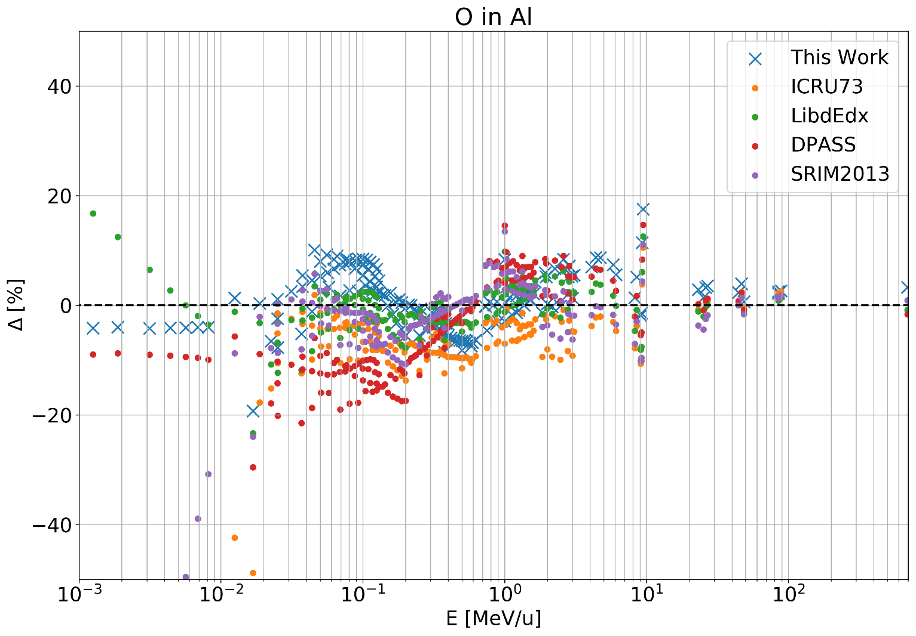
LET Models in comparison with experimental data over projectile Energy
Current Project
ESR-1, WP-1

Slide 4
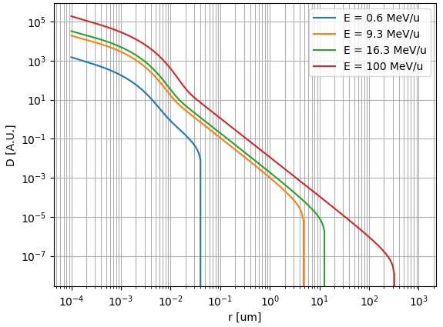
Qualitative Ion Track structure for different kinetic energies in H20
Current Project
ESR-1, WP-1

Slide 5
SEE Cross-section modelling based Sensitive Volume (SV) approach
  Combining SV approach with LET and ion track model
    Minor adjustment to establish algorithms
  Prediction of SV dimensions from experimental data
    Elimination of extensive MC Simulation between iterations
Planned Project
ESR-1, WP-1

Slide 6
Time of Flight (TOF) Measurement of RADEF Ion Cocktails
  TOF measurement of new RADEF ion cocktail
    LET in silicon
  Validation of the LET model discussed earlier
  Implementation in LET experimental database and JYUs ECIF (European Component Irradiation Facilities) Calculator
Planned Project
ESR-1, WP-1

Slide 7
ESTIMATION OF PROTON INDUCED SINGLE EVENT RATE IN VERY DEEP SUBMICRON TECHNOLOGIES
  Cooperation with Alter Technology, Toulouse France, for ESA
  Investigation and modeling of SEEs and Rate Predictions for 28nm Technology
    Focus on Low Energy Protons
Planned Project
ESR-1, WP-1

