Slide 1
Status of the new
BGI (Beam Gas Injection) of the new
BGI (Beam Gas Ionization)
Jose A. Ferreira Somoza

Slide 2
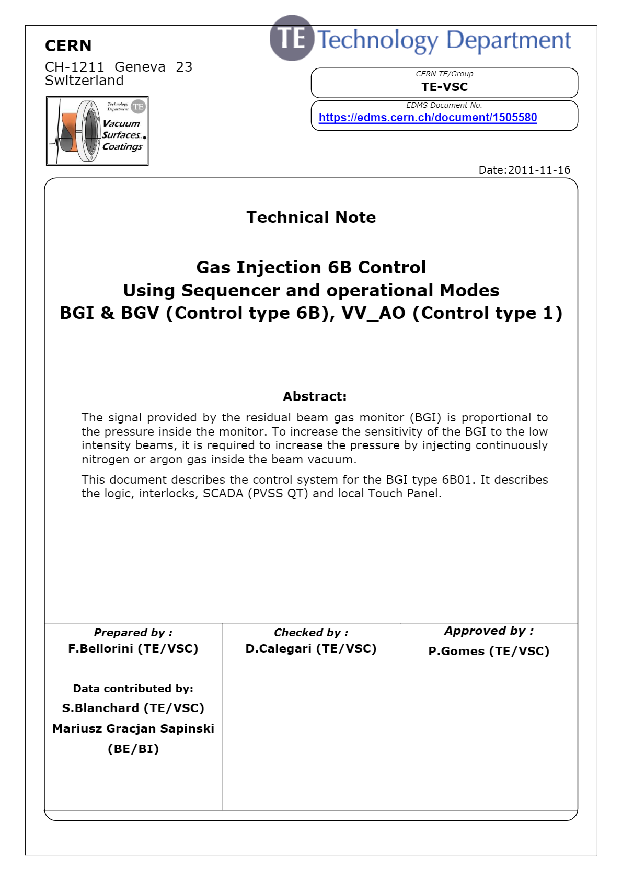
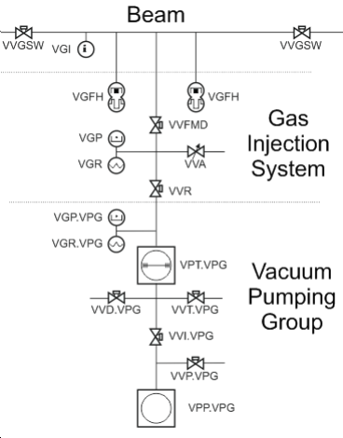
Layout
Beam VVGSW Next (or Previous) Sector Valve VVGSW Previous (or Next) Sector Valve VGI Bayard-Alpert Gauge Gas Injection System VVR Pumping Group Insulation Valve VVA Analog Injection Valve VVFMD Beam Vacuum Insulation Valve VGR BGI Dome Pirani Gauge VGP BGI Dome Penning Gauge VGFH BGI Monitor Full-Range Gauge n°1 VGFH BGI Monitor Full-Range Gauge n°2 Vacuum Pumping group VPP.VPG Primary pump VPT.VPG Turbo Pump VVP.VPG Venting Valve Primary VVI.VPG Intermediate Valve between Primary Pump and Turbo Pump VVD.VPG Leak Detection valve VGR.VPG Pumping Group Pirani Gauge VGP.VPG Pumping Group Pennig Gauge
Standard configuration used in SPS and LHC
Control system available and integrated in SCADA
Proven logic

Slide 3
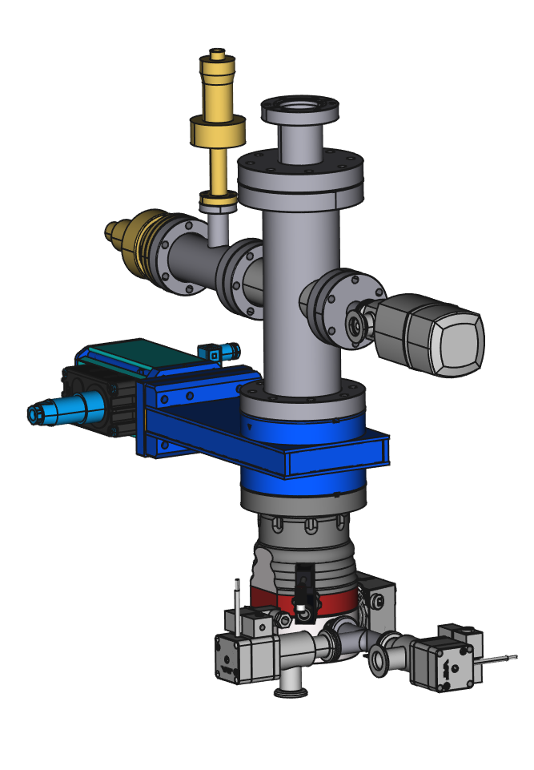
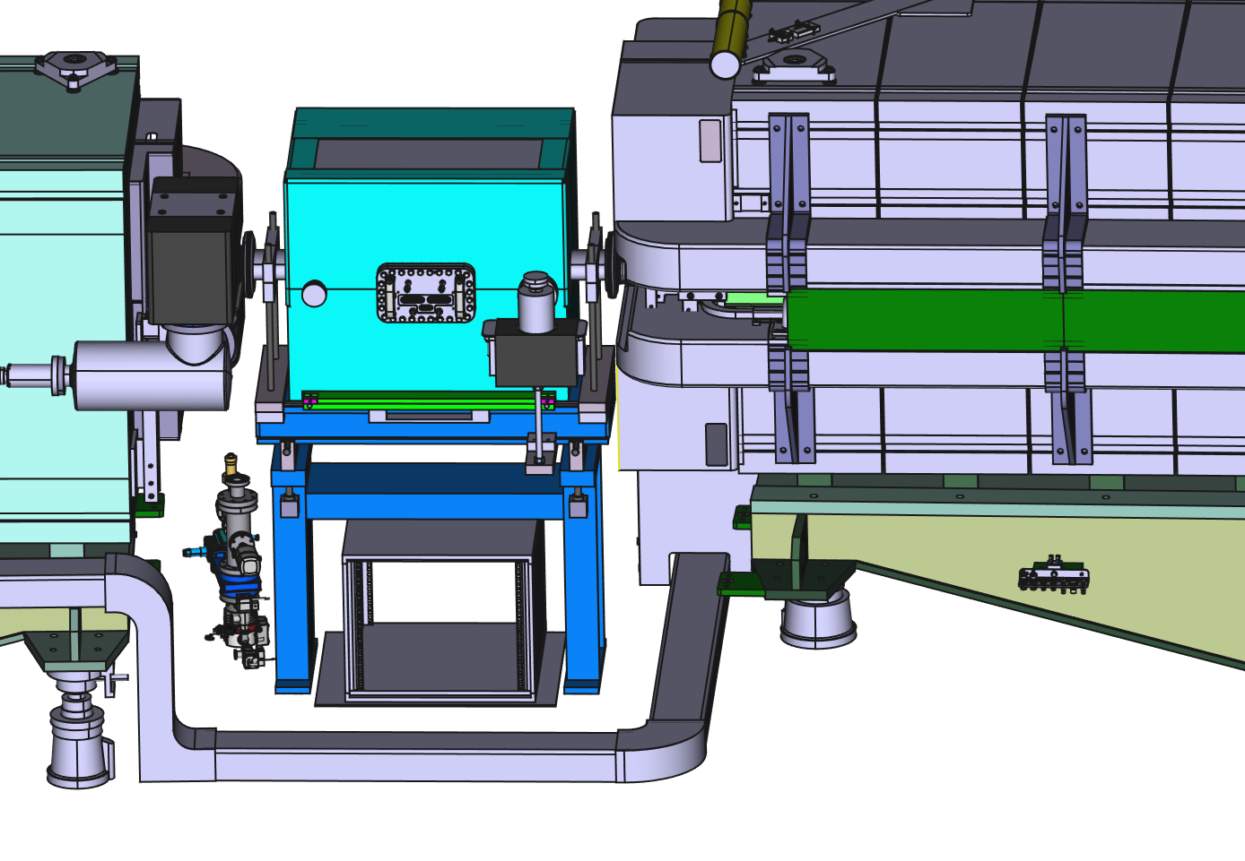
Integration

Slide 4
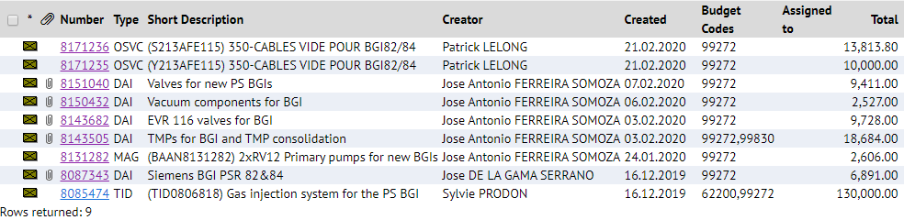
Status
Most of the material already ordered
  65 kCHF
Savings
  10 kCHF saved (actual cost)
  VVFMD from stock
All critical elements for installation already ordered

Slide 5
Strategy
Cables from the 18th – 31st Mars (approved by EN-EL and agreed with EN-ACE)
Close SS82 and SS84 with valve and close machine
Prepare ECR with integration
Receive and test injection system
Install in machine (one day of access). No need of venting

