Slide 1
LIU-PS EVM Status
Data extraction: 3 March 2020

Slide 2
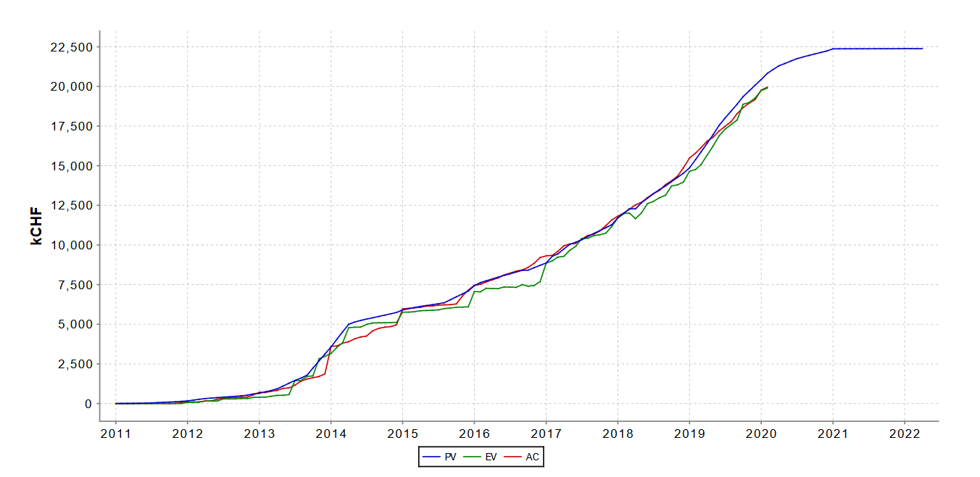
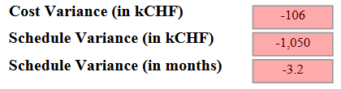
LIU-PS Dashboard
Reporting up-to-date for 41% of the workunits

Slide 3

LIU-PS Crosstab by Group

Slide 4
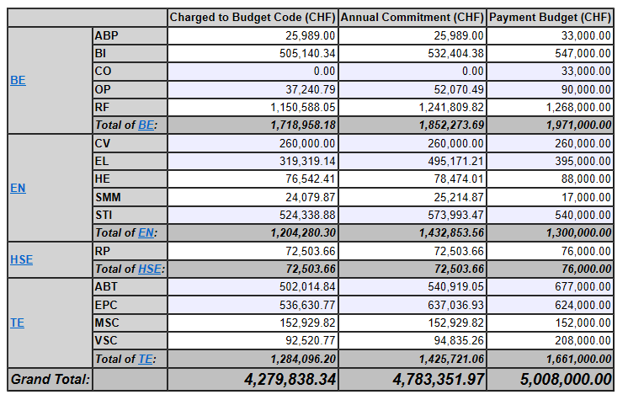
Out-turn 2019

Slide 5
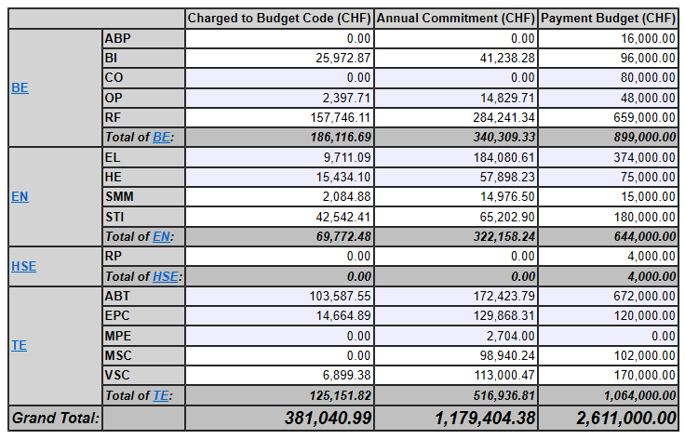
Budget 2020

Slide 6
Next steps
EVM reporting for March Council
Budget codes closing: from Sep-20 to Oct-20

