Slide 1
Snowmass All Frontier Conveners Meeting #1
Noon-1pm CST, February 13, 2020
Young-Kee Kim
DPF Chair
Connection Information is by Zoom
Join by Web: https://fnal.zoom.us/j/9082275310
Join by Phone: Dial +1 408 638 0968 (US Toll) or +1 646 558 8656 (US Toll) and use Meeting ID: 908-227-5310

Slide 2
Snowmass Co-Conveners
THANK YOU!!
Frontier | Co-Conveners
Energy Frontier | Meenakshi Narain | Brown University | meenakshi_narain@brown.edu
 | Laura Reina | Florida State University | reina@hep.fsu.edu
 | Alessandro Tricoli | Brookhaven National Laboratory | atricoli@bnl.gov
Frontiers in Neutrino Physics | Patrick Huber | Virginia Tech | pahuber@vt.edu
 | Kate Scholberg | Duke University | schol@phy.duke.edu
 | Elizabeth Worcester | Brookhaven National Laboratory | etw@bnl.gov
Frontiers in Rare Processes and Precision Measurements | Marina Artuso | Syracuse University | martuso@syr.edu
 | Bob Bernstein | Fermi National Accelerator Laboratory | rhbob@fnal.gov
 | Alexey Petrov | Wayne State University | apetrov@physics.wayne.edu
Cosmic Frontier | Aaron Chou | Fermi National Accelerator Laboratory | achou@fnal.gov
 | Marcelle Soares Santos | Brandeis University | marcelle@brandeis.edu
 | Tim Tait | University of California, Irvine | ttait@uci.edu
Theory Frontier | Nathanial Craig | University of California, Santa Barbara | ncraig@physics.ucsb.edu
 | Csaba Csaki | Cornell University | csaki@cornell.edu
 | Aida El-Khadra | University of Illinois, Urbana-Champaign | axk@illinois.edu
Accelerator Science and Technology Frontier | Steve Gourlay | Lawrence Berkeley National Laboratory | sagourlay@lbl.gov
 | Tor Raubenheimer | SLAC National Accelerator Laboratory | tor@slac.stanford.edu
 | Vladimir Shiltsev | Fermi National Accelerator Laboratory | shiltsev@fnal.gov
Instrumentation Frontier | Phil Barbeau | Duke University | psbarbeau@phy.duke.edu
 | Petra Merkel | Fermi National Accelerator Laboratory | petra@fnal.gov
 | Jinlong Zhang | Argonne National Laboratory | zhangjl@anl.gov
Computational Frontier | Steve Gottlieb | Indiana University | sg@indiana.edu
 | Oliver Gutsche | Fermi National Accelerator Laboratory | gutsche@fnal.gov
 | Ben Nachman | Lawrence Berkeley National Laboratory | bpnachman@lbl.gov
Underground Facilities and Infrastructure | Jeter Hall | SNOLAB | Jeter.Hall@snolab.ca
 | Kevin Lesko | Lawrence Berkeley National Laboratory | ktlesko@lbl.gov
 | John Orrell | Pacific Northwest National Laboratory | john.orrell@pnnl.gov
Community Involvement | Ketevi Assamagan | Brookhaven National Laboratory | ketevi@bnl.gov
 | Breese Quinn | University of Mississippi | quinn@phy.olemiss.edu

Slide 3
Roles of Frontier Co-Conveners
Co-conveners represent the HEP community in all their activities, not their personal and/or organization agendas
Optimize topical groups
Establish topical conveners
  Propose topical convener candidates based on nominations from the HEP community and other input. The Steering committee will endorse the list of topical convener candidates.
Contact the candidate topical conveners
Together with topical conveners, review the 2013 Snowmass write-up and capture lessons-learned
Together with Steering committee and DPF program committee, organize the Snowmass kick-off meeting during the 2020 APS April meeting
Solicit community input in the form of white papers
Organize meetings for their frontier and work with topical conveners to organize specialized workshops leading up to 2021 Snowmass Summer Study.
Together with the Steering committee, organize 2021 Snowmass Summer Study
Be responsible for the 2021 Snowmass report (by Fall 2021)

Slide 4
Snowmass Steering Committee (2019)
Convener / Community Summer Study selections
  DPF Executive Committee
    Chair
    Chair-Elect
    Vice Chair
    Past Chair
    Secretary/Treasurer
    Councilor
    Member-at-Large
    Member-at-Large
    Member-at-Large
    Member-at-Large
    Member-at-Large
    Member-at-Large
    Early Career Member-at-Large
  Other Divisions
    DPB Representative
    DNP Representative
    DAP Representative
    DGRAV Representative

Slide 5
Snowmass Advisory Group (2020-2021)
Snowmass Steering Group
DPF Chairline
(4/5)
DPB, DNP, DAP, DGRAV representatives
(4)
Representatives from Americas, Asia, Europe
(~6)
Under discussion
Editors (1 or 2)
Secretary (1)
Other DPF EC members
(9)

Slide 6
Snowmass Advisory Group (Steering Group)
DPF Executive Committee
  Chair: Young-Kee Kim
  Chair-Elect: Tao Han
  Vice Chair: Joel Butler
  Past Chair: Prisca Cushman
  Secretary/Treasurer: Mirjam Cvetic
  Councilor: Elizabeth Simmons
  Member-at-Large: Rick Van Kooten
  Member-at-Large: Elizabeth Worcester
  Member-at-Large: Natalia Toro
  Member-at-Large: Andre de Gouvea
  Member-at-Large: Mary Bishai
  Member-at-Large: Lauren Tompkins
  Early Career Member-at-Large: Sara Simon
Representatives from other Divisions
  DPB: Sergei Nagaitsev, Chair of DPB
  DNP: Yury Kolomensky
  DAP: Glennys Farrar, Chair-Elect of DAP
  DGRAV: Gabriela Gonzales, Vice-Chair of DGRAV
Representatives from the International Community
  2 from Americas
    1 from Canada
    1 from Latin America
  2 from Europe
  2 from Asia
Under discussion
  Editors
  Secretary

Slide 7
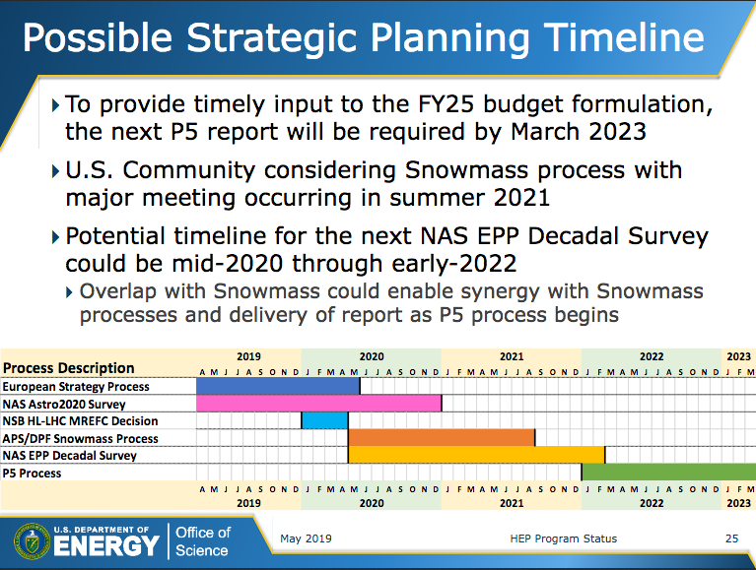
Timeline
Snowmass Final Report: Fall 2021
NAS (National Academy of Sciences) Decadal Survey Report: end 2020 or very early 2022

Slide 8
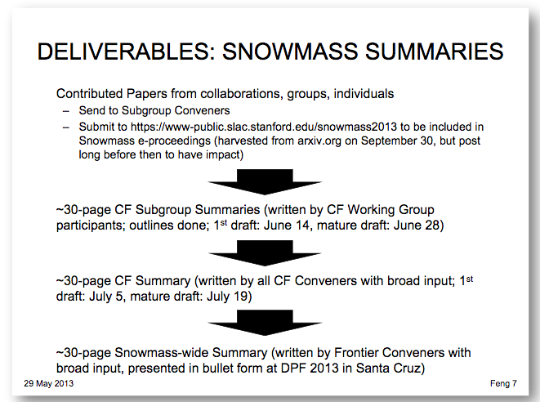
Snowmass 2012-2013: Timeline (e.g. Cosmic Frontier)
Snowmass 2012-2013 workshops and meetings
Google spreadsheet (working in progress)

Slide 9
Snowmass workshops (2012-2013)
Google spreadsheet (working in progress)
Incomplete list
Community-wide | Frontier | Dates | # participants | Location
Community Planning Meeting |  | October 11-13, 2012 | 450 | Fermilab
 | Cosmic Frontier | March 6-8, 2013 | 338 | SLAC
 | Energy Frontier | April 3-6, 2013 | 171 | Brookhaven
 | Intensity Frontier | April 25-27, 2013 | 309 | Argonne
 | Theory | May 29-31, 2013 |  | Santa Barbara
 | Energy Frontier | June 30-July 3, 2013 |  | Seattle
Community Summer Study |  | July 29 - August 6, 2013 | 600 | Minnesota

Slide 10
Snowmass 2020-2021: Tentative Timeline
Goals | ~Time | Location
Contributed Papers | Summer 2020
Community Planning Meeting | Fall 2020 | ~ Fermilab
Subgroup Summaries: 1st DRAFT | March 2021
Community Midterm Meeting | April 2021 | Options: Combined with the 2021 APS April meeting (Sacramento, CA) Combined with one of Frontier workshops
Frontier Summaries: 1st DRAFT | June 2021
Community Summer Study | July 2021 | UW Seattle
Snowmass Report: 1st DRAFT | August 2021
Snowmass Report: FINAL | October 2021
Forcused workshops between Late Spring 2020 and Spring 2021

Slide 11
Frontier Workshops
We have 10 Frontiers. Having 10 Frontier workshops between late Spring 2020 and Spring 2021 might be too much. We expect that most of Frontier workshops will be organized jointly. This helps coordination between relevant frontiers. No more than 5 workshops (across the country). One option:
  Joint Energy – Accelerator Workshop
  Joint Neutrino – Cosmic – Community Workshop
  Joint Instrumentation – Computing – Facilities Workshop
  Theory Workshop
  Rare / Precision Workshop
Community-wide meetings are good opportunities for further coordination between frontiers. At least we plan two such meetings
  Fall 2020 (Community Planning Meeting)
  Spring 2021 (Community Mid-term Meeting)
Selection of workshop locations
  Agree on the list of workshops (~end Feb.)
  Receive proposals from the community (~end March)
  Decision on locations and dates before the April meeting and announce it at the Town Hall Meeting (Sat. April 18)

Slide 12
Timeline: January 2020 – April 2020
January 2020
  Announcement of frontier conveners and 2021 Snowmass site (DPF Newsletter)
  Create a mailing list (listserv) of all frontier conveners
  Schedule the first all frontier conveners meeting
February – March 2020
  All frontier conveners meetings
  Finalize topical groups and conveners
    proposal by frontier conveners and approval by Snowmass Steering Group
  Site selection of the Community Planning Meeting
  Agree on the list of workshops (~end Feb.) / Receive proposals (~end March)
  Plan for the April meeting
Early April 2020
  Decision on workshop locations and dates
  Finalize the charge of Snowmass
2020 APS April meeting (Saturday, April 18 – Tuesday, April 21)
  In-person meetings of all frontier conveners / topical conveners
  Outline frontier and topical workshops (late Spring 2020 – Spring 2021)
  Town Hall meeting to communicate with the community (5:30pm-7:00pm, Saturday, April 18)

Slide 13
Involvement of the International Community
Particle physics is global; long-term strategy study done in the global context
25% of APS members are from foreign institutions
European / U.S. Process
  European Physics Preparatory Group (PPG) ~ U.S. Snowmass
  European Strategy Group (EGC) ~ U.S. P5
European Physics Preparatory Group (PPG) 2018-2019
  17 PPG Members, including 4 members from Americas and Asia
  16 Conveners (8 groups), including 4 conveners from Americas and Asia
U.S. P5 2014
  25 members, including 5 members from Europe and Asia
U.S. Snowmass 2020-2021
  Currently all (but 1) of conveners are from U.S. institutions
  Add representatives from foreign institutions to
    Advisory Group
    Sub group conveners

Slide 14
Questions concerning frontier / topical conveners
Availability for travel funding from APS/DPF for conveners to organize workshops?
  Unfortunately No.
  DPF budget is small. Most of it goes to student travel grants for APS April meeting and DPF meeting. For Snowmass workshops, we hope to get support from funding agencies for students.
Uniform policies on international topical conveners – What’s expected from them if they can not “take part in person”?
  This will be a question to all topical conveners.
  We expect combination of remote and in-person participation.

Slide 15
Involvement of Early Careers (input from them)
Get young members involved in planning and process
2013 Snowmass surveyed young physicists. We could do something similar:
  Survey what projects have the most enthusiasm
  Survey what challenges/barriers young members are finding on their career paths
  Demographics on young membership
  See if there are programs for young members' career development in their collaborations and investigate how we can make these programs broader across the community (this would be a new addition)
Integrate career development events during and leading up to:
  Talking with funding agencies
  Career panels (academia, national lab, industry)
  Coffee chats (1:1, ~15-minute career advice chats with more senior members during meeting break of their choosing. We could have a designated area where people meet for this to simplify logistics versus making individual matches)
Have a strong statement about the code of conduct for meeting at the beginning and identify ombudspeople where attendees can report behavior in conflict with this code.

Slide 16
Communication
Fermilab has been providing key service for communication
Bob Bernstein is the official liaison
  Snowmass mailing lists (anyone can subscribe)
    All: SNOWMASS@FNAL.GOV
    Early careers: SNOWMASS-YOUNG@LFNAL.GOV
  Wiki pages to be updated (https://snowmass-wiki.fnal.gov/wiki/Main_Page)
  Concerns on SLACK (https://app.slack.com/client/TNNU4A570/CNLN41C21)
    Slack gives free accounts up to 10K messages before they start rolling messages off. Right now we are at nearly 2K messages out of the 10K and we've barely gotten started.
    Keeping messages is too expensive for DPF to cover.
    There are various ways to save public conversations (not private ones) in channels with restrictions, but this requires a lot of human effort.
    Discussion:
      Look for volunteers to do the work for saving messages?
      Other options?
APS
  DPF webpage to be updated (https://www.aps.org/units/dpf/snowmass-2021.cfm)
  Snowmass ENGAGE for meeting materials

Slide 17
Message from Michael Peskin
The full proceedings of Snowmass 2013 are published on eConf at https://www.slac.stanford.edu/econf/C1307292/. You should decide soon what you would like to do for the Snowmass 2013 proceedings. I can offer to create a similar web site, also to be archived on eConf.
  Level 1: Overall reports from the various frontiers, and the overall summary report
  Level 2: Subgroup reports from the various frontiers
  Level 3: Contributed papers
One of the important points of Snowmass is that all members of our the community can contribute white papers expressing their ideas. On the other hand, many of these contributed papers are written by large collaborations (e.g., arXiv:1307.7292 was submitted by the ATLAS Collaboration).
Norman Graf and I asked that all of these papers be posted on the arXiv, with an email notice to the Snowmass organizers. For the level 1 and 2 papers, we supplied a LaTeX template, and we edited the LaTeX submissions to put these into a uniform style. The final proceedings web site has
  all level 1 and level 2 papers in pdf format, edited for style (not content), and links to the arXiv versions
  a list of all level 3 papers, with links to the arXiv versions.
  a glossary of acronyms
The papers are organized by frontier. The physical published Snowmass proceedings volume contains the level 1 papers and the glossary.
We need conveners’ feedback:
Adopting the Snowmass 2013 proceedings mechanism
Providing a clear format of white papers to the community
Accepting Michael’s offer as an editor of the the Snowmass 2021 proceedings

Slide 18
Charge
Snowmass 2012-2013
The American Physical Society's Division of Particles and Fields is initiating a long-term planning exercise for the high-energy physics community. Its goal is to develop the community's long-term physics aspirations. Its narrative will communicate the opportunities for discovery in high-energy physics to the broader scientific community and to the government.
Snowmass 2020-2021
For discussions
  Update of Snowmass 2012-2013?
  Particle physics instead of high-energy physics?
  …

Slide 19
Short Status Report / Questions by Frontier Groups
Write here

