Slide 1
New MKB generators capacitors
Viliam Senaj et al, Machine Protection Panel meeting, April 3rd 2020

Slide 2
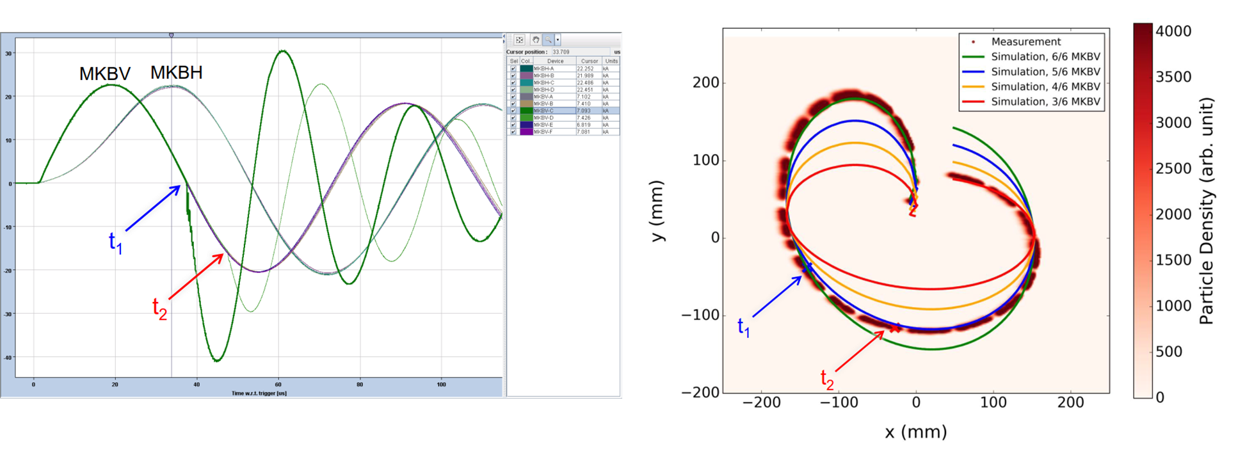
MKBV/B2 flashover on 14/07/2018/03:00:23.365
Strong flashover during programmed dump at 6.5 TeV with 2556 bunches starting in MKBV C and propagating ~ 10 us later to MKBV D; (the same vacuum tank)

Slide 3
Investigation after flashover
Potential source of flashover:
  Beam losses - not confirmed by BLM
  Vacuum pump flashover (up to > 2e-6 mBar observed in the past) - excluded by VSC experts
  Outgassing during dump – usually insufficient amplitude (~1e-7 mBar)
  Bad contact of magnet - not confirmed during inspection
  Foreign object (dust, metal stripe.. creating local field enhancement) – not confirmed
Static vacuum level in tank with MKBV C+D – historically at the best level (~3e-8 mBar)
Visual inspection of the tank and magnets not concluding – some graphite and silver dust found; signs of breakdown near feedthrough without expected localized damage (up to 40 kA in plasma arc lasting 10’s of us!)
Improvement possible and under preparation but not feasible for LS2 – preparation of complete set high current conductors to be installed in situ with necessary venting of magnets (YETS or LS3):
  Insulation of HV conductor (now naked)
  Increasing of distances between HV bus bar and ground
  Increasing radiuses of the conductor connection setup

Slide 4
Modifications proposed
MKBV C+D tank after breakdown was replaced by a spare one but without modifications
MKBV and MKBH generate sine waves of ~ 24 kA peak @ 7TeV, but since MKBV magnet has higher inductance (larger aperture and 2 loops coil) it requires higher voltage
Historically, the frequency of MKBV magnet was slightly higher than MKBH (13.9 kHz vs 13.1 kHz) resulting in further increased voltage stress to MKBV magnet
Presently the only way to reduce magnet breakdown probability is reduction of the voltage applied to magnet MKBV (and preferably to MKBH as well)
Proposed solution: increasing of internal capacitor value of MKBV and MKBH generators and fitting the oscillation frequencies of both systems
Cost effective solution: re-using of MKBH capacitors (now 23.5 uF) in MKBV generators (20 uF) and purchase of new capacitors for MKBH with a value that match the new oscillation frequency of MKBV (25 uF); new frequency ~ 12.7 kHz; new T_period ~ 78.6 us
Price offer received (46 kEuro, 20 w lead time) - feasible before RRR

Slide 5
Conclusion
Reason for the MKBV breakdown not fully understood yet
Due to plasma propagation from the first magnet flashover to the second magnet in the tank, the later one experienced breakdown as well with some current already built up
Due to current freewheel in the low resistance plasma discharge (between naked power bus bars of the second magnet), slowly decaying field in the second magnet appeared in the antiphase with magnetic field of the residual magnets towards the end of dump resulting in more than just proportional loss the dilution kick (~-2.6/6)
The same phenomenon is possible in MKBH tank as well!
Proposed solution (increasing of MKB capacitors value) will lead to 8.4 % and 3.1 % reduction in the voltage applied to the MKBV and MKBH magnets respectively
Modifications will be validated by pulsing up to 7.5 TeV
Cost of modifications: 46 kEuro (capacitors) + ~ 10 kEuro (manpower)
Magnet modifications are under preparation for potential deployment during YETS or LS3

Slide 6
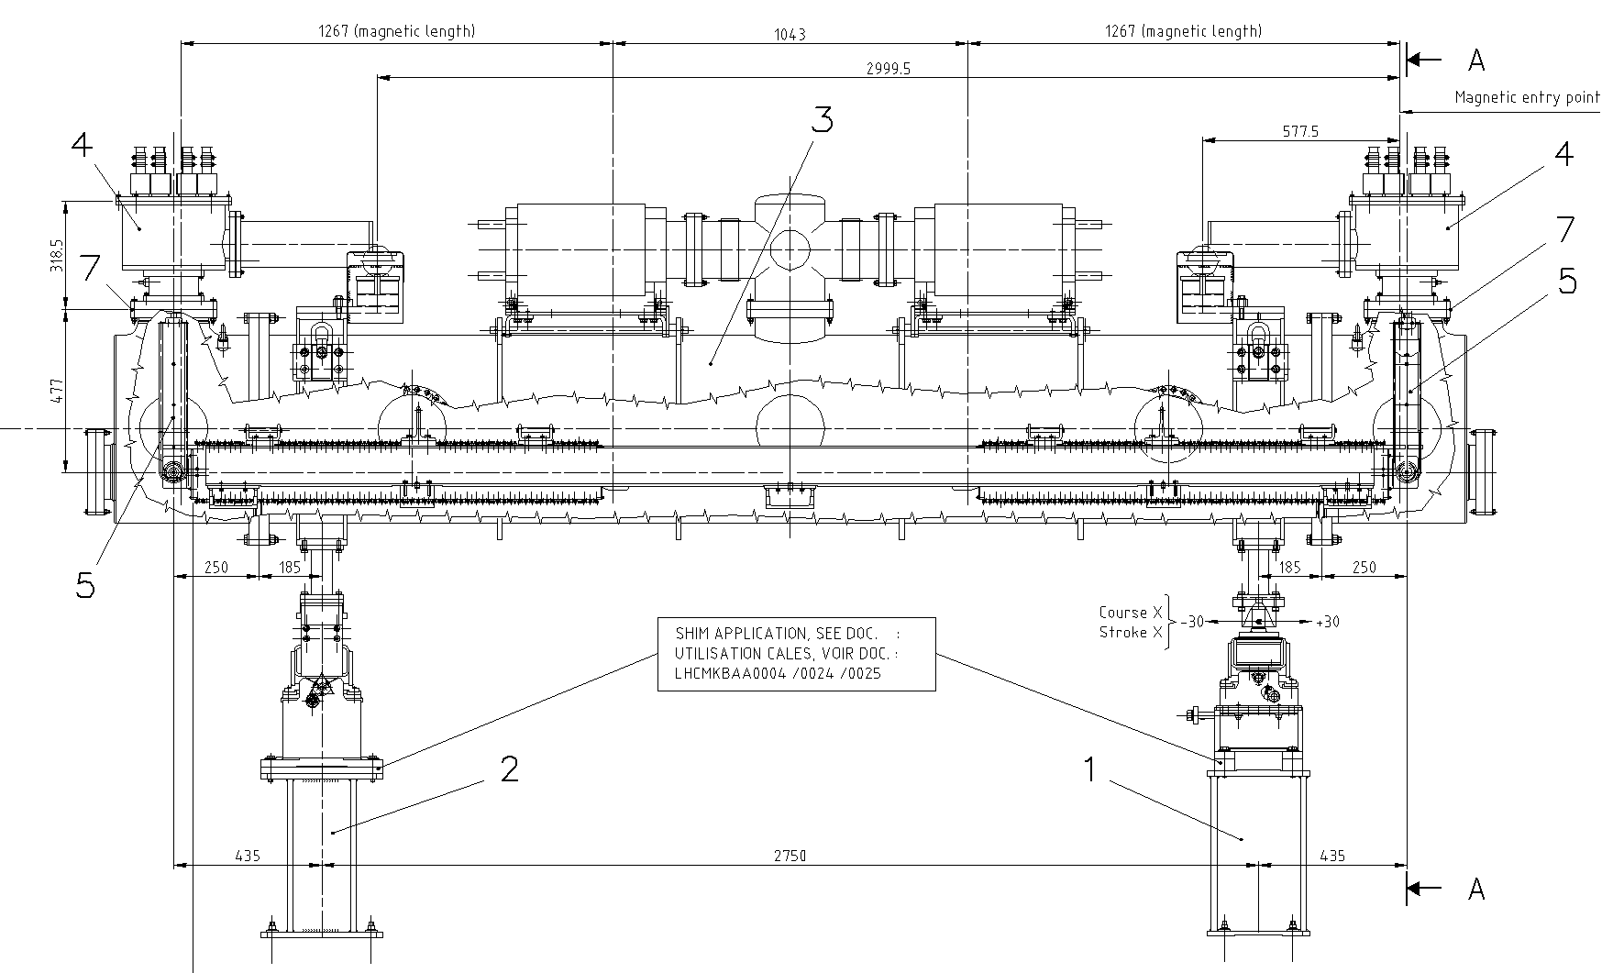
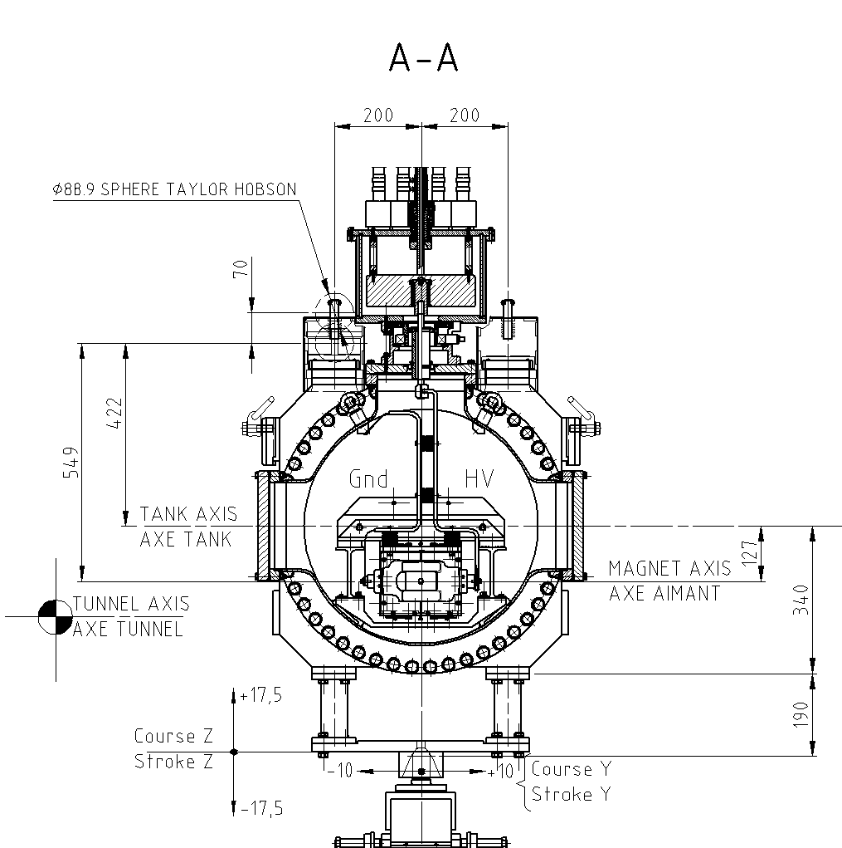
MKBV tank setup

