Slide 1
Crab Cavities - current status
Marco Spitoni
HL-LHC / Work Package 9 / Heat Load Working Group
CERN, 05/May/2020

Slide 2
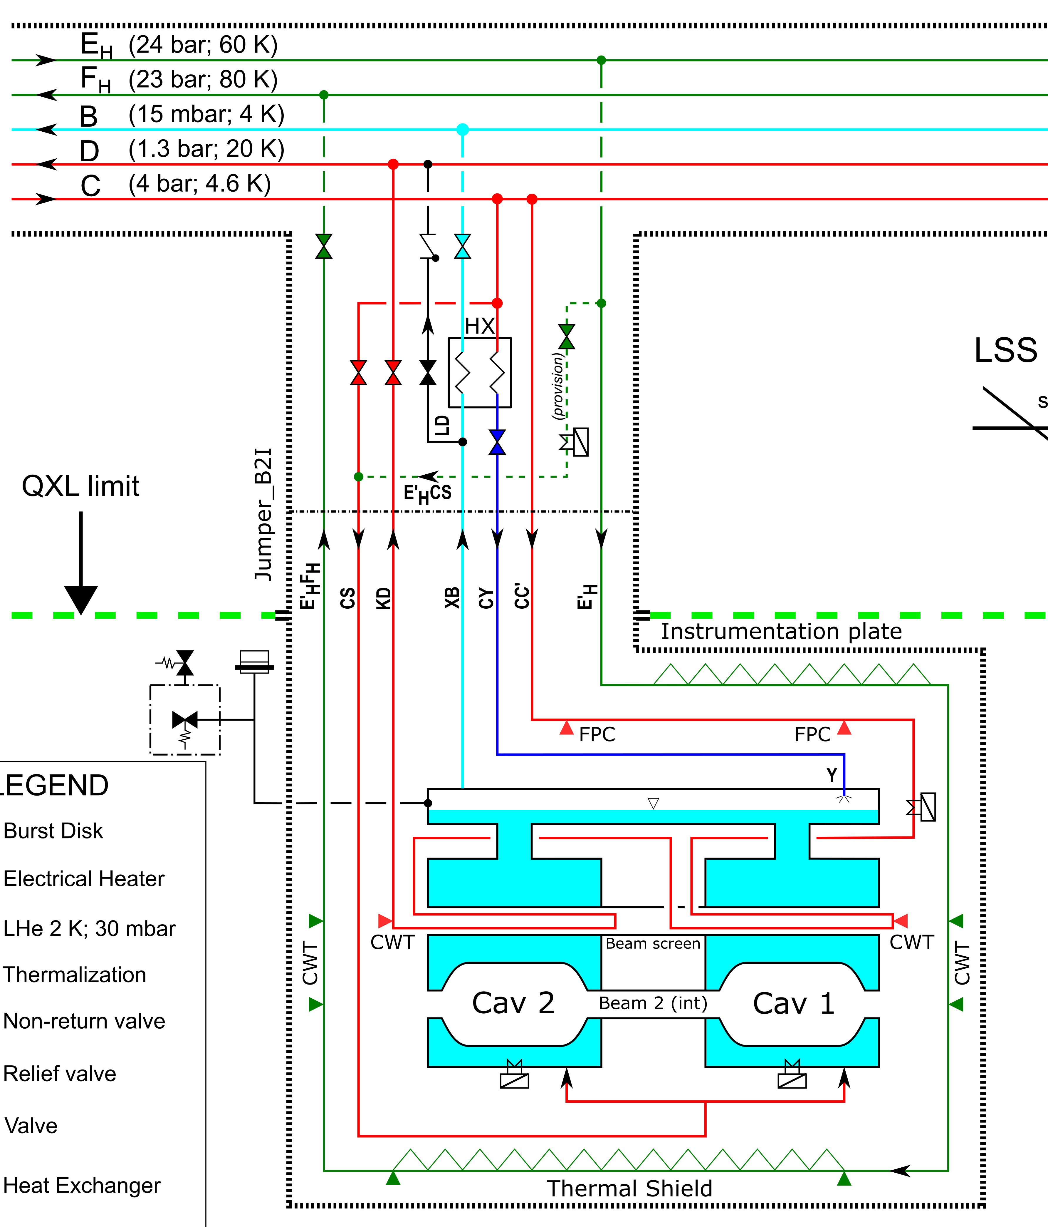
Process Flow Diagram
EDMS 2013776 v.3.1
Thermal shield (60-80 K)
Instrumentation plate
Cold to Warm Transitions thermalization
Beam screen (4.5-20 K)
Fundamental Power Coupler thermalisation
Cold to Warm Transition thermalization
Dedicated circuit for each cavity
Warm-up line (60 K)
1 g/s for warm-up to 60 K in 1-2 h
First proposal for valve size → Kv = 0.05
Protection system
CV to header D → recommended Kv = 1.5
SV to air → recommended ID 10 mm
BD to air → 100 mm for ~ 1 kg/s
He II bath at 2 K ; 30 mbar
M. Spitoni (TE-CRG) – 05/May/2020

Slide 3
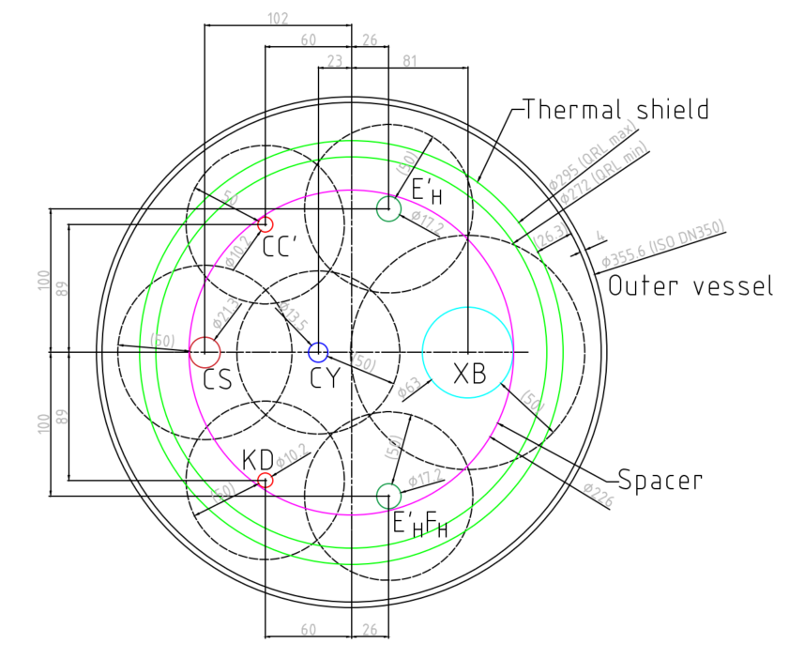
Jumper cross-section
Latest cross-section and pipes ID
Pipe name | Chosen ID (OD) [mm] | Remarks
E_{H}E’_{H} | 14 (17.2) | T.S. circuit
E’_{H}F_{H} | 14 (17.2) | T.S. circuit
CC’ | 8.2 (10.2) | B.S. circuit
KD | 8.2 (10.2) | B.S. circuit
CS | 18.1 (21.3) | Cool down/warm-up
CY | 10.3 (13.5) | Driven by HEX size
XB | 60 (63) | Pumping line
Hydraulic calculations showed no issues with proposed diameters
M. Spitoni (TE-CRG) – 05/May/2020

