Slide 1
RFD – Cryogenic Instrumentation
CRG WP9 working review #2
K. Brodzinski
with contribution from CERN Design Office: O. Capatina and T. Capelli

Slide 2
General information – production strategy
Reminder: we will have 5 DQW+5 RFD modules fabricated for LHC (8 operational and 1+1 spares).
Apart of above before series production for LHC there are 2 prototypes of CC:
1 DQW (already in SPS) – CERN fabrication
1 RFD (production starting) – Daresbury UK
Series production and instrumentation strategy:
5 RFD to be produced by TRIUMF Canada
4 DQW to be produced by Daresbury UK
1 DQW to be produced by CERN
Instrumentation strategy: 2 prototypes and 3 series modules (one module from each producer) will be fully equipped with instrumentation.
Remaining 7 series modules will be equipped with reduced instrumentation.

Slide 3
Thermometers summary table – RFD proto.
The thermometers quantity/cryomodule. Table 1 shows proposal for RFD prototype. Table 2 for HL-LHC series cryogenic needs (to be agreed with BE-RF).
Table 1:
Table 2:
Delivery dates:
First batch for one cryomodule will be needed in October 2020. The remaining part shall be available during 2021 (9 cryomodules to be fabricated 4+1 DQW and 4 RFD with 1 proto as a spare).
Remarks:
Installation definition for specific TTs is under definition (screwed or glued), required cable length will be 4 m.
Detailed specification of instrumentation will be sent in May 2020 at latest.
In KB opinion a few PT100 are missing to cover monitoring+interlock on tuners and blades (installed in air).
K. Brodzinski 28.01.2020_Instrum. review #1

Slide 4
Thermometers summary table – RFD proto.
Full version (per module):
28 cernox is confirmed (27 channels,1 redundant TT included)
8 for regulation (7 channels needed, 1 redundant TT included)
19 for monitoring
At least 4 cernox are to be precisely calibrated (LHe and BS)
21 PT100 is confirmed (19 channels, 4 redundant TTs included)
16 for regulation (12 channels, 4 redundant TTs included)
5 for monitoring
Reduced series version (per module):
13 cernox is confirmed (12 channels,1 redundant TT included)
8 for regulation (7 channels needed, 1 redundant TT included)
5 for monitoring
At least 4 cernox are to be precisely calibrated (LHe and BS)
16 PT100 is confirmed (12 channels, 4 redundant TTs included)
16 for regulation (12 channels, 4 redundant TTs included)

Slide 5
Sum calculation for TTs
Full version:
28 cernox * 4 modules = 112
(16 of 112 precisely calibrated)
21 PT100 * 4 modules = 84
Total:
Cernox: 112 + 91 = 203
(16 of 203 precisely calibrated)
PT100: 84 + 112 = 196
Reduced series version:
13 cernox * 7 modules = 91
16 PT100 * 7 modules = 112
Delivery dates:
First batch for one cryomodule will be needed in October 2020. The remaining part shall be available during 2021.

Slide 6
Next steps
Definition of installation method with CERN design office (May 2020)
Preparation of PIDs for full and reduced versions (to be started asap by CRG)
Filling of request to CI – “big table of Juan” (~June 2020)
Review of installation method with CRG-CI (~June 2020)
Delivery of first batch to Daresbury in October 2020
Visit to Daresbury for installation training end of 2020/ beginning of 2021
Remaining deliveries and trainings in 2021
SM18 test of RFD proto in Seprember 2021 (com. channels to be ready)

Slide 7
Back up slides

Slide 8
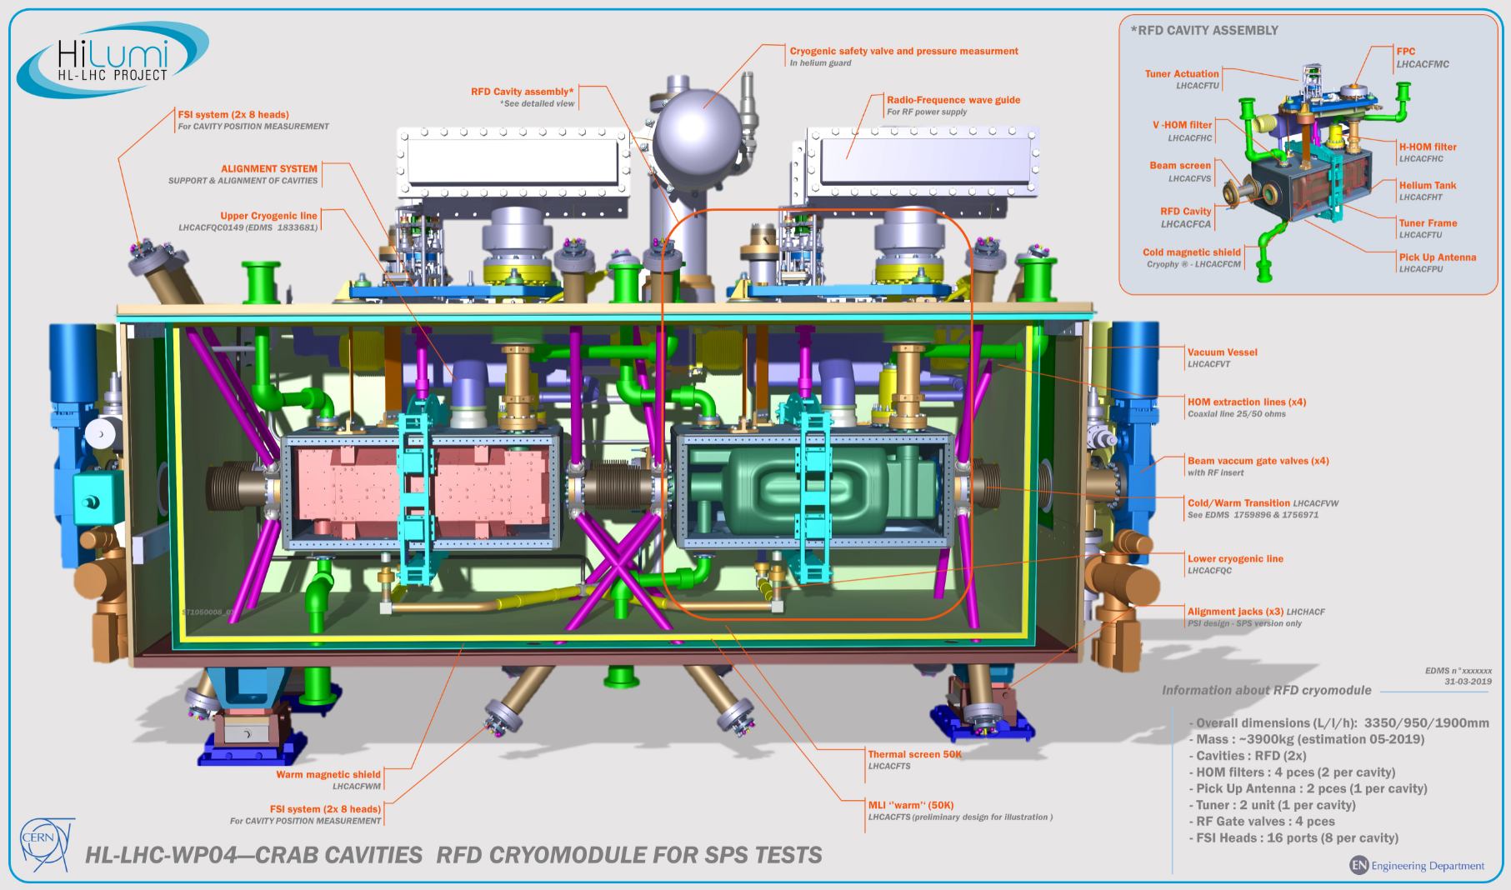
Cryomodule preview
Cavity #1
Cavity #2

Slide 9
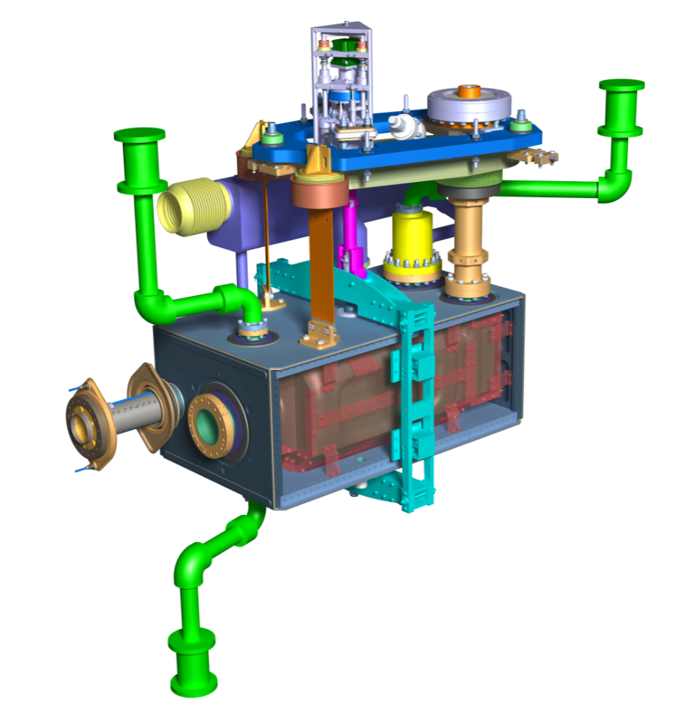
Cavity Layout
Tuner Actuation
Cavity alignment
Cryogenic biphase line
HOM extraction lines
Coaxial line 25 ohms LHCACFRL
Right support blade
FPC outer pipe
Fundamental Power Coupler
Left support blade
V-HOM suppressor
H-HOM Suppressor
Beam screen
Tuner Frame
LHCACFTU
Pick Up Antenna

Slide 10
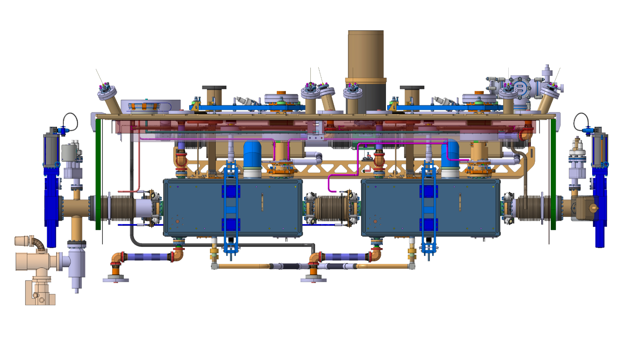
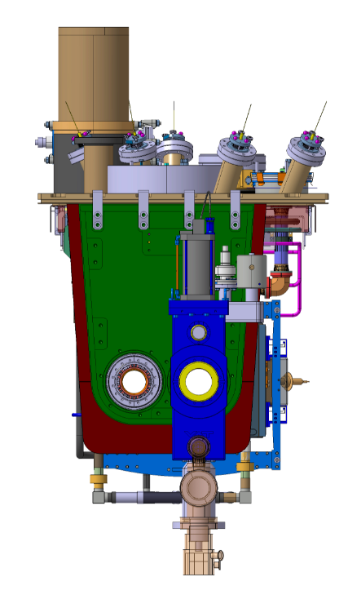
Instrumentation layout
Cryomodule internal dimensions
Distances in the cryomodule for informations
Position of instrumentation feedthrough
565 mm
1180 mm
760 mm
880 mm

Slide 11
Table of instrumentation Page 1/2
# ref | Type | Location | Temp (K) | Range of Measurment | Connexion | Time of assembly
#010 | cernox | Helium tank 1- bottom in liquid He | 2 K | 300 – 1.5 K | Inside liquid He glued on level gauge | Operation Lhe temperature (calibrated, tol. 5 mK at cold)
#020 | cernox | Helium tank 1-middle height | 2 K | 300 – 1.5 K | Bolted with copper support | Cool down speed regulation, tol. 2 K at warm
#030 | cernox | Helium tank 1 top | 2 K | 300 – 1.5 K | Bolted with copper support | Cool down speed regulation, tol, 2 K at warm
#040 | cernox | Helium tank 2 – bottom in liquid He | 2 K | 300 – 1.5 K | Inside liquid He glued on level gauge | Operation Lhe temperature (calibrated, tol 5 mK at cold)
#050 | cernox | Helium tank 2 – middle height | 2 K | 300 – 1.5 K | Bolted with copper support | Cool down speed regulation, tol. 2 K at warm
#060 | cernox | Helium tank 2 – top | 2 K | 300 – 1.5 K | Bolted with copper support | Cool down speed regulation, tol. 2 K at warm
#070 | PT100 | H-HOM cavity 1 coaxial line “warm” | 150 K | 300 – 100 K | Glued on Ø41mm | RF requested – monitoring
#080 | cernox | H-HOM cavity 1 coaxial line “thermalisation 50K” | 70 K | 300 – 40 K | Glued on Ø41mm | RF requested - monitoring
#090 | cernox | H-HOM cavity 1 coaxial line “Thermalisation 20K” | 30 K | 300 – 10 K | Glued on Ø41mm | RF requested - monitoring
#100 | cernox | H-HOM CF35 "Feedthrough" on HOM FT flange Cav 1 | ~4 K | 300 – 3 K | Collar monted on CF40 FLANGE | RF requested - monitoring
#110 | cernox | H-HOM CF100 "cavity" on cavity 1 HOM flange | 2 K | 300 – 1.5 K | Collar monted on CF100 FLANGE | RF requested - monitoring
#120 | cernox | H-HOM CF35 "Feedthrough" on HOM FT flange Cav 2 | ~4 K | 300 – 3 K | Collar monted on CF40 FLANGE | RF requested - monitoring
#130 | cernox | H-HOM CF100 "cavity" on cavity 2 HOM flange | 2 K | 300 – 1.5 K | Collar monted on CF100 FLANGE | RF requested - monitoring
#140 | PT100 | V-HOM cavity 1 coaxial line “warm” | 150 K | 300 – 100 K | Glued on Ø41mm | RF requested - monitoring
#150 | cernox | V-HOM cavity 1 coaxial line “thermalisation 50K” | 2 K | 300 – 1.5 K | Glued on Ø41mm | RF requested - monitoring
#160 | cernox | V-HOM cavity 1 coaxial line “thermalisation 20K” | 2 K | 300 – 1.5 K | Glued on Ø41mm | RF requested - monitoring
#170 | cernox | VHOMS CF40 "cavity" on cavity 1 flange | 2 K | 300 – 1.5 K | Collar monted on CF FLANGE (same that therm) | RF requested - monitoring
#180 | cernox | VHOMS CF40 "cavity" on cavity 2 flange | 2 K | 300 – 1.5 K | Collar monted on CF FLANGE (same that therm) | RF requested - monitoring
#190 | cernox | Pick up antenna cav. 1 - Antenna flange | 2 K | 300 – 3 K | Collar monted on CF40 FLANGE | RF requested - monitoring
#200 | cernox | Pick up antenna cav. 2 - Antenna flange | 2 K | 300 – 3 K | Collar monted on CF40 FLANGE | RF requested - monitoring
#210 | PT100 | FPC "warm" cavity 1 | 300 K external | 300 – 220 K | Collar to be designed | RF requested – monitoring – EH regulation
#220 | cernox | FPC "Thermalization 50K" cavity 1 | 70 K | 300 – 40 K | Collar to be designed | RF requested – monitoring – cryo interested
#230 | cernox | FPC "Thermalization 20K" cavity 1 | 50 K | 300 – 30 K | Collar to be designed | RF requested – monitoring – cryo interested
#240 | cernox | FPC "cavity" cavity 1 (Flange of FPC pipe)) | 4 K | 300 – 2 K | Collar monted on CF63 FLANGE | RF requested – monitoring – cryo interested
#250 | PT100 | FPC "warm" cavity 2 | 300 K external | 300 – 220 K | Glued on pipe | RF requested – monitoring – EH regulation
#260 | cernox | FPC "Thermalization 50K" cavity 2 | 70 K | 300 – 40 K | Glued on pipe | RF requested – monitoring – cryo interested
#270 | cernox | FPC "Thermalization 20K" cavity 2 | 50 K | 300 – 30 K | Glued on pipe | RF requested – monitoring – cryo interested
#280 | cernox | FPC "cavity" cavity 2 (Flange of FPC pipe)) | 4 K | 300 – 2 K | Collar monted on CF63 FLANGE | RF requested – monitoring – cryo interested
#290 | PT100 flex | CW cavity 1 crab line "Thermalisation 50K" | 70K |  | Bolted on screen ? To be checked | RF requested - monitoring
#300 | cernox | CW cavity 1 crab line "C COLD" - on chamber flange | 10K |  | Collar to be designed | RF requested - monitoring
#310 | cernox | CW cavity 1 beam screen "BS COLD" - on chamber flange | 20K |  | Collar to be designed | BS regulation (calibrated, tol. 0.1 K at cold)
#320 | PT100 flex | CW cavity 2 crab line "Thermalisation 50K" | 70K |  | Bolted on screen ? To be checked | RF requested - monitoring
#330 | cernox | CW cavity 2 crab line "COLD" - on chamber flange | 10K |  | Collar to be designed | BS regulation (calibrated, tol. 0.1 K at cold)
#340 | cernox | CW cavity 2 beam screen "BS COLD" - on chamber flange | 20K |  | Collar to be designed | RF requested - monitoring

Slide 12
Table of instrumentation Page 2/2
# ref | Type | Location | Temp (K) | Range of Measurment | Connexion | Time of assembly
#350 | Pressure trans. | Safety port | 30 mbara | 2 bara – 10 mbara | Installed in Helium guard
#360 | Level gauge | Helium tank 1 | 2 K (30 mbara) | 0 – 100% | RFD L= ??
#370 | Level gauge | Helium tank 2 | 2 K (30 mbara) | 0 – 100% | RFD L= ??
#380 | Resistive glued printed foil | Helium tank 1 | 4.5 K | 100 W | Max 160x250 mm
#390 | Resistive glued printed foil | Helium tank 2 | 4.5 K | 100 W | Max 160x250 mm
#400 | Cartridge x4 | FPC flange cavity 1 | ~250-300 K | 75 W | Diam 6.5 mm, length 23 mm
#410 | Cartridge x4 | FPC flange cavity 2 | ~250-300 K | 75 W | Diam 6.5 mm, length 23 mm
#420 | Cartridge | Level port cavity 1 | ~250-300 K | 75 W | Diam 6.5 mm, length 23 mm
#430 | Cartridge | Level port cavity 2 | ~250-300 K | 75 W | Diam 6.5 mm, length 23 mm
#440 | Cartridge | TUNER cavity 1 | ~250-300 K | 75 W | Diam 6.5 mm, length 23 mm
#450 | Cartridge | TUNER cavity 2 | ~250-300 K | 75 W | Diam 6.5 mm, length 23 mm
#460 | Cartridge | BLADE left cavity 1 | ~250-300 K | 75 W | Diam 6.5 mm, length 23 mm
#470 | Cartridge | BLADE right cavity 1 | ~250-300 K | 75 W | Diam 6.5 mm, length 23 mm
#480 | Cartridge | BLADE left cavity 2 | ~250-300 K | 75 W | Diam 6.5 mm, length 23 mm
#490 | Cartridge | BLADE right cavity 2 | ~250-300 K | 75 W | Diam 6.5 mm, length 23 mm
#500 | Cartridge x2 | Crab line CW cavity 1 | ~250-300 K | 75 W | Diam 6.5 mm, length 23 mm
#510 | Cartridge x2 | Second line CW cavity 1 | ~250-300 K | 75 W | Diam 6.5 mm, length 23 mm
#520 | Cartridge x2 | Crab line CW cavity 2 | ~250-300 K | 75 W | Diam 6.5 mm, length 23 mm
#530 | Cartridge x2 | Second line CW cavity 2 | ~250-300 K | 75 W | Diam 6.5 mm, length 23 mm
#550 | Cartridge x2 | Safety port | ~250-300 K | 75 W | Diam 6.5 mm, length 23 mm
#560 | Cartridge x2 | RF feedthrough coax H-HOM cavity 1 | ~250-300 K | 75 W | Diam 6.5 mm, length 23 mm
#570 | Cartridge x2 | RF feedthrough coax V-HOM cavity 1 | ~250-300 K | 75 W | Diam 6.5 mm, length 23 mm
#580 | Cartridge x2 | RF feedthrough coax Antenna cavity 1 | ~250-300 K | 75 W | Diam 6.5 mm, length 23 mm
#590 | Cartridge x2 | RF feedthrough coax H-HOM cavity 2 | ~250-300 K | 75 W | Diam 6.5 mm, length 23 mm
#600 | Cartridge x2 | RF feedthrough coax V-HOM cavity 2 | ~250-300 K | 75 W | Diam 6.5 mm, length 23 mm
#610 | Cartridge x2 | RF feedthrough coax Antenna cavity 2 | ~250-300 K | 75 W | Diam 6.5 mm, length 23 mm
#620 | Cartridge rotfil | Beam screen cooling circuit entre FPC et BS | 5-60K |  | See drawing
#630 | Thermocouple J | Inside heating cartrige #460 |  |  | in cartridge
#640 | Strain gauge | Blade left cavity 1 |  |  | Glued on blade
#650 | Strain gauge | Blade right cavity 1 |  |  | Glued on blade
#660 | Strain gauge | Blade left cavity 2 |  |  | Glued on blade
#670 | Strain gauge | Blade right cavity 2 |  |  | Glued on blade
#680 | Strain gauge | FPC outer pipe cavity 1 |  |  | Glued on blade
#690 | Strain gauge | FPC outer pipe cavity 2 |  |  | Glued on blade

Slide 13
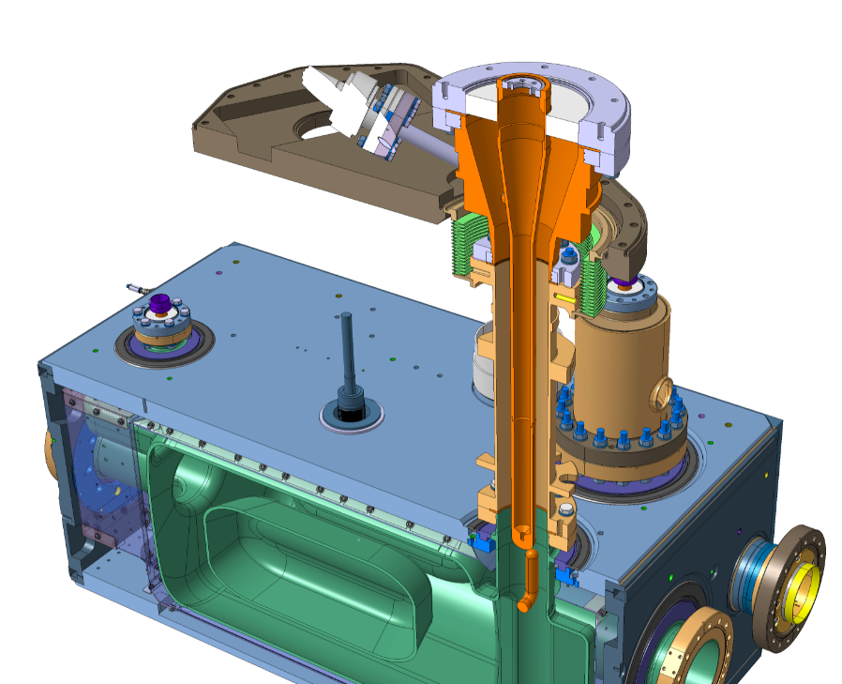
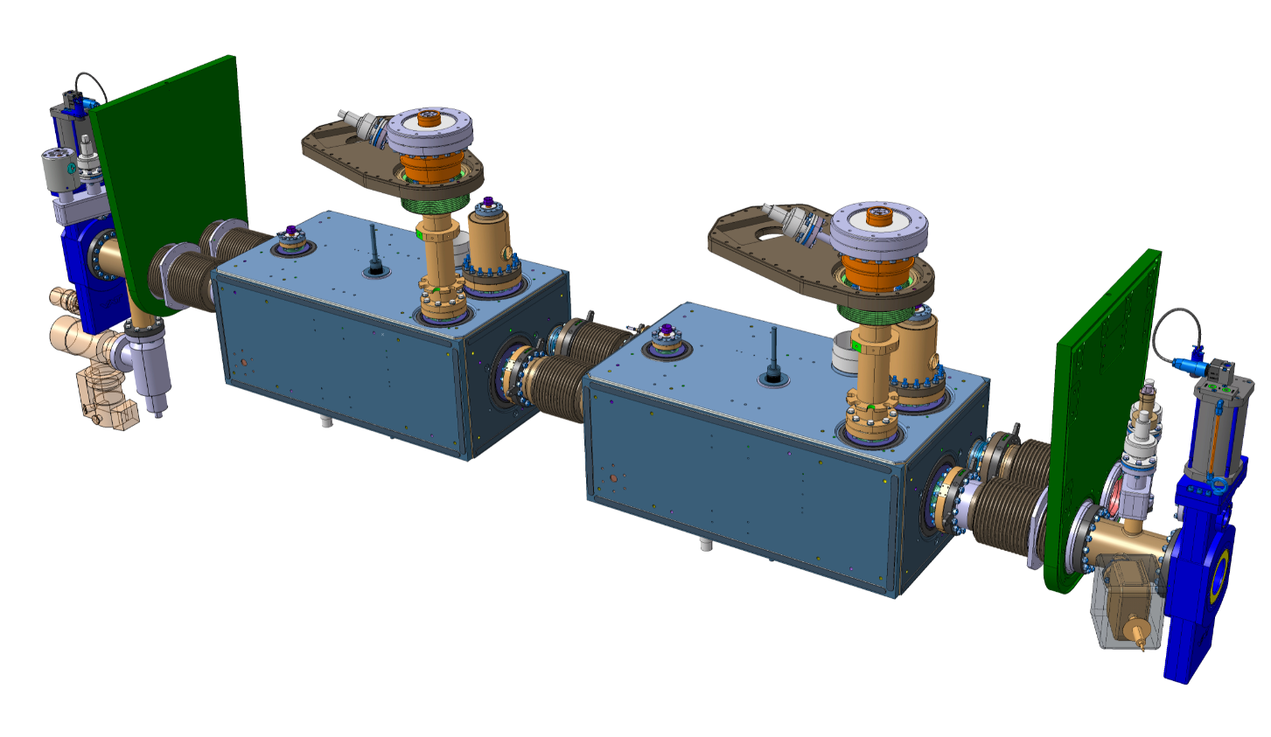
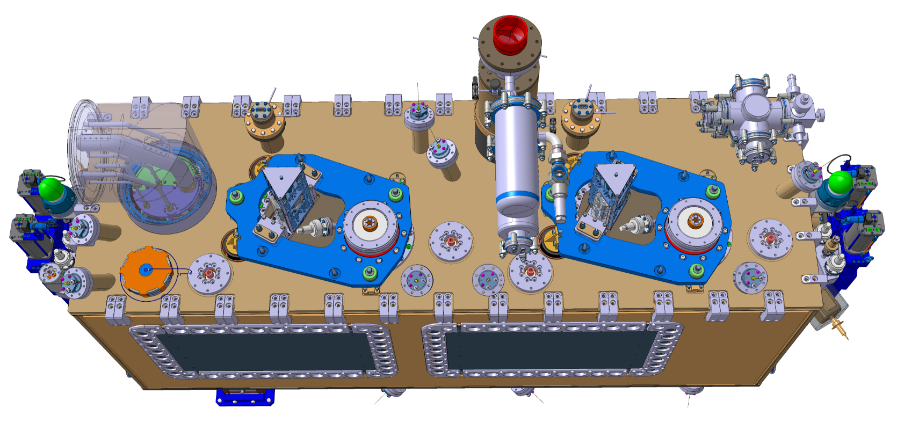
Instrumentation layout
HEATERS 1/7
FPC HEATERS (8x – 4/FPC)
Ø6.5mm – L25mm – 75W
Installed ouside of the cryomodule
Location
Heating cartridge (x4/FPC – 8 in total)
Cavity 1
Cavity 2
(Installed during step 1 of assembly sequence)
Labels : #400 & #410
Distance on the top plate :
880 mm
1180 mm
460 mm

Slide 14
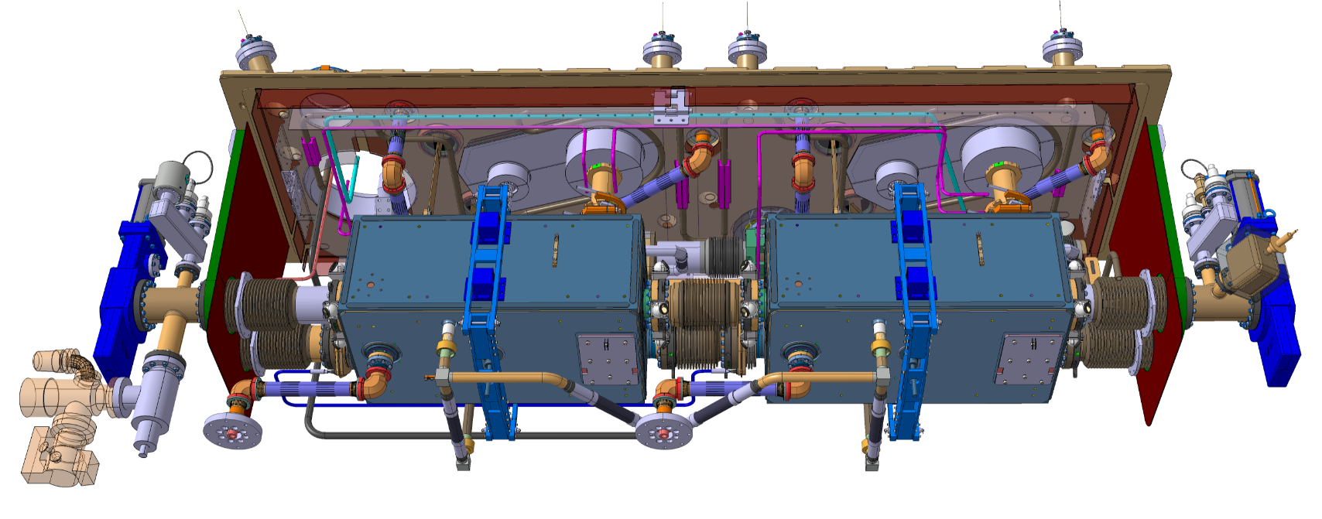
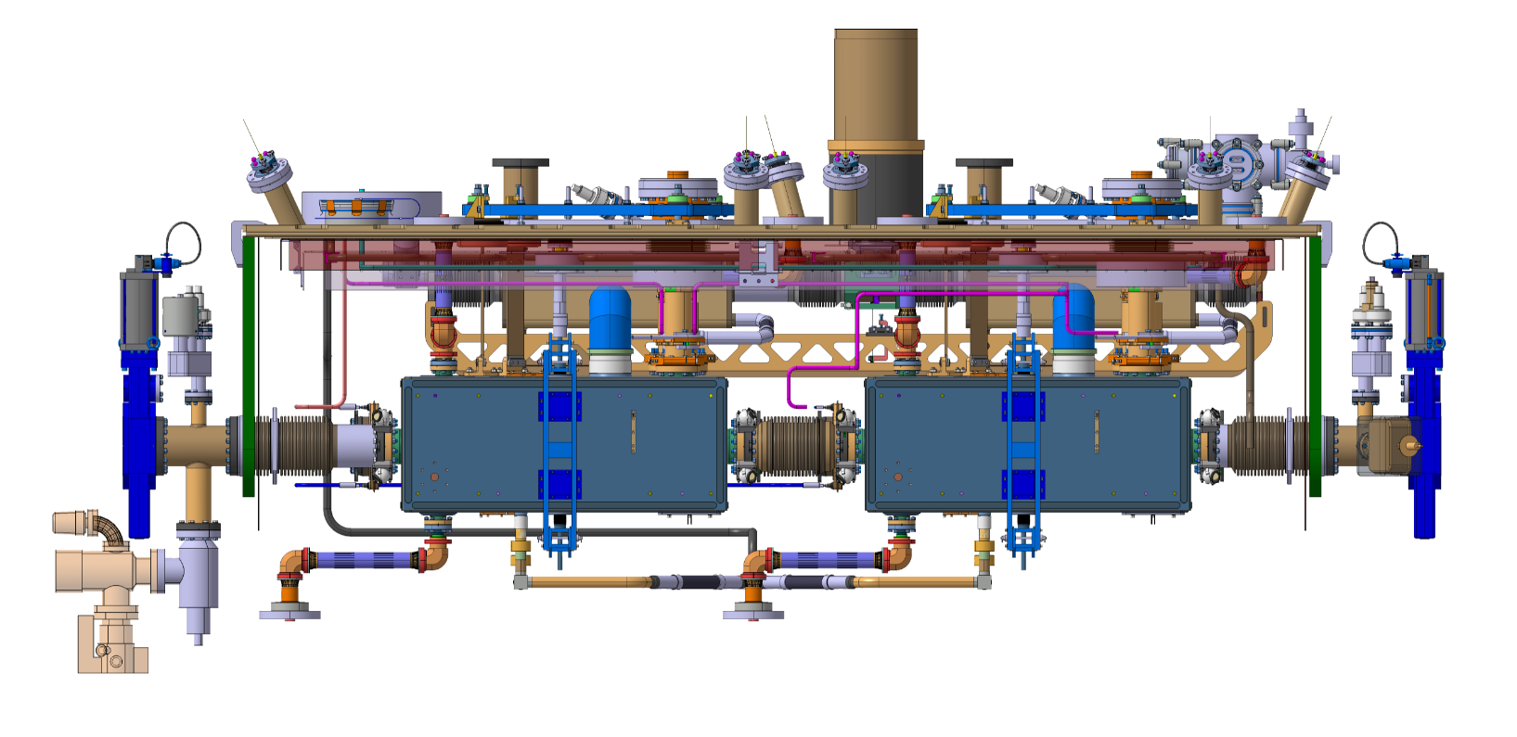
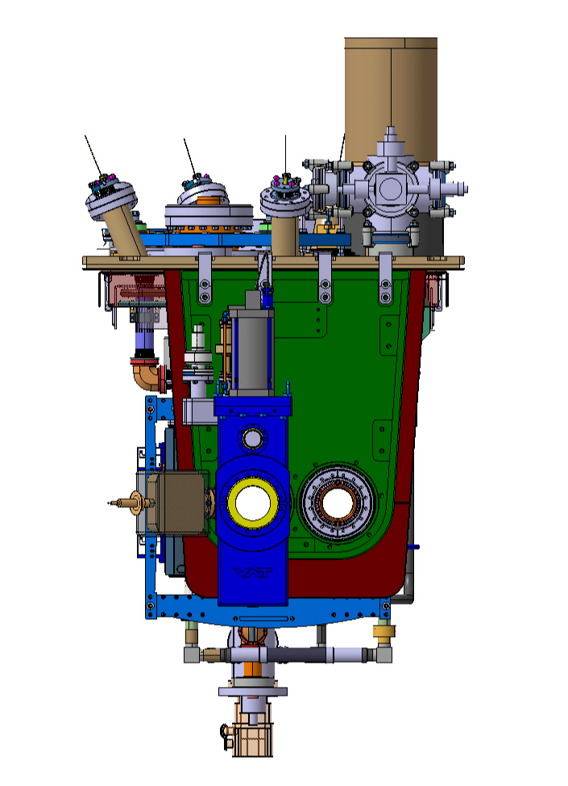
Instrumentation layout
HEATERS 2/7
Helium tank HEATERS (2x – 1/Cavity)
Location
Resistive glued printed foil
100W
#380
#390
Installed during step xx of assembly sequence
Labels : #380 & #390
Distances in the cryomodule
750 mm
1180 mm
435 mm
450 mm

Slide 15
Instrumentation layout
HEATERS 3/7
Tuner HEATERS (2x – 1/Tuner)
Location and distances
Heating cartridge (x1/Tuner – 2 in total)
Ø6.5mm – L25mm – 75W
Installed ouside of the cryomodule
880 mm
#440
#450
1180 mm
760 mm
Installed during step xx of assembly sequence
Labels : #440 & #450

Slide 16
Instrumentation layout
HEATERS 4/7
Blade HEATERS (4x – 1/Blade)
Location and distances
Heating cartridge (x1/blades – 4 in total)
Ø6.5mm – L25mm – 75W
Installed ouside of the cryomodule
#470
#490
880 mm
#460
#480
1180 mm
960 mm
Installed during step xx of assembly sequence
Labels : #460, #470, #480 & #490

Slide 17
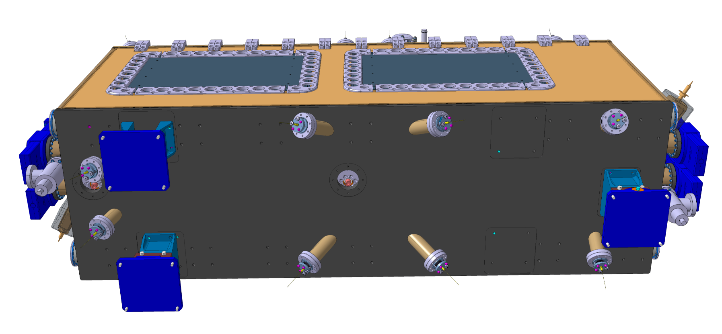
Instrumentation layout
HEATERS 5/7
RF coaxial feedthrough HEATERS (6x – 1/line)
Location and distances
Heating cartridge (x1/FT – 6 in total)
Ø6.5mm – L25mm – 75W
Installed ouside of the cryomodule
880 mm
#560
#590
#570
#600
890 mm
890 mm
290 mm
165 mm
Installed during step xx of assembly sequence
Labels : xx
#580
#610
1180 mm
1450 mm

Slide 18
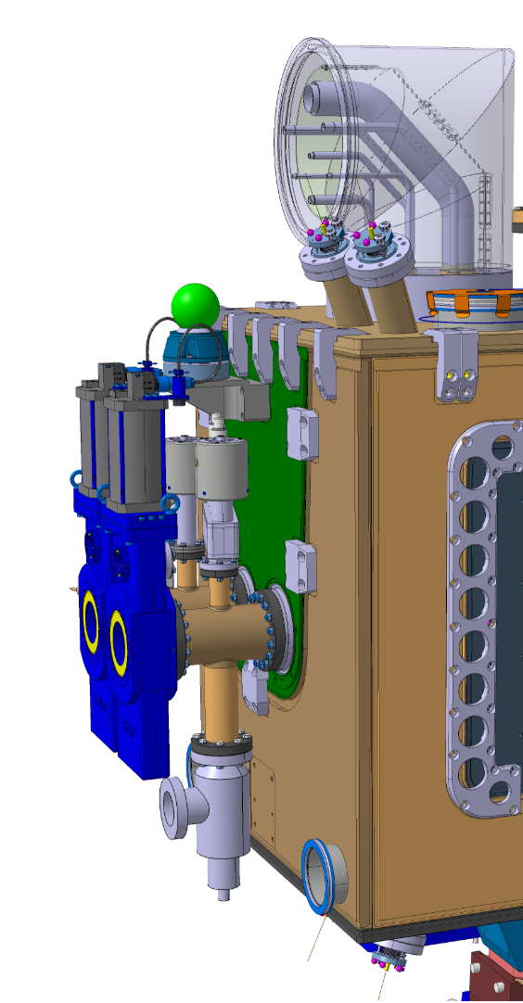
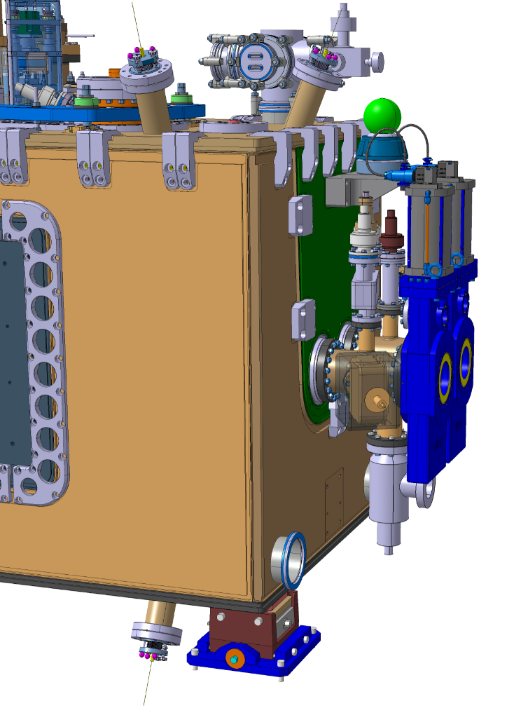
Instrumentation layout
HEATERS 6/7
Cold warm transition HEATERS (8x – 2/line)
Location and distances
Labels : To be defined
Heating cartridge (x2/flange – 6 in total)
Ø6.5mm – L25mm – 75W
Installed ouside of the cryomodule
565 mm
#510
#530
#500
#520
Installed during step xx of assembly sequence

Slide 19
Instrumentation layout
HEATERS 7/7
Cryo ports HEATERS (4x)
Location and distances
Heating cartridge (safety port - 2/port)
Ø6.5mm – L25mm – 75W
Installed ouside of the cryomodule
Heating cartridge (level gauges port -1/port)
Ø6.5mm – L25mm – 75W
Installed ouside of the cryomodule
#550
#420
#430
880 mm
900 mm
860 mm
Installed during step xx of assembly sequence
280 mm
Labels : To be defined

Slide 20
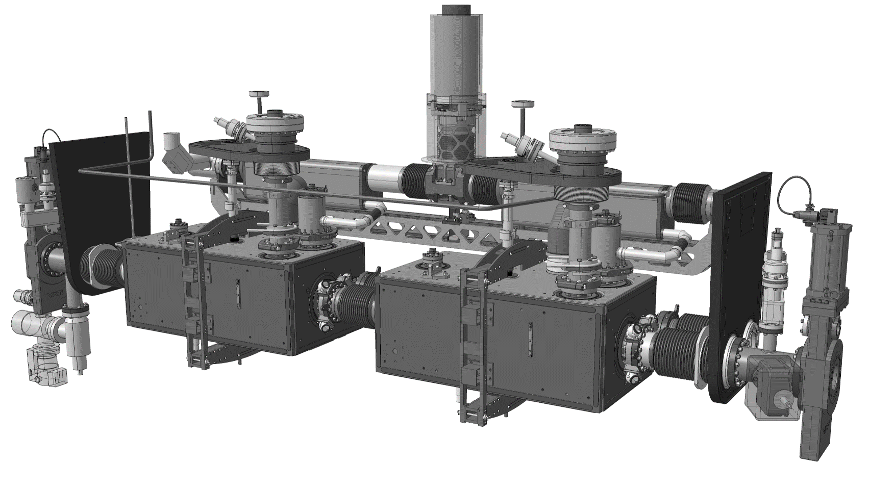
Instrumentation layout
Temperature sensors 1/4
#210
#100
#220
#110
#250
#230
#260
#240
#270
#170
#280
#120
#130
#030
#180
#020
#060
Installed during step xx of assembly sequence
#050

Slide 21
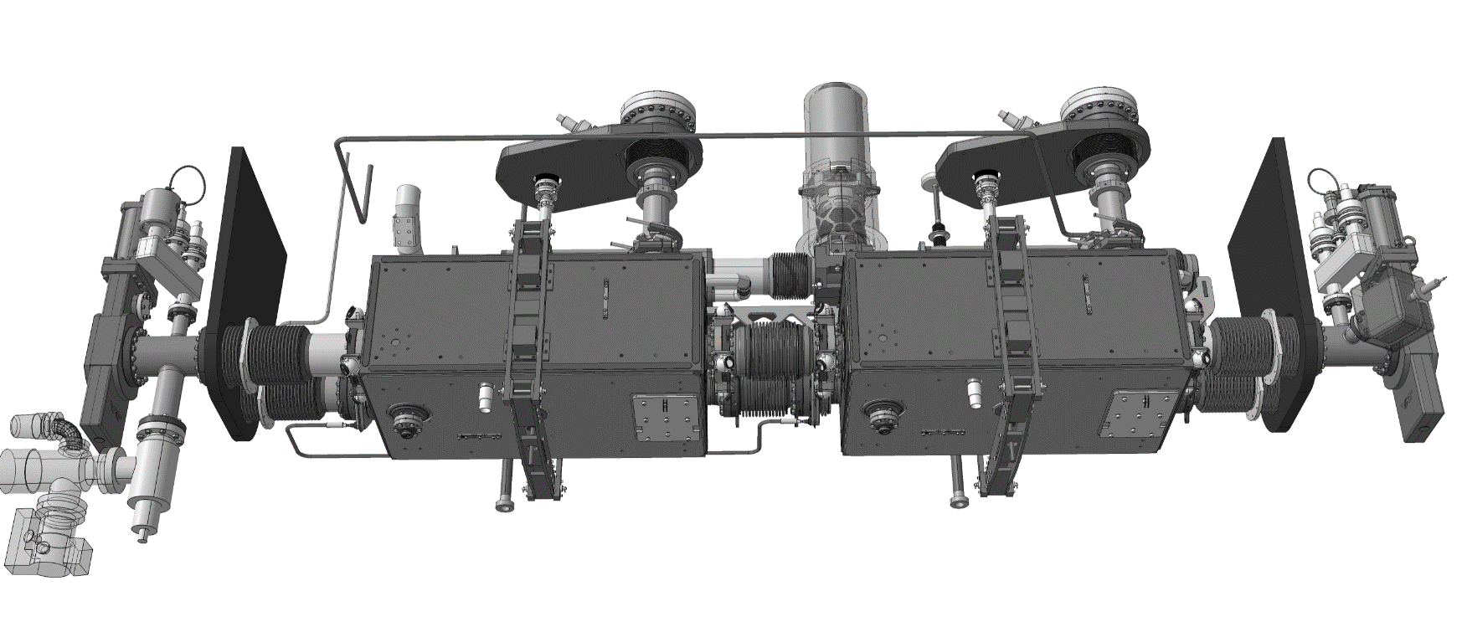

Instrumentation layout
Temperature sensors 2/4
#190
#200
#300
#310
#010
#040
#330
#340
Installed during step xx of assembly sequence

Slide 22
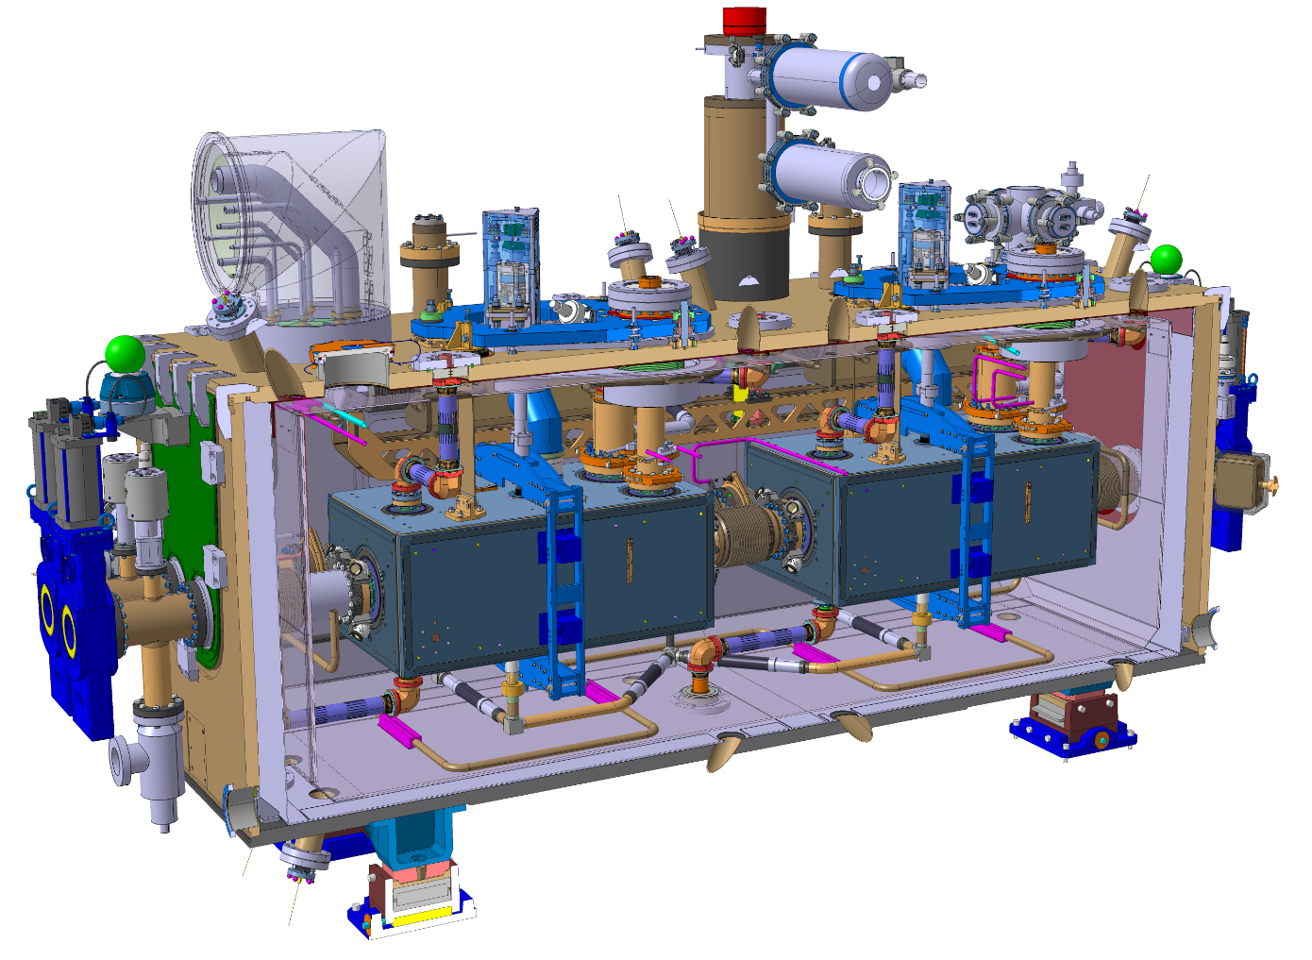
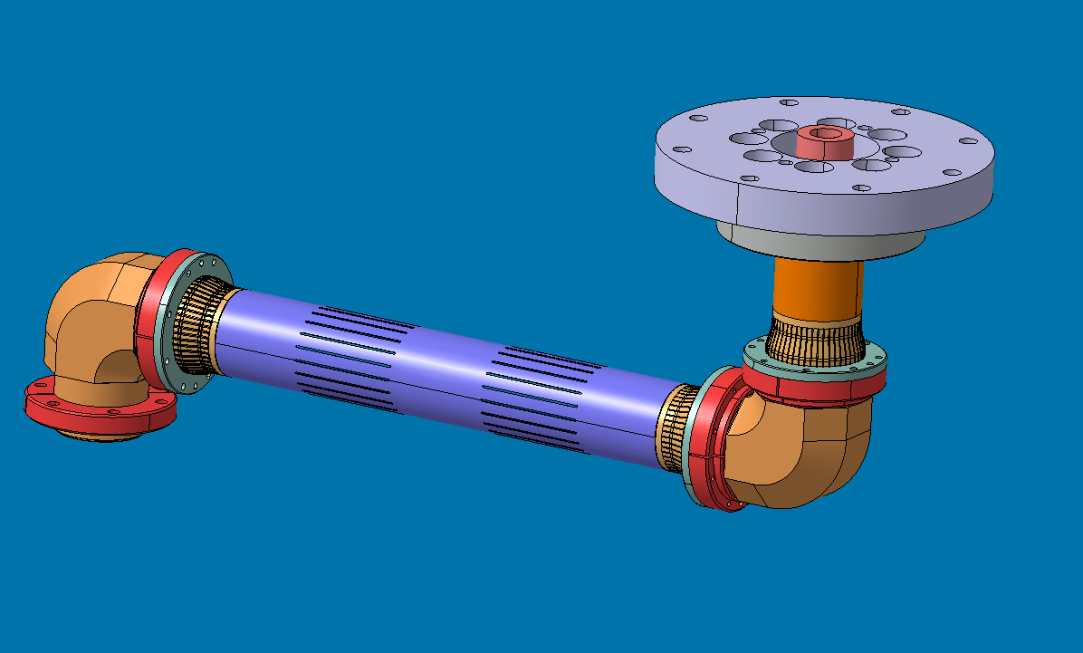
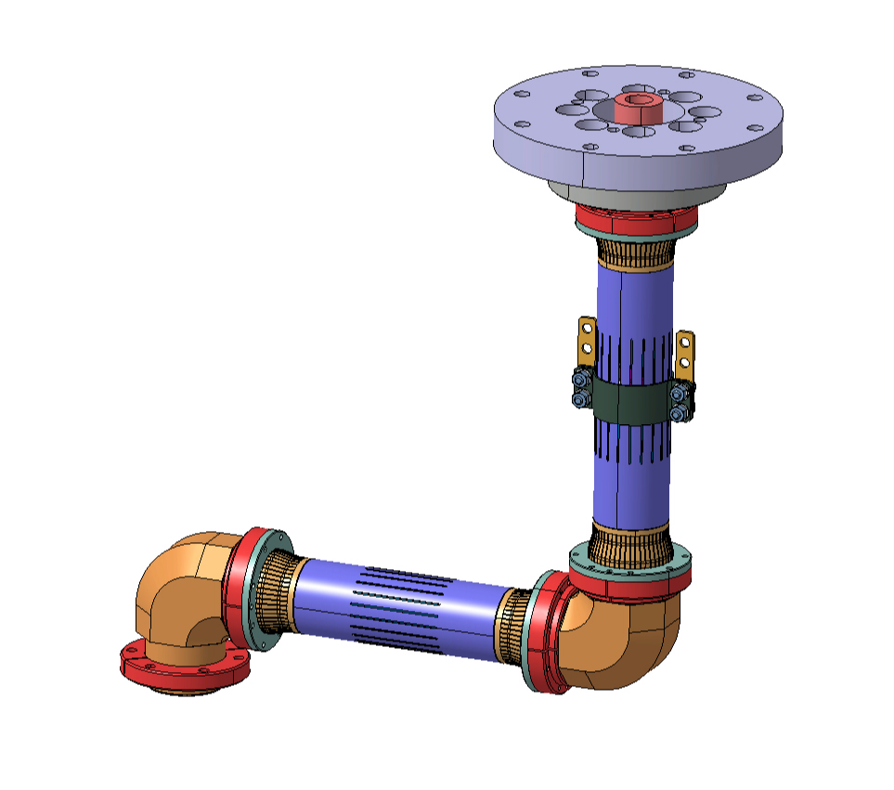
Instrumentation layout
Temperature sensors 3/4
H-HOMS coaxial line cavity 1
Line to be reviewed !!!!! Just for illustration
#090
#080
#070
V-HOMS coaxial line cavity 1
Line to be reviewed !!!!! Just for illustration
#140
#160
#150
Installed during step xx of assembly sequence

Slide 23
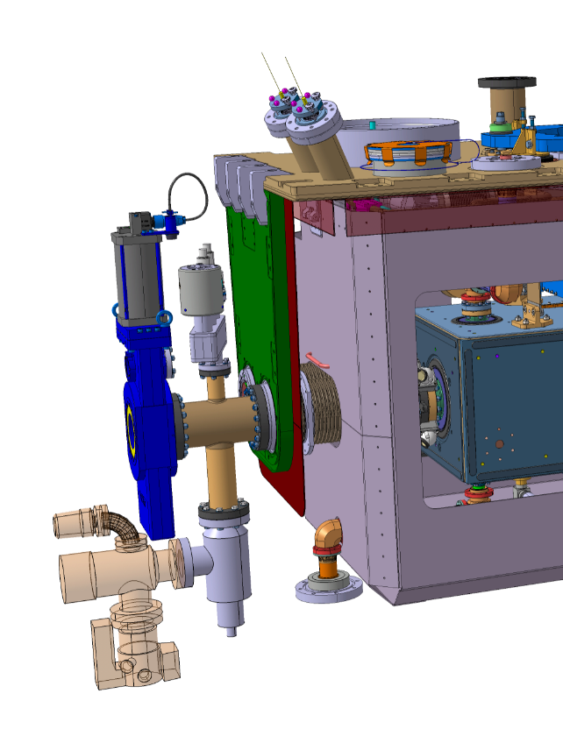
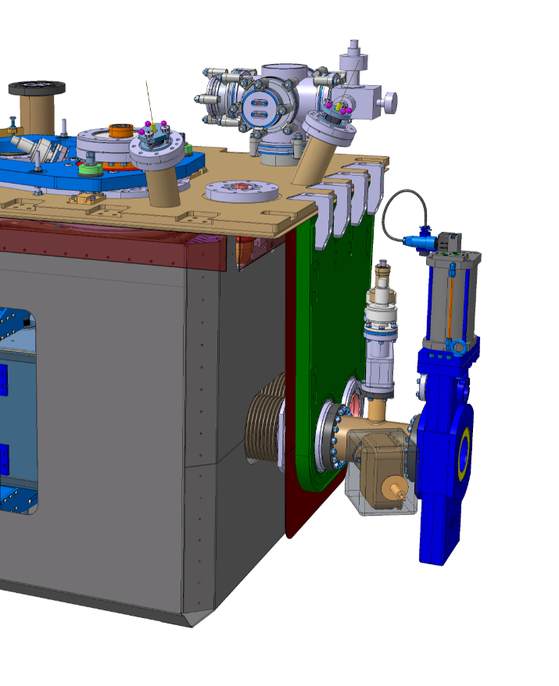
Instrumentation layout
Temperature sensors 4/4
#320
#290
Installed during step xx of assembly sequence

Slide 24
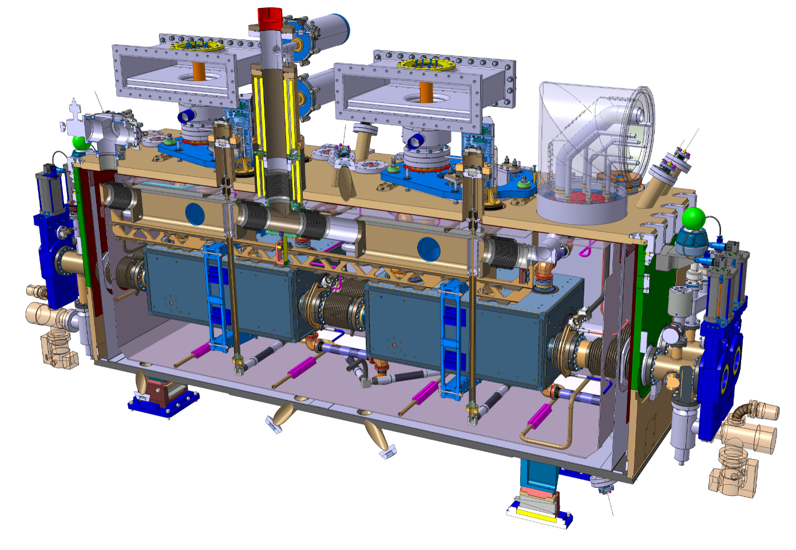
Level gauges
Level gauges - 1/port
AMI Helium Level Sensor
Sensor Diameter : 1/4"
Active Length : 30"
Overall Length : 31"
Supplier : American Magnetics Inc.
Reference : HS-1/4-RGD-30/31in-4LdCp-LL6-S
#370
#360
Installed during step xx of assembly sequence

Slide 25
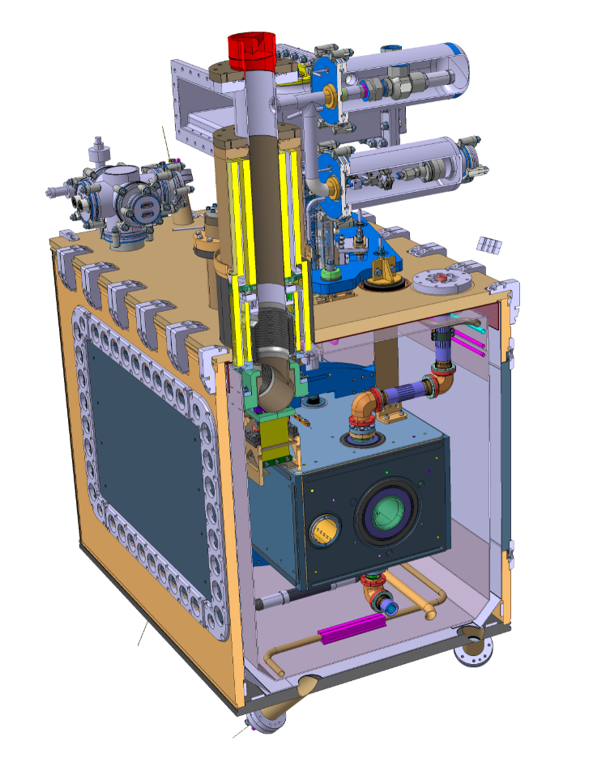
Pressure transmitter
Gauge Pressure Transmitter
266GST (NPT MALE) ABB - Dismantled
Gauge 266GST, version male threaded NPT 1/2
Supplier : ABB
Reference : 266GST (NPT Male)
#350
Installed during step xx of assembly sequence

Slide 26


