Slide 1
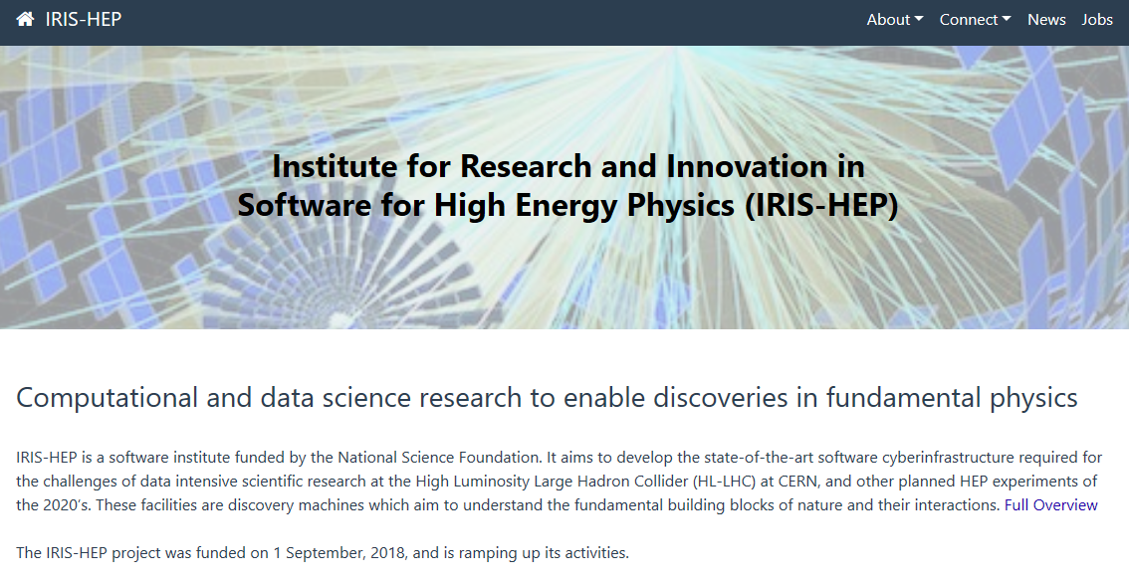

Slide 2


IRIS-HEP Steering Board
Meeting #7
G. Watts
For the IRIS-HEP Executive Board
2020-09-08
“The IRIS-HEP Steering Board represents the Institute’s stakeholders to provide, to the Executive Board, the stakeholder’s input on the priorities, execution, and strategy of the Institute.”

Slide 3
Thank You
Danilo Piparo (CERN)
CMS
Oliver Gutsche (FNAL)
US CMS Ops Program
Patrick Koppenburg (NIKHEF)
LHCb
Paolo Calafiura (LBNL)
US ATLAS Ops Program
Simone Campana (CERN)
WLCG
Graeme Stewart (CERN)
HSF
James Catmore
ATLAS
Ken Bloom (U. Nebraska-Lincoln)
The OSG Council

Slide 4
Welcome
steering-board@iris-hep.org
(you)
exec-board@iris-hep.org
(us)

Slide 5
Next Meeting Dates
November 24, 2020
Feb 16, 2021
Early in the new year will fill out 2021 meeting dates after the HSF community calendar is updated

Slide 6
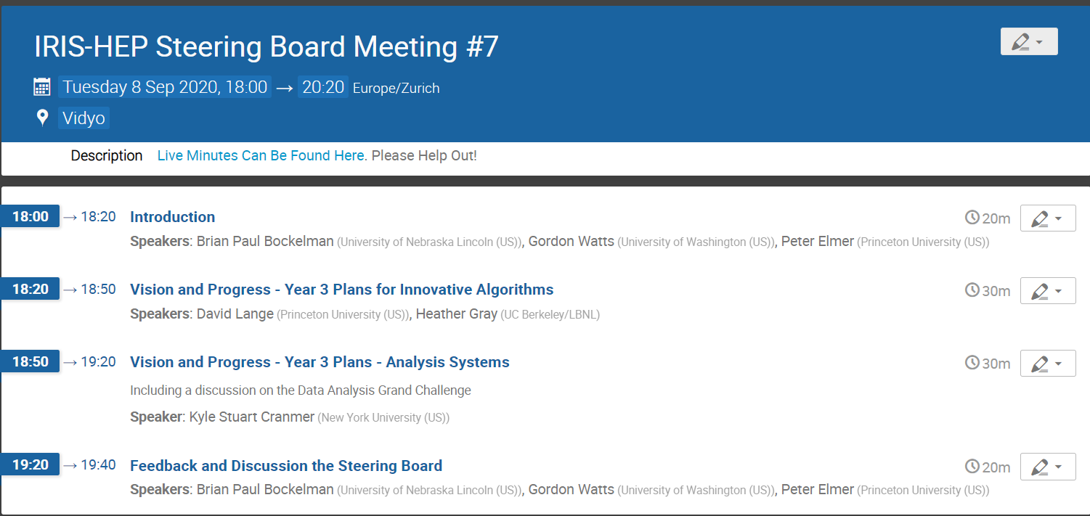
Today
Year 3 plans
Y3 Plans from Innovative Algorithms and Analysis Systems
Discussion

Slide 7
Closing out Year 2
A few highlights
OSG-LHC demonstrated a prototype of an entire GSI-free site and is driving the worldwide transition from GSI/X.509 and GridFTP technologies.
This work also touches on DOMA and WLCG, of course (web tokens, etc.)
U.S. LHC site (the U.S. CMS Tier-2 at University of Nebraska) has been able partially migrate its production bulk data transfers from GridFTP to HTTP-TPC; approximately 20% of the CMS production traffic to Nebraska is over HTTP.
For the first time in HEP, the full likelihood for an ATLAS search was uploaded to HEPData. This used the pyhf data format and was featured on the CERN homepage
Efforts in Analysis Systems to both improve tools used by analyzers and increase ways to preserve physics analyses.

Slide 8
Closing out Year 2
A few highlights
The func_adl language has been integrated into DOMA’s ServiceX project and tested on a 9.5 TB ATLAS xAOD sample. It was able to transform the sample in 2 hours into columns suitable for analysis in the python ecosystem. It was run on the UChicago SSL cluster, River. The bottleneck was the ability for an external system to furnish ServiceX with files to transform at a high enough rate.
Work with US ATLAS, Analysis Systems, DOMA, and SSL.
The LHCb experiment chose the GPU-based Allen framework, to which IRIS-HEP is contributing, for its Run 3 high-level trigger facility.

Slide 9
Closing out Year 2
A few highlights
The func_adl language has been integrated into DOMA’s ServiceX project and tested on a 9.5 TB ATLAS xAOD sample. It was able to transform the sample in 2 hours into columns suitable for analysis in the python ecosystem. It was run on the UChicago SSL cluster, River. The bottleneck was the ability for an external system to furnish ServiceX with files to transform at a high enough rate.
Work with US ATLAS, Analysis Systems, DOMA, and SSL.
IRIS-HEP collaborators hosted two international workshops on data reconstruction algorithms in HEP: on machine learning approaches to jets (ML4Jets) and on pattern recognition problems including tracking (Connecting the Dots).
We have also hosted a number of innovative training and tutorial workshops

Slide 10

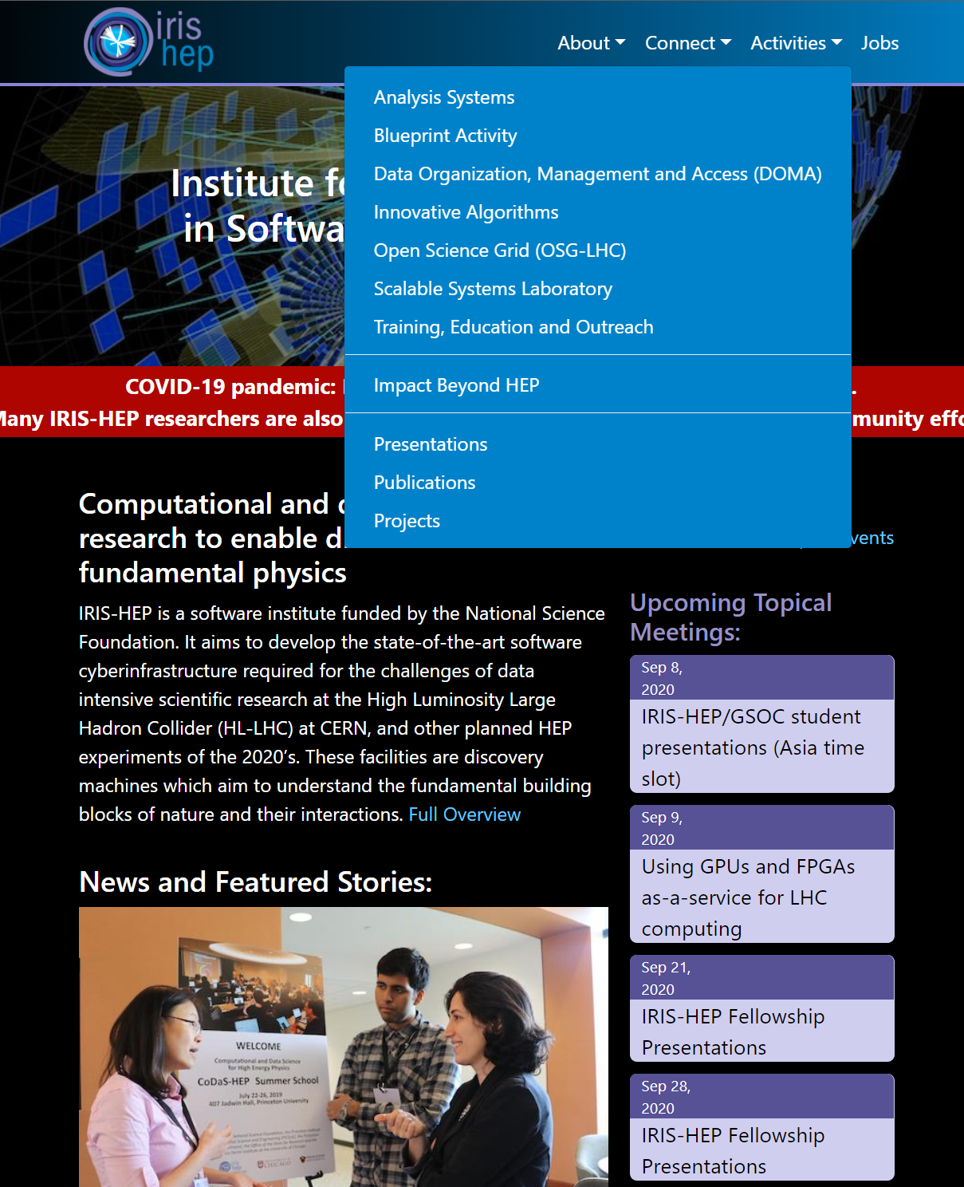
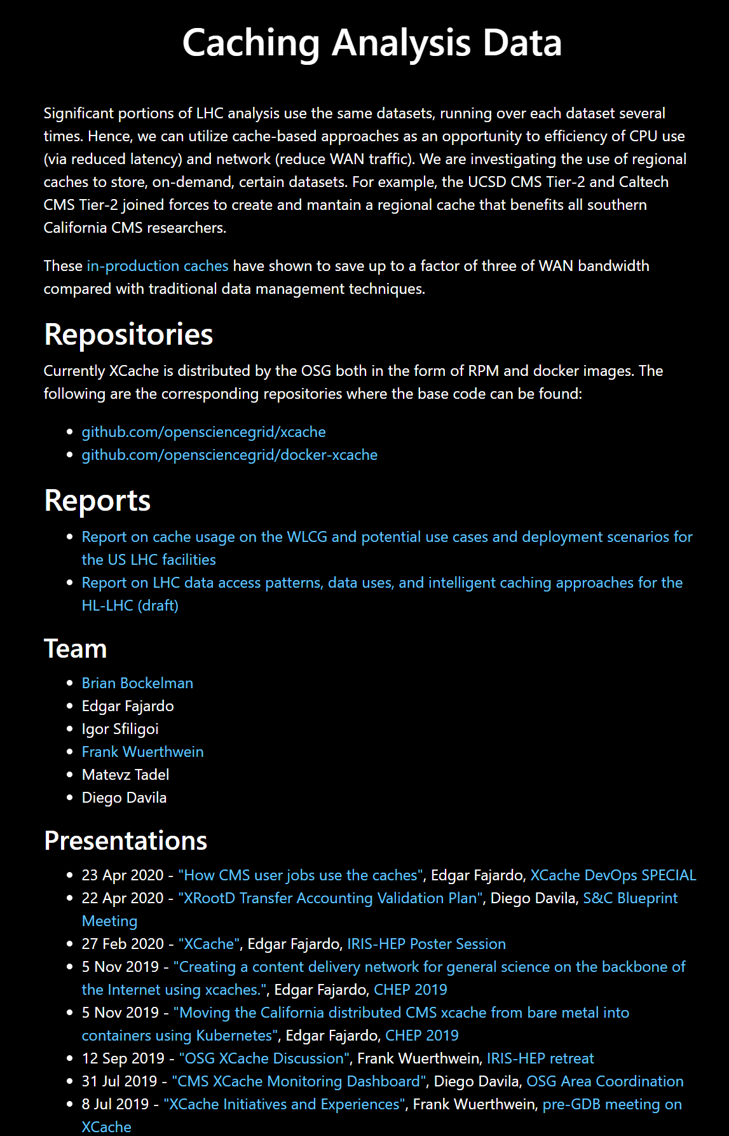
Project Information
Per-project information is available on all IRIS-HEP projects.
(often, but not always)

Slide 11
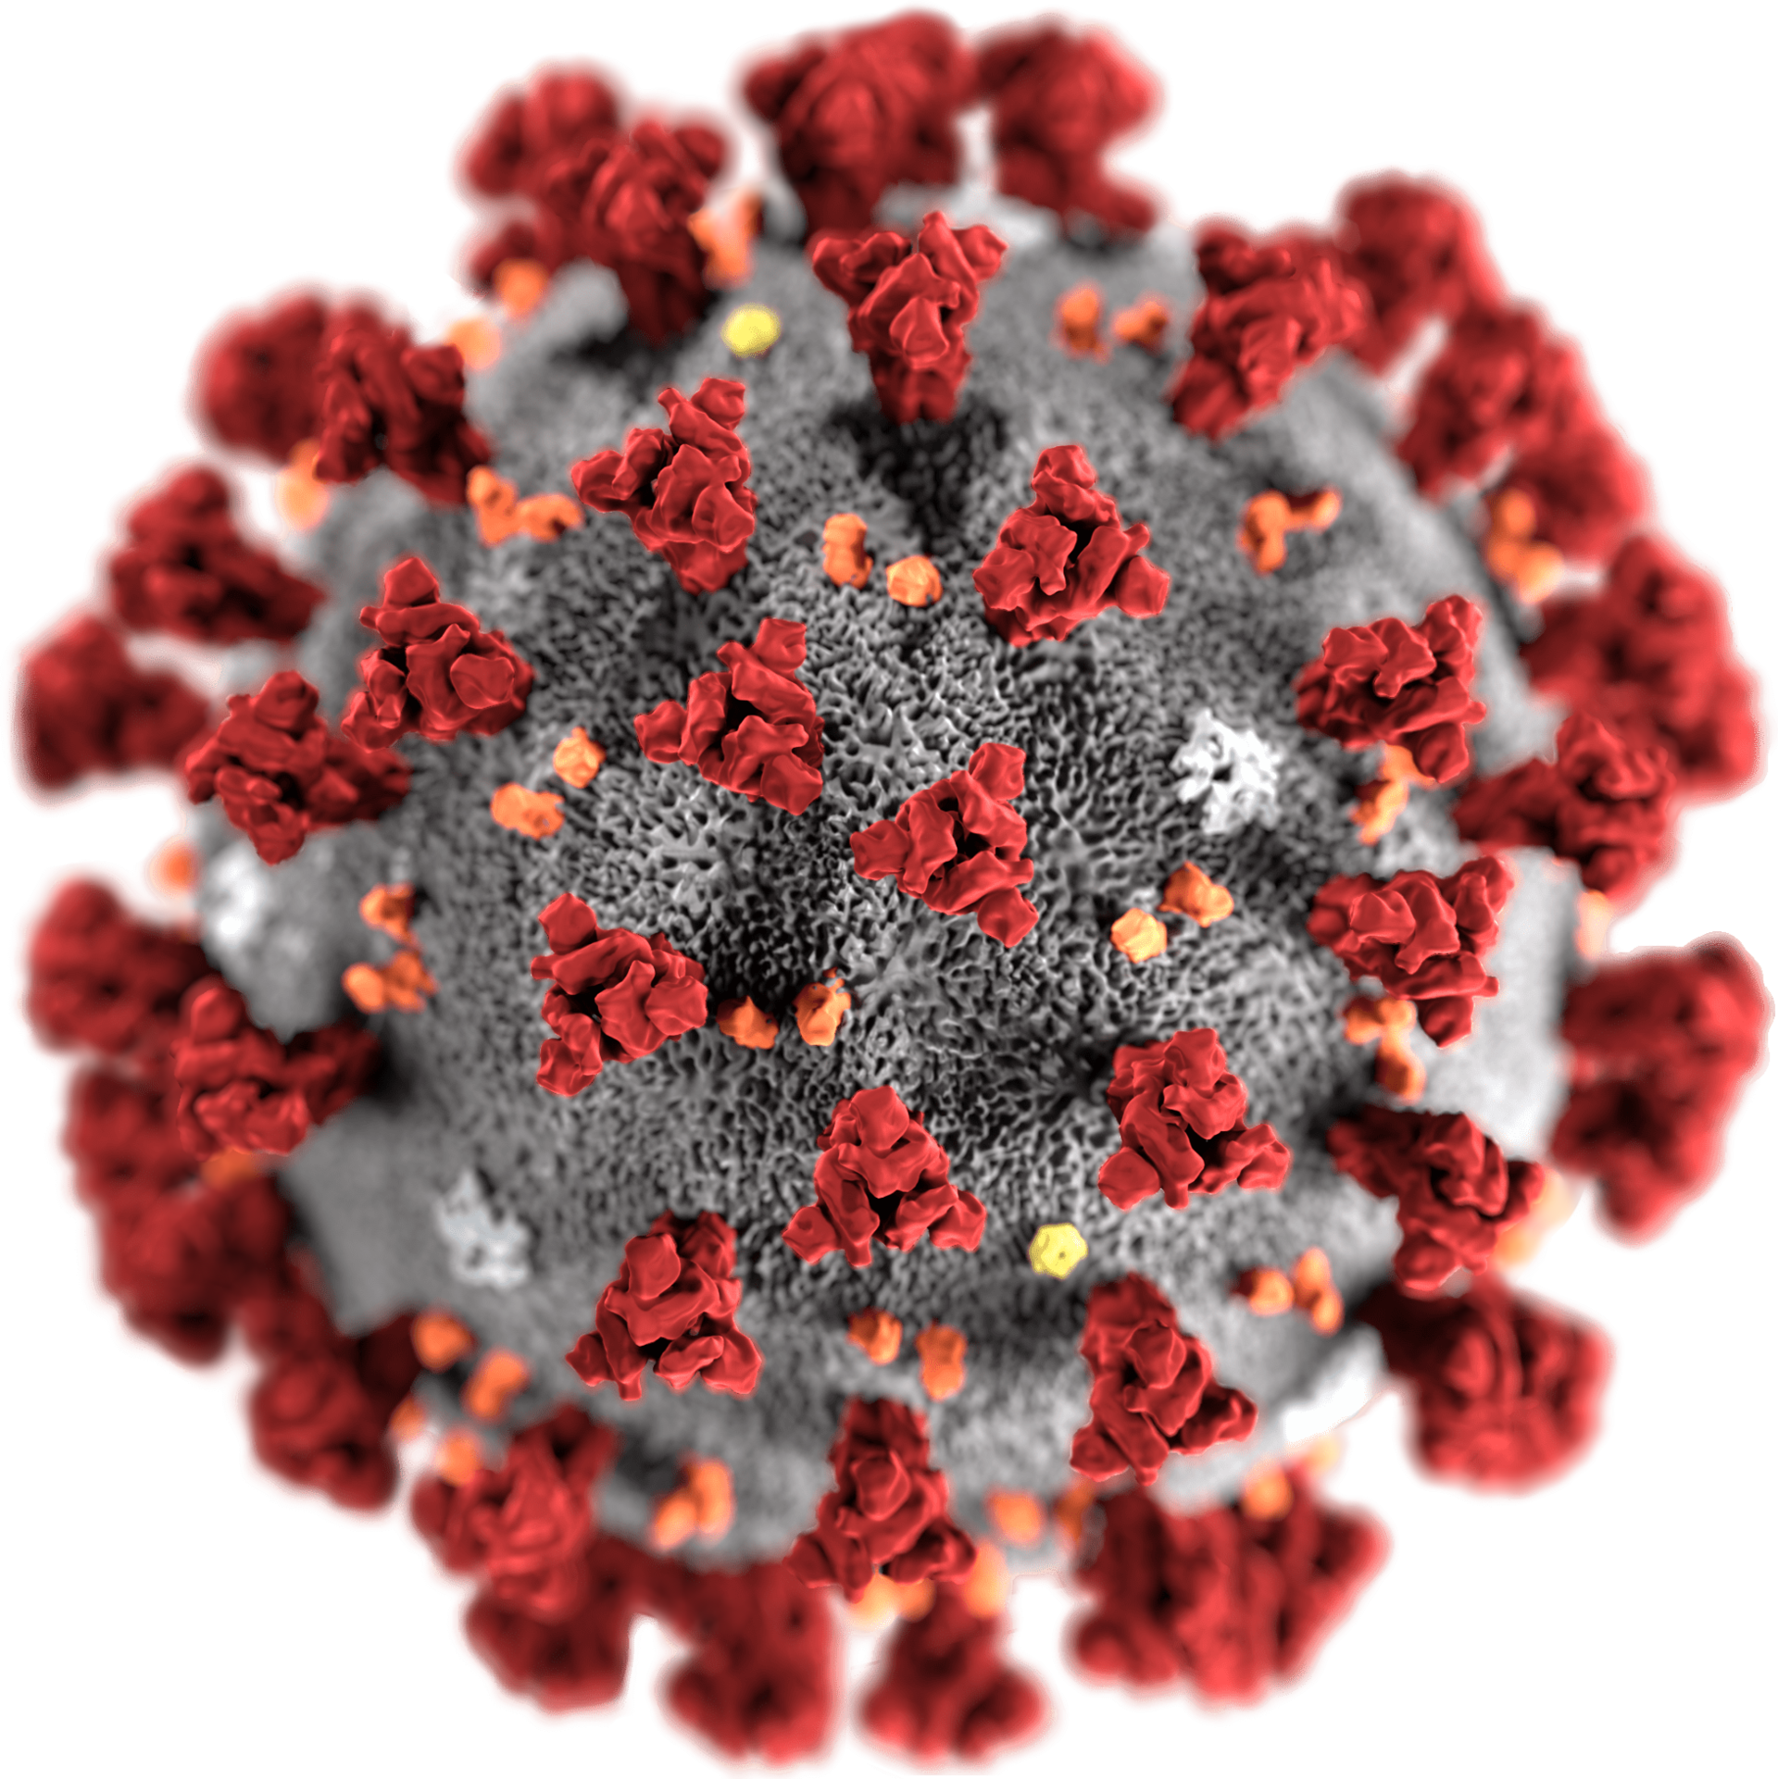
IRIS-HEP Summer
Blueprint Meeting: Sustainable Software in HEP (~90 registered)
Fellows Program
Class of COIVD-19:
Goal: undergraduate and graduate students learn new stills from IRIS-HEP R&D
Mostly located locally or remotely
No travel, but pay salary
Was able to support 13
LHCb PV, LHCb GPU trigger, GNN on FPGAs, pyhf testing, ServiceX testing, compression on nanoAOD, SkyHook testing & Spark interface, OSG Monitoring, ACTS track seeding & fitting & integration, CMS HGCAL CAN fast sim, awkward1 on GPUs, GNN on FPGA’s, REANA,
See fellows page, final presentations.
Normal Fellows Program:
Goal: graduate students learn new stills from IRIS-HEP R&D
Room & Board for 2 months
Travel to an institute university

Slide 12
IRIS-HEP Year 3
Some “dates” of interest
Nov 24, 2020 | Steering Board Meeting #8
Feb 16, 2020 | Steering Board Meeting #9
Late Feb (?) | NSF Yearly Review
End of April, start of May | Yearly Retreat
We would like to do experiment feedback again.
Other meetings being planned

Slide 13
Review and Y3 Planning
From SB#6 Talk
The NSF 18 Month Review Results
Focus Area Discussions
PI Discussions
US Ops Programs Discussion
Steering Board Meeting
Full-Team Retreat
PEP Draft
Iterated over by PI’s
Given to the NSF
Iterate until approved
Year 3 starts Sept 1, 2020
PEP will be close to final at our next Steering Board Meeting – an obvious topic.

Slide 14
Year 3
1
Now that we have run for 2 years, improve milestones and metrics
Two comments from the IRIS-HEP NSF Review we’ve spent the summer working on
2
Grand Challenges to help tie activities at the institute and the US operations programs, and the experiments together.

Slide 15
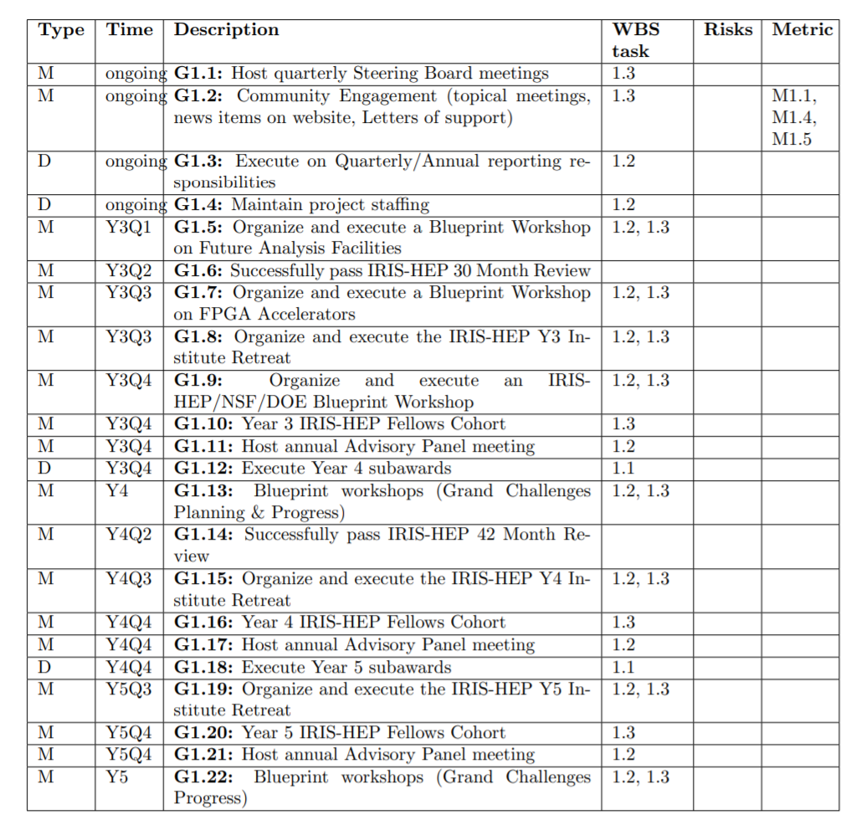
Milestones & Metrics
All IRIS-HEP NSF milestones and metrics are public
We will post Y3 shortly
Management
Blueprint meeting on Analysis Facilities
DOE/NSF/IRIS-HEP Workshop
Year 4 Milestones
We’ve written them to indicate where we are doing
Will refine as part of the Year 4 processes

Slide 16
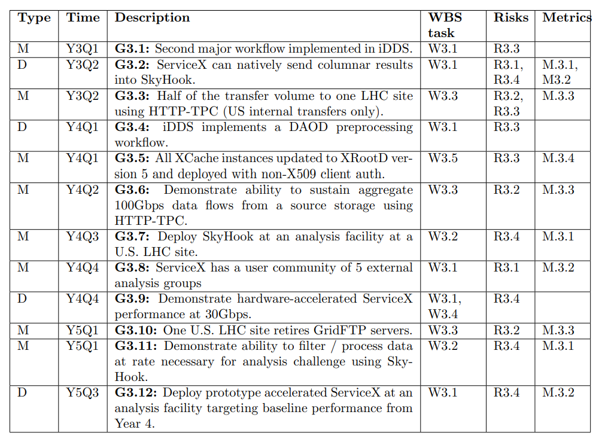
DOMA
ServiceX and SkyHook integration
50% of one site transfers via HTTP
iDDS and DAOD preprocessing workflow (Y4)

Slide 17
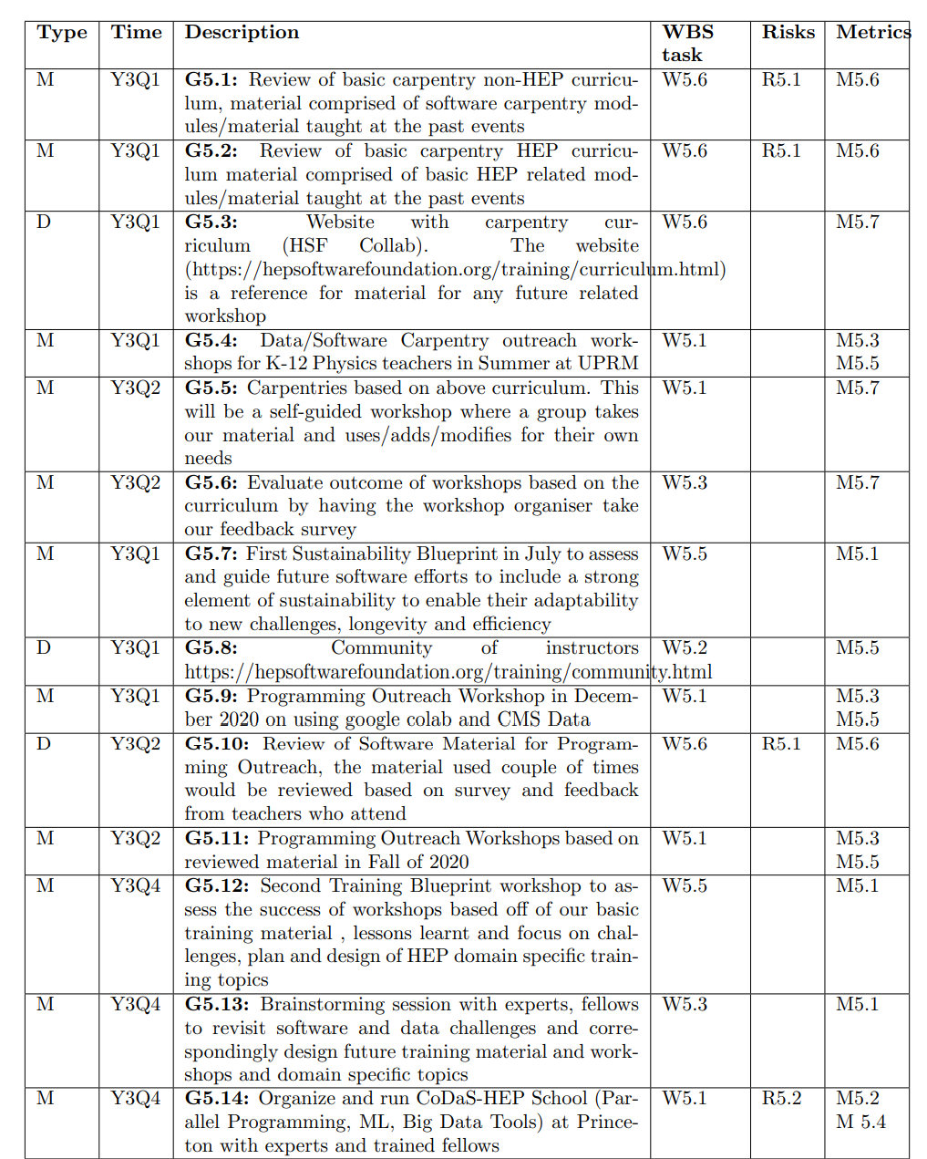
SSC
Improve the existing workshops with feedback, latest techniques
Using Google Collab and CMS Data – Training Workshop

Slide 18
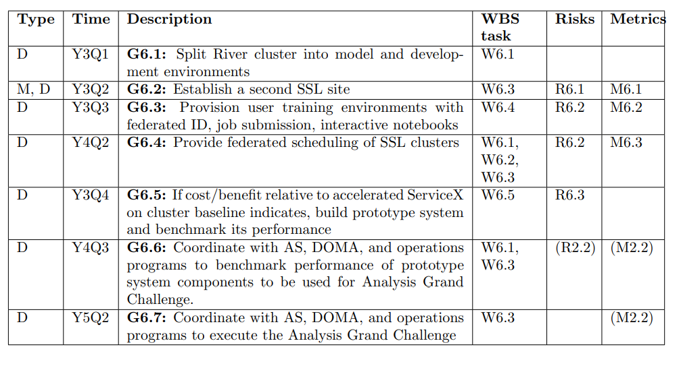
SSL
Establish second SSL site
Federation of SSL sites

Slide 19
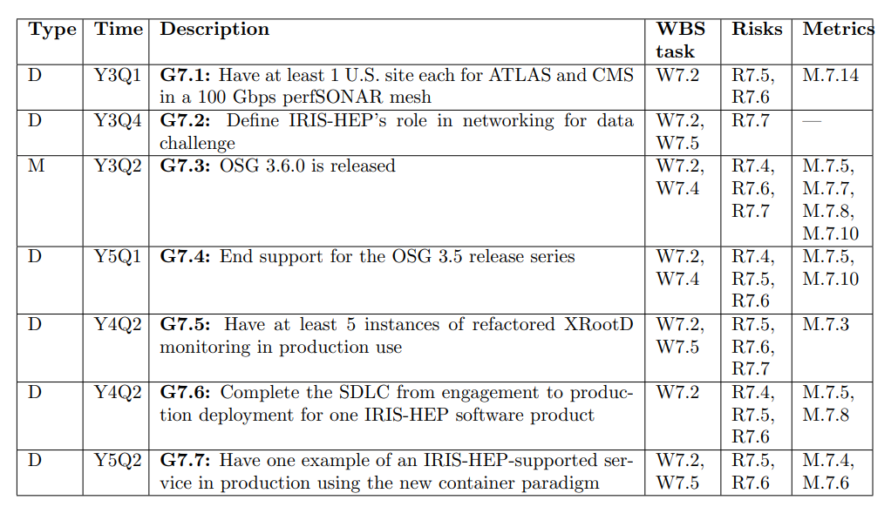
OSG
Data Processing Challenge
OSG 3.5 -> 3.6

Slide 20
Grand Challenges
Review Committee: Global challenges to knit together disparate parts of the institute
Demonstrate useful work for the LHC Run 4 Era
Force building of tools for longer-term than just the challenge
Span more than one area of the institute
Have stakeholder participation
Fine to span multiple years (encouraged)
Analysis Grand Challenge
In today’s Analysis Systems Talks
Data Processing Grand Challenge
Next Steering Board Meeting

Slide 21
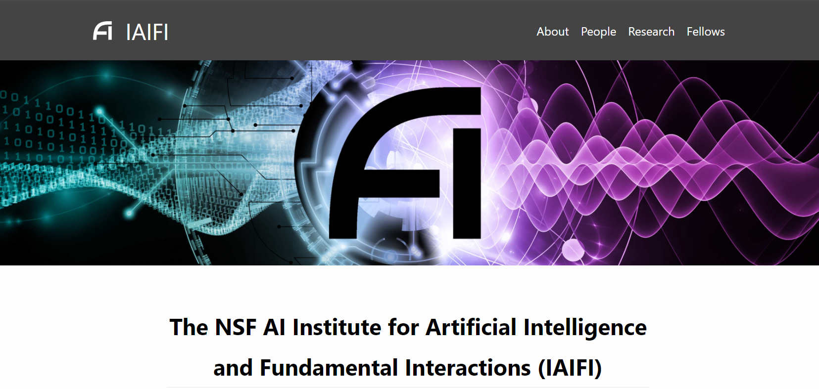
NSF: IAIFI
Two members of IRIS-HEP are founding members of IAIFI
As they spin-up we will look for points of collaboration

Slide 22
Questions? Comments?

