Slide 1

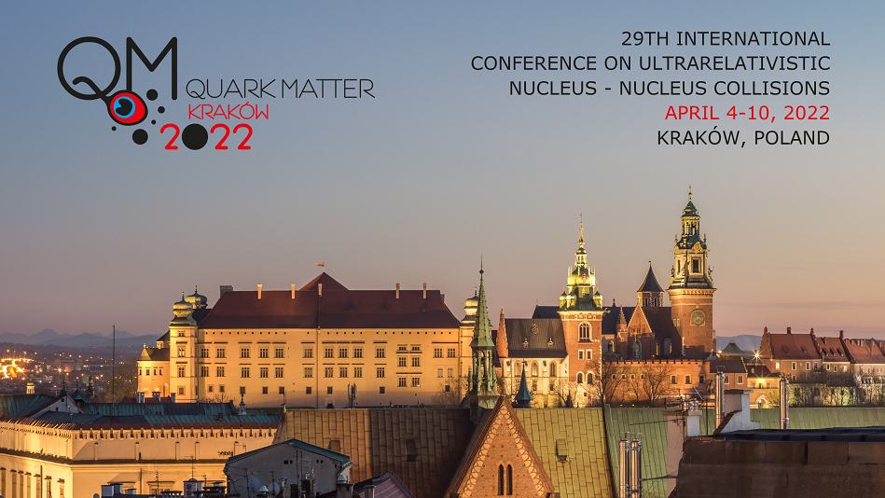
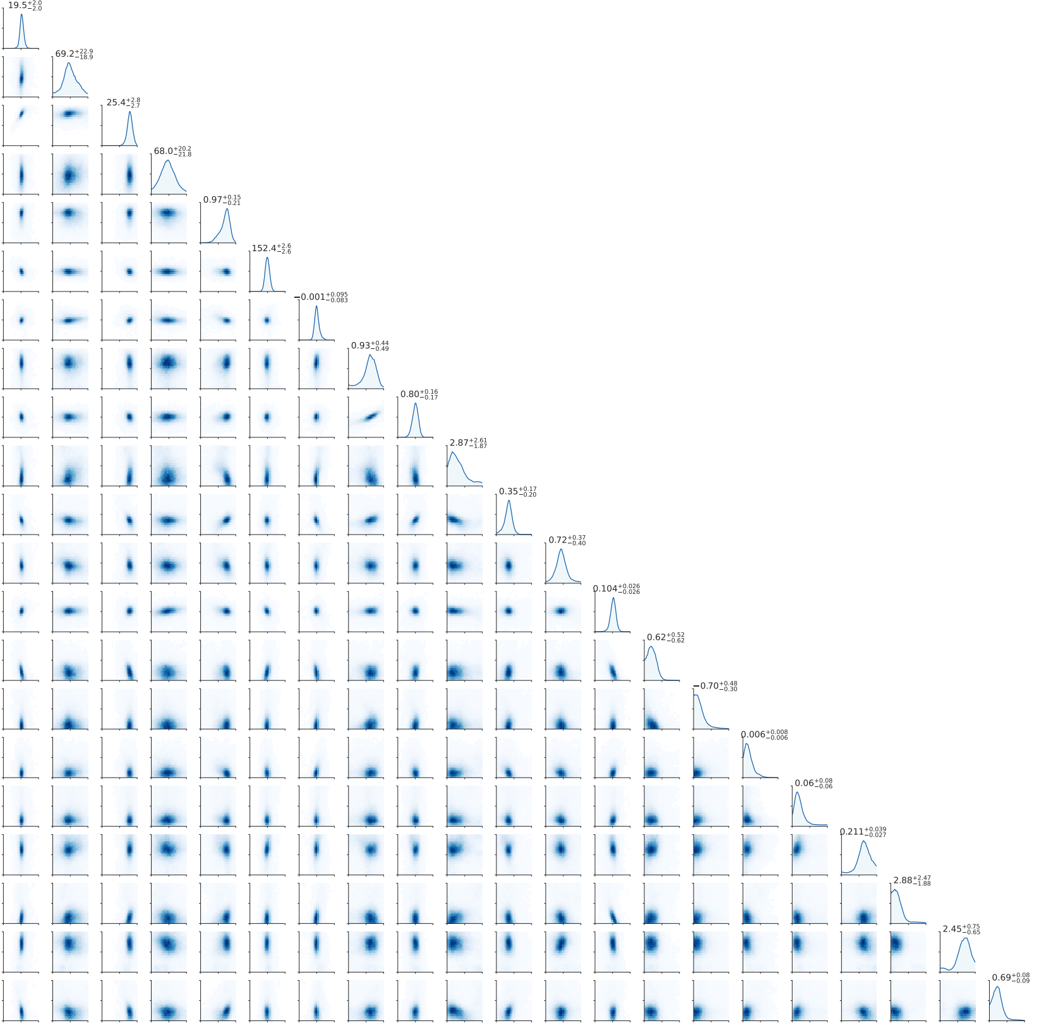
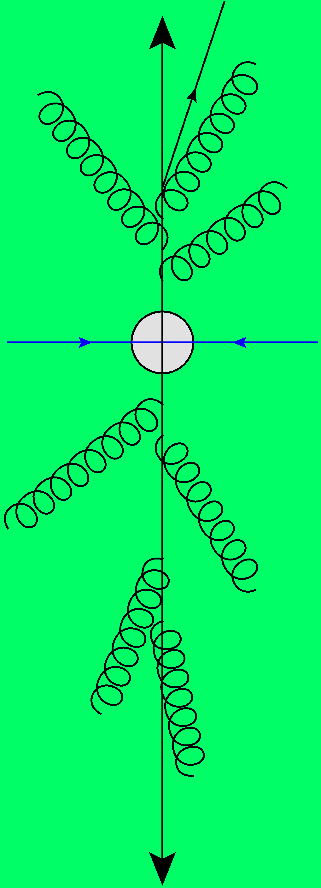
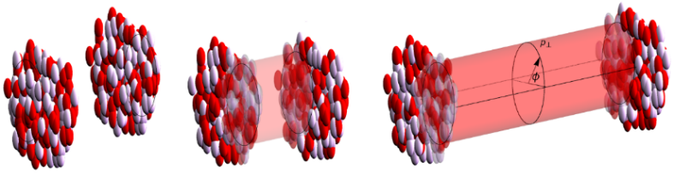
Hydrodynamics and Bayesian Inferences in isobar collisions
Latest Trajectum results on Isobar collisions
Based on 2112.13771 with Govert Nijs
Big thanks to STAR for sharing their data at very early stage
Wilke van der Schee
QM2022, Krakow
6 April 2022

Slide 2


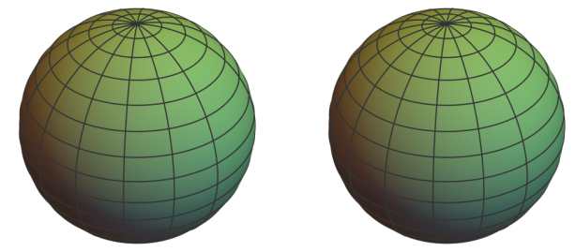
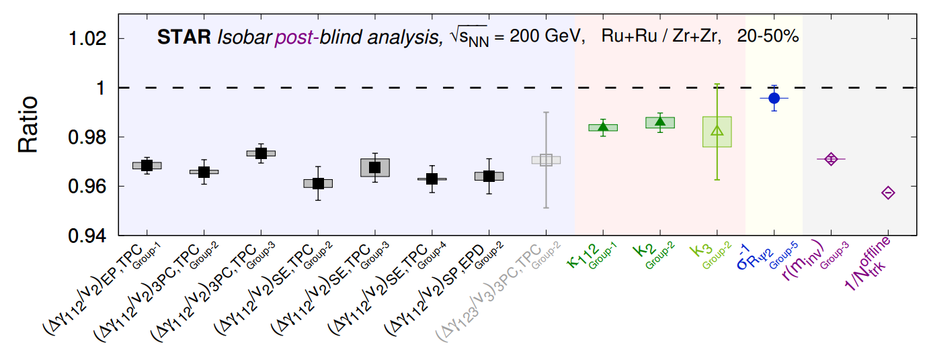
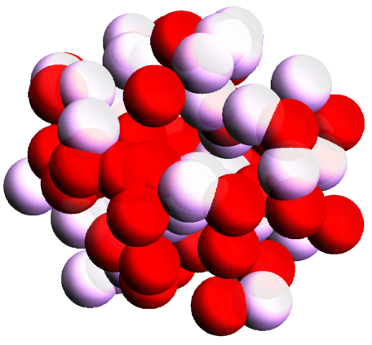
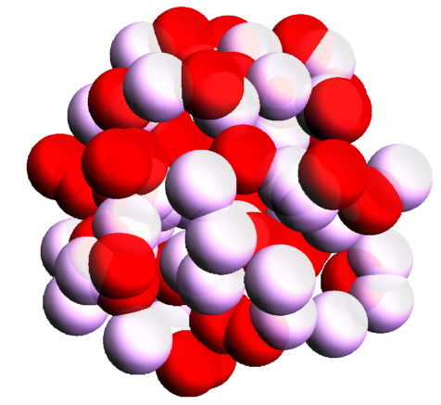

Isobar collisions at STAR
Varying the magnetic field
Wilke van der Schee, CERN
Idea: similar nuclei (same # of baryons), different charge
Ruthenium generates a 10% larger magnetic field
Ideal set-up to suppress background and detect
Chiral Magnetic Effect (CME)
Very precise blinded analysis by STAR:
CME-like
Averaged
No CME
Fluctuating (realistic)
Unfortunately (?), no CME detected
STAR, Search for the Chiral Magnetic Effect with Isobar Collisions at √s_{NN} = 200 GeV by the STAR Collaboration at RHIC (sept 2021)

Slide 3
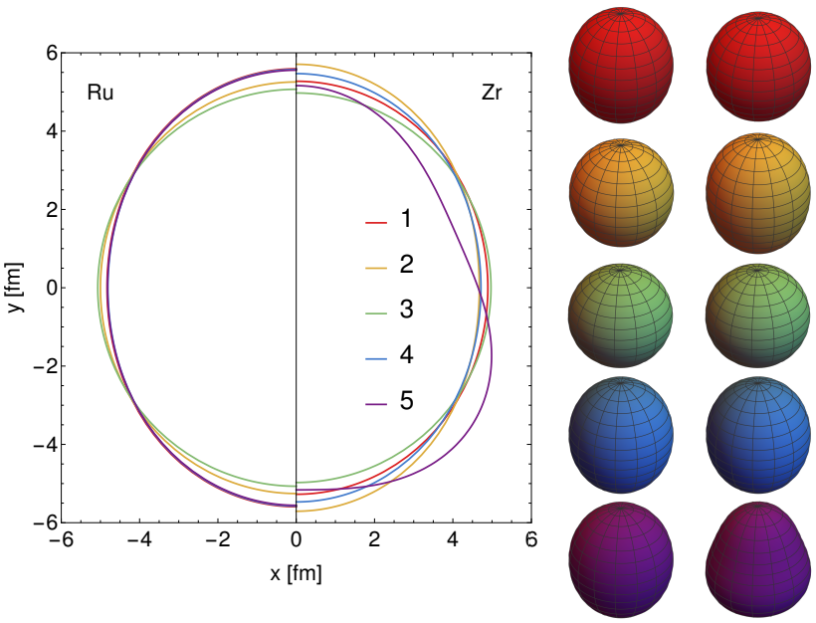
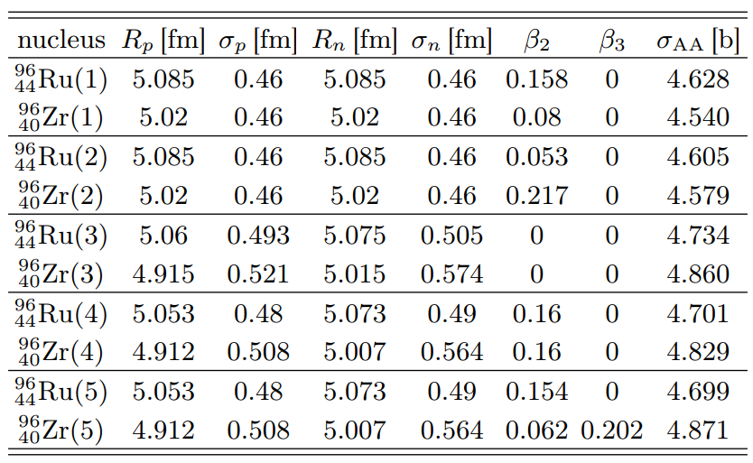
Isobar collisions at STAR
Wilke van der Schee, CERN
Five different cases simulated:
e-A scattering experiments(STAR case 1)
Theory (finite-range liquid drop model, STAR 2)
DFT with neutron skin (spherical) [1]
DFT with neutron skin (deformed, β₂ = 0.16) [1]
As 4, but with β₂ from electric transition probability and β₃ from comparing AMPT with STAR [2]
[1] Hao-jie Xua, Hanlin Lib, Xiaobao Wanga, Caiwan Shena and Fuqiang Wang, Determine the neutron skin type by relativistic isobaric collisions (2021)
[2] Chunjian Zhang and Jiangyong Jia, Evidence of quadrupole and octupole deformations in 96Zr+96Zr and 96Ru+96Ru collisions at ultra-relativistic energies (2021)

Slide 4


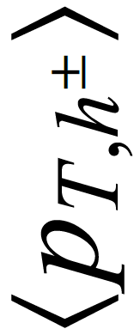
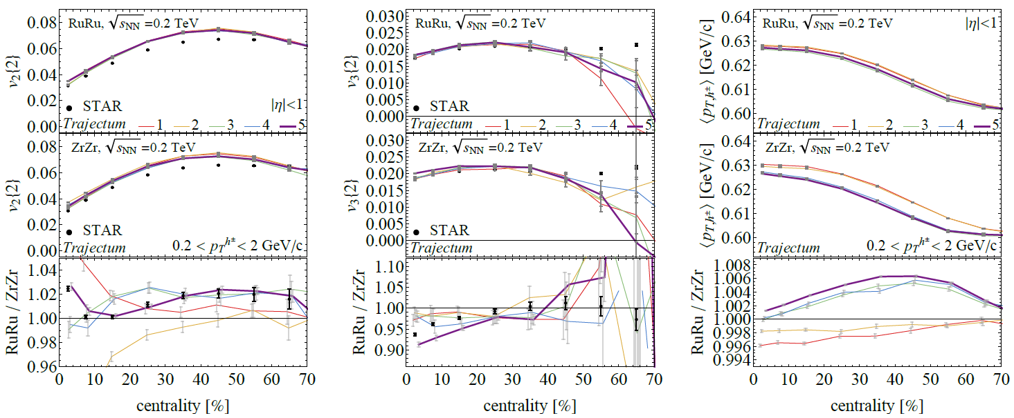
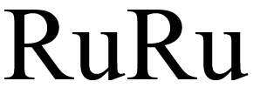
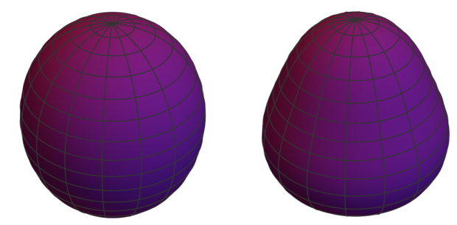
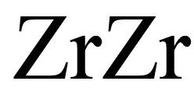
Isobar collisions at STAR – Flow and mean p_{T}
Wilke van der Schee, CERN
Statistics better for best case (5, with 5M collisions)
Excellent fit, especially for v2 ratio, v3 ratio overestimated at central
Note that Trajectum is not fitted to RHIC energies, no absolute agreement
Mean transverse momentum is a prediction
STAR, Search for the Chiral Magnetic Effect with Isobar Collisions at √s_{NN} = 200 GeV by the STAR Collaboration at RHIC (sept 2021)

Slide 5
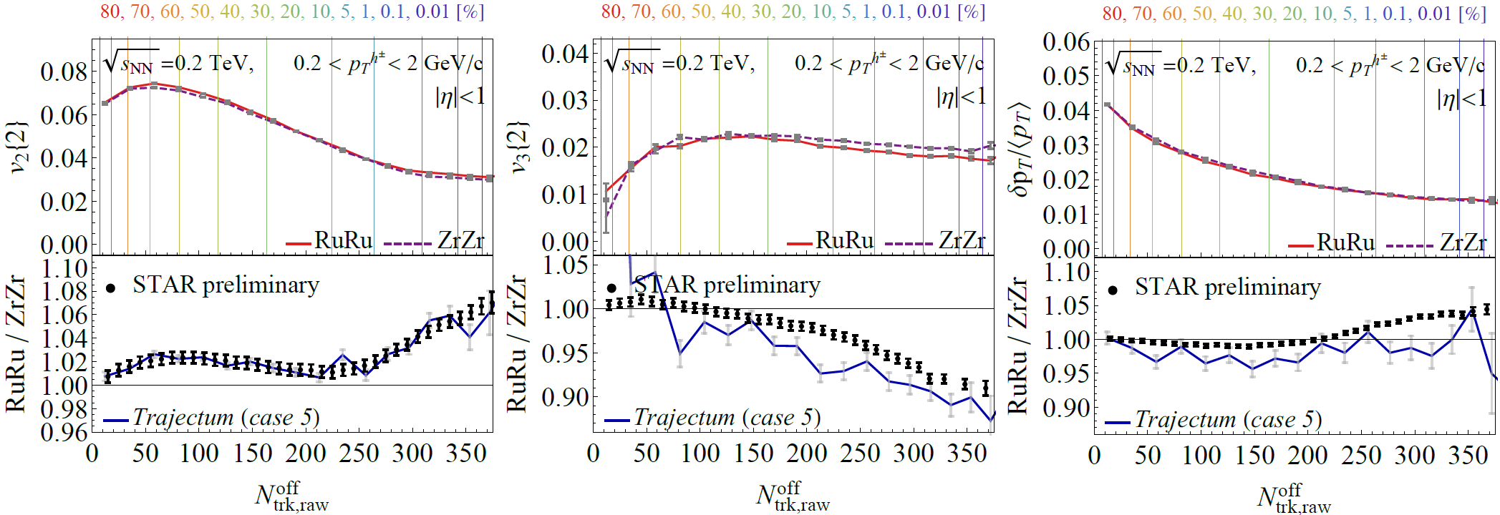
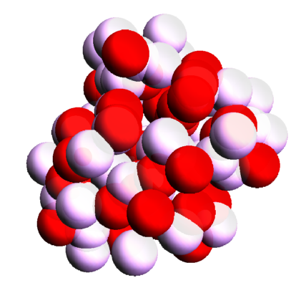
Extremely ultracentral collisions
Wilke van der Schee, CERN
Going to 0.01% centrality (we sample from 250M Trento events)
Excellent match v2, v3 en pt fluct somewhat overpredicted
Extremely ultracentral is ideal regime to probe nuclear structure
> β₂
> β₃
Averaged
Fluctuating (realistic)
ATHIC2021 talk Chunjian Zhang, https://drupal.star.bnl.gov/STAR/files/ATHIC_Nov_STAR_SBU_ChunjianZhang.pdf

Slide 6
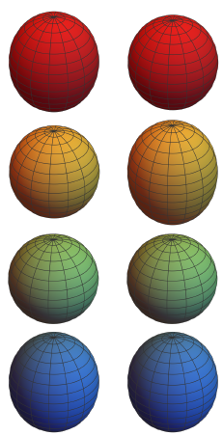
Discussion
Isobar collisions: an opportunity at unprecedented precision
  So many systematics cancel, both experimentally and in theory
  Implies a need for statistics… of order 1M events at least to be competitive
A Bayesian point of view
  So far only performed a scan of several Wood-Saxon parameters (see also [1, 2])
  Global analysis would be preferred, but statistically hard to pull off
  Initial state predictor would be ideal, but first tests are not encouraging
Towards magnetic effects
  First things first: understanding nuclear structure. Interesting in itself (!), see also neutron stars
  Trajectum done without 3+1D or baryon number…
  Isobars still ideal setting to probe magnetic effect, but will take time to have theory at required precision
[1] Hao-jie Xua, Hanlin Lib, Xiaobao Wanga, Caiwan Shena and Fuqiang Wang, Determine the neutron skin type by relativistic isobaric collisions (2021)
[2] Chunjian Zhang and Jiangyong Jia, Evidence of quadrupole and octupole deformations in 96Zr+96Zr and 96Ru+96Ru collisions at ultra-relativistic energies (2021)

Slide 7
Back up

Slide 8

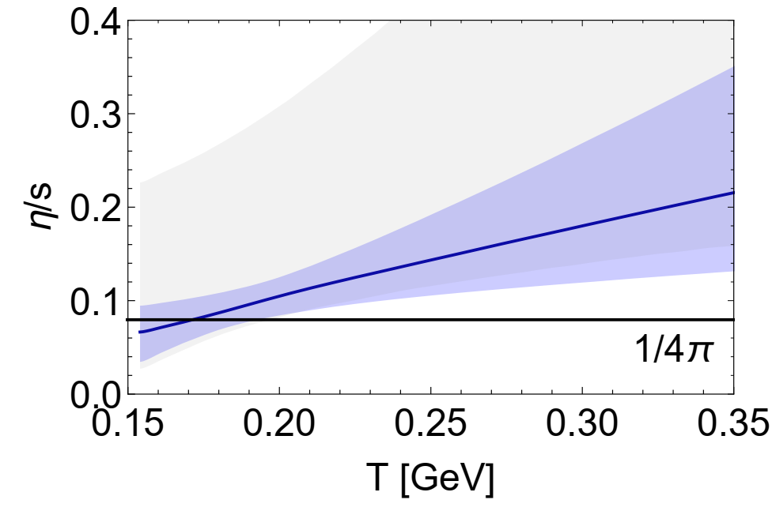
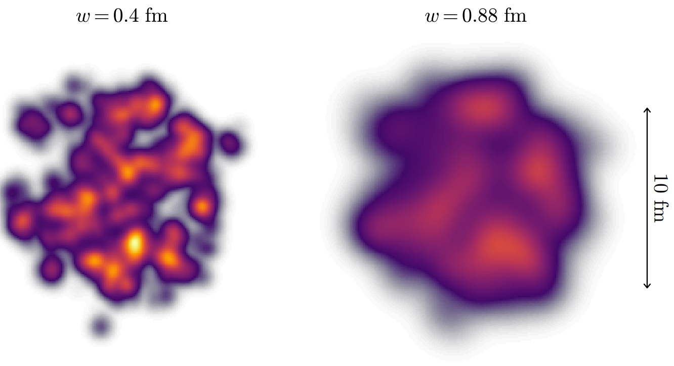
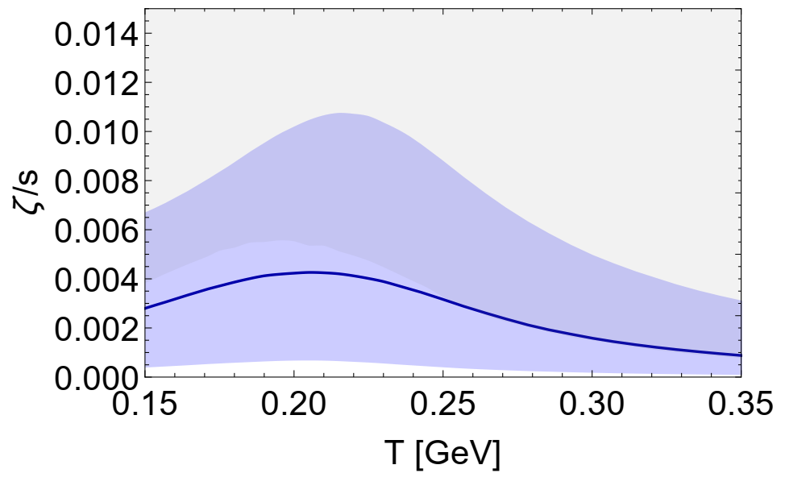
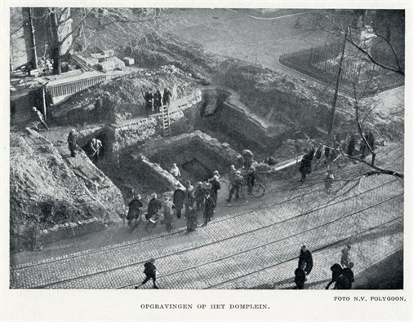
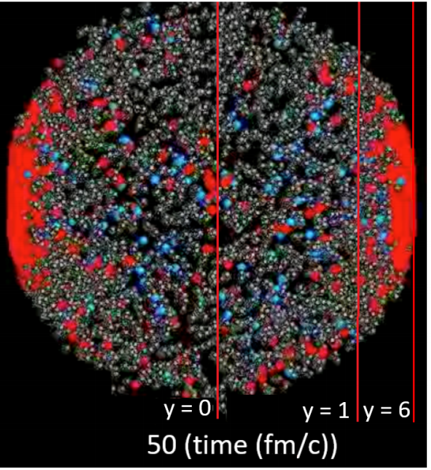
Standard model of heavy ion collisions
Wilke van der Schee, CERN
(# parameters)
Trajectum
New public heavy ion code
Originally Utrecht (now MIT/CERN)
Fast
Precise (all cuts equal to experiment)
Scalable
Initial stage (9)
Viscous hydrodynamics (9)
Subnucleonic structure? (7)
Non-thermal flow? (2)
with varying speed (new)
Fluctuations? (1)
Shear viscosity (3)
Bulk viscosity (3)
Second order transports: 3 (new)
Cascade of hadrons (1)
Roman excavations in Utrecht in 1929
Jonah Bernhard, Scott Moreland and Steffen Bass, Bayesian estimation of the specific shear and bulk viscosity of quark–gluon plasma (2019)
Govert Nijs, WS, Umut Gursoy and Raimond Snellings, A Bayesian analysis of Heavy Ion Collisions with Trajectum (2020)

Slide 9
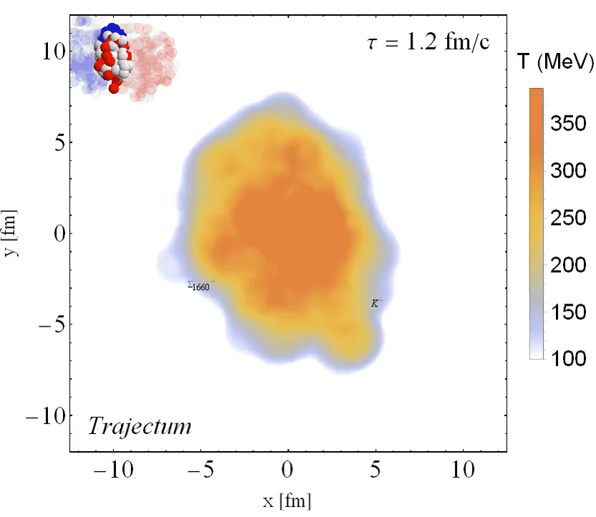
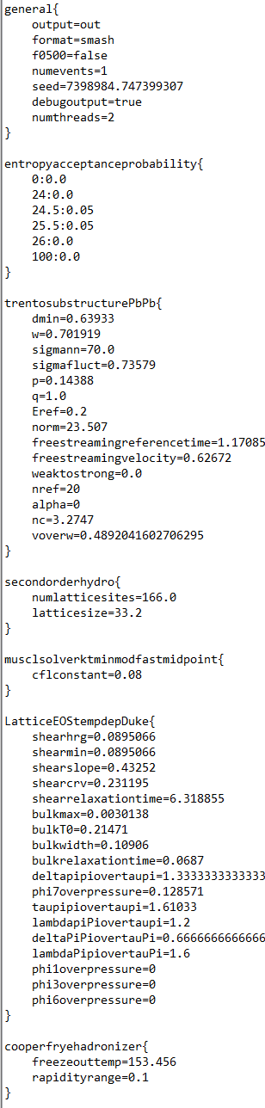

Trajectum
Quite straightforward to use
(see param file, right)
Includes analyse routine
  Parallelised: can analyse unlimited number of events
http://sites.google.com/view/govertnijs/trajectum
http://wilkevanderschee.nl/trajectum

Slide 10
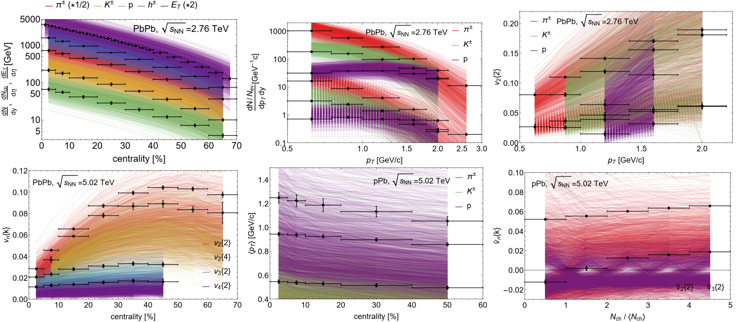
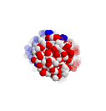
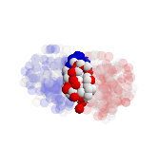
Experimental observables: a wealth of data
Prior
Yields, spectra, identified v_{n}{2} versus p_{T}, pPb and PbPb (514 datapoints)
First study with a comprehensive analysis including
p_{T}-differential observables

Slide 11
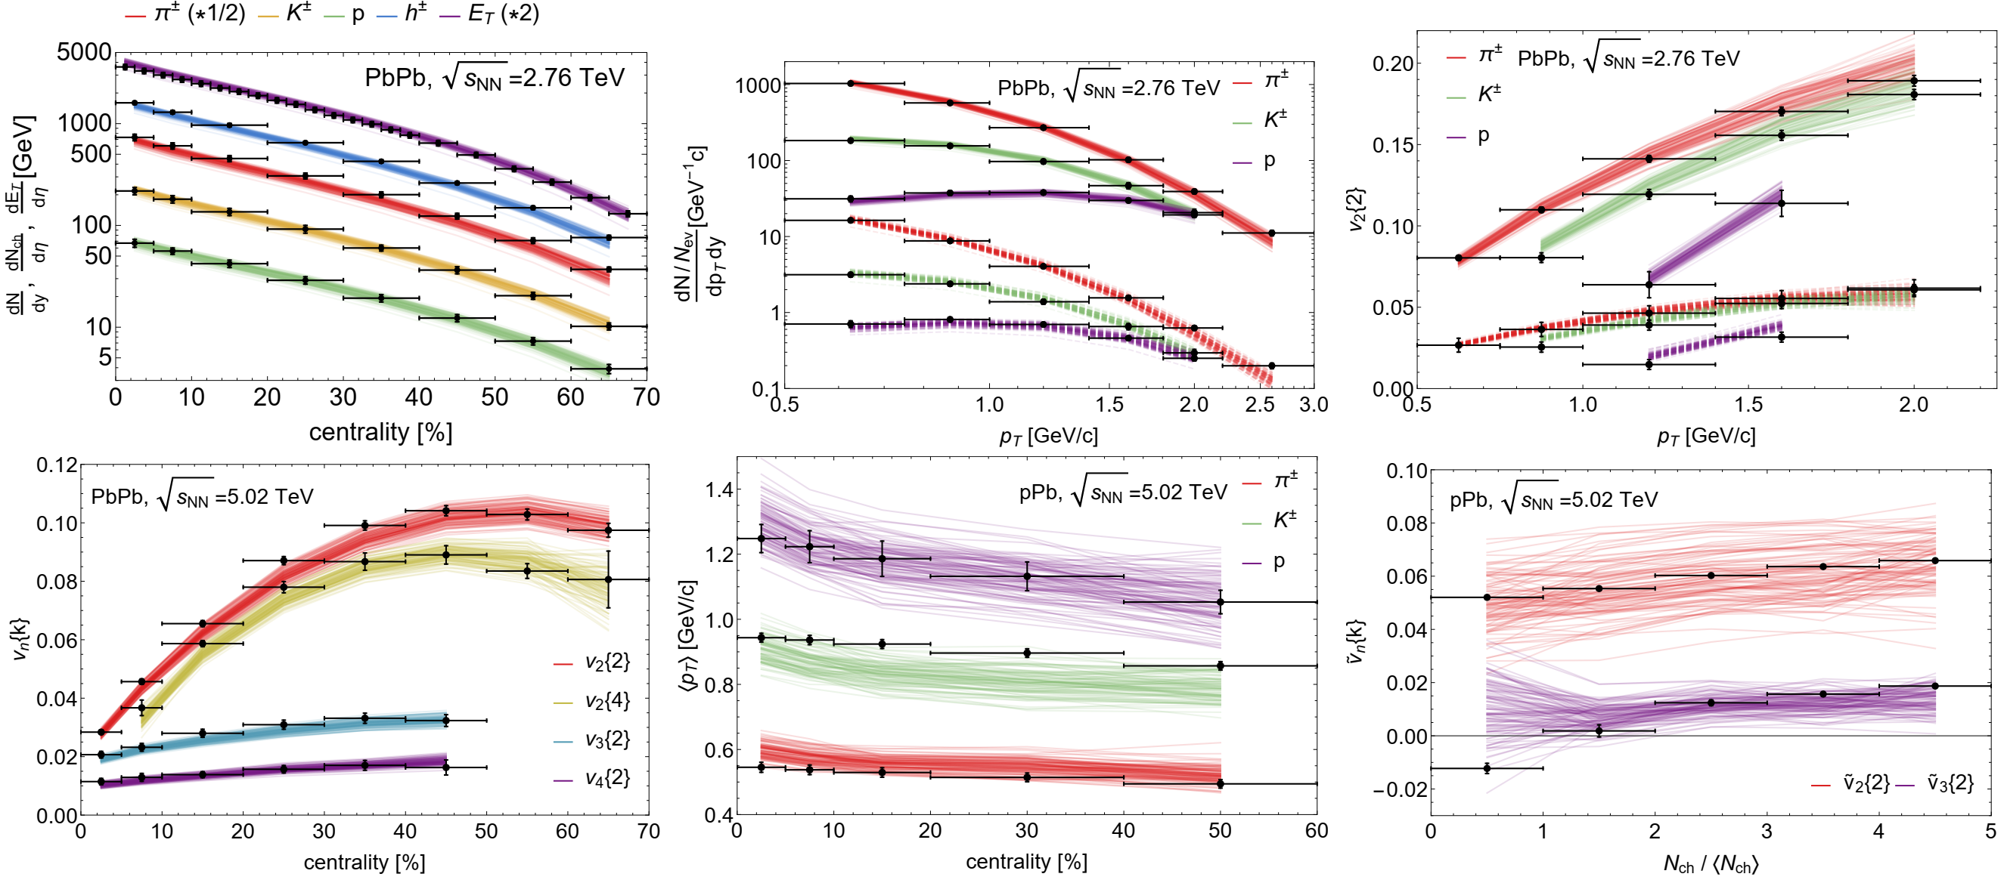
Experimental observables: a wealth of data
Posterior
Yields, spectra, identified v_{n}{2} versus p_{T}, pPb and PbPb (514 datapoints)
First study with a comprehensive analysis including
p_{T}-differential observables

Slide 12
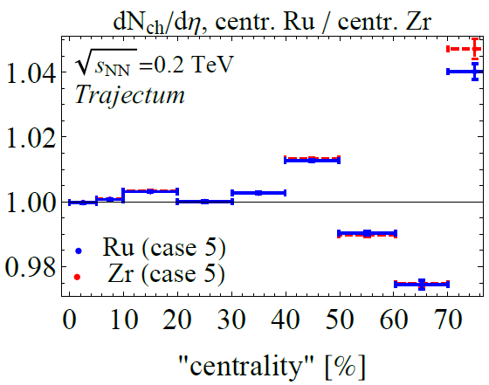
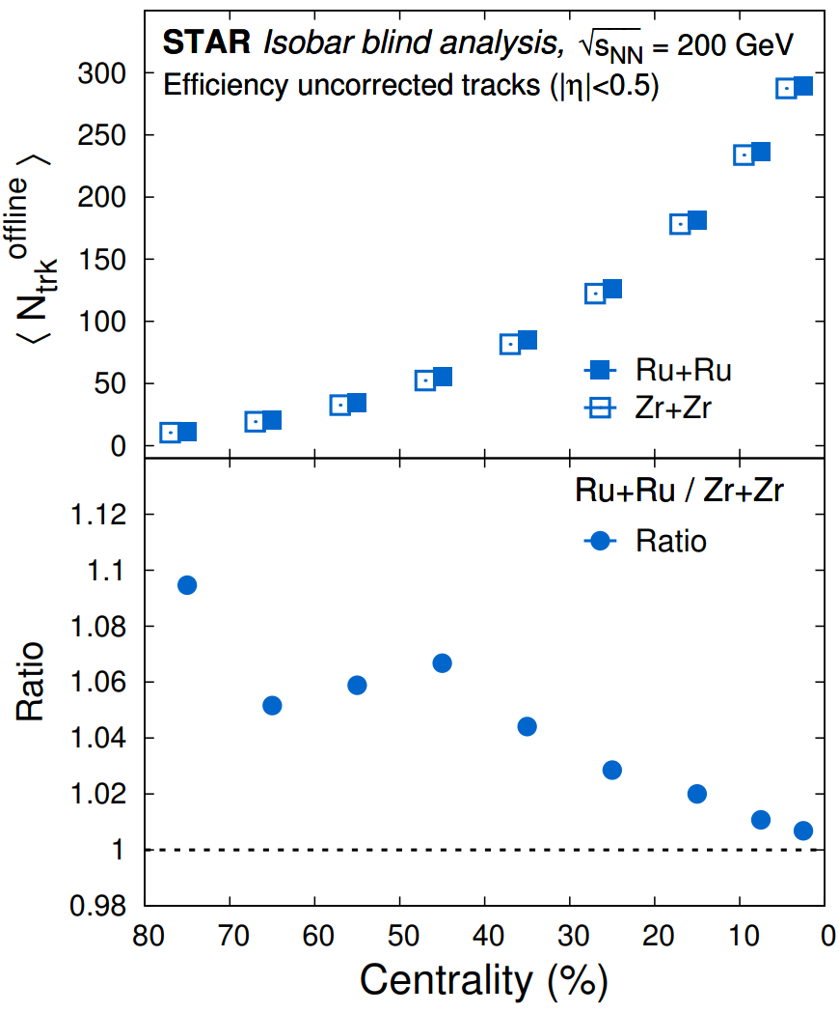


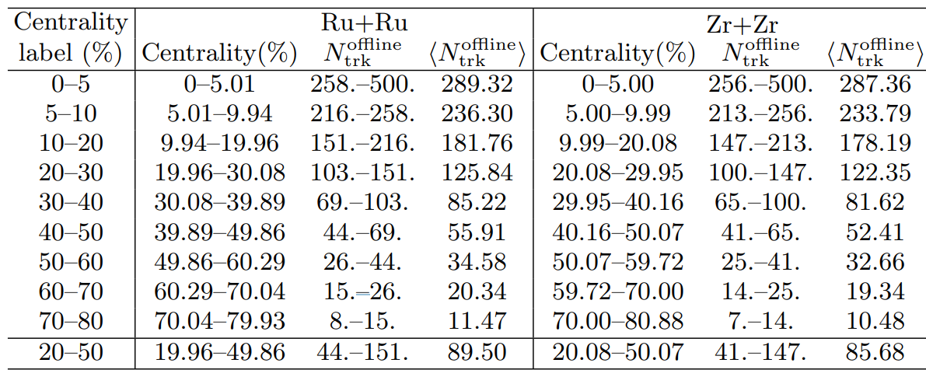
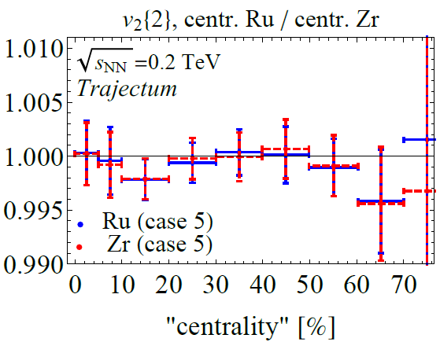
Isobar collisions at STAR - Multiplicity
For each case we run 0.5M collisions except for case 5 (5M), 14M in total.
Wilke van der Schee, CERN
Theory: only change
centrality bounds
Precision and non-conventional definition of centrality
Subtlety in STAR data: “centrality label” is different for Ru and Zr
Especially important for multiplicity (~7% effect)
Hardly significant for other observables (<0.5% for v₂)
STAR, Search for the Chiral Magnetic Effect with Isobar Collisions at √s_{NN} = 200 GeV by the STAR Collaboration at RHIC (sept 2021)

Slide 13
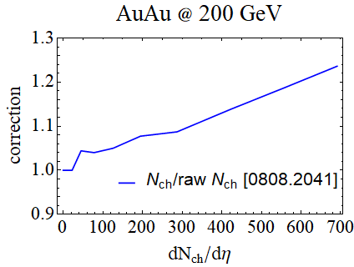
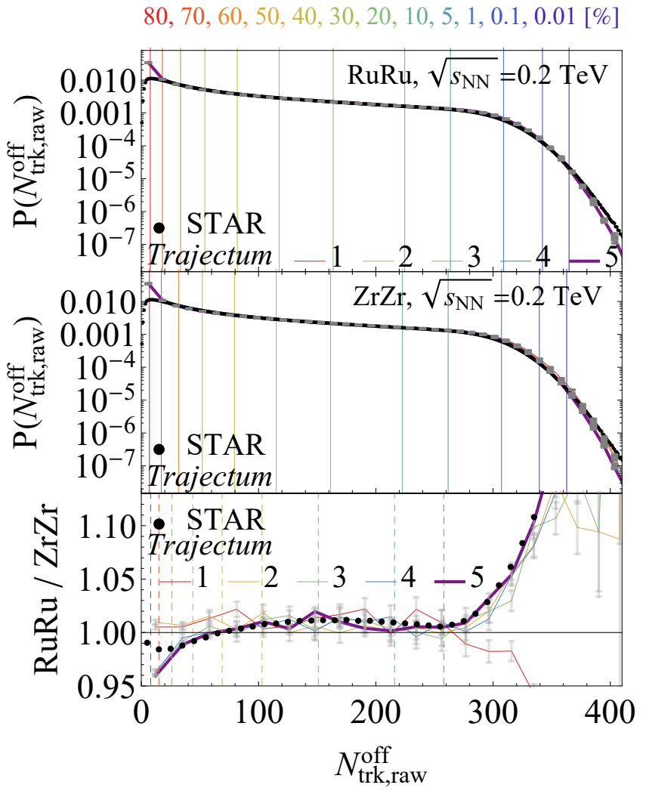
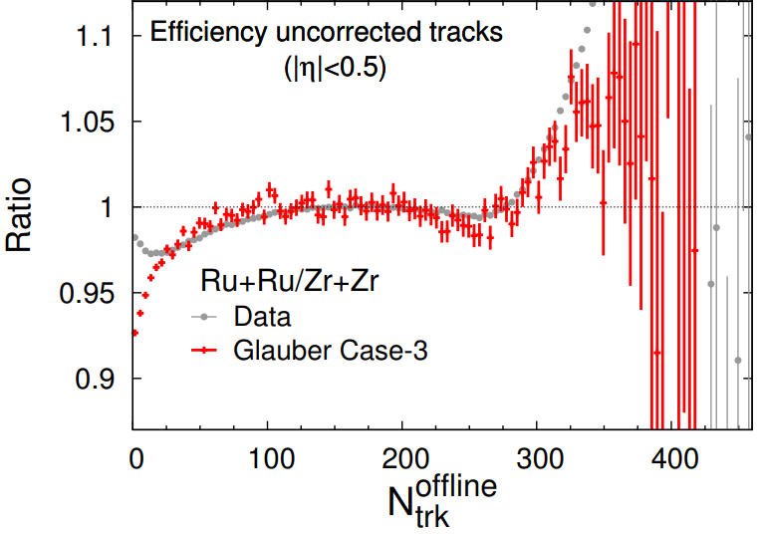
Isobar collisions at STAR - Multiplicity
Wilke van der Schee, CERN
Better to directly look at (raw) data
Experimental subtlety: crucial to correct
for detector efficiency
Trajectum subtlety: norm not fitted to RHIC energy: multiply mult by 1.21
Experiment misses (many) very peripheral collisions: multiply P(N) by 1.31 to correct for this (not for ratio)
Ratio experiment: normalise both and divide
Subtle: experiment unreliable for N_{trk} < 50
Ratio theory: integrate Ru+Zr experiment and Ru+Zr theory for N_{trk} > 50 and require ratio to match
Exp-theory comparison only depends on N_{trk} > 50
Only case 3, 4 and 5 match well over entire range (neutron-skin)
STAR, Search for the Chiral Magnetic Effect with Isobar Collisions at √s_{NN} = 200 GeV by the STAR Collaboration at RHIC (sept 2021)

Slide 14
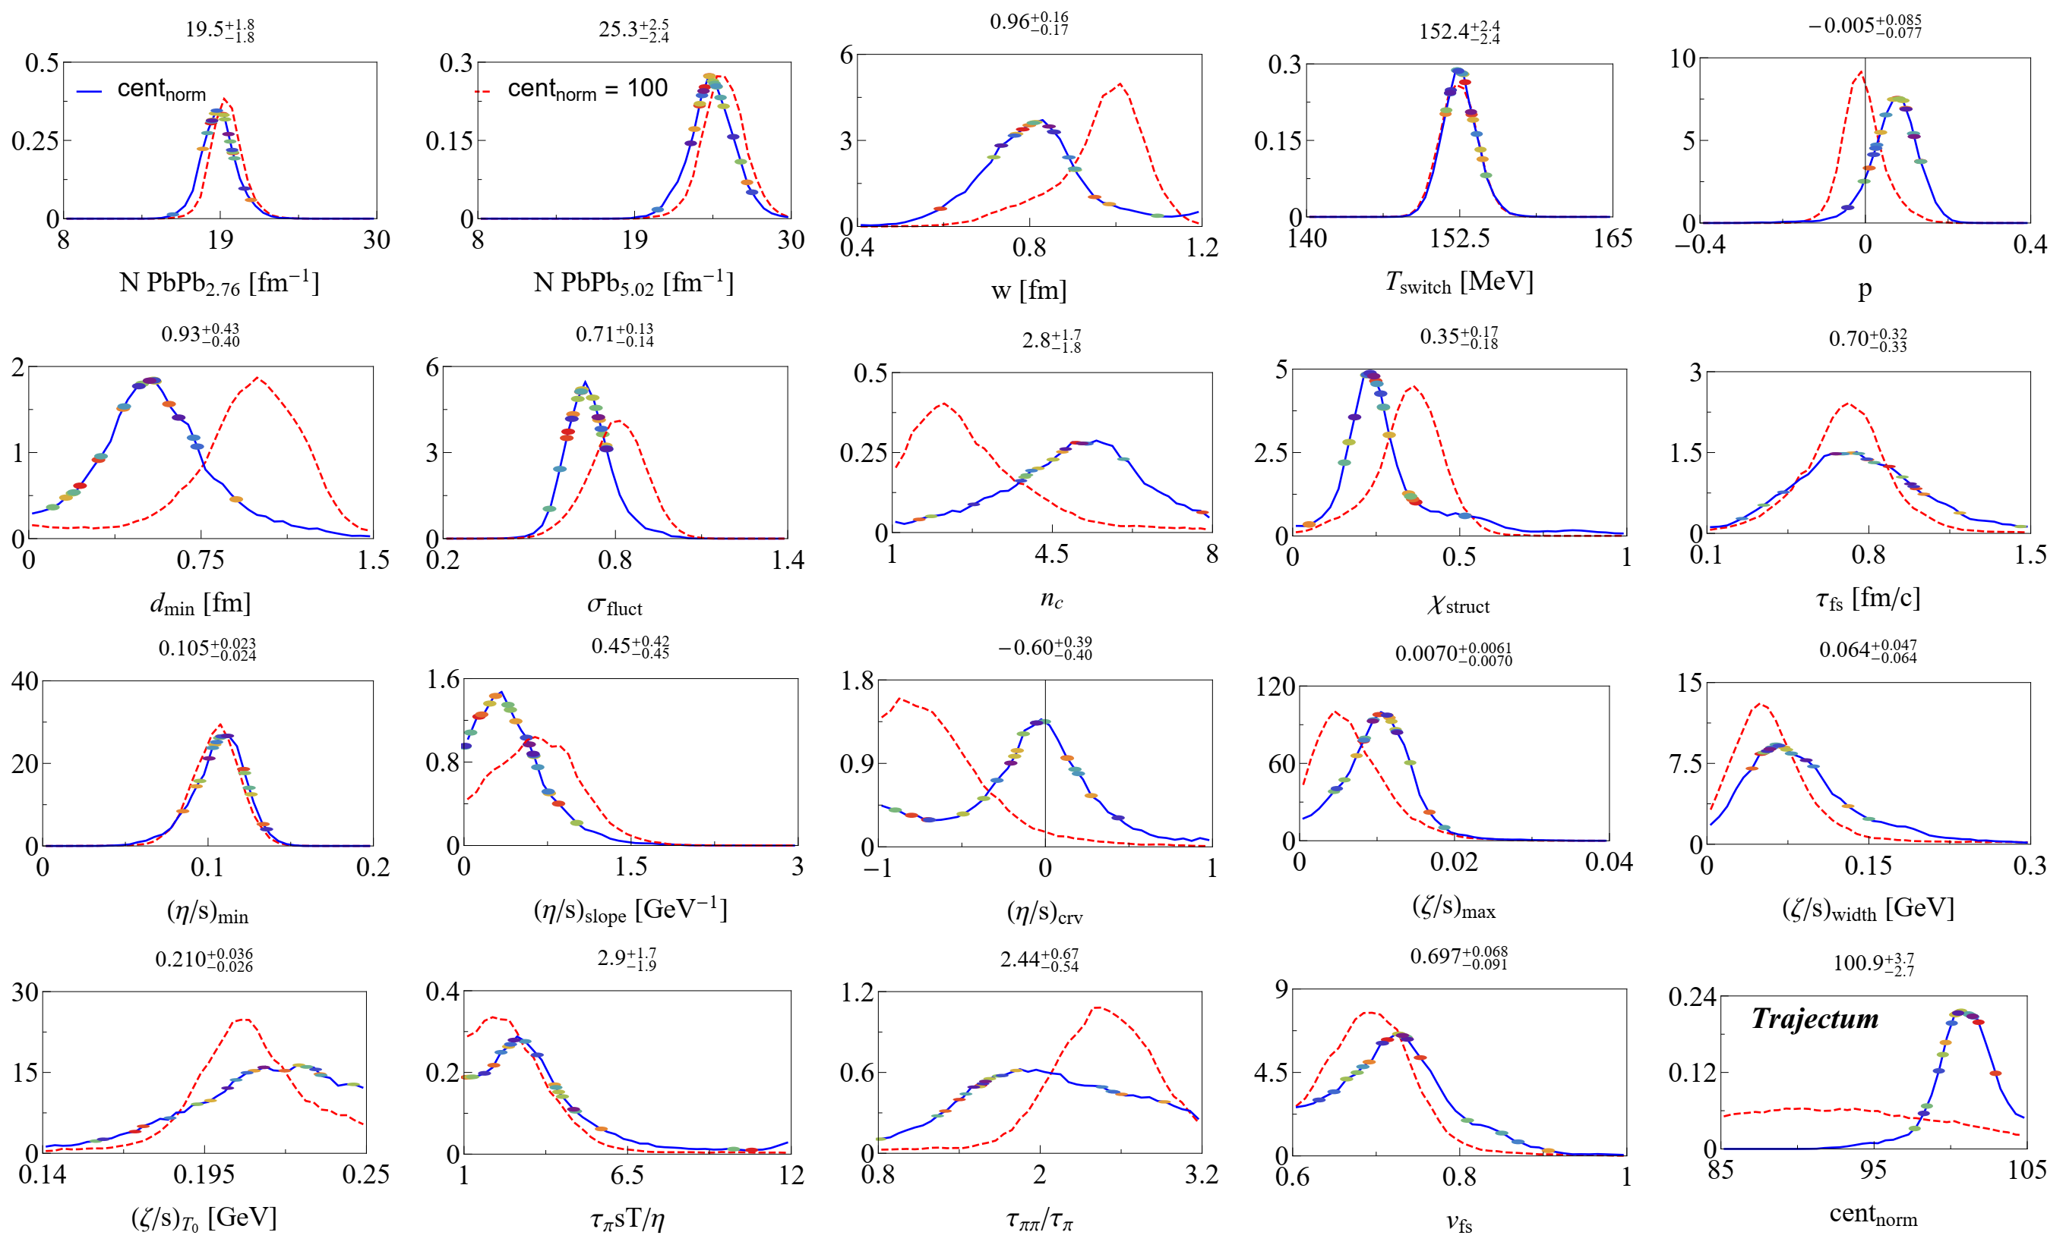
Posterior distributions
Wilke van der Schee, CERN
Dashed: standard cent_{norm}
  Emulation effects for cent_{norm} itself
Solid: posterior distributions
  More accurate than previously
Also indicated: 20 randomly drawn points
-> allows for systematic uncertainties
This work: take MAP
Govert Nijs, WS, Predictions and postdictions for relativistic lead and oxygen collisions with Trajectum (2021)

Slide 15
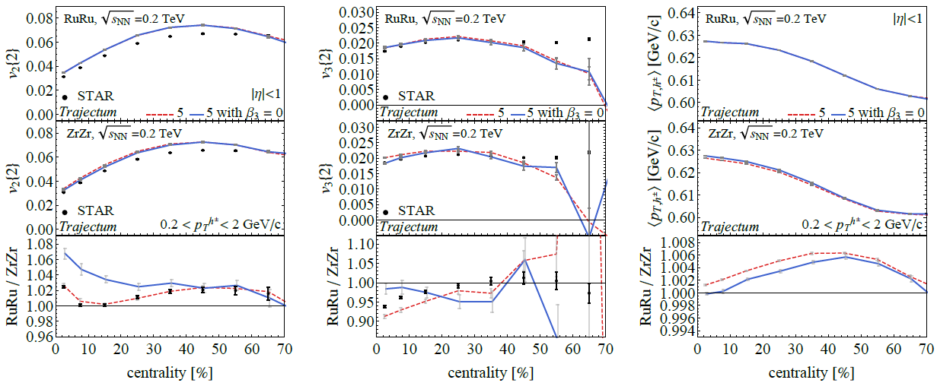
Effect of β₃ on observables
Wilke van der Schee, CERN
Clear effect on v₃, but also on v₂. Need a (Bayesian) refit of β₂ as well to fit v₂ and v₃?
Averaged
Fluctuating (realistic)

Slide 16
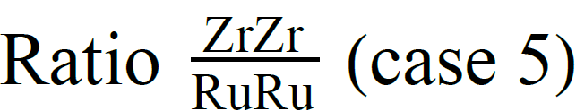
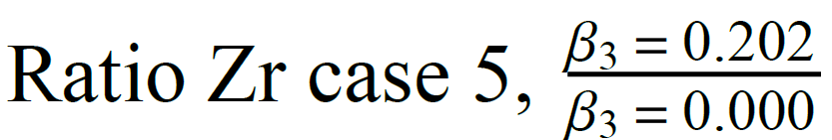
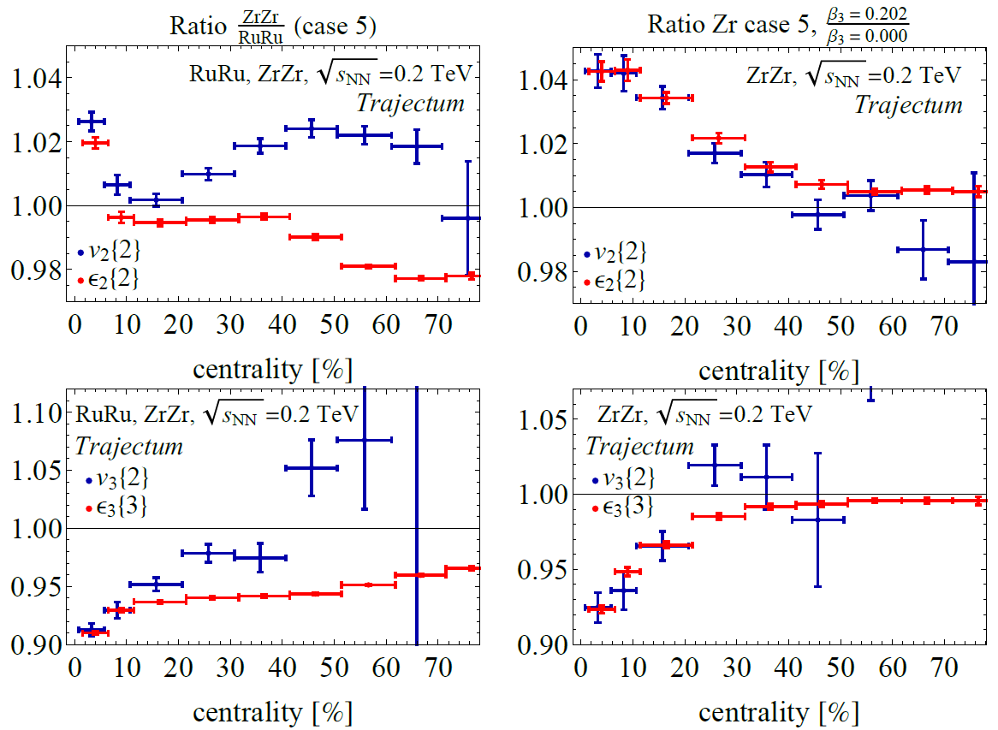
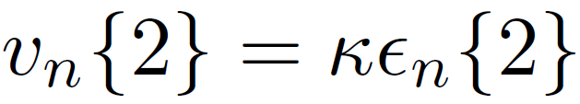
Initial state predictors
Wilke van der Schee, CERN
With large sample we can verify the relation
All else being equal this works,
e.g. within Zr as in right plots
If also size changes etc (Zr vs Ru), it can affect κ
and the initial geometry cannot be used
Unfortunate: hydro is expensive…

Slide 17
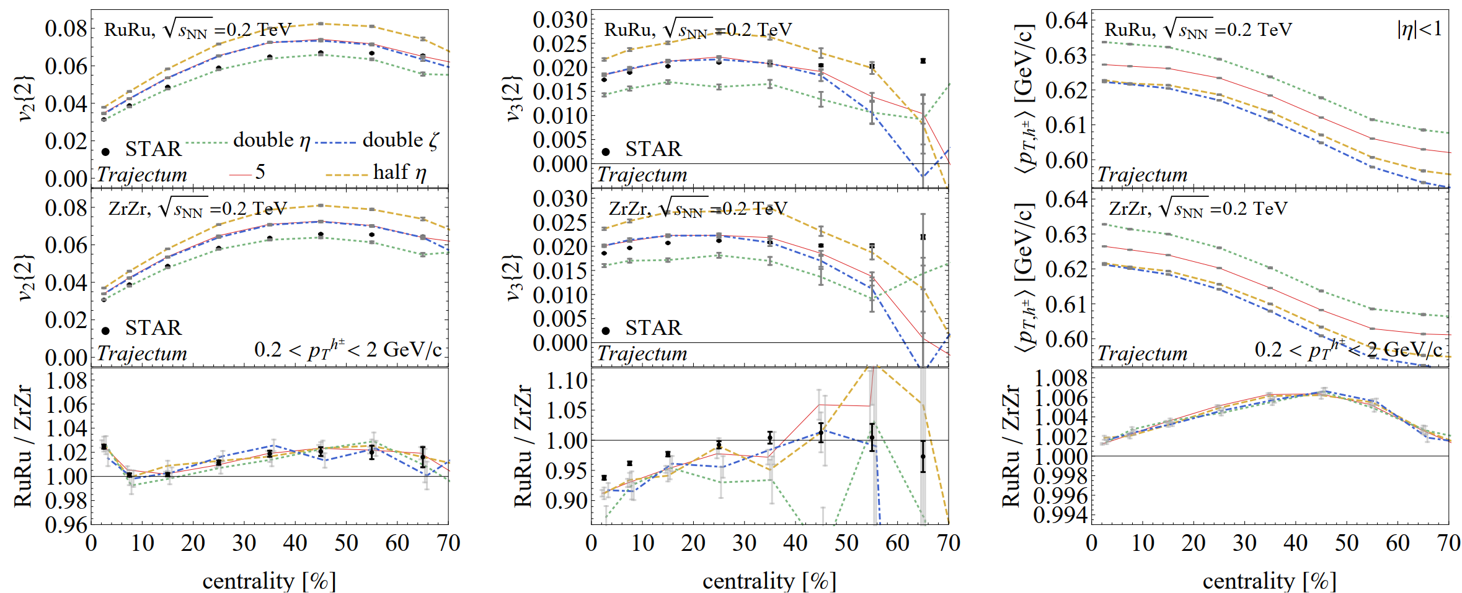
Effect of viscosity on observables
Wilke van der Schee, CERN
Clear effect on v₃, but also on v₂. Need a (Bayesian) refit of β₂ as well to fit v₂ and v₃?
Averaged
Fluctuating (realistic)

