Slide 1
Update MBHA-001 2020-03-06
TE-MSC-TF
F. Mangiarotti, G. Willering,
G. Ninet, V. Desbiolles
M. Bajko
Acknowledgements to all involved.

Slide 2
Tests done since last meeting
Reflectometry (Jaromir)
Impedance measurements (Jaromir)
6 kA discharge with standard protection
11.85 kA discharge with standard protection
HV tests: standard + special 200 V QH to QH
6 kA discharge with D1U QH delayed 100 ms

Slide 3
Special HV test
Each QH to each other QH: 200 V
All QH to coil: 300, 640, 1850, 3200 V
Coil to ground: 300, 640, 1850, 3300 V
All QH to ground: 300, 640, 1850, 3300 V
All tests passed OK

Slide 4
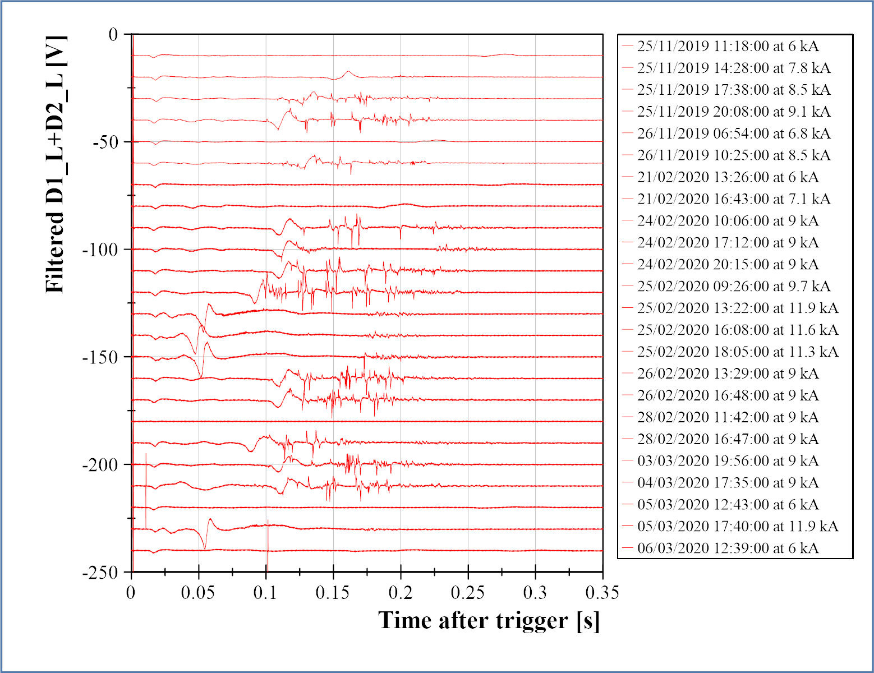
Summary of discharges so far
“Standard” 6 kA: no spikes
6 kA with delayed QH: no spikes
4.5 K
4.5 K
no DAQ
4.5 K
D1U QH delayed
D1U QH delayed
I include the “no DAQ” line to keep track of what was done

Slide 5
Summary of discharges so far
Nominal current discharges:
Very little spikes ~150-200 ms
4.5 K
4.5 K
no DAQ
4.5 K
D1U QH delayed
D1U QH delayed

Slide 6
Summary of discharges so far
4.5 K
4.5 K
no DAQ
4.5 K
At 8.5 kA we see many spikes before the “bump”
D1U QH delayed
D1U QH delayed

Slide 7
Summary of discharges so far
Trying to see the “envelope” of the spikes:
Get maximum absolute value every 10 ms
4.5 K
4.5 K
no DAQ
4.5 K
D1U QH delayed
D1U QH delayed

Slide 8
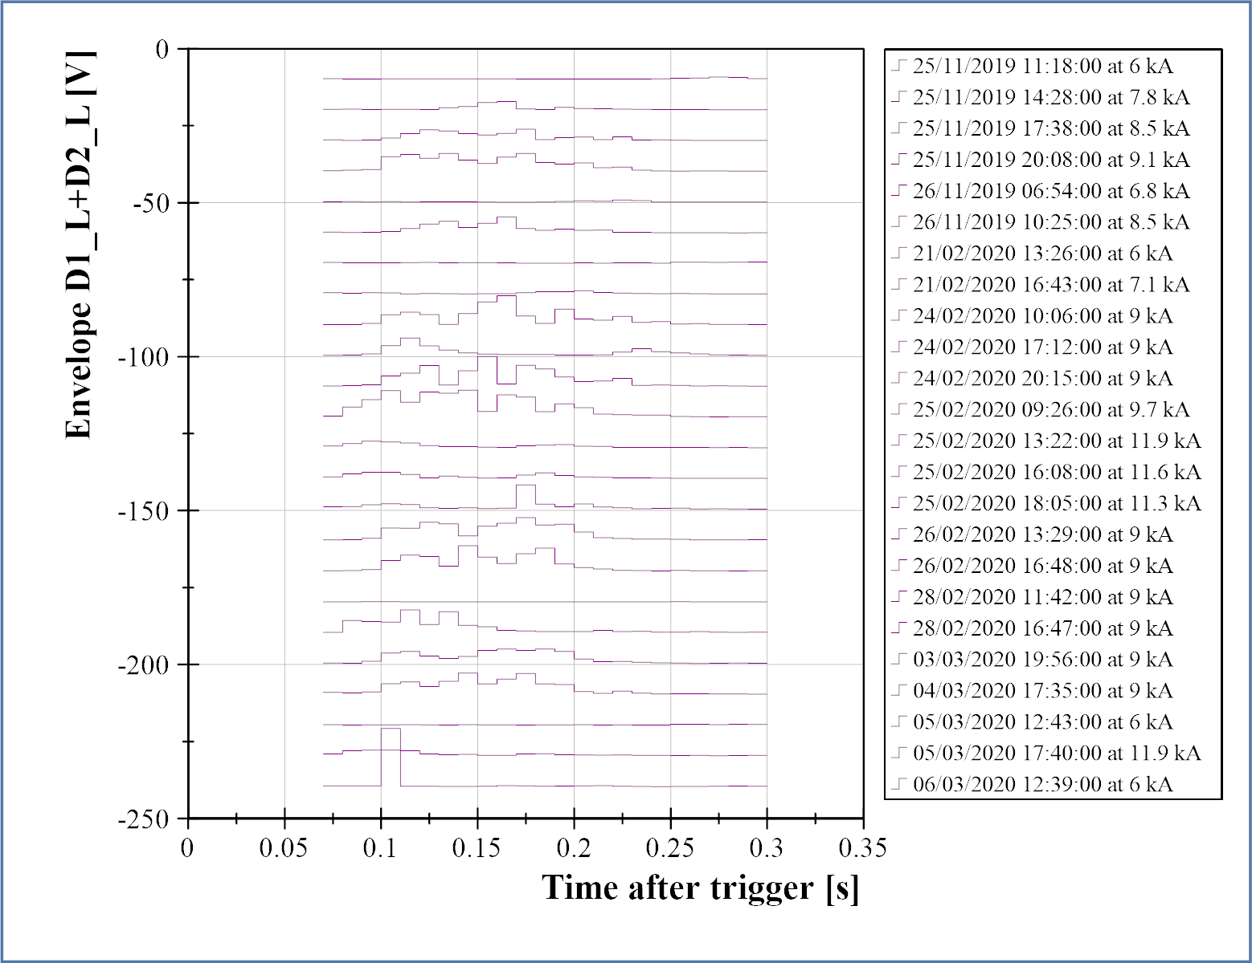
Summary of discharges so far
Trying to see the “envelope” of the spikes:
Get maximum absolute value every 10 ms
4.5 K
4.5 K
no DAQ
4.5 K
D1U QH delayed
D1U QH delayed

Slide 9
Summary of discharges so far
Trying to see the “envelope” of the spikes:
Get maximum absolute value every 10 ms
4.5 K
4.5 K
no DAQ
4.5 K
D1U QH delayed
D1U QH delayed

Slide 10
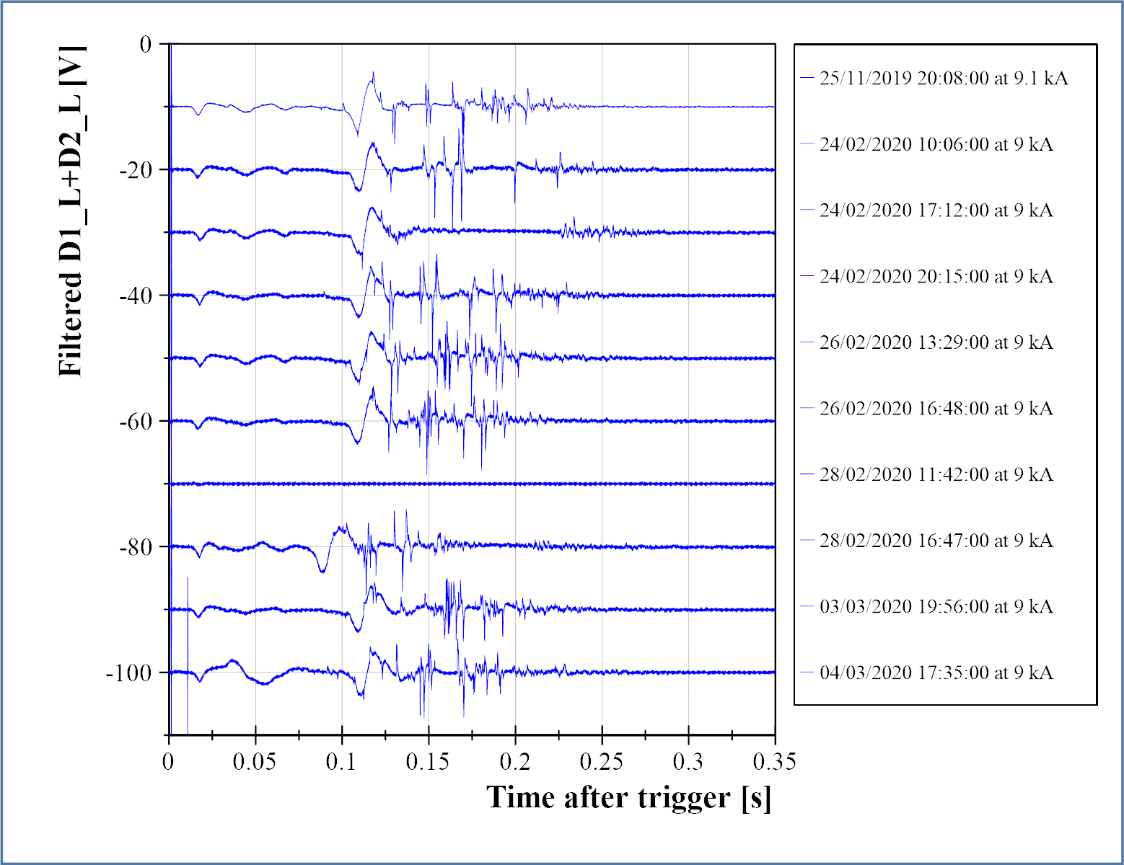
Summary of 9kA discharges so far
Same procedure for 9kA discharges
no DAQ
4.5 K
D1U QH delayed

Slide 11
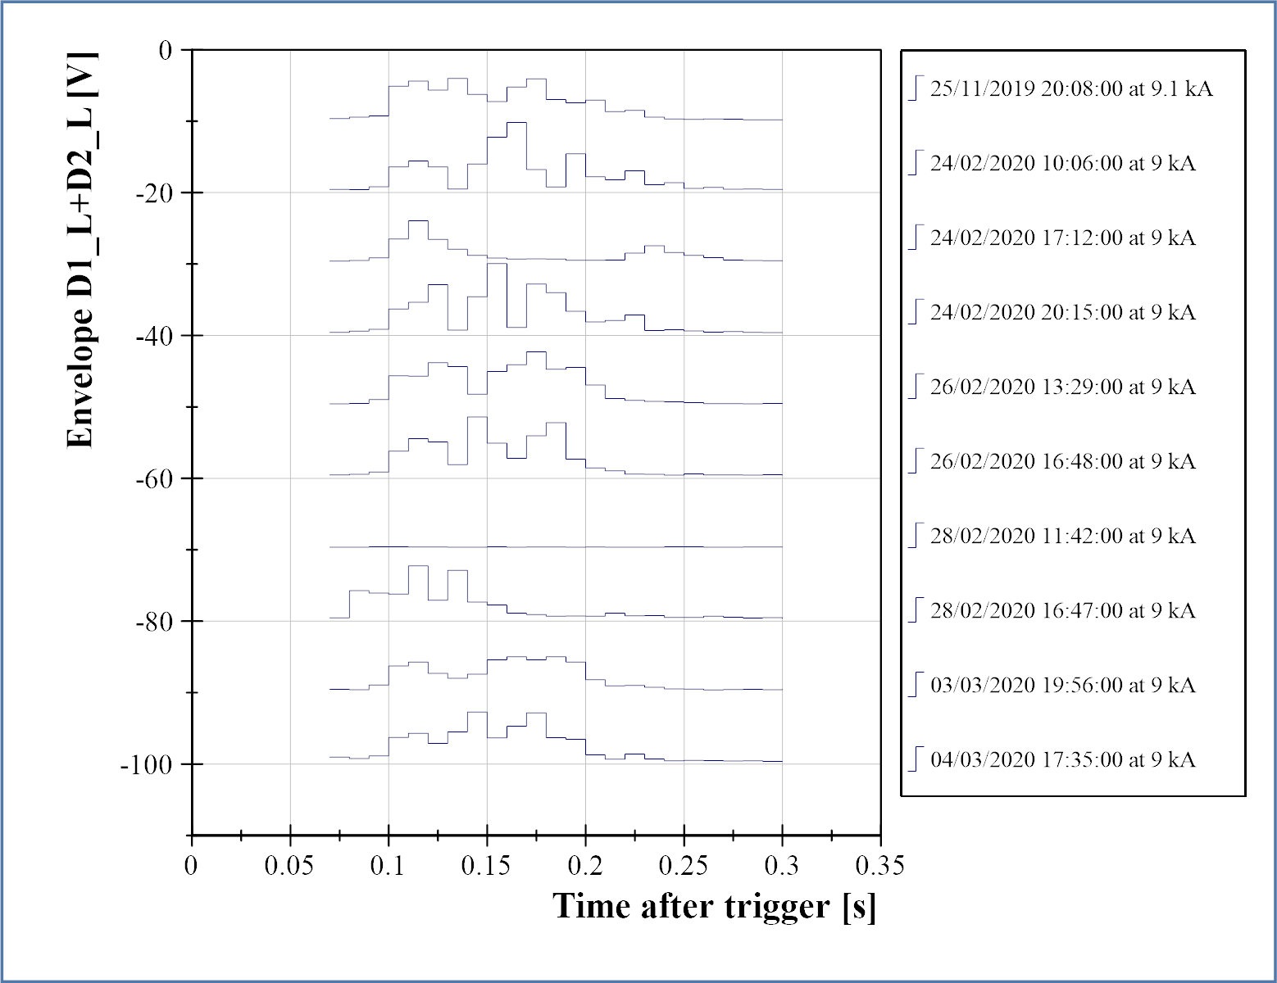
Summary of 9kA discharges so far
Same procedure for 9kA discharges
no DAQ
4.5 K
D1U QH delayed

Slide 12
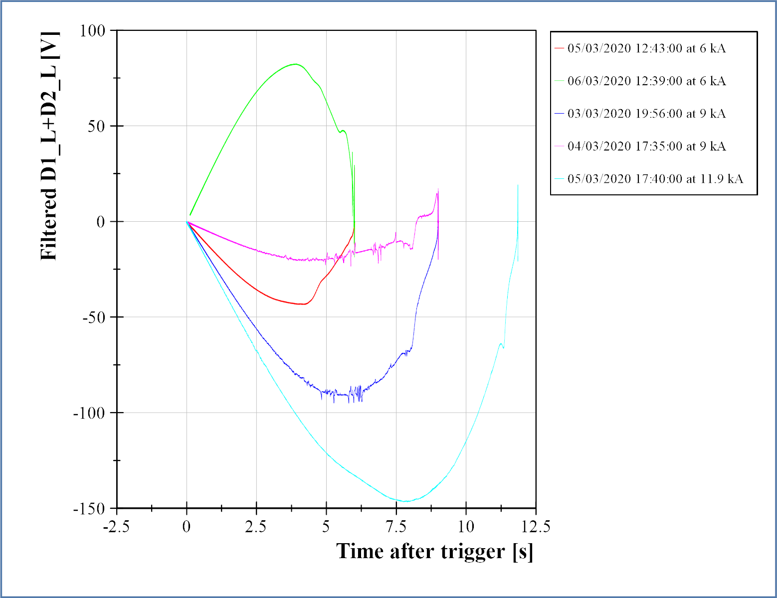
Suspected short voltage vs current
D1U QH delayed
Plot idea: Emmanuele Ravaioli
No clear correlation of current level or voltage level for spikes appearance

Slide 13
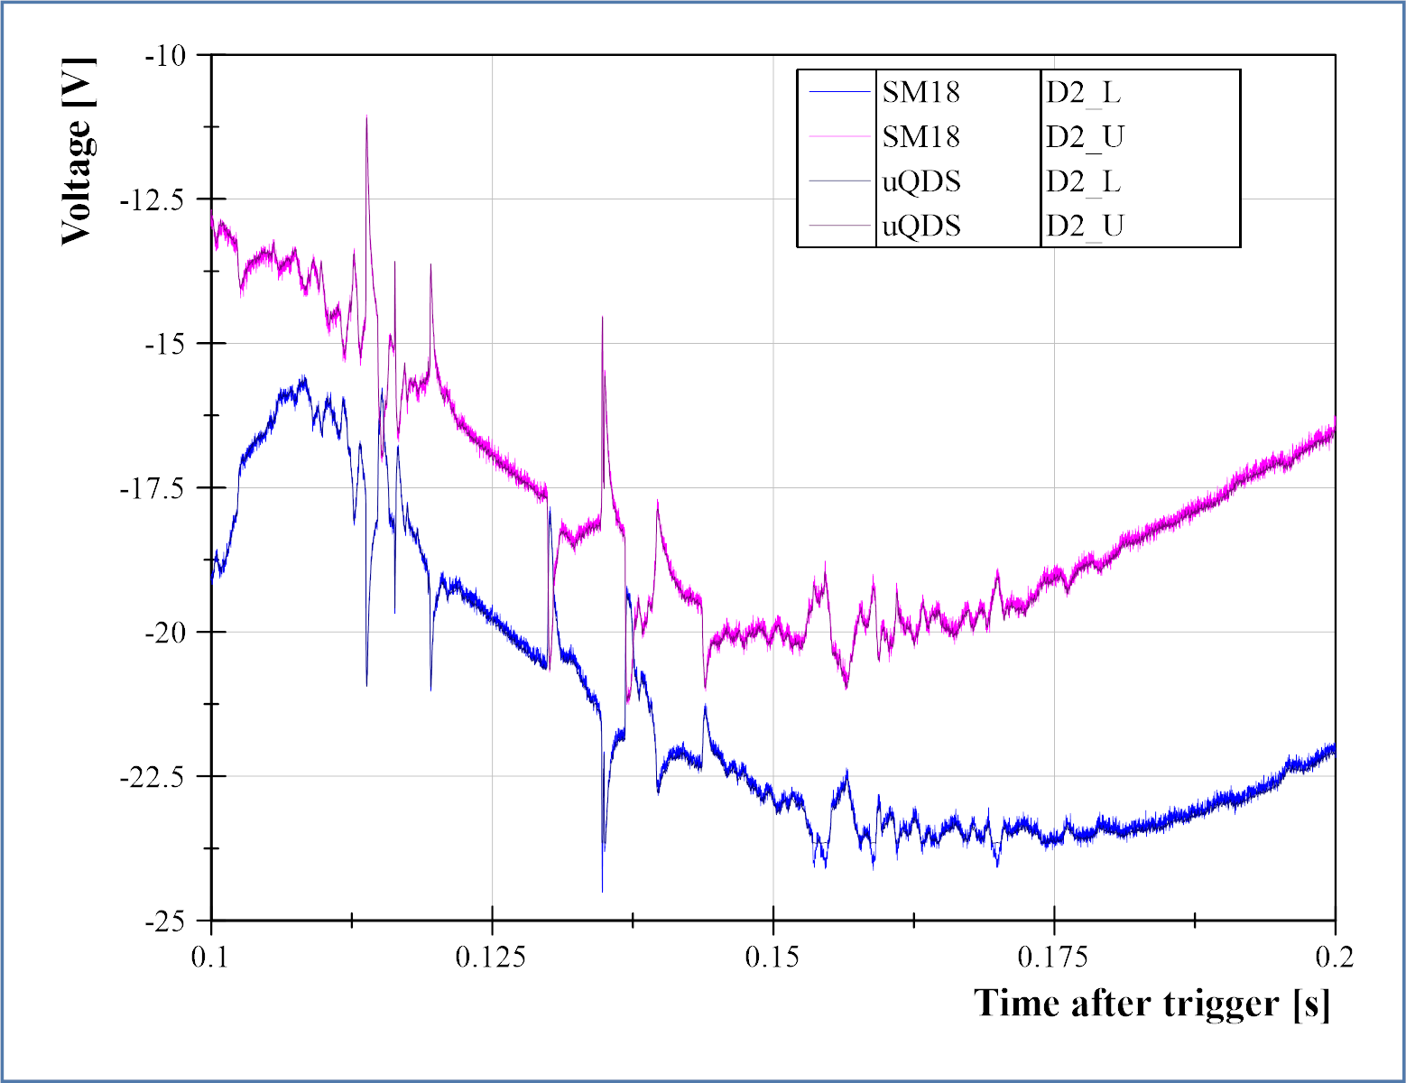
uQDS and SM18 DAQ spikes
SM18 and uQDS data recorded for the 4.5 K discharge at 9 kA
SM18 data at 50 kSPS + low pass filter (~600 Hz ?)
uQDS data at 205 kSPS
Spikes are identical

Slide 14
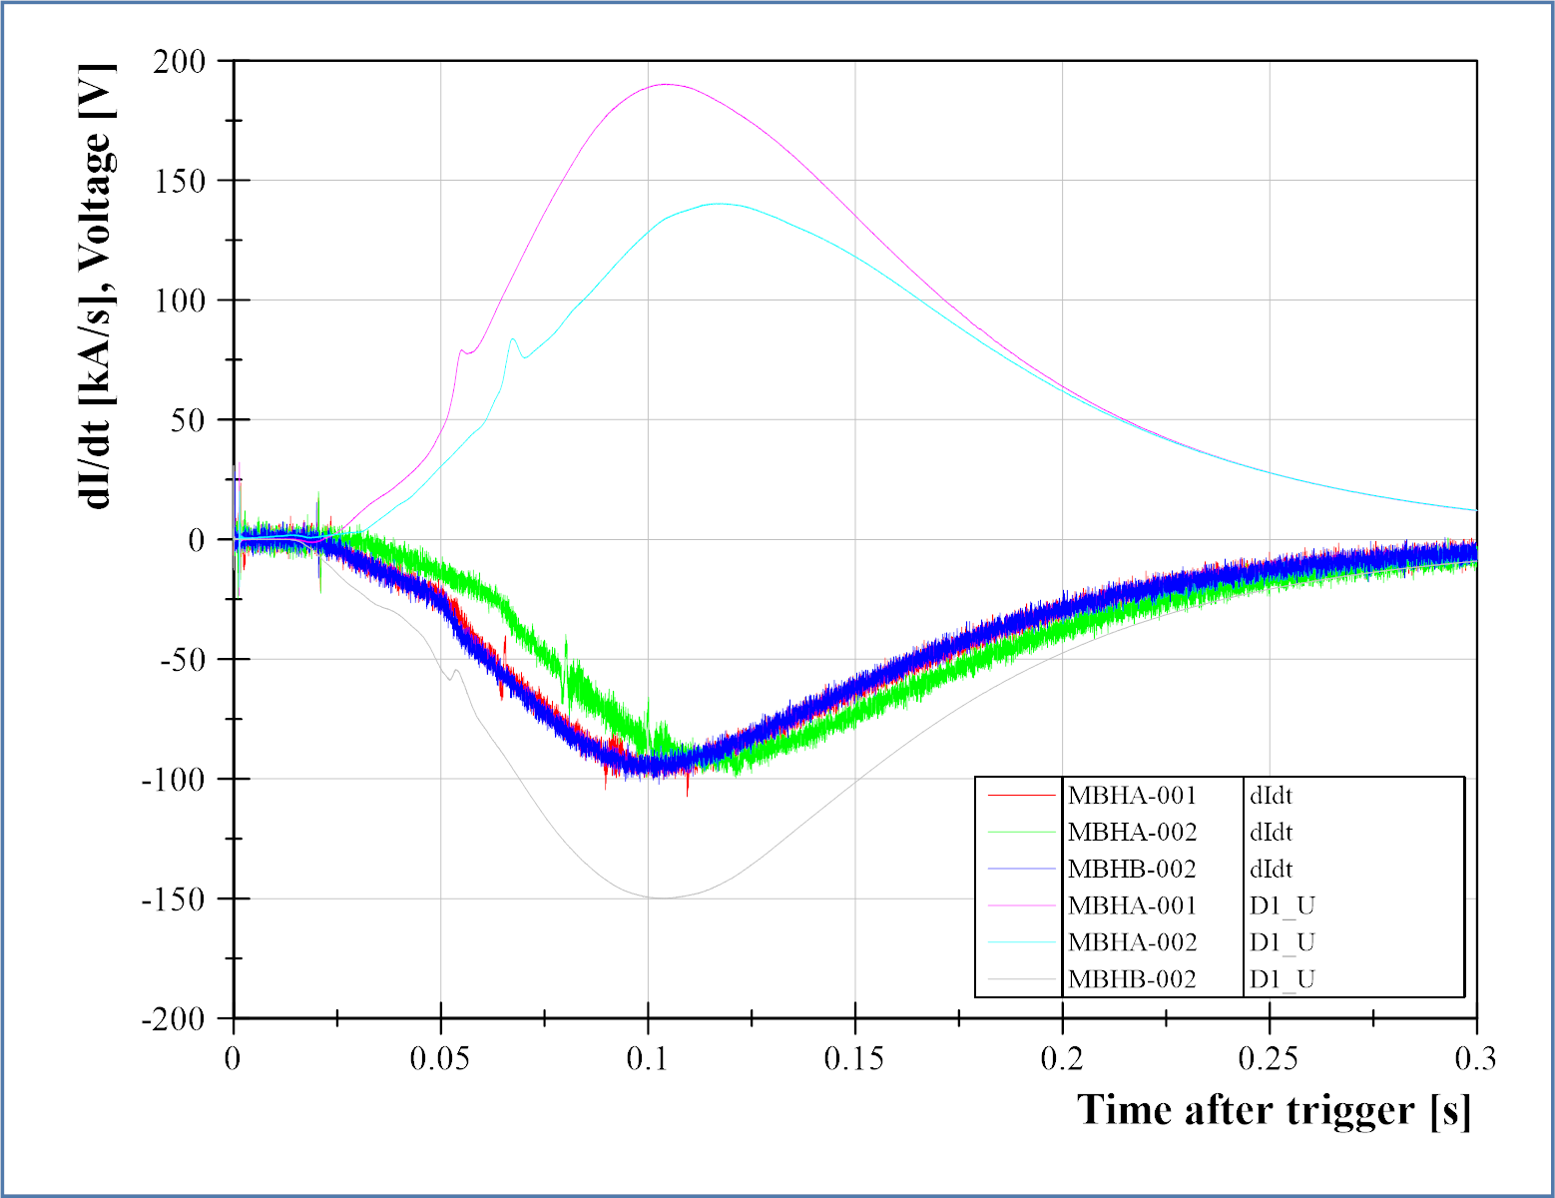
Bump in voltage and dI/dt
Discharges at nominal current (11.85 kA) for the three MBH magnets
Bump in voltage is visible in dI/dt as well
MBHA-002 has delayed bump and current decay due to external QH

Slide 15
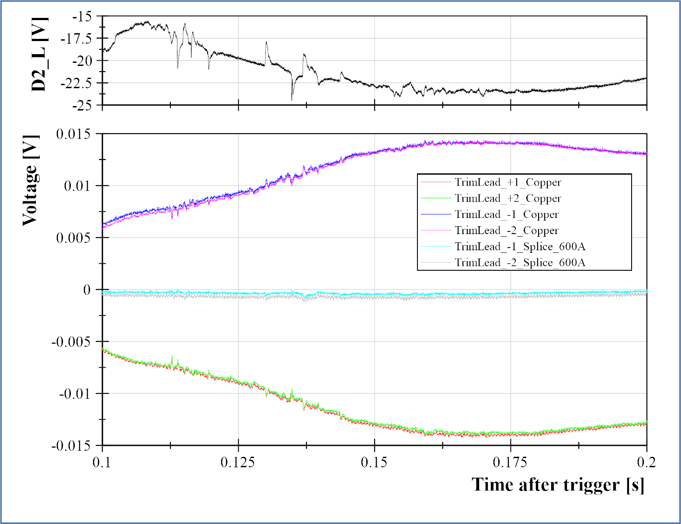
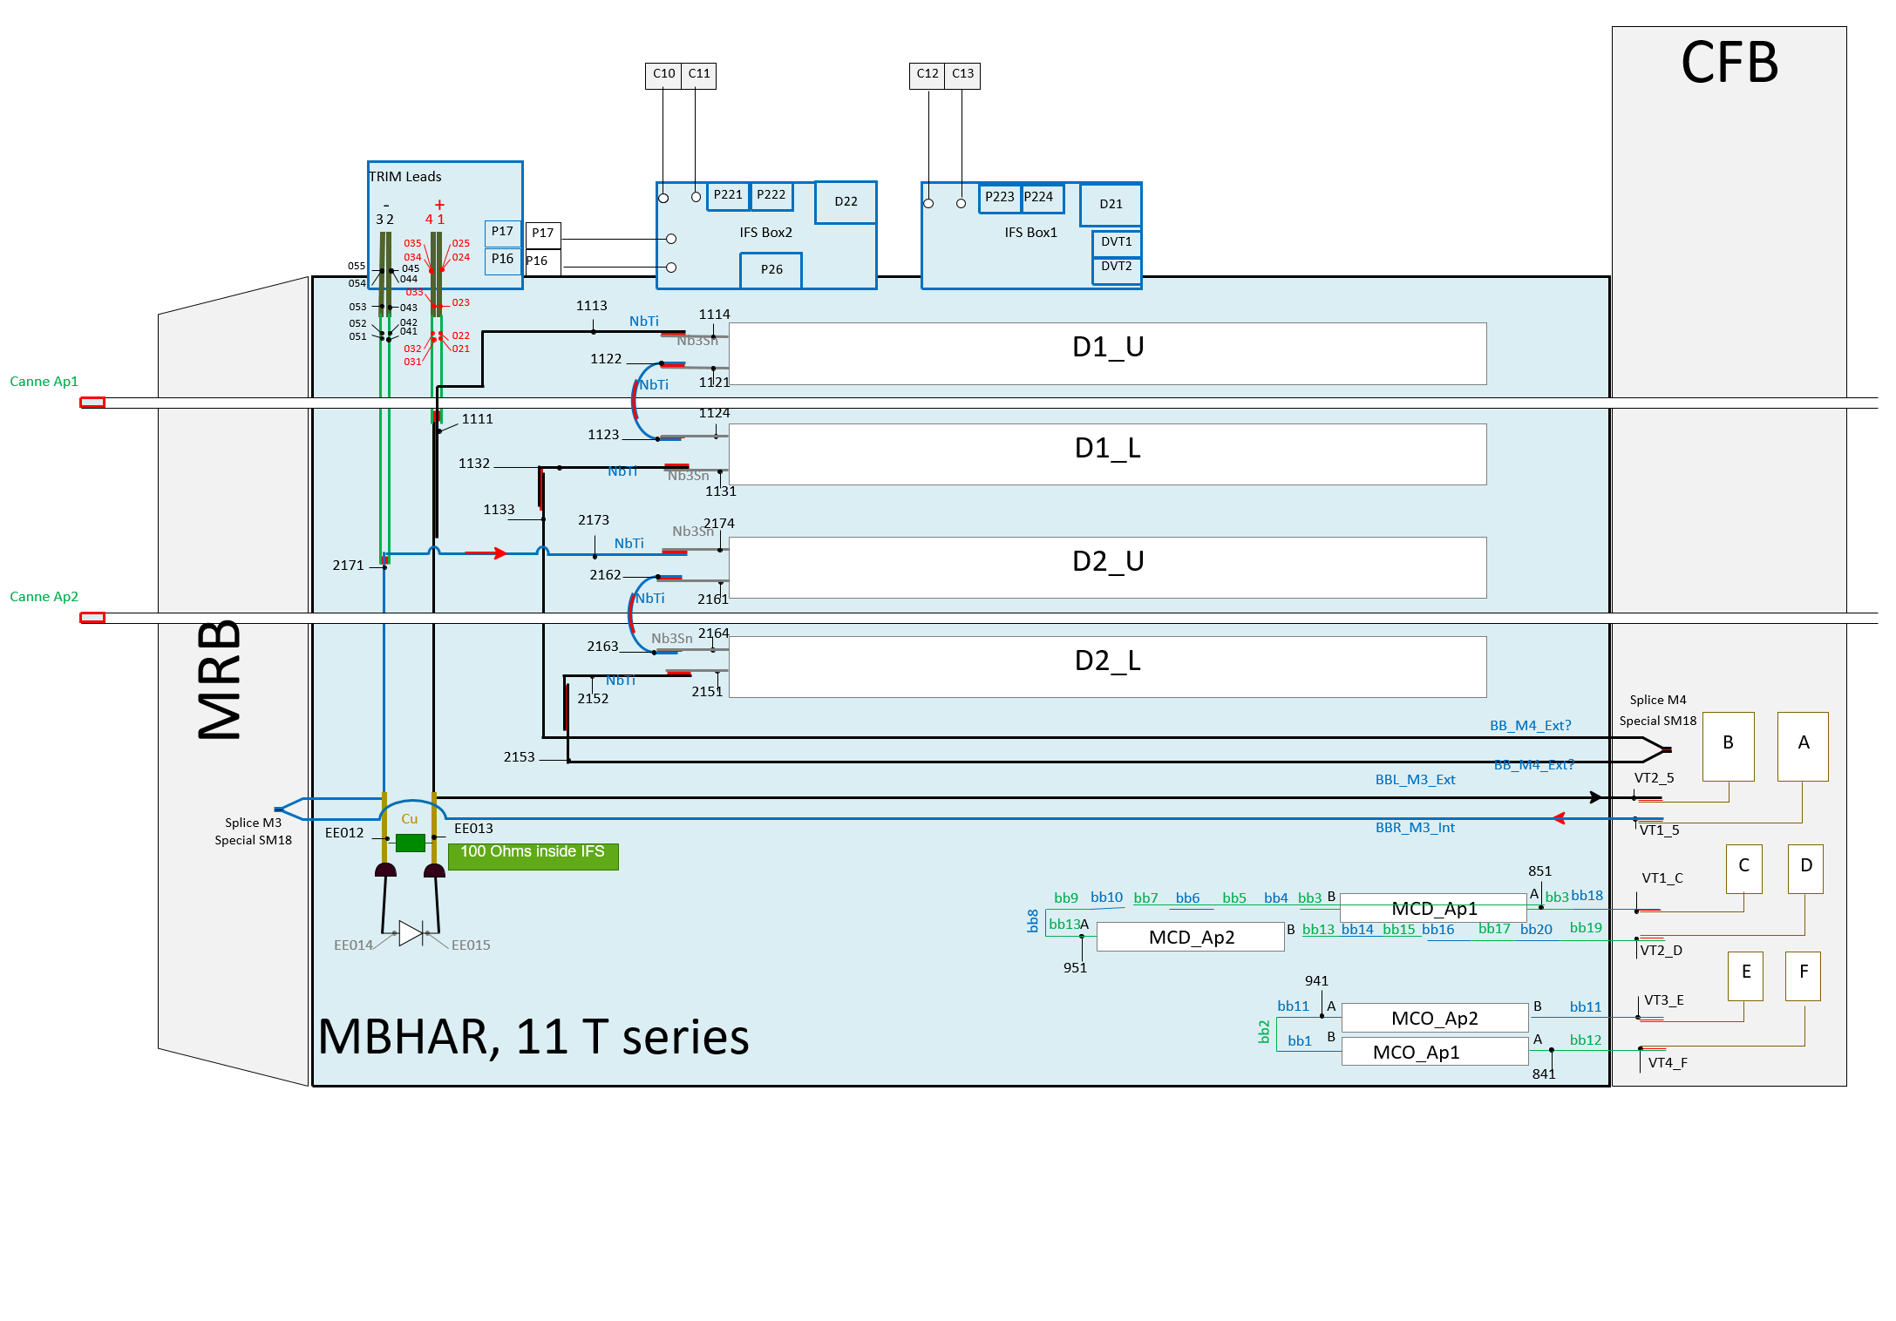
Trim leads spikes
We observe reaction to the spikes in the trim lead signals
Amplitude < ~1mV
We will continue to investigate
“copper”
“splice”

Slide 16
Next steps
10.5 kA discharge, standard QH
9 kA discharge, QH with inverse polarity
9 kA discharge, standard QH
9 kA discharge, standard QH, artificial short
9 kA discharge, QH at lower current ?
Impedance measurements at high current ?
SPA (-120 A/s) ?
Magnetic measurements ?

