Slide 1





Upgrade of the vertex detector of the Belle II experiment
Jerome Baudot, for the VXD Upgrade R&D Working Group of the Belle II collaboration
Context of the current VXD
Opportunity for a VXD upgrade
On-going relevant R&Ds
Full simulations for optimisation

Slide 2

The VXD roles within the Belle II setup
Physics program @ SuperKEKB with Belle II
  Thorough test of Std Model
  DIrect/indirect search for New Physics
  Hadronic Physics
  Based on accumulation of 50 ab⁻¹ of e⁺+e⁻ at √s = M_{Y(4S)}
    within ~10 years → instantaneous luminosity close to 10³⁶ cm⁻².cm⁻¹
The Belle II experiment
  “classical” B-factory detector + enhanced features
with billions of $B\overline{B},c\overline{c}$, $τ\overline{τ}$ pairs
In “clean” environment of B-factory
⇒ The Belle II physics book
PTEP 12 (2019) 123C01
SuperKEKB collider implementing
the nano-beam scheme @ high currents
High collision rate
High beam-induced bkg
LHC
outer ITK
The vertex detector (VXD)
  Better vertexing ← lower boost
  Smarter tracking ← higher hit rate
  + Harsher radiation environment
  + Belle II trigger rate ~ 30 KHz
Belle II
Radiation tol.
ee Higgs factory
vertex
Granularity & Material

Slide 3
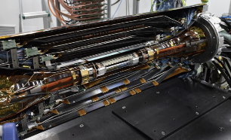
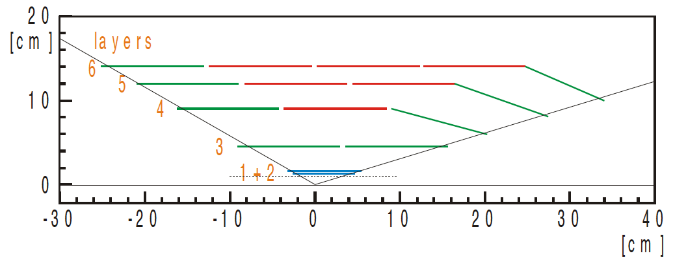
The current VXD
Two technology system
  SVD = Double-Sided Strip Detector
    Read-out sensor connected on sensor = Origami
    Hit time-stamping σ_{t} ~ 2-3 ns
    Spatial resolution σ_{s.p.}~ 20 μm
  PXD = DEPFET sensors
    Very low material budget 0.2 % X₀ / layer
    Small first layer radius = 1.4 cm
    Long integration time 20 μs / trigger rate & injection bkg
    G.Rizzo SVD overview talk on Monday
      + Y.Uematsu Hit-time reconstruction poster
      + S.Hazra Particle identification Poster
65 cm long – 30 cm in diameter
Strips
1.2 m²
Pixels
0.3 m²
⇒ Q.Liu PXD overview talk on Monday
The plan is successful so far! ⇒ C.Praz Tracking performance and interaction point properties talk on Tuesday

Slide 4
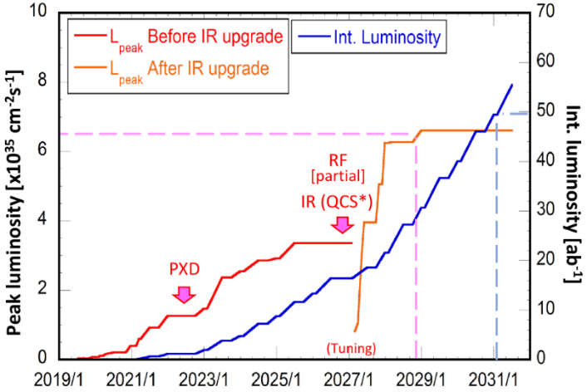
A decade of operation → Upgrades?
Short term ~ 2026
  Long shutdown for QCS upgrade
    Needed before next jump in luminosity
  Inner region needs to be opened up
    Current VXD moved anyway
  Opportunity for Belle II sub-det. upgrades
    Let’s investigate possibilities…
    short time → with currently ~available techno.
Longer term > 2030
  Further increase of peak luminosity
    Possibly beam polarization?
    Enhanced physics program with 250 ab⁻¹
  A renewed detector is needed
    New set of requirements → not this talk!
Current SuperKEKB-Belle II projection (June 2020)
Target L_{int}
Target L_{peak}
2026 L_{int}

Slide 5
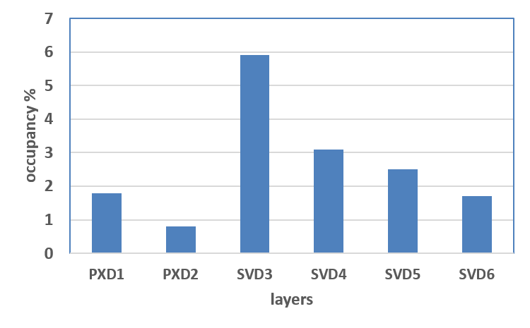
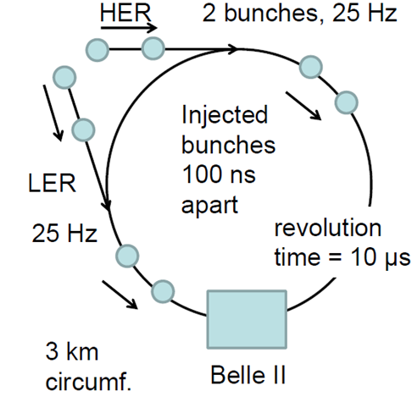
Current VXD & nominal luminosity
Beam-induced background extrapolations
  A long way to reach Data/MC ratio ~ O(1)
  Still with large uncertainties
    Drastic change of beam optics for max L_{peak}
      β_{y}* today 800 μm  nominal 300 μm
    Continuous injection effect not predicted
      currently too small for good estimate
⇒ Belle II VXD Open workshop July 2019
Tracking / vertexing
  Track pattern recognition with SVD hits only
  required in // to tracking in Central Drift Chamber
  Then extrapolation to match PXD hits
    Also used for reduction of PXD output bandwidth
  Final pointing resolution somewhat limited
  by beam-pipe thickness
    0.8 % X₀ ← partially required against synchrotron rad.
Current prediction @ nominal L_{peak}
with hit-time rejection
PXD DAQ limit
Good tracking limit
Performances within limits
BUT without much margin

Slide 6
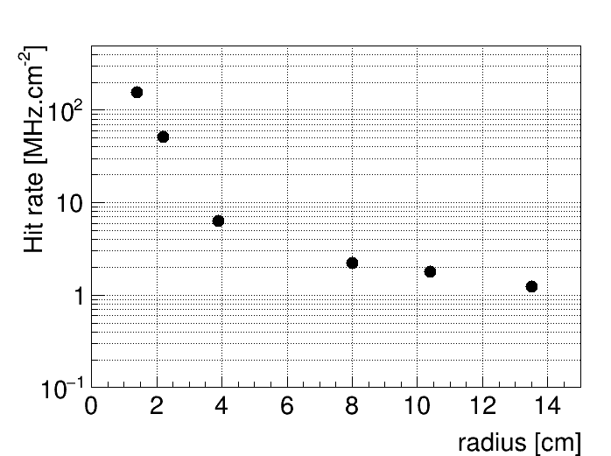
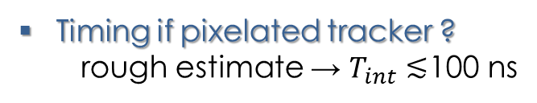
Requirements for short-term VXD upgrade
Vertexing & Tracking performances at least as good as current VXD
  Radius range 14 – 135 mm
  Single point resolution ≤10-15 μm
Robust against environment for inner layer (r=1.4 cm)
  Hit-rate ~ 120 MHz.cm⁻²
  Total Ionizing Dose ~ 10 Mrad / year
  NIEL fluence ~ 50x10¹² n_{eq}.cm⁻² / year
Possibly improve performances
  Impact parameter resolution
  Tracking efficiency (p_{T} < 100 MeV) & Fake rate
  Faster High Level Trigger
    Simplified track pattern recognition
  Total material budget < (2x 0.2 + 4x 0.7) % X₀
    total power budget < 1000 W
For trend only
(no uncertainties)
 Based on current extrapolation with safety factor (x5)
bear In mind large uncertainties (previous slide)
Timing if pixelated tracker ?
rough estimate → $T_{int}≲$100 ns

Slide 7
Current strategy
General concepts
discussed
Full simulation
→ performances
R&D efforts
Keep Strips+Pixels
with upgraded performances
~ current Belle II concept
Thin & fine-pitch strips
standard Belle II
geometry
DEPFET pixel sensors
All pixel layers
with upgraded techno.
~ ALICE ITS2 concept
SOI pixel sensors
+
New geometry
implemented
Integration concept
for layer ~ 0.1-0.3 % X0
CMOS pixel sensors
(various flavours)
within Belle II Upgrade group
R&D groups
(outside Belle II welcome!)
Which concepts bring best performances?
Which technology fit requirements?
Which technology can allow install in ~2026?
Effort built up to answer
within ~1 year
CDR

Slide 8
Thin and fine-pitch DSSD
@ KEK
Main R&D targets
  Handling higher hit-rate / SVD
    10 MHz/cm² (radii>3 cm)
  Improved resolution σ_{z}
  & decrease material budget
  Longer trigger latency & rate
R&D paths
  Shorter strips
  Finer pitch
  Thinner sensor
R&D challenges
  Heat dissipation (larger #chan.)
  Noise reduction (lower signal)
Solutions
  Double-Sided Sensors prototyped by Micron
  Front-End ASIC = SNAP128A under dvpmt
    Based on SliT chip for g-2 (J-PARC experiment)
    180 nm CMOS process
Sensor dim. | Thickness | Pitch P-side | Pitch N-side
40x125 mm² 60x125 mm² | 300-320 μm | 50-75 μm | 160-240 μm
Current
  ENC = 650 e-
  Total power 2.8 mW/chan.
  127 MHz output
  σ_{t} ~ 8 ns
  2k-depth memory
  → latency ~16 μs
(with intermediate strip)
Upgrade
51.2x57.6 mm² | 140 μm | 50 μm | 75 μm
128 inputs
⇒ K.Nakamura Development of thin and fine-pitch DSSD poster
⇒ First Sensor+FEE in 2021

Slide 9

DEPFET pixel sensors
Drain Current Digitizer
DCD
Data handler
Belle II DEPFET collaboration
Current Belle II - PXD
  First use of the technology in HEP experiment
  Many lessons learned
R&D directions
  Gain increase with shorter FET length L
    thinner oxide
    higher signal → improved rad. tolerance
  Rotating read-out direction + switcher intergration
    Speed x3
    Pixel size along beam x1/2
  Faster driving & read-out circuits
    Require advanced processed
    Speed x2
  All-silicon module improvements
    Microchannel cooling
    Thinner drivers
switcher
$$g=\frac{\text{d}I_{\text{drain}}}{\text{d}Q}∝\sqrt{\frac{t_{\text{ox}}}{L^{3}}}$$
45/62 mm along beam
switcher
DCD
Within reach
  T_{int}: 20  3 μs
  Improved σ_{z}
  Mat. budget 0.21  0.15 % X₀

Slide 10
DuTiP - SOI pixel sensors
@ KEK
Main R&D targets
  Low material budget
    Monolothic technolgy
  Handling high-rate
    Time-stamping < 100 ns
    Global-shutter style
Dual Timer Pixel concept
  16 MHz clock for TIMER
  2x 60 ns “integration” window
  Trigger latency 8 μs
  Occupancy << 0.1 %
SOI Implementation
  0.2 μm LAPIS
  Full depletion
  Pixel pitch 45x45 μm²
  Sensitive thickness 50-75 μm
Pixel layout
In pixel
45 μm
7  0
~ ALPIDE
FEE
2x timers
Comparison with counter
⇒ Initial prototype DuTIP 1
submission in Nov.2020
⇒ M.Yamada R&D status of monolithic SOI pixel sensor for vertex detector talk on Wed.

Slide 11
CMOS pixel sensor optionS
⇒ Various R&D on-going outside Belle II
⇒ Monolithic sessions on Wednesday
Sensor available 2020 | MIMOSIS-1 (CBM-MVD) | Belle II requirements “First guess” | MONOPIX-2 (ATLAS-ITK) | ATLASPix3 (ATLAS-ITK)
Time precision (ns) | 5000 | 50 to 100 | 25 | 25
Pixel pitch (μm²) | 30x27 | 30x30 to 40x40 | 33x33 | 150x50
TID (Mrad) | 5 | 10 | 100
Power (mW/cm²) | ~50 | < 100 to 200 | ~150 | ?
Trigger delay (μs) | No trigger | 5 → 10 | long
In test
IPHC
Submitted
Bonn, CERN, CPPM
Tested
Barcelona, CPPM, Geneva, Heidelberg, KIT, Liverpool
180 nm HR-CMOS process
~full depletion
180 nm HV-CMOS process
In pixel
Periphery
Demonstrated
  Monolithic & low power → low material budget granted
  Excellent granularity → σ_{s.p.}~ 5-10 μm
  Short integration → occupancy = O(10⁻³)
  ⇒ 1st dedicated version in 2021 ~ realistic
amp
comp
Timing / Trigger
logic
sensing
node
(+ToT)

Slide 12
Integration concept
Context = new geometry with all VXD fully pixelated
@ IFIC, Valencia
Inner layers = full silicon module
  2 to 3 layers, radius < 4 cm
  Target 0.1 % X₀ / layer
Outer layers ~ ALICE-ITS concept
  3 to 4 layers, radius 4-14 cm
  Target 0.3 % X₀ / layer
C.Marinas
G.Vidal
C.Gargiulo
CERN - ALICE

Slide 13
Integration concept
Context = new geometry with all VXD fully pixelated
Inner layers = full silicon module
  2 to 3 layers, radius < 4 cm
  Target 0.1 % X₀ / layer
Outer layers ~ ALICE-ITS ladder concept
  3 to 4 layers, radius 4-14 cm
  Target 0.3 % X₀ / layer
Forward disks
  2 disks at z= 16.5 & 25.6 cm
  Target 0.3 % X₀ / layer
@ INFN-Pisa
F.Bosi
M.Massa
C.Gargiulo
CERN - ALICE
Disk (Ring 2)

Slide 14
Simulated tracking performances
Context = new geometry with all VXD fully pixelated = VTX
Realistic pixel sensor model
  Digitizer assuming
    fully depleted thin layer 30 μm
    Pixel 33x33 μm² with 7bits Time over Threshold
  Tuned with Monopix-1 beam data
    JINST 14 (2019) C06006
    Pitch 40x40 μm²
    ToT 6 bits
θ=60º
θ=0º
Monopix-1 data from Bonn group
Test-beam at DESY with 5 GeV e-
Results by T.Fillinger (Strasbourg), B.Schwenker (Göttingen), C.Wessel (Bonn)

Slide 15
Simulated tracking performances
Context = new geometry with all VXD fully pixelated = VTX
Realistic pixel sensor model
  Digitizer assuming
    fully depleted thin layer 30 μm
    Pixel 33x33 μm² with 7bits Time over Threshold
  Tuned with Monopix-1 beam data
Geometry
  Taken from fast simulation
  5 or 7 barrel layers with/without 2 forward disks
  Crude layer description but with targeted material budget
  → per layer: 0.1 % X₀ for radii <4 cm then 0.3 % X₀
Full tracking chain
  VTX standalone
  CDC standalone
All VTX layers included in pattern-reco.
→ other possible simpler/faster scheme
⇒
beneficial to
High Level Trigger
then combined
Results by T.Fillinger (Strasbourg), B.Schwenker (Göttingen), C.Wessel (Bonn)

Slide 16
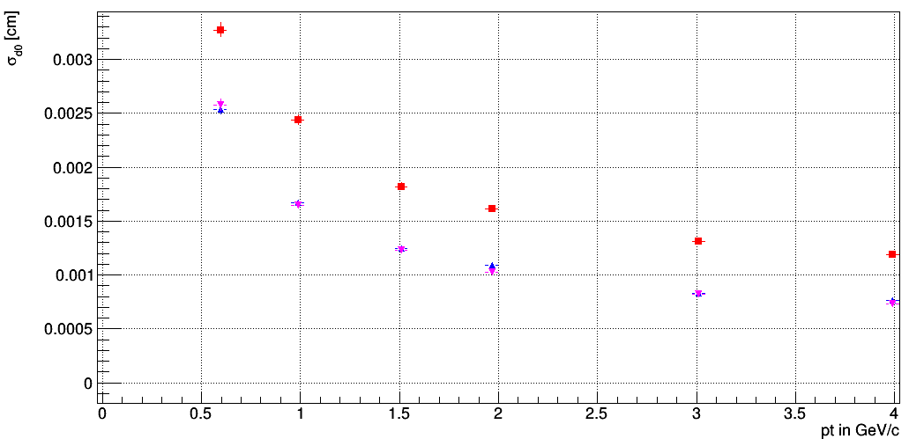
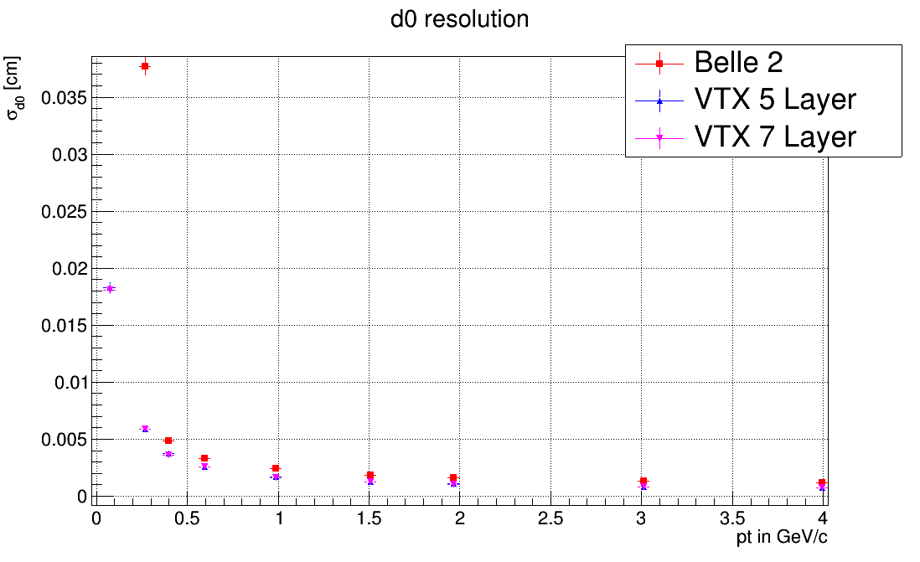
Simulated tracking performances
Context = new geometry with all VXD fully pixelated = VTX
Realistic pixel sensor model
  Digitizer assuming
    fully depleted thin layer 30 μm
    Pixel 33x33 μm² with 7bits Time over Threshold
  Tuned with Monopix-1 beam data
Geometry
  Taken from fast simulation
  5 or 7 barrel layers with/without 2 forward disks
  Crude layer description but with targeted material budget
  → per layer: 0.1 % X₀ for radii <4 cm then 0.3 % X₀
Full tracking chain
  VTX standalone
  CDC standalone
Preliminary
then combined
Results by T.Fillinger (Strasbourg), B.Schwenker (Göttingen), C.Wessel (Bonn)

Slide 17
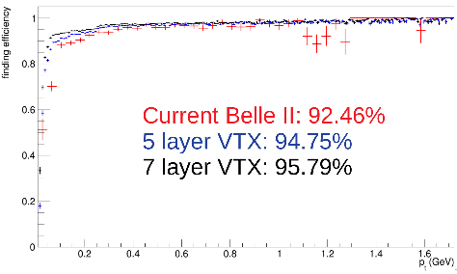
Simulated tracking performances
Context = new geometry with all VXD fully pixelated = VTX
Realistic pixel sensor model
  Digitizer assuming
    fully depleted thin layer 30 μm
    Pixel 33x33 μm² with 7bits Time over Threshold
  Tuned with Monopix-1 beam data
Geometry
  Taken from fast simulation
  5 or 7 barrel layers with/without 2 forward disks
  Crude layer description but with targeted material budget
  → per layer: 0.1 % X₀ for radii <4 cm then 0.3 % X₀
Full tracking chain
  VTX standalone
  CDC standalone
Preliminary
then combined
Results by T.Fillinger (Strasbourg), B.Schwenker (Giessen), C.Wessel (Bonn)

Slide 18
Summary & Outlook
There is an opportunity for an upgraded vertex detector (VXD) in Belle II
  Shor-term target ~ 2026
  Main requirement = additional robustness / hit-rate & radiation environment
  Also opportunity to enhance vertexing & tracking performances
  ⇒ Will benefit to physics with > 30 ab⁻¹ still to accumulate over expected 50 ab⁻¹
Initial work status
  R&D concepts on various strip / pixel & integration technologies on-going
  Full simulation for fully pixelated VXD option → first evaluation of expected performances
Still a lot to do in a short time
  Letters of Intent describing draft proposals @ end of 2020
  First dedicated prototypes in 2021 → CDR 2021
  Physics benchmarking with full simulation
  Then 5 years rush to development & install
⇒ It is time to join,
R&D contributors outside
Belle II welcomed!

Slide 19
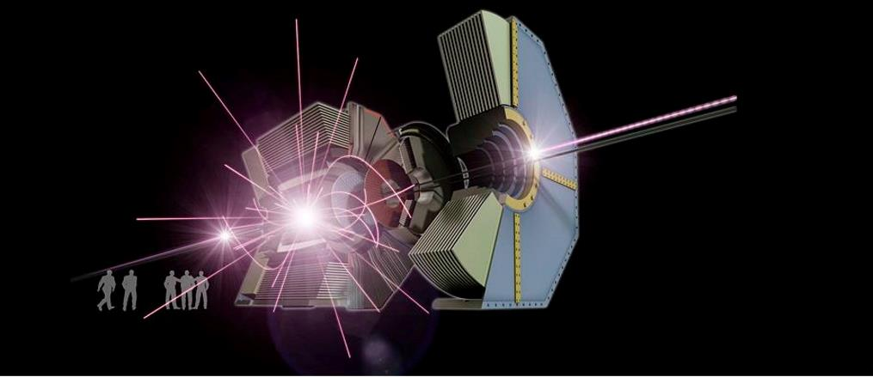
SUPPLEMENTARY SLIDES

Slide 20
Related talks at VERTEX 2020
Belle II related talk
  PXD
    Q.Liu Operational Experience and Performance of the Belle II Pixel Detector Talk on Monday 5th
  SVD
    G.Rizzo The Belle II SVD performance and operational experience in the first data taking Talk on Monday 5th
    Y.Uematsu A Study for Hit-time Reconstruction of Belle II Silicon Vertex Detector Poster on Monday 5th
    S.Hazra Particle identification in Belle II silicon vertex detector Poster on Monday 5th
  Tracking
    C.Praz Tracking performance and interaction point properties at the Belle II experiment Talk on Tuesday 6th
  R&D
    K.Nakamura Development of the thin and fine-pitch silicon strip detector aiming for the Belle II upgrade Poster on Monday 5th
Generic R&D on pixel
  Sessions on Wednesday 7th morning: Monolithic I Monolithic II
    M.Yamada R&D status of monolithic SOI pixel sensor for vertex detector Wednesday talk
    M.Barbero Depleted Monolithic Active Pixel Sensors in LFoundry 150 nm and TowerJazz 180 nm CMOS technologies: The Monopix developments talk
    - H-C.Augustin MuPix10: First Results from the Final Design talk

Slide 21
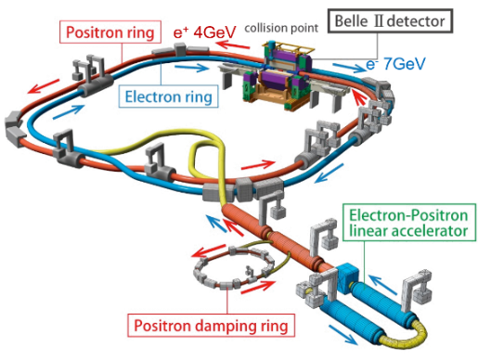
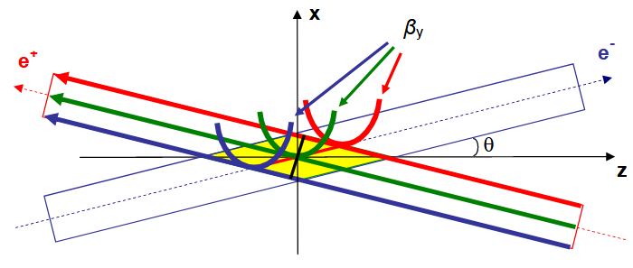

SuperKEKB collider
Recipe to high luminosity
  & specific beam crossing features
    Crossing angle (83 mrad) + crab waist (80%)
High currents:
> 1A
Nano-scale beam size:
σ_{x}×σ_{y} ~ 10µm × 60 nm
β_{y}*<< 1 mm
 | KEKB | SuperKEKB
 |  | 2020 | Nominal
Energy (GeV) LER/HER | 3.5 / 8 | 4 / 7
Current (A) LER/HER | 1.6/1.2 | 0.7/0.6 | 2.8 / 2.0
β_{y}* (mm) | 5.9 | 0.8 | 0.3
Instant. Lumi. (cm⁻².s⁻¹) | 2.1x10³⁴ | 2.4x10³⁴ | ~6x10³⁵
Cost = severe beam
induced background

Slide 22
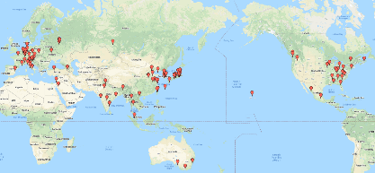
Belle II detector
upgraded
KLong and muon detector (KLM)
Resistive Plate Chambers (barrel outer layers)
Scintillator + WLSF + SiPM’s (end-caps , inner 2 barrel layers)
Planned for better performances / Belle under:
  Higher beam-background rate
  Higher trigger rate (30 kHz)
upgraded
EM Calorimeter (CDC)
CsI(Tl), waveform sampling (barrel+ endcap)
Particle Identification
TOP detector system (barrel)
Prox. focusing Aerogel RICH (fwd)
electrons (7 GeV)
new
new
Final focusing magnets
Beryllium beam pipe
2cm diameter
new
positrons (4 GeV)
SuperCond. Solenoid
1.5 T magnetic field
new
new
Belle II collab
~1000 researches / 26 countries
Central Drift Chamber
He(50%):C2H6(50%), small cells, long lever arm, fast electronics
Vertex Detector (VXD = PXD+SVD)
2 layers DEPFET pixels + 4 layers DSSD

Slide 23
From Eugenio Paoloni, July 2019

Slide 24
Details on beam-induced background
Extrapolations still under progress
PXD

Slide 25
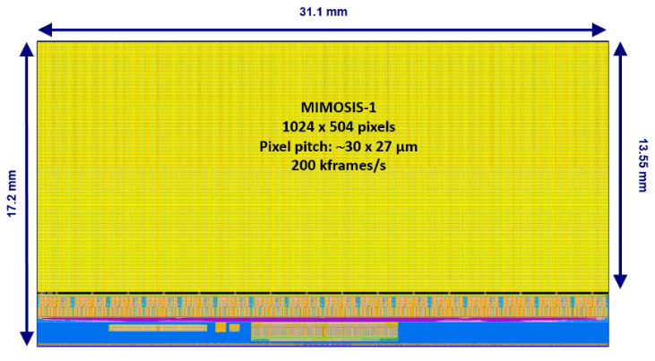
CMOS pixel sensor
Typical application-ready sensor (180 nm techno)

Slide 26
Full pixelated VXD: Geometry details
5 layers + 2 disks

Slide 27
Material budget full pixelated VXD

Slide 28
About timeline: the ALPIDE-ITS case
~4 years from tech-proto to final sensor
Few remarks
  TJ180 nm exploration started in 2011
  This is not a small team
+3 years for assembly
(ALICE-ITS ~10 m²)
P.Riedler CERN, PSI Seminar

Slide 29
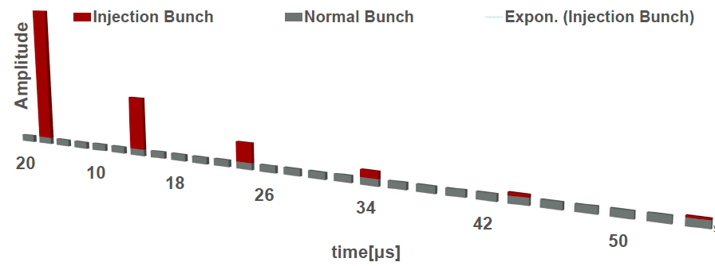
Tower Jazz 180 nm time response simulations
bias
current
Front-end structure
in-pixel
Simulated behavior
(MALTA case)
  From I. Berdalovich,
  JINST 13 (2018) C01023
  Short recovery time
  for node requires I_{bias}~500 nA
  → 0.9 μW/pixel
  ALPIDE with μs timing
  reaches 0.040 μW/pixel
10 µs
Occur every 20 ms
amp
comp
logic
Occur every 20 ms
sensing
node
4 ms
100 ns
⇒ Suggest gating injection for ~100-200 ns doable after comparator

