Slide 1
Newly completed JLab experiment (E12-17-003): Determine the unknown Λn interaction by investigating the possible Λnn resonance
Liguang Tang
Hampton University / JLAB
On behalf of the JLab Hypernuclear and
Hall A collaborations
Publications
“The cross-section measurement for the ³H(e, e’K⁺)nnΛ reaction”, K. N. Suzuki, T. Gogami, B. Pandey, K. Itabashi, S. Nagao, K. Okuyama, et al., Prog. Theor. Exp. Phys. 2022 013D01.
“Spectroscopic study of a possible Λnn resonance and a pair of ΣNN states using the (e, e’K⁺) reaction with a tritium target”, B. Pandey, L. Tang , T. Gogami, K. N. Suzuki, K. Itabashi, S. Nagao, et al., Phys Rev. C 105, L051001 (2022).
HYP2022, June 27 – July 1, 2022
1

Slide 2
INTRODUCTION
Experimental data from study of hypernuclei have so far made significant contributions in acquiring indirect or supplemental information on the ΛN interact.
However, the standing puzzles, such as Charge-Symmetry-Breaking (CSB) urges us to obtain more direct ΛN interaction data.
Λp scattering data does exists but limited. Λn data: NONE! Λn interaction has been treated the same as Λp interaction.
Suggested by the HypHI result, the possible neutral Λnn system (if it exists) may be unique to determine the unknown Λn interaction experimentally. This was the motivation of the JLab experiment E12-17-003.
* Iraj R. Afnan and Benjamin F. Gibson, Phys. Rev. C 92, 054608 (2015)
2

Slide 3
THE JLAB EXPERIMENT E12-17-003
Advantages and Opportunity
Production: ³H(e, e’K⁺)(Λnn) reaction. It is the best for searching the Λnn state by precision mass spectroscopy.
Tritium target already exists in JLab Hall A for four other approved experiments, providing a unique opportunity.
Disadvantages and Unfortunates
The existing standard HRS-HRS configuration was not optimized for the (e,e’K⁺) reaction, –Q² ≈ 0.5 (GeV/c)² and q_{Λ} ≥ 400 MeV/c.
No knowledge of the photo-production cross section available and the available beam time was limited.
Available detector system has only limited power to reject the background π⁺ and p.
7

Slide 4
EXPERIMENT E12-17-003 IN HALL A
e’
K⁺
HRS path-length: 26 meters
L-HRS: Scattered electrons (e’)
R-HRS: Reaction kaons (K⁺)
Beam Energy: 4.319 GeV
e
Cylindrical gas target: 25 cm
Data were collected with two different kinematic conditions:
H Kinematics: H target
P_{K} = 1.8231 GeV/c @13.2°
P_{e’} = 2.1000 GeV/c @13.2°
Producing both Λ and Σ⁰ for kinematics calibration
T Kinematics: T and H targets
P_{K} = 1.8231 GeV/c @13.2°
P_{e’} = 2.2180 GeV/c @13.2°
Obtain the Λnn mass spectroscopy from T₂ and reference Λ from H₂ targets
8

Slide 5
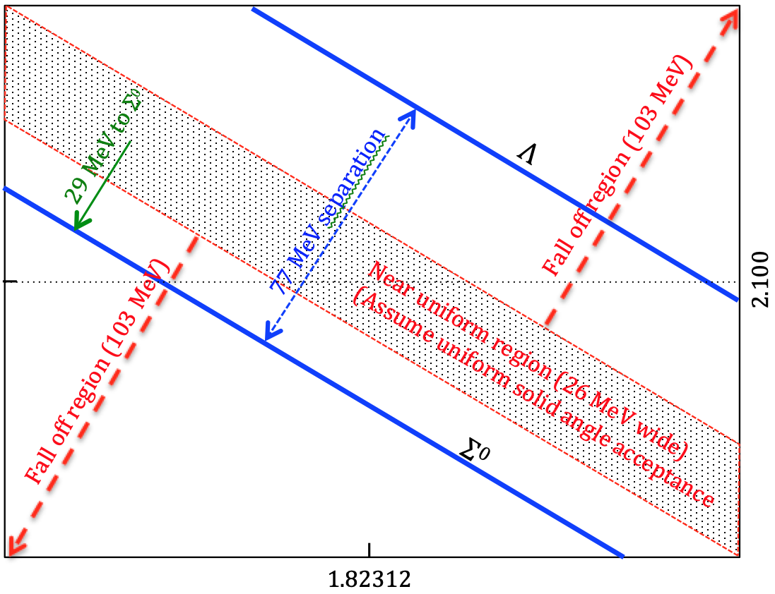
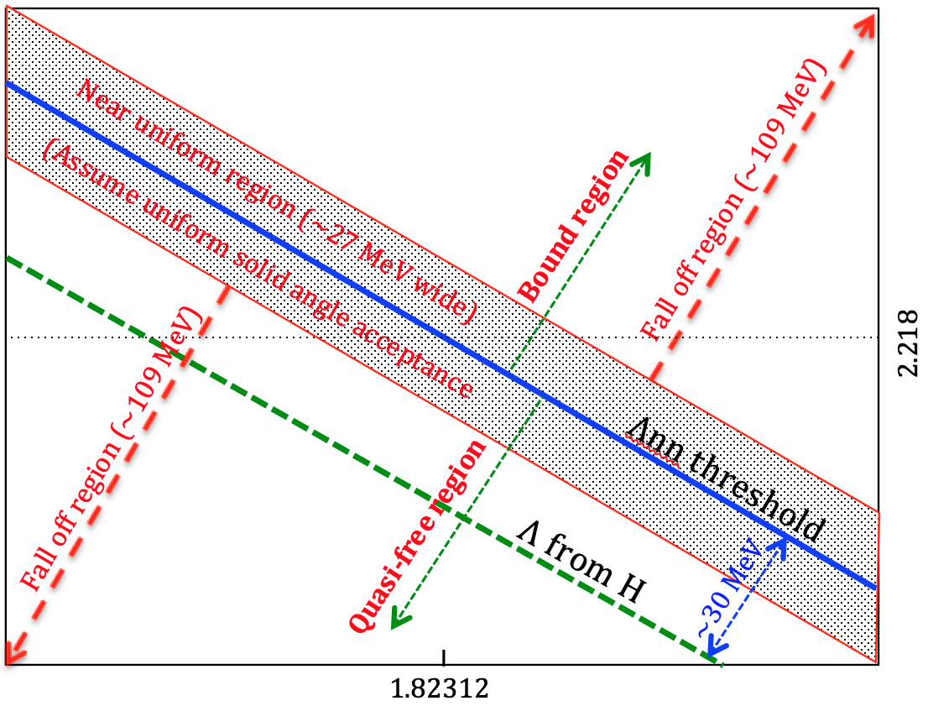
DIFFERENCE OF THE TWO KINEMATICS
H Kinematics
T Kinematics
P_{e’}
P_{e’}
Σ⁰nn thresh.
P_{K}
P_{K}
Using the known masses of Λ and Σ⁰ to ensure high precision on the absolute missing mass scale (systematic uncertainty of the binding energy of the Λnn resonance)
9

Slide 6
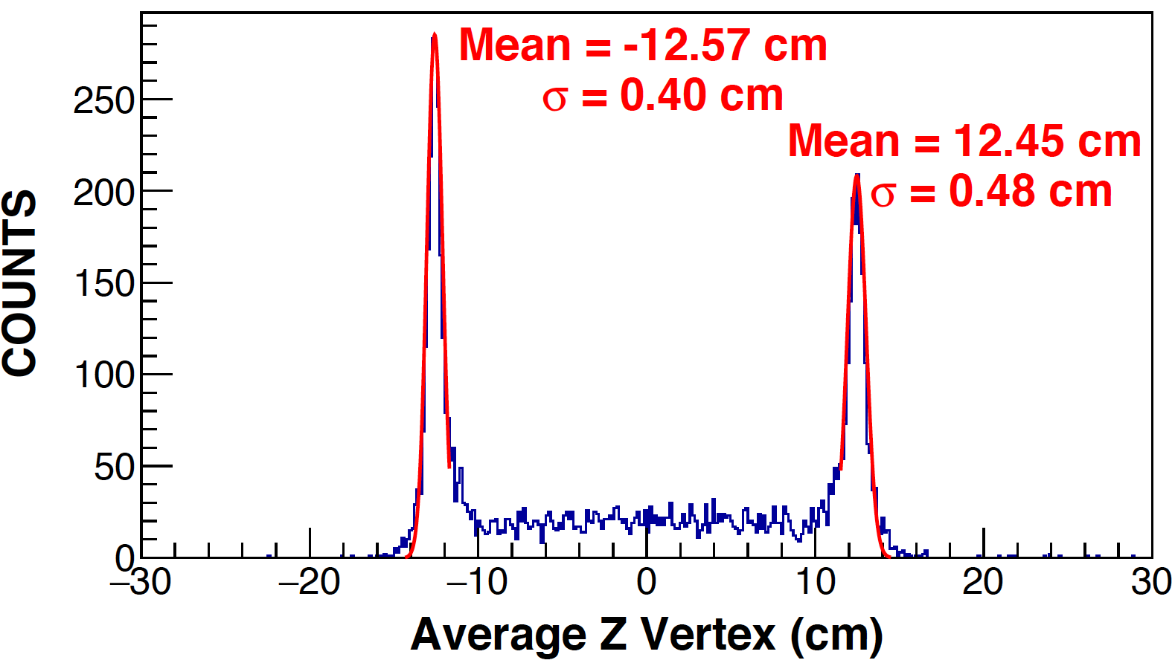
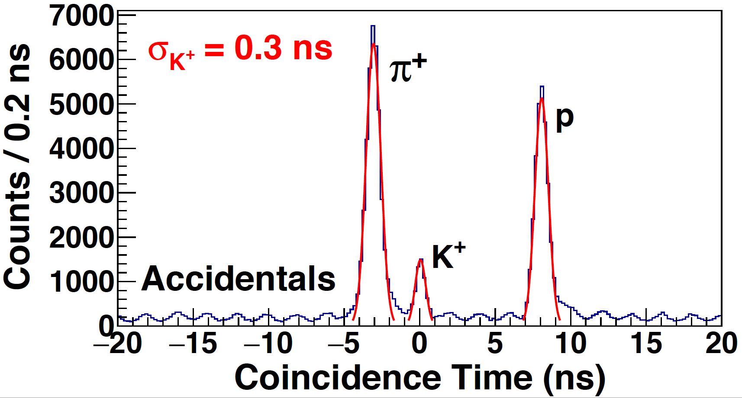
ANALYSIS RESULTS – Z-vertex & Coincidence time
Al cap
Gas region
Al cap
25 cm gas cell target
Z-vertex resolution: σ_{Z} ≈ 4.5 mm
± 10 cm vertex cut
Inefficiency of aerogel detectors
Accidentals from π⁺ and p.
10

Slide 7
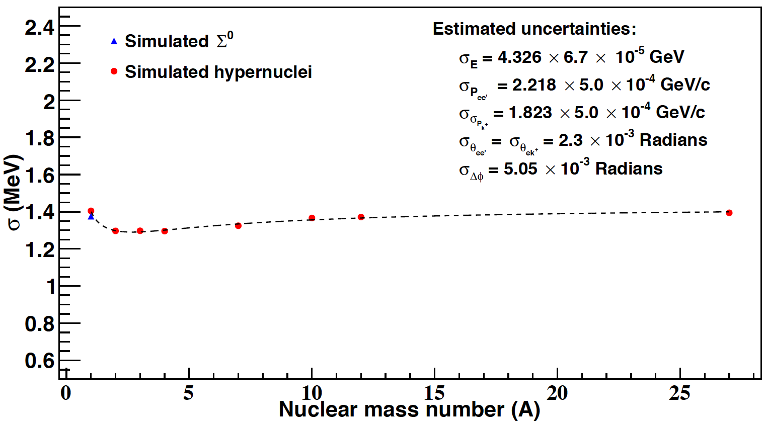
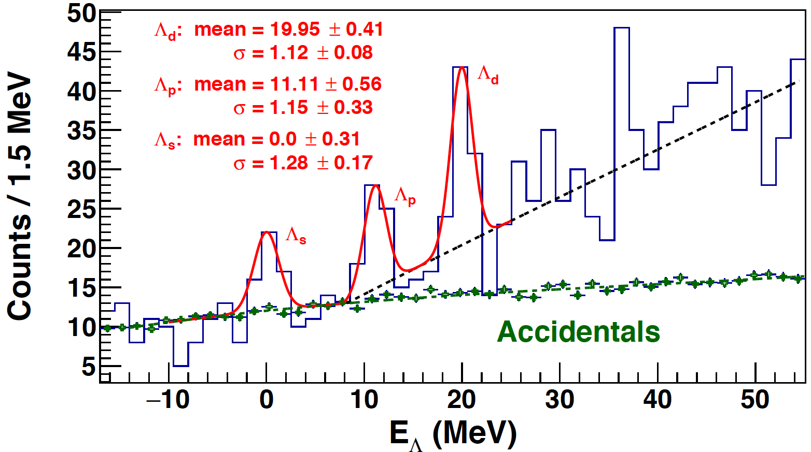
ANALYSIS RESULTS – Energy Cal. & Momentum Matrix Opt.
Simulation for expected resolution
Matrix optimization involving ²⁷_{Λ}Mg events
Events from Λ and Σ⁰ (H) and ²⁷_{Λ}Mg (Al caps) for momentum matrix optimization
Known mass of Λ and Σ⁰ provides the absolute energy/ mass calibration
Heavy ²⁷_{Λ}Mg events improve the momentum matrix optimization
11

Slide 8
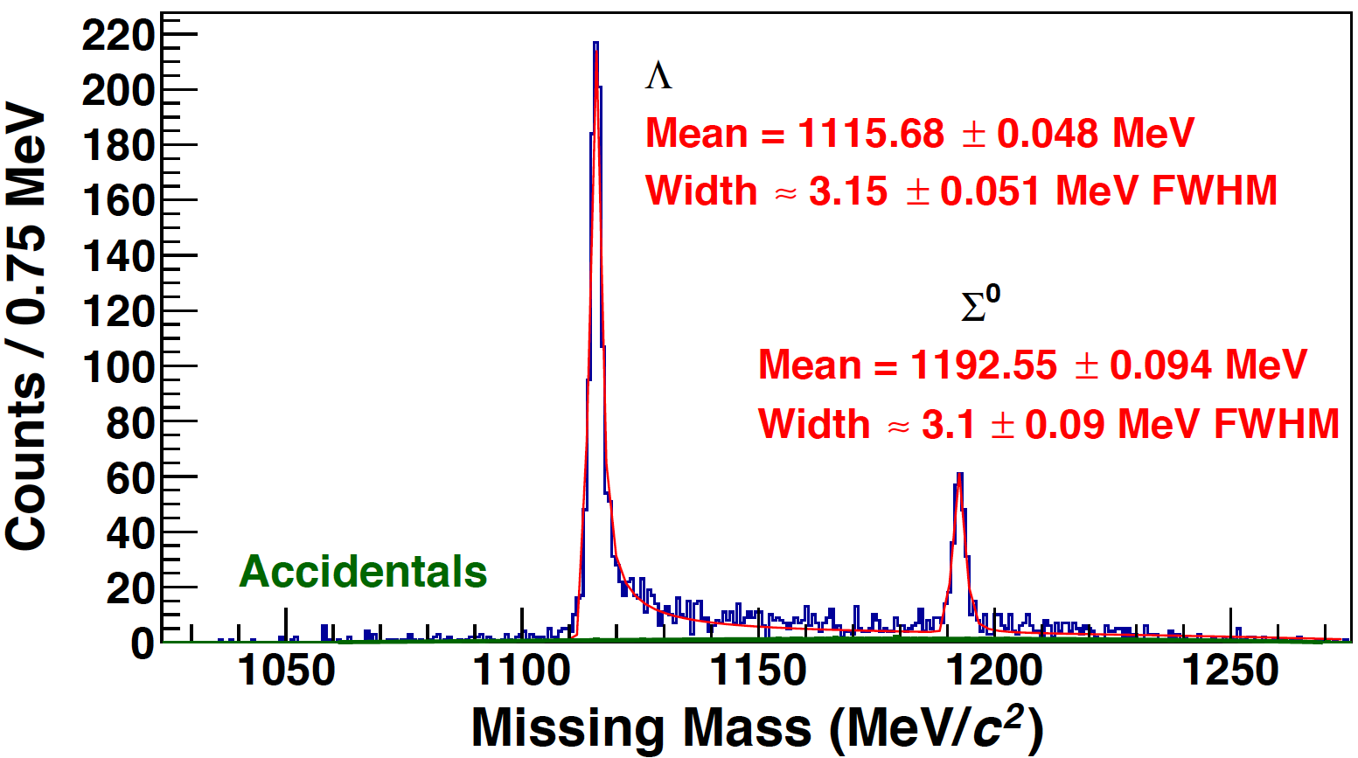
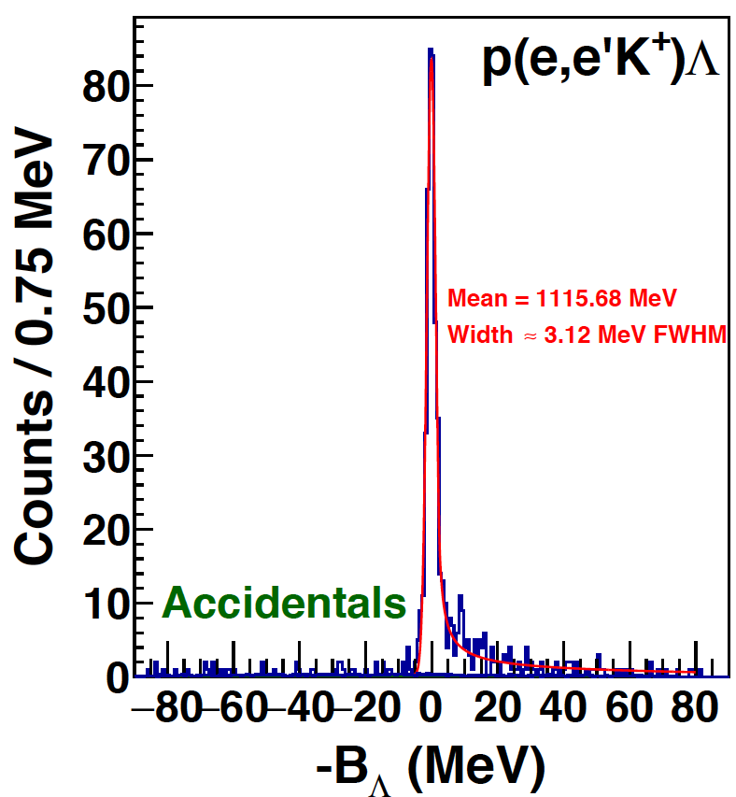
ANALYSIS RESULTS – Λ/Σ⁰ Spectrum
H Kinematics
T Kinematics
Data collected under both H and T kinematic conditions
Resolution reached to the optimum as the simulation indicated
ΔM = 76.94 MeV/c² (nominal: 76.96 MeV/c²)
12

Slide 9
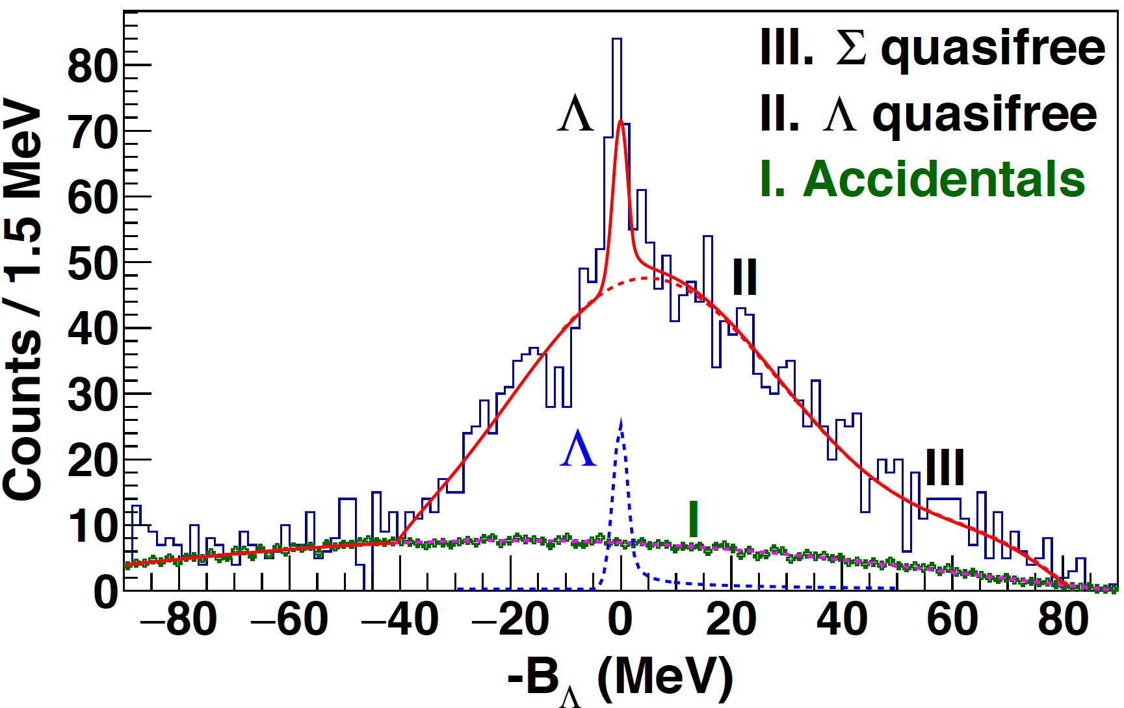
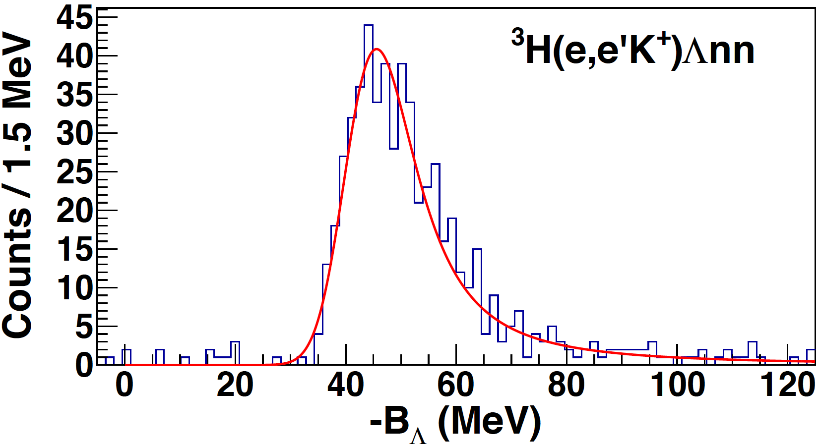
ANALYSIS RESULTS – H Contamination in T
T data analyzed assuming H target
H data analyzed assuming T target
T data analyzed with the H kinematics
~158 counts of free Λ, correspond to ≈ 3% H contamination
Expect a free Λ peak in the Λnn spectrum with large width
13

Slide 10
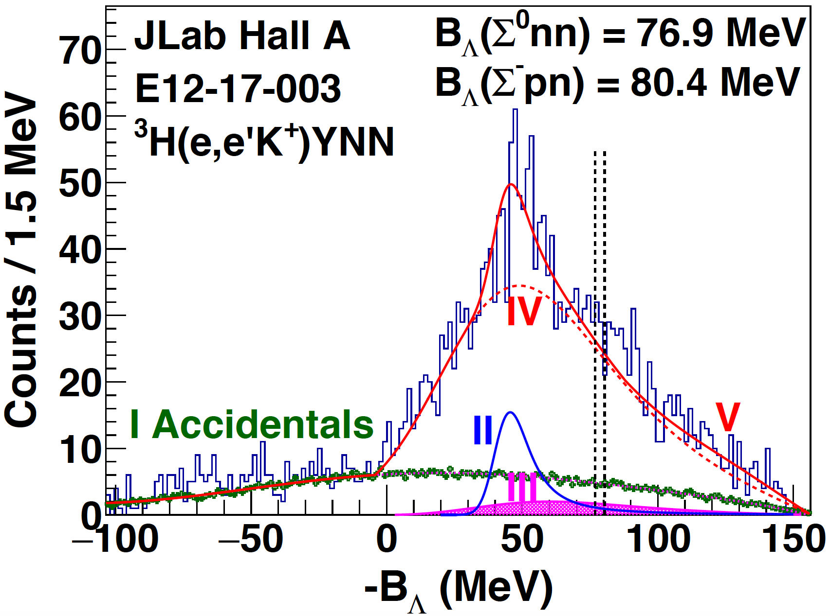
ANALYSIS RESULTS – Λnn Spectrum
Although no definite identifications could be made, enhancements at both the Λnn and ΣNN thresholds are highly interesting
14

Slide 11
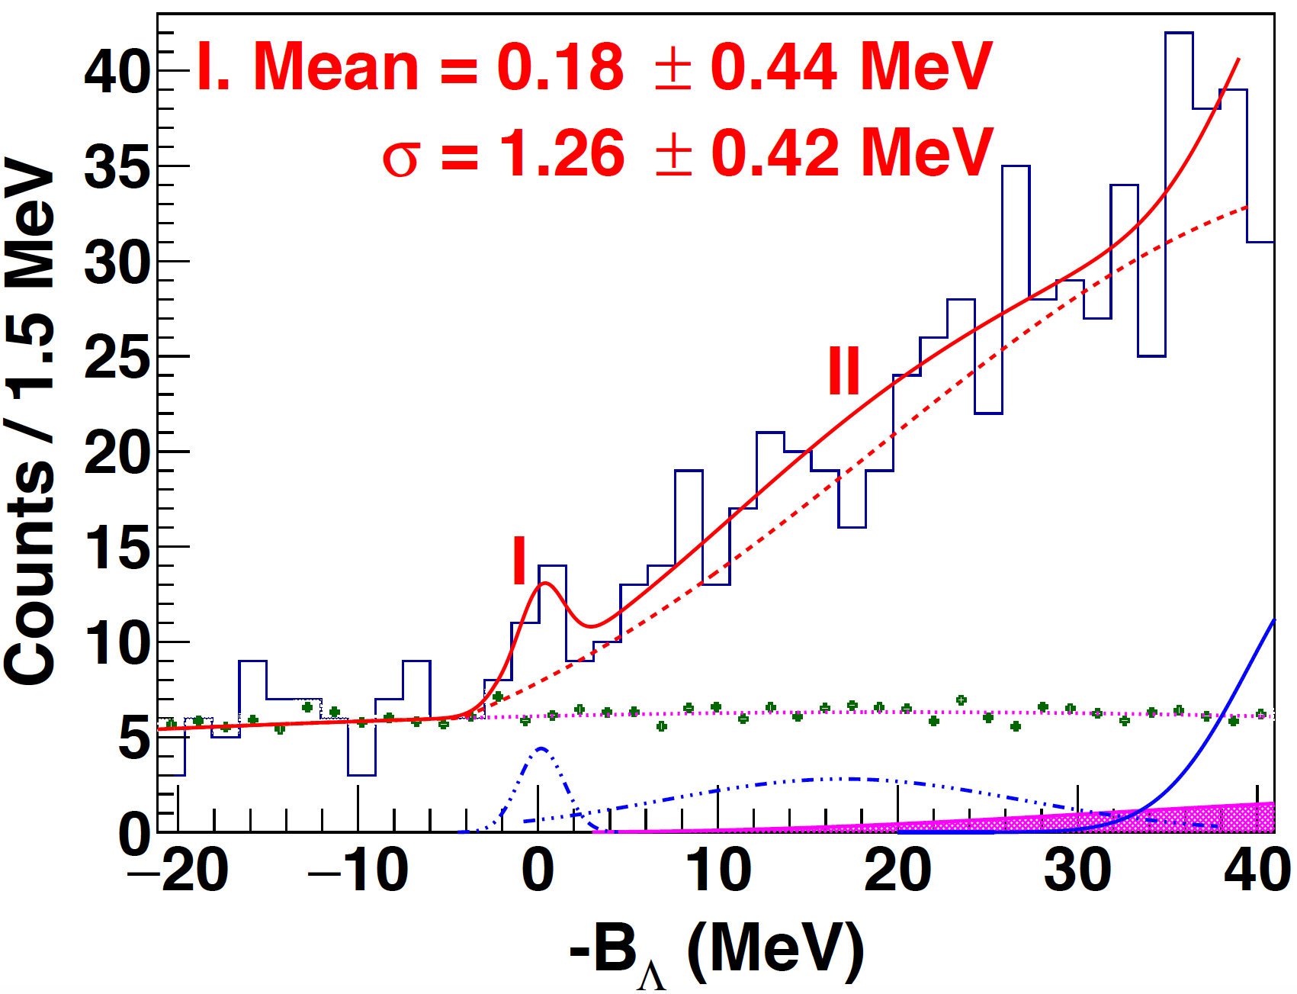
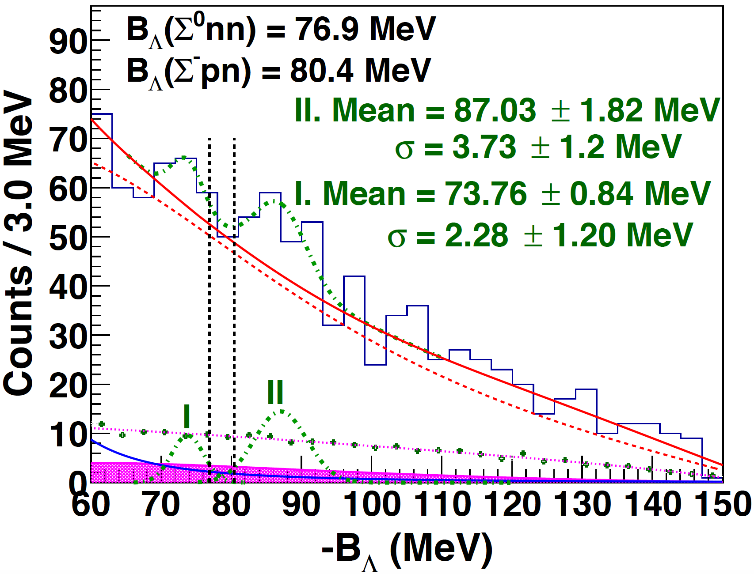
ANALYSIS RESULTS – Possible YNN Resonances
Possible Λnn resonance:
-B_{Λ} = 0.18 ± 0.44 (stat) ± 0.4 (sys)
Γ/2 = 0.35 ± 0.42 (stat) ± 0.5 (sys)
Significance: ~2.2. If real, cross section ≈ 10 nb/sr)
Possible bound Σ⁰nn state (1st):
-B_{Σ0nn} = -3.14 ± 0.84 (stat) ± 0.4 (sys)
2nd peak is about 13 MeV away
Cross sections (1st/2nd) ≈ 20/45 nb/sr
15

Slide 12
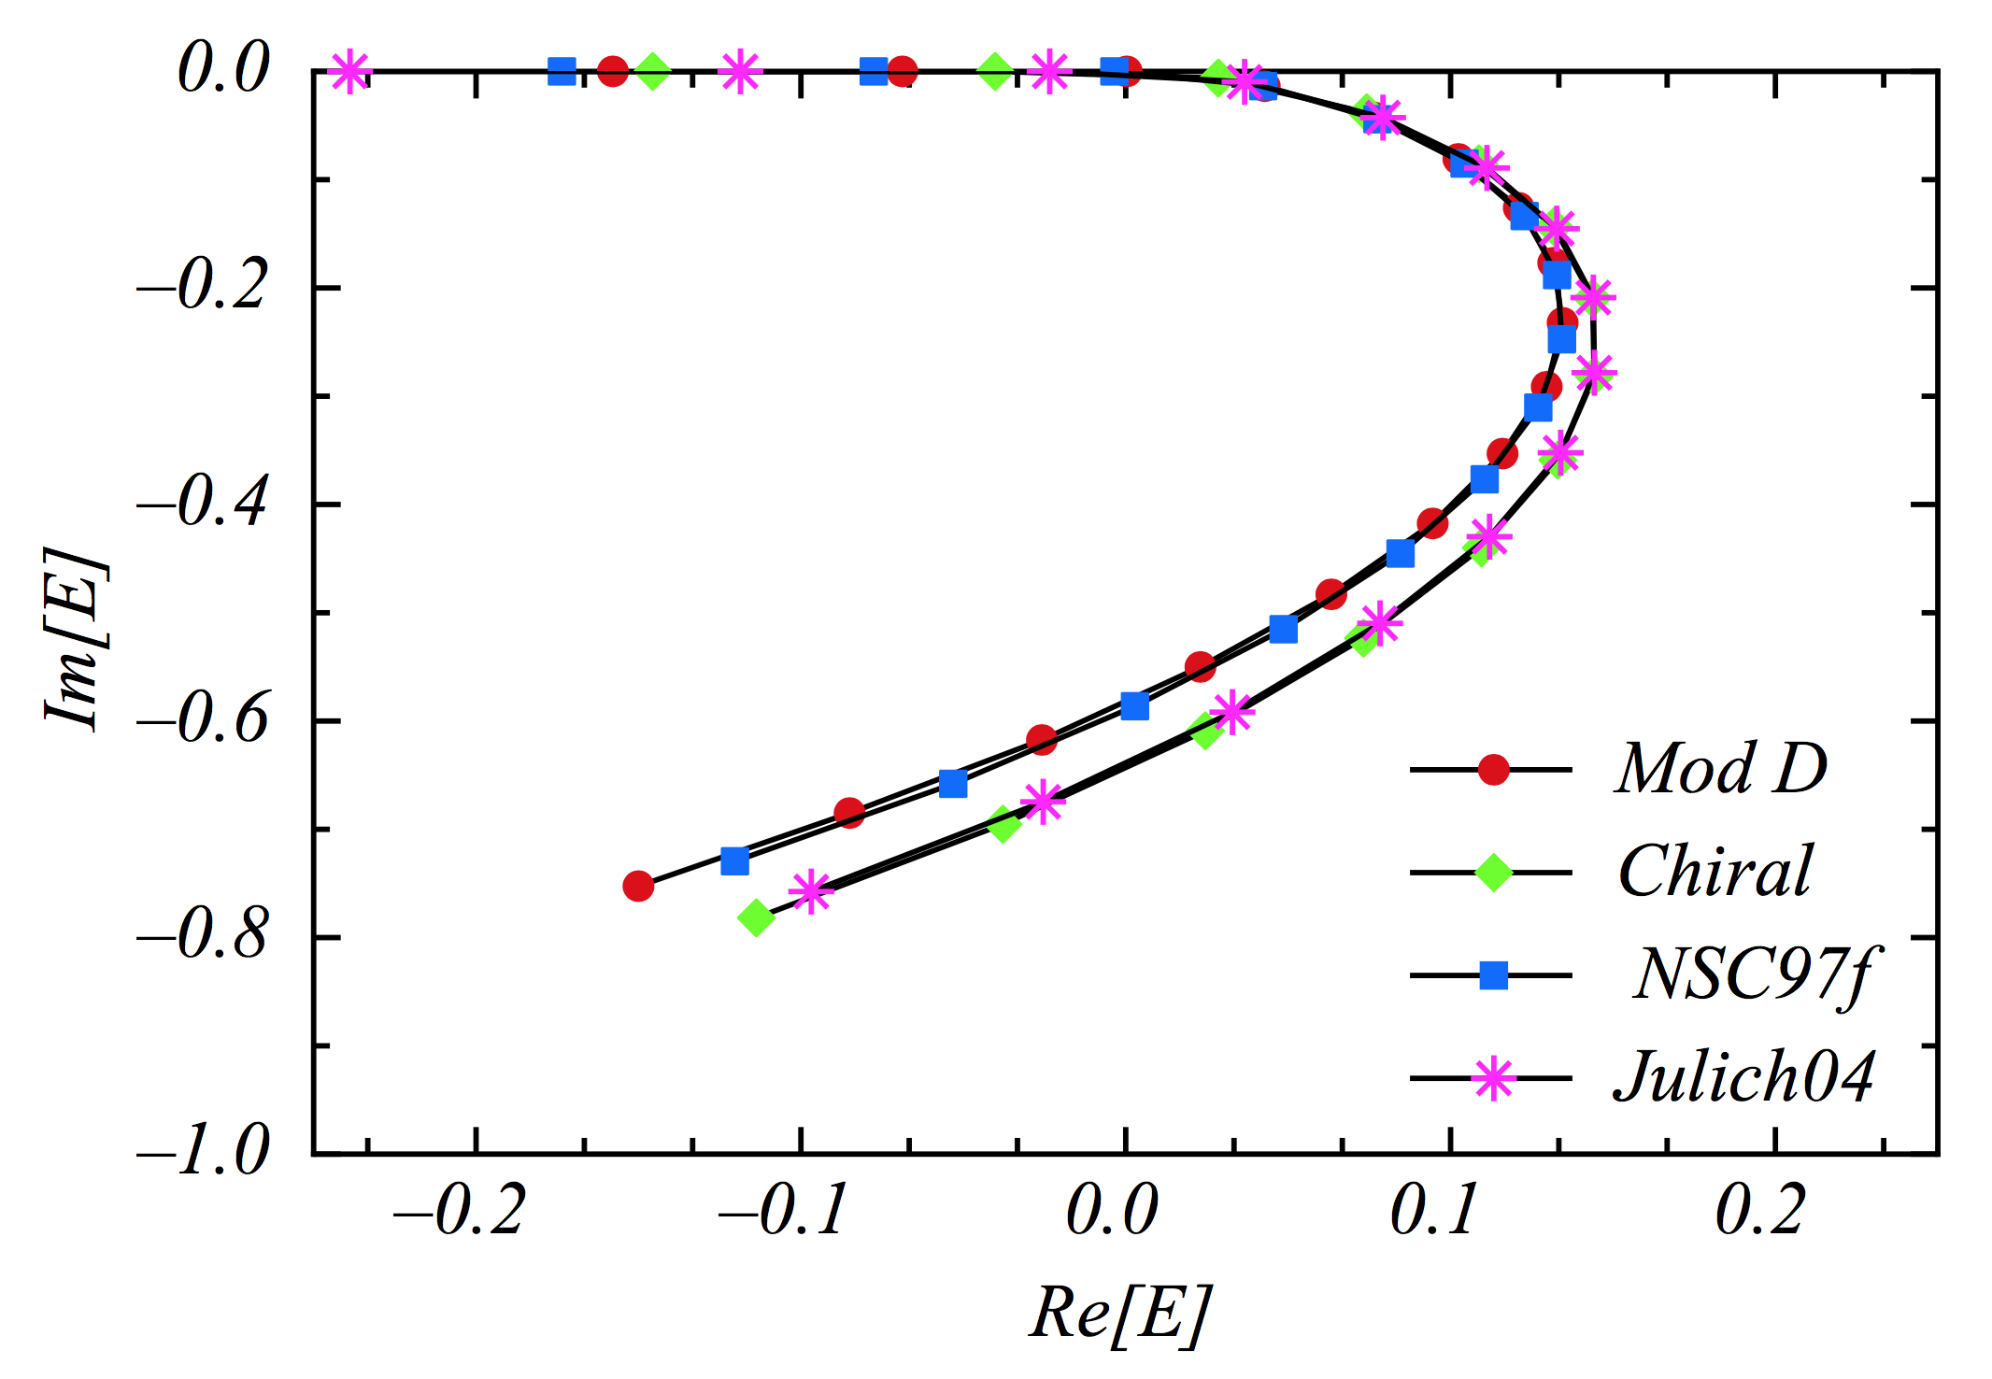
SUMMARY
E12-17-003 has proven the uniqueness of using the (e,e’K⁺)
reaction at JLab.
The experiment had possible
observation of the Λnn
resonance and a bound
(A = 3) ΣNN state.
Obtained statistics is too
low to allow a definitive
identification, information
is not precise enough to
determine the Λn and Λ-Σ
interactions.
The new proposal was conditionally approved.
A Λnn 3-body system
(MeV)
(MeV)
16

